Slide 1
Merging the metrics for financial and carbon accounting
Jimmy Jia
Oxford Sustainable Finance Group
Oxford Net Zero
jimmy.jia@ouce.ox.ac.uk
8th International ICARB Conference 2023
25 Sept 2023
Notes:
NB: You can change the background image for this title page in the ‘slide master’ view (you can’t change it directly on this slide)
To add new slides, right click on your slide list and select a new slide from the layout options.

Slide 2
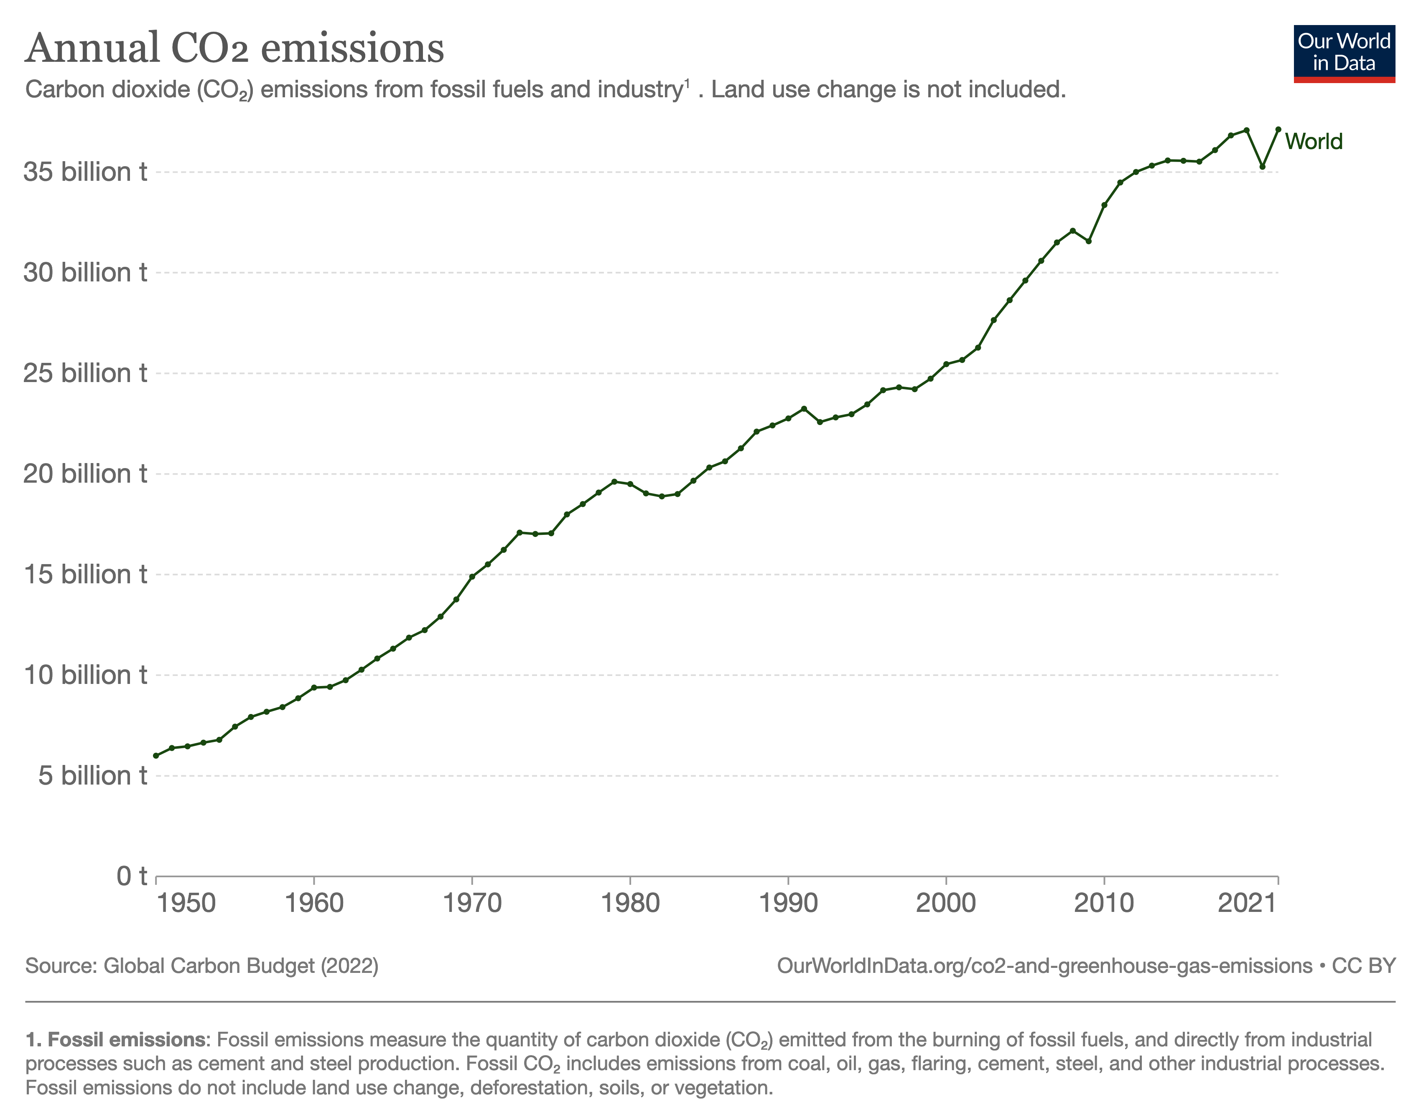
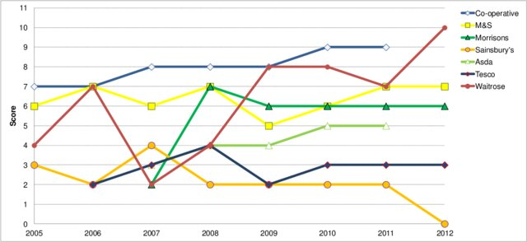
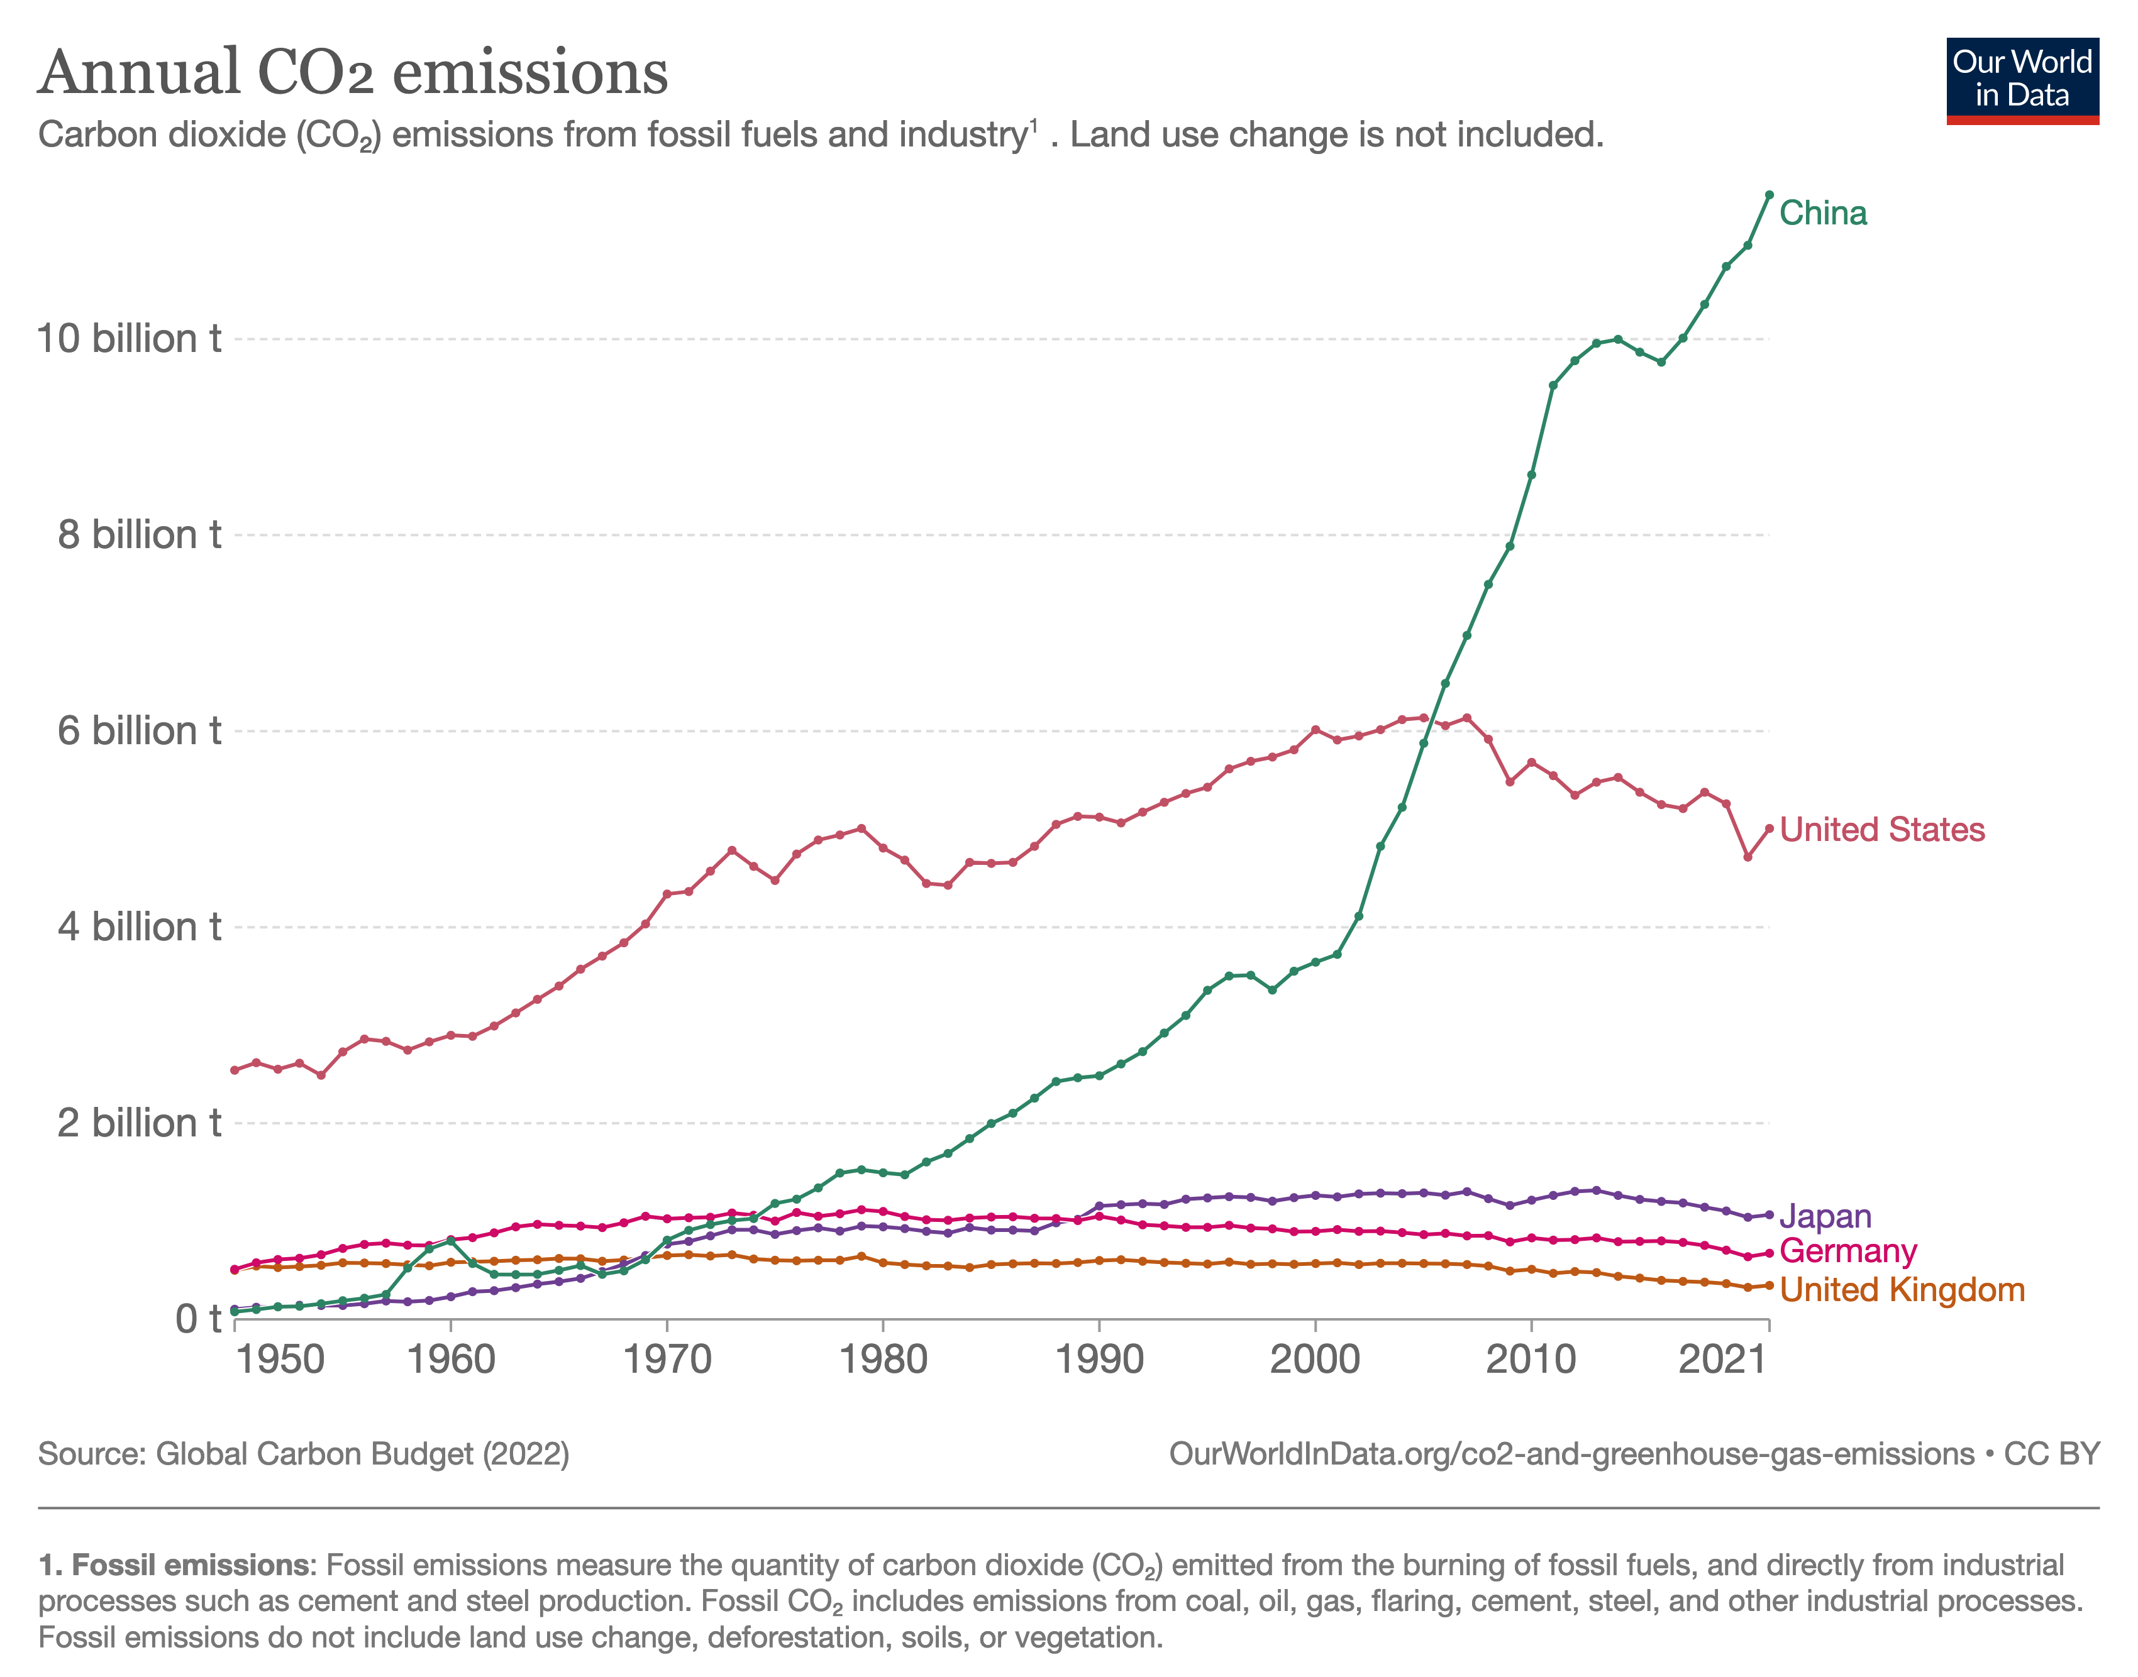
How much GHG?
Accounting for Corporate Emissions
Accounting for Global Emissions
Accounting for National Emissions
https://www.researchgate.net/publication/264703343_Enhancing_Corporate_Environmental_Performance_Through_Reporting_and_Roadmaps
Source: https://ourworldindata.org/greenhouse-gas-emissions
Notes:
POINT: How the financial community defines comparability is different than how the environmental community defines comparability!
SUPPORT:
TRANSITION:

Slide 3
How much GHG?
Accounting for Corporate Emissions
Accounting for Global Emissions
Accounting for National Emissions
Based on IPCC methodologies
Based on Life Cycle Assessment (LCA) methodologies
https://www.researchgate.net/publication/264703343_Enhancing_Corporate_Environmental_Performance_Through_Reporting_and_Roadmaps
Source: https://ourworldindata.org/greenhouse-gas-emissions
Notes:
POINT: How the financial community defines comparability is different than how the environmental community defines comparability!
SUPPORT:
TRANSITION:

Slide 4
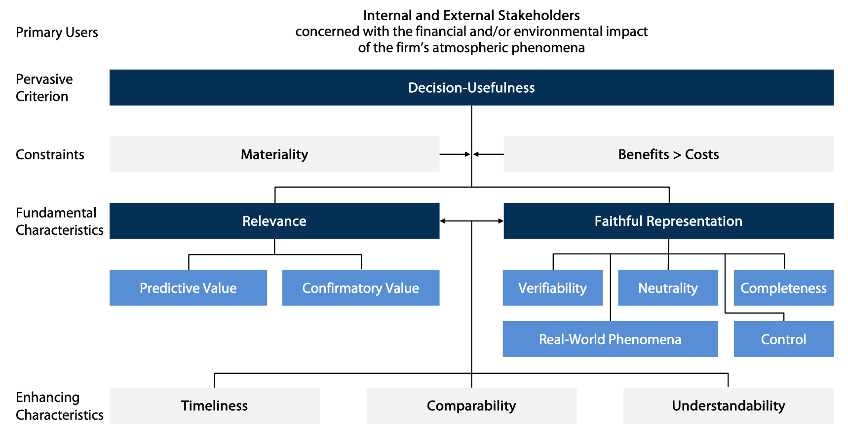
What is financial decision usefulness?
Source: Glenk 2023
Notes:
POINT: How the financial community defines comparability is different than how the environmental community defines comparability!
SUPPORT:
TRANSITION:

Slide 5
What is decision usefulness?
Source: Glenk 2023
Notes:
POINT: How the financial community defines comparability is different than how the environmental community defines comparability!
SUPPORT:
TRANSITION:

Slide 6
What is comparability?
Financial Comparability
The accounting profession emphasizes comparability as a core principle of the financial reporting system.
Formally: “Similar information about other entities and with similar information about the same entity for another period or another date,” (IASB, 2018)
To tell what is similar and what is different between items being compared.
GHG “Comparability”
GHG accounting emphasises consistency as a means to enable comparisons over time.
Formally: “CONSISTENCY Use consistent methodologies to allow for meaningful comparisons of emissions over time. Transparently document any changes to the data, inventory boundary, methods, or any other relevant factors in the time series” (GHG Protocol)
To tell how a single thing changes over time.
Notes:
POINT: How the financial community defines comparability is different than how the environmental community defines comparability!
SUPPORT:
TRANSITION:

Slide 7
What’s been built on top of GHG accounting
Net zero policies
UN-HLEG, TPT,
ISO IWA 42
Regulations
SFDR, CSRD
Laws
EU Taxonomy
Commercial applications
Ratings, EFTs, M&A
Alliances
GFANZ, NZAOA
Disclosure standards: TCFD, CDP, GRI, ISSB, ICLEI
GHG accounting standards: GHG Protocol
Model: Emissions = Activity Data x Emission Factor
Notes:
POINT: The non comparability challenges is buried deeply into the modelling equations for carbon emissions.
SUPPORT:
TRANSITION:

Slide 8
What’s been built on top of GHG accounting
Net zero policies
UN-HLEG, TPT,
ISO IWA 42
Regulations
SFDR, CSRD
Laws
EU Taxonomy
Commercial applications
Ratings, EFTs, M&A
Alliances
GFANZ, NZAOA
In (Jia et al 2023) we show how all GHG accounting standards reference the GHG Protocol, either directly or indirectly
Disclosure standards: TCFD, CDP, GRI, ISSB, ICLEI
In (Glenk 2023) showed that GHG Protocol does not follow the rules for financial decision usefulness
GHG accounting standards: GHG Protocol
Model: Emissions = Activity Data x Emission Factor
In (Jia & Taylor 2022) we show how non-comparability is introduced in the choice of emission factors
Notes:
POINT: The non comparability challenges is buried deeply into the modelling equations for carbon emissions.
SUPPORT:
TRANSITION:

Slide 9
Prior work: Designing for Comparability
We can’t tell the difference between operational differences and accounting choices
Emissions
Activity Data
Emission Factor
Operational data (gallons, miles, kWh)
Tells us if the company is operating efficiently
What investors need to know!
An accounting choice, based on combustion, LCA, EEIO, or other estimates.
Values can differ by 38%, because existing standards gives flexibility to choose!
LCA = life cycle assessment
EEIO = environmentally extended input/output
Source: Jia & Taylor 2022

Slide 10
Prior work: Designing for Comparability
We can’t tell the difference between operational differences and accounting choices
Emissions
Activity Data
Emission Factor
Operational data (gallons, miles, kWh)
Tells us if the company is operating efficiently
What investors need to know!
An accounting choice, based on combustion, LCA, EEIO, or other estimates.
Values can differ by 38%, because existing standards gives flexibility to choose!
LCA = life cycle assessment
EEIO = environmentally extended input/output
Conditions for comparability:
Account for activity data separate from Emission Factor – (Accounting Condition)
Use only Combustion Emission Factors – (Dimensional Analysis Condition)
Account for energy before accounting for carbon
25 September, 2023
Source: Jia & Taylor 2022

Slide 11
A difference in accounting for time
Usage / Maintenance
Production
Use stage
End of life
In LCA, time passes between events, regardless of how long it takes.
This is known as single entry bookkeeping
Manufacturing 2
Manufacturing 1
Repair
Transport
Transport
Disposal
Raw material supply
Transport
Waste processing
Transport
In financial accounting, reports are disclosed in regular time periods, regardless of what happens.
This uses double entry bookkeeping
…
Year 1
Year 2
Year 3
Year 4
Year 5
Year 6
Year 7
Year 8
Source: Jia & Taylor 2022

Slide 12
The Information Architecture to account for time
Usage / Maintenance
Production
Use stage
End of life
In LCA, time passes between events, regardless of how long it takes.
This is known as single entry bookkeeping
Manufacturing 2
Manufacturing 1
Repair
Transport
Transport
Disposal
Raw material supply
Transport
Waste processing
Transport
In financial accounting, reports are disclosed in regular time periods, regardless of what happens.
This uses double entry bookkeeping
…
Year 1
Year 2
Year 3
Year 4
Year 5
Year 6
Year 7
Year 8
Conditions for comparability:
Account for activity data separate from Emission Factor – (Accounting Condition)
Use only Combustion Emission Factors – (Dimensional Analysis Condition)
Use DEBK to synchronize time and accrual accounting to accumulate energy/carbon footprint (Category Theory)
Account for energy before accounting for carbon
Source: Jia & Taylor 2022

Slide 13
From Single to Double entry bookkeeping in accounting: Cash is in balance
 | Single entry bookkeeping (SEBK) | Double entry bookkeeping (DEBK)
Currencies (Goldthwaithe 1985) | Reports can be in different currencies (Venetian Lira, French Franc, etc.) | All reports needs to be converted to a single currency (Dollars, Euros, etc.)
Accounting Books (Sangster 2016) | Debit / Credit | Debit / Credit Cash / Merchandise / Expenses
Treatment of Time (Quattrone 2005) | Time is recorded as ‘between activities’ | Time is synchronized into periods.
Profit and Wealth (Goldthwaithe 1985) | Merchant had to take inventory each time they wanted to calculate wealth. | Enables the periodic reporting of profit and wealth
Regulation (Sangster 2016) | Complied with Usury laws of the Catholic Church because it was easier to hide profit and wealth. | Complies with financial disclosure and audit rules and regulations.
Source: Jia & Taylor 2023

Slide 14
An Energy Balance Sheet system: Energy is in Balance
 | LCA (and GHGI) is Single-Entry | EBS is Double-Entry
Currencies | LCA can be done for any unit (kWh, Joules, BTU, etc.) | Propose to standardize to Million Joules (MJ)
Accounting Books | Inflow / Outflow | Inflow / Outflow Intrinsic / Embodied / Operational
Treatment of Time | LCA is a summation of activities over time, based on an action taken | EBS synchronizes activities into time periods.
Valuations | Inventory needs to be repeated at every step of the value chain | Enables the periodic reporting of inventory at any step of the value chain.
Regulation | Disclosure regulations ask for GHG Inventories | Enables alignment with IFRS Conceptual Framework (matching, conservatism, etc.)
We also gain:
Auditability (Power 2021) | Not auditable at the moment (can perform limited assurance) | Feeds into the ‘meta-logic’ of the audit trail.
Additivity | LCAs do not add up into a national inventory, unlike corporate activities to GDP | The summation of corporate activities will equal national inventories.
Comparable (Jia & Taylor 2022) | Unable to compare | Ability to tell apart similarities and differences
25 September, 2023
Source: Jia & Taylor 2023

Slide 15
The 3 financial reports: (1) Balance Sheet
Balance Sheet
(Present)
A balance sheet is a snapshot in time that represents a balance:
Assets = Liability + Equity
NOTE: Cash is a type of Asset
Assets
Liabilities
Cash
Equity

Slide 16
The 3 financial reports: Time
Balance Sheet
(Past)
time
Balance Sheet
(Present)
Cash
Two balance sheets represent the passage of time
Equity
Assets
Liabilities
Cash
Equity

Slide 17
The 3 financial reports: (2) Cash Flow Statement
Balance Sheet
(Past)
time
Balance Sheet
(Present)
Cash
(2) Statement of Cash Flow
(Ending balance sheet) – (Beginning balance sheet)
Equity
Assets
Liabilities
Cash
The cash flow statement depicts the change in cash between two balance sheets.
Equity

Slide 18
The 3 financial reports: (3) Profit & Loss Statement
Balance Sheet
(Past)
time
Balance Sheet
(Present)
Cash
(2) Statement of Cash Flow
(Ending balance sheet) – (Beginning balance sheet)
Equity
Assets
Liabilities
(3) Statement of Profit & Loss
Cash
The Profit & Loss depicts a sale transaction between two entities. If there are no sales, there is no P&L.
Depicts inflows and outflows due to sales
Equity

Slide 19
From Single to Double entry bookkeeping in accounting
Energy Balance Sheet
(Past)
time
Energy Balance Sheet
(Present)
Energy
Cash
(2) Statement of Cash Flow
Lock-in
Energy Flow
Energy
Energy Assets
Liabilities
(3) Statement of Profit & Loss
Cash
Energy
Dependencies
Gains and Uses
Energy
Lock-In
Equity

Slide 20
From Single to Double entry bookkeeping in accounting
We will construct the Asset Stack of the Energy Balance Sheet
Energy Flow Statement is the difference between two balance sheets
Assume before commercial start – all transactions are capitalized (No Gains & Use Statement)
We will show how energy shifts up and down the asset stack.
Energy
(2) Statement of Energy Flow
(Ending balance sheet) – (Beginning balance sheet)
Energy Assets
Energy

Slide 21
Constructing the Energy Balance Sheet

Slide 22
Definitions: Intrinsic Energy
Intrinsic energy: amount of energy stored that is capable of being used later. (Electric energy and equivalents)
Accounting equivalent: Cash and cash equivalents stored inside a bank account, money market account, etc.
Batteries stores Electric Energy
Cash is stored in Banks
Coal stores Chemical Energy
Flywheels stores Mechanical Energy
Cash equivalents are stored in bonds, commercial paper, and other notes.
Dams stores Gravitational Energy
Water heaters stores Thermal Energy

Slide 23
Definitions: Operational Energy
Operational Energy: Energy that is consumed for transformation between forms of energy
Accounting equivalent: Expenses for a period that does not accrue or accumulate.
Electric Energy
Mechanical Energy
Nuclear Energy
Radiant Energy
Gravitational Energy
Thermal Energy
*
Elastic Energy
Chemical Energy
Sound Energy
* This transformation is the predominant source of most GHG emissions

Slide 24
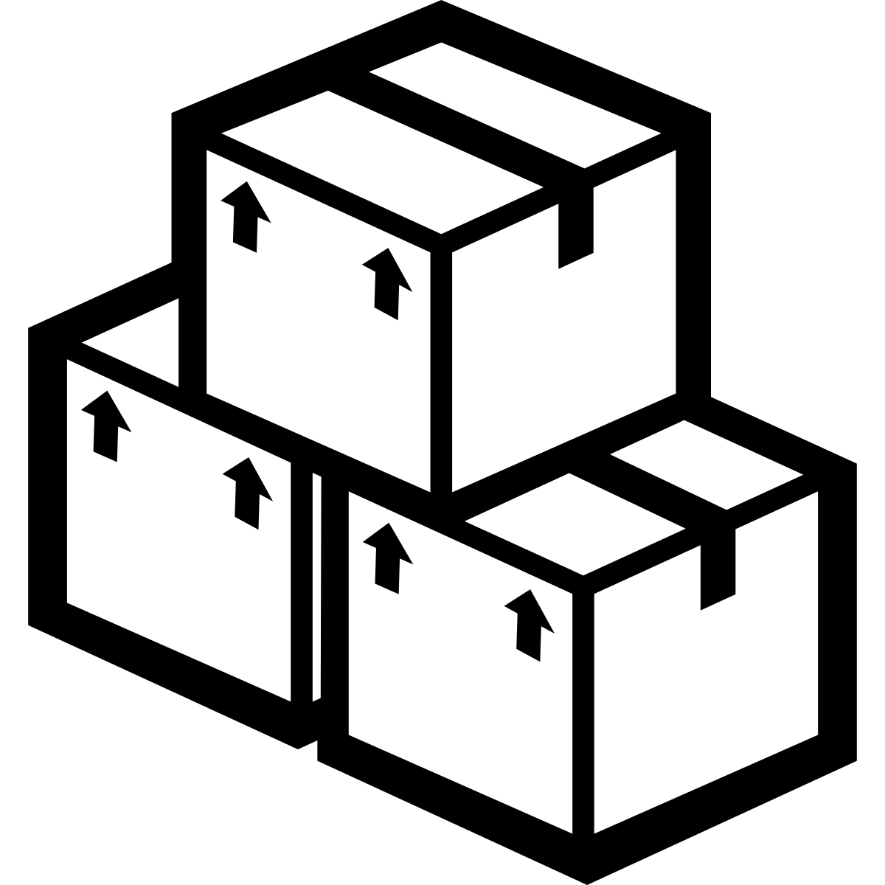
Definitions: Embodied Energy
Embodied Energy: Energy that was consumed in the past but whose benefits are in the future.
Embodied energy is accumulated operational energy.
It can be transported between two points
Embodied energy follows rules of embodiment, paralleling rules of capitalization.
Accounting Equivalent: An asset is a resource controlled by the entity as a result of past events and from which future economic benefits are expected to flow to the entity. (IFRS)
Assets are accumulated by following capitalization rules.
Operational Energy
Embodied energy
(at Point A)
Embodied energy
(at Point B)
Electric Energy
Mechanical Energy
i.e., petrol in a truck
Chemical Energy
etc…

Slide 25
Energy also has embodied energy attributes!
It takes energy to produce energy
It takes energy to transport energy
Point A
Point B
Mechanical Energy
i.e., petrol in a truck
Drilling Oil
Refining Oil
Petrol
Electric Energy
i.e., ancillary services, such as demand or capacity charges
Mining Coal
Generating
Electric Energy
Electric Energy
25

Slide 26
How to create an energy asset stack (part 1)
Financial assets are organized based on flexibility, often called liquidity.
The more options available and more flexibly the resource can be used (hence more liquid), the higher it is listed in the asset stack.
FINANCIAL ASSET STACK
High Flexibility of Use
(High Liquidity)
Cash
Cash Equivalents
Current Assets
Inventory (Benefit derived from exchange)
Non-current Assets
Plant, Property and Equipment (PPE)
(Benefits derived from use)
Low Flexibility of Use
(Low Liquidity)

Slide 27
How to create an energy asset stack (part 2)
Entropy is a measure of energy quality, or its flexibility of use.
Low Entropy is a measure of energy quality, or high flexibility (more options)
High Entropy is a measure of low flexibility
ENERGY ASSET STACK
Electric Energy has the lowest entropy, so it gets listed at the top.
“Electric Equivalents” are other forms of energy, that can be converted to electricity or embodied for exchange and use.
High Flexibility of Use
(Low entropy)
Electric Energy
Electric Equivalents: Chemical
Mechanical,
Thermal, etc.
Current Embodied Energy
i.e., Inventory
(Embodied Energy to be exchanged
between entities)
Non-current Embodied Energy
i.e., Plant, Property and Equipment (PPE)
(Embodied Energy to be used)
Embodied Energy can further be split into two categories
Low Flexibility of Use
(High entropy)

Slide 28
Transactions to be modelled: Building a house
Assumptions: Before commercial start (Prior to any sales activity, so no P&L, only Balance sheet)
Scenario: Build a house with steel and timber; demolish it before a sale.
All energy is embodied
[1] Mine the coal
[2] Transport coal
[3] Generate electricity
[4] Extract iron ore
[5] Transport ore
[6] Steel production
[10] Build a house
[11] Demolish house
[12] Landfill materials
[7] Harvest trees
[8] Transport trees
[9] Timber production
[13] Electric
energy recovery
[14] Materials Recovery

Slide 29
Double Entry Notation: Mining coal
Transaction | Journal Entry | Debit | Credit
[1] Mine the coal | Fuel energy |  | ↑
 | Embodied energy (EE) of coal | ↑
Opening
Energy Balance Sheet
Closing
Energy Balance Sheet
Energy Flow
Statement
Fuel energy
(-) Fuel energy
Representation on
Energy Balance Sheet and Energy Flow Statement
EE coal

Slide 30
Numerical Example
Row | Transaction | Journal Entry | Debit (in MJ) | Credit (in MJ)
2 | [4] Extract iron ore (China) | 3 Fuel energy |  | 375.00
3 |  | 4 Embodied energy (EE) of iron ore | 375.00
4 | [5] Transporting ore (China => UK) | 3 Fuel energy |  | 3,500,000.00
5 |  | 4 Embodied energy (EE) of iron ore | 3,500,000.00
6 | [6.1] Steel production (Teeside, UK) | 3 Fuel energy |  | 108,000.00
7 |  | 4 Embodied energy (EE) of iron ore |  | 3,500,375.00
8 |  | 5 Embodied energy (EE) of steel | 3,608,375.00
9 | [6.2] Transport steel (Teeside => Oxford) | 3 Fuel energy |  | 522.00
10 |  | 5 Embodied energy (EE) of steel | 522.00
11 | [7] Harvest tree (Sweden) | 3 Fuel energy |  | 4,500.00
12 |  | 1 Tree farm (Intrinsic Energy) |  | 0.28
13 |  | 4 Embodied energy (EE) of tree | 4500.28
14 | [9.1] Timber production (Sweden) | 3 Fuel energy |  | 5,000.00
15 |  | 4 Embodied energy (EE) of tree |  | 4,500.28
16 |  | 5 Embodied energy (EE) timber | 950.28
17 | [9.2] Transport timber (Sweden => Oxford) | 3 Fuel energy |  | 4.30
18 |  | 5 Embodied energy (EE) timber | 4.30
Transactions for making steel
Transactions for making timber

Slide 31
Manufacturing Steel and Timber
Energy Assets | Opening Balance Sheet (in MJ)
Intrinsic Energy
Electric energy | -
Fuel energy | -
Tree farm | -
Current Energy Assets
Embodied energy (EE) of steel | 3,608,897.00
Embodied energy (EE) timber | 9,504.58
Non-Current Energy Assets
Embodied energy (EE) of a house | -
Energy Flow | Quantity (in MJ)
Beginning Energy | 0.00
Inflow
Tree Farm | (+) 0.28
Fuel Energy | (+) 3,618,401.30
Outflow
Ending Energy | 3,618,401.58

Slide 32
Building a house
Energy Assets | Opening Balance Sheet (in MJ) | Closing Balance Sheet (in MJ)
Intrinsic Energy
Electric energy | - | -
Fuel energy | - | -
Tree farm | - | -
Current Energy Assets
Embodied energy (EE) of steel | 3,608,897.00 | -
Embodied energy (EE) timber | 9,504.58 | -
Non-Current Energy Assets
Embodied energy (EE) of a house | - | 3,620,579.18
Energy Flow | Quantity (in MJ)
Beginning Energy | 0.00
Inflow
Fuel Energy | (+) 477.60
Coal Mine | (+) 1,700.00
Outflow
Ending Energy | 2177.60

Slide 33
Scenario Analysis of end-of-life
The EBS model captures the non-linearity of the circular economy
[Production]
[10] Build a house
[11] Demolish house
[12] Landfill
[13] Electric
energy recovery
[14] Materials Recovery

Slide 34
Investment options: End-of-life Options
Energy Assets | Opening Balance (in MJ) | Closing Balance (in MJ)
Intrinsic Energy | - | -
Current Energy Assets | - | -
Non-Current Energy Assets (House) | 3,620,579.18 | -
Option A: Landfill the House
Complete write-off full amount of embodied energy
Option B: Energy Recovery
Waste-to-energy of the timber for 0.28 MJ and write-off the rest.
Energy Assets | Opening Balance (in MJ) | Closing Balance (in MJ)
Intrinsic Energy | - | 0.28
Current Energy Assets | - | -
Non-Current Energy Assets (House) | 3,620,579.18 | -
Energy used to recycle material as compared to manufacture from virgin sources
Option C: Materials Recovery
Retain EEE of Steel and EEE of Timber
Energy Assets | Opening Balance (in MJ) | Closing Balance (in MJ)
Intrinsic Energy | - | -
Current Energy Assets (Steel) | - | 2,165,338.20
Current Energy Assets (Timber) | - | 4752.29
Non-Current Energy Assets (House) | 3,620,579.18 | -
Aluminum | 5%
Steel | 40%
Glass | 80%
Paper | 50%
Plastic | 40%

Slide 35
Definitions of Carbon Categories
Borrowed from the energy categories
New Carbon Categories
Carbon Statements
Intrinsic Carbon (IC): The amount of carbon stored within an energy resource that may be released during future energy work.
Operational Carbon (OC): The amount of carbon released into the atmosphere during transformations between different forms of energy.
Embodied Carbon (EC): An allocation of atmospheric carbon to an item that represents the operational carbon released in the past, plus the intrinsic carbon of the material.
Carbon Balance Sheet (CBS): A statement of carbon position that represents a snapshot-in-time of carbon owned by the entity.
Carbon Gains and Uses (CGU): A statement of carbon performance that represents the trade of carbon between entities through sales and purchase transactions.
Carbon Flow Statement (CFS): Represents real-time change of carbon. Most categories of Scope 1, 2, and 3 can be found on the CFS.

Slide 36
The carbon asset stack
The carbon asset stack is a translation of the energy asset stack via combustion emission factors.
Carbon ASSET STACK
High Flexibility of Use
(Low entropy)
Intrinsic Carbon
Embodied Carbon for Exchange (EC for Exchange)
i.e., Inventory
Embodied Carbon of Use (EC for Use)
i.e., Plant, Property and Equipment (PPE)
(Embodied Energy to be used)
Low Flexibility of Use
(High entropy)

Slide 37
We start accounting for Emission Factors
Now we introduce the accounting of methodological choice when determining carbon emissions.
We can use Emission Factors as the ‘exchange rate’ between energy and emissions
 | Emission Factor (kg / TJ)
Gas Oil | 0.020
Crude | 0.021
Coal | 0.026
These factors carry an uncertainty with them!
Source: U.K. BEIS, 2020

Slide 38
Carbon transactions (by applying emission factors to energy transactions)
Transaction | Journal Entry | Debit (kgCO2) | Credit (kgCO2)
[1] Extract iron ore (China) | IC of fuel energy (Gas Oil) | - | 7.50
 | EC of iron ore | 7.50 | -
[2] Transporting ore (China -> UK) | IC of fuel energy (Crude) | - | 73,500.00
 | EC of iron ore | 73,500.00 | -
[3.1] Steel production (Teeside, UK) | IC of fuel energy (Coal) | - | 2,808.00
 | EC of iron ore | - | 7.50
 | EC of steel | 2,815.50 | -
[3.2] Transport steel (Teeside -> Oxford) | IC of fuel energy (Gas Oil) | - | 10.44
 | EC of steel | 10.44 | -
[4] Harvest tree (Sweden) | IC of fuel energy (Gas Oil) | - | 90.00
 | IC of wood from a Tree farm | - | 1,321.20
 | EC of tree | 1,411.20 | -
[5] Timber production (Sweden) | IC of fuel energy (Gas Oil) | - | 100.00
 | EC of tree | - | 1,411.20
 | EC of timber | 1,511.20 | -
[6] Transport timber (Sweden -> Oxford) | IC of fuel energy (Gas Oil) | - | 0.09
 | EC of timber | 0.09 | -
[7] Mine the coal | IC of fuel energy (Gas Oil) | - | 9.54
 | IE of coal from a mine | - | 44.20
 | EC of coal | 53.74 | -
[8] Transport coal | IC of fuel energy (Gas Oil) | - | 0.01
 | EC of coal | 0.01 | -
[9] Generate electricity | EC of coal | - | 53.75
 | EC of electric energy | 53.75 | -
[10] Build a house | EC of electric energy | - | 53.75
 | EC of steel | - | 2,825.94
 | EC of timber | - | 1,511.29
 | EC of building | 4,390.98 | -
Manufacture of steel
Manufacture of timber
Generation of
electric energy
Assembling a house

Slide 39
Sample Carbon Asset Stack
Carbon Assets | Opening Balance Sheet (in kgCO2) | Closing Balance Sheet (in kgCO2)
Intrinsic Carbon
Electric energy | - | -
Fuel energy | - | -
Tree farm | - | -
Current Carbon Assets
Embodied carbon (EC) of steel | 76,326 | -
Embodied carbon (EC) timber | 1,511 | -
Non-Current Energy Assets
Embodied carbon (EC) of a house | - | 77,891

Slide 40
Sample Carbon Flow Statement
Carbon Flow Statement | Quantity (in kgCO2) | Quantity (in kgCO2)
BEGINNING CARBON | - | -
Inflow of fuel (Scope 1)
Crude | 73,500 | -
Gas Oil | 208 | -
Coal | 2,808 | -
Inflow of electric energy (Scope 2) | - | 54
Inflow of embodied carbon (Upstream Scope 3) | - | -
Timber (Category 1 Products) | 1,321 | -
Outflow | - | -
ENDING CARBON | 77,837 | 54

Slide 41
Application: Depicting fuel choice
Carbon Flow Statement | Quantity (in kgCO2) | Quantity (in kgCO2)
BEGINNING CARBON | - | -
Inflow of fuel (Scope 1)
Crude | 73,500 | -
Gas Oil | 208 | -
Coal | 2,808 | -
Inflow of electric energy (Scope 2) | - | 54
Inflow of embodied carbon (Upstream Scope 3) | - | -
Timber (Category 1 Products) | 1,321 | -
Outflow | - | -
ENDING CARBON | 77,837 | 54
 | Carbon Content (kgCO2)
IC of fuel (Coal) | 2,808
IC of fuel (Gas Oil) | 2,160
A reduction of | 648

Slide 42
In Summary
The GHG Protocol does not follow the rules for decision usefulness as required by the financial sector.
We developed three conditions for comparability that are necessary to be met for a metric to be decision useful to the financial sector.
We constructed an energy balance sheet by introducing double-entry bookkeeping into energy accounting.
We constructed a carbon balance sheet by applying the emissions factor to the energy balance sheet
The sheets can improve strategic decision making by enabling comparative assertions in scenario plans and forecasting.

Slide 43
References
Glenk, G. (2023). Toward Decision-Useful Carbon Information (121). https://ssrn.com/abstract=4444037
Goldthwaithe, R. A. (1985). Goldthwaite Local banking in Renaissance Florence.pdf. 5–55. https://www.econbiz.de/Record/local-banking-in-renaissance-florence-goldthwaite-richard/10001017340
IASB. (2018). Conceptual framework for financial reporting. International Accounting Standards Board. https://doi.org/10.1007/978-1-137-00662-2_5
Jia, J. Y., Axelsson, K., Chaudhury, A., & Taylor, E. (2023). A Rapid Review of GHG Accounting Standards. In SSRN Electronic Journal. https://doi.org/10.2139/SSRN.4523132
Jia, J. Y., & Taylor, E. (2022). Designing for Comparability: A foundational principle of analysis missing in GHG emission reporting systems. https://doi.org/https://dx.doi.org/10.2139/ssrn.4258460
Jia, J. Y., & Taylor, E. (2023). The Energy Balance Sheet: Maintaining Entity-Level Comparability in Carbon Accounting.
Power, M. (2021). Modelling the Micro-Foundations of the Audit Society: Organizations and the Logic of the Audit Trail. Academy of Management Review, 46(1), 6–32. https://doi.org/10.5465/amr.2017.0212
Quattrone, P. (2005). Is time spent, passed or counted? The missing link between time and accounting history. Accounting Historians Journal, 32(1), 185–208. https://doi.org/10.2308/0148-4184.32.1.185
Sangster, A. (2016). The genesis of double entry bookkeeping. The Accounting Review, 91(1). https://doi.org/10.2308/accr-51115
WRI/WBCSD. (2004). The Greenhouse Gas Protocol: A Corporate Accounting and Reporting Standard, Revised Edition. In Greenhouse Gas Protocol.

Slide 44
Thank You!
Jimmy Jia
Oxford Sustainable Finance Group
Oxford Net Zero
jimmy.jia@ouce.ox.ac.uk

