Slide 1
ICARB 2023
Measuring Net Zero
Transitioning the World to 100% Clean, Renewable Energy and Storage for Everything
Mark Z. Jacobson Edinburgh, Scotland
Stanford University September 25, 2023

Slide 2
What are the Problems? Why act Quickly?
Fossil-fuel and biofuel air pollution cause ~7.4 million air pollution deaths/yr worldwide, costing ~$30 trillion/year
Global warming will cost ~$30 trillion/year by 2050.
Fossil fuels will become scarce, increasing energy prices and economic, political, and social instability
Drastic problems require immediate solutions

Slide 3
Wind, Water, Solar (WWS) Solution Electrify or Provide Direct Heat For All Sectors and Provide the Electricity and Heat with 100% WWS
ELECTRICITY/HEAT TRANSPORTATION BUILDINGS INDUSTRY
Wind Battery-electric Heat pumps Arc furnaces
Solar PV/CSP H₂ fuel cell Induction cooktops Induction furnaces
Geothermal LED lights Resistance furnaces
Hydro Insulation Dielectric heaters
Tidal/Wave Electron beam heaters
Solar/Geo Heat Heat pumps

Slide 4
Types of Storage for a 100% WWS System
ELECTRICITY HEATING/COOLING OTHER
CSP with storage Water tank Non-grid hydrogen
Pumped hydro storage Ice
Existing hydroelectric Underground
Batteries Borehole
Flywheels Water Pit
Compressed air Aquifer
Gravitational Storage Building materials
Grid hydrogen/fuel cells

Slide 5
Good and Bad Sources and Uses of Hydrogen
Sources:
Good: Green (wind-water-solar electricity)
Bad: Gray and Blue (natural gas without and with carbon capture)
Black and Brown (anthracite and lignite coal)
Pink (nuclear electricity), Turquoise (methane pyrolysis)
Uses:
Good: Long-distance aircraft, ships, trains, trucks, military vehicles w/fuel cells; Ammonia and steel manufacturing; Electricity and heat with fuel cells for remote microgrids; Grid electricity (some cases)
Bad: All other vehicles transport; Heating buildings;
Combustion; Grid electricity (most cases)

Slide 6
Why Not Carbon Capture, Direct Air Capture, Blue Hydrogen Non-H₂-e-Fuels, Bioenergy, Small Modular Nuclear, Geoengineering?
Los Angeles, Sept. 9, 1958
San Pedro California, Sunday, Feb. 19, 2023, 9:30 AM
Notes:
August 22, 1964 photo by Art Worden. Courtesy Los Angeles Public Library, Los Angeles Herald Examiner Collection
February 19, 2023, photo by Mark Z. Jacobson

Slide 7
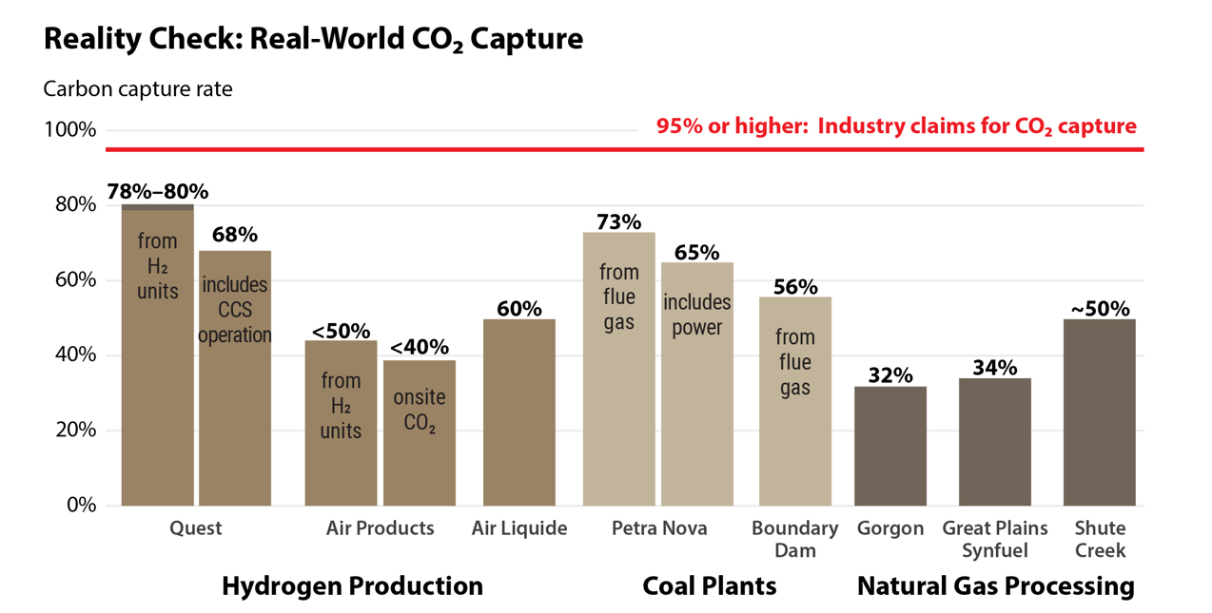
Source: IEEFA (David Schlissel – dschlissel@ieefa.org)

Slide 8
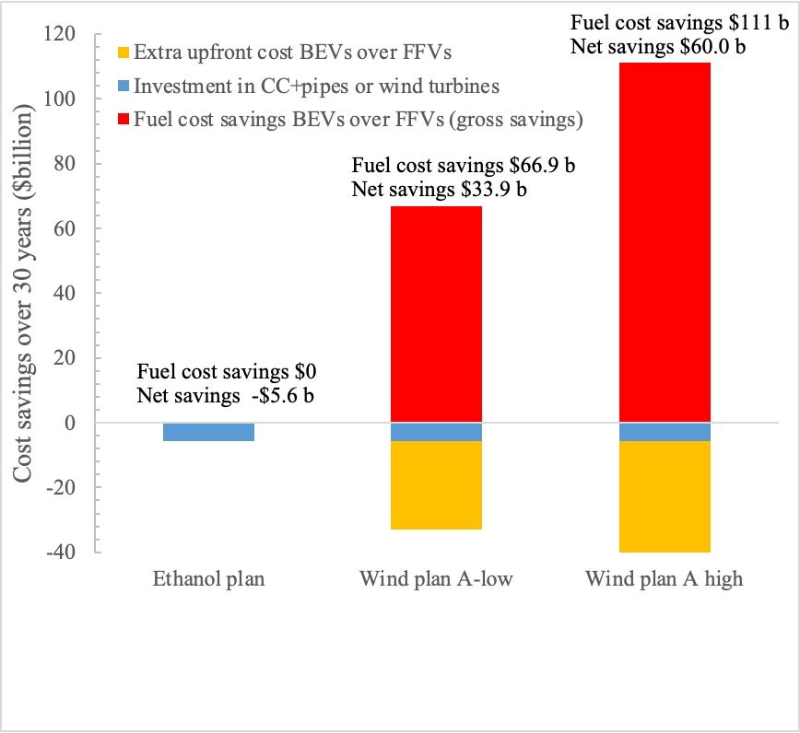
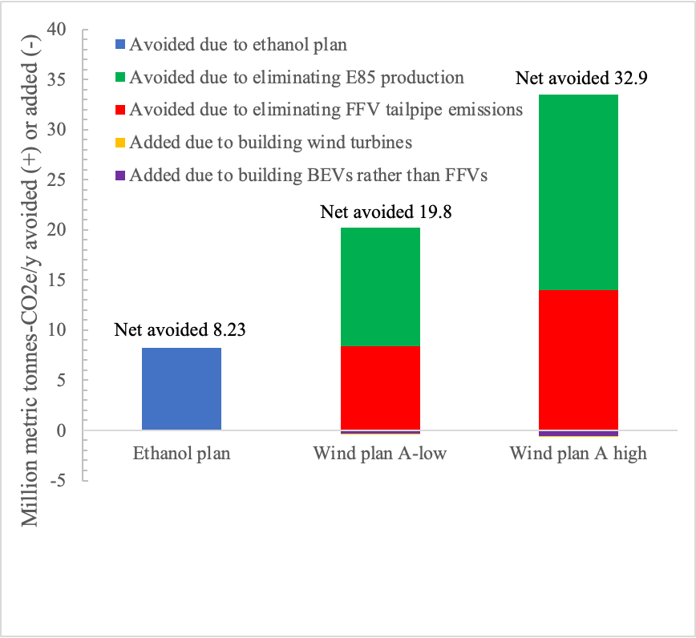
Cost (left) and CO2e (right) of Spending Same Money on E85 With Ethanol Using CCS/pipes vs. BEVs With Electricity From Wind
Source: Jacobson (2023)

Slide 9
Issues With Nuclear as Part of the Solution
Produces 9-37 times more CO₂e & pollution per kWh than wind
Takes 10-22 y between plan & operation v 0.5-3 y for new wind/solar
Capital costs 15-24 x; annual cost/kWh 5-10 x that of wind/solar
→ Nuclear never pays off the CO₂ & pollution emissions it causes due to its 10-22 y of such emissions prior to operation and its preventing 5-10 x the energy-output-equivalent of wind/solar
IPCC 2014: P. 517. “Robust evidence, high agreement” that increased use of nuclear leads to more
Weapons proliferation risk
Meltdown risk
Waste risk
Mining risk
Notes:
6-24 times more CO₂ & pollution per kWh than wind from mining & refining uranium and using fossil fuels for electricity during the 10-19 years to site permit (3.5-6 y), construction permit (2.5-4 y), and construct (4-9 y) nuclear plant compared with 2-5 years for a wind or solar farm

Slide 10
Transitioning an Individual Home to Run on WWS Electricity/Storage and No Gas

Slide 11
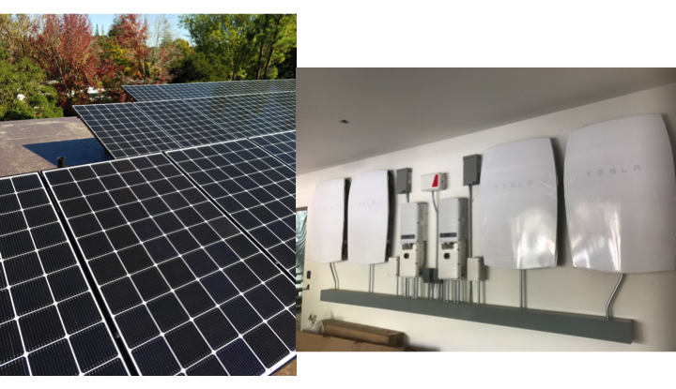
Rooftop Solar Plus Battery Storage
Photo by M.Z. Jacobson

Slide 12
Ductless Mini-Split Electric Heat Pump Air Heater / Air Conditioner
M.Z. Jacobson
Notes:
Indoor unit blows warm air from the room over cold evaporator coils. Refrigerant running through the coils absorbs the heat and takes it through thin pipes to the outside unit, where the heat is released to the outside air.

Slide 13
Electric Heat Pump Water Heater
Photo by M.Z. Jacobson
Notes:
https://www.atlantic-comfort.com/How-to-choose/Choosing-your-water-heater/Water-heating-technologies/Heat-pump-water-heaters-working-principle

Slide 14
Electric Induction Cooktop
Photo by M.Z. Jacobson
Notes:
Left: Stand-alone electric induction cooker. © Della Liner/AdobeStock. Right: Five electric induction cookers on a cooktop. © Mark Z. Jacobson.
Iron or stainless steel pots.

Slide 15
Five Years of Energy Use Generated 120% of all home and vehicle energy → No electric bill, natural gas bill, or gasoline bill Received average $860/yr from CCA for excess electricity to grid
Avoided costs of all-electric home Gas hookup fee: 3-8 K
Gas pipes: 2-15 K
Electric bill 1-3 K per year
Natural gas bill 1-3 K per year
Vehicle fuel bill 1-4 K per year
Total: 5-23 K plus 3-10 K per year
5y payback with subsidy; 10y w/o
M.Z. Jacobson
Notes:
http://home.costhelper.com/install-gas-line.html
https://www.pge.com/en/myhome/customerservice/other/newconstruction/projectcosts/results.page?serviceType=gas&gasType=gas_new&electricOverType=&electricUnderType=&pevType=&proj=gas_new

Slide 16
No Blackout on Hottest Day of Year Sept. 6, 2020 Outside temperature: 106 F Inside temperature: 77 F Blue=consumption by solar during day or batteries after sunset (2-3.3 kW/6.4 kWh) Red=grid electricity
M.Z. Jacobson

Slide 17
Can the World Transition to 100%, Clean, Renewable Energy for all Purposes? Roadmaps for 145 Countries

Slide 18
All-Purpose End-Use Power Demand
Year and Fuel Type | 145-Countries
2018 End-use demand | 13.1 TW
2050 Demand with current fuels (BAU) | 20.4 TW
2050 Demand with WWS | 8.9 TW
2050 Demand reduction with WWS 20.5% efficiency of BE, HFC v. ICE 4.3% efficiency of electric industry 13.6% efficiency of heat pumps 11.3% eliminating fuel mining 6.6% efficiency beyond BAU | 56.4%
Notes:
145-Country Paper

Slide 19
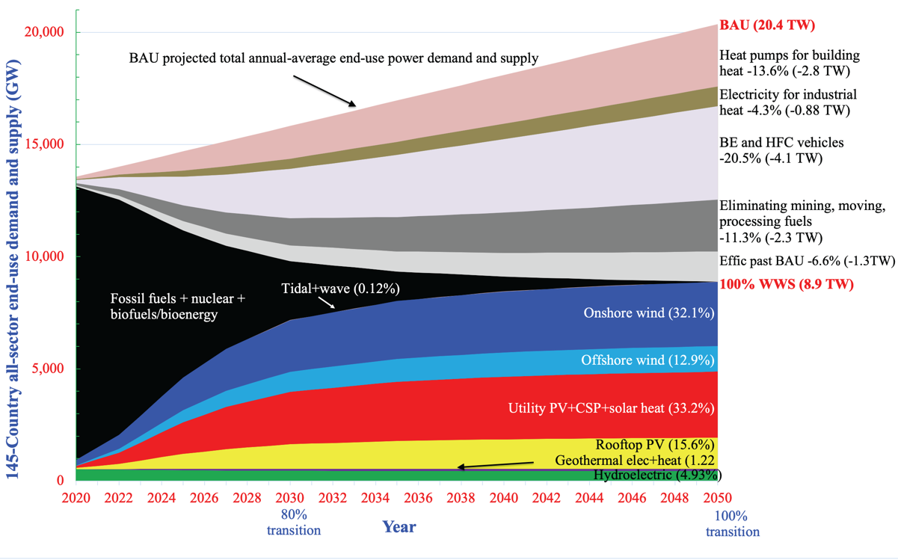
Timeline for a 145-Country Transition

Slide 20
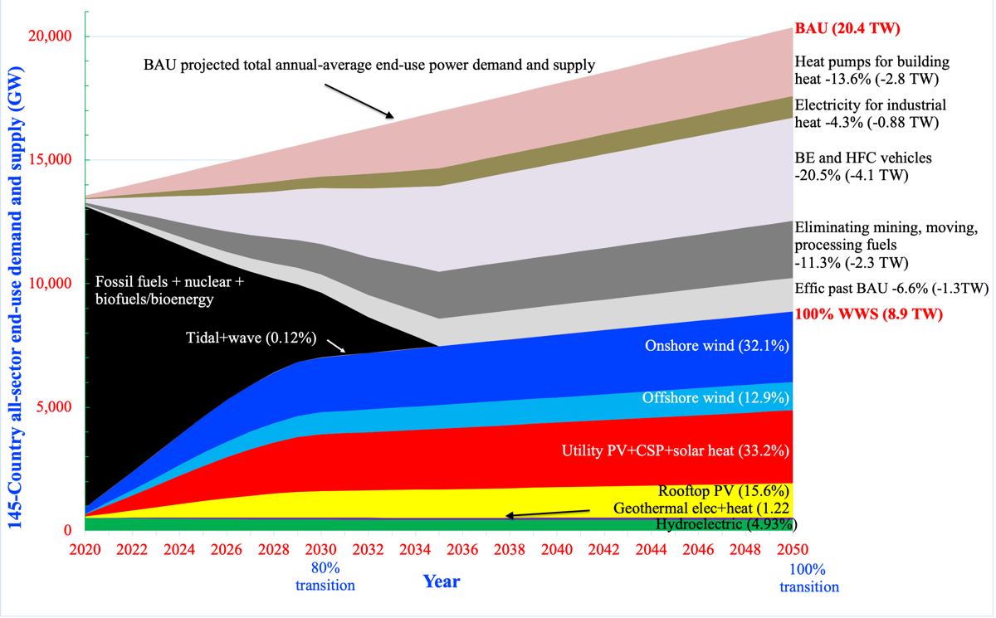
Faster Timeline for a 145-Country Transition

Slide 21
Percent of 2050 End-Use Demand Supplied by WWS
TECHNOLOGY World Europe
Onshore wind 32.1% 43.3%
Offshore wind 12.9 19.2
Rooftop Solar PV 15.6 11.9
Utility PV 30.0 16.2
CSP 2.73 0.89
Geothermal electricity 0.73 0.23
Hydroelectric 4.93 6.45
Tidal 0.04 0.11
Wave 0.08 0.08
Geothermal heat 0.49 1.42
Solar heat 0.42 0.30
100% 100%

Slide 22
Percent of Land Beyond 2018 Installations to Power Location for all Purposes With 100% WWS in 2050
Onshore wind: 0.36%
Utility PV+CSP: 0.17%
Total 145 Countries 0.53%
Onshore wind: 0.88%
Utility PV+CSP: 0.23%
Total Europe 1.12%

Slide 23
Matching Europe All-Sector Demand Every 30 Seconds With 100% WWS+Storage for all of 2050 and for 100 Days
Red = Energy supply
Blue = Energy demand + change in storage + losses + shedding

Slide 24
Capital Cost Resulting in a Stable Grid Upon Electrification of all Energy With 100% WWS+Storage
World: $61.5 trillion
U.S.: $8.9 trillion
China: $13.1 trillion
Europe: $6.0 trillion

Slide 25
2050 World BAU vs WWS Cost
BAU fuel energy cost $17.8 trillion/yr
BAU fuel health cost $33.6 trillion/yr
BAU fuel climate cost $31.8 trillion/yr
BAU total social cost $83.2 trillion/yr
WWS total social cost $6.6 trillion/yr
WWS reduces energy cost 63% and economic (social) cost 92%
Jacobson et al. (2022)

Slide 26
2009
100% worldwide wind, water, solar (WWS) all-sector energy plan introduced
Basis for Green New Deal
Conclusion
While technically and economically possible to transition by 2030, social and political barriers make complete transition more practical by 2050 with most (~80%) by 2030
Notes:
https://www.congress.gov/bill/114th-congress/house-resolution/540/cosponsors?q=%7B%22search%22%3A%5B%22%5C%22hres540%5C%22%22%5D%7D&resultIndex=1
https://www.demconvention.com/wp-content/uploads/2016/07/Democratic-Party-Platform-7.21.16-no-lines.pdf

Slide 27
62 Countries Committed to 100% Renewable Electricity
Afghanistan Denmark Kirbati Papua N.G. Tanzania
Aruba Djibouti Lebanon Philippines Timor-Les
Bangladesh Dominica Madagas Portugal Tokelau
Barbados Dom Rep. Malawi Rwanda Tunisia
Bhutan Ethiopia Maldives Samoa Tuvalu
Burkina Faso Fiji Marsh Is. Senegal Scotland
Cabo Verde Gambia Mongolia Solom Is. Vanuatu
Cambodia Ghana Morocco S. Sudan Vietnam
Colombia Grenada Nepal Spain Yemen
Comoros Guatemala Niger Sri Lanka Germany
Congo, DR Haiti Niue St. Lucia
Cook Islands Honduras Palau Sudan
Costa Rica Kenya Palestine Sweden

Slide 28
Some of the >400 Companies Committed to 100% Renewables
IKEA Adobe JPMor/Chas Coca Cola
Google H&M HP Goldman-Sachs
Microsoft Nestle Nike Johnson & Johnson
Apple S&P Starbucks Walmart
Workday T-Mobile AB InBev Bank of America
Bloomberg BMW Group Burberry Citi
P&G Ebay Facebook Estee Lauder
GM Goldman-Sachs HSBC Infosys
Kellogg’s Lego Mars Morgan Stanley
Salesforce Organic Valley Amazon Wells Fargo
Notes:
http://there100.org/companies
https://weather.com/science/environment/news/clean-energy-cities

Slide 29
Laws/Exec Orders in 19 U.S. States/Territories to go to 100% Renewable Electricity
100% by 2032
Washington D.C.
By 2033
Rhode Island
By 2040
Connecticut, Minnesota, New York, Oregon
By 2045
Hawaii, Calif., New Mexico, Wash. State
By 2050
IL, NV, ME, NC, NE, NJ, Puerto Rico, VA, WI
Notes:
https://www.congress.gov/bill/114th-congress/house-resolution/540/cosponsors?q=%7B%22search%22%3A%5B%22%5C%22hres540%5C%22%22%5D%7D&resultIndex=1
https://www.demconvention.com/wp-content/uploads/2016/07/Democratic-Party-Platform-7.21.16-no-lines.pdf
https://malegislature.gov/Bills/190/SD1932

Slide 30
Some of 180 US Cities/Counties Committed to 100% Renewables
Atlanta (GA) Salt Lake City (UT) Sylva (NC)
Chicago (IL) San Diego (CA) Moab (UT)
Cincinatti (OH) San Francisco (CA) Boulder (CO)
Cleveland (OH) San Jose (CA) Burlington (VT)
Denver (CO) Spokane (WA) Rochester (MN)
Kansas City (MO) St. Louis (MO) Fayetteville (AR)
Los Angeles (CA) St. Paul (MN) Palo Alto (CA)
Madison (WI) St. Petersburg (FL) Middleton (WI)
Minneapolis (MN) Tallahassee (FL) Missoula (MT)
Orlando (FL) Abita Springs (LA) Questa (NM)
Philadelphia (PA) Sarasota (FL) Fayetteville (AR)
Portland (OR) Hanover (NH) Clarkston (GA)

Slide 31
Left: 14 Countries With Annual Elec. Generation 90-100% WWS
Right: 3 States+1 Country With Annual Consumption >90% WWS
Albania 100% (H, S) S. Dakota 120% (W,H)
Bhutan 100% (H) Wash. State 97.2% (H,W)
Iceland 100% (H,G) Montana 92.6% (H,W)
Nepal 100% (H,S) Scotland 91.2% (W,H)
Paraguay 100% (H)
Ethiopia 99.97% (H,W)
Congo, DR 99.77% (H,S) H = hydro
Norway 99.17% (H,W) G = geothermal
Costa Rica 98.47% (H,W) W = wind
Namibia 96.68% (H,S) S = Solar
Uganda 94.45% (H,S)
Kenya 92.23% (G,H)
Kyrgyzstan 90.74% (H)
Tajikistan 90.11% (H)

Slide 32
Summary – Transitioning World to 100% WWS
Creates 28 million more jobs than lost worldwide
Requires only 0.17% of land for footprint; 0.36% for spacing
Avoids ~7 mil. air pollution deaths per year
Slows then reverses global warming
Grids can stay stable throughout the world with 100%
WWS annual energy costs are 63% less than of fossils
WWS annual energy+health+climate costs 92% less than of fossils

Slide 33
Book on 100% WWS (“No Miracles Needed”)
https://web.stanford.edu/group/efmh/jacobson/WWSNoMN/NoMiracles.html
100% WWS Plans for Countries, States, Cities
web.stanford.edu/group/efmh/jacobson/Articles/I/WWS-50-USState-plans.html
Online Course on 100% WWS
https://stanford.io/windwatersolar
Infographic maps
https://sites.google.com/stanford.edu/wws-roadmaps/home
Twitter: @mzjacobson

