Slide 1
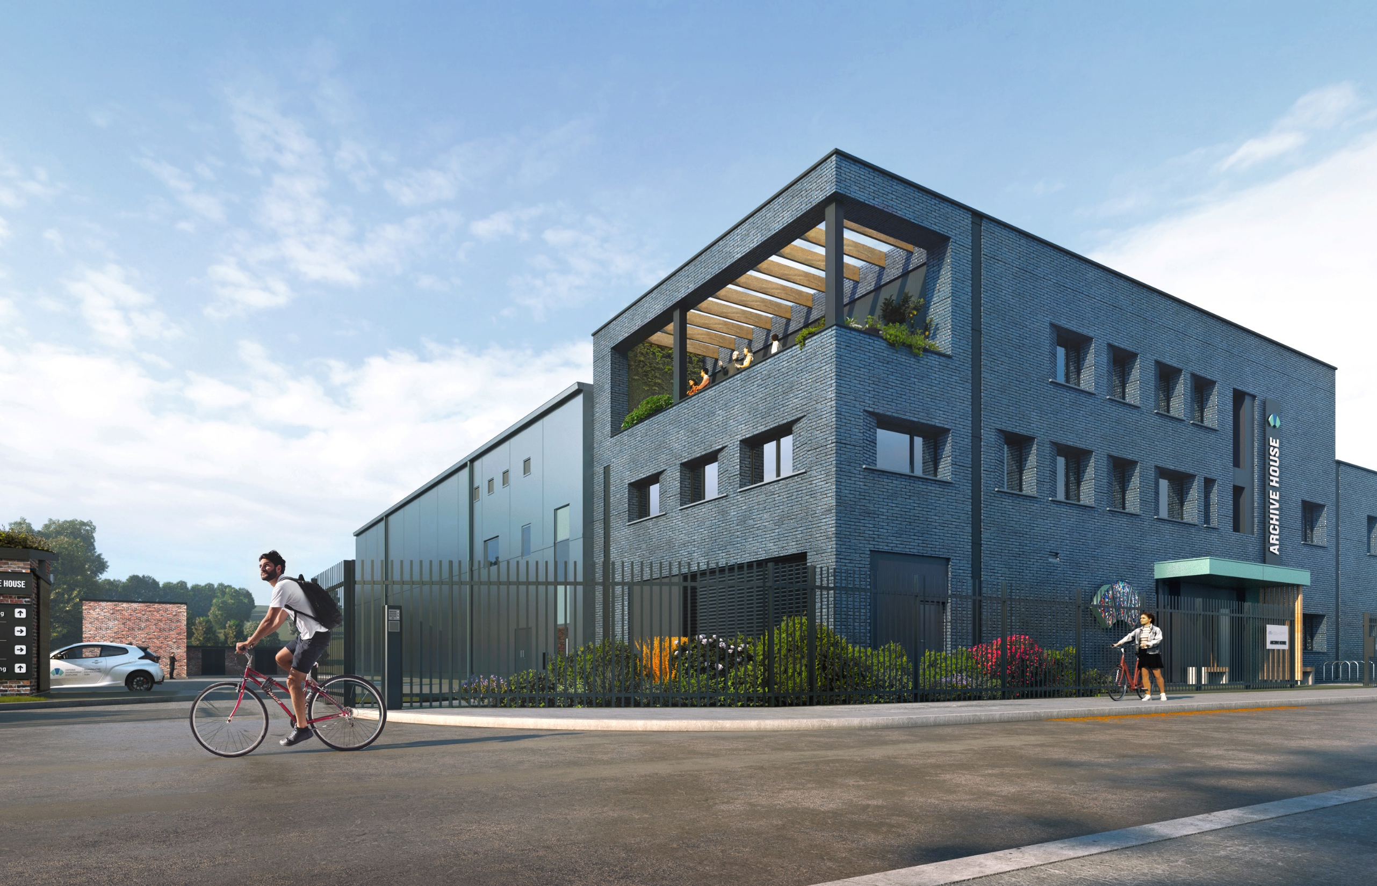
Jumping the Hurdles of a True Net Zero Construction ICARB Conference 25th September 2023 Samantha McCabe Director of Sustainability Oberlander Architects B. Built Environment, B.Arch (Hons),RIBA, RIAS & Passive House Designer
Notes:
Hi, my name is Samantha McCabe and it’s a pleasure to be here today, I am an architect and Passive House designer, Director of Sustainability at Oberlanders Architects and Board Member for Architecture and Design Scotland.
The ultimate challenge I’d like to discuss today is HAS THE CONSTRUCTION INDUSTRY REQUIREMENT TO JUSTIFY COST & EXPENDITURE OF NET ZERO GONE TOO FAR…
A perfect case study to demonstrate this is a project I’m leading for Historic Environment Scotland – their new archive facility called Archive House. containing 3 new world class Archive repositories retrofitted into an existing shed to the rear and a new build extension to the front of the site consisting of archive studios and offices for the HES team.
Archive House will be the UK’s first truly Net Zero EnerPHit archive facility, making it world class. The project is currently at RIBA Stage 4, detailed design stage and starts on site in Spring 2024.
The ultimate goal of the project is to protect the archive and the users by creating a stable, comfortable environment that uses as little as the earth’s resources as it needs to in order to function.

Slide 2
Setting the scene
Challenge 1 – The Net Zero Standards
Challenge 2 – How to prioritise
Challenge 3 – Are we asking the right questions?
Notes:
Today I’m going to talk to about the key challenges we are working through.
Challenge 1 is how we prove we’ve met the net zero standards
Challenge 2 is How do we prioritize, primarily the decision framework and how we align the accreditation scheme with the detailed design
And Challenge 3 is the overall complexity of the process are we asking the right questions?
The point of this is that the Industry has set these standards the construction team are trying to meet them and prove them. The requirements of proof are so incredibly onerous that it is costing the client significantly, I wonder if we are losing sight of the bigger picture.

Slide 3
Challenge 1 :
The Net Zero Standards
Notes:
The project has a very ambitious brief, pushing the team to strive for numerous standards. We are committed to achieve the new Scottish Government Net Zero Public Sector Building Standard which tackles 6 separate aspects of sustainability in the form of Objectives.
From placemaking and the justification for development, to embodied and operational carbon, water use and wellbeing targets for the occupiers and Whole life Carbon.
It is a truly holistic approach to construction and has thrown up a few interesting hurdles that the design team have been solving in collaboration with Scottish Futures Trust and HES.
For today’s purpose I’ll focus on the Objectives 2 and 3 - Embodied and Operational Carbon and the hurdles to jump in order to prove adherence .

Slide 4
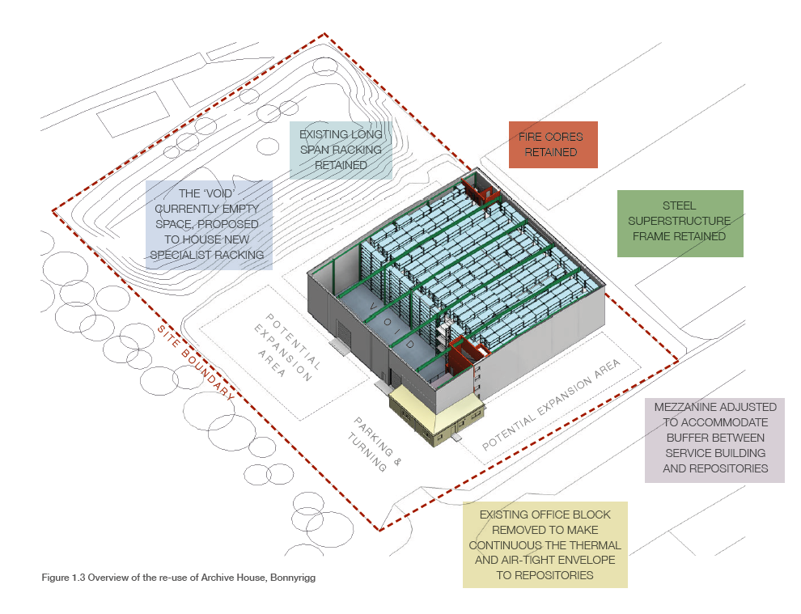
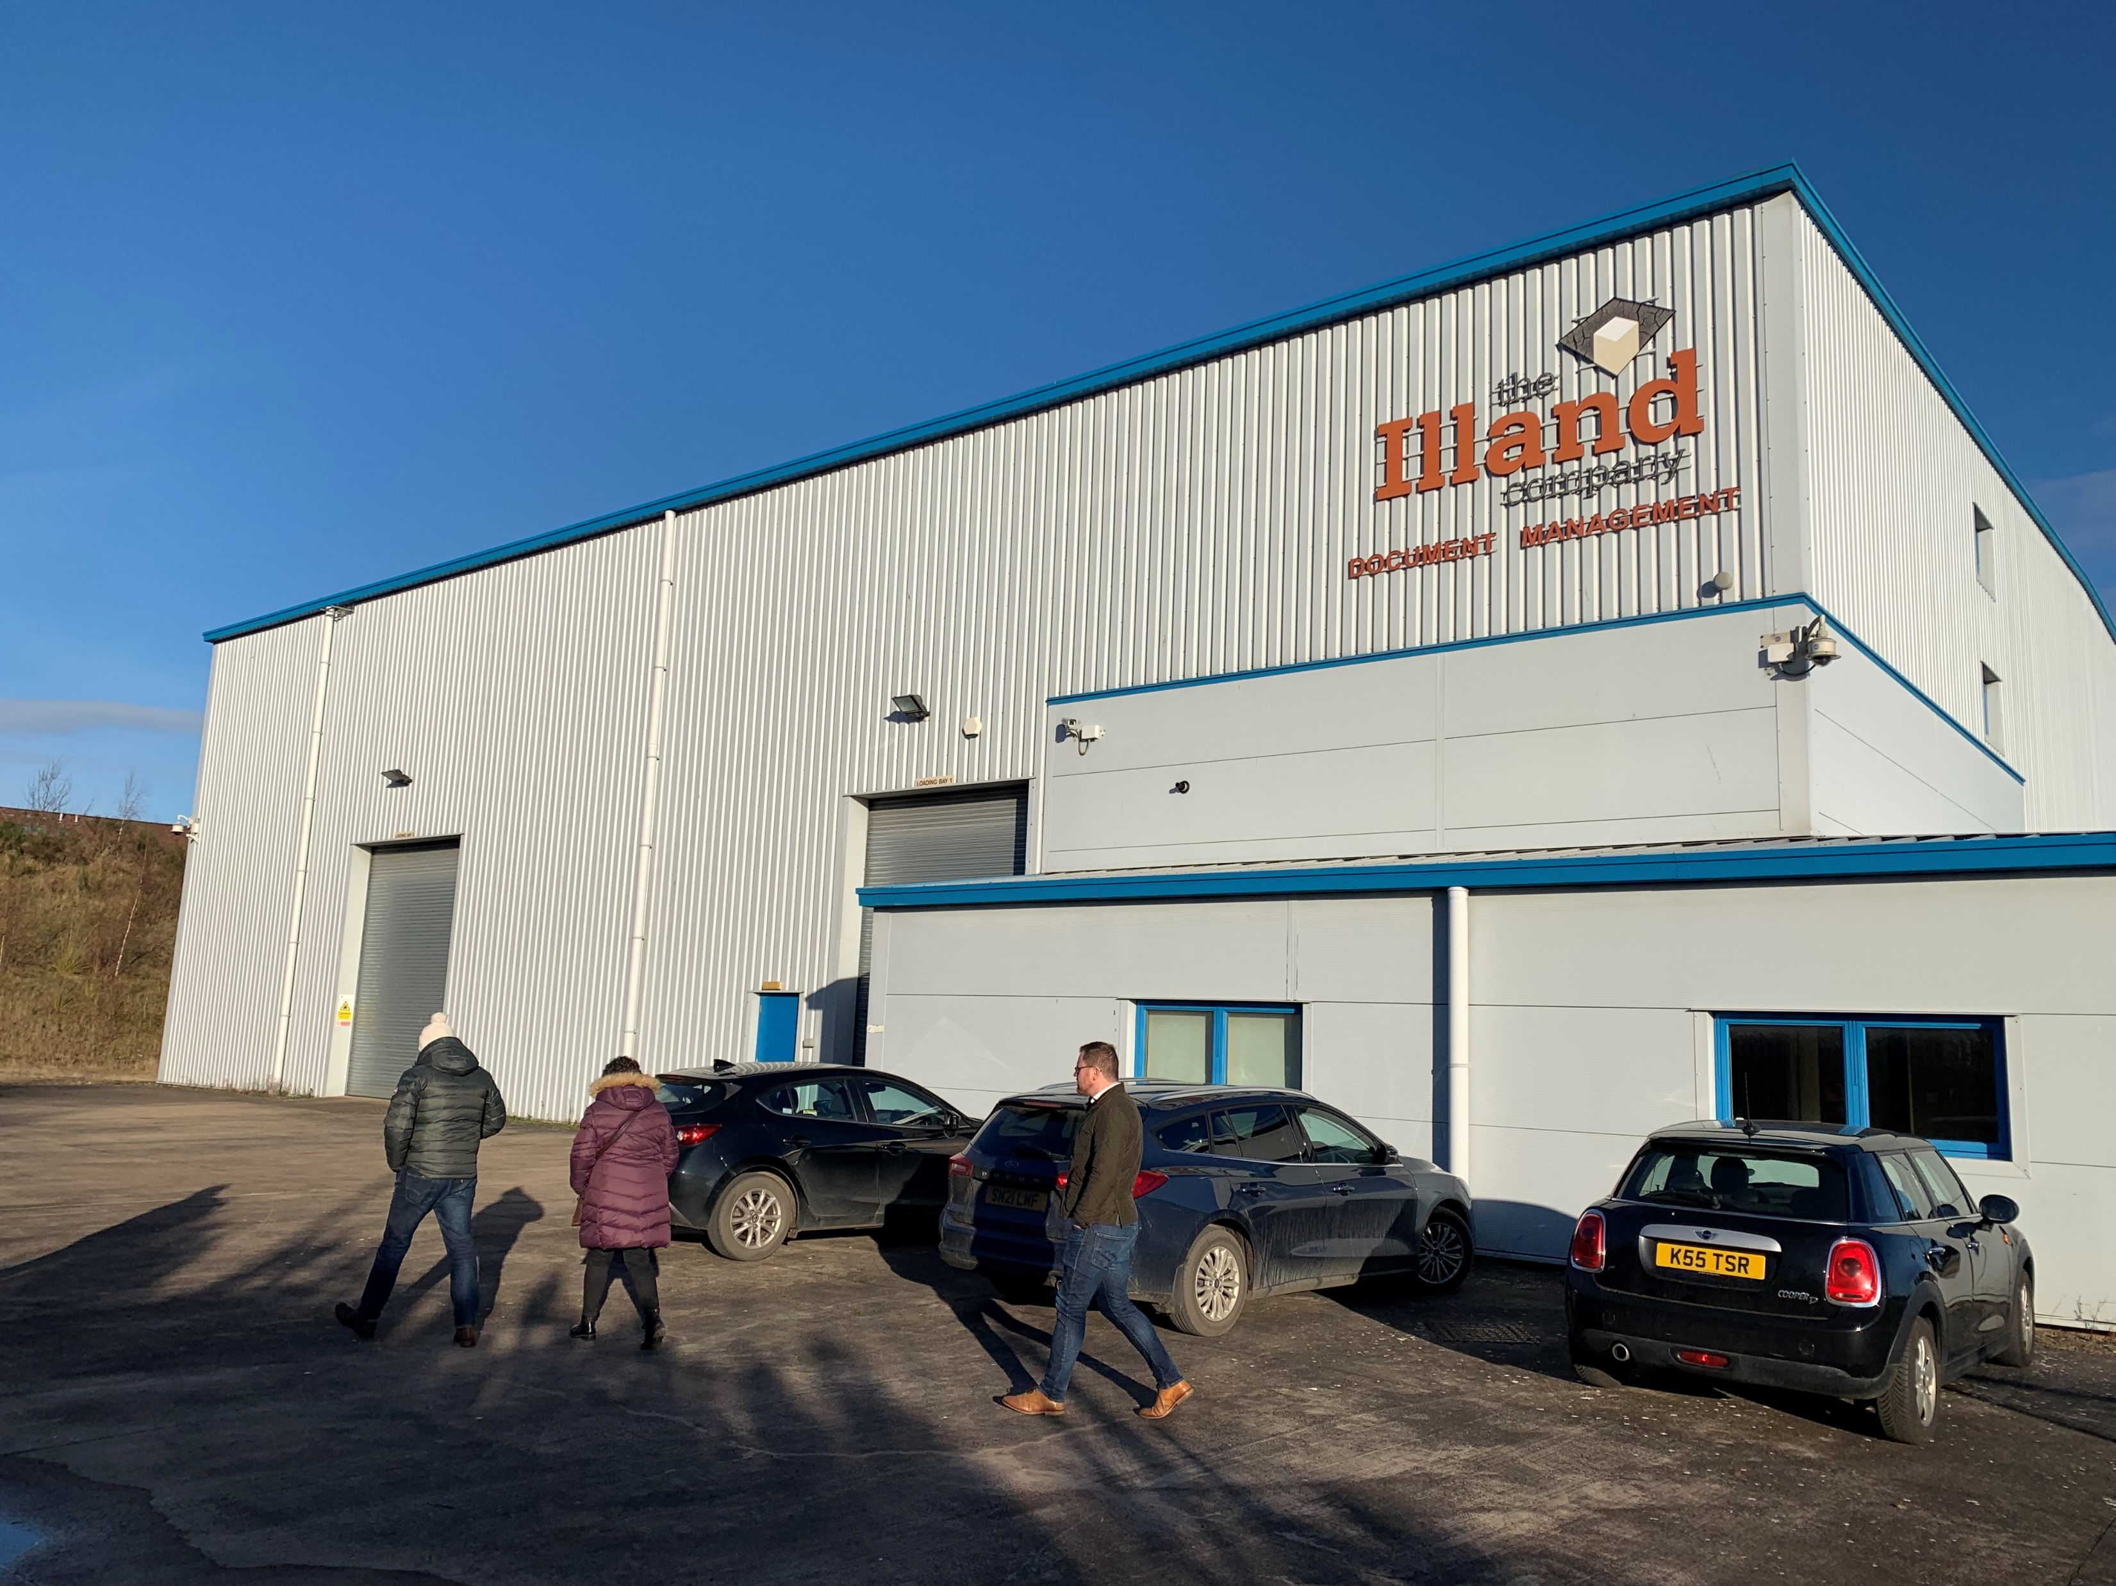
Challenge 1:
The Net Zero Standards
From an existing shed with it’s own merits…
Our starting point…
Notes:
One of the overriding themes of this conference and this project is achieving the maximum result by having the minimum impact on our resources. We are retaining as much of the existing building structure and substructure as possible.
Creating a world class clean stable environment to protect the archive.
We have started with an existing building essentially a shed filled with storage racking, existing structure and concrete slab as shown in the images above.
The Net Zero Standard is pushing us to prove and justify all carbon usage for the project so if we can minimise carbon by retaining and using existing materials…we will!

Slide 5
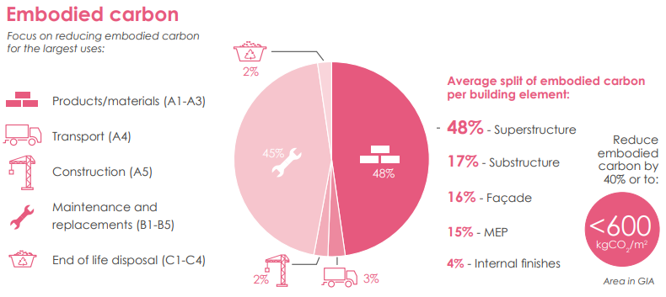
Challenge 1 – The Net Zero Standards
- Objective 2 Embodied Carbon
Leti Guide for Embodied Carbon for a Commercial Building
Notes:
Lets start to look with Embodied Carbon Objective 2.
We are retrofitting part of the building but we are also building new archival studios so essentially two building typologies and consequently two sets of targets are required for each Objective.
We are using software to measure the embodied carbon in the model however as no two retrofits are the same, bespoke targets were set based on the level of anticipated works.
To set the target we have started with Leti guidance of 600kgCo2/sqm shown on the above diagram for a new commercial building. This diagram represents 100% of the carbon of a new construction as I’ve indicated we are building a mixture of retrofit and new… for the New 600kgCo2/m is acceptable …Generally the diagram above shows how much of the carbon that various elements of the construction represent. We are keeping the substructure, this is the slab and the foundations therefore we can remove 17% of the 600kgCo2/sqm from our targets. We are retaining some of the superstructure so therefore we have extrapolated the % retention and subtracted this as well and on and on leaving us with an embodied carbon target of 320kgCo2/sqm for the refurb and 600kgfor the new building a combined aggregate of 460kgCo2/sqm.
There are many benefits of retaining the structure from improving thermal mass and carbon storage but critically just building less.

Slide 6
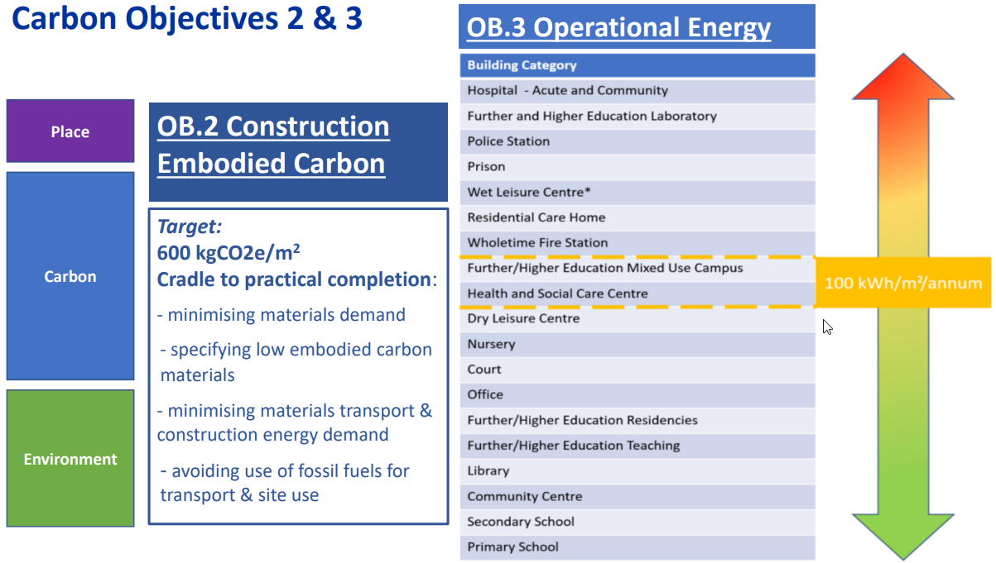
Challenge 1 – The Net Zero Standards
Notes:
Both the Embodied and operational carbon are intrinsically linked, because if you alter a product like the cladding for example it has impact on both the embodied carbon and the operational performance of the cladding system. NZPS Building Standard – at the moment doesn’t allow for trade offs between the two, making it difficult to connect the embodied carbon and operational both require specific target and measuring systems, software and training in order to prove. And achieving one does not guarantee the other and occasionally decisions need to be taken to prioritise one over the other.
The average standard for embodied carbon is materials, creation of them and maintenance. Operational carbon is the energy we use in operation of the building. The targets are based on industry standard at 100 kwh/m2/annum

Slide 7
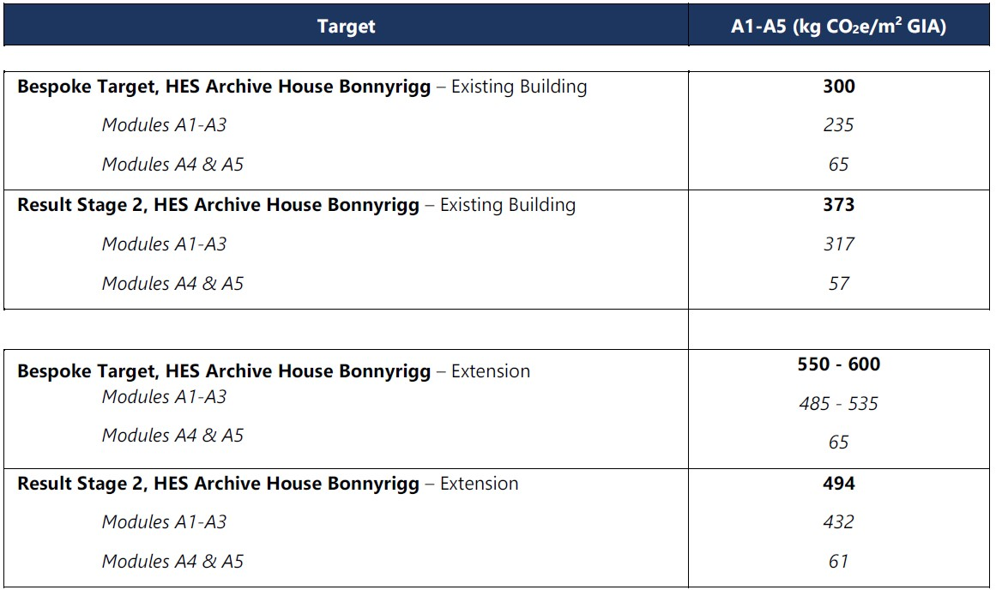
Embodied carbon targets + Stage 2 results:
Notes:
So how are we performing so far…Embodied Carbon, Targets versus reality… we are sitting slightly above our target for the retrofit but significantly below for the extension. Not to worry to much as yet as we are on track and everyone needs a starting point… There is still a lot of refinement to be detailed and taken account of before we reach site.

Slide 8
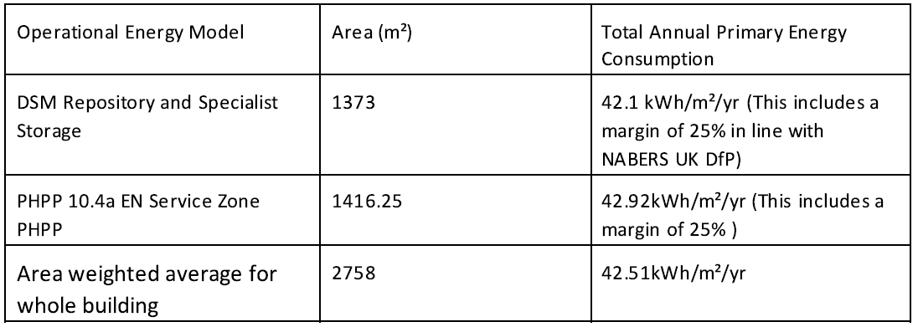
SFT NZPSB Operational Energy Target = 100 kWh/m²/yr:
Notes:
Operational Energy, Targets versus reality…Operational carbon – the target set of 100kWh/m2a was based on the hybrid of Archive and office-type accommodation. By coupling with the Passivhaus low-energy standard, and significant optimisation of the MEP provision, the current modelled Operational energy is less than 43% of this target at 42kWH/m2a.
Raising the question…When the target was set…so was the target to generous, should we have been more ambitious?

Slide 9
Breakdown the complexity
Our starting point…
The Existing site
The Proposed Plan
Notes:
In order to prove our Operational energy consumption we are targeting Passive House’s EnerPHit accreditation. This accreditation works in conjunction with the other standards and will ensure that the modelled data matches the end built result now and for the life of the building. It takes into account all elements of operational energy consumption from the kettle and computer usage through to location and orientation of each building element.
In order to simplify the complexity of the building and it’s different spaces. We decided to start breaking the proposed building down into temperature and humidity zones. The red line in the plan above being the extent of the existing building, the green line being the extension.

Slide 10
BUILDING FIRST – PASSIVE DESIGN DECISIONS:
DIFFERENT TEMPERATURE
ZONES
Orange = Office accommodation 20⁰C
Yellow = Main Repository 13-18 ⁰C
Blue = Cold store 10⁰C
Notes:
Each Zone had different requirements not only for temperature and humidity but for the activity and occupants within them.
On the diagram above The main and lower repositories shown in yellow to the north and south west deliberately with no windows. They are temperature controlled to between 13-18 deg C all year round.
The cold store on the 2nd floor (in blue) is controlled to 12 deg C
The main offices and Archivist studios (in orange) are controlled to 20deg C the orange zone consists of archive studios, digitalization and conservation studios, all with their own inherent spatial qualities.
The conservation studio wants north facing non direct light hence it’s location. The digitization studio wants no light generally creating a blackout space…but people do need to have comfortable space to work in when they aren’t within the blackout space.
The archive studios want natural light and steady temperatures year-round. requiring us to harness the Scottish sunshine throughout the year.
Staff breakout zone and kitchen want natural daylight good ventilation, beautiful views, out door space, sunshine and shade.
from time to time we have had to decided and make a clear decision as to priorities that often conflict with either the passive house requirement of the Net Zero Construction...which one takes precedent?
AS THE PROJECT PROGRESSES, WE FIND THAT OTHER ASPECTS OF THE BRIEF BEGIN TO CHALENGE OUR ABILITY AS A DEISGN TEAM TO DELIVER THE NET ZERO GOALS…

Slide 11
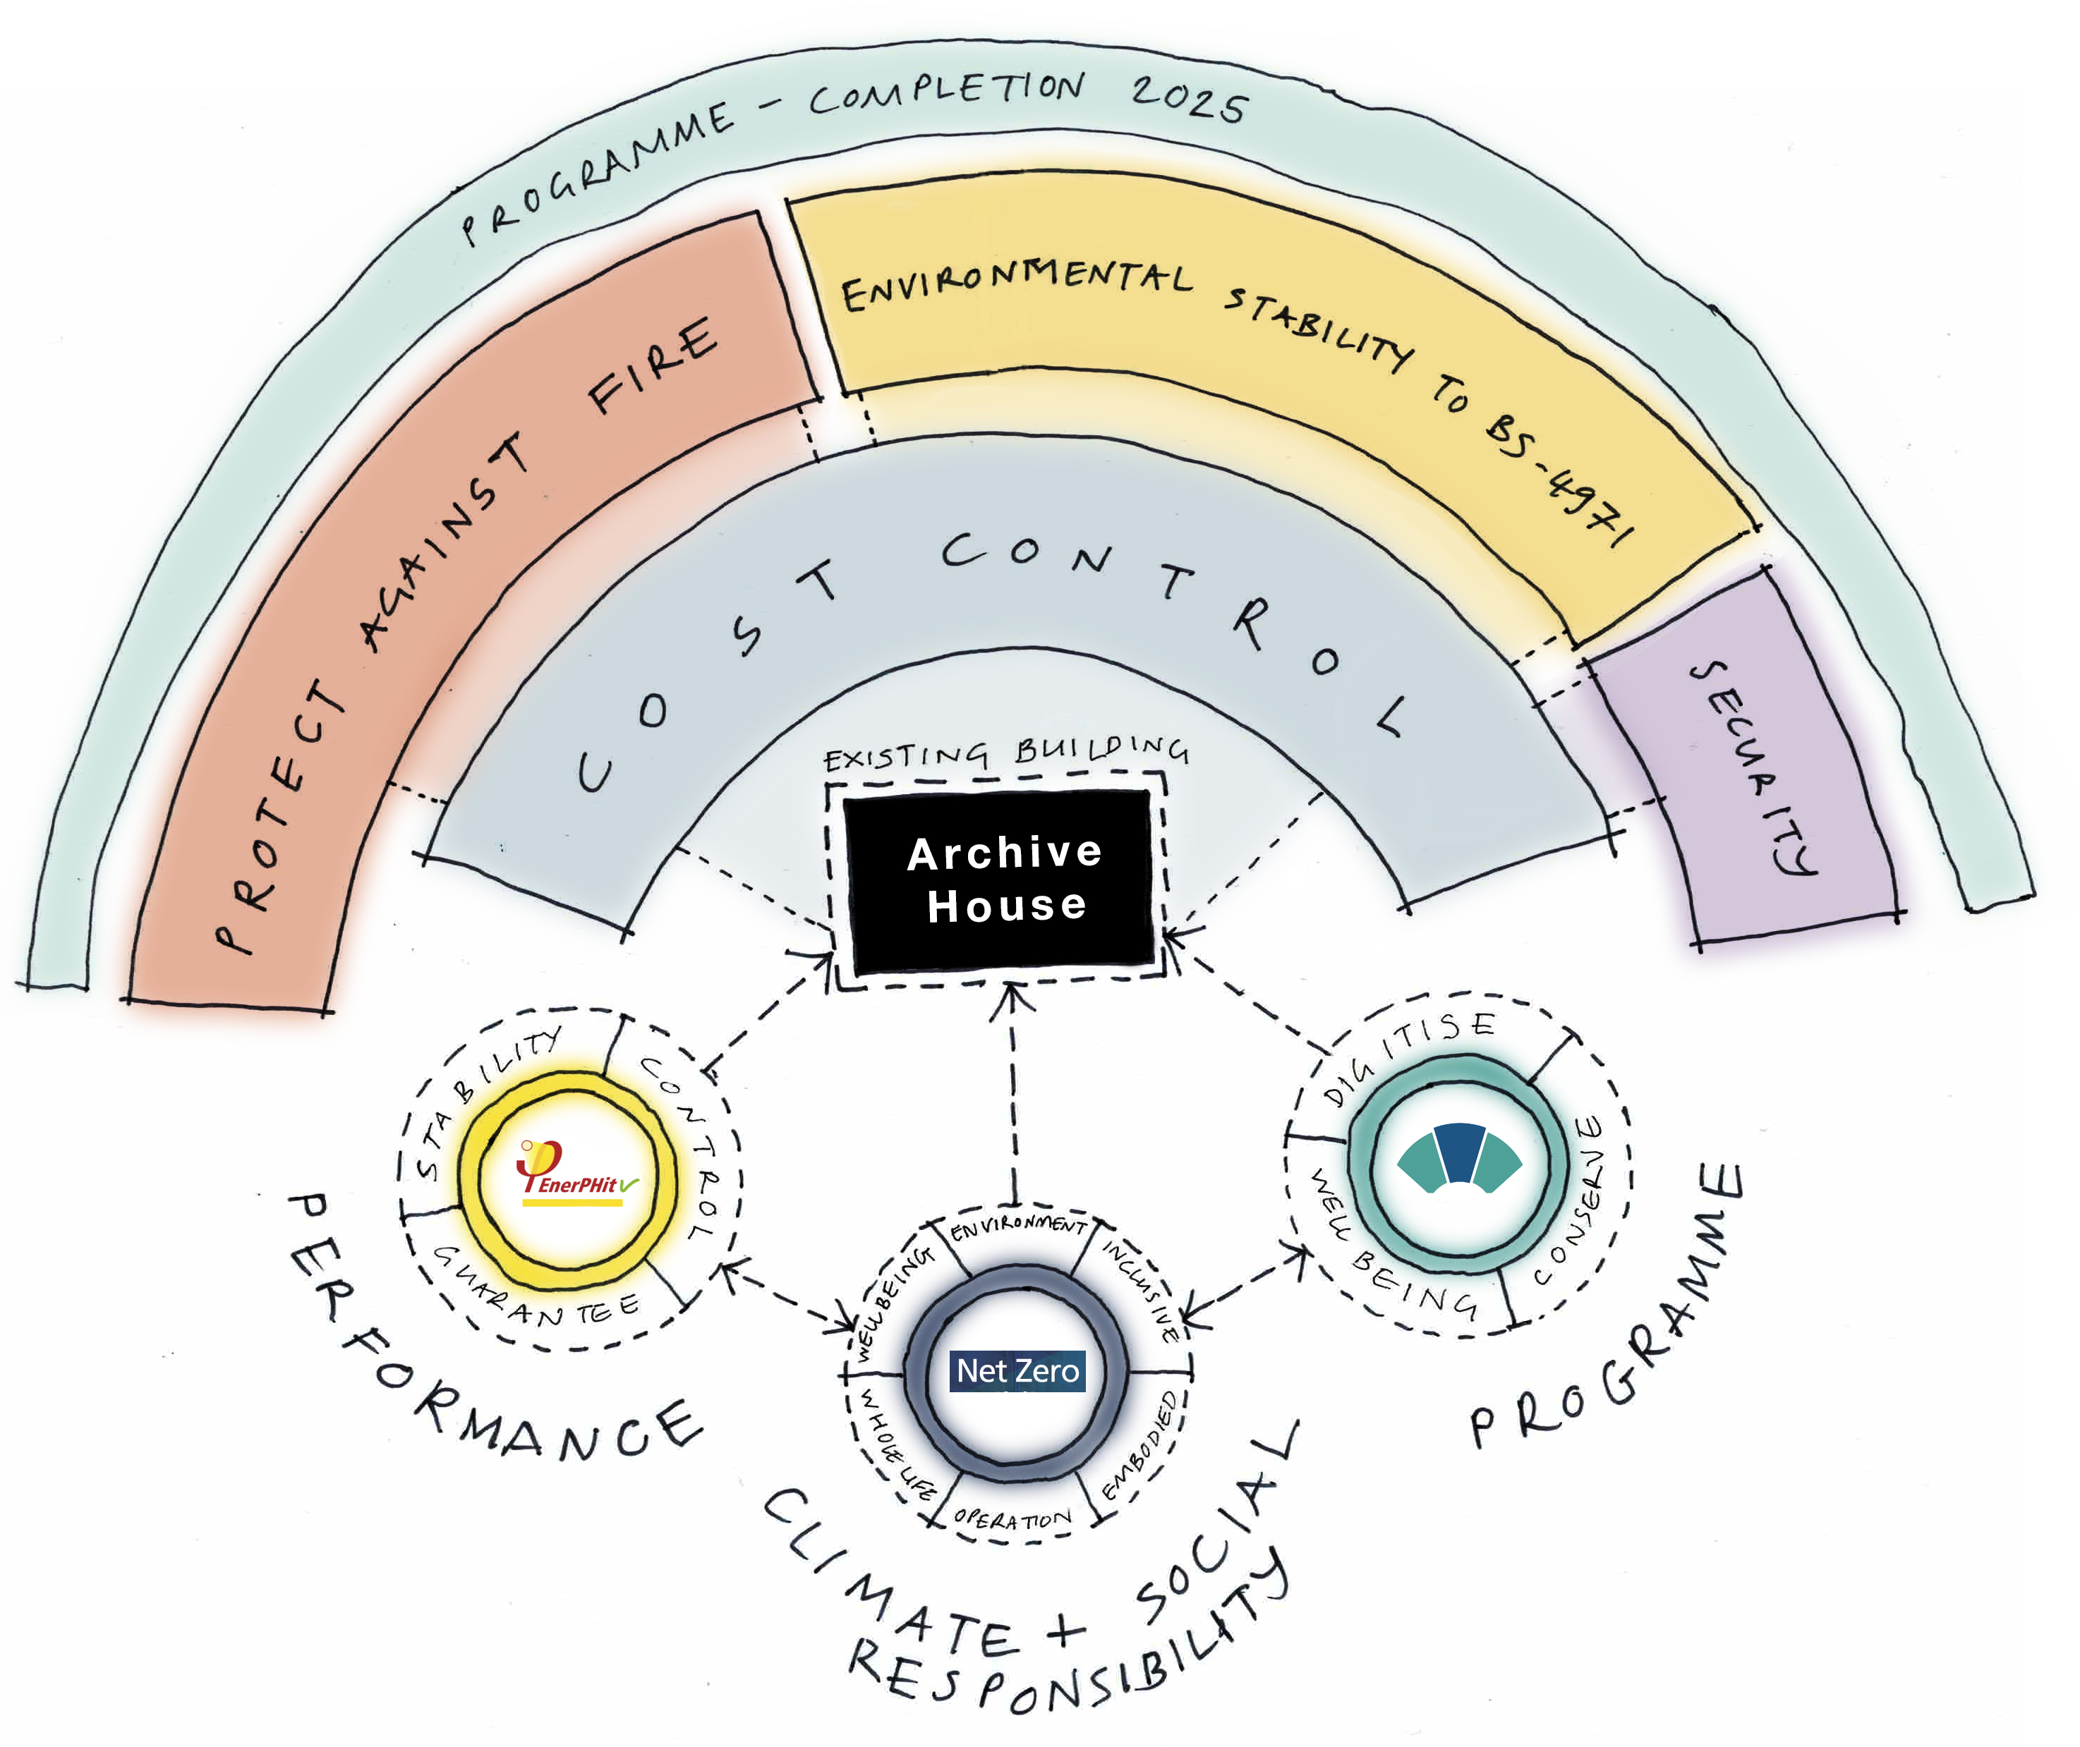
Challenge 2 :
How to prioritise
Notes:
We needed to work out a priority list. Breaking down the challenge and the options to achieve the accreditation into smaller pieces became essential.
The priorities are clear:
Protect against fire and Environmental Stability
Security and Future proof for climate change and resilience
Cost and a Circular economy
Climate and Social Responsibility and Performance embody, Thermal comfort, Operational, Embodied and Whole life Carbon
and over arching all others is Programme HES need to move by a certain time.

Slide 12
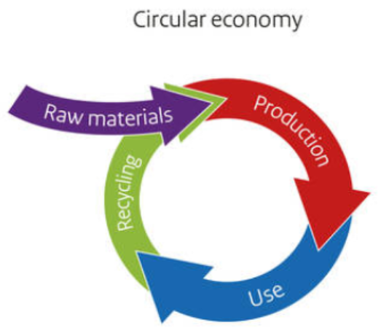
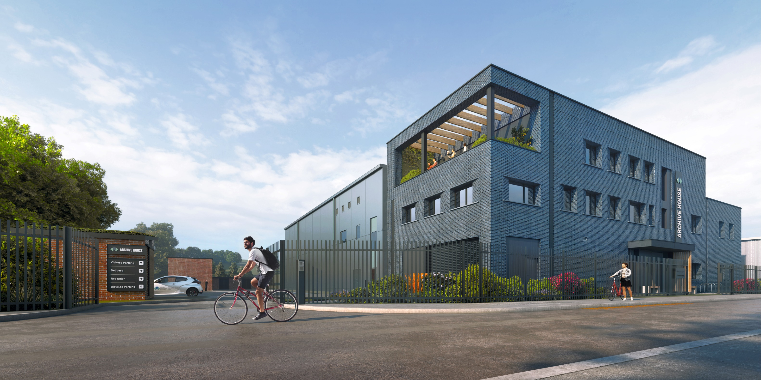
The Big Key Moves
Achieving a low energy construction with a palette of industry standard materials
Keep existing Frame
Orientate Staff spaces
Targeted Window Openings and window splay
Circular Economy
Minimal & Recycled materials
Keep it simple
Standard panel sizes to reduce waste
Simple materials palette
Minimal alteration to existing infrastructure
Existing Building
Notes:
Based on the project priorities there have been some simple key decisions we’ve taken as a team to reduce the overall cost, complexity and carbon of the project,
optimising user experience and comfort. these are:
Orientate Staff spaces in this case the staff terrace and break out facilities for maximum Solar Gain and views to the South
Open window splay to optimise light infiltration to the east,
Deep window reveals provide shade in the summer and splaying the windows reveals ensures longer light penetration in the winter.
When it comes to Embodied carbon The big key moves are:
minimal alteration and disruption to existing roads, fence, paving infrastructure
Keep existing Frames and substructure in this case the steel frame, racking and foundations.
Create a tea cozy around existing frame to ensure minimal thermal bridges and clean clear airtightness lines.
recycled elements in this case bricks to outbuildings ensuring maximum performance to the critical spaces
Simple, clean lines, brick dimensions, standard panel sizes to reduce waste
simple transitions between elements
simple materials palette

Slide 13
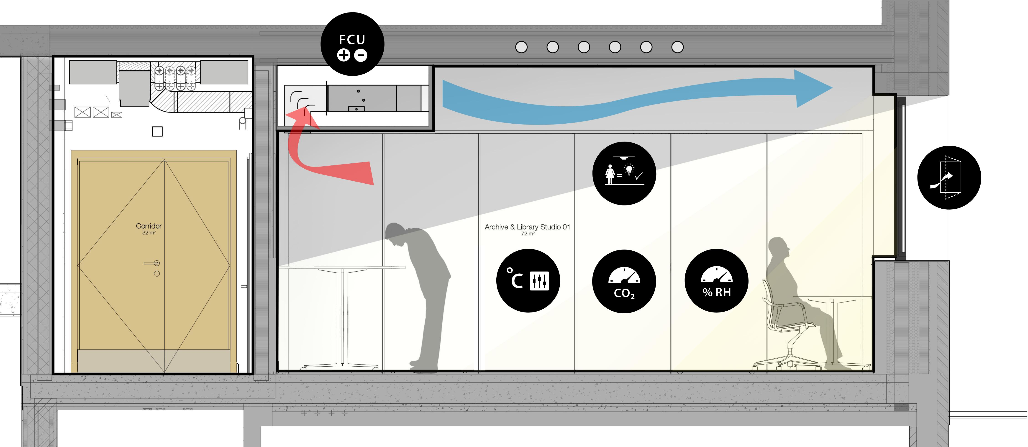
Simple Solutions for Complex Challenges
Notes:
Reducing energy and improving comfort of occupants requires optimization of Natural Ventilation strategy. Particularly in the staff occupied spaces natural ventilation and natural light are paramount in creating a welcoming environment. This works hand in hand with creating warm comfortable well insulated spaces for the occupants.
We have integrated heat recovery systems, deep reveals to promote shade on warm summer days and high windows to push natural light to the back of the archive studios during the short winter days.

Slide 14
ORIGIN
BRITTISH STANDARD
MATERIAL TYPE
FIRE
OPERATIONAL ENERGY
WARRANTIES
EMBODIED CARBON /SQM
COST
SOURCE
THICKNESS
MANUFACTURER
Materials Matrix
Notes:
Transparency on this project is absolutely critical to ensure we are delivering as one team.
We have created a materials matrix that assess all our material choices against all the various priorities we listed above ensuring trade offs are clearly stated.

Slide 15
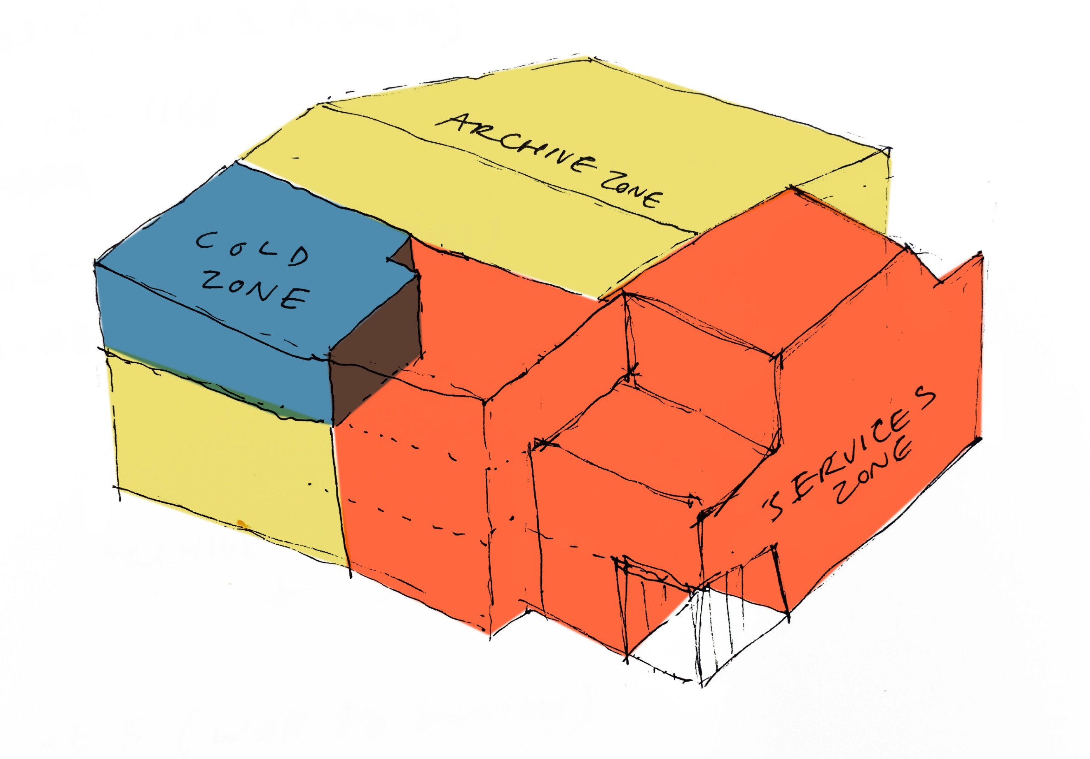
Aspirational Carbon Targets - Beyond The Industry Standard
ACHIEVED - ENHANCING INDUSTRY STANDARDS
Notes:
What fundamentally matters is the design of the building and protection of the archive itself to enable energy storage in the mass and natural ventilation where necessary.
We are designing for the client to create a sufficiently controlled environment using minimal mechanical intervention. Our fabric first approach has to ensure a Passive house, EnerPHit building is possible and ensures that the building is doing all the work for us instead of the systems within it.

Slide 16
Challenge 3 :
Are we asking the right questions?
Notes:
Overlaying all our decisions is questions about sufficiency and building the most with the least. All of this must be aligned to Historic Environment Scotland Visionary Climate Challenge statement and their budget. However, with these hugely aspirational targets there is always the questions of proof…
How and when do we prove our performance against the standards and to whom?
At this stage I’m not sure that we have all the answers.

Slide 17
But are we asking the right questions?
Notes:
Design teams have to jump many hurdles to meet the various standards, many of which have similar principles but don’t recognize each other’s commonalities and so demand repetitive leg work. Of course this risks diverting attention away from design and instead towards bureaucracy.
Don’t get me wrong, we’ve got this, and we are on track to deliver a first class facility. I’ll make sure of that.
However it’s time to ask what actually matters. My question to you is…
How do we create a streamlined and safe pathway to creating truly low carbon buildings through Net Zero standards? How do we get to a place where Net Zero is a help rather than a hindrance? A focus rather than a diversion.
Let me give you some context, for this project alone we are using a NZPSB tracker, LCA one Click for embodied carbon, Passive house PHPP, IES TM54 models, building warrant submissions, building regulations, British standards for Archives, British standards for fire design, nd whole life carbon models. Each of these standards adds cost for the client.

Slide 18
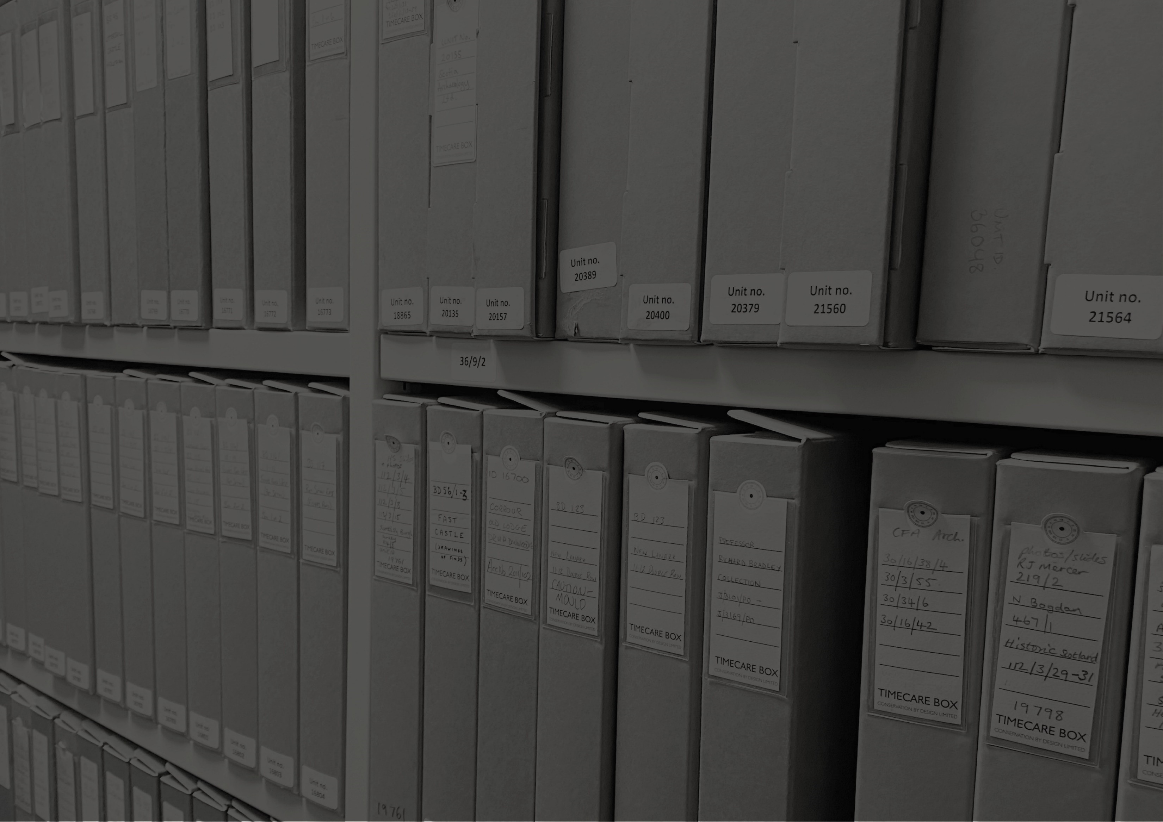
Leading edge Net Zero Construction
projects serve to push boundaries and evolve the industry
So many hurdles, so few Net Zero Carbon Buildings…
Notes:
Perhaps it all boils down to good design that looks beyond just technologies, to innovation and future proofing.
That’s how we’ve tackled Archive House. We’ve minimized energy use whilst maximizing occupancy comfort through local natural energy, thermal storage, natural ventilation, orientation and building form.
Is it time to step back from a culture of justification, to focus back on need driven, simplistic, anthropologic design?
This project run by HES – is hugely significant and important - allowing us as a design team to push the boundaries and ask the industry questions. I believe we need to step back from time to time and ask our clients why they are building and start to simplify.
It’s important that projects such as this are allowed to progress in order to allow the industry to learn and grow.

