Slide 1
ICARB 2023
Measuring Net Zero
Managing net-zero strategies for a complex university estate
By Julio Bros-Williamson
The University of Edinburgh, School of Engineering, Edinburgh, Scotland, UK
j.broswilliamson@ed.ac.uk
25th /September/2023

Slide 2
Introduction
Building Estates departments across the country struggle to find an efficient and cost-effective way to meet net-zero targets
Often in dispute are the methods and the speed of delivery to reduce energy demand and carbon emissions
The real concern is what to do with the existing stock
The Further and Higher Education (FHE) sector has made significant pledges to become net-zero carbon by reducing both direct and indirect emissions.

Slide 3
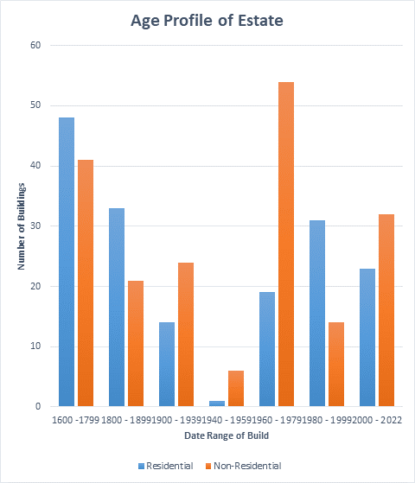
The University : A large and diverse estate with a complex infrastructure
3 Colleges, 27 Schools
5 Main campuses
c50,000 students
c17,000 staff
550 Buildings (940,000m²) (171 listed)
One of the largest Universities in the UK
Teaching, learning and specialist research
World class sport & exercise facilities
2 farms, very large data centres
Student accommodation (10,000 beds)
5 District heating and private HV networks
CHP, boilers, absorption chillers (74.2MW heat)
CHP electrical output (7.7MW elect)
30+ major chillers + district cooling networks(4.5MW)
30 UoE owned HV substations
272 boilers (domestic up to 9MW), 30 Boilers with a rating over 500kW, (total 106MW)
Annual Energy £40Million

Slide 4
New Climate Strategy – The challenge ahead!
Grid Decarbonisation
Residual Emissions at 2040
Decarbonisation plan required
2030
2040
New Energy Masterplan
Major accelerated energy transition
Energy efficiency programme
A Paradigm shift required – heat!

Slide 5
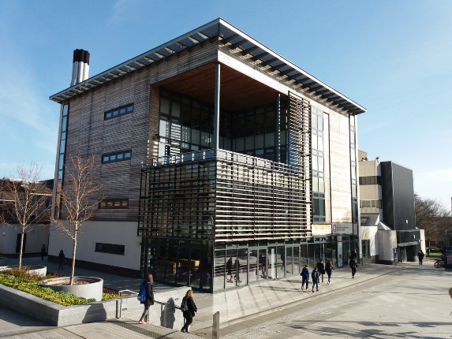
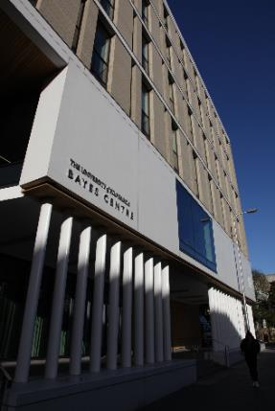
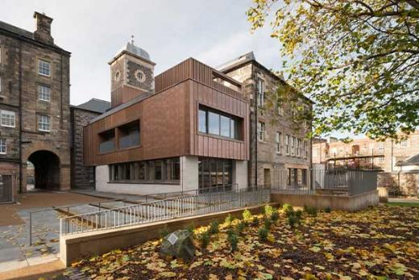
How complex?
Complex buildings in FHE institutions have a range of issues split into two scenarios
1] The management of new buildings, designed and built using conventional natural gas heating technology and standard level building envelope performance, NOW REDUNDANT
2] the existing heritage and older buildings within FHE Estates – late 16th C buildings

Slide 6
Estates Department
Centre for Future Infrastructure
Full support – Trials + Data
The problem: Beyond net-zero CO₂ performance
Real efficiency – COP's
Building archetype
Building envelope retrofit
Low CO₂ heating
(heat pumps)
Occupancy (decanting)
Maintenance/ install
Start – study/ data + parameters
Start – study/ data + parameters
FABRIC first – retrofit interventions
Balanced approach to net-zero
Economic assessment
Operation + controls
Conservation/ heritage
Maintenace – whole life approach
Reduced (kWh/ CO₂) demand
Occupant comfort
Slow reduction
Fast reduction
How do we identify the benefits + speed of roll-out?
HOW!
OUTPUTS – Pathway project
Cost Health Energy Carbon

Slide 7
Reaching the sweet spot
The approach seeks to find the sweet spot that reaches net-zero
The evaluation needs a whole life carbon viewpoint
A Net Zero Potential (NZP) should be applied – How close to 0% can a building reach?
Some buildings may reach 0% easily by retrofit and low-carbon heat others will rely on the decarbonised grid.
A 5 step approach:
1] assess your building stock using benchmarks and the net-zero potential, 2] cluster buildings by archetype and heating type, 3] decide on a common archetype approach which is affordable and can reduce energy demand and carbon emissions, 4] use district heating and/or renewable energy and take advantage of surplus heat where possible, and 5] understand your occupants as they will be in these buildings through this net-zero journey.
Each Building will have an optimum investment plan
Project Cost
Revenue Savings
Energy/Carbon Savings
Degree of disruption

Slide 8
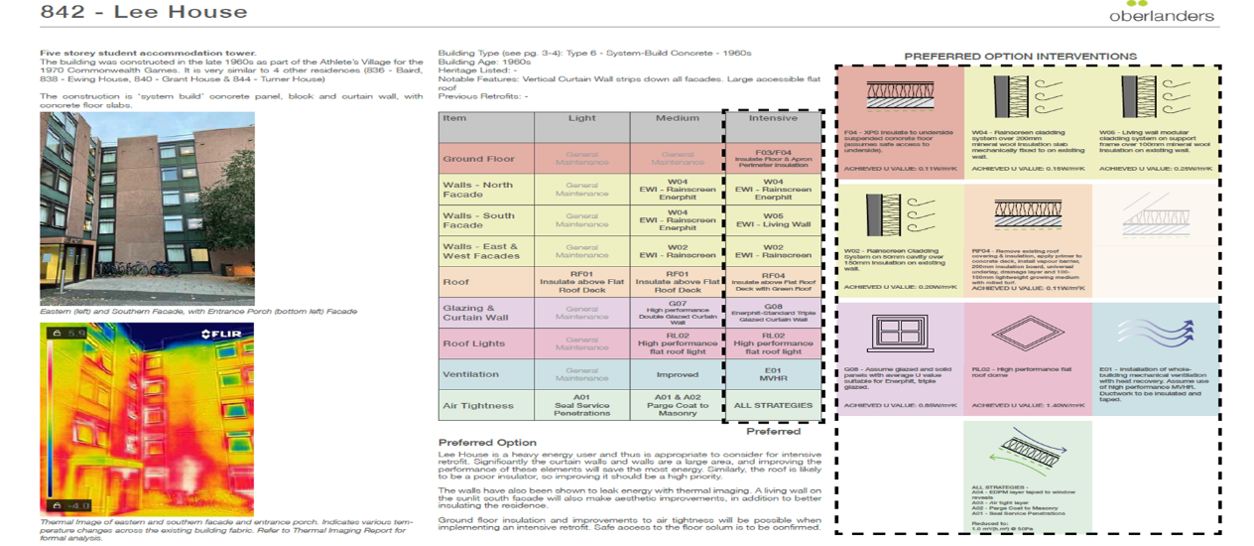
The correct balancing act
Building estates need to understand the size of the problem – there needs to be an energy survey of buildings
An archetype approach is needed where buildings are identified and clustered
Retrofit interventions then follow the common approach as a pattern book of solutions
Low carbon technology then is applied – with a reduced load (low demand)
Avoid relying on low-carbon technology before reducing the energy demand!

Slide 9
ICARB 2023
Measuring Net Zero
Thank You!
j.broswilliamson@ed.ac.uk

