Slide 1

ICARB 2023
Measuring Net Zero

Slide 2
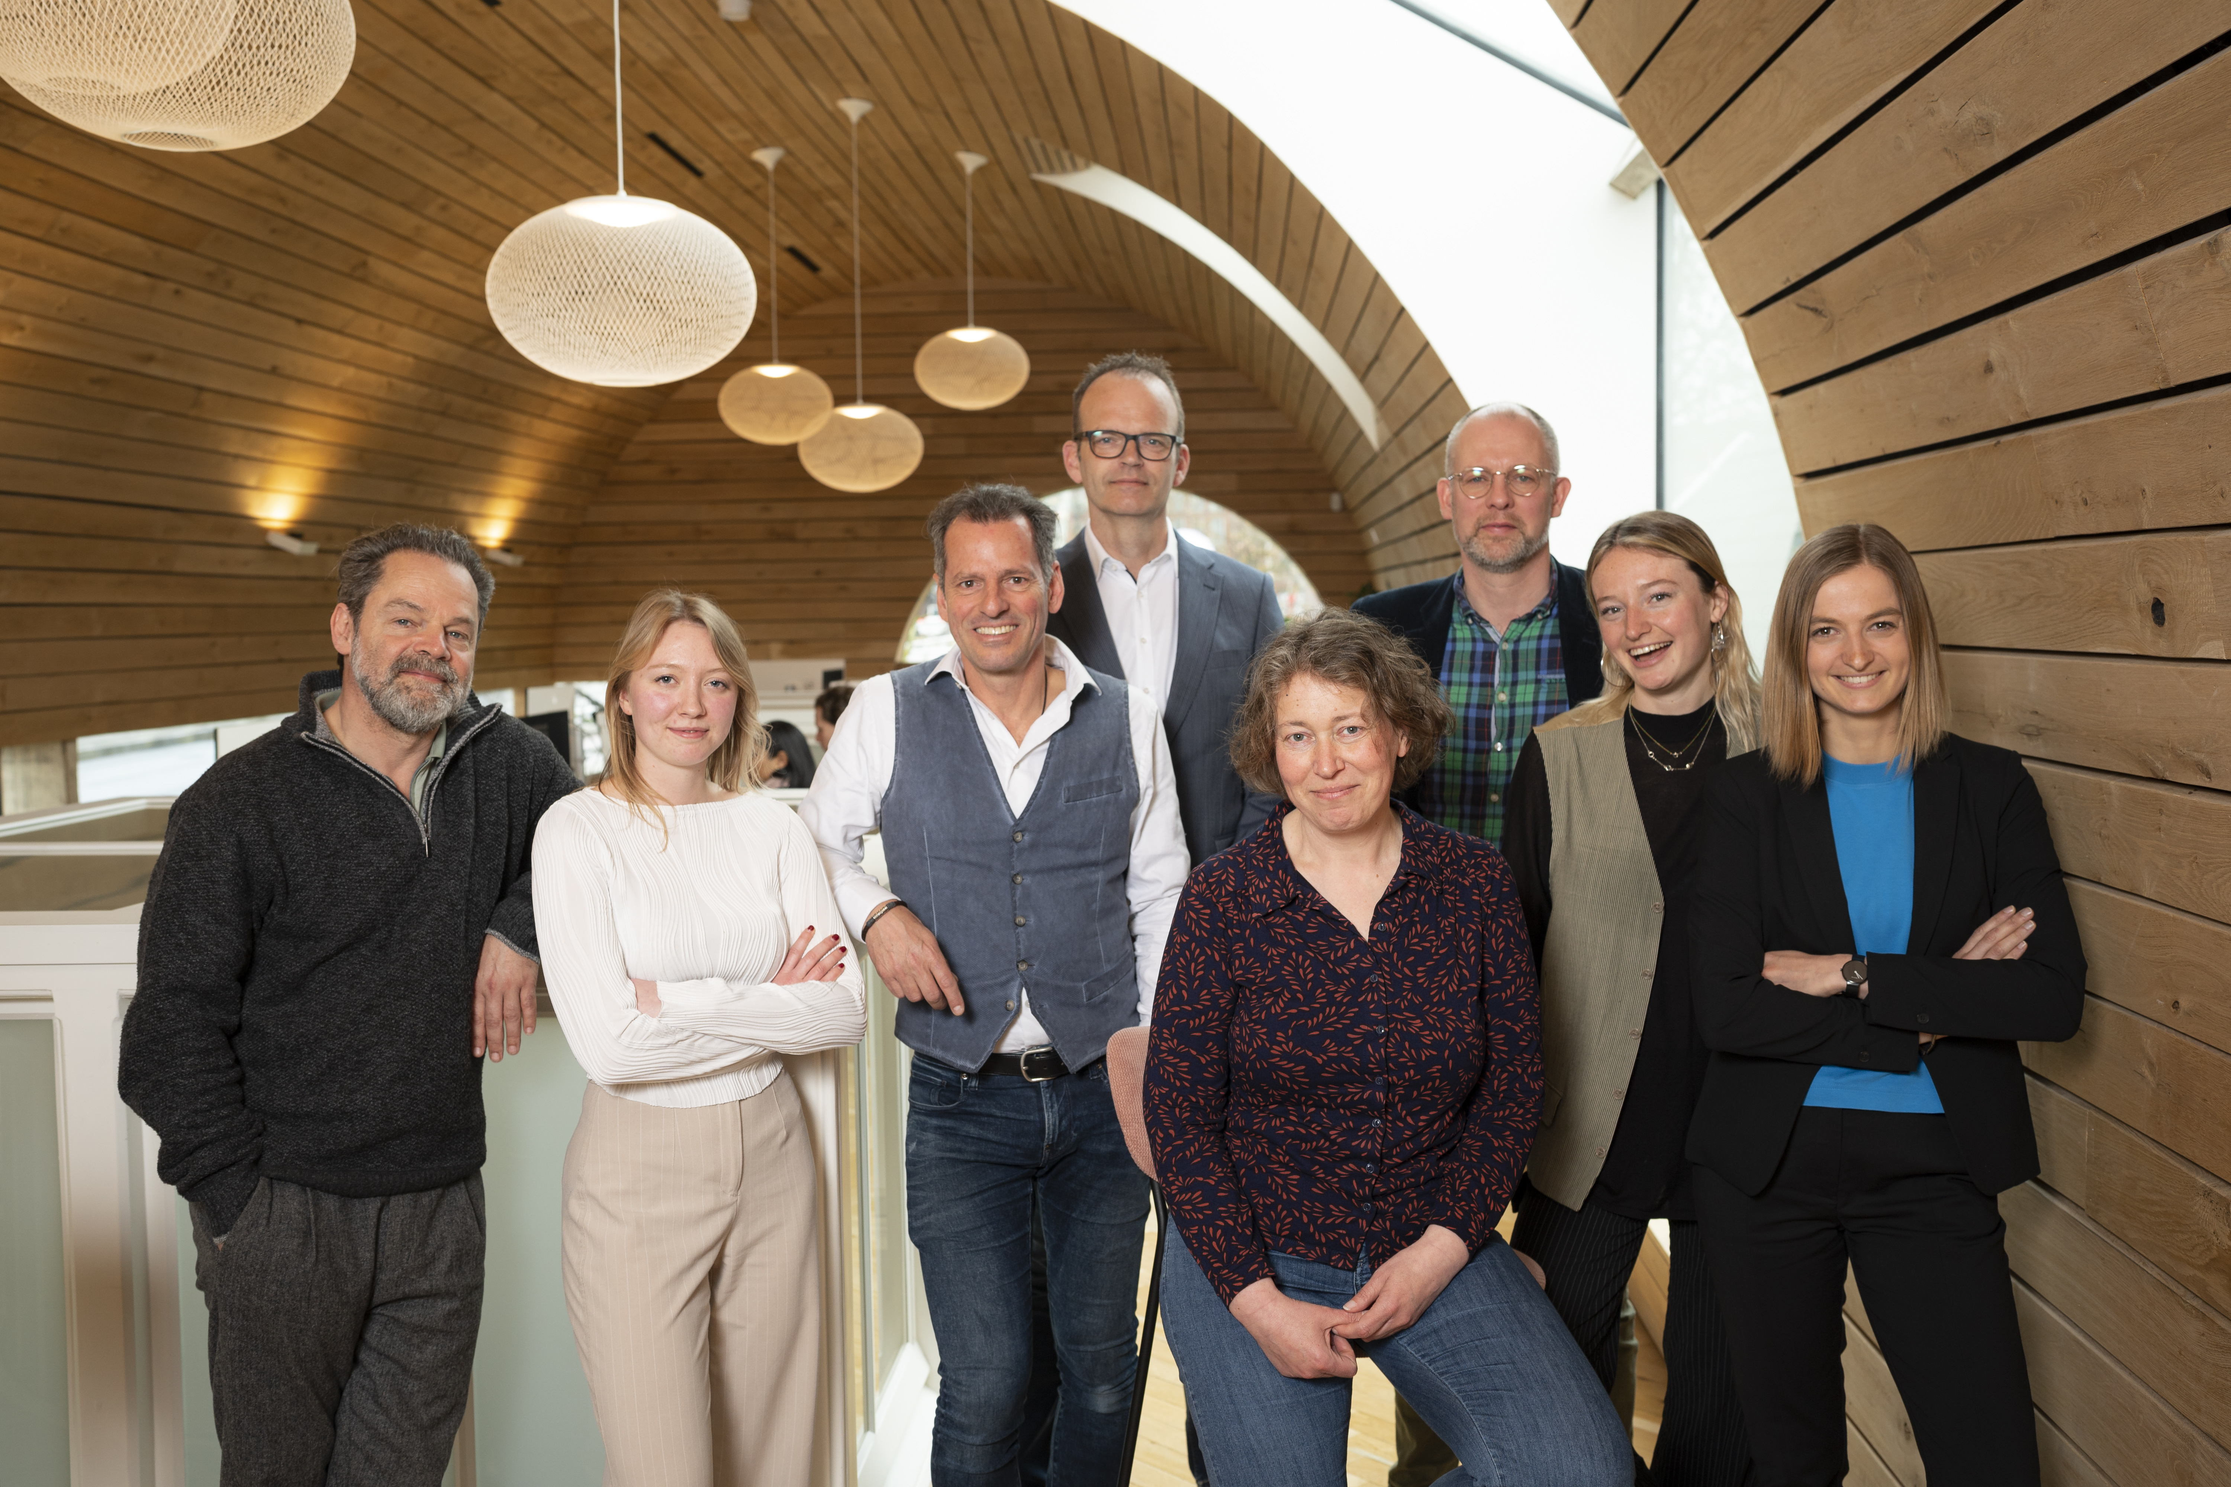
Photograph of Core team. Marcel Krijger (2023)

Slide 3
Photograph of Core team. Marcel Krijger (2023)

Slide 4
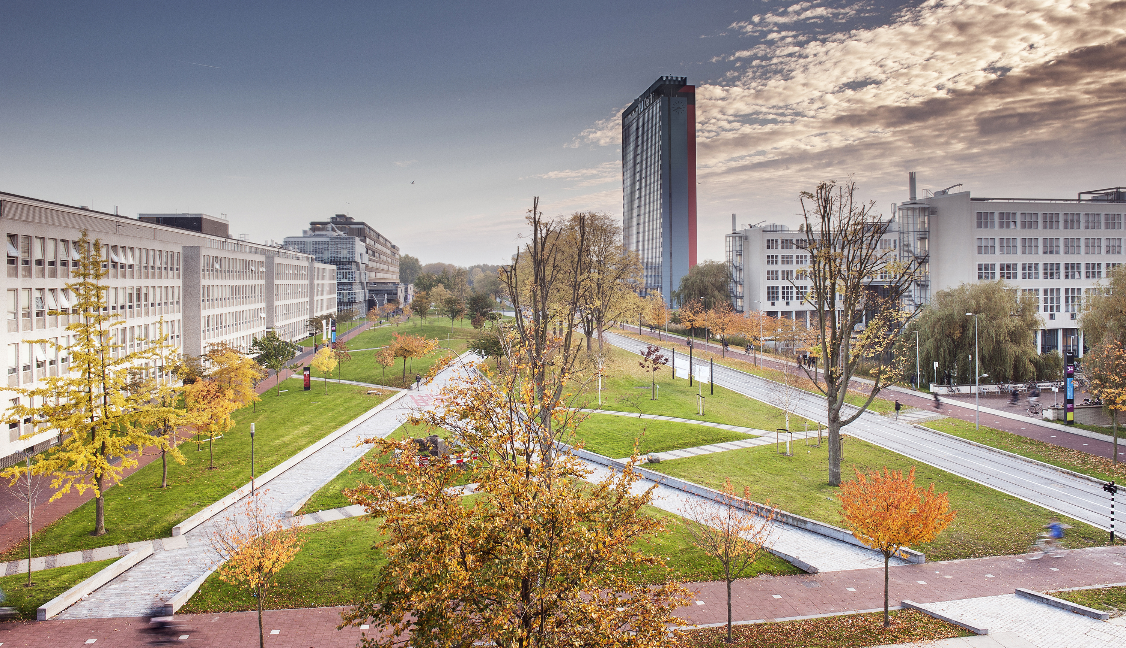
ICARB 2023
Measuring Net Zero
The Sustainable Campus
Working towards a Carbon-Neutral University
Deirdre van Gameren, MSc
TU Delft Sustainability Project Manager
Prof. Andy van den Dobbelsteen, PhD MSc
TU Delft Sustainability Coordinator & full professor of Climate Design & Sustainability
Noot. Overgenomen uit “Mekelweg”, door Wikipedia, n.d., De Mekelweg met het Mekelpark, gezien vanuit de Aula van de TU Delft (https://nl.wikipedia.org/wiki/Mekelweg)
Notes:
https://nl.wikipedia.org/wiki/Mekelweg

Slide 5
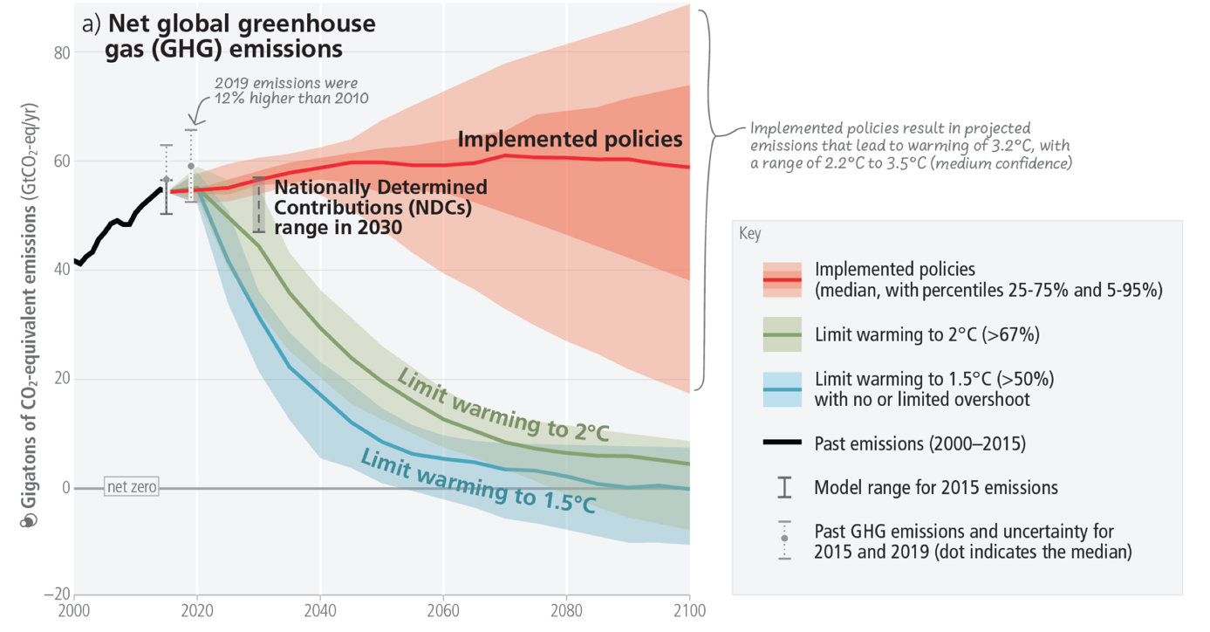
Immediate action is needed
Noot. Overgenomen uit “CLIMATE CHANGE 2023 Synthesis Report ”, door IPCC, 2023, (https://www.ipcc.ch/report/ar6/syr/).

Slide 6
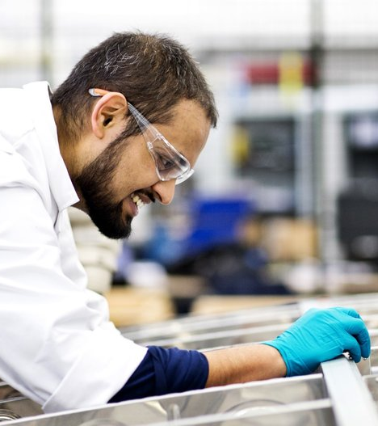
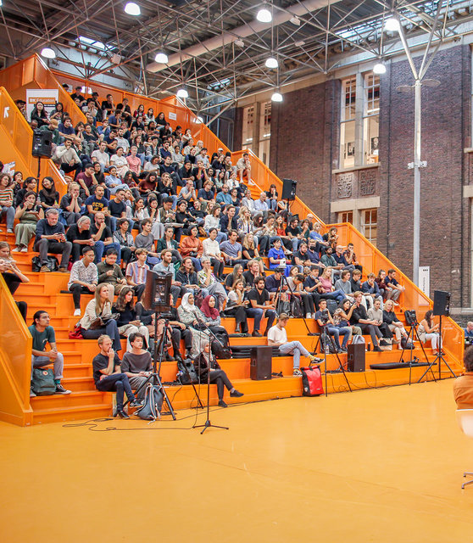
Title
Noot. Overgenomen uit “Werken bij TU Delft, door TU Delft, n.d. (https://www.tudelft.nl/over-tu-delft/werken-bij-tu-delft/wetenschapper).
Noot. Overgenomen uit “Succesvolle Kick off BK Public Programs met Herman Hertzberger”, door TU Delft, n.d. (https://www.tudelft.nl/2022/bk/succesvolle-kick-off-bk-public-programs-met-herman-hertzberger)
Notes:
https://www.tudelft.nl/over-tu-delft/werken-bij-tu-delft/

Slide 7
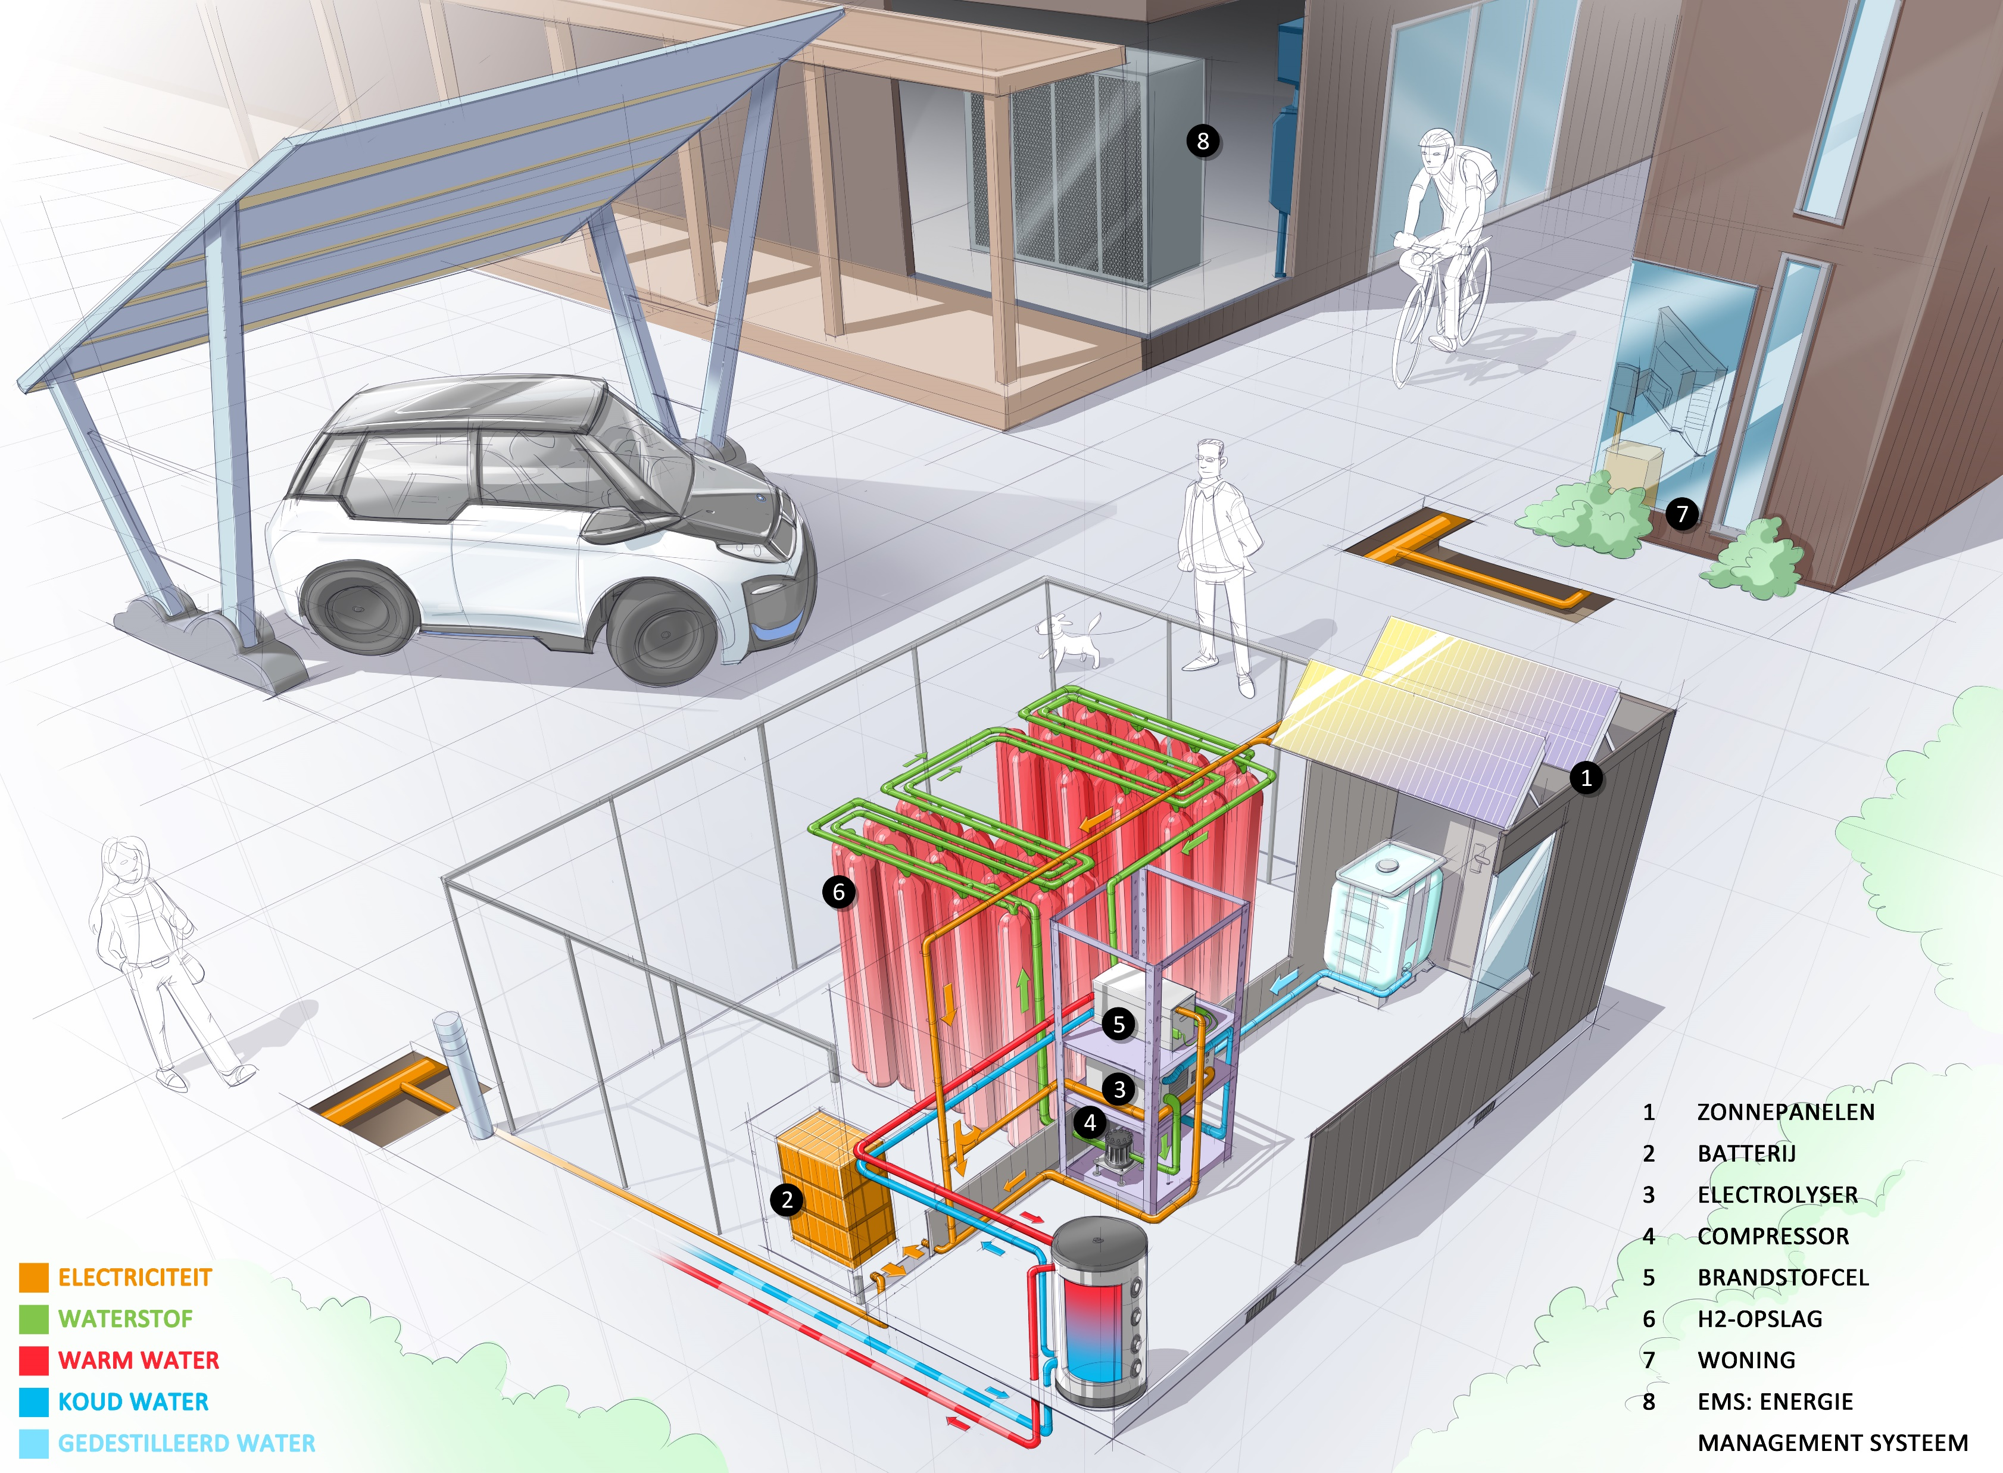
Leadership
New models, approaches, and technologies can be tested
Pave the way for other organisations
Show how to reach the climate goals.
Noot. Overgenomen uit “TU DELFT BOUWT LOKAAL, CO2-VRIJ ENERGIESYSTEEM VOOR GEBOUWDE OMGEVING ”, door The Green Village, 2022, (https://www.thegreenvillage.org/tu-delft-bouwt-lokaal-co2-vrij-energiesysteem-voor-gebouwde-omgeving/).
Notes:
https://www.tudelft.nl/over-tu-delft/werken-bij-tu-delft/

Slide 8
How did it start?

Slide 9
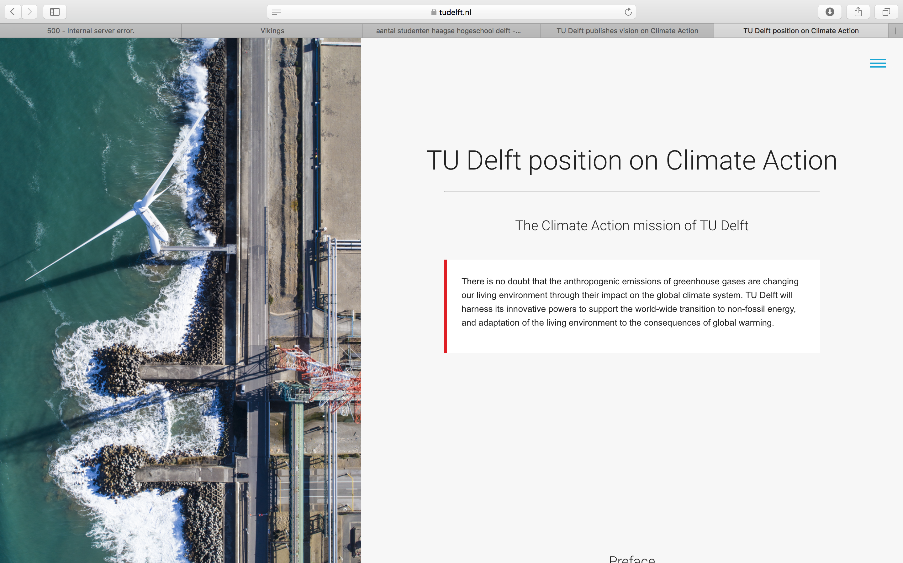
Noot. Overgenomen uit “TU Delft position on Climate Action ”, TU Delft, n.d., (https://www.tudelft.nl/en/tu-delft-climate-institute/tu-delft-position-on-climate action#:~:text=TU%20Delft%20sets%20out% 20to,implement%20such%20measures%20in%20practice.)

Slide 10








TU DELFT
CLIMATE ACTION PROGRAMME 2021
Noot. Overgenomen uit “Seed fund grants for 9 TU Delft climate scientists”, TU Delft, 2023, (https://www.tudelft.nl/en/2023/climate-action-programme/seed-fund-grants-for-9-tu-delft-climate-scientists).

Slide 11
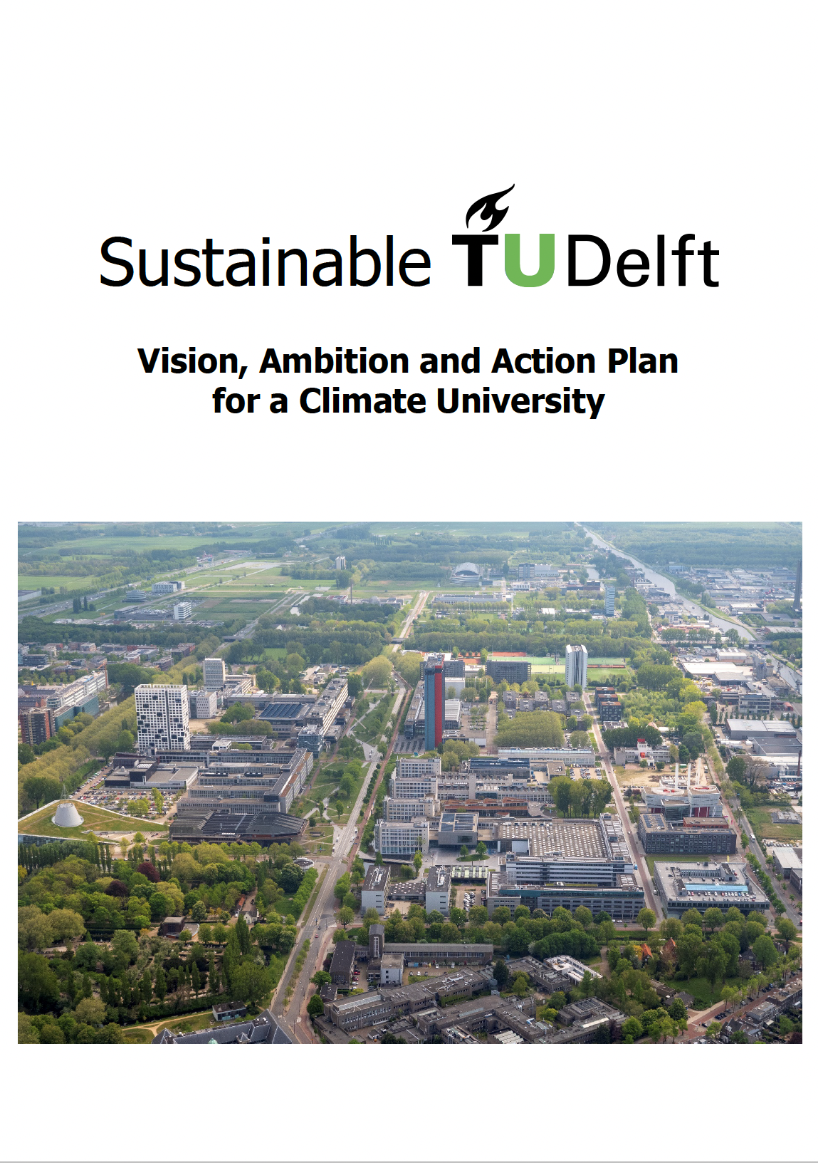
First year
Developed a Vision, Ambition and Action plan
  A clear overall ambition and vision
  Superimposed on the primary processes, and
  community and operations.
Expertise from all Faculties & University
Services
Noot. Overgenomen uit “Vision, Ambition and Action Plan for a Climate University”, Dobbelsteen and Gameren, 2021 (https://www.tudelft.nl/en/sustainability).

Slide 12
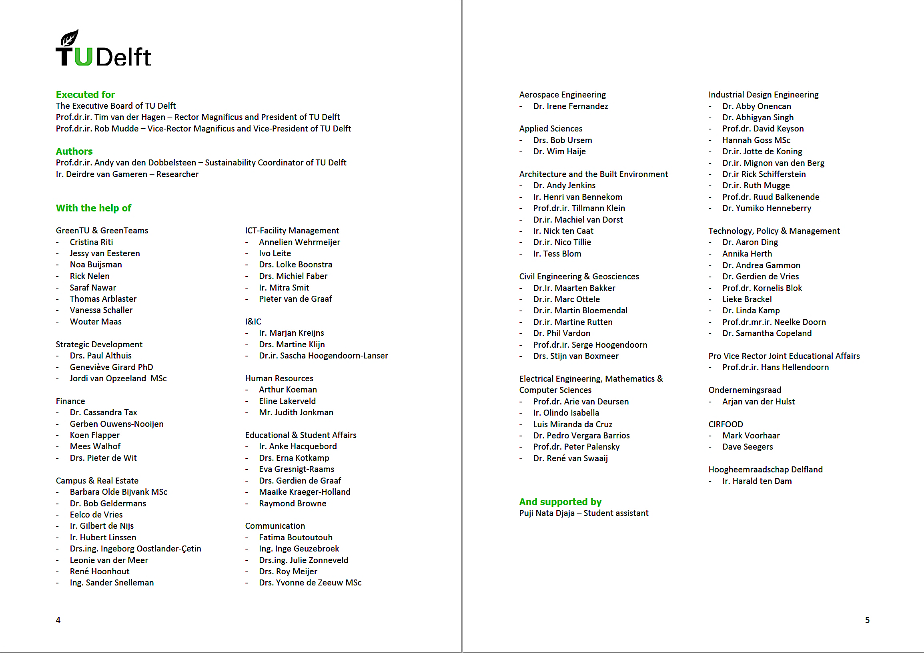
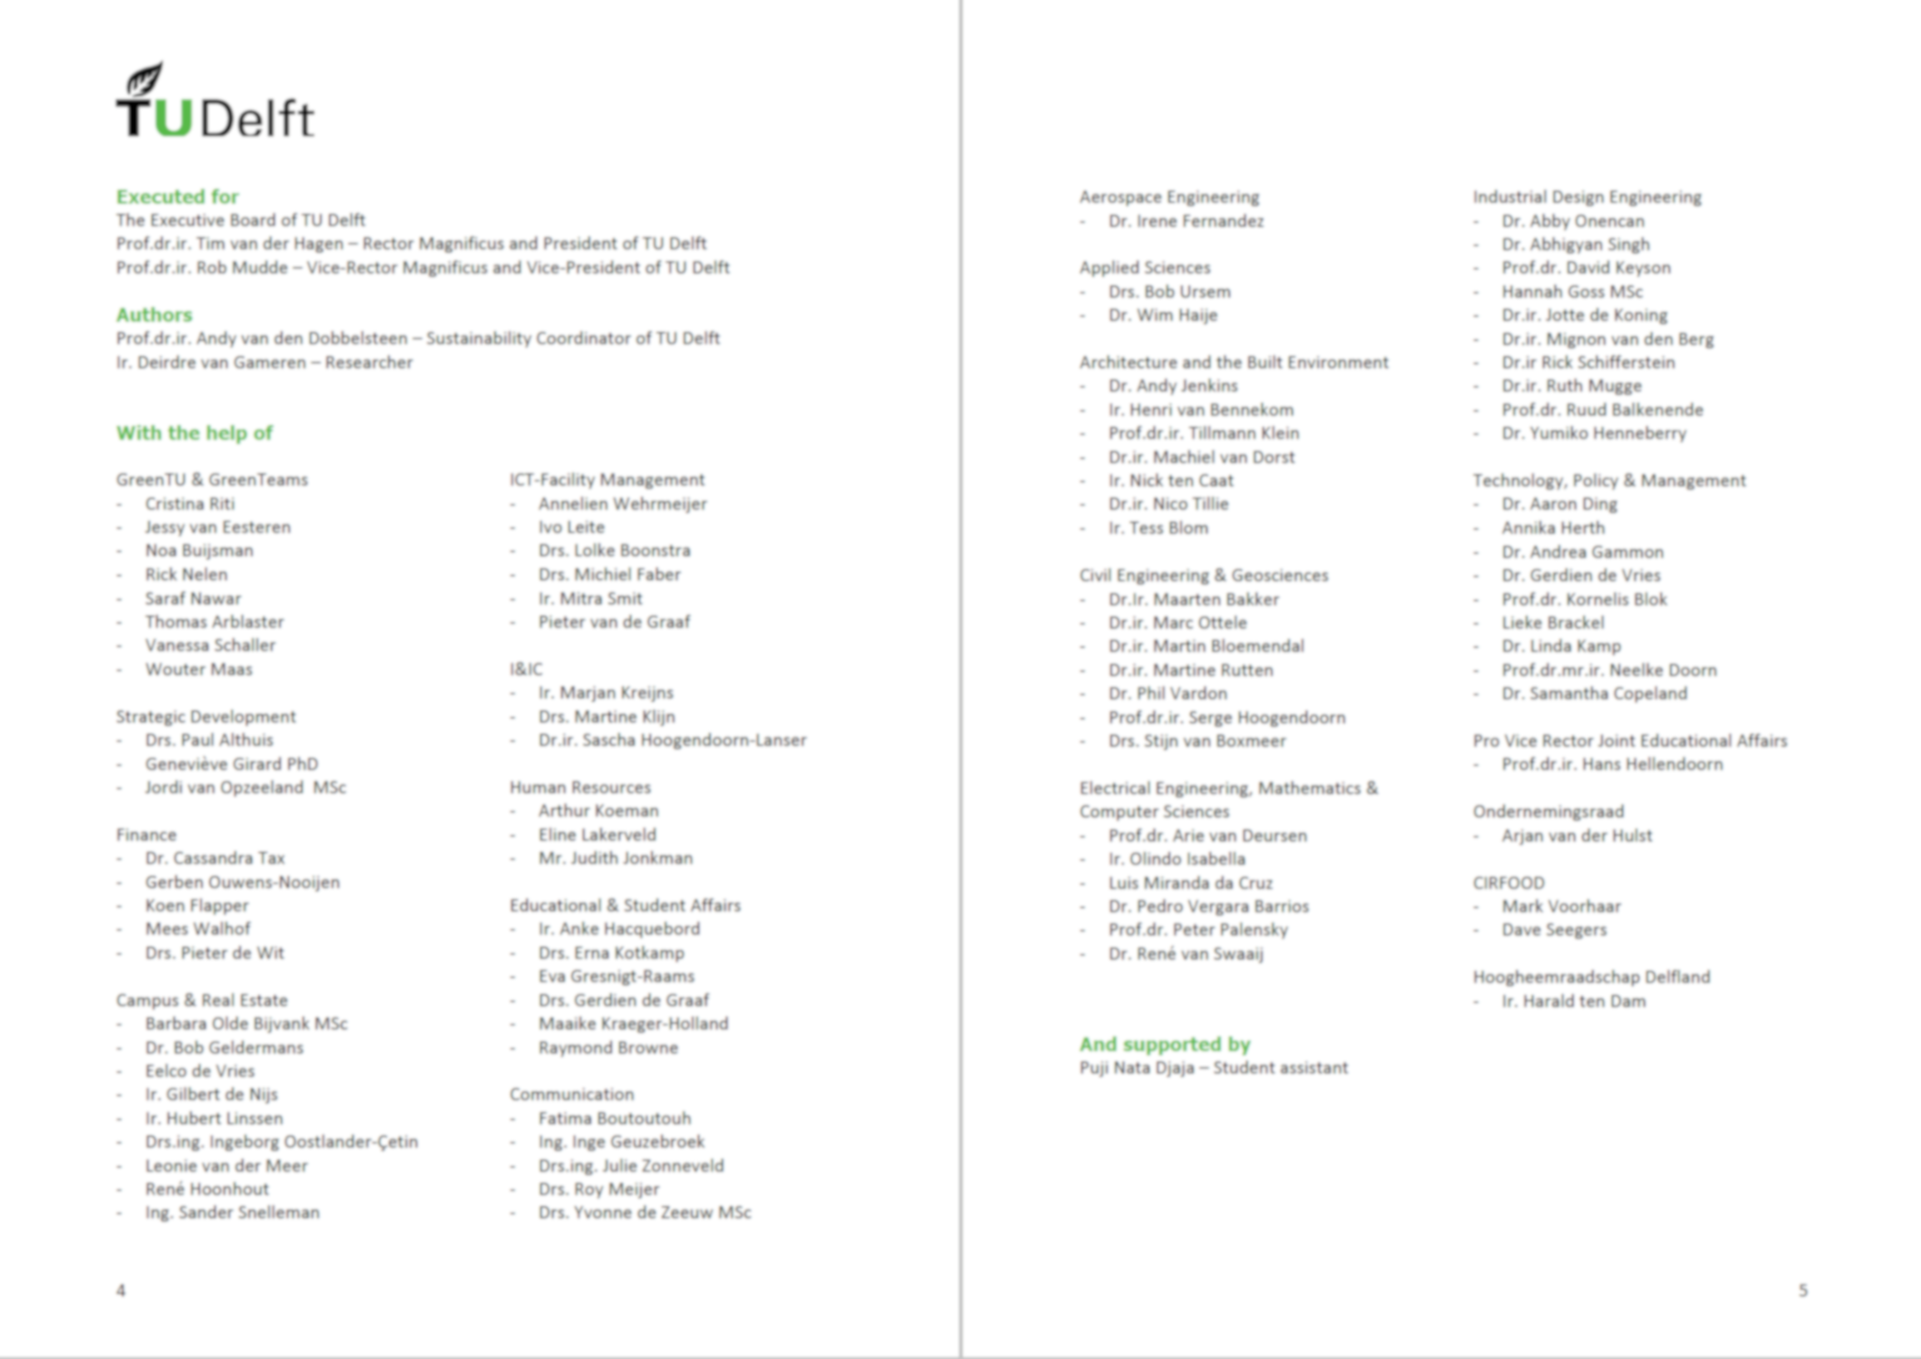

Everyone joins
F
ICT-FM
VC
CRE
M&C
.
.
.
.
.
.
.
.
.
.
.
.
.
.
.
.
.
.
HRM
teams
.
.
.
.
.
.
.
ABE
.
.
.
.
.
.
.
.
.
.
.
.
Theme
.
Core team
Green TU
.
.
.
.
.
.
.
.
.
CEG
.
.
.
.
.
.
.
.
.
.
.
.
.
.
.
IDE
CAP
AS
AE
TPM
EEMCS
3ME
CvB
Noot. Overgenomen uit “Vision, Ambition and Action Plan for a Climate University”, Dobbelsteen and Gameren, 2021 (https://www.tudelft.nl/en/sustainability).

Slide 13
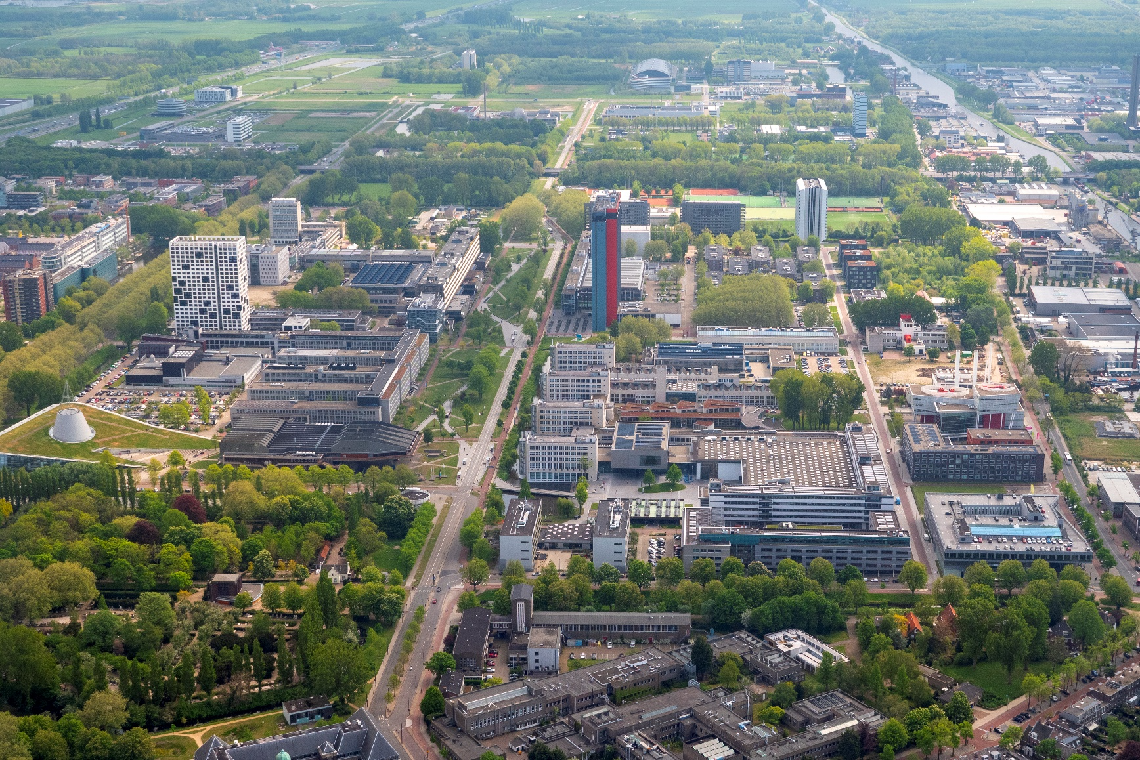
Sustainability goals approved by the Executive Board
Practise what we teach & preach
Carbon neutral, by 2030
for all activities on and from the campus
Circular, by 2030
related to all resource and waste flows on the campus
Climate adaptive, by 2030
dealing with heat, drought, precipitation, floods, extreme weather
Contributing to quality of life
aimed at biodiversity, safety, health, inclusiveness, happiness
Showing our excellence in research and sustainability
accommodating and demonstrating living labs and innovation on the campus
Noot. Overgenomen uit “Welcome at TU Delft”, TU Delft, n.d. (https://www.tudelft.nl/studenten/faculteiten/tbm-studentenportal/international-student/welcome-to-delft/welcome-at-tu-delft).

Slide 14
Concrete policy
Fixed in BVMs
Vision, Ambition & Action Plan
(framework, objectives and actions)
Commitment Executive Board: 100 M€
(ambition and means) September 2022
Now to be broadly supported
by the entire TU Delft community

Slide 15
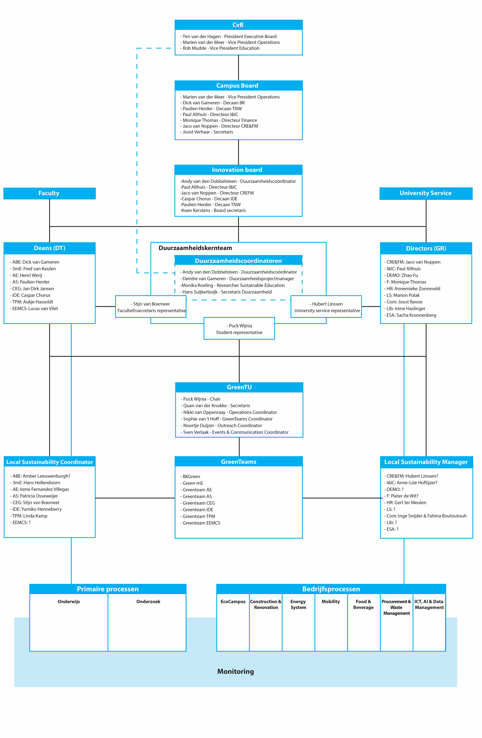
Governance of sustainability
D. Van Gameren, 2023

Slide 16
Governance of sustainability
D. Van Gameren, 2023

Slide 17
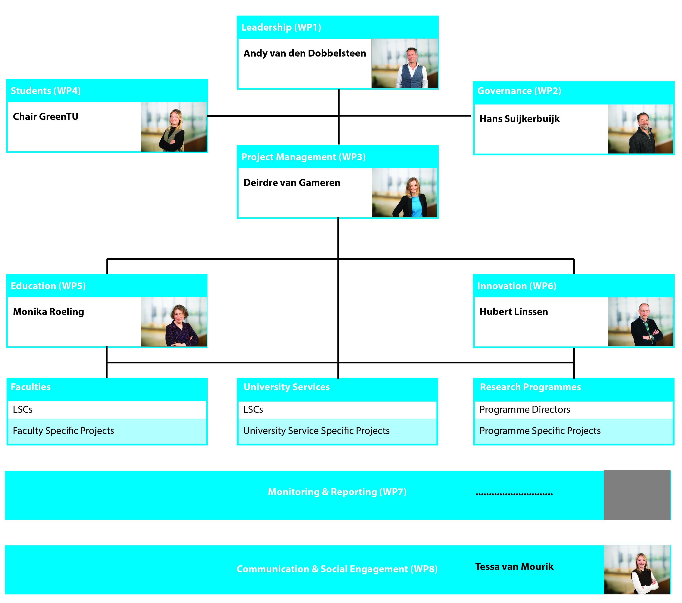
Governance of sustainability team
Fixed in BVMs
Core of all activities
Make ourselves redundant
Sustainability part of the daily tasks and activities
D. Van Gameren, 2023

Slide 18
Local Sustainability Coordinators of faculties
Faculty
ABE
3mE
AE
CEG
IDE
TPM
EEMC
AS
  Q-tech
Dean
Dick van Gameren
Fred van Keulen
Henri Werij
Jan Dirk Jansen
Caspar Chorus
Aukje Hassoldt
Lucas van Vliet
Paulien Herder
LSC
Wing Yung
Hans Hellendoorn
Irene Fernandez Villegas
Stijn van Boxmeer
Hans Suijkerbuijk
NN
Dianne Elsinga
Tim Vos (niet ISC)
  Charlotte van Hees

Slide 19
LSCs of University Services
Division
CREFM
I&IC
DEMO
F
HR
LS
Lib
ESA
Comm
Director
Jaco van Noppen
Paul Althuis
Zhao Fu
Monique Thomas
Annemieke Zonneveld
Manon Polak
Irene Haslinger
Sacha Kroonenberg
Joost Ravoo
LSC
Hubert Linssen
Marjan Kreijns
NN
Pieter de Wit
NN
NN
Ingrid Klok
Renate Marsh
Inge Snijder (extern) & Sharita Balgobind (intern)

Slide 20
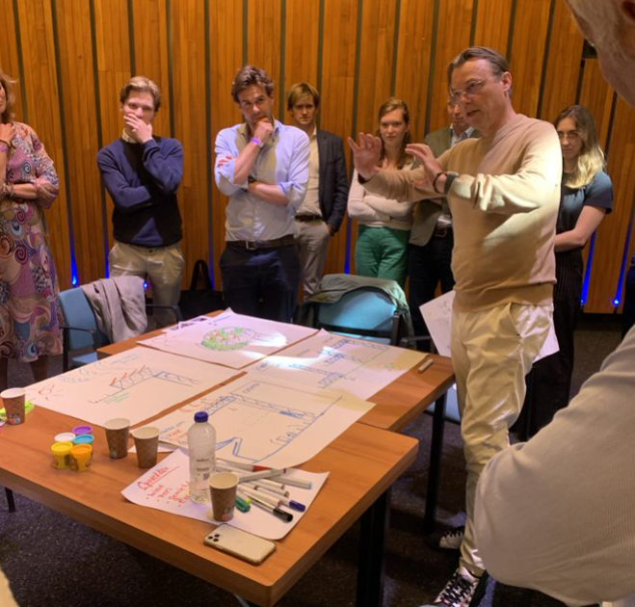
LSC Meeting
Connect the LSCs
Create positive energy
→ Specific theme meetings
T. Van Mourik, 2023

Slide 21
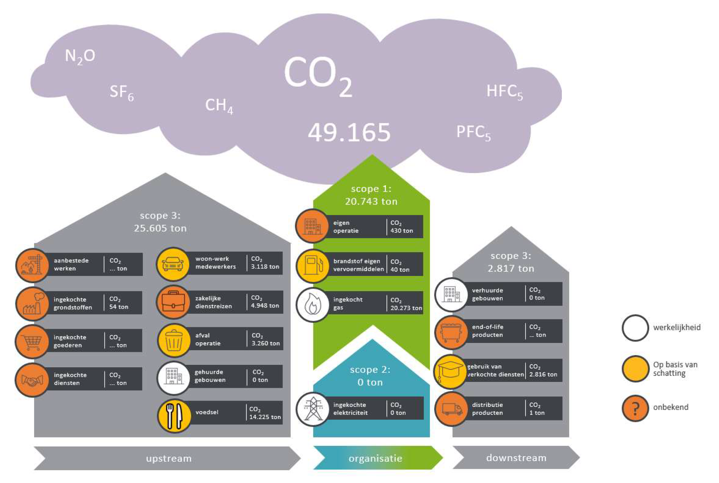
Carbon accounting: the basis
CO₂-eq in 2019
according to the
CO₂-Prestatieladder
(GHG emission protocol)
Noot. Overgenomen uit “Rapport CO2-voetafdruk 2019”, Tax, 2021 (https://www.tudelft.nl/en/sustainability).

Slide 22
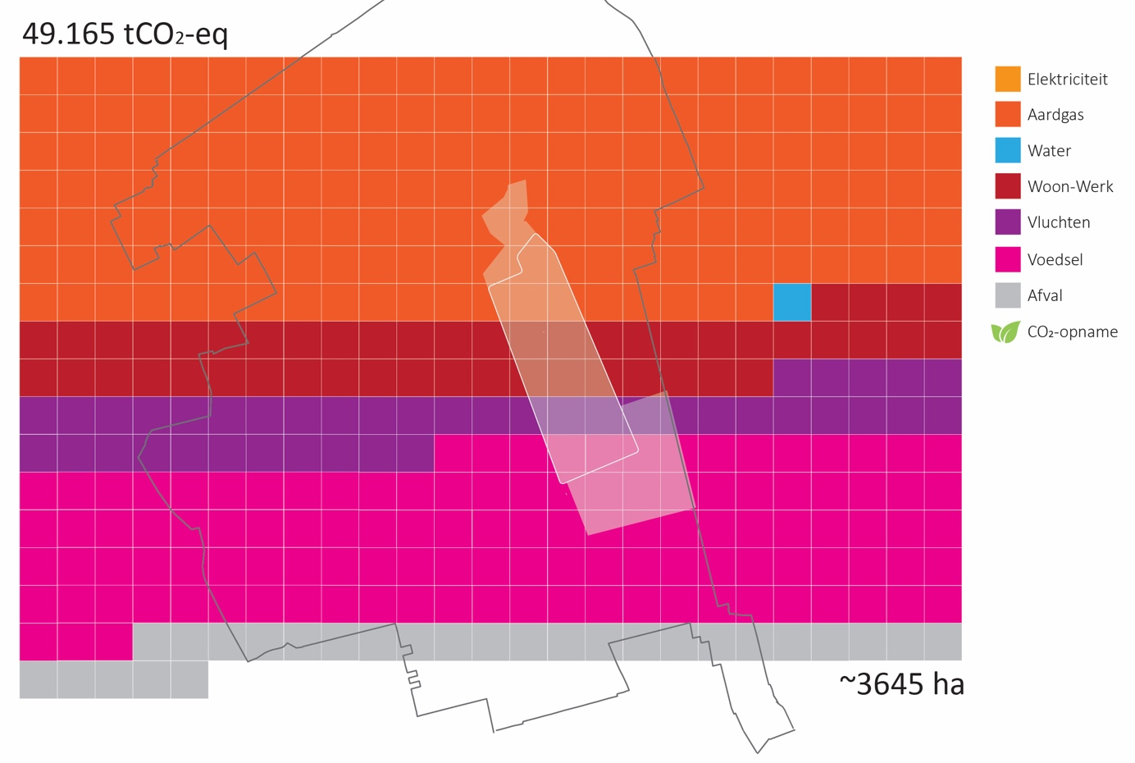
Carbon footprint (2019)
Municipal border of Delft
Forest area
required to
sequester all
GHG emissions
With procurement included, the area is twice as big.
energy use in buildings
water
commuter travel
business travel (flights)
food
waste
49,165 tCO₂-eq =
Noot. Overgenomen uit “Rapport CO2-voetafdruk 2019”, Tax, 2021 (https://www.tudelft.nl/en/sustainability).

Slide 23
Purchasing
  stationary
  furniture
  equipment
  (building) materials
  Services
Calculate footprint based on financial data
Ask suppliers in new contract to report on their emissions
Procurement was missing…
Noot. Overgenomen uit “Vision, Ambition and Action Plan for a Climate University”, Dobbelsteen and Gameren, 2021 (https://www.tudelft.nl/en/sustainability).

Slide 24
= the 2020 baseline
3% less energy on campus, but extra at home
70% less travel
75% less food on campus, but more at home
75% less water on campus, but more at home
Noot. Overgenomen uit “Vision, Ambition and Action Plan for a Climate University”, Dobbelsteen and Gameren, 2021 (https://www.tudelft.nl/en/sustainability).

Slide 25
Financial principles to get to carbon neutral
Invest in alternatives to avoid carbon emissions
Subsidise carbon-friendly (but more expensive) alternatives
Compensate the emission of CO₂-equivalents
Peter Bakker (World Business Council for Sustainable Development)
Work with TCO₂: Total Cost of Ownership, including a CO₂ price
TCO: Cost and benefits of a service or product over its whole lifespan.
CO2 price: first as shadow price and later as real price

Slide 26
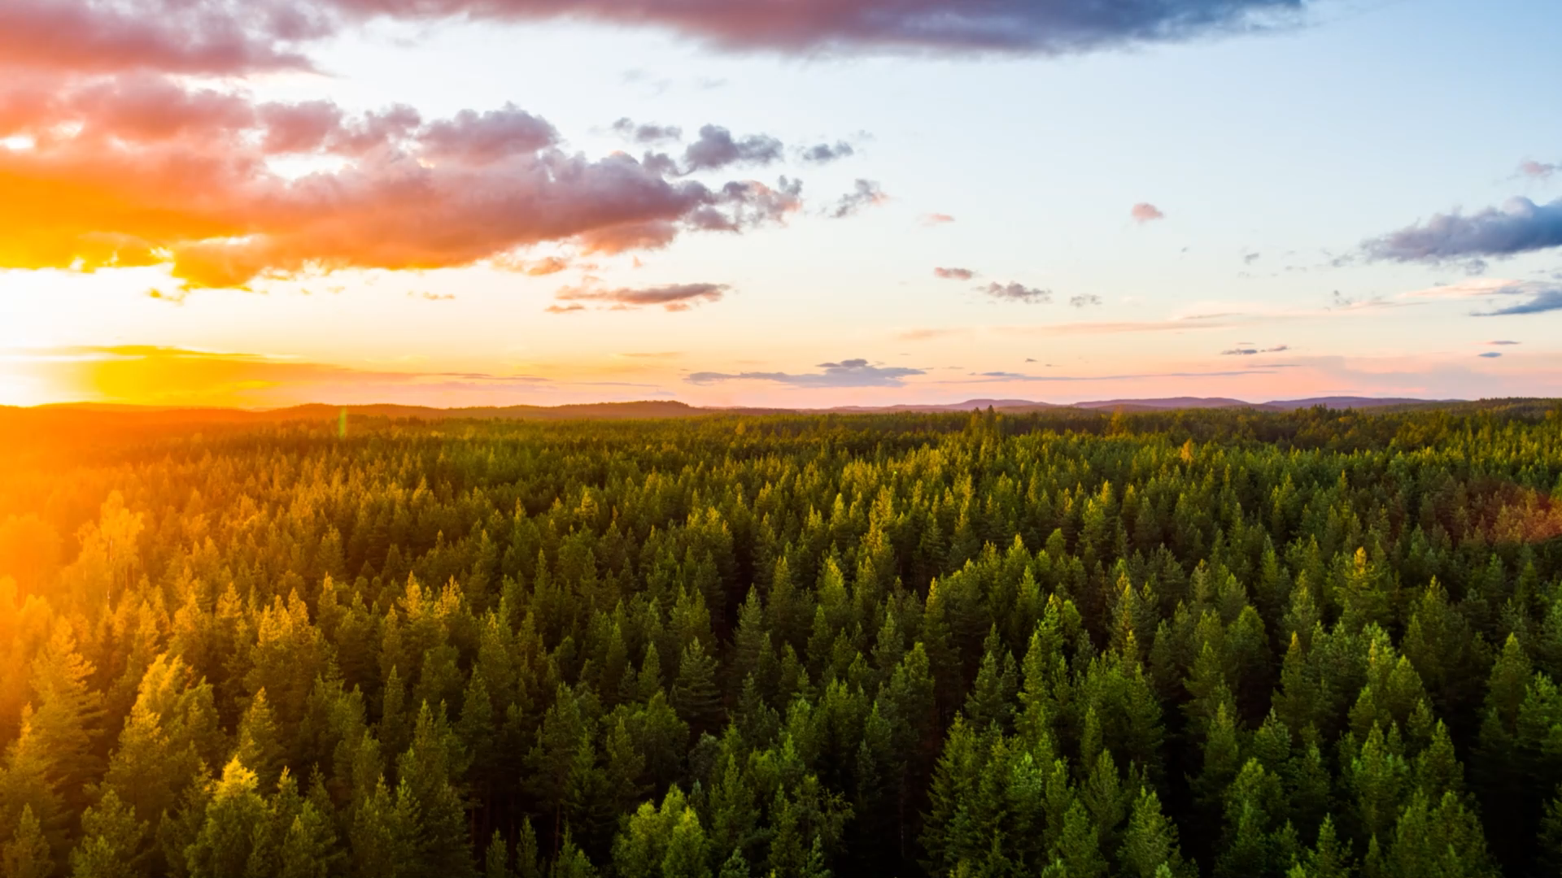
A new financial approach
Total Cost of Ownership (TCO)
+ additional CO₂ price* = TCO₂
All important financial decisions
Selection of proposals and partnerships
Internal carbon tax (e.g. for flying)
Internal price corrections (e.g. for food)
* Currently set at € 150/ton CO₂-eq; will probably be raised soon

Slide 27
Practise what you Teach and Preach

Slide 28
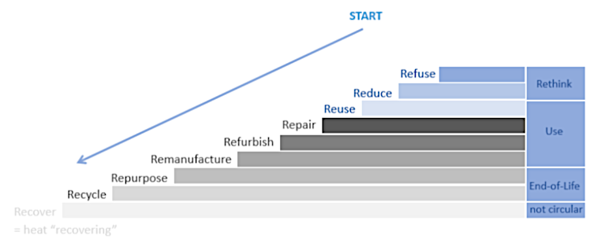
Sustainable, circular procurement
Use the R ladder
Getting supply chains sustainable
  Equipment
  Furniture
  Products
  Materials
  Services
Agreements and circular contracts with suppliers and partners
Campus wide inventory method
Noot. Overgenomen uit “Vision, Ambition and Action Plan for a Climate University”, Dobbelsteen and Gameren, 2021 (https://www.tudelft.nl/en/sustainability).

Slide 29
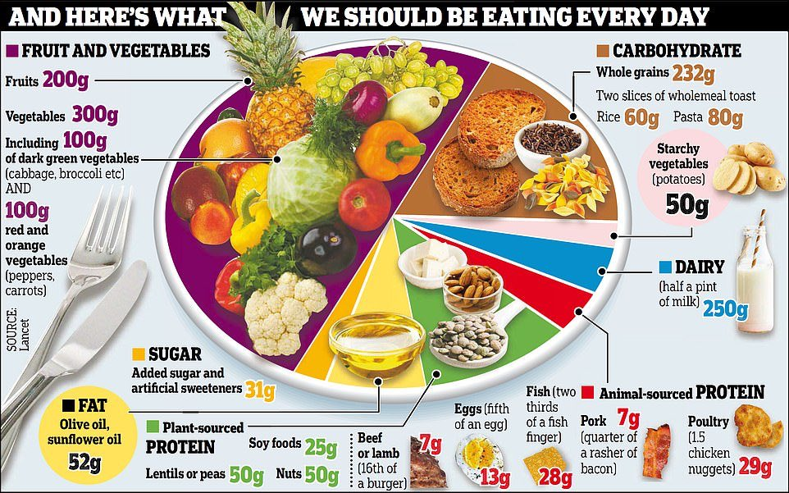
Requirement for food on the campus
Healthy
Tasty
Local
Seasonal
More vegan
Less animal-based
Organic
Scientific evidence:
→ EAT Lancet diet
Noot. Overgenomen uit “Human diet is causing 'catastrophic' damage to the planet: Scientists says we should eat half a rasher of bacon a day”, dailymail, 2019 (https://www.dailymail.co.uk/health/article-6603237/Human-diet-causing-catastrophic-damage-planet.html).

Slide 30
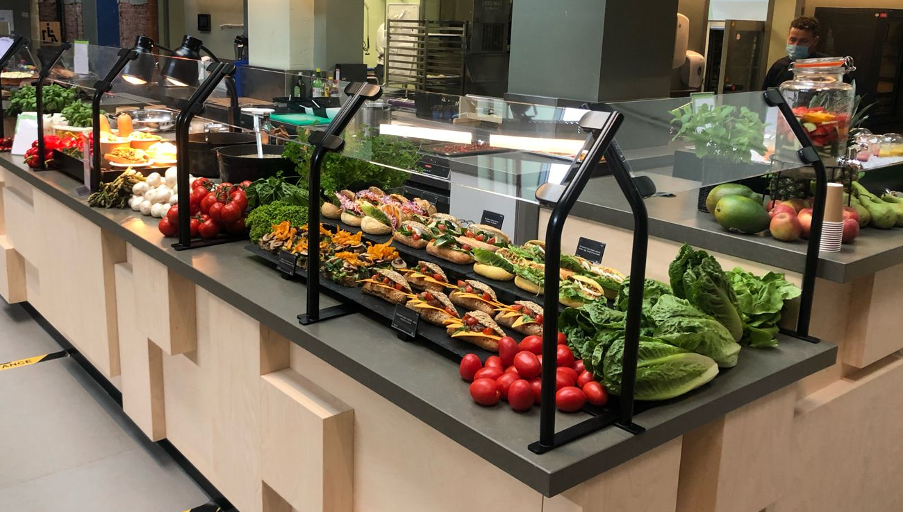
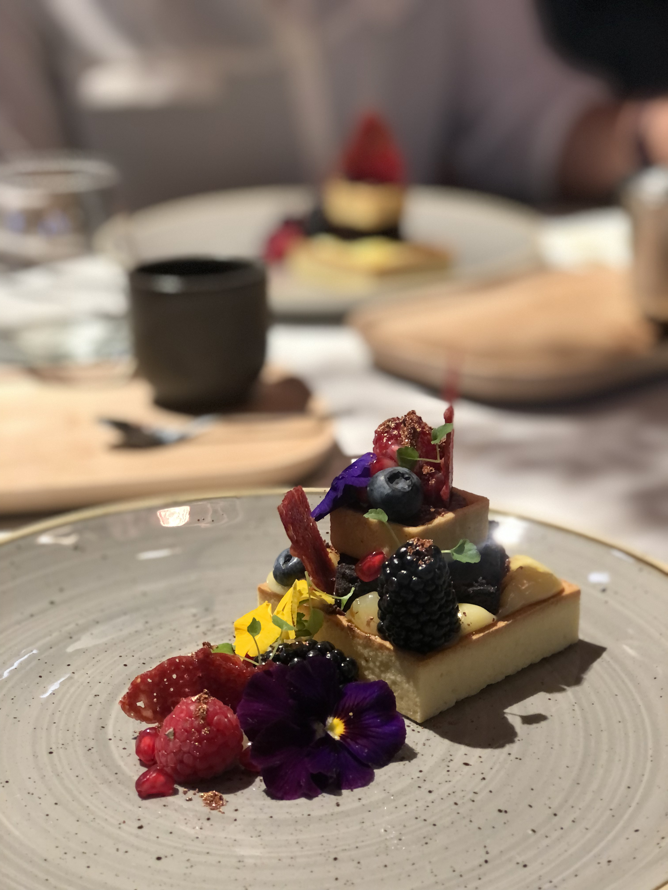
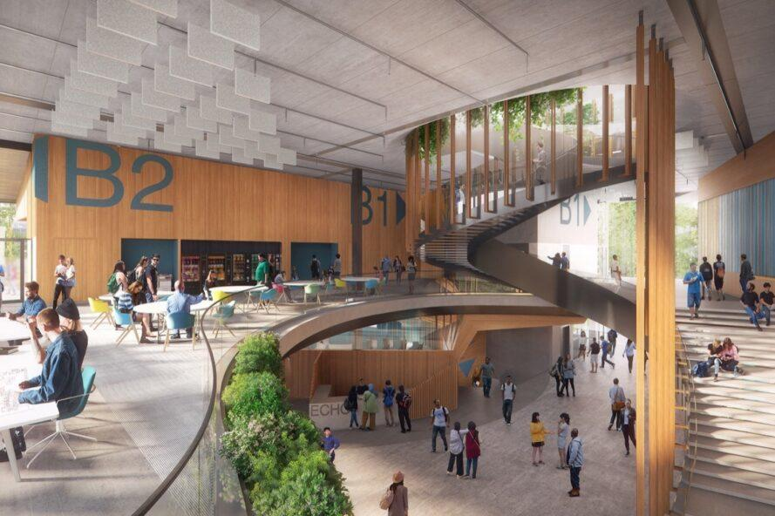
More vegetarian and vegan
Restaurant of the faculty of Architecture & the Built Environment
50% of carbon emission reduction
Top-class food in the Faculty Club
Restaurant of ECHO, educational building
A. van den Dobbelsteen, 2022

Slide 31
The future energy system
Solar power
Wind power
E-fuels
Geothermal heat
Environmental heat
Noot. Overgenomen uit “Vision, Ambition and Action Plan for a Climate University”, Dobbelsteen and Gameren, 2021 (https://www.tudelft.nl/en/sustainability).

Slide 32
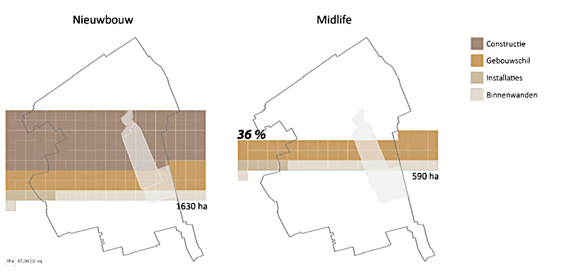
Sustainable new building or energy renovation?
Forest area needed to compensate carbon emissions of the production of materials, projected onto the city of Delft
[Blom & Dobbelsteen 2019]
Embodied carbon of building materials is huge → renovation is preferred
Noot. Overgenomen uit “Vision, Ambition and Action Plan for a Climate University”, Dobbelsteen and Gameren, 2021 (https://www.tudelft.nl/en/sustainability).

Slide 33
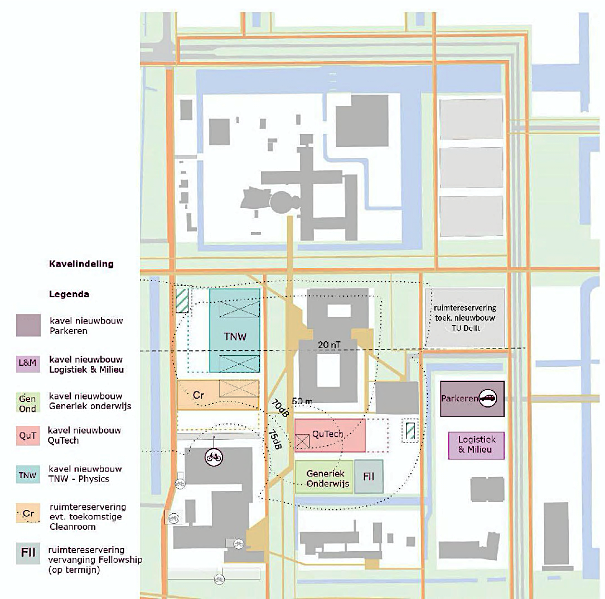
South Campus: super-sustainable new construction site
- Carbon positive
- Circular
- Climate adaptive
- Contributing to liveability

Slide 34
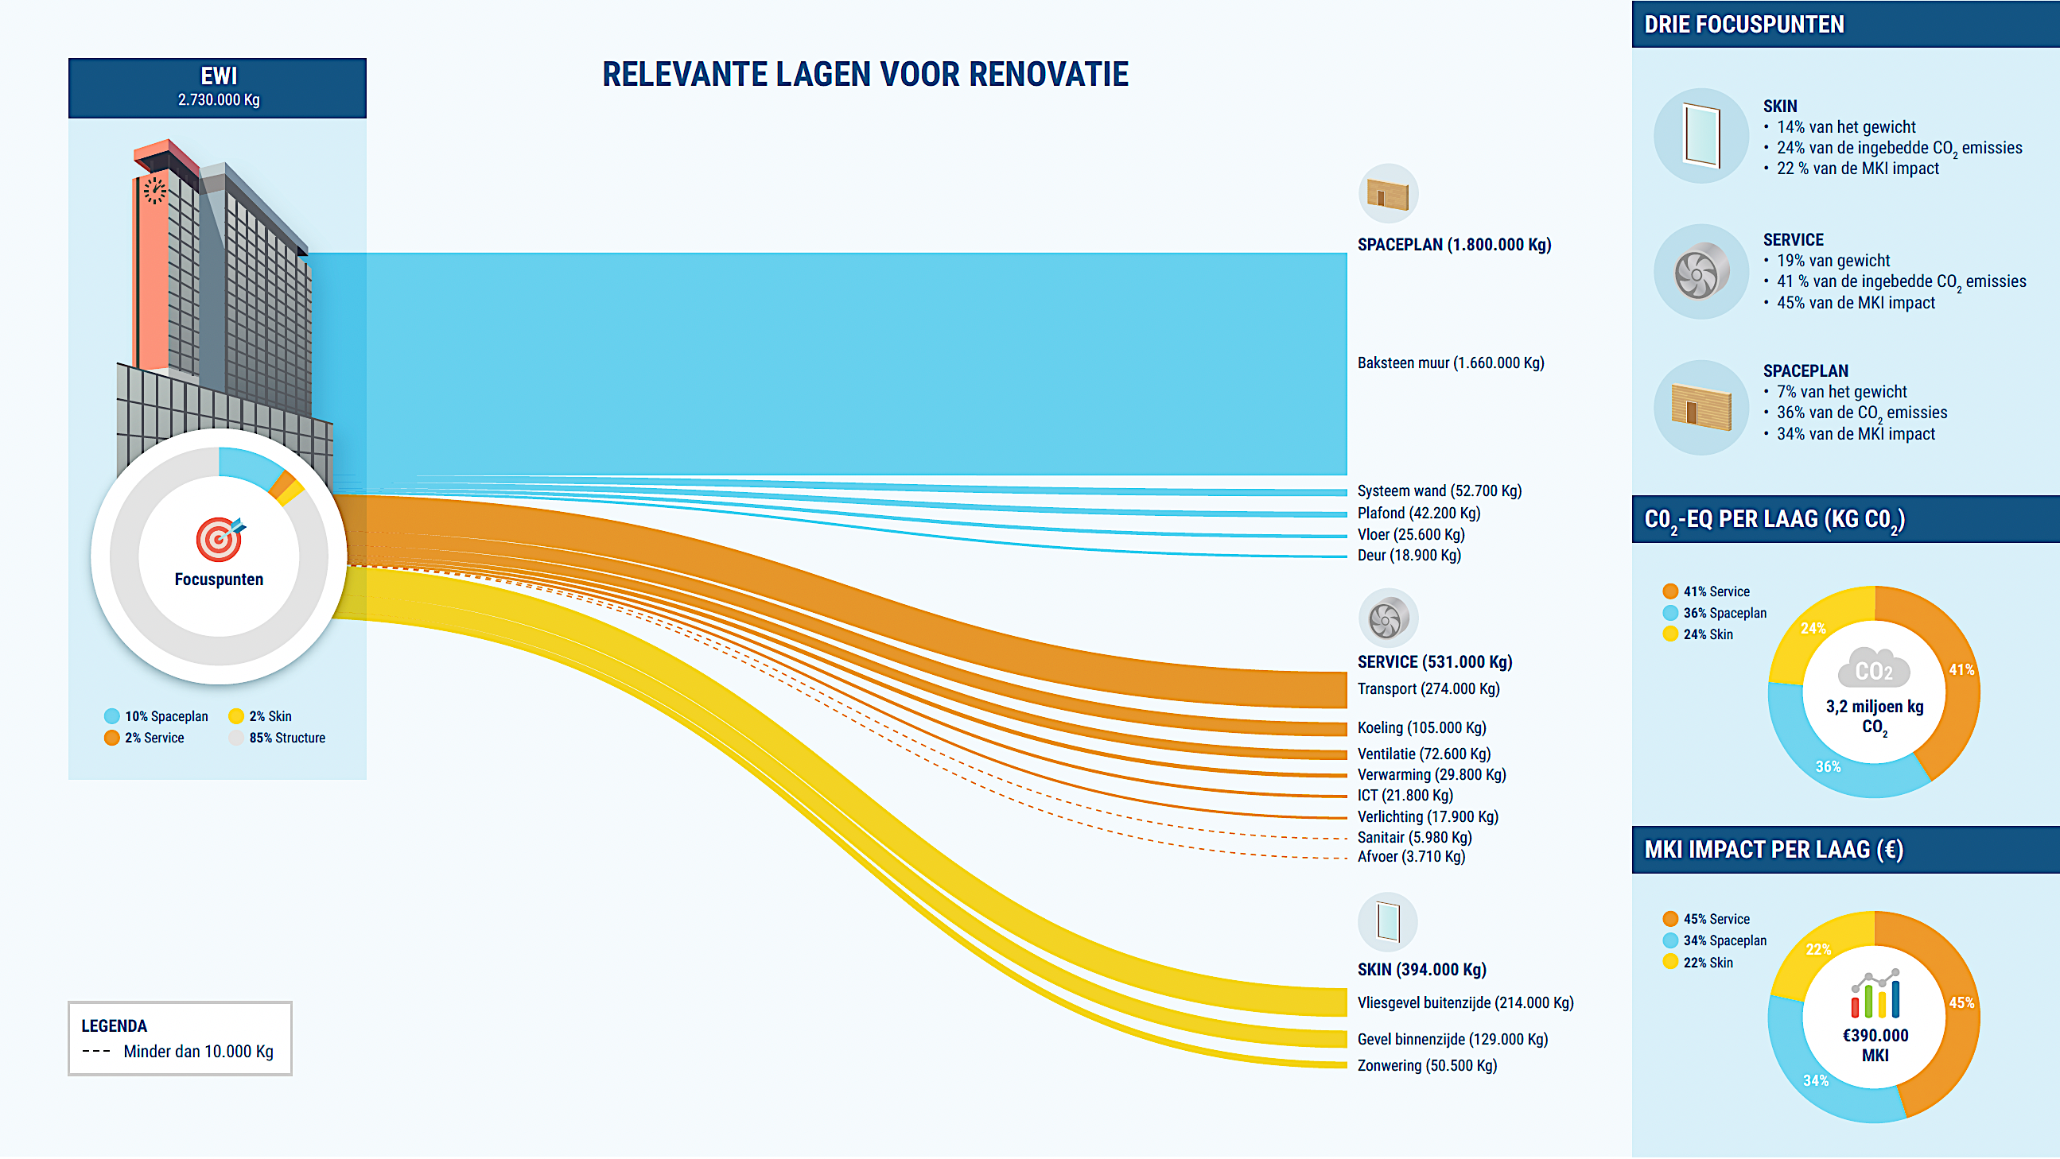
Buildings listed for ‘midlife renovation’
Circular renovation EWI tower
Noot. Overgenomen uit “EWI Circulaire scenario analyse”, Metabolic, 2021.
Notes:
Gebouwen 22, 23, 34 en 36 hebben de hoogste totale energieverbruiken van de campus.
Met name de warmtegebruiken van de gebouwen ligt hoog en dienen gehalveerd te worden om aan de KPI-eisen te voldoen. Tevens zijn dit de gebouwen die samen met de af te stoten gebouwen verkeren in een matige technische staat, daarbij is Midlife renovatie niet alleen nodig voor het energiegebruik, maar tevens om het gebouw de overlast door gebreken aan de bouw- en installatiedelen te verhelpen.

Slide 35
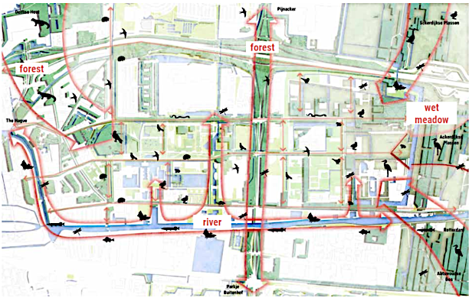
EcoCampus: climate adaptive & biodiverse
[Suxin Liaw]
Noot. Overgenomen uit “BIODIVERSE. RESILIENT. PLAYSCAPE”,Liaw, 2021 (https://repository.tudelft.nl/islandora/object/uuid%3A07b9bbaf-d34b-4297-abaf-6c0d7b57e6b1).

Slide 36
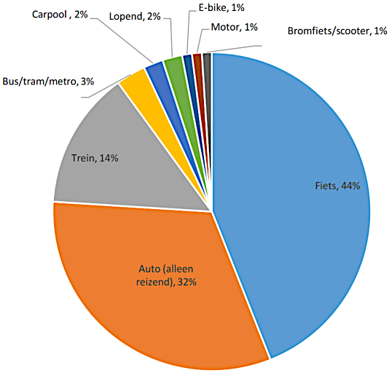
Sustainable travel to & from a fossil-free campus
New Mobility Policy
Promote (electric) bikes, public transport and electric (shared) cars
Work from home for a certain time
Online/hybrid meetings & conferences
Less parking lots, more green and blue
Fossil free campus by 2030
Train: 14%
Bike: 44%
Car (travelling alone): 32%
Noot. Overgenomen uit “Vision, Ambition and Action Plan for a Climate University”, Dobbelsteen and Gameren, 2021 (https://www.tudelft.nl/en/sustainability).

Slide 37
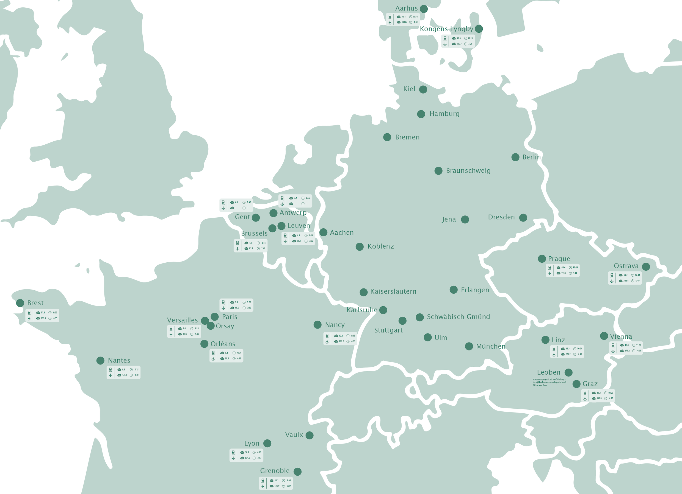
International travel: avoid + trains, not planes
Pilot projects at 3 faculties
Green
train prescribed
plane prohibited
Yellow
train preferred
plane discouraged
Red
train recommended
plane optional
Plan: internal carbon tax
(€ 150/t CO₂eq)
→ sustainability fund
Noot. Overgenomen uit “Vision, Ambition and Action Plan for a Climate University”, Dobbelsteen and Gameren, 2021 (https://www.tudelft.nl/en/sustainability).

Slide 38
Behavioural Change

Slide 39
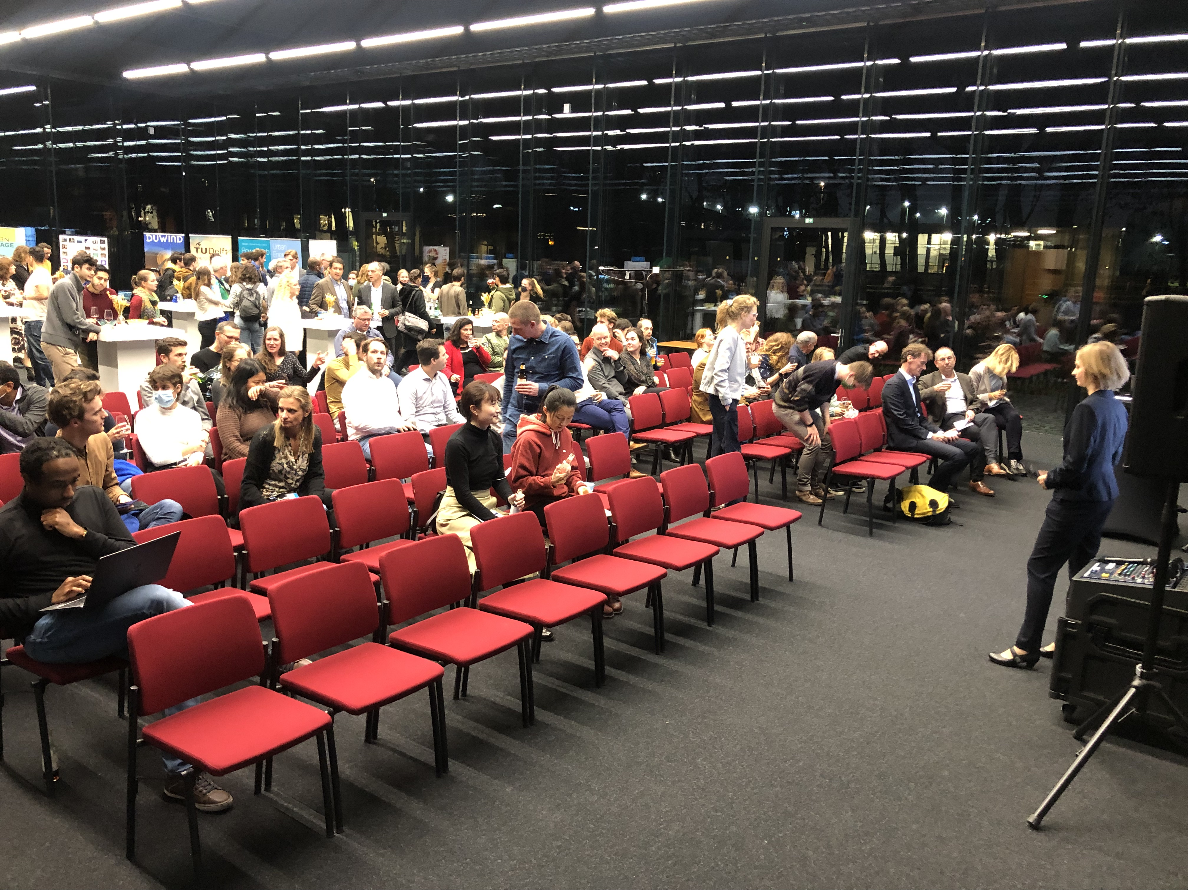
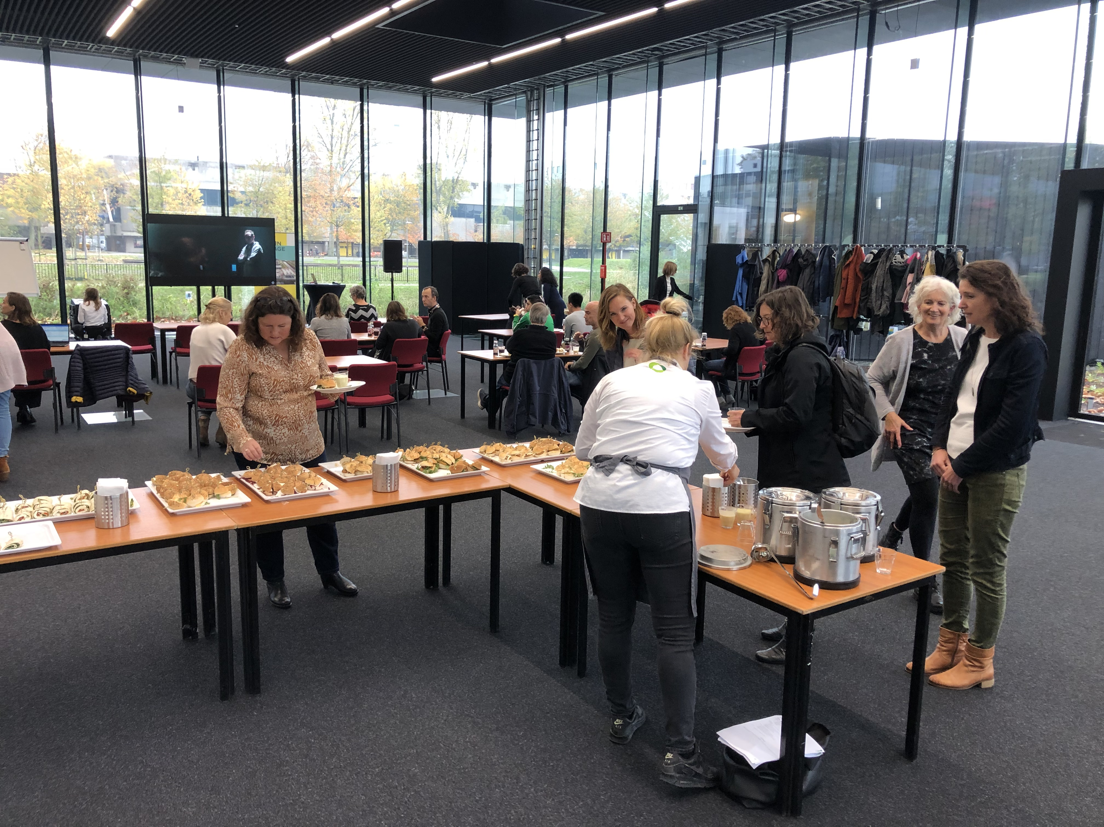
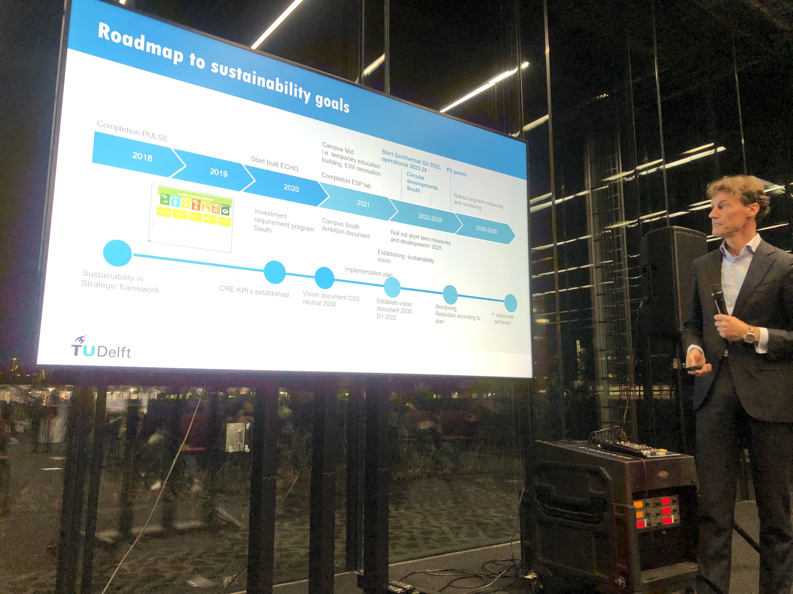
Through a process of engagement…
Presentations and discussion meetings
21/06/21: AE townhall (online)
24/06/21: Utrecht University (online)
13/07/21 Collegelunch (Lijm & Cultuur, in person)
14/07/21: ASR Real Estate (online)
14/07/21: Delft Startup Community (online)
03/08/21: OWEE (Aula, recordings, online later)
20/08/21: CEG MT (online)
25/08/21: IDEA League Summerschool, Aachen (online)
31/08/21: ABE MT (ABE, in person)
03/09/21: Opening Academic Year (Aula, online)
02/09/21: CRE College (online)
14/09/21: UvA masterclass (online)
28/09/21: TPM MT (online)
28/09/21: 3mE MT (online)
29/09/21: KLM catering (ABE in person/online)
04/10/21: IDE MT (IDE, in person)
05/10/21: Stadsakkoord Utrecht (Utrecht, in person)
06/10/21: Urban Energy Institute (3ME, in person/online)
07/10/21: AS MT (AS, in person)
08/10/21: Polytechnic University of Valencia, ES (online)
13/10/21: GreenTU (TU Delft Library, in person)
14/10/21: QiR international conference (Jakarta, online)
22/10/21: Masterclass FAUP, University of Porto (Porto, P)
25/10/21: Groepsraad (AS, in person)
02/11/21: Prometheus (TGV, in person)
03/11/21: Wonen Midden-Delfland (Maasland, in person)
09/11/21: COP26 Climate Drinks (TGV, in person)
12/11/21: NOC-NSF / Chef de Emission symposium (TGV, in person)
15/11/21: Nachhaltige Hochschulen (Detmold, D, online)
19/11/21: Smart WorkPlace ‘Energietransitie op de campus’ (online)
30/11/21: Drenthe Woont Circulair (Assen, online)
06/12/21: Finance MT (online)
09/12/21: ICT-FM MT (online)
09/12/21: ICSBE2 conference (Eindhoven, online)
15/12/21: CRE project leaders (online)
21/12/21: Let’s talk about X podcast (X, online in January 2022)
25/01/22: GroenLinks Delft (online)
03/02/22: European Climate Alliance (online)
14/02/22: Raad van Toezicht (WAD Delft, in person)
22/02/22: Ecocity World Summit (ABE, online)
24/02/22: Olympic Games 2024 (Aula TU Delft, in person)
09/03/22: FSW Leiden University (Leiden, online)
10/03/22: OR (ABE, in person)
15/03/22: Department heads (Art Centre Delft, in person)
22/03/22: Building the future symposium (Zwolle, in person)
A. van den Dobbelsteen, 2022

Slide 40
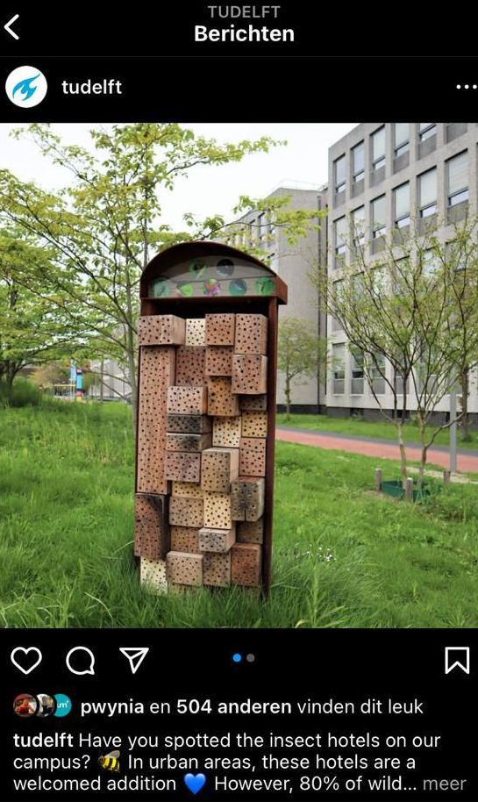
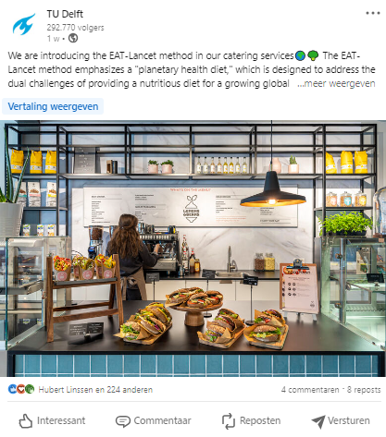
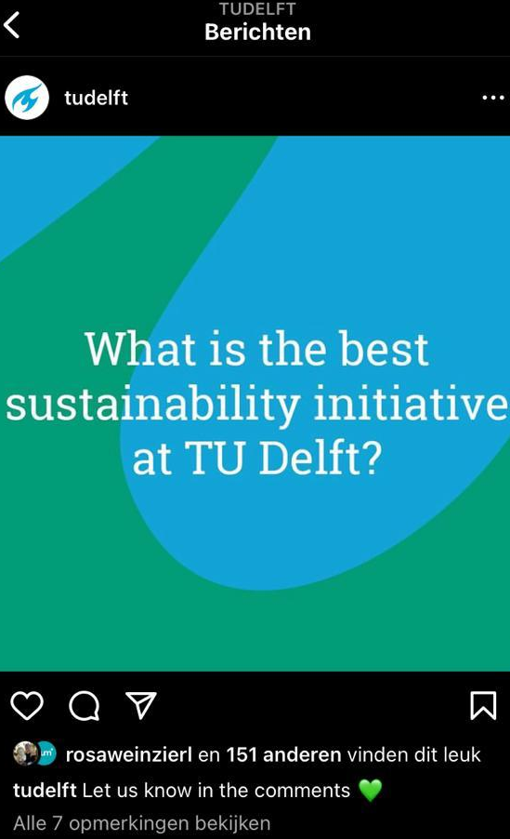
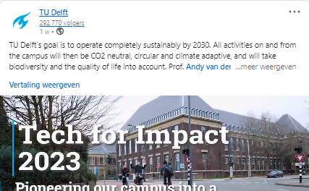

Slide 41
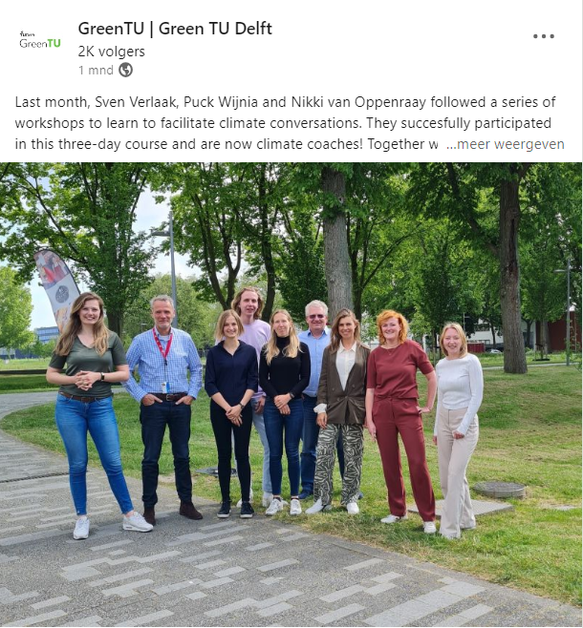
Climate Conversation
Open up meaningful
conversations
Safe place to talk and learn
Noot. Overgenomen uit “GreenTU | Green TU Delft”, GreenTU, 2023 (https://www.linkedin.com/company/tu-delft-green-office/posts/?feedView=all).

Slide 42
Lessons learned

Slide 43
Lessons Learned
Ambition and support from the highest level, the executive board
People willing (change managers) to get the initial work done
Measuring is knowing: a zero assessment as the starting-point
A roadmap – preferably via backcasting – to reach the desired goal
It is a technical and personal transition. Inform and engage the community
Start small and share those small wins. This will reduce the resistance and create a ripple effect.
Communicate in various ways to reach the whole community
Be prepared for resistance and see this as something positive

Slide 44
Towards net zero carbon
Carbon price included in decisions
Energy system based on geothermal energy and renewable production
Energy retrofit of existing buildings
Supersustainable, climate-adaptive, circular, nature-inclusive new buildings
Circular contracting, circular procurement & waste management
Fossil-free, emission-free campus
Sustainable travel, or carbon taxed
Sustainable food in restaurants
Emission compensation by forestation
Noot. Overgenomen uit “Vision, Ambition and Action Plan for a Climate University”, Dobbelsteen and Gameren, 2021 (https://www.tudelft.nl/en/sustainability).

Slide 45
7 – Steps
Acknowledging climate change by the highest management (the Executive Board)
Researching the current footprint (creating a baseline)
Continuing carbon accounting
Appointing a Sustainability Coordination team
Creating a vision, ambition and action plan
Setting clear goals
Allocating financial means
Noot. Overgenomen uit “Vision, Ambition and Action Plan for a Climate University”, Dobbelsteen and Gameren, 2021 (https://www.tudelft.nl/en/sustainability).

Slide 46
ICARB 2023
Measuring Net Zero

