Slide 1

ICARB 2023
Measuring Net Zero
Circular Renewable Energy Supply for Existing Buildings
Matthias Haase and Andras Sailer
ZHAW Zurich University of Applied Sciences
Department Life Sciences and Facility Management
IFM Institute of Facility Management
CH-8820 Wädenswil

Slide 2
The power of Photovoltaic Technology
Photovoltaic panels are an ideal solution for clean energy
Recent advances in cost-effectiveness, performance, and environmental benefits
How can PVs contribute to circular principles?
Distributed Production
Energy Self-Sufficiency
Sustainable Energy Production
PVs enable distributed renewable energy production
Planned to be the backbone of our future energy systems
PVs can create self-sufficient energy sources for entire regions, enhancing the circularity of energy use.
Renewable energy production must be decentralized and sustainable to ensure energy supply in the long term.

Slide 3
The Emerging Prosumer Strategy
In the move away from old, unsustainable structures of energy production and consumption - how can individuals be important players in energy supply chains?
Simultaneous Consumption and Production
The Role of the Prosumer in Energy Transition
1
2
Prosumers consume electricity from the grid while also feeding electricity back into the grid as a producer.
Prosumers are active players in the energy markets and the transition process.
Solar System on the Roof of
Private Households
3
Individuals become prosumers by installing solar systems on the roofs of their private households, disrupting traditional energy consumption patterns

Slide 4
Self-Sufficiency in Energy Production
Can buildings and entire regions become energy self-sufficient?
To what degree can this happen with innovative technologies and practices?
Definition
Proposed Scenarios
Tendential Self-Sufficiency
Partial reliance on grid energy and partial energy production through self-sustainable methods.
Most energy needs met through sustainable self-production, with a supplementary connection to the traditional energy grid.
Soft or On-Grid Self-Sufficiency
Complete self-sufficient energy production through sustainable methods without reliance on the traditional energy grid.
Strong, Hard, or Complete Autarky

Slide 5
Photovoltaic Systems in Residential Buildings
How can PVs contribute to energy self-sufficiency for residential buildings?
What challenges exist for implementating such systems and how can they be addressed?
Economic and Efficiency Challenges
PV systems require substantial up-front investments, with multi-year paybacks.
1
2
3
Implementation Challenges
Incentives and Policies to Boost Adoption
Building integrated PVs face challenges of limited surface areas and potential structural constraints
Financial incentives enhance PV adoption in residences and help overcome their associated challenges.

Slide 6
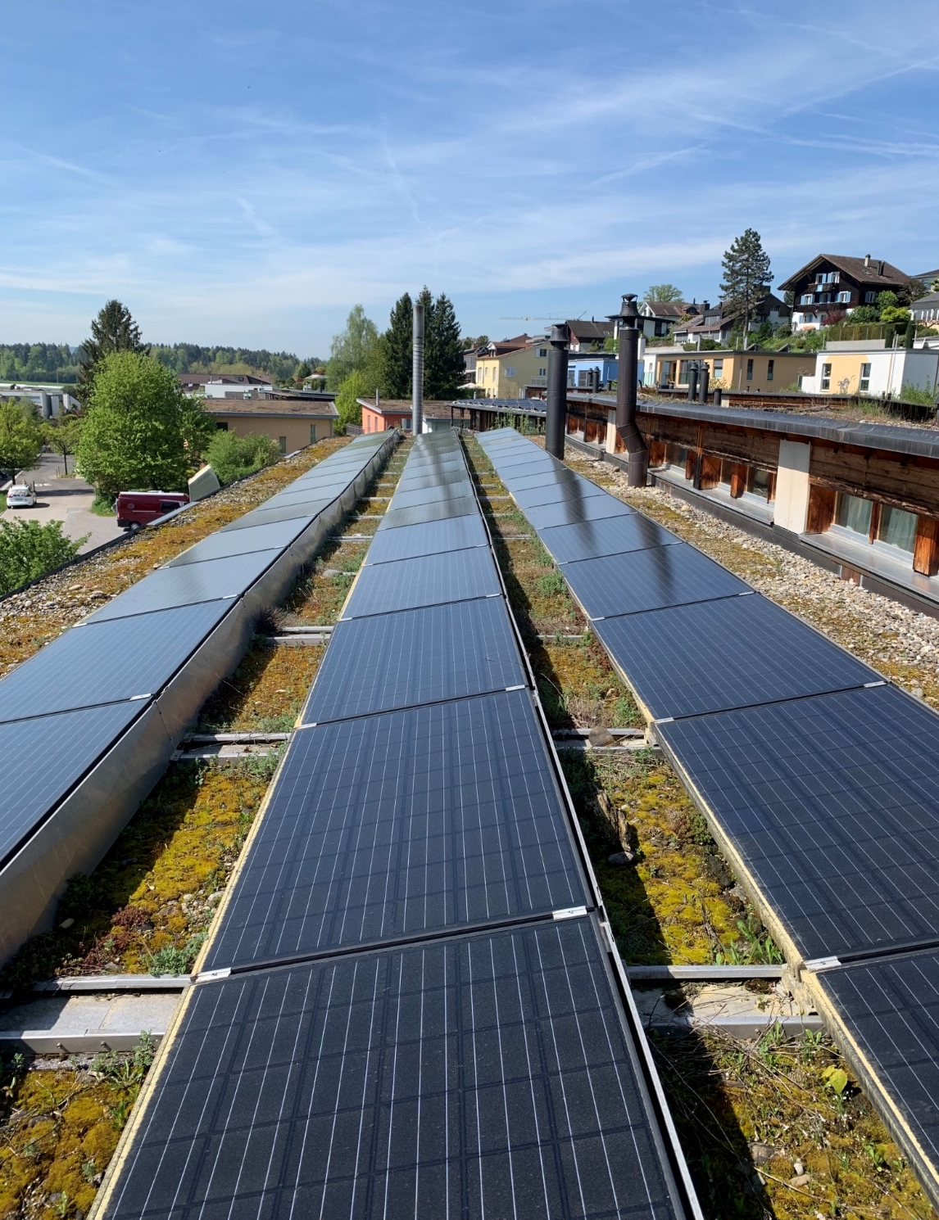
Case study
The Wingertstrasse Project
Case study of a real-life residential BIPV project in Zurich, Switzerland.
The Project
Results
The project began in 1996, to promote renewable energy use in residential buildings.
The PV system was built in 2012 to only produce the required amount of electricity to achieve self-sufficiency rates of up to 30%.
Photovoltaikanlage Projekt Wingertstrasse

Slide 7
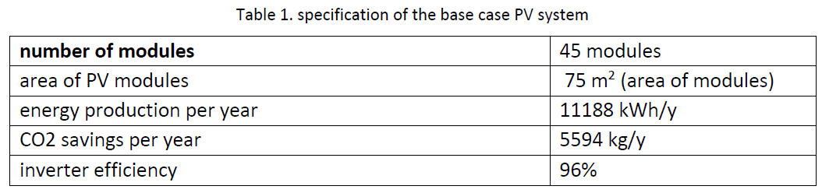
Three Case Study Scenarios
First case – with consumers
The first case scenario differs in the inclusion of the consumers. The consumers are three apartment buildings with a total of 22 residents.
Second case – with consumer and storage
In this scenario PVs are supplemented with the use of a battery (10kWh).
Third case – with consumer and storage and three times larger PV system
135 modules were installed and the dimension of the battery enlarged to 45 kWh.

Slide 8
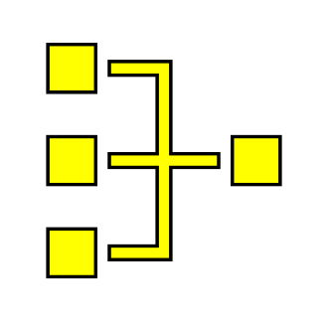


Results of Photovoltaic System Simulations
What results can be expected from photovoltaic systems in residential buildings?
The following table provides some answers.
Key Data
Base Case
Case 1
Case 2
Case 3
Case 1
Case 2
Case 3
Avg. Self-Sufficiency Ratio per Year (%)
-
37.0%
46.5%
72.9%
Avg. Self-Consumption Ratio per Year (%)
-
67.9%
84.7%
50.2%
Avg. Feed-in Ratio per Year (%)
100%
32.1%
15.3%
49.8%
Photovoltaic System Yield per Year (kWh)
11,800
11,800
11,800
35,421
Self-Consumption per Year (kWh)
-
7,097
9,291
15,191
Grid Feed-in per Year (kWh)
11,800
4,703
2,127
17,540
Electricity Purchase per Year (kWh)
20,064
12,967
10,773
4,873
Remuneration per Year / Case (CHF)
4,708.20
1,876.50
848.67
6,998.46
Electricity Costs per Year / Case (CHF)
4,314.76
2,788.55
2,316.73
1,047.94

Slide 9
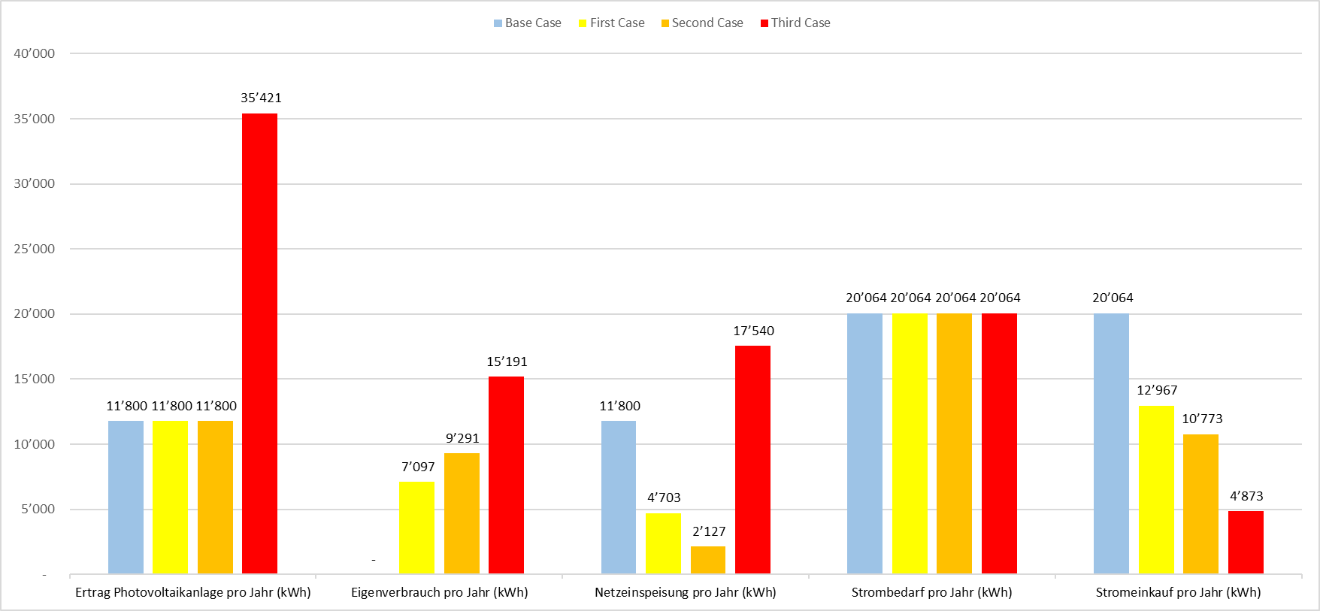
Results of Photovoltaic System Simulations
kWh p.a.
el. production self- grid electricity grid
PV consumption load demand supply

Slide 10
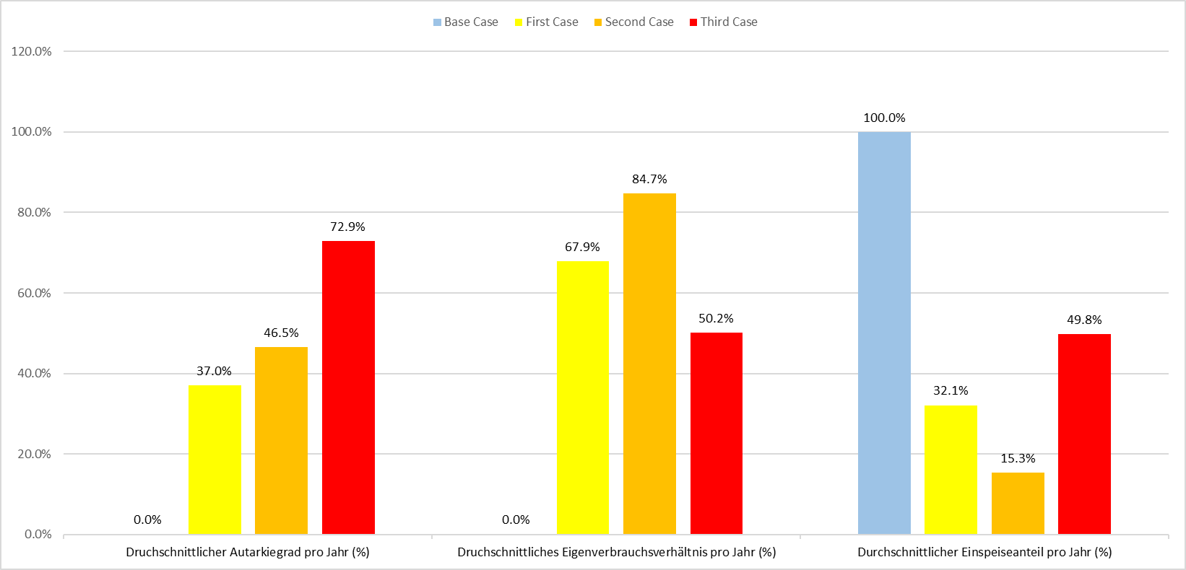
Results of Photovoltaic System Simulations
Level of self-sufficiency self-consumption ratio share feed-in to grid

Slide 11
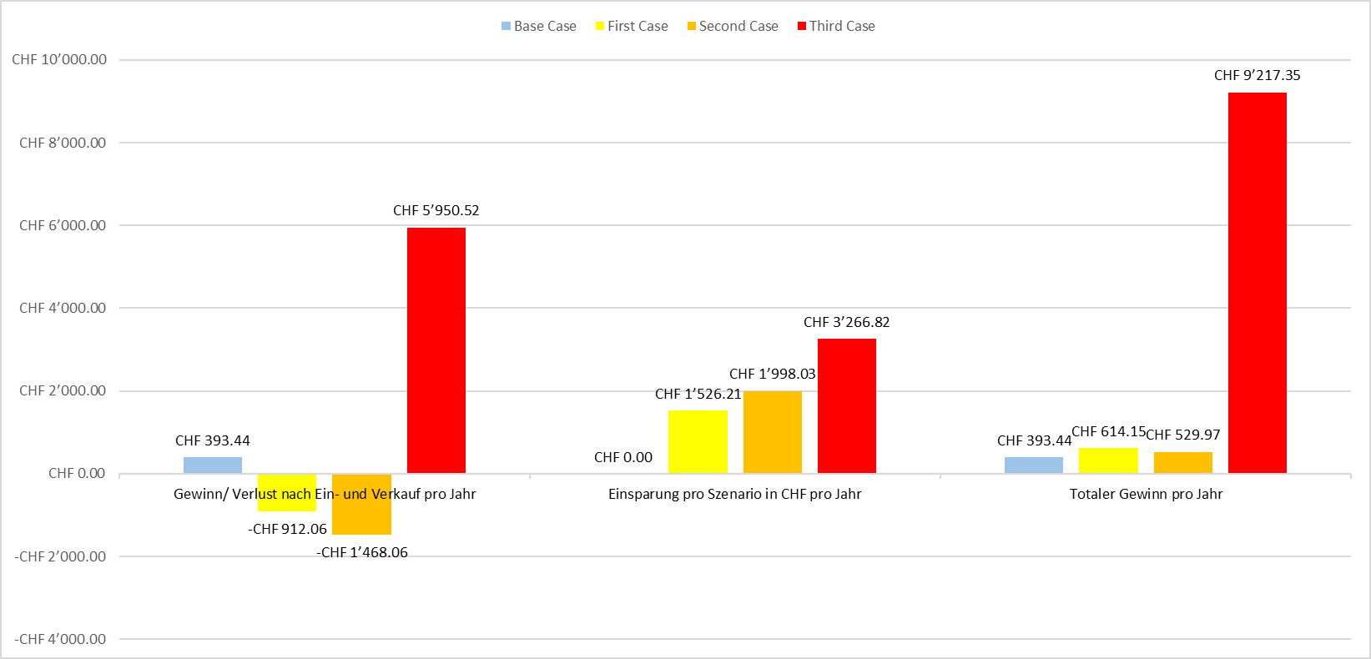
Results of Photovoltaic System Simulations
Profit/loss savings total profit

Slide 12
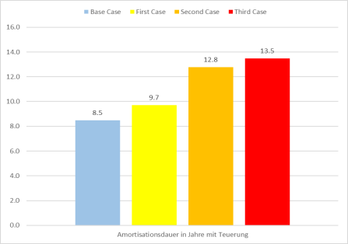
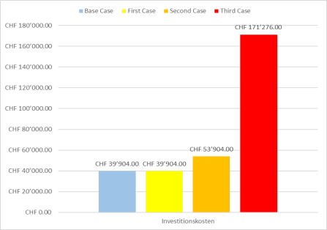
Results of Photovoltaic System Simulations
years
CHF
Payback period
investment

Slide 13
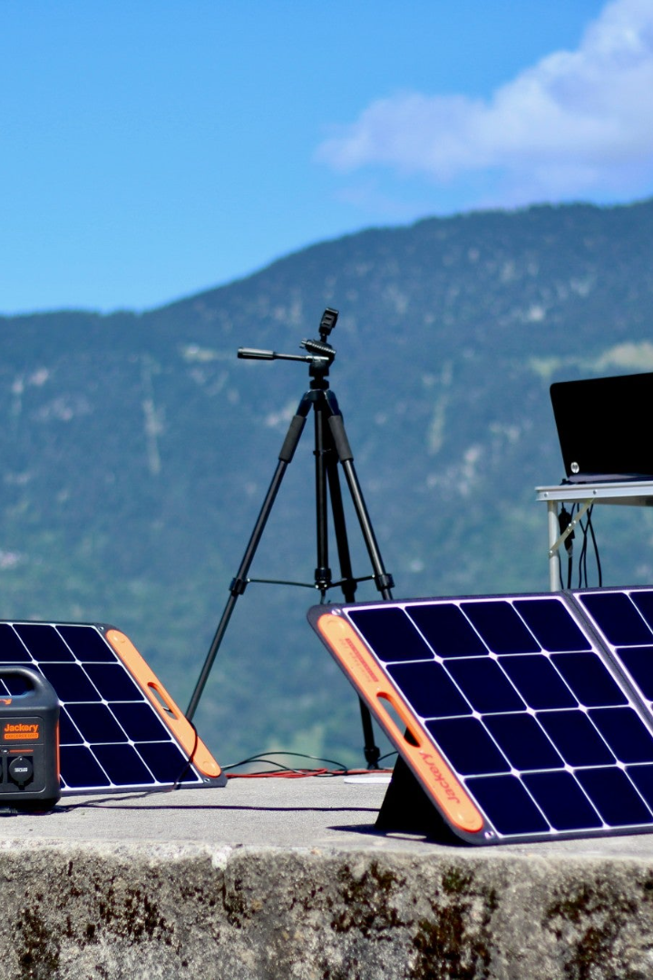
Conclusion
The energy transition to a renewable energy future can only be achieved by addressing related challenges
Photovoltaic systems can provide viable alternatives to traditional energy consumption, with self-sufficient Prosumers and sustainable energy supplies that can contribute to the circular economy
Finally, one answer to the question of how to optimize the business models for residential photovoltaics is to ensure that the system dimensions should not be based on self-consumption, but on the maximum size of system that can be achieved on a site.

