Slide 1
Prepared for iCARB Conference 2023
Accounting for socio-spatial impacts of energy storage technologies – Learning from energy infrastructures literature
Laura Moldovan, Sonja Oliveira, Ombretta Romice
Presented by Laura Moldovan
PhD Candidate, University of Strathclyde

Slide 2
01
UK: Energy storage technologies
Contents
02
Research Problem and Study Aim
03
Methods
04
Findings: empirical insights
05
Findings: theoretical insights
06
Implications

Slide 3
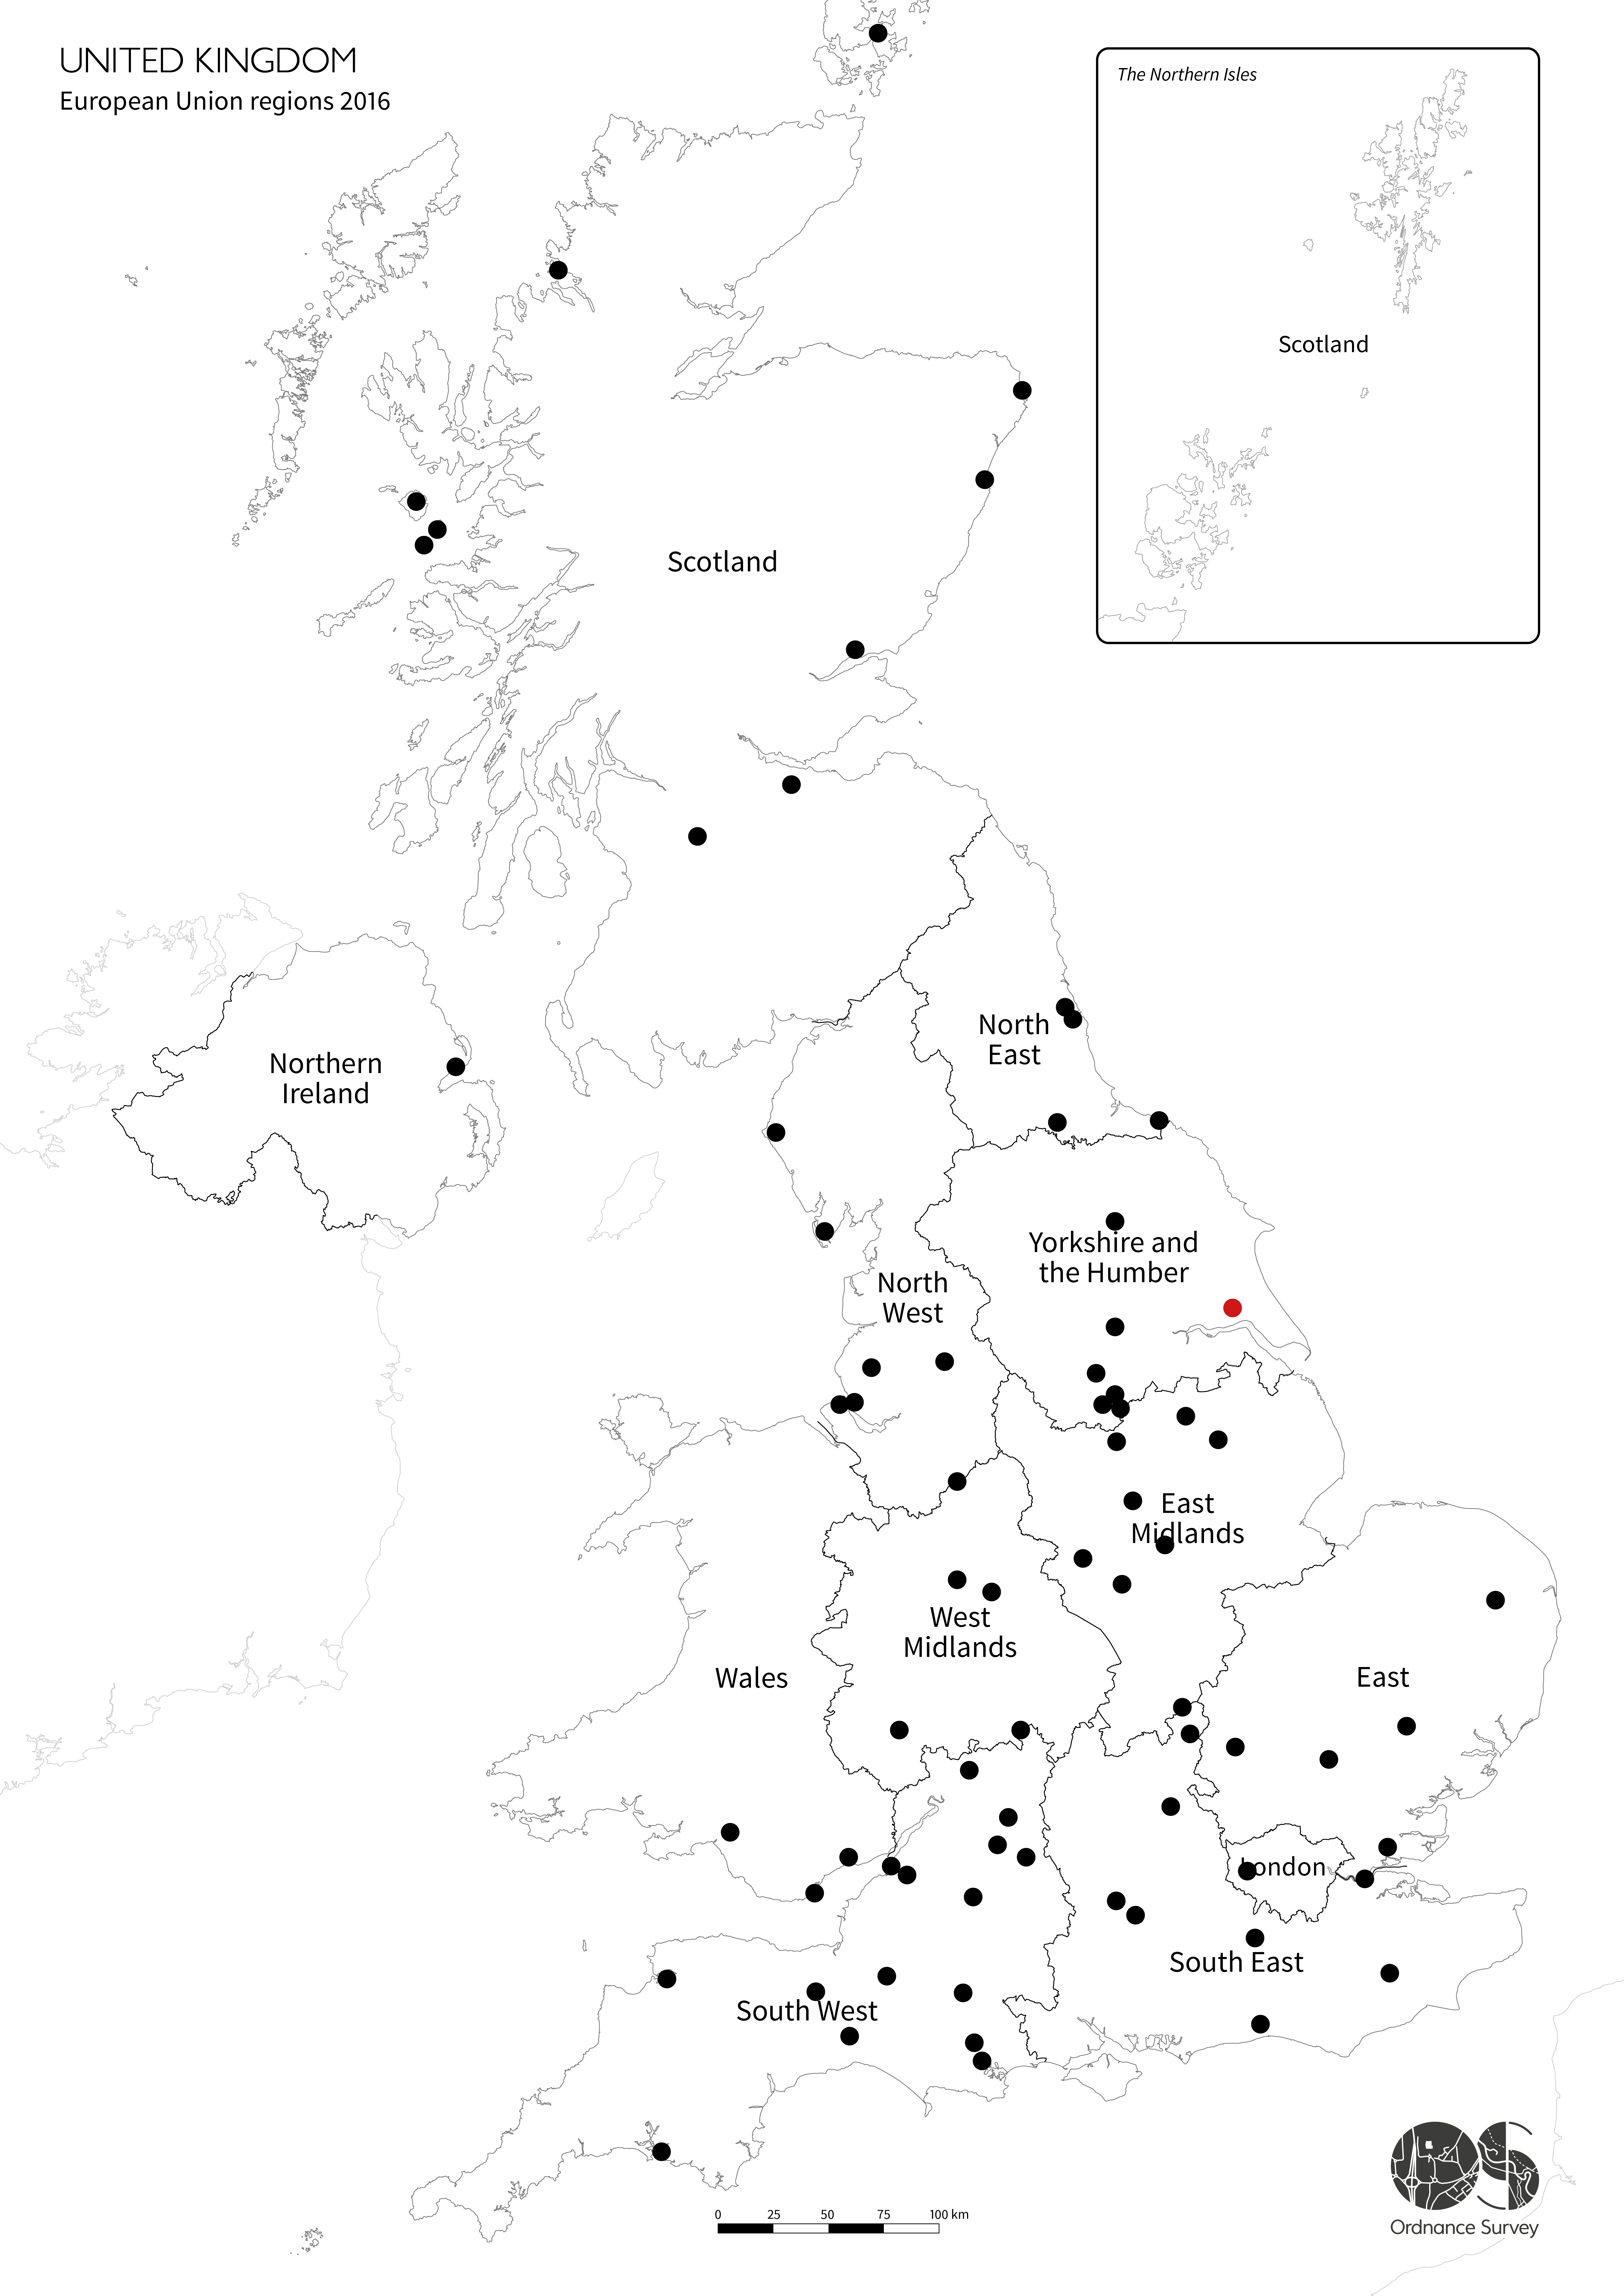
01 UK: Energy storage technologies
Harmony Energy Pillswood
Battery Energy Storage installation
Yorkshire, UK
Operational Nov 2022
196 MWh / 300 000 homes for 2h
Largest BESS in Europe by MWh
Left: Operational BESS installations (0-196MWh) in UK as of 2023; no. 80 . Source: BEIS/ OS Maps; map created by author
Notes:
Bess status
Operational vs under/awaiting construction

Slide 4
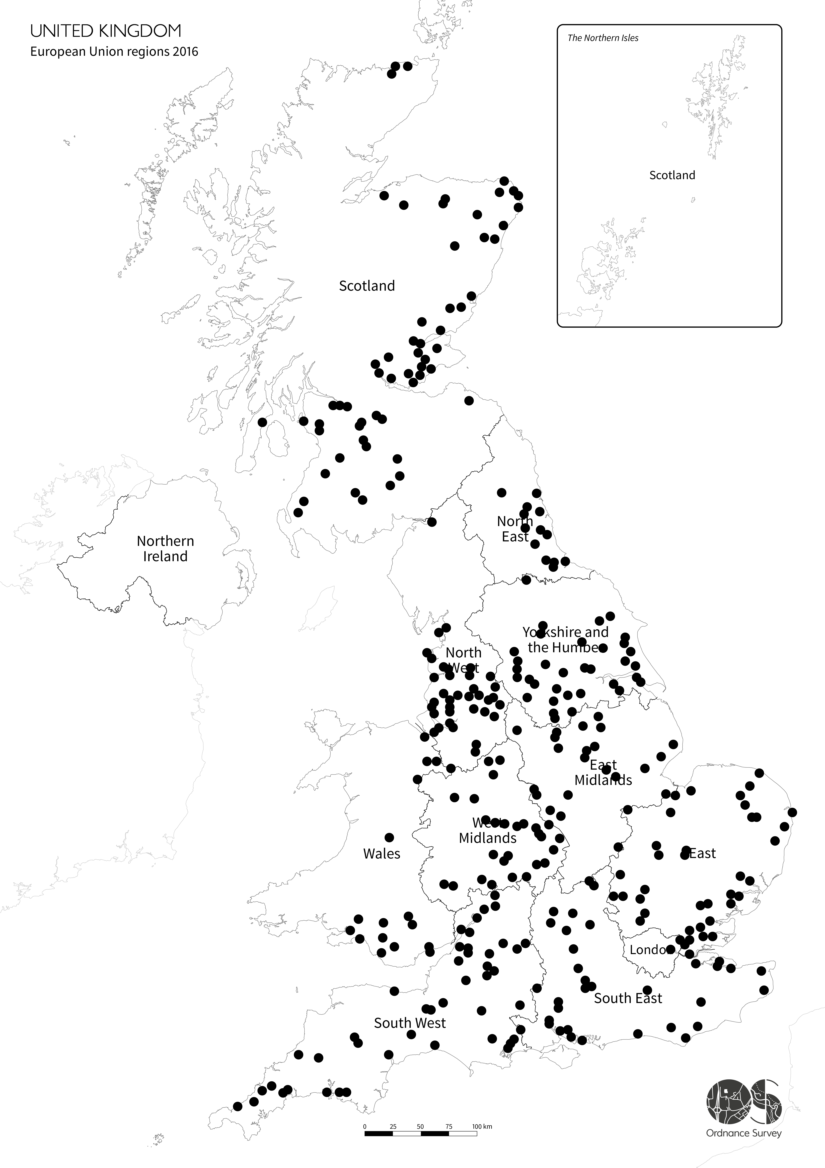
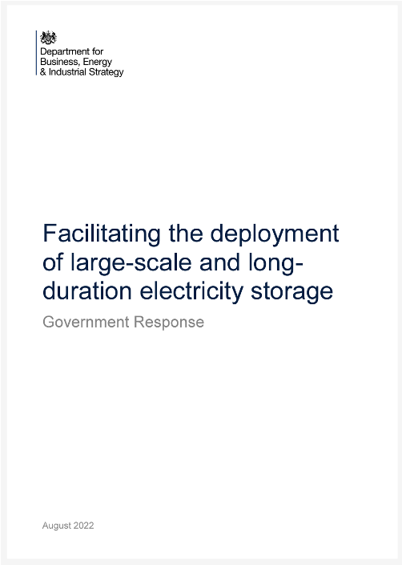
01 UK: Energy storage technologies
August 2022: BEIS publishes consultation key proceedings
More inclusive definitions of LLES
Facilitate higher deployment rates for community-scale BESS
Comprehensive BESS policies to be finalized by 2024
408 Storage installation under construction and awaiting construction
Left: Map of energy storage installations - awaiting and under construction status as of 2023.
Source: BEIS/ OS Maps; map created by author
Notes:
Bess status
Operational vs under/awaiting construction

Slide 5
02 Research Problem and Study Aim
Research problem
Aim – literature review
Increased BESS deployment
No accounts of social and spatial implications
Empirical account
Theoretical account
Notes:
A review of published literature on the social and spatial impacts posed by energy infrastructures on nearby communities, how these impacts have been accounted for and in which contexts, can help provide not only knowledge on ways energy storage can be examined in future research but also the likely impacts that can be anticipated.

Slide 6
03 Methods
Initial Search
Inclusion Criteria
Second Search
Duplicate Removal
Key Themes
Exclusion Criteria
Final Sample
Snowball
Semi-systematic (narrative) literature review
Total
41 papers
Databases
Google Scholar, Scopus
Searches
energy and social impacts
energy and spatial impacts
lived experiences of energy infrastructures
Sense making
and Meaning making
Place-making
Theoretical insights
Databases
Google Scholar, Scopus
Searches
energy infrastructures and sensemaking
energy infrastructure and meaning making
energy infrastructure and place-making
English published
Peer-reviewed
All publishing years
Non-English published
Editorials
Reviews
No theoretical ground
Non-peer reviewed
89 papers
24
papers
+ 17
papers
Stage I
Stage II

Slide 7
04 Findings: empirical insights
Social Acceptability Studies
NIMBY
‘describes opponents of new developments who recognise that a facility is needed but are opposed to its siting within their locality’
NIMBY (Not-in-my-Backyard)
Support/opposition
Does not account for fine-grained socio-spatial impacts
Burningham et al., 2006:2
Notes:
NIMBY and why acceptability alone does not offer a full perspective (finer-grain picture) of socio-spatial implications generated by energy infrastructures.
1. Social acceptability is widely studied in relation to renewable energy infrastructures (refs) and is most often framed using NIMBY (Not-in-my-Backyard) literature. NIMBY ‘describes opponents of new developments who recognise that a facility is needed but are opposed to its siting within their locality’ (Burningham et al., 2006:2). However, it received extensive criticism for its over-simplistic nature (Devine-Wright and Howes, 2010, Warren et al., 2005), with scholars showing that identity, in some instances, is more important than proximity to development in forming attitudes (Phadke, 2011, Wester-Herber, 2004).
2. research on energy storage implications to date has mainly focused on matters of social acceptability (Thomas et al., 2019, Devine-Wright et al., 2017). Acceptability studies on generally explore reasons behind public support or opposition towards potential energy storage deployment, without accounting for fine-grained social and spatial implications of energy storage installations.

Slide 8
04 Findings: empirical insights
Experiences
‘deep-rooted socio-psychological mechanisms, through which individuals make sense of and give meaning to reality and associated changes ’
— Weick et al., 2005, Sommer and Baumeister, 1998
Notes:
In order to gain finer-grain insight, research needs to look at experiences.

Slide 9
04 Findings: empirical insights
SENSE AND MEANING MAKING
Lifestyle
Attitudes
Identity
PLACE MAKING
Place identity
Place attachment
Disruption
Risk
Positive
Negative
Disruption
Risk
Disruption
Disruption
Themes overview
Notes:
Experiences can be categorized into sense+meaning making and place-making mechanism. Both mechanisms have deep psychological roots.

Slide 10
04 Findings: empirical insights
Energy Infrastructure Impacts
 | Wind Farms | Hydro Dams | Solar Farms | Shale Gas | Electricity Lines
Social | Disruption to daily routines | Negative impact on social relations | +/- Impact on social relations | Fear of unknown (well-being, jobs, lifestyle) | Health concerns
 | Disruption to social relations | - | Social tension/local pride | Long-term impact on mental health (stress) | Negative feelings (industrialization)
Spatial | Negative shift in feelings of belonging/identity | Community displacement | +/- Increased migration | - | Negative landscape impact
 | Relocation | Job loss | Negative Identity Shift | - | Decline in local agriculture
 | Potential impact on housing market prices (up/down) | Loss of community and feelings of belonging | Concerns over hazards | - | Novel infrastructures
Notes:
While some impacts can be specific to a technology, such as relocation or housing market prices impact; many other impacts (both social and spatial) are not tied to a specific technology. While BESS are not the same scale as say hydro or wind infrastructures, some studies show that in fact, type of technology is irrelevant. Next slide: impacts can be generated by several factors.
For solar farms, the study referred to here looked at several sites. Positive impacts were outweighed by negative impacts. Interestingly, some aspects, such as preferential treatment regarding sourcing materials and labour, benefited some communities but negatively impacted others, who felt unjustified. For identity, author says: Local community members associated the transformation of rural landscapes into an industrial zone with negative effects on psychological well-being and feelings of alienation, because of their emotional ties and cultural attachment to their ancestral land. Also, on hazards: Concerns related to the potential for increased crime rates related to drug and alcohol abuse due to the influx of external and/or foreign workers and students, as well as concerns that increased traffic to the project site could cause an increase in fatal road accidents.
For electricity lines: the study referred to here (Soini) looked at new transmission lines in an area which already had lines installed (very familiar with this infrastructures) – nevertheless, residents still had an overwhelming negative perception of potential new lines.

Slide 11
General post-installation attitudes can vary depending on 1) local, regional and national scale (Devine-Wright and Batel, 2017), and 2) factors such as demographic (del Río and Burguillo, 2008, Soini et al., 2011), past experiences (Kim and Chung, 2019), media coverage, socio-cultural and economic values (Delicado et al., 2016) or duration of exposure to technology (Sherren et al., 2019).
04 Findings: empirical insights
Energy Infrastructure Impacts: Factors
Scale (local, regional,national)
Socio-cultural values
Devine-Wright and Batel, 2017
Delicado et al., 2016
Demographics
Duration of exposure to technology
del Río and Burguillo, 2008
Sherren et al., 2019
Soini et al., 2011
Past Experiences
Media Coverage
Kim and Chung, 2019
Notes:
Scale: demographics- longevity of residence in some cases also matters ; media coverage: key stakeholders’ opinions also matter

Slide 12
05 Findings: theoretical insights
Key Themes and Theoretical frameworks
SENSE AND MEANING MAKING
Science and Technology Studies (STS)
Social Construction Studies
Social Acceptance Studies
PLACE MAKING
Socio-Spatial Studies
Actor-Network Theory (ANT)
Social Representation Theory (SRT)
Social Impact Assessment (SIA)
Place Identity/Attachment Theory
Territory-Place-Scale-Network (TPSN)
Notes:
Both social and spatial impacts have been studies using a variety of frameworks. Here are the most common frameworks. STS has a long-standing history of studying relationship between people and energy; SRT looks at how people make sense of things around them; SIA is a more technical/practical framework which tries to calculate, mitigate and monitor potential impacts caused by infrastructures and general developments; On the place-making side, PIT and PAT tend to be looked at and considered interchangeably; and both deal with how people relate to a specific place.

Slide 13
05 Findings: theoretical insights
BESS | Benefits and Limitations
Benefits
Limitations
SENSE AND MEANING MAKING
Science and Technology Studies (STS)
Social Construction Studies
Social Acceptance Studies
PLACE MAKING
Socio-Spatial Studies
Actor-Network Theory (ANT)
Social Representation Theory (SRT)
Social Impact Assessment (SIA)
Place Identity/Attachment Theory
Territory-Place-Scale-Network (TPSN)
Social order insights
Can be interpretative/ prescriptive
Deep insights
Context-dependent
Versatile
Multiple stakeholders
Deep insights
Can be overly deterministic
Multiple-actors
Narrow focus
Notes:
How each of these frameworks can help researchers/professionals in understanding BESS implications. No one framework is able to provide full insight, however each has certain benefits which might help with this.

Slide 14
06 Implications
Limitations
Implications for carbon accounting
Small scale energy infrastructures
Empirical
Use of/ moving between spaces
Relation to BESS
Theoretical limitations
Theoretical account
Spatial analysis
Limited BESS studies to date
Notes:
We see a lot of infrastructure being installed in built environments; the implications of this review for accounting for carbon are both empirical, and theoretical. Empirical- such infrastructures might change they way people use spaces, and move between spaces as well as how people relate to such infrastructure, on an experiential level. Secondly, theoretical – generally, studies do not tend to look at social and spatial implications simultaneously, although we now know that both social and spatial changes might occur at the same time; therefore, perhaps incorporating spatial analysis in a socially-embedded study might be the missing link in gaining a better understanding of the implications BESS poses on individuals and community.

Slide 15
06 Implications
[there is urgent need for] analysing questions such as: what is being said about storage?
How is it being used? What is being associated with it? Which images are used to make sense of storage?
Since storage solutions are emerging at different scales of deployment, governance at various scales needs to be understood in a comprehensive manner [..]
Devine-Wright et al, 2017
Notes:
Emphasize that based on impacts presented today, it is imperative that BESS installations’ impacts are also accounted for; this will ensure not only accounting for human wellbeing but also ensuring energy transitions are more sustainable.

Slide 16
References
BAILEY, E., DEVINE-WRIGHT, P. & BATEL, S. 2016. Using a narrative approach to understand place attachments and responses to power line proposals: The importance of life-place trajectories. Journal of Environmental Psychology, 48, 200-211.
BATEL, S. & DEVINE-WRIGHT, P. 2015. Towards a better understanding of people's responses to renewable energy technologies: Insights from Social Representations Theory. Public Underst Sci, 24, 311-25.
BERGQUIST, P., ANSOLABEHERE, S., CARLEY, S. & KONISKY, D. 2020. Backyard voices: How sense of place shapes views of large-scale energy transmission infrastructure. Energy Research & Social Science, 63.
BURDGE, R. J. & VANCLAY, F. 1995. Social impact assessment. Environmental and social impact assessment, 31-65.
BURNINGHAM, K., BARNETT, J. & THRUSH, D. 2006. The limitations of the NIMBY concept for understanding public engagement with renewable energy technologies: a literature review.
DEL RÍO, P. & BURGUILLO, M. 2008. Assessing the impact of renewable energy deployment on local sustainability: Towards a theoretical framework. Renewable and Sustainable Energy Reviews, 12, 1325-1344.
DELICADO, A., FIGUEIREDO, E. & SILVA, L. 2016. Community perceptions of renewable energies in Portugal: Impacts on environment, landscape and local development. Energy Research & Social Science, 13, 84-93.
DEPARTMENT FOR BUSINESS, E. I. S. 2023. Renewable Energy Planning Database (REPD) [Online]. https://data.barbour-abi.com/smart-map/repd/beis/?type=repd. [Accessed 1.08.2023 2023].
DEVINE-WRIGHT, P. 2011. Place attachment and public acceptance of renewable energy: A tidal energy case study. Journal of Environmental Psychology, 31, 336-343.
DEVINE-WRIGHT, P. & HOWES, Y. 2010. Disruption to place attachment and the protection of restorative environments: A wind energy case study. Journal of Environmental Psychology, 30, 271-280.
ÉGRÉ, D. & SENÉCAL, P. 2003. Social impact assessments of large dams throughout the world: lessons learned over two decades. Impact Assessment and Project Appraisal, 21, 215-224.
GAILING, L., BUES, A., KERN, K. & RÖHRING, A. 2019. Socio-spatial dimensions in energy transitions: Applying the TPSN framework to case studies in Germany. Environment and Planning A: Economy and Space, 52, 1112-1130.
GROTH, T. M. & VOGT, C. 2014. Residents' perceptions of wind turbines: An analysis of two townships in Michigan. Energy Policy, 65, 251-260.
IPCC 2018. Global Warming of 1.5°C. V. Masson-Delmotte, et al.
IRIE, N., KAWAHARA, N. & ESTEVES, A. M. 2019. Sector-wide social impact scoping of agrivoltaic systems: A case study in Japan. Renewable Energy, 139, 1463-1476.
JACQUET, J. B. 2009. Energy Boomtowns & Natural Gas: Implications for Marcellus Shale Local Governments & Rural Communities. NERCRD Rural Development.
JACQUET, J. B. & STEDMAN, R. C. 2013. The risk of social-psychological disruption as an impact of energy development and environmental change. Journal of Environmental Planning and Management, 57, 1285-1304.
KIRCHHERR, J. & CHARLES, K. J. 2016. The social impacts of dams: A new framework for scholarly analysis. Environmental Impact Assessment Review, 60, 99-114.
KÜPERS, S. & BATEL, S. 2023. Time, history and meaning-making in research on people's relations with renewable energy technologies (RETs) – A conceptual proposal. Energy Policy, 173, 113358.
MCLACHLAN, C. 2009. ‘You don’t do a chemistry experiment in your best china’: Symbolic interpretations of place and technology in a wave energy case. Energy Policy, 37, 5342-5350.
MEXIS, I. & TODESCHINI, G. 2020. Battery Energy Storage Systems in the United Kingdom: A Review of Current State-of-the-Art and Future Applications. Energies, 13.
MOORE, S. & HACKETT, E. J. 2016. The construction of technology and place: Concentrating solar power conflicts in the United States. Energy Research & Social Science, 11, 67-78.
MORDINI, E. 2007. Technology and fear: is wonder the key? Trends in Biotechnology, 25, 544-546.
MOSCOVICI, S. 1988. Notes towards a description of Social Representations. European Journal of Social Psychology, 18, 211-250.
PHADKE, R. 2011. Resisting and Reconciling Big Wind: Middle Landscape Politics in the New American West. Antipode, 43, 754-776.
SOINI, K., POUTA, E., SALMIOVIRTA, M., UUSITALO, M. & KIVINEN, T. 2011. Local residents’ perceptions of energy landscape: the case of transmission lines. Land Use Policy, 28, 294-305.
SNYDER, H. 2019. Literature review as a research methodology: An overview and guidelines. Journal of Business Research, 104, 333-339.
Notes:
Refs used throughout presentation

Slide 17
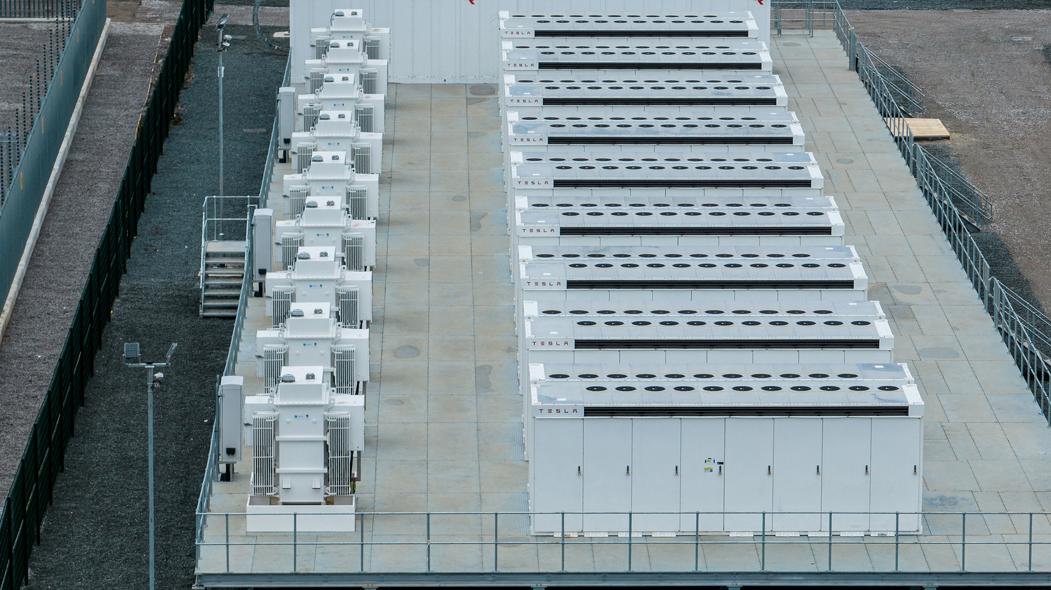
Laura Moldovan, PhD candidate
Contact: laura.moldovan@strath.ac.uk
Photo: Pillswood Battery Energy Storage, UK
Credit: Harmony Energy Income Trust Plc
Notes:
Thank you and please feel free to ask any questions.

