Slide 1
ICARB 2023
Measuring Net Zero
Quantifying the Embodied Emissions of Building Envelope Systems in a Toronto Context
A research collaboration between Toronto Metropolitan University and RDH Building Science Inc., funded by The Atmospheric Fund (TAF)
1
Bofa Udisi, MEB, PMP, CEM, CMVP
Ph.D. Candidate, Toronto Metropolitan University

Slide 2
2
Content
01
Why do we care about embodied carbon?
02
Current Canadian landscape
03
Research gap & objective
04
Methodology
05
Results
06
Application and limitations
07
Questions

Slide 3
3
Why do we care about embodied carbon?
01
More stringent codes and standards for operational efficiency
Relatively clean grid in Canada
02
03
Embodied carbon 80% of whole life carbon
Notes:
You’ve heard about embodied and whole-life Carbon throughout this conference, so I’ll skip the definitions. So, why do we care about embodied carbon? I’ll answer this question in a Canadian context. We’ve been making some progress on reducing operational emissions due to more stringent building codes and standards around energy efficiency in buildings. Some of these regulations include fuel switching from natural gas to electricity. This is good because the majority of Provinces/Territories in Canada have relatively clean electricity grids. So, fuel switching significantly reduces the operational emissions of our buildings. However, as our buildings become more energy efficient, studies have shown that the embodied carbon will represent a higher percentage of the building’s whole-life carbon – up to 80%. This is why much attention needs to be paid to embodied carbon, just like operational carbon.
<number>

Slide 4
CURRENT CANADIAN LANDSCAPE
4
Toronto
Vancouver
CaGBC ZCB
TGS v4:
Mandatory targets for city-owned buildings
Maximum embodied carbon intensity of 350 kgCO2e/m2
Embodied carbon by-law:
40% reduction target by 2030
10% target by 2025 for new construction
Must demonstrate 10% reduction
OR
Must not exceed 500kgCO2e/m2
Notes:
Again, thankfully, this is the case globally and in Canada as more jurisdictions start to include language around embodied carbon in their standards. In Toronto, the current standard of the Toronto Green Standard, requires city-owned buildings to conduct an upfront carbon assessment to identify low-carbon material alternatives that result in an embodied carbon intensity of 350 kgCO2e/m2.
In Vancouver, there is the Vancouver Building Bylaw (VBBL) code, which now requires the tracking and reduction of embodied carbon in Part 3 buildings (large buildings). Aiming for a 40% EC reduction by 2030.
The Canadian Green Building Council (CaGBC) developed the Zero Carbon Building Design Standard to help us meet this target. Version 3 of the standard was published in 2022 with better emphasis on embodied carbon. The embodied carbon requirement for projects looking to get certified is that they must demonstrate a 10% reduction in embodied carbon intensity compared to the baseline or must not exceed 500 kgCO2e/m2.
<number>

Slide 5
5
Research gap and objectives
Research Gap
System-level EC analysis by enclosure layer
Few that focus on enclosure systems exclude roof and floor assemblies
Research Objectives
Replicable LCA methodology for enclosure assemblies
Quantify the embodied carbon of 26 commonly used enclosure assemblies of commercial, institutional, and MURBs in the GTHA
Notes:
Our preliminary research showed limited studies on the detailed analysis of the embodied carbon of the layers of building enclosures at a system level. The few that focused on enclosure systems excluded the roof and floor assemblies, which also play a critical role in the energy efficiency of buildings. This gap doesn’t provide designers, policy-makers, and procurement professionals with enough information to better understand the embodied impacts of enclosure layers and easily select the most sustainable materials and systems early in the design process.
So our objectives were to develop a replicable methodology for enclosure assemblies and then quantify the embodied carbon of 26 commonly-used enclosure assemblies of Part 3 buildings in the Greater Toronto and Hamilton Area.
<number>

Slide 6
6
Methodology
Enclosure
Selection
RDH Building Science Inc.
LCA
TMU
Notes:
I have broken our methodology into two parts - enclosure selection and LCA for embodied carbon analysis. Our research partners at RDH worked on the enclosure selection because of their wealth of experience in this area and their relationship with manufacturers, contractors, and other consultants in the industry. At TMU, we conducted the embodied carbon analysis.
<number>

Slide 7
7
Enclosure Selection Methodology
SET PERFORMANCE TARGETS
ASSEMBLY CONFIGURATIONS IN THE GTHA
26 ASSEMBLIES BUILT
Notes:
There were three steps in the enclosure selection methodology - the first was setting performance targets, the second was exploring the assembly configurations in the GTHA to determine the 26 most-commonly used assemblies as the last step. I’ll touch on each step a little more in the coming slides
<number>

Slide 8
Enclosure Selection Methodology
SET PERFORMANCE TARGETS
R-25 (RSI-4.4) for the floors
R-25 (RSI-4.4) for walls
R-30 (RSI-5.3) was set for the roof
Notes:
When we began this research, the TGS version 3 was in effect, and we wanted to set reasonable performance targets that exceeded the standard then. We used an R-value of R-25 for the walls and floors and R-30 for the roofs. These targets are not ambitious by today’s standards but represent mainstream base targets.
<number>

Slide 9
Enclosure Selection Methodology
ASSEMBLY CONFIGURATIONS IN THE GTHA
New constructions and retrofits
Commonly-used assemblies
9
Variety of materials
Notes:
Based on RDH’s experience working with envelope systems and in consultation with other consultants in the GTHA, the RDH team gathered several enclosure configurations for review. It was important that the assemblies were among the commonly-used in the GTHA and the selections had a variety of materials. It was also important that they could be used in new construction and some for retrofit applications.
<number>

Slide 10
Enclosure Selection Methodology
26 ASSEMBLIES BUILT
Four floor assemblies
Seventeen wall assemblies
10
Five roof assemblies
Notes:
So, after the evaluation, 26 assemblies were shortlisted. 17 of them were wall assemblies and five roof and four floor assemblies were selected.
<number>

Slide 11
Enclosure Selection Methodology
11
Notes:
This slide shows the 17 wall assemblies shortlisted. W14 to 17 are for retrofit applications.
<number>

Slide 12
Enclosure Selection Methodology
12
Notes:
These are the roof assemblies. We have roof systems on metal, concrete, and CLT deck for variety. R04 is for retrofit applications.
<number>

Slide 13
Enclosure Selection Methodology
13
Notes:
These are the floor assemblies.
<number>

Slide 14
LCA Methodology
Goal and Scope
Study System Boundary A1-A3
9 m2 of enclosure assemblies
Thermal performance function (specified R-values)
Focus on GWP
60-year lifespan
14
Out of scope of
EN 15978 LCA
Notes:
The goal of our research from an LCA perspective was to quantify the absolute and embodied carbon intensity of 26 enclosure assemblies, using a functional unit of 9 square metres of assembly area, the prescribed thermal performance I mention previously, and a 60-year life span. Our scope was focused on the Global Warming Potential impact category. Our temporal boundary was A1-A5. We had included B1 to B5, but due to limited data and uncertainty in these life cycle modules, we had to exclude them from the final results. We didn’t analyse the impact of the assemblies on the energy use in the buildings as that was out of the scope of this research.
<number>

Slide 15
LCA Methodology
Inventory Analysis
Quantity takeoffs
Material volume for 9 m2 of each component
Impact Assessment
Generic EPDS
Specific EPDs
Biogenic impacts reported separately
15
Notes:
We did the quantity takeoffs using an Excel spreadsheet using the assembly specifications received from our partners at RDH. We calculated the volume of each component layer for the functional unit area of 9 square metres. Once that was calculated, we used One Click LCA for the impact assessment. We used generic EPDs from industry associations or regional averages for standardisation and comparability. In some situations, we had to use specific EPDs for products that didn’t have generic EPDs. We reported biogenic carbon separately for the assemblies with sequestered carbon.
<number>

Slide 16
Results
16
Notes:
Our results showed a diverse range of values, with assemblies built with wood-based back-up structures performing better than concrete, brick, steel, etc. The worst-performing assemblies were the ones with concrete backup structures. This slide and the next two slides show a visualisation of the results. Here, we are looking at the embodied carbon of walls 1 to 9.
<number>

Slide 17
Results
17
Notes:
<number>

Slide 18
Results
18
Notes:
<number>

Slide 19
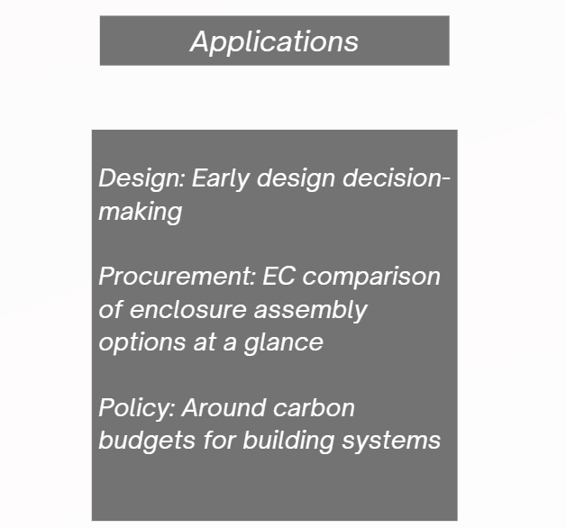
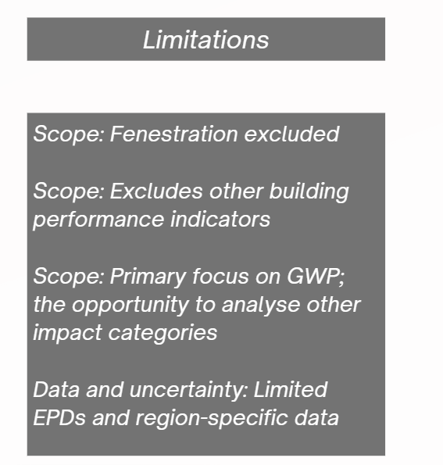
Applications and Limitations
19
Notes:
The feedback we’ve received from industry professionals in Canada has been phenomenal. They see the value of our results and methodology for early design decision-making. Similarly, procurement professionals can use our guidance document to quickly compare the impact of specified designs.
On the policy side, the results can be used to define carbon budgets for building enclosures in new construction and retrofit scenarios.
The limitations of our research provide room for future research. For example, similar research could be conducted for fenestration systems - doors, windows, and curtain walls. Research could be conducted that considers other building performance indicators like hygrothermal qualities of materials, indoor air quality, and the impact of these enclosure systems on the operational emissions. As mentioned previously, this research focused on GWP, but future research could provide a more balanced view by including a weighted comparison of the other impact categories. A significant limitation was the lack of data and EPDs, which introduced uncertainties in our results. As more jurisdictions call for LCAs, we expect that more quality EPDs will become available and help reduce uncertainties.
<number>

Slide 20
Acknowledgments
Dr. Mark Gorgolewski
Dr. Russell Richman
Fatma Osman
Jerry Kim
YuXin Shi
Kelsey Saunders
Rehanna Devraj-Kizuk
Steve Kemp
Alex Lukachko
Erica Barnes
20

Slide 21
THANK YOU.
QUESTIONS?
Bofa Udisi
bofa.udisi@torontomu.ca

