Slide 1
ICARB 2023
Measuring Net Zero
Impact of Location Selection on Whole Life Carbon of a Multi-National Manufacturing Facility
Dr Rosi Fieldson & Dr Ozlem Duran

Slide 2
Introduction
Global manufacturing characterised by high scope 1 and 2 energy use
Increasingly corporations are required to report and reduce scope 3 emissions
They may have set strategic and challenging targets to meet net zero before or by 2050
They may need to purchase offsetting against scope 3 emissions
The amount of carbon emitted will vary depending on where manufacturing is located

Slide 3
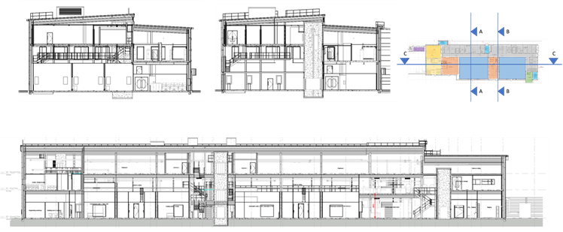
Baseline project LCA
Manufacturing facility recently completed in UK
High unregulated energy consumption
Heavily serviced with walkable ceiling voids (off-site manufactured)

Slide 4
Baseline project Energy use (B6)
Energy Consumption |  |  | 7561.1 | m²
 | Actual kWh/m² | Annual kWh | BRUKL % | Total %
Heating | 3.36 | 25,405 | 9.37%
Cooling | 9.65 | 72,965 | 26.91%
Auxiliary | 11.28 | 85,289 | 31.46%
Lighting | 8.24 | 62,303 | 22.98%
Hot water | 3.34 | 25,254 | 9.31%
BRUKL Total regulated | 35.86 | 271,141 |  | 16.61%
Equipment | 180.05 | 1,361,376 |  | 83.39%
Total consumption | 215.91 | 1,632,517
Energy Production
Photovoltaic installation | 5.96 | 45,064 | 16.62% | 2.76%
CHP | 0 | 0
Calculated operational energy consumption based on BRUKL output (B6)

Slide 5
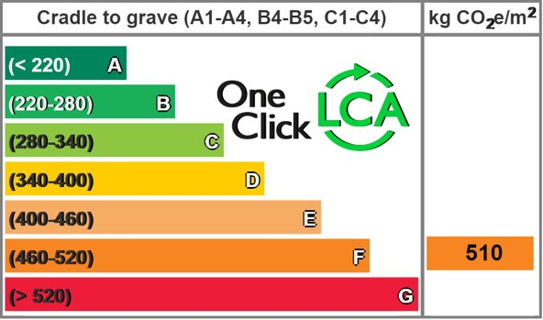
Baseline project embodied imapct
 | Total tCO₂e | kgCO₂e /GIFAm² | %
Substructure | 202 | 26.716 | 6
Superstructure | 1852 | 244.973 | 55
Cladding and roof | 360 | 47.556 | 11
Interior and finishes | 639 | 84.452 | 19
MEP services | 153 | 20.181 | 5
Total | 3369 | 511 | 100
Calculated materials impact (A1-A3) of the baseline model

Slide 6
Design life sensitivity and reference period
Reference period | Module A1-A5 (excl. biogenic carbon) kgCO₂e/m² | Module B1-B5 | Module C1-C4 (excl. biogenic carbon) | TOTAL kg CO₂e
60 years | 511 | 82 | 15 | 5,201
25 years | 511 | 18 | 15 | 2,457
Building services replacement impacts are so significant that refurbishment is disincentivised?

Slide 7
Alternative locations considered: methodology
1. Adjust national energy mix for nation/state.
2. Review energy demand in relation to climate, latitude solar potential and building standards.
3. Adjust key higher-impact materials groups to local Environmental Product Declarations (EPD).
4. Adjust the majority of bulk materials to local EPD.
5. Review frame options based on EPD.

Slide 8
Alternative locations: Grid decarbonisation
 | B6 Energy Mix (source used in LCA software) | B6 Grid Intensity modelled in 2022 kg CO₂e / kWh | Future scenario references | Whole life impact if discounted tCO₂e
UK | National SAP 10.1 rating | 0.14 | Decarbonised by 2050 (GOV.UK, 2022) | 2,445
Australia | Queensland (Green Star) | 0.96 | Decarbonised by 2050 or sooner, (NABERS,2022) (Australian Government, 2021 | 9,586
Argentina | Proxy (2021) | 0.57 | Decarbonised by 2050 (UNEP, 2022) | 5,953
Finland | National average | 0.15 | Carbon neutral projected by 2035 (Fingrid consultation report 2023) | 6,891
India | National average (Noted that localised generation is preferable due to the unreliability of grid) | 1.01 | Decarbonised by 2085 (McKinsey, 2022) | 20,381
Canada | National average (also available for each state) | 0.12 | 95% decarbonized by 2050 (CER, 2021) | 1,672

Slide 9
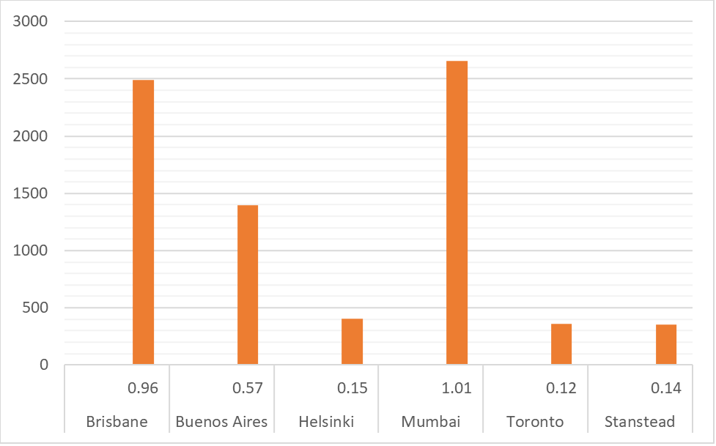
Alternative locations: Operational emissions
Annual emissions tCO₂e if constructed in the year of modelling and grid intensity kgCO₂e/kwh (B6)

Slide 10
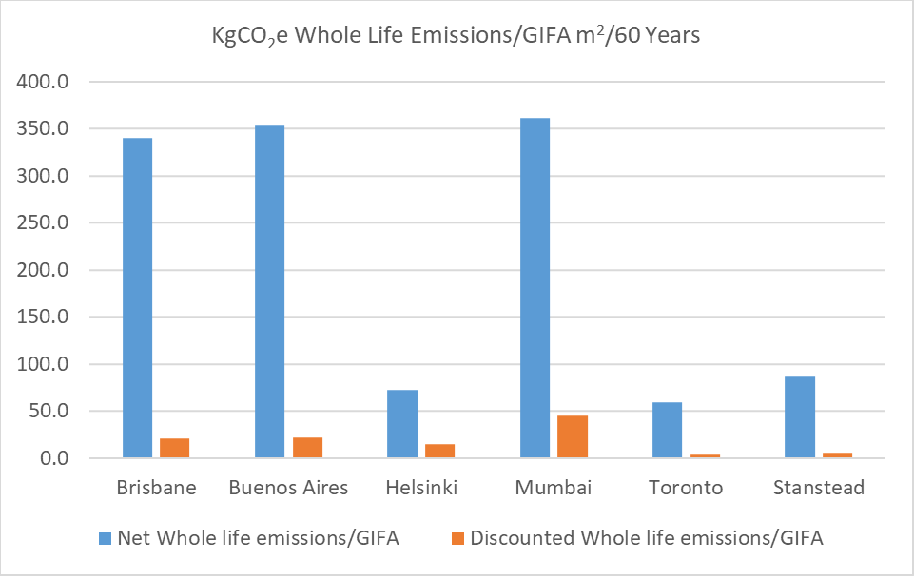
Discounting future carbon intensity

Slide 11
Questioning Whole Life Carbon metrics
Using GIA when considering the walkable service voids/ceilings pushes the building above UK targets for embodied impact rate
Longer reference period than true design life
Reliance on national decarbonisation targets may be a risky strategy for big corporations that have committed to zero carbon deadlines
Preference for off-grid and on-site generation seem preferable

Slide 12
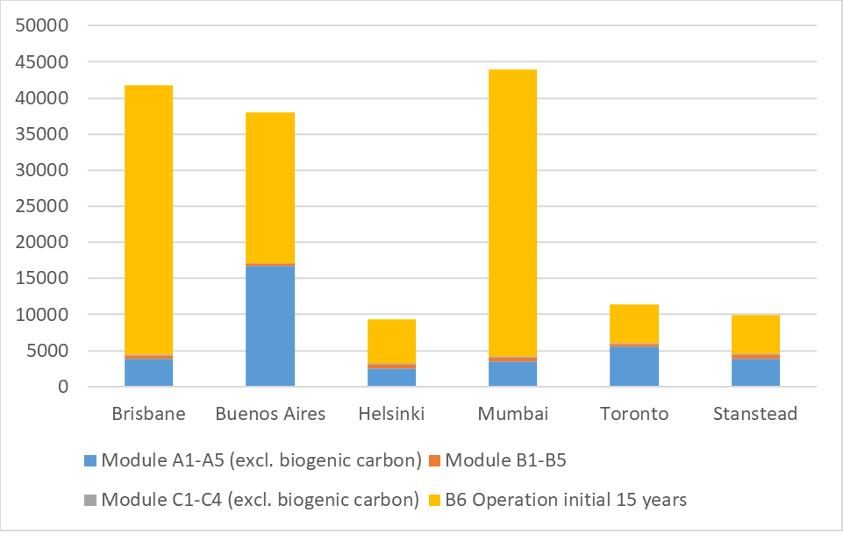
Impact up to first cycle of services replacement
Body Text
Proportionality of embodied impacts on operation in the first 15 years (kgCO₂e)

Slide 13
Recommendations (end user)
Prioritising savings in manufacturing processes
Utilising parametric models and digital twins to model embodied emissions
Retaining EPD information to assess end of life decisions for materials and products when future refurbishment or demolition occurs
Particular focus on frequency of replacing services

Slide 14
Recommendations (end user)
1. Scope opportunities and constraints for local decarbonisation and energy reduction adaptations
2. Model operational energy targets and design life with local grid emissions both with and without proposed national decarbonisation
3. Test frame selection impact including construction methodology (i.e. offsite)
4. Refine modelling with materials for the envelope, cladding and internal finishes
5. Engage suppliers and contractors in the EPD and fuel consumption conversation alongside procurement pathways.

Slide 15
Recommendations (UK construction industry)
Include LCA in procurement approach and contract documentation and adopt benchmark/target
Pay close attention to the geography of supply-chain mapping
Scope 1 and 2 emissions will be monitored closely by commercial end users
Building services must be considered carefully

Slide 16
Limitations
Availability of EPD in a wide construction range of materials limits accurate results for use of LCA in strategic business decisions
The research used one software tool and its associated databases
Confidential use of a parametric model and collaboration with project design team

Slide 17
Conclusions
Urgency for LCA to be communicated and more EPD published
Uncertainty about the pace and effectiveness of grid decarbonisation could limit focus on embodied impact
Productivity may always precede flexibility in capital investment decisions (limiting longevity of assets)

