Slide 1
Visualising carbon
in the design and delivery of buildings - a review of the evidence
Luke Gooding and Sonja Oliveira
ICARB Conference – Edinburgh September 2023

Slide 2
PRESENTATION CONTENTS
Aim
2
Research Problem
Approach
4
Empirical Setting and Method
Findings
Implications

Slide 3
Carbon Artifacts
2022-2024
ESRC (540K) Carbon Artifacts: a socio-material approach to low and net zero carbon building design from concept to handover
+ multiple built environment professionals

Slide 4
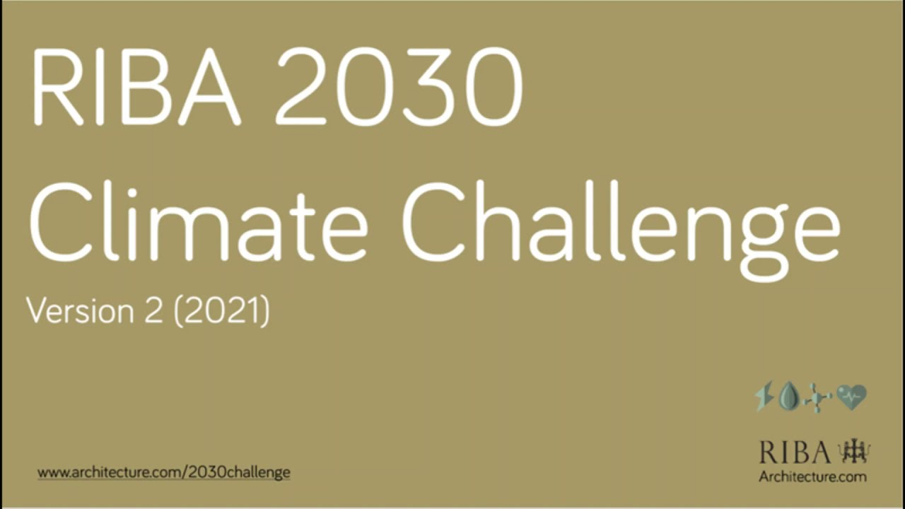
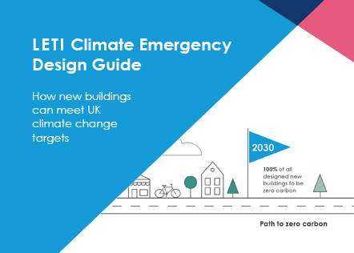
Proliferation of Decarbonisation Guides
Aim
BREEAM
CIBSE TM52
Passivhaus
to provide a review of carbon reduction, low carbon or carbon overall is represented
in published research on low carbon/net zero or energy efficient design and delivery of buildings
LETI
WLCN
SAP
RIBA 2030
Climate Challenge Standard
Wired Score
RICS
CIBSE TM54
NABER
FitWel
UKGBC
HAPPI
EPC
Part L
Target
Assessment
(He and Prasad, 2022; Prasad et al., 2023; Satola, et al., 2022).

Slide 5
RESEARCH PROBLEM?
Although new research is beginning to examine how design professionals visualise energy in buildings (Oliveira et al., 2023), there have been no analytical accounts or reviews of visual practices emerging for carbon reduction in design.
This is problematic as the design of buildings is characterised by a reflective, tacit, and highly visual design practice + as understandings of carbon reduction/low carbon become taken for granted and visually ingrained

Slide 6
APPROACH
Semi-Systematic, Narrative Literature Review Approach (Anthony, 2023; Vågerö and Zeyringer, 2023).
Including
International Studies
Empirical Studies
Case Studies
Theoretical Frameworks
Conceptual Discussions
Time frame: The last 5 Years
Built Environment Literature
Exploring Contextual and Conceptual dimensions and how visual representations are employed to address carbon reduction in real-world settings

Slide 7
METHODS
Searching via Key Words
Carbon visualisation
Carbon representation
Carbon representation
Net-zero visualisation
Net-zero representation
Stage 1 (Abstract Screening) : 1112 Article
Stage 2 (Full Article Screening) : 116 Article

Slide 8
Analysis Phase 1: Exploring Themes

Slide 9
Name and example references | Frequency | Functionality | Type of article
Bar chart | 54 | Comparison of embodied carbon across materials and replacements. Tracking emissions over time. Representing of total emission of materials or components. Comparison of embodied carbon calculation with different present or predicted standards. | Research papers comparing carbon implications of different design options, materials, or technologies (e.g., Rock et al., 2020). Whole life carbon research presenting the carbon emissions associated with different life cycle stages or building components (e.g., Meneghelli, 2018). Performance analysis, investigating the carbon performance of existing buildings or building systems use bar charts to visualize energy consumption, greenhouse gas emissions, or carbon intensity over time (e.g., Ji et al., 2019).
Line graph | 21 | Comparison of carbon emissions across buildings or projects. | Time-series analysis papers examining the carbon performance of buildings or building systems over time often use line graphs (e.g., Eberhardt et al., 2019). Energy modelling and simulation studies, displaying the carbon intensity or emissions profiles of different scenarios or design alternatives, allowing for easy comparison and identification of the most effective strategies (e.g., Rock et al., 2020).
Box plot | 9 | Benchmarking building elements. Representation of how building may meet incoming carbon related standards. | Sensitivity analysis research, employing box plots to investigate the sensitivity of carbon emissions to different parameters or variables (e.g., Cang et al., 2020). Performance benchmarking against standards (e.g., Pasanen and Castro, 2019)
Scatter graph | 24 | Plotting numerous embodied carbon calculations for different buildings and building configurations/material specification. | Simulation modelling using scatter graphs to analyse the relationship between input parameters (such as building characteristics, occupancy profiles, or energy systems) and carbon emissions (e.g., Schmidt and Crawford, 2018).
Cascading target chart | 5 | Compartmentalisation of building elements based on carbon (e.g., operational or embodied carbon. | Performance benchmarking: cascading target charts can be utilized in research papers that compare the carbon performance of different buildings, building systems, or design alternatives (e.g., Jusselme et al., 2018).
Pie chart | 19 | Division of building carbon origin (e.g., materials, energy consumption, end of life). | Carbon footprint research: using pie charts to assess the carbon footprint of buildings (e.g., Marsh et al., 2018).
3D colour-coded images | 8 | Division of building elements to show magnitude of carbon per element class or area. | Building energy simulation, using 3D colour images to represent energy performance, including carbon emissions (e.g., Rock et al., 2018). Embodied carbon assessment using 3D colour images can be used to represent the embodied carbon of different materials, components, or building systems (e.g., Alwan et al., 2021).
Virtual and augmented reality | 4 | Overlaying of energy data from energy services with VR. | Building performance assessment research, using VR/AR to simulate and visualize the carbon performance of buildings (e.g., Kamari et al., 2020). Energy management and monitoring research, exploring how VR/AR can enhance the visualization of real-time energy consumption and carbon emissions within buildings (e.g., Chen et al., 2020). Stakeholder engagement and education research, looking at how VR/AR can facilitate stakeholder engagement by providing interactive and engaging experiences to communicate the carbon impact of design choices (Caldas et al., 2022).
Flowchart | 23 | Outlining of environment assessment process for determining material choices. | Carbon management strategies, using flowcharts to outline the various strategies and measures implemented to reduce carbon emissions in buildings (e.g., Li et al., 2021). Carbon accounting and reporting, using flowcharts to illustrate the process of carbon accounting and reporting, showcasing how carbon emissions are quantified, tracked, and reported for a building (e.g., Li et al., 2022).
Representation approaches

Slide 10
FINDINGS

Slide 11
Impacts and Comparisons
Focus on conveying
Impacts of emissions or interventions –mostly over time
GRAPHS
CHARTS

Slide 12
Patterns and Plots
Focus on conveying
Relationships between emissions+ area+occupancy+time+
variables

Slide 13
Components & Proportions
Focus on conveying
Components or Stages of emissions

Slide 14
Scenarios & Spatiality
Focus on conveying
Experiences of carbon in real-life contexts

Slide 15
Representing carbon – overview of focus
Name and example references | Functionality
Bar chart | Comparison of embodied carbon across materials and replacements. Tracking emissions over time. Representing of total emission of materials or components. Comparison of embodied carbon calculation with different present or predicted standards.
Line graph | Comparison of carbon emissions across buildings or projects.
Box plot | Benchmarking building elements. Representation of how building may meet incoming carbon related standards.
Scatter graph | Plotting numerous embodied carbon calculations for different buildings and building configurations/material specification.
Cascading target chart | Compartmentalisation of building elements based on carbon (e.g., operational or embodied carbon.
Pie chart | Division of building carbon origin (e.g., materials, energy consumption, end of life).
3Dcolour-coded images | Division of building elements to show magnitude of carbon per element class or area.
Virtual and augmented reality | Overlaying of energy data from energy services with VR.
Flowchart | Outlining of environment assessment process for determining material choices.

Slide 16
Representing carbon – overview of stage

Slide 17
IMPLICATIONS
Prevalence of charts and graphs – is this consistent with architectural visual lexicon or prevalent climate iconography?
Dominance of representation of anticipated outcome - early stages
Lack of approaches that convey complexity+ uncertainty+interdependence
Lack of context?
Lack of scale? Connections and entanglements across scale?
Largely static?
Does this limit – delineate understandings of carbon+ low carbon+carbon emissions?
Is there a danger of one-dimensionality obscuring the intangible+the complex+ the difficult?

Slide 18
IMPLICATIONS – and?
Study of images enables an understanding of how unverbalized meanings are shaped (Messaris and Abraham 2001).
Next steps
- Examine case study documentation
-Categorise and classify visual representations
-Code the selected images
-Conduct photo-elicited workshops in Glasgow

Slide 19
References
Eberhardt, L. C. M., Birgisdóttir, H., & Birkved, M. (2019). Life cycle assessment of a Danish office building designed for disassembly. Building Research & Information, 47(6), 666-680.
Jusselme, T., Rey, E., & Andersen, M. (2018). An integrative approach for embodied energy: Towards an LCA-based data-driven design method. Renewable and Sustainable Energy Reviews, 88, 123-132.
Messaris, P., & Abraham, L. (2001). The role of images in framing news stories. In Framing public life (pp. 231-242). Routledge.
Oliveira, S., Shortt, H., & King, L. (2023). From data to strata? How design professionals “see” energy use in buildings. Energy Research & Social Science, 101, 103117.
Płoszaj-Mazurek, M., Ryńska, E., & Grochulska-Salak, M. (2020). Methods to optimize carbon footprint of buildings in regenerative architectural design with the use of machine learning, convolutional neural network, and parametric design. Energies, 13(20), 5289.
Quattrone, P., Ronzani, M., Jancsary, D., & Höllerer, M. A. (2021). Beyond the visible, the material and the performative: Shifting perspectives on the visual in organization studies. Organization Studies, 42(8), 1197-1218.
Ravasi, D. (2017). Visualizing our way through theory building. Journal of Management Inquiry, 26(2), 240-243.
Suryawinata, B. A., & Mariana, Y. (2022, February). The role of virtual reality in green building design. In IOP Conference Series: Earth and Environmental Science (Vol. 998, No. 1, p. 012037). IOP Publishing.

Slide 20
Acknowledgements and contact
This project is supported by ESRC funding (Ref: Ref: ES/W004216/1)
We also acknowledge input of Dr Heba Sarhan into development of the paper draft initial presentation.
CONTACTS
luke.gooding@york.ac.uk
sonja.dragojlovic-oliveira@strath.ac.uk

