Slide 1
Exploration of the Green Interventions of the Peculiar Boarding House for the Enhancement of Urban Environment comfort and energy savings to alleviate climate change----Case in Pécs
By Xiaonan Li, Dr. Tianyu Zhao
Marcel Breuer Doctoral School of Architecture, University of Pécs
shininghersey@gmail.com

Slide 2
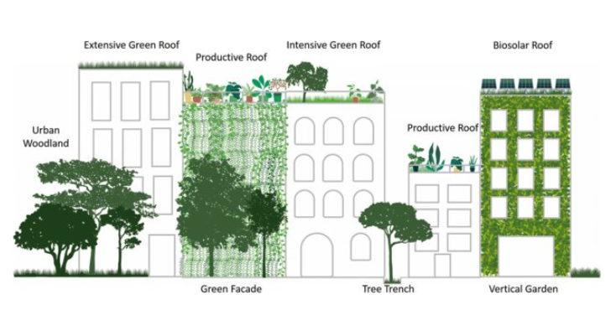
PART ONE
Research background
The role of Vertical greenery
Urban environment and comfort simulation
PART TWO
Experimental building
Energy savings,Green roof application
Simulation
Conclusion
CONTENT
ICARB CONFERENCE PRESENTATION | XIAONAN LI | TIANYU ZHAO | 2023.09.25

Slide 3
ENVIRONMENTAL COMFORT

Slide 4
RESEARCH INTRODUCTION:
Existing building
Unpredictable extreme weather events
In Hungary:
Panel house is specific
VGF and green roof offers greater application possibilities
climate resilience of infrastructure
climate change (CC).
maintaining the stable
construction industry 50%
urban green blue infrastructure.
Users comfort inside and outside of panel house
ICARB CONFERENCE PRESENTATION | XIAONAN LI | TIANYU ZHAO | 2023.09.25
Notes:
In response to global warming, façade greening is known to work. Universality in the application of panel house.The paper focuses on its green intervention on the existing building's envelope, which serves both insulation/protection to the building and living wall of the adjacent public open space. The positive impact of green intervention to existing buildings and the subsequent construction of livable and comfortable adjacent buildings is therefore discussed.
Unpredictable extreme weather events caused by CC are introducing new risks to urban infrastructure.
Infrastructure is one of the primary guarantees for maintaining the stable operation of a city.
Therefore, it is imperative to strengthen the climate resilience of infrastructure to avoid loss of life and property caused by climate risks.

Slide 5
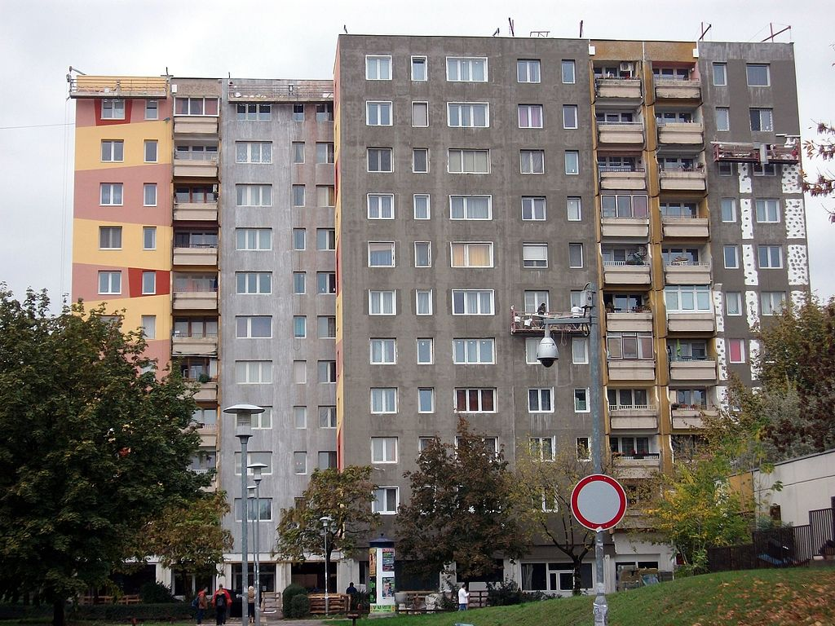
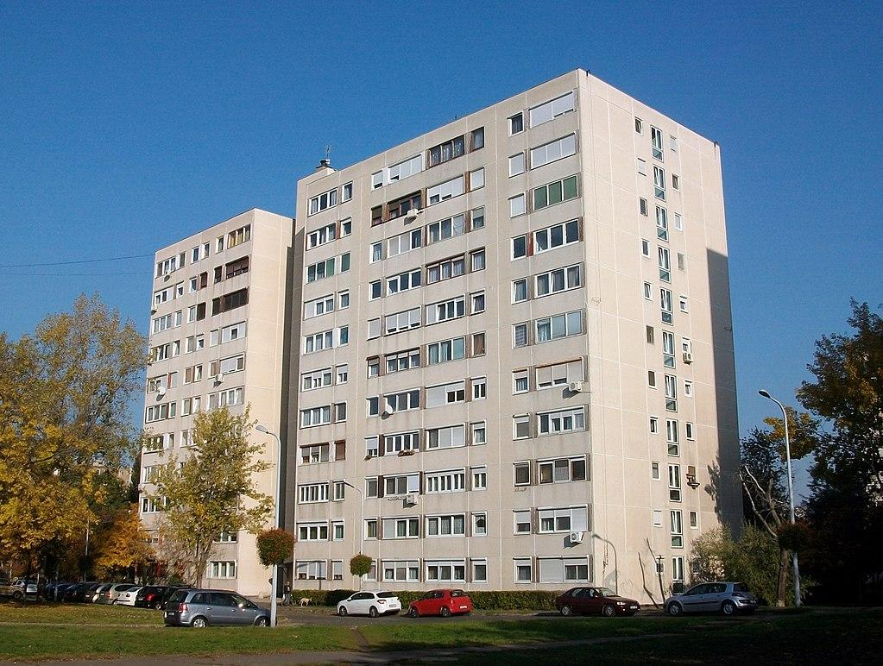
TYPICAL PANEL BUILDING:
ICARB CONFERENCE PRESENTATION | XIAONAN LI | TIANYU ZHAO | 2023.09.25

Slide 6
THE STUDY OF PANEL BUILDING FACADE
the opening ratio can be carried out.
It can also be calculated that the area ratio for the potential of vertical green intervention is (53%-78%).
 | Opening Ratio | Solid Ratio | Type
A | 43% | 57% | Multi-Storey
B | 47% | 53% | Multi-Storey
C | 35% | 65% | Multi-Storey
D | 46% | 54% | Multi-Storey
E | 22% | 78% | High-rise
F | 30% | 70% | High-rise
ICARB CONFERENCE PRESENTATION | XIAONAN LI | TIANYU ZHAO | 2023.09.25

Slide 7
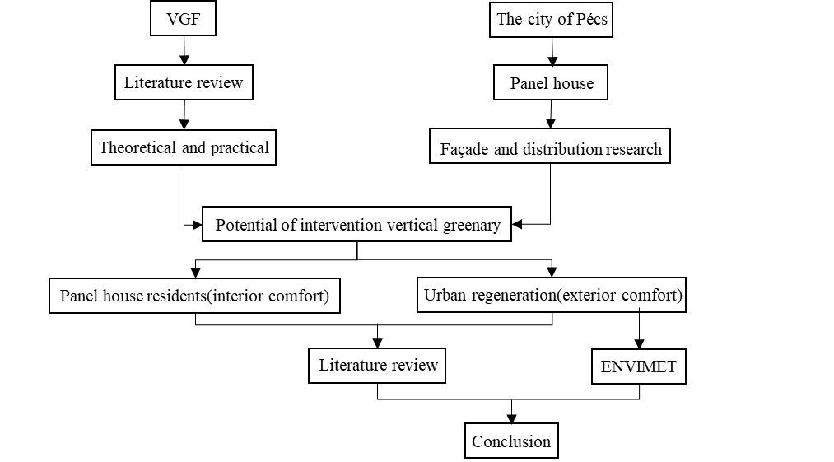
METHOD BIBLIOMETRIC ANALYSIS:
METHOD DIAGRAM
ICARB CONFERENCE PRESENTATION | XIAONAN LI | TIANYU ZHAO | 2023.09.25
Notes:
.1 Summary Legend for Buildings in Pécs. From the energy point of view, a scientifically planned green envelope of buildings can effectively reduce the interior heating or cooling demand, and this effect shows more significantly in mid-to-high latitude cities.

Slide 8
LITERATURE REVIEW
Author(s) | Opinion(s) | Categories
Abdollah Baghaei Daemei, et al. | 1. VGS have considerable effect on reducing nearby temperatures (range between 0.32 °C and 0.75 °C). 2. Temperature increases at farther distances from the VGS. 3. VGS improves microclimatic condition through a thin layer of air among the leaves which increases the temperature near the wall. 4. VGS can create better situations by reducing the temperature in the summer time, increasing temperature in the winter time, and providing more outdoor thermal comfort. | Greenery and thermal comfort
Tobi Eniolu Morakinyo, et al. [25] | 1. Facade greening is beneficial for daytime urban cooling and heat island mitigation. 2. The degree of cooling benefit is mostly dependent on greened facade ratio (GFR). 3. For a high-density Hong Kong, ∼1 °C temperature drop requires 30–50% GFR. | Greenery and thermal comfort
Hayder Alsaad, et al. [26] | 1. The living wall resulted in a slight reduction of outdoor air temperature. 2. Facade greening reduced outdoor MRT (mean radiant temperature) and indoor temperature significantly. 3. Facade greening presents a good potential to combat the effects of heatwaves. | Greenery and thermal comfort
Dongjin Cui, et al. [27] | 1. Centralized façade greening within 3 m from the ground has the greatest thermal benefit at pedestrian level. 2. Façade greening has negligible effect of improving pedestrian air quality. | Greenery and thermal comfort Pavement comfort
ICARB CONFERENCE PRESENTATION | XIAONAN LI | TIANYU ZHAO | 2023.09.25

Slide 9
LITERATURE REVIEW
Negar Mohammadzadeh, et al. [28] | 1. Outdoor thermal comfort is positively associated with outdoor acoustic comfort | Outdoor environmental comfort indicators
Rui Sun, et al. [29] | 1. Ourdoor comfort considerably depends on wind speed and solar radiation. 2. Building form and oriantation can contribute to the optimization of wind speed and solar radiation at the adjacent environment. 3. The optimization design depends on the climate characteristics of the region. | Outdoor environmental comfort indicators
Luigi Schibuola, et al. [30] | 1. To improve pedestrian comfort, the best technology for the building envelope is resulted the introduction of vertical greenery. 2. The benefits also include storm water capture and air quality improvement. | Pavement comfort
Ratih Widiastuti, et al. [31] | 1. Bare wall has higher temperature than green facade. 2. Temperature decrease was more visible from 1.8 °C to 7.8 °C when building facade covered by greater vegetation. | Indoor thermal comfort
Nyuk Hien Wong, et al. [32] | 1. the effect of the vertical greening system on the ambient temperature was found to be dependent on the particular vertical greening system. vgs 2 had almost no effect on the ambient temperature, while the effect of vgs 4 was felt at a distance of 0.60 m. 2. The physical structure, material and size of the panels carrying the substrate and plant species, the type of substrate, composition, depth and moisture content, all influence the various properties of the vertical greening system. | Surface temperature
A. De Bock, et al. [33] | 1. LAI is considered to be a key performance indicator for vertical greening | Outdoor environmental comfort indicators
Timothy Van Renterghem, et al. [34] | 1. Noise reduction is one of the multiple benefits of greening measures for the building envelope | Outdoor environmental comfort indicators
Samar Sheweka, et al. [35] | 1.Problems like the Heat Island Effect, Global Warming, CO2 reduction in cities are all addressed by Green Roofs and Walls. | Outdoor environmental comfort indicators

Slide 10
SIMULATION (ENVI-MET)
simulated based on their distribution and street environment in Pécs.
External air temperature data at pedestrian height and top level height were extracted and presented through the Leonardo component of ENVIMET
after intervening the facades with greenery
this simulation data indirectly shows that the intervening panel house facade with greenery has a positive effect on reducing the surface temperature of the wall, which in turn can have a positive effect on mitigating the indoor temperature, which is also in line with the established findings listed in the table.
ICARB CONFERENCE PRESENTATION | XIAONAN LI | TIANYU ZHAO | 2023.09.25

Slide 11
RESEARCH BACKGROUND: The research frame work
The role of VGF
Potential of Panel house
VGF offers greater application possibilities
Renewal of existing buildings and places has an increase in the intervention of greenery
multi-beneficial to urban enrichment and the building itself
thermal performance
noise and light pollution
Aesthetic
the social value
social safety
easing stress and raising work efficiency
not only an effective way to revitalise the skin
also makes an important contribution to the quality of the adjacent streets and public spaces.
concrete-insulation composite panels
a relatively fixed apartment layout
more efficient in planning and construction
Conclusions & Suggestions & Prospects
Notes:
左边汇总文献，结论这里可以得出，温度是首要重要的，是公认可以衡量舒适度的一个变量。需要模拟的，不否认其它的重要性。右边表格，简化一下，换颜色。

Slide 12
ENERGY SAVINGS

Slide 13
METHOD BIBLIOMETRIC ANALYSIS:
ICARB CONFERENCE PRESENTATION | XIAONAN LI | TIANYU ZHAO | 2023.09.25

Slide 14
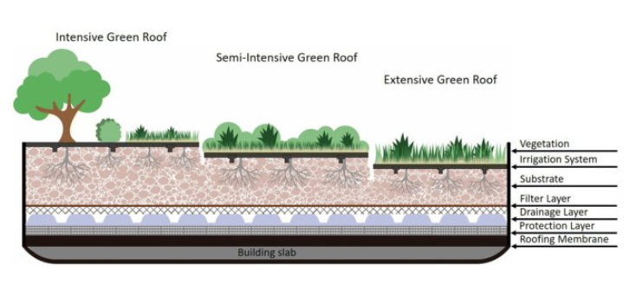
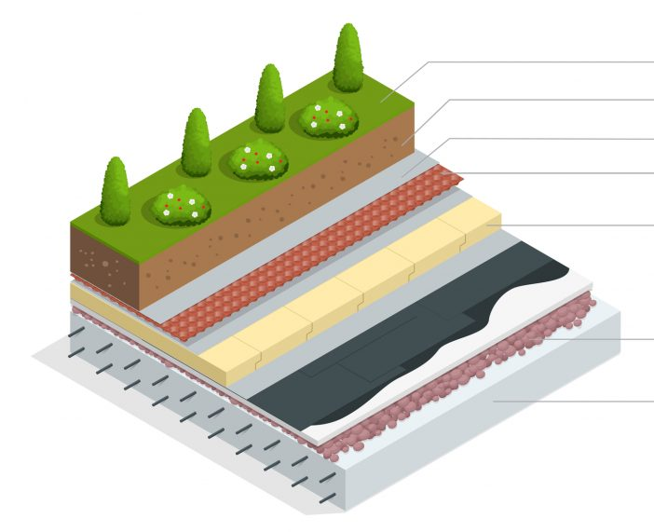
EXPERIMENTAL BUILDING:
 | Thickness [m] | Thermal conductivity (W/mK)
Vegetation: sedum | 0,05 | -
Anti-root sheet | 0,001 | 0,33
EPDM Waterproof sheet | 0,0012 | 0,25
XPS Thermal insulation | 3,5-14,01 | 0,033
Plastic nodular drainage layer | 0,04 | 0,33
Filter sheet | 0,001 | 0,038
Substrcture | 0,10 | 0,435
Location of Pecs and the experimental building
Main characteristics of the layers of the extensive roof construction systems.

Slide 15
SIMULATION (ENERGY PLUS):
The annual building energy demand between two different scenarios
ICARB CONFERENCE PRESENTATION | XIAONAN LI | TIANYU ZHAO | 2023.09.25

Slide 16
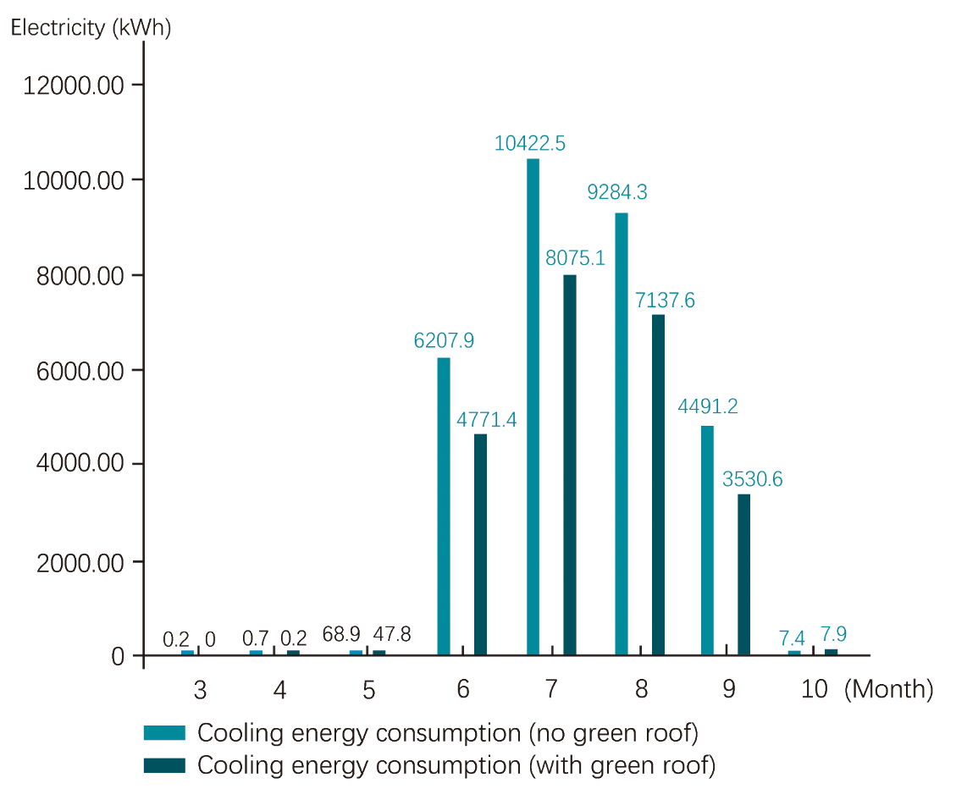
SIMULATION (ENERGY PLUS):
Annual cooling and heating energy consumption of experiment building in two different scenarios
ICARB CONFERENCE PRESENTATION | XIAONAN LI | TIANYU ZHAO | 2023.09.25

Slide 17
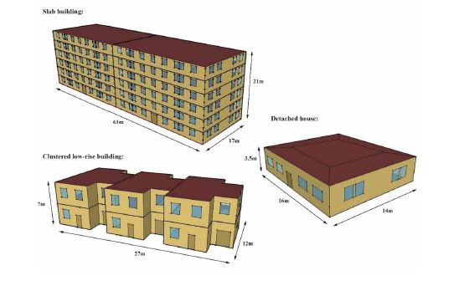
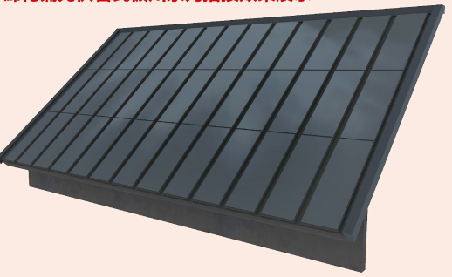
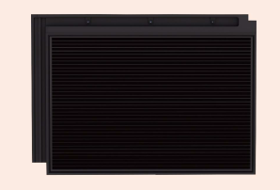
FUTURE PLAN THE IMPACT OF ADDING GREEN ROOFS:
COMPARISON (Norway, Italy, Hungary)
PV panel roof and facade
Three cities, oslo, rome, and szombathely, were selected for comparative simulation analysis in three different climate zones in Europe. The impact of adding green roofs on the microclimate of the surrounding urban environment and on the total energy consumption of the house itself is studied.
Three typical residential building bloack
types: detached,clustered low-rise,
ICARB CONFERENCE PRESENTATION | XIAONAN LI | TIANYU ZHAO | 2023.09.25

Slide 18
CONCLUSION:
Green interventions play a role in building design to increase the amount of urban greenery and effectively reduce building energy consumption. From the comparative measurements, it is clear that it is possible to reduce the overall building energy consumption throughout the year by applying green interventions.
Green interventions: energy savings, reduction of noise, interior thermal regulation, improve the quality of the public space and the home environment.
Future plan : PV-VGF
ICARB CONFERENCE PRESENTATION | XIAONAN LI | TIANYU ZHAO | 2023.09.25

