Slide 1
Remote sensing-based frameworks to quantify city-level carbon fluxes in urban green infrastructures
Oz Kira

Slide 2
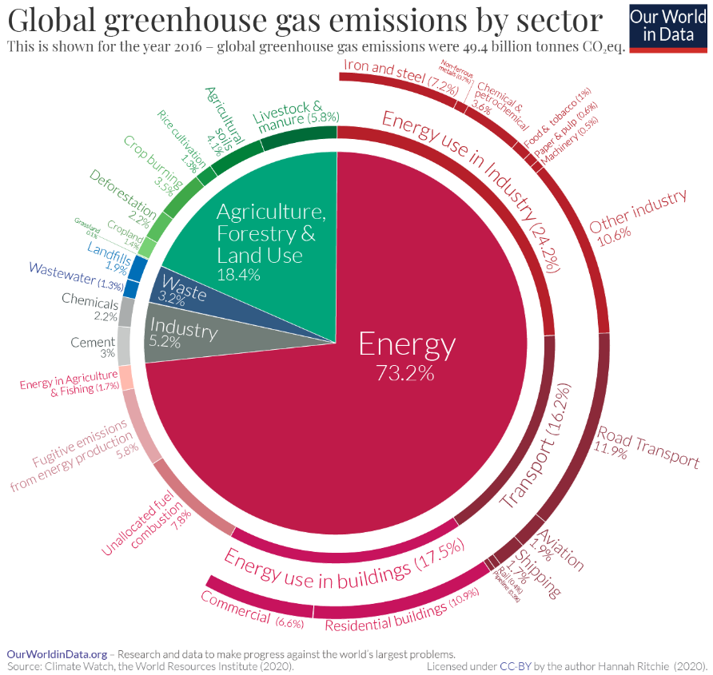
Urban population
Today, 55% of the world’s population lives in urban areas.
This proportion is expected to increase to ~70% till 2050, and ~90% till 2100.
A large portion of anthropogenic CO₂
emissions are related in one way or
another to the urban environment

Slide 3
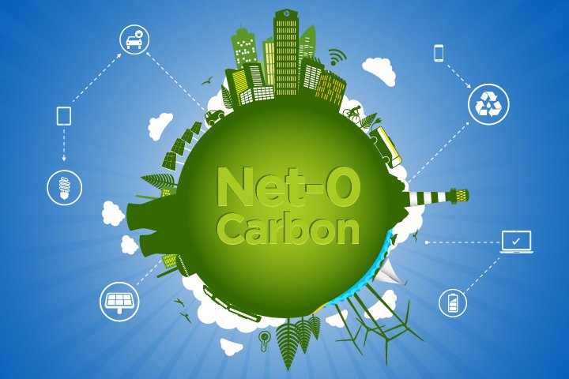
Cities' carbon neutrality
Many cities, such as Barcelona, Boston, London, Melbourne, New York City, and Paris, have pledged to reach carbon neutrality by 2050.
Carbon neutrality is having a balance between emitting and absorbing carbon – net zero emissions
The main way to achieve carbon neutrality is by reducing carbon emissions.
Additionally, carbon capture can assist in reaching carbon neutrality and the main way to date is by plant photosynthesis.
In the city, this is done by Green Infrastructures.

Slide 4
The role of urban green infrastructures
A center for recreational activities.
Reduce air pollution (and sometimes increase…).
Improve thermal comfort.
Sequester CO₂.
What factors affect the quality of green infrastructures?
CO₂
CO₂
CO₂
CO₂
CO₂
CO₂
CO₂
CO₂
Plant type
Greenery management
Topography
Soil type
Climate and weather
Urban planning

Slide 5
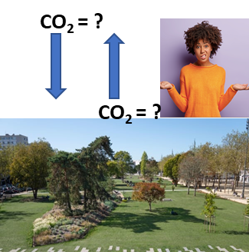
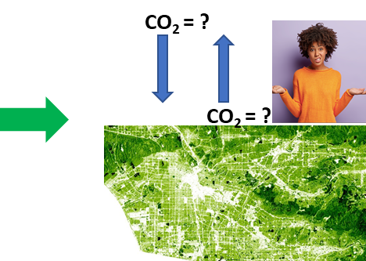
Gap in knowledge
We have limited knowledge of green infrastructures’ role in the urban carbon balance, from the single green element to the whole-city scale.
Moreover, our tools are limited to local measurements, while a solution for whole-city level estimations is needed.
In our research, we offer to:
Develop a remote sensing platform that estimates net CO₂ fluxes of urban vegetation at high spatial resolution and for the whole city.

Slide 6
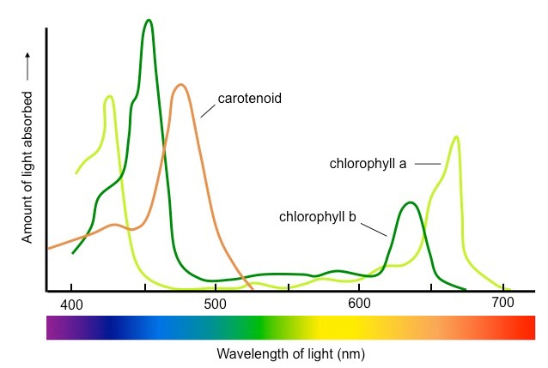
Estimating CO₂ balance from remote – an indirect approach
Carbon sequestration by the plant (GPP - gross primary production)
$$GPP=f(satellite observations, incoming radiation)$$
Carbon emission by plants and soil (R_{eco} - ecosystem respiration)
$$Reco=f\left(temperature\right)$$
Calculating carbon net flux - Net Ecosystem Production (NEP)
$$NEP=GPP−Reco$$

Slide 7
Research aims
Estimate local carbon fluxes of vegetation in various green infrastructures.
Model the dependence of these carbon fluxes on environmental factors using machine learning algorithms and biophysical connections.
Using satellite-based remote sensing, and map the city's green infrastructures.
Combine satellite remote observations and local models to map the city’s carbon fluxes of green infrastructures.
Motivation: Understanding the contribution of green infrastructures to the city's carbon budget is crucial for future sustainable urban planning of low-carbon-emitting cities. There is still much to be detected …

Slide 8
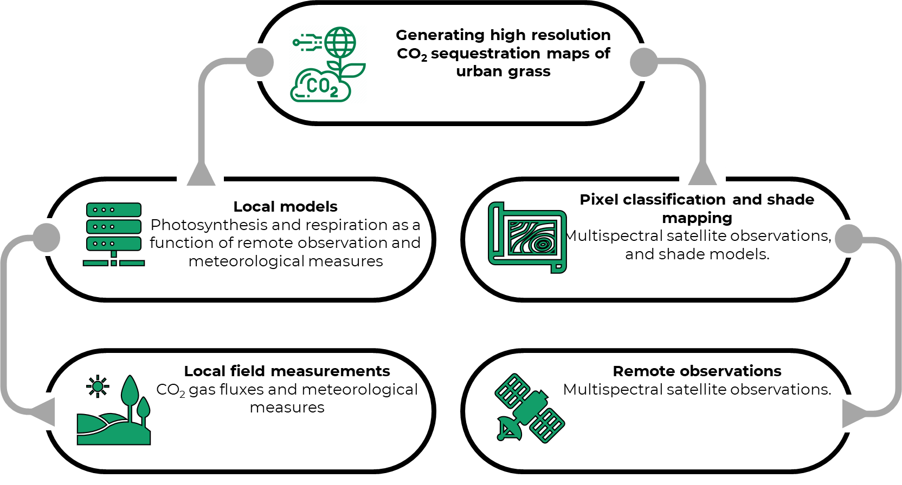
Research outline

Slide 9
Results

Slide 10
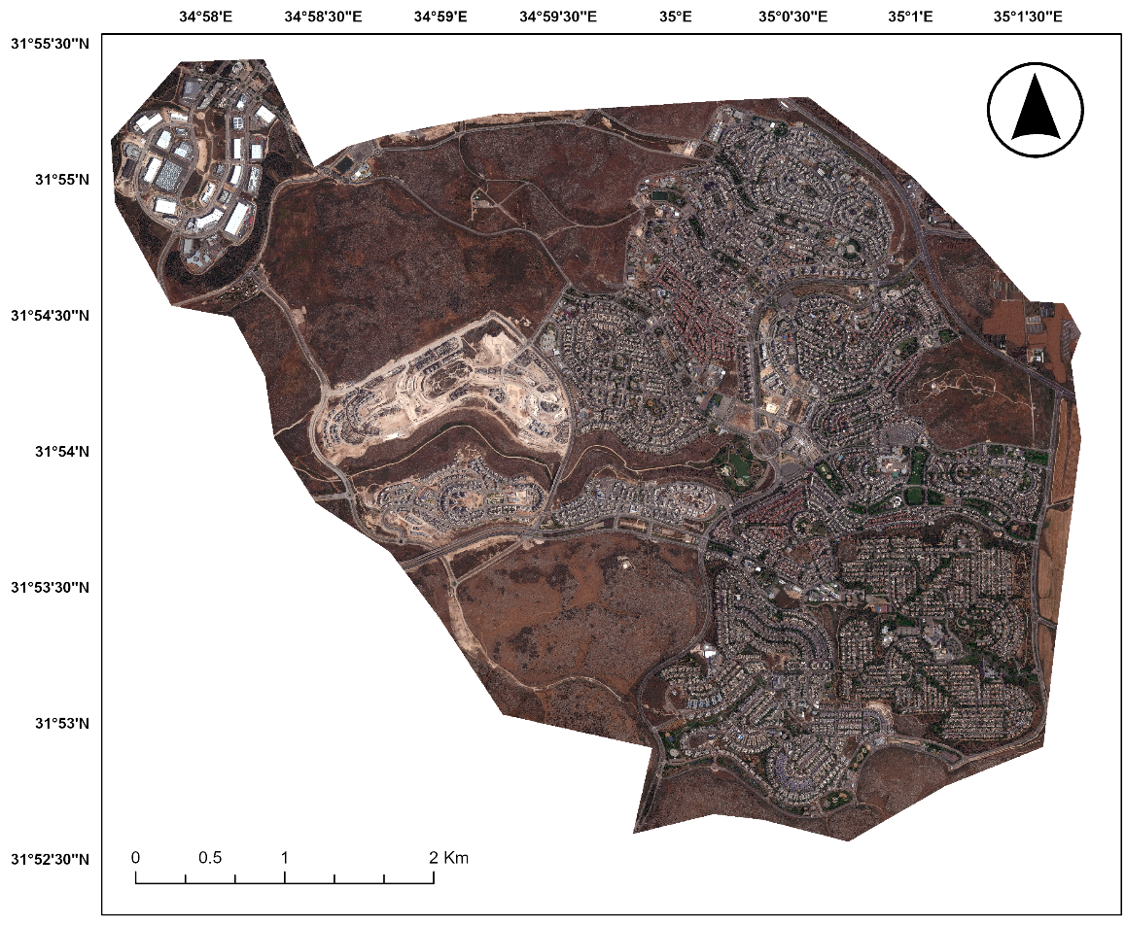
Modi’in

Slide 11
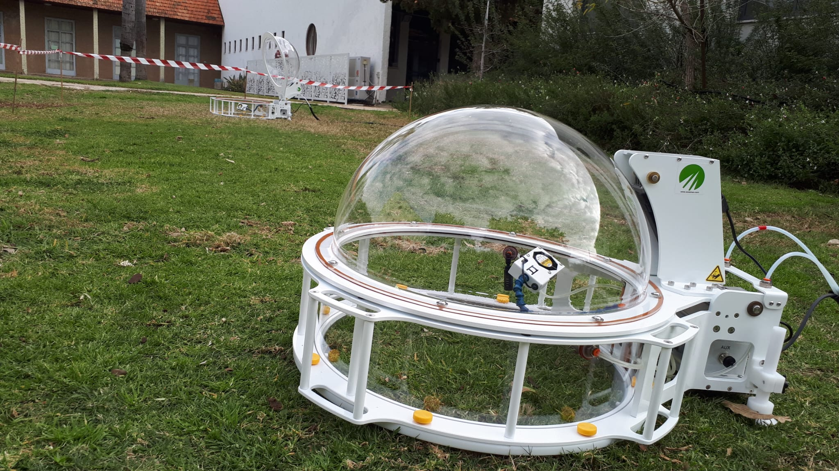
Local measurements
We measured plants locally using an automated chambers
The measurements include CO₂ flux, temperature, and PAR.

Slide 12
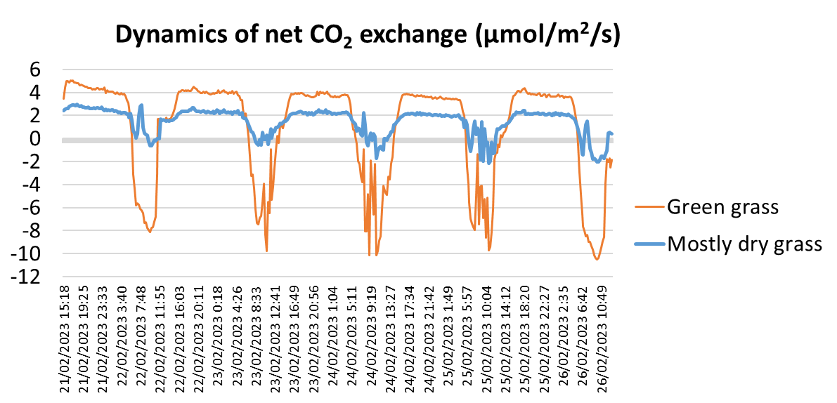
Local measurements

Slide 13
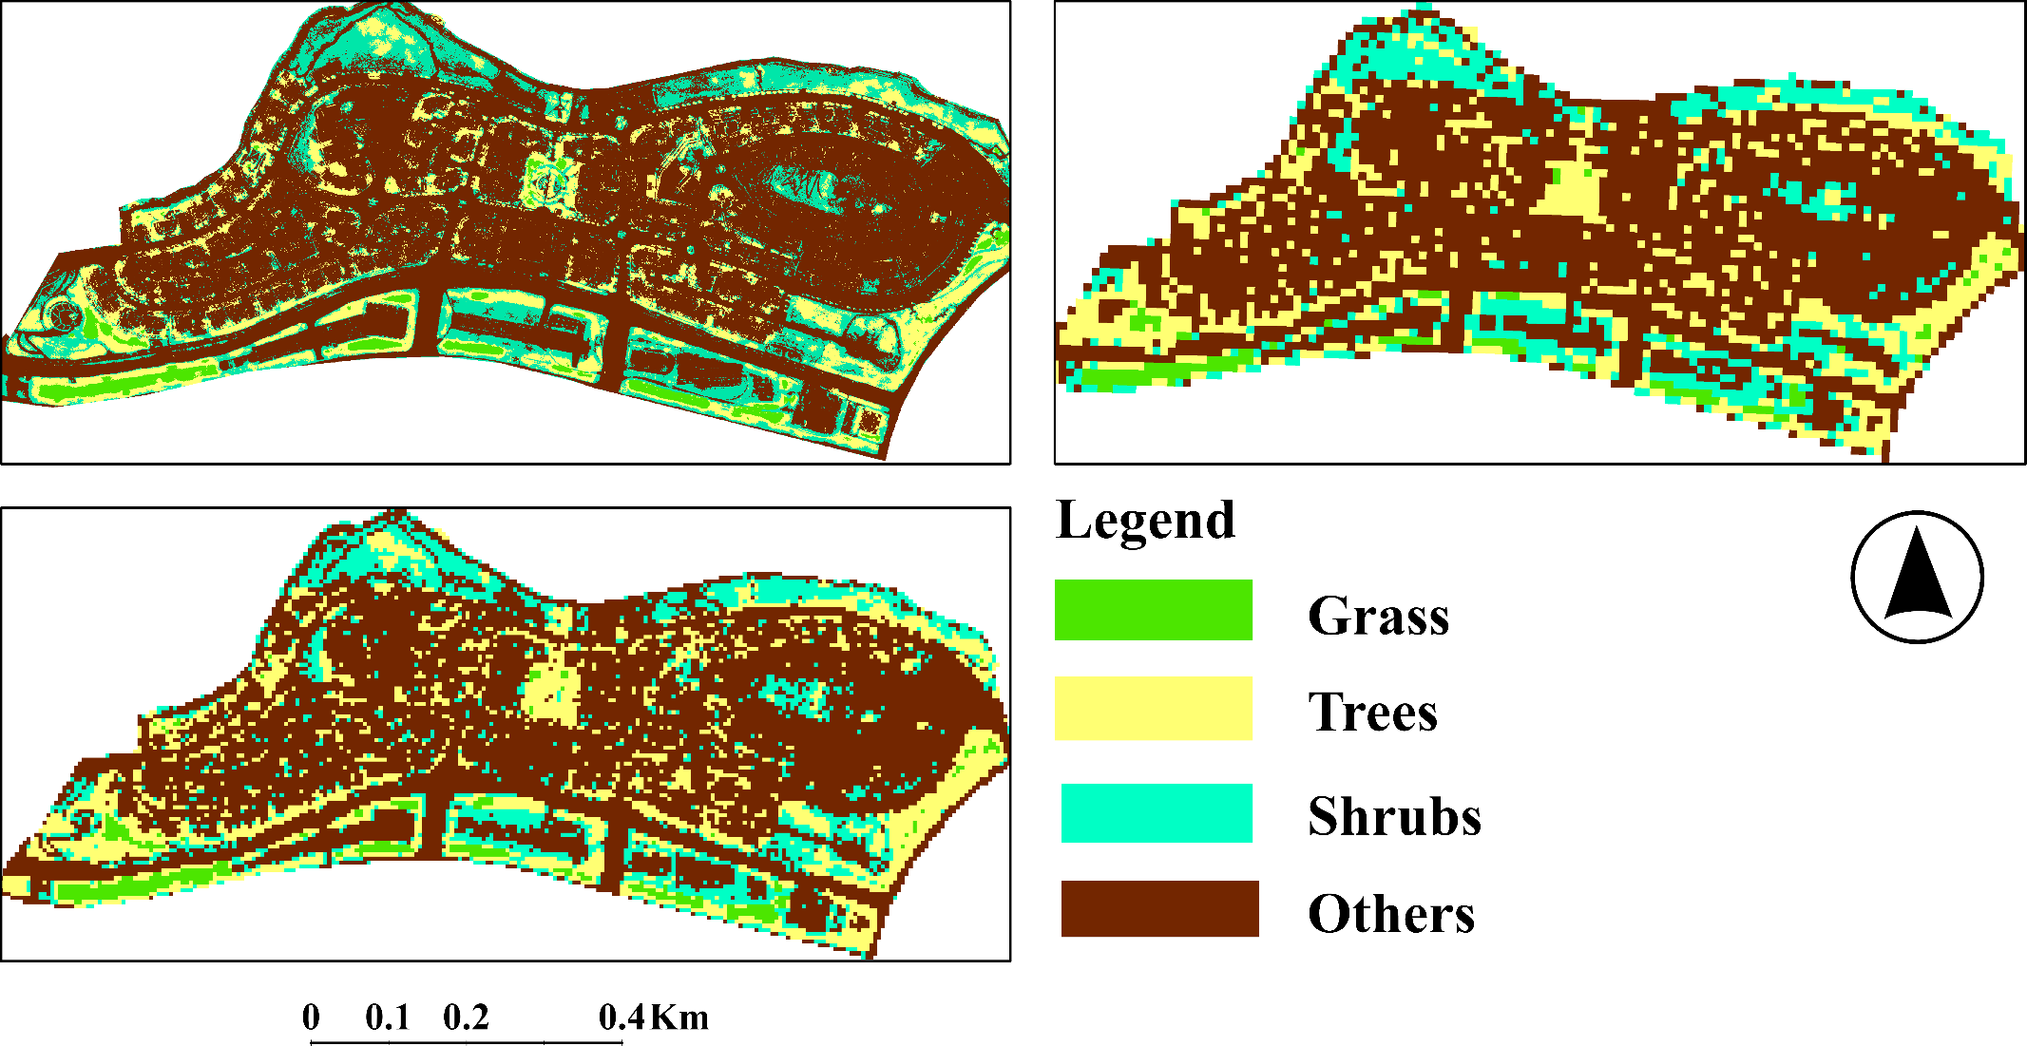
Mapping Modi’in’s green infrastructure
The influence of spatial resolution. Support Vector Machine-based classification
Worldview 2 (0.5 meter)
10 meter
5 meter

Slide 14
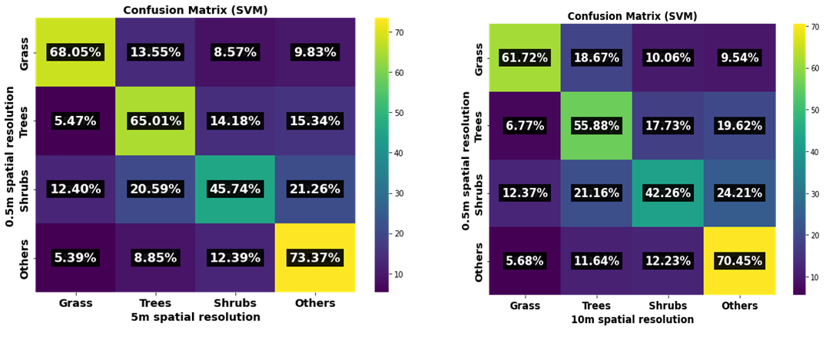
Mapping Modi’in’s green infrastructure
The influence of spatial resolution. Support Vector Machine based classification

Slide 15
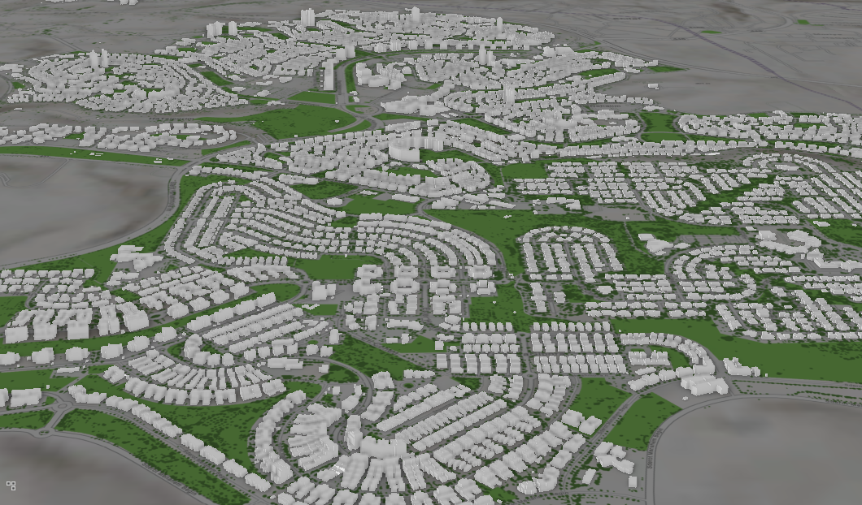
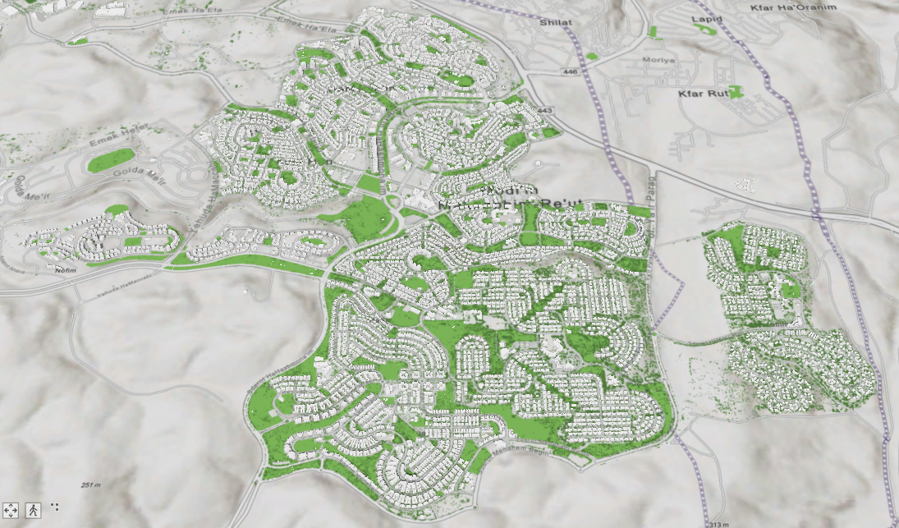
Shade modeling
Shade impacts photosynthesis and respiration. We use GIS-based models to estimate the green infrastructure’s incoming radiation.

Slide 16
Shade modeling

Slide 17
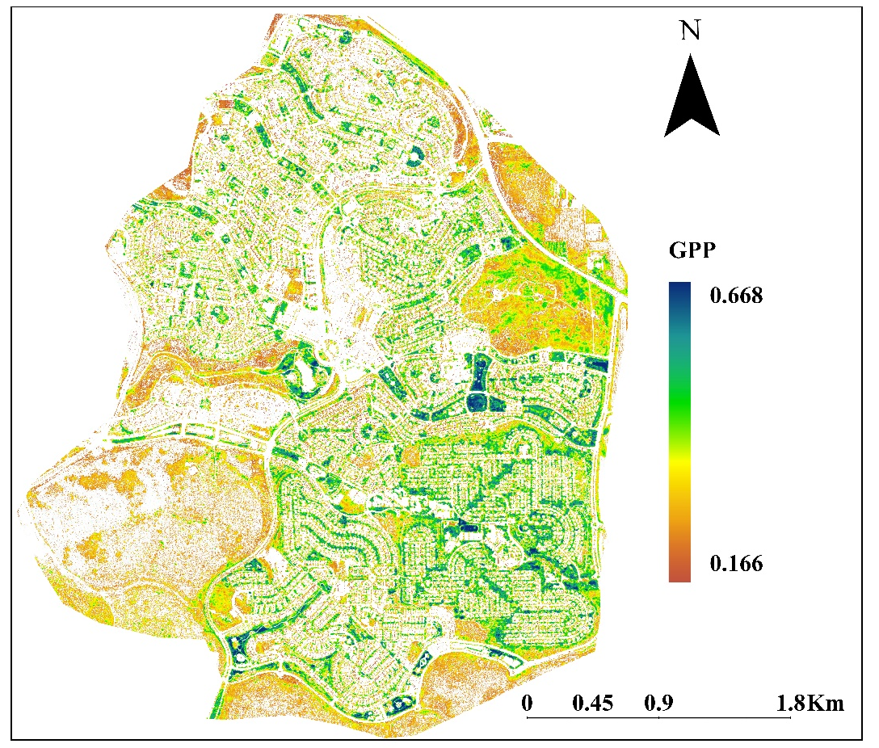
CO₂ flux models based on local measurements
Combining local measurements with reflectance observations to generate NEP models and estimate them from remote
µmol m⁻² s⁻¹
15
0

Slide 18
Future plans
Complete the local measurements and model a year-round CO₂ flux model.
Use LiDAR images to improve vegetation classification and add Tree shade to the shading model.
Examine the feasibility of doing vegetation-specific models.
Add transpiration.

Slide 19
Thank You
Oz Kira: oz.kira@bgu.ac.il

