Slide 1

ICARB 2023
Measuring Net Zero
Variations of input parameters in EPC calculation methodologies across European countries
Mahsa Sayfikar1
Prof David Jenkins1
1 Urban Energy Research Group, Heriot-Watt University

Slide 2
EPCs
ICARB 2023
Measuring Net Zero
What are EPC?
What are EPCs used for?
  Energy performance and Carbon emissions
  Compliance
  Legislations and policies
Notes:
Energy performance certificates, Documents providing information regarding the energy performance and carbon emissions of a building
Mainly designed for compliance purposes,
but used for legislations and policies for example regarding decarbonising the building stock in the EU.

Slide 3
EPBD
ICARB 2023
Measuring Net Zero
The Energy Performance of Buildings Directive
the main EPC legislative tool in EU
  general outlines of regulations
  leaves the calculation details to each country.
  Differences across countries

Slide 4
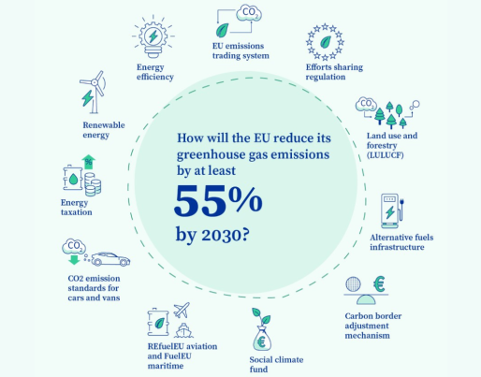
Fit for 55 package
ICARB 2023
Measuring Net Zero
2021
makes all sectors of the EU’s economy fit to meet:
reaching at least 55% net greenhouse gas emissions reduction by 2030
achieving climate neutrality by 2050
Revised EPBD
Notes:
In 2021, the European Commission published a round of proposals for new legislative measures called the “Fit for 55” package. The goal of this package is to reach at least 55% net greenhouse gas emissions reduction by 2030 and to achieve climate neutrality by 2050 .

Slide 5

The revised EPBD
ICARB 2023
Measuring Net Zero
EU–wide minimum energy performance standards for worst performing buildings
  public and non-residential buildings:
  at least level F by 2027, at least level E by 2030
  Residential buildings:
  From G to at least F by 2030, and to at least E by 2033
Source: https://energy.ec.europa.eu/

Slide 6






ICARB 2023
Measuring Net Zero
Harmonization of EPCs across the EU
several H2020 projects
Notes:
This has sparked a lot of interest towards harmonization of EPCs across the EU. As a result, several H2020 projects have been launched adderssing concepts related to the next-generation of EPCs
The Horizon2020-funded project “crossCert” (crossCert, 2023) is aiming to achieve this goal by cross assessing EPCs across ten European countries. One of the initial steps of the project is studying the EPC methodology of each country and comparing certain aspects to highlight the main differences, the results of which will be used in later phases of the project for devising recommendations towards next generation harmonized EPCs.
The main body of information used in this study has been collected using questionnaires answered by each partner country involved in the crossCert project, and complemented by the results of desk research.

Slide 7
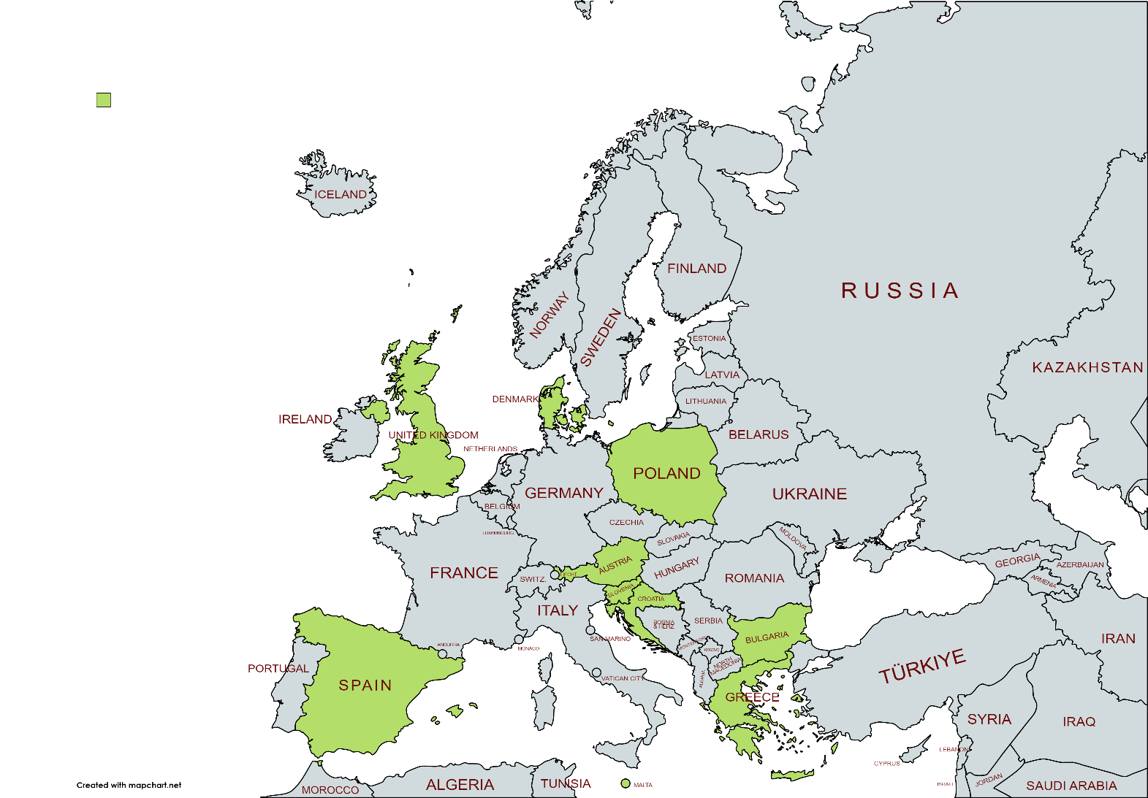
crossCert
ICARB 2023
Measuring Net Zero
cross assessing EPCs across ten European countries
comparing details to highlight the main differences
devising recommendations towards
next generation harmonized EPCs
Notes:
crossCert is aiming to achieve this goal by cross assessing EPCs across ten European countries. One of the initial steps of the project is studying the EPC methodology of each country and comparing certain aspects to highlight the main differences, the results of which will be used in later phases of the project for devising recommendations towards next generation harmonized EPCs.
The main body of information used in this study has been collected using questionnaires answered by each partner country involved in the crossCert project, and complemented by the results of desk research.

Slide 8
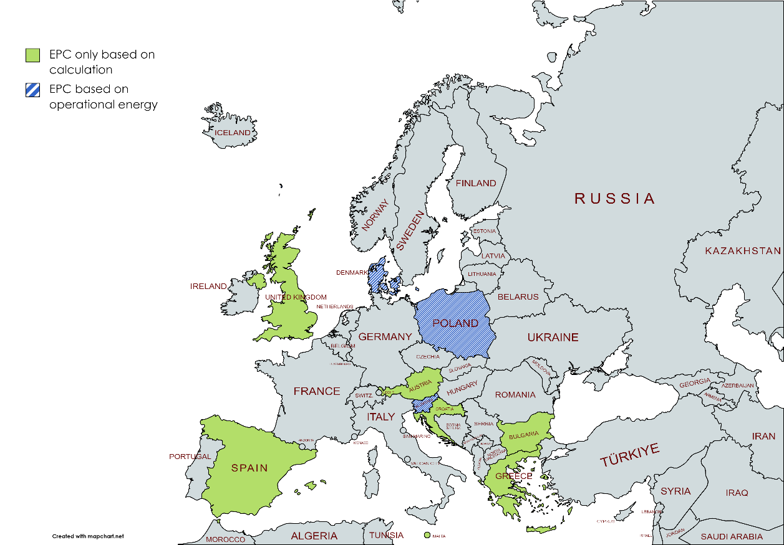
General assessment methodology
EPBD: Asset rating OR operational rating
  Denmark
  Poland
  Slovenia
  Bulgaria, based on calculation, calibration based on the energy consumption data.
Steady state or dynamic
  UK and Spain
Simplified methodology for certain buildings:
  Spain, UK and Austria
Notes:
EPBD allows countries to issue EPCs based on calculations (asset rating) or actual energy consumption (operational rating)
In Denmark, if monthly energy consumption for at least one year is available for a building, the EPC can be issued based on the actual data. In Poland, the minimum required data for issuing an operational EPC is 36 continuous months of utility bills. Slovenia only allows the use of energy consumption data for EPC certification for existing non‑residential buildings. All of the other studied countries only allow EPC certification based on calculations. In Bulgaria, even though the EPC is based on calculation, real energy consumption is used for calibrating the EPC model.
The EPC calculation methodology can be either steady state or dynamic (EPBD, 2018). Most of the studied countries use the steady state approach, with the exception of UK and Spain. In the UK, complex buildings with certain HVAC systems or architectural characteristics (e.g., atrium, demand-controlled ventilation, automatic blind control) should be modelled using government approved dynamic simulation tools such as IES-VE, EnergyPlus, etc. (EEABS, 2022). In Spain, some official software tools including HULC, SG SAVE, CYPE THERM HE PLUS and TEXTON3D TK-CEEP use DOE-2 or EnergyPlus calculation engines which perform dynamic simulation.

Slide 9
Software
ICARB 2023
Measuring Net Zero
Official software or commercial software.
  Malta, Bulgaria and Spain only official tools
  Austria, Greece, Denmark, Poland, Slovenia and the UK (for residential buildings), the official calculation program has been implemented in several commercial tools.
  UK an official software for non-residential building assessments
Malta and UK have different software tools for residential and non-residential buildings.
Notes:
Among crossCert countries, Spain, UK and Austria provide simplified versions of their methodology for certain categories of buildings.
In all of the studied countries, the national calculation methodology has been implemented either in an official software or several commercial ones. Malta, Denmark, and Greece have specific official software which should be used by all assessors for the certificate to be valid. For Greece and Denmark, there is one official calculation program in each country, but it has been implemented in several commercial tools as well, which are also certified for EPC assessments. UK only offers an official software for non-residential building assessments, while the official calculation methodology for residential buildings has been implemented in several approved commercial software. Bulgaria and Spain offer several different official tools, while there is no official software in Austria, Poland and Slovenia and only commercial tools are used in these countries.
Malta and UK have different software tools for residential and non-residential buildings.

Slide 10

Energy categories
ICARB 2023
Measuring Net Zero
Jessica Few, Despina Manouseli, Eoghan McKenna, Martin Pullinger, Ellen Zapata-Webborn, Simon Elam, David Shipworth, Tadj Oreszczyn,
The over-prediction of energy use by EPCs in Great Britain: A comparison of EPC-modelled and metered primary energy use intensity,
Energy and Buildings,
Volume 288,
2023,

Slide 11

Building envelope parameters
ICARB 2023
Measuring Net Zero
U-values:
Most countries, a database of commonly used building fabric material implemented in the software.
  Exceptions: Bulgaria and Malta (residential buildings).
Some countries allow inferring values based on the building sector, climate zone and the building regulations that were in use at the time of construction.
  Spain and UK
Infiltration rates
Pressure test
Some provide default values based on building characteristics.
  For all buildings in Greece and Spain and the UK, existing residential buildings in Malta.
Notes:
Exceptions: the Bulgaria and the Malta (residential buildings), for which there is no database implemented in the national software and assessors must calculate U-values separately using information from other official resources and enter the results into the software.

Slide 12
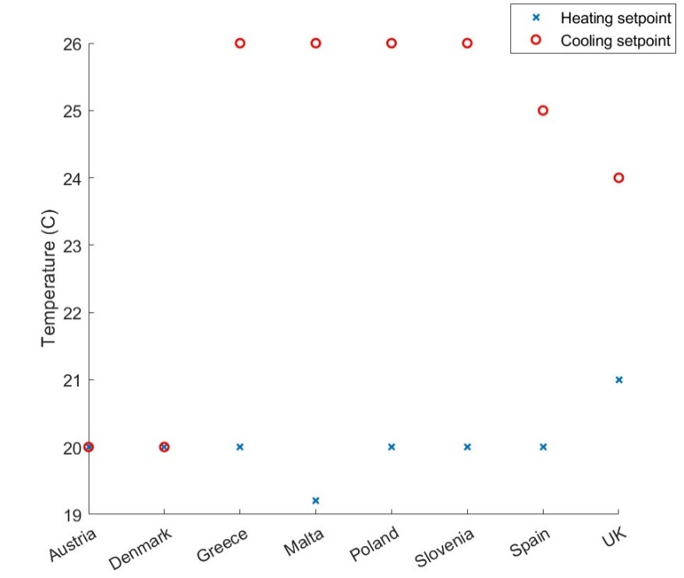
Temperature setpoints
ICARB 2023
Measuring Net Zero
Default temperature setpoints
  Exception: Bulgaria
  different across different countries
  due to the country specific norms of temperature settings in buildings.
Default temperature setpoints are generally defined in a static way;
  Exceptions: UK and Spain
Temperature setpoints for residential buildings

Slide 13
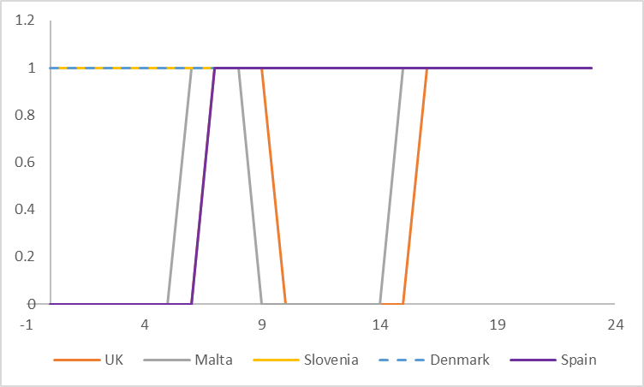
Profiles
ICARB 2023
Measuring Net Zero
occupancy, lighting, and electrical appliances, HVAC operation times
Most countries: pre-defined profiles
Different across countries
Exceptions:
Bulgaria and Poland: up to the assessor
Slovenia provides default schedules, allows the assessor to override these
Spain: actual schedules for HVAC operation allowed, only for non-residential buildings
HVAC operation profiles for residential buildings
Notes:
To standardize and facilitate better comparison between buildings.
Assessors must use these profiles in order for the EPC to be valid.

Slide 14
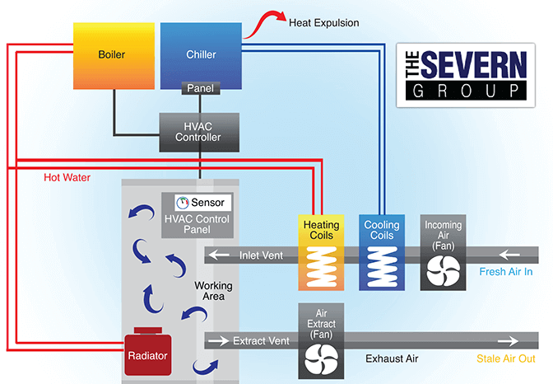
HVAC systems
ICARB 2023
Measuring Net Zero
Most countries: the assessor collects information (COP, EER, SEER)
Default values: Austria, Denmark, Greece, Malta (only for non-residential buildings), Poland, Slovenia, and the UK
Exception: Bulgaria, if manufacturer data isn’t available, the assessor should measure device performance on-site.
Spain only allows using default parameters in cases where the installed HVAC system doesn’t meet the necessary setpoint temperatures, for example in older buildings with no installed heating systems.
Source: https://www.theseverngroup.com/hvac-system/
Notes:
Default values: Austria, Denmark, Greece, Malta (only for non-residential buildings), Poland, Slovenia, and the UK in the software or in a separate database which can be used in the calculations instead of the actual values. These values are selected based on system type, range of system power, or device manufacturing date.
Exception: Bulgaria, if manufacturer data isn’t available, the assessor should use instruments to measure device performance on-site.
Spain only allows using default parameters in cases where the installed HVAC system doesn’t meet the necessary setpoint temperatures, for example in older buildings with no installed heating systems.

Slide 15
Conclusion
ICARB 2023
Measuring Net Zero
Methodologies vary in terms of the level of standardization
Given the comparative purpose of an EPC, most partner countries’ approaches are closer to the standardized end of the spectrum with the exception of Bulgaria, and Poland which uses a highly tailored approach.
  It is not necessarily the case that a country using a high degree of standardisation for one parameter will adopt the same approach for other parameters.
Notes:
The EPC methodologies in EU vary across different countries. With increased attention towards EU-level convergence of these methods, it is vital to understand the main similarities and differences between methodologies in order to create harmonized methodologies for next generation EPCs.

Slide 16
Thank you for your attention!
ICARB 2023
Measuring Net Zero

