Slide 1
ICARB 2023
Measuring Net Zero
Carbon accounting in the context of
multi-criteria assessment for SLES: challenges and opportunities
Presented by Christina Francis^{1, b}
^{b} Current address: School of the Built Environment and Architecture, London South Bank University, 103 Borough Road, London SE1 0AA, UK, francc23@lsbu.ac.uk
Co-Authors: Bjarnhedinn Gudlaugsson^{1, a}, David Ingram¹, Camilla Thomson¹
¹ Institute of Energy Systems, School of Engineering, The University of Edinburgh, Colin Maclaurin Road, Edinburgh EH9 3DW, UK, David.Ingram@ed.ac.uk, C.Thomson@ed.ac.uk
ª Current address: Department of Engineering, Reykjavik University, Menntavegur 1, 102 Reykjavik, Iceland, bjarnhedinng@ru.is

Slide 2
Carbon accounting in the context of multi-criteria assessment (MCA) for SLES
MCA tool for Smart Local Energy Systems (SLES) can be used to evaluate the carbon emissions; carbon reduction potential of smart RE technology; and provide insights into the socioeconomic and environmental benefits and impacts. However, there are challenges to apply such a complex tool.
We will discuss:
How we can mitigate this challenges
Opportunities to employ SLES MCA tool to assess project feasibility
Notes:
National and local governments use simplified carbon accounting methods to calculate accumulated carbon emissions, however, they may neglect broader socioeconomic impacts and benefits.
Transitioning the global energy systems away from burning of fossil fuel for energy generation towards greener and low-carbon energy systems is a critical element in global efforts to combat the climate crisis and mitigating the overall negative future impact caused by climate change (Blanco et al. 2020; Morrissey et al. 2020; Ford et al. 2021).
Carbon reduction is thus one of the core objectives of the energy transition strategy centred around the phase-out of fossil-fuel-driven energy technologies with renewable and low-carbon energy technologies (Clarke et al. 2017; Bottero et al. 2021; Ahmed et al. 2023).

Slide 3
Carbon accounting in the context of multi-criteria assessment (MCA) for SLES
Development of the MCA tool for SLES
Integration of carbon accounting and LCA fundamentals to track climate change impacts and,
multiple other criteria in a simplified and user-friendly modelling framework.
Notes:
The application of a broad multi-criteria assessment (MCA) to complex SLESs is, however, a challenge. This paper provides insights into the development of such an MCA-SLES tool, describing how it embraces and integrates carbon accounting and LCA fundamentals to track climate change impacts alongside multiple other criteria in a simplified and user-friendly modelling framework.

Slide 4
Background
Carbon Accounting - recognition, evaluation, and monitoring of GHG emissions on all levels of the value chain and the effects of these emissions on the carbon cycle of ecosystems.
Limitations: underestimating GHG emissions.
Life-Cycle Analysis (LCA) –
input-output analysis (a top-down technique);
process-based (PB) (a bottom-up approach); and
hybrid LCA (Kennelly et al., 2019).
For all methods, the system boundary should identify how the allocation is managed for multiple co-products i.e. physical or economic or system expansion.
Limitations: double counting, uncertainties in the assumptions on the performance of future technologies; spatial differences depending on data variability.
Notes:
National and local governments use simplified carbon accounting methods to calculate accumulated carbon emissions, however, they may neglect broader socioeconomic impacts and benefits.
Transitioning the global energy systems away from burning of fossil fuel for energy generation towards greener and low-carbon energy systems is a critical element in global efforts to combat the climate crisis and mitigating the overall negative future impact caused by climate change (Blanco et al. 2020; Morrissey et al. 2020; Ford et al. 2021).
Carbon reduction is thus one of the core objectives of the energy transition strategy centred around the phase-out of fossil-fuel-driven energy technologies with renewable and low-carbon energy technologies (Clarke et al. 2017; Bottero et al. 2021; Ahmed et al. 2023).

Slide 5
MCA tool for smart local energy system (SLES)
A simplified energy system assessment framework for use by local policymakers, project teams, and planners designed by the EnergyREV Consortium
A general calculation of a range of variables to be measured (system characteristics and impacts; socioeconomic and environmental impacts).
A qualitative self-assessment across 6 high-level themes:
technical performance,
governance,
data management,
people and living,
business economic and
environment
Notes:
by the project team focused on setting targets of their goals for each of the variables, which allows for progress analysis
Transitioning the global energy systems away from burning of fossil fuel for energy generation towards greener and low-carbon energy systems is a critical element in global efforts to combat the climate crisis and mitigating the overall negative future impact caused by climate change (Blanco et al. 2020; Morrissey et al. 2020; Ford et al. 2021).
Carbon reduction is thus one of the core objectives of the energy transition strategy centred around the phase-out of fossil-fuel-driven energy technologies with renewable and low-carbon energy technologies (Clarke et al. 2017; Bottero et al. 2021; Ahmed et al. 2023).

Slide 8
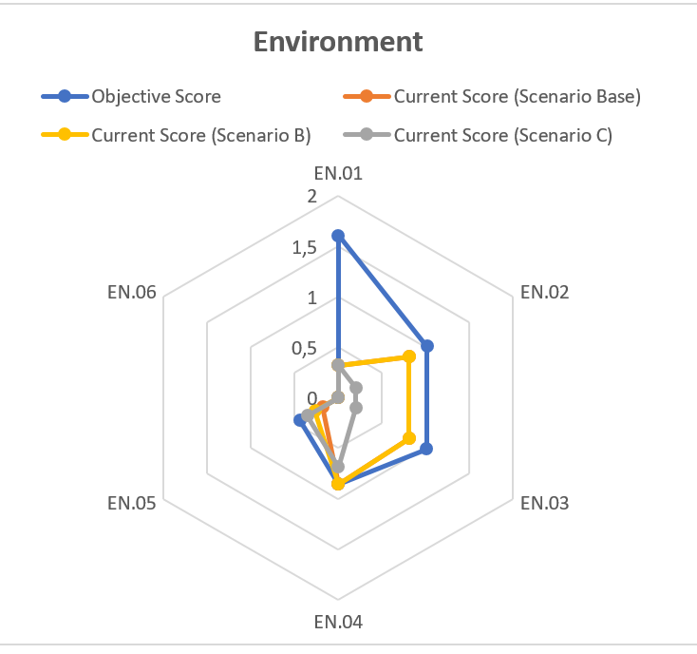
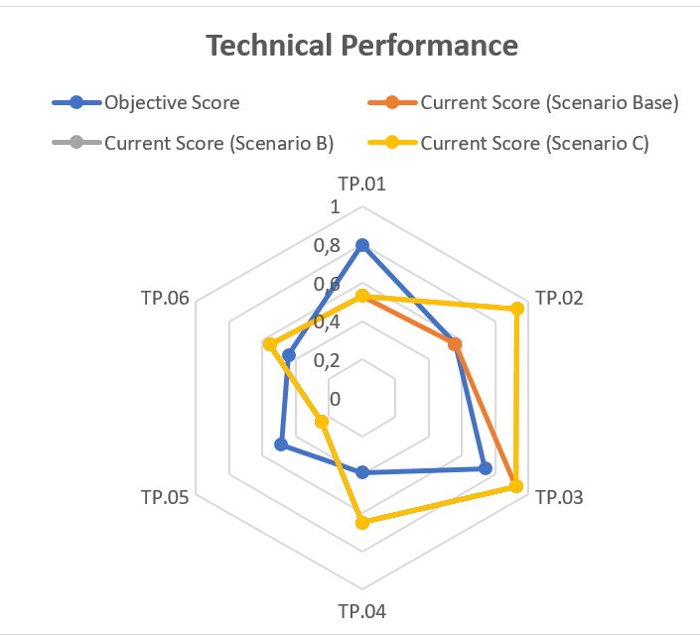
Self-Assessment Section
The input data provided to assess the multiple criteria for the SLES monitors the progress made towards the objectives set by the project team and primary stakeholders. E.g.:
Notes:
by the project team focused on setting targets of their goals for each of the variables, which allows for progress analysis
Transitioning the global energy systems away from burning of fossil fuel for energy generation towards greener and low-carbon energy systems is a critical element in global efforts to combat the climate crisis and mitigating the overall negative future impact caused by climate change (Blanco et al. 2020; Morrissey et al. 2020; Ford et al. 2021).
Carbon reduction is thus one of the core objectives of the energy transition strategy centred around the phase-out of fossil-fuel-driven energy technologies with renewable and low-carbon energy technologies (Clarke et al. 2017; Bottero et al. 2021; Ahmed et al. 2023).

Slide 9
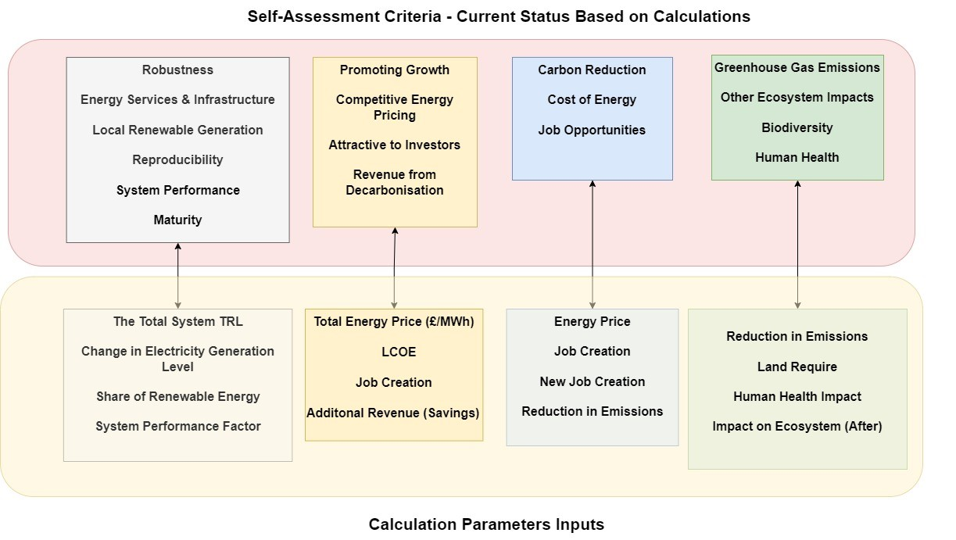
Notes:
The Calculator includes 93 parameters across 4 sections, which may require inputs from the practitioners of the MCA-SLES tool to conduct the assessment calculations
The calculation parameters (Figure 2) are divided as follows: Section 1 – System Characteristics – focuses on the technical aspects of the energy system and gives insight into share of renewables, Technology Readiness Level, etc.; Section 2 – System Impact – focuses on the economic impact such as cost of energy, level of renewable and fossil fuels in the system, and potential revenue; Section 3 – Socioeconomic – focuses on the social impact such job creation and energy price; Section 4 – Environmental Impact – focuses on understanding the environmental impact of the system change.
The Tool incorporates data from LCA databases and analyses for values on land usage, emissions, human health impact and ecosystem impact for different energy generation technologies to enable the whole-system analysis to capture the holistic environmental impacts of the energy system transition and development.
The Self-Assessment includes 37 parameters - input by the practitioners relating to the project aspirations and objectives
MCA-SLES tool parameters, and relationship between the Calculator and Self-Assessment Sections
MCA-SLES tool parameters, and relationship between the Calculator and Self-Assessment Sections
This also gives some examples of required inputs; for example, Technology Readiness Level of the technologies in the current and proposed system, job creation in relation to system changes, and land requirements for each energy technology in the current and proposed systems.

Slide 10
Challenges in developing MCA tool for smart local energy system (SLES)
Estimates the carbon footprint of the whole SLES from climate change impacts per kWh for each type of energy generation
Limitations: overestimating GHG emissions.
Environmental impacts are assumed to be constant per unit of energy produced,
Renewable energy
Fossil fuel generation
Environmental impacts associated with manufacture and installation
Environmental impacts associated with fuel combustion for energy production
overestimating GHG emissions in areas higher RE resource

Slide 11
MCA –SLES Tool
Estimates the carbon footprint of the whole SLES from climate change impacts per kWh for each type of energy generation
FUTURE MCA TOOL
Renewable energy
Estimate the impacts of non-thermal renewable generation based on installed capacity, rather than energy production
Environmental impacts associated with manufacture and installation
Allow estimation of the benefits or penalties of higher/lower RE resource
overestimating GHG emissions in areas higher RE resource

Slide 12
MCA tool for smart local energy system (SLES)
We tested this, by estimating the LCA of different RE technologies and fossil fuel-based technologies from a leading Life Cycle inventory dataset and the ReCiPe impact assessment method (Goedkoop et al., 2009).
Notes:
In order to test this, we estimated the LCA of different renewable energy technologies and fossil fuel-based technologies from a leading Life Cycle inventory dataset and the ReCiPe impact assessment method (Goedkoop et al., 2009).

Slide 13
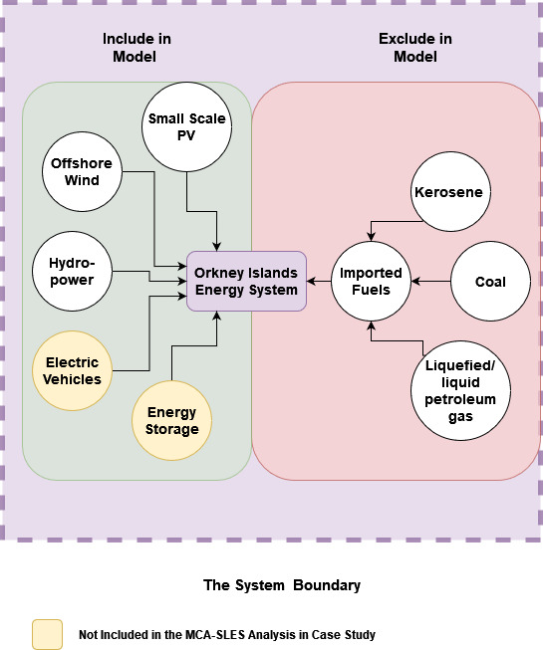
Case Study – Energy Technology and Generation Capacities (AquaTerra Ltd & Community Energy Scotland, 2022)
 | Local Energy Technologies | Generation Values (MW)
 | Large scale Offshore wind power | 44.7
 | Hydropower | 30
 | Photovoltaic | 1.3
Case A | Total Energy Generation | 76
 | Large scale Offshore wind power (accepted/planning) | 47.3
Case B | Total Energy Generation | 123.3
 | Large Scale Offshore Wind power (in development) | 183.5
Case C | Total Energy Generation | 306.8
Notes:
Then we mapped out the energy system and energy technology portfolio of a small local energy system (in this case the Orkney Islands), and generated three development scenarios based on published reports
The LCA data was used to calculate the carbon emission and footprint of the current technologies in the system and added installed capacities.

Slide 14
Case Study – Energy Technology and Generation Capacities (AquaTerra Ltd & Community Energy Scotland, 2022)
Case | Local Energy Technologies | Generation Values (MW) | Carbon footprint kgCO2eq/kWh
Case A | Large Scale Offshore wind power | 44.7 | 0.012
 | Hydropower | 30
 | Photovoltaic | 1.3
Case A | Total Energy Generation | 76 | 0.012
Case B | Large scale Offshore wind power (accepted/planning) | 47.3 | 0.013
Case B | Total Energy Generation | 123.3 | 0.013
Case C | Large Scale Offshore Wind power (in development) | 183.5 | 0.015
Case C | Total Energy Generation | 306.8 | 0.015
Notes:
Then we mapped out the energy system and energy technology portfolio of a small local energy system (in this case the Orkney Islands), and generated three development scenarios based on published reports
The LCA data was used to calculate the carbon emission and footprint of the current technologies in the system and added installed capacities.
Therefore, highlighting the overall impact of change in generation mix of the Orkney Islands, this increase is due to the higher share of the offshore wind added to the system, which has a higher carbon footprint then existing hydropower. The MCA-SLES tool is capable of evaluating the impacts of some demand and infrastructure technologies, such as electric vehicles and energy storage, but does not strictly consider the whole system as the impacts of the network infrastructure and any imported fuels are excluded, as illustrated in Figure 4.

Slide 15
MCA tool for smart local energy system (SLES)
Can conduct environmental impact (carbon footprint),
Highly simplified result
Facilitates rapid use of a holistic MCA of SLES - intended to minimise the time required for extensive data collection and defines and frames an LCA modelling analysis.
Allows consistency and comparison across assessments in an user friendly Excel-based tool
Limitations:
Based on the uncertainty of the source data
Further work is required to refine the carbon accounting process to improve reliability and robustness and reduce any burden on the end-user.
Notes:
This shows that the MCA-SLES Tool is has the ability to carry out environmental impact (carbon footprint), however the application is a result of the highly simplified nature of the analysis. This compromise was made to facilitate rapid use of the MCA-SLES tool for a holistic multi-criteria assessment. Furthermore, the results have a significant uncertainty due to the uncertainty of the source data. Further work is required to refine the carbon accounting process to improve the reliability and robustness of the results without creating an unacceptable burden for the end-user.

Slide 16
lntegration of Carbon Accounting and LCA Methods to MCA-SLES Tool
Integrates the LCA, carbon accounting, and system thinking fundamentals into the tool’s analytical process
Provides the practitioners with predefined system boundaries and framing of the analysis.
Practitioners and policy makers found the tool easy to use due to the Excel based tool
Tool accounts for system-wide impacts
Moreso the calculation parameters System Characteristics; System Impact; Socioeconomic; Environmental Impact
Incorporates LCA databases and analyses for values on land usage, emissions, human health impact and ecosystem impact for different energy generation technologies to enable the whole-system analysis
Notes:
define the system boundaries and frame the analysis (Grafakos et al., 2017, Blanco et al. 2020). These provide the scope of the analysis and highlight what input data are required, identifying what components or factors of the system are included and excluded (Blanco et al. 2020).
The MCA-SLES tool’s analytical framing is structured around energy system modelling and assessment, and the system boundary is structured around the energy system and key energy vectors (energy resources, generation technologies, energy demand and generation).
The MCA-SLES Tool users are given analytical framing and boundaries with creative freedom to adjust the energy system that being analysed i.e., a practitioner is asked in the System Characteristics section of the Calculator (see Figure 1) to define what energy technologies are in the system currently as well as those which are planned to be added to the system. In addition, the user is also asked to provide technical information on each technology, and current and planned generation capacity (following new technology integration), which allows the MCA-SLES tool to calculate any change in impacts associated with the change in generation capacity and energy technologies portfolio mix due to the SLES development.
The MCA-SLES tool is designed to account for multi-dimensional aspects of an energy system in 4 separate sections. The calculation parameters (Figure 2) are divided as follows: Section 1 – System Characteristics – focuses on the technical aspects of the energy system and gives insight into share of renewables, Technology Readiness Level, etc.; Section 2 – System Impact – focuses on the economic impact such as cost of energy, level of renewable and fossil fuels in the system, and potential revenue; Section 3 – Socioeconomic – focuses on the social impact such job creation and energy price; Section 4 – Environmental Impact – focuses on understanding the environmental impact of the system change.
The Tool incorporates data from LCA databases and analyses for values on land usage, emissions, human health impact and ecosystem impact for different energy generation technologies to enable the whole-system analysis to capture the holistic environmental impacts of the energy system transition and development.

Slide 17
Conclusion & Further Work
Quickly provide digestible information on the potential impacts, co-benefits and barriers concerning a specific energy policy strategy at a specific local level.
Integrates LCA and carbon accounting methodological frameworks to conduct emissions and environmental impacts assessment
Incorporates multi-criteria and system thinking approaches to accounting for the dynamic and interconnective nature of an energy system for wider system analysis
Mitigates the potential limitations and challenges encountered due to system boundary issues and double counting input and output values
Provides practitioners with a structured analytical framework focused on the energy system with some predefined input parameters.
Further work is required to test in real communities, real data and work with a range of possible practitioners
Notes:
The ability for local communities, policymakers, and energy strategy designers to carry out energy system analysis may be increasingly important to the success of local energy system transitioning towards greener and low carbon energy system. The described SLES MCA-SLES tool empowers local community policy making and design by providing visual illustrations and easily digestible information on the potential impacts, co-benefits and barriers concerning a specific energy policy strategy at a specific local level. The MCA-SLES tool incorporates LCA and carbon accounting methodological frameworks to conduct emissions and environmental impacts assessment while also incorporating multi-criteria and system thinking approaches to accounting for the dynamic and interconnective nature of an energy system to being able to carry out the wider system analysis of an SLES project. The MCA-SLES tool accounts for, and mitigates the potential limitations and challenges resulting from issues pertaining to the system boundary and double counting challenges of input and output values by providing practitioners with a structured analytical framework focused on the energy system with some predefined input parameters.
Regarding the collection of geographical location and local data availability the MCA-MCA-SLES tool requires local practitioners using the MCA-SLES tool to engage with the local stakeholders to acquire local data is possible. Where that is not possible the MCA-SLES tool provides a generic data input sheet providing information attained from literature, LCA databases and simulations. Overall, the MCA-SLES tool developed by the team at IES at the University of Edinburgh can provide practitioners with an excel based analytical tool that can be used carry out whole system assessment on current local energy systems while also providing a comparative scenario analysis tool to compare current local energy system performance before and after the proposed energy system changes in policy or strategy are implemented. Lastly, further work is required to test the MCA-SLES tool in real communities, real data and work with a range of possible practitioners to explore how the MCA-SLES tool might best be employed in future to cost-effectively accelerate the transition to a lower carbon future.

Slide 18
For more details on the EnergyREV project visit us at https://www.energyrev.org.uk/ This research was funded by UK Research and Innovation through the Prospering from the Energy Revolution programme of the UK Industrial Strategy Challenge Fund (Grant number EP/S031863/1).
Institute for
Energy Systems

Slide 19
MEET THE TEAM
DAVID INGRAM
UNIVERSITY OF EDINBURGH
david.ingram@ed.ac.uk
BJARNHEDINN GUDLAUGSSON
REYKJAVIK UNIVERSITY
bjarnhedinng@ru.is
CHRISTINA FRANCIS
CAMILLA THOMSON
LONDON SOUTH BANK UNIVERSITY
UNIVERSITY OF EDINBURGH
francc23@lsbu.ac.uk
c.thomson@ed.ac.uk

