Slide 1
Carbon metrics for PV systems
Ian Marius Peters^{1,2}
¹ HI ERN Helmholtz-Institut Erlangen-Nürnberg, 91058 Erlangen, Immerwahrstraße 2
² i-MEET Institute Materials for Electronics and Energy Technology, 91058 Erlangen, Martensstraße 7
25.09.2023 || ICARB 2023 || Ian Marius Peters
Notes:
Thank you for the introduction and thank you for inviting me to this event
My name is Marius Peters, I‘m with the Helmholtz Institute for Renewable Energies Erlangen Nuremberg
And Sue asked me to tell you something about carbon accounting for PV.

Slide 2
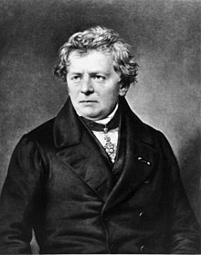
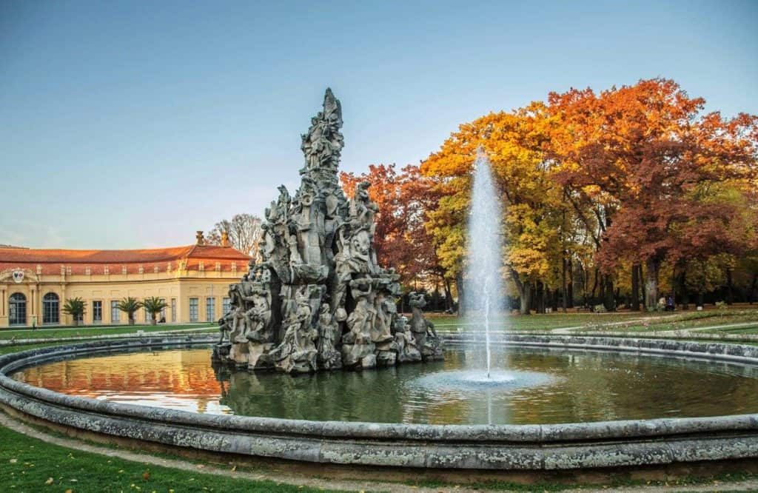
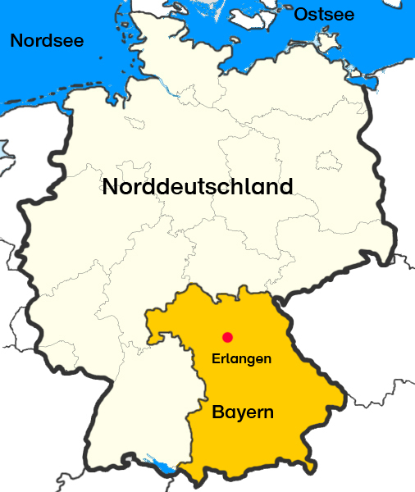
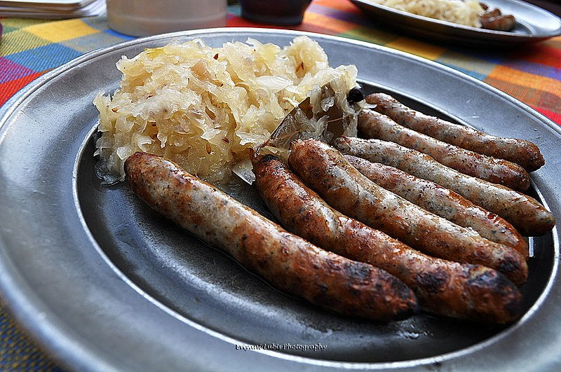
Introduction
Erlangen
Georg Simon Ohm
(1789 – 1854)
Notes:
Before I start with this, I wanted to briefly tell you something about Erlangen, where I‘m from.
Contrary to what this picture wants to believe you, we‘re not in Bavaria but in Franconia. It‘s this weird thing that we have that the people in the North of the State cultivate their own identity, I‘m not sure whether this is something you can relate to
Erlangen is a beautiful place, I can only recommend you to visit it.
The typical food from Frankonia btw is exactly what you would picture if I were to ask you what is typical for Germany – Sauerkraut and suassages. They‘re absolutely delicious!
We also have a celbrity, anyone recognize him? This is Georg Simeon Ohm the inventor of the resistor, so you can see we have a very proud tradition to put obstacles in the way of current.

Slide 3
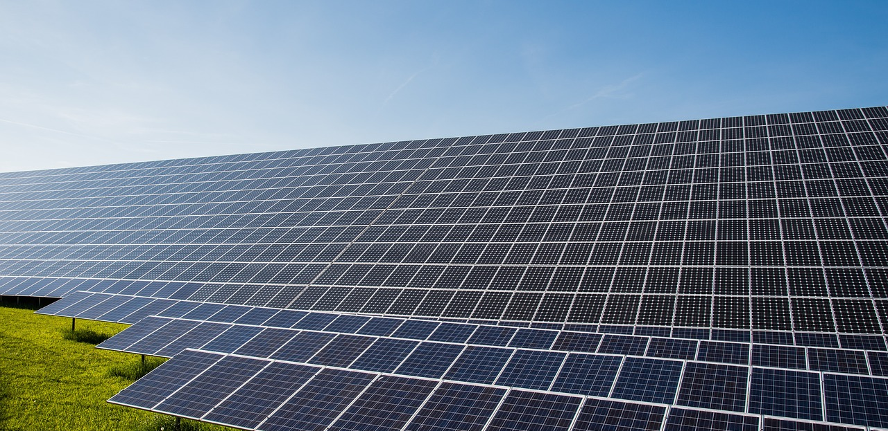

Carbon emission of a PV system
A PV system does NOT emit CO₂
Notes:
But now to the reason of why I‘m here. Susan asked me to think about carbon metrics for PV.
That was a tricky assignment, and I thought long and hard about it, and after a lot of research, I can finally conclude here in this conference that PV systems do not emit carbon.
I‘m really glab I could sort this one out.

Slide 4


Glad we could reslve this one. Questions?
Kontakt:
Dr. Ian Marius Peters-
Helmholtz Institut Erlangen-Nürnberg
+49 9131 9398 152,
im.peters@fz-juelich.de
Notes:
So thank you for having me here. I hope you enjoyed my presen…
Somehow I get the nasty feeling now that this is not what you wanted to see from me.
Oh dear.
I aslo seem to have a bit of time left on my talk, so, maybe I can show you some of my backup slides.

Slide 5
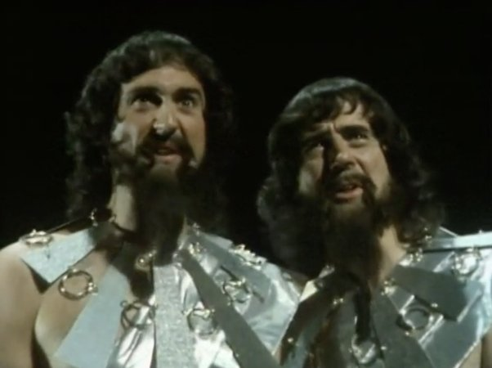
Carbon emission of a PV system
Backup slides
A PV system does NOT emit CO₂
Notes:
OK, here we go
Does anyone recognize the two gentleman on this slide? They are called Lunkwill and Fook and they play a very special role in Douglas Adams Hitchhikers Guide to the Galaxy. The picture is from the, I believe 1978 BBC series, I don‘t want to spoil it in the rear case that someon here should be unfamilir with the book, but what I will say is that in the scene that they appear in they discover that the purpose of the world is to discover the right question.
And I really love the thought that what we‘re here for is to figure out what the right questions are, so let‘s ask some.

Slide 6

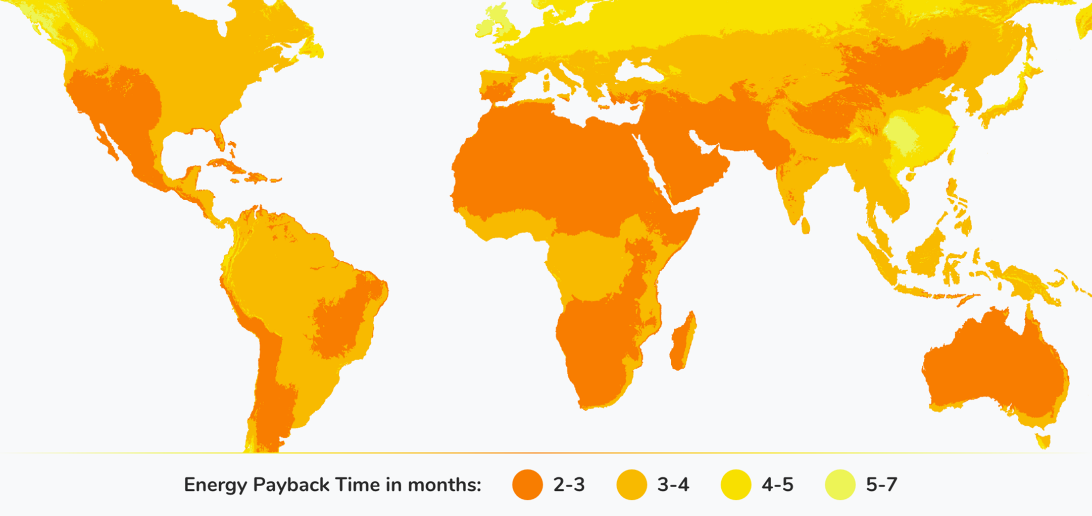
Does a PV module generate more energy than is used for its production ?
Notes:
The first question one could ask about PV is whether a PV panel actually generates more energy than is used for ist fabrication. This is a question that comes up quite often…

Slide 7
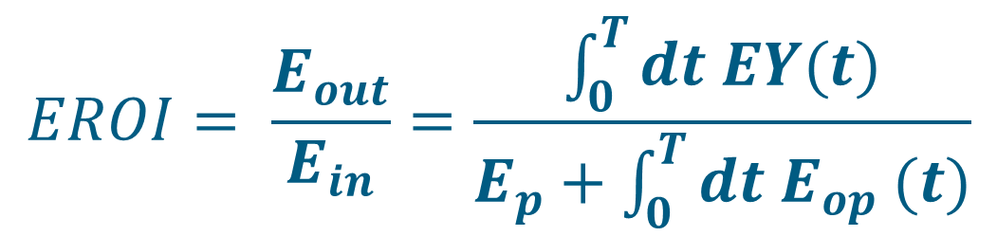
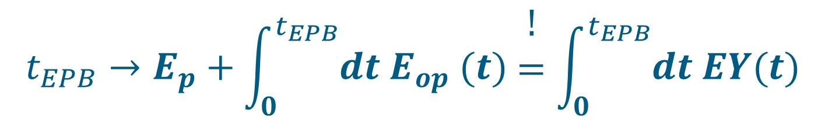
Energy Return of Investment (EROI) and Energy Payback Time (EPBT)
Energy Return of Investment (EROI):
Energy Payback Time (EPBT):
$$EROI= \frac{E_{out}}{E_{in}}=\frac{\int_{0}^{T}{dt EY(t)}}{E_{p}+\int_{0}^{T}{dt{ E}_{op} (t)}}$$
$$t_{EPB}→E_{p}+\int_{0}^{t_{EPB}}{dt{ E}_{op} (t)}\begin{matrix}! \\ = \\ \end{matrix}\int_{0}^{t_{EPB}}{dt EY(t)}$$
Notes:
… and it leads to two related metrics. The first is called Energy Return of Investment (EROI) and the second is called Energy Payback time.
Both metrics related the energy needed to make a solar panel Ein and the enrgy a solar panel produces Eout, but they do it in slightly different ways. EROI is simply the ratio of the total amount of energy produced in ist life over the total energy needed for the system. Obviously, you want this metric to be greater than 1.
Payback time is the period it takes until EROI=1 is reached. We want this one to be as short as possible.
So how do solar panels do on this metric?

Slide 8
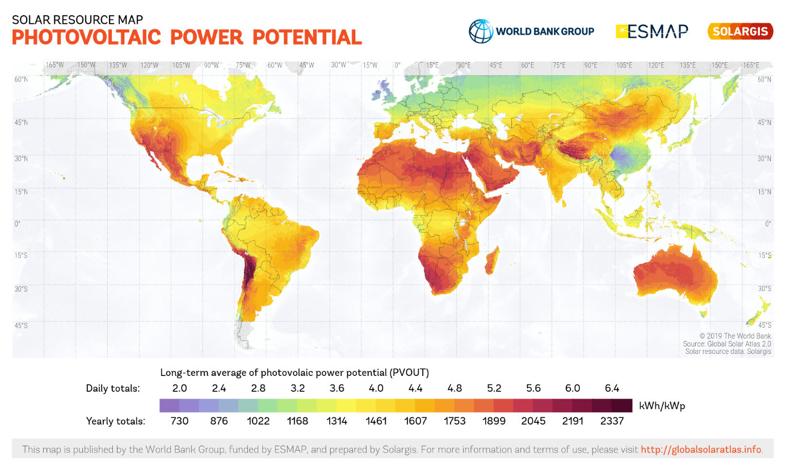

Energy Return of Investment (EROI) and Energy Payback Time (EPBT)
Energy generated by a PV system ($E_{out}$)
$E_{out}$ depends on:
The available solar resource
The operation time of the module
The degradation rate of the module
A 340W Modul in Edinburgh (909 kWh / kWp) with a lifetime of 30 Jahren and anual degradation of 0.9% anually generates: 8.300 kWh
https://globalsolaratlas.info/map
D. Jordan et al., Compendium of photovoltaic degradation rates, Prog.Photovolt:Res.Appl.2016;24:978–989
I. M. Peters et al., The value of stability in Photovoltaics, Joule (2021)
Notes:
Let‘s start with the easier part – the energy a solar panel produces. How much energy you can generate depends on the power rating of your module, on where you are and on how quickly the panel degrades.
I apologize that I only have numbers for Germany here, but you can easily figure out the numbers fo Edinburgh by just scaling this.
In Freiburg, a 340W panel with a degradation rate of 0.9% anually – these are typical values for a solar panel today, produces about 10MWh. Please keep that number in mind.

Slide 9
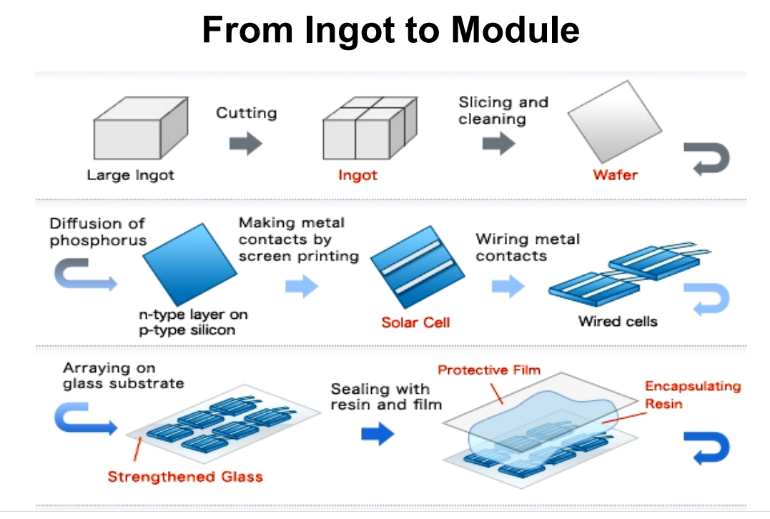
Energy Return of Investment (EROI) and Energy Payback Time (EPBT)
Energy needed to make a PV module $E_{in}$
Metalurgical grade silicon
(20 kWh / Modul)
Solar grade silicon
(92 kWh / Modul)
Czrochalski Ingot
(67 kWh / Modul)
Wafering
(31 kWh / Modul)
Cell production
(77 kWh / Modul)
Panel Production
(211 kWh / Modul)
-
~500 kWh / Modul
E. Leccisi et al., Updated sustainability status of crystalline silicon-based photovoltaic systems: Life-cycle energy and environmental impact reduction trends, Prog Photovolt Res Appl. 2021;29:1068–1077.
N Cheung, U.C. Berkeley, Lecture on Solar Cell Fabrication Tecniques, UC Berkely (2010)
Notes:
Ein is a bit more complicated, let‘s start with the amount of energy needed to produce a panel. I have to say that there is surprisingly little literature on this metric, but a few studies exist, one from Lecissi at the Institute for Life Cycle Analysis in the US and one from Fraunhofer ISE in Freiburg.
According to those studies, it takes about 500kWh to make a single module. What is notewothy is that there has been a lot of innovation in this pat as well, particularly in the production of high quality silicon, between 2015 and 2020, the amount of energy required to make a silicon panel has gone down by about 50%.
The amount of energy needed to make a module has halved in about 5 years!
A recent study of Fraunhofer ISE suggests that numbers are lower and could already be around 400kWh for a 365W module

Slide 10
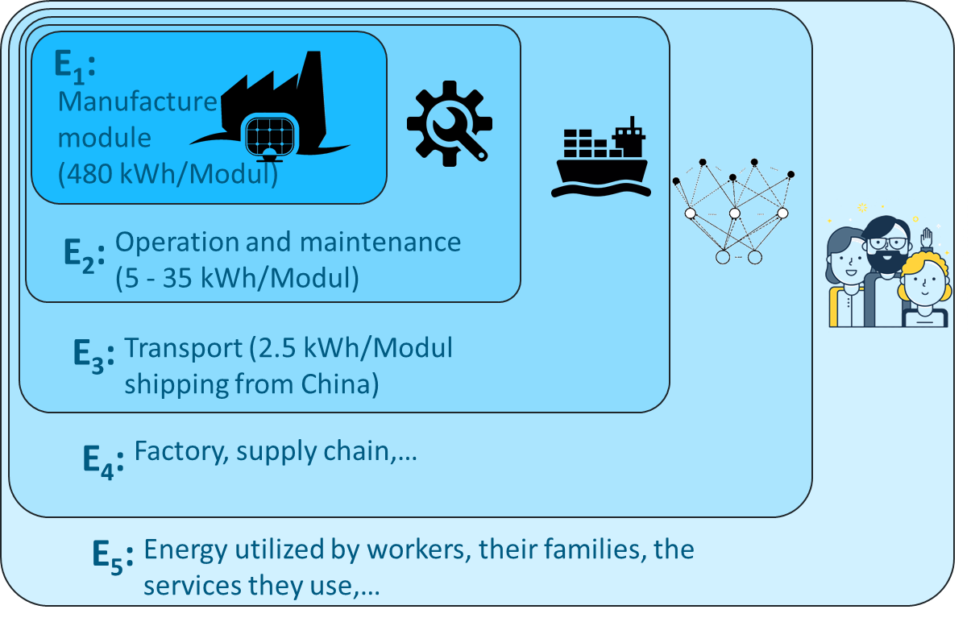
Energy Return of Investment (EROI) und Energy Payback Time (EPBT)
Calculating $E_{in}$ - a problem of categories
Which factors are considered?
There is a recommendation by the IEA, which we will follow in this work.
IEA recommendation: Fabrication, system constructions, operation and End-of-Life.
If you compare different technologies – use consistent numbers
Still around: 500kWh pro Modul
M. Raugi et al., Energy Return on Energy Invested (ERoEI) for photovoltaic solar systems in regions of moderate insolation: A comprehensive response, Energy Policy 102 (2017), 377-384.
R. Frischknecht eal.,, 2016. Methodology Guidelines on Life Cycle Assessment of Photovoltaic Electricity. 3rd ed. International Energy Agency (IEA) PVPS Task 12, Report T12-08:2016. Available at: 〈http://www.iea-pvps.org〉
Notes:
The problematic thing about Ein, as most of you are probably well aware, is that you‘re not done with just module fabrication. The problem is one of boundaries

Slide 11
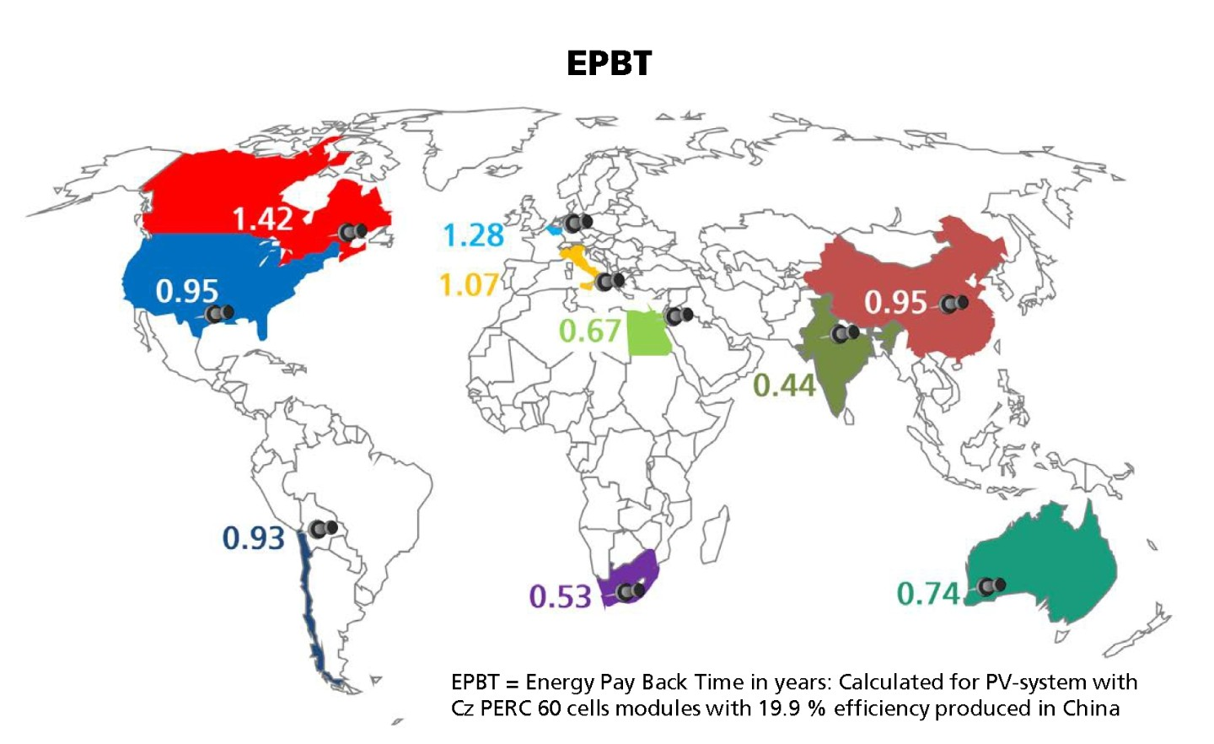
Energy Return of Investment (EROI) and Energy Payback Time (EPBT)
EPBT in different countires
In this scenario, the module generates 16 times as much energy as needed for ist production (EROI)…
…and recovers the energy required for production in 1.53 years (EPBT).
In many countries, EPBT is below one year, for thin-film PV (CdTe) even below 0.5 years.
Photovoltaics Report Fraunhofer ISE (2021)

Slide 12
Energy Return of Investment (EROI) and Energy Payback Time (EPBT)
Comparison with other technologies
Taking into account the entire system (including under-construction, inverters and operation), EROI falls between 10 and 30, depending on location.
If you run your system for 50 years, and you are in a very sunny area, and you use a thin-film technology, you can reach values up to 100.
C. Hall et al., EROI of different fuels and the implications for society, Energy Policy 64 (2014), 141-152.
E. Leccisi et al., Life cycle energy demand and carbon emissions of scalable single-junction and tandem perovskite PV, Prog Photovolt Res Appl. 2021;29:1078–1092.

Slide 13
Energy Return of Investment (EROI) and Energy Payback Time (EPBT)
Why is there a controversy about this?
The study by Ferroni and Hopkirk (2016)
In a 2016 study Ferroni and Hopkirk calculated an EROI for a PV system in Switzerland, concluding that there was a net energy-loss.
The study was challenged by a collaboration of several scientists working on carbon accounting (Raugi et al. 2017) who concluded that:
The paper deviates from recommendations for reference systems and uses different assumptions across their comparisons.
The paper uses outdated information about PV systems.
The paper double-accounts for several factors when calculating Ein.
A revised calculation resulted in a factor of between 7 and 8.
E. Ferroni and R. J. Hopkirk, Energy Return on Energy Invested (ERoEI) for photovoltaic solar systems in regions of moderate insolation, Energy Policy 94 (2016), 336-344.
M. Raugi et al., Energy Return on Energy Invested (ERoEI) for photovoltaic solar systems in regions of moderate insolation: A comprehensive response, Energy Policy 102 (2017), 377-384.,

Slide 14
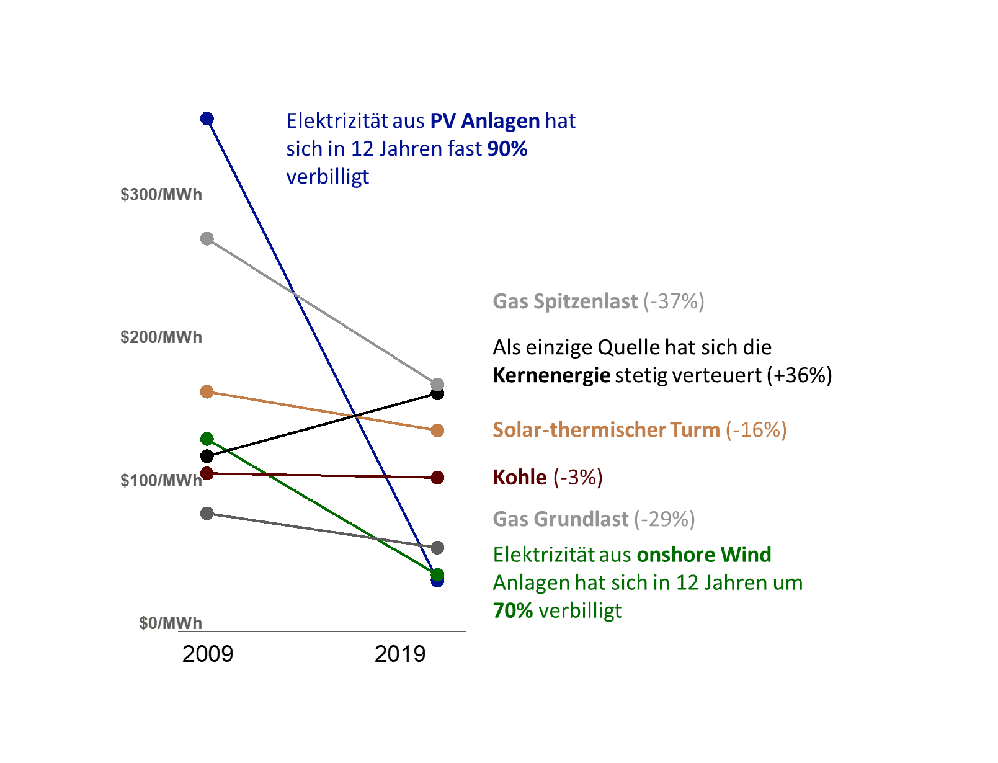
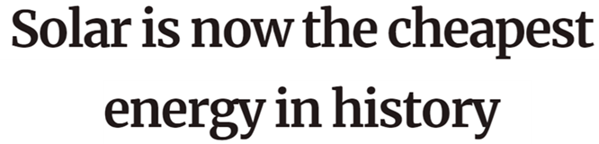
Accounting for Solar!
The almost unbelievable development of photovoltaics
Photovoltaic energy is the fastest developing energy technology in human history.
Photovoltaics is the cheapest form to produce electricity that has ever been available to humankind.
Science – 9. Oktober 2022
Quellen:
Lazard – Levelized Cost of Energy V16 (2023)
Notes:
Bevor ich über die Zukunft der Photovoltaik spreche wollte ich ein paar Worte über deren Entwicklung verlieren.
Die Photovoltaik zeichnet sich dadurch aus, dass es die sich am rasantesten entwickelnde Energietechnologie in der Geschichte der Menschheit ist.
Keine andere Energietechnologie ist je so schnell besser und günstiger geworden wie die Photovoltaik.
In der Graphik hier links sieht man, wie sich die Stromentstehungskosten verschiedener Energietechnologien zwischen 2009 und 2021 entwickelt haben.
Die blaue Linie repräsentiert PV Anlagen. 2009 waren diese noch die teuerste Form Strom zu erzeugen, 2021 war es die preisgünstigste.
Die einzige andere Technologie, die ähnlich niedrige Stromentstehungskosten hat ist Windenergie, welche ebenfalls eine beachtliche Kostenreduktion zu verzeichnen hat.
Interessant ist auch, dass Kernkraft die einzige Technologie ist, die konsistent teurer wird.
Der rapide Übergang von teuerster zu billligster Art der Stromerzeugung, wie in die PV erfahren hat, ist vollkommen einzigartig.
Es ist sogar so, dass PV, wie in einem Artikel in Science am 09.Oktober 2022 betitelt, heute die günstigste Form der Stromerzeugung ist, die der Mensch jemals zu Verfügung hatte.

Slide 15
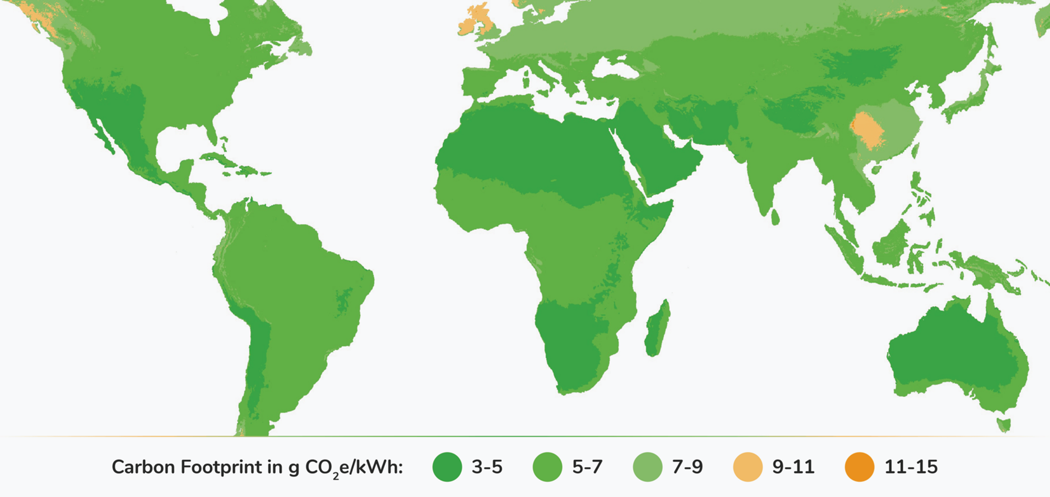
Do PV Modules contribute to Reducing Carbon Emissions?

Slide 16

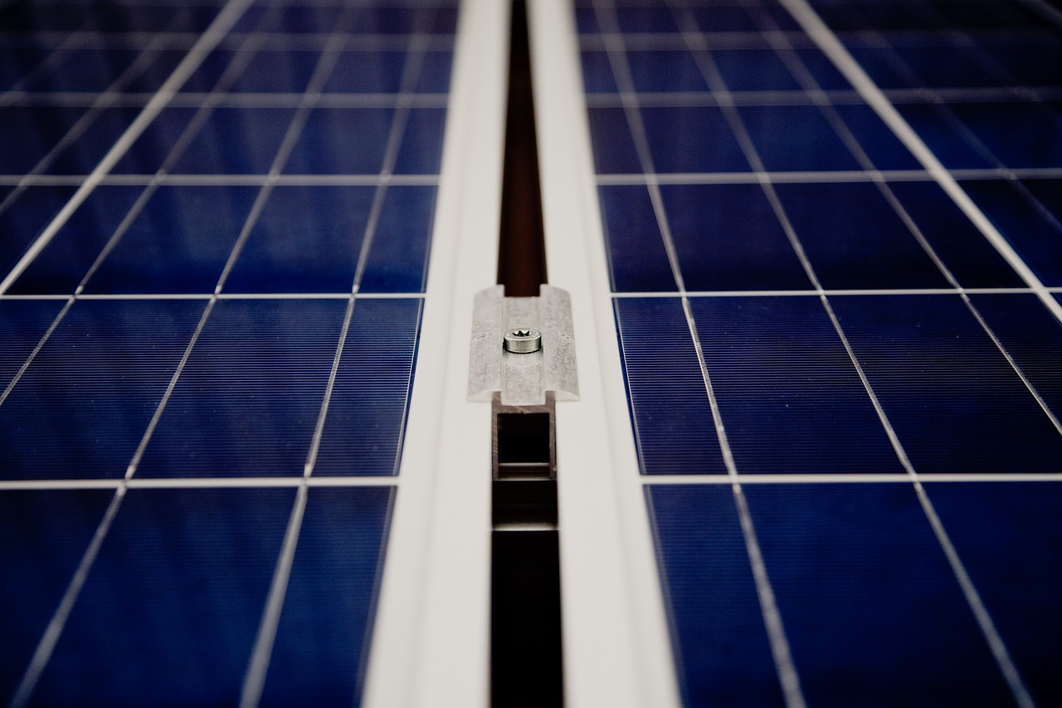


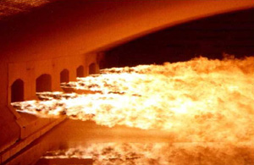
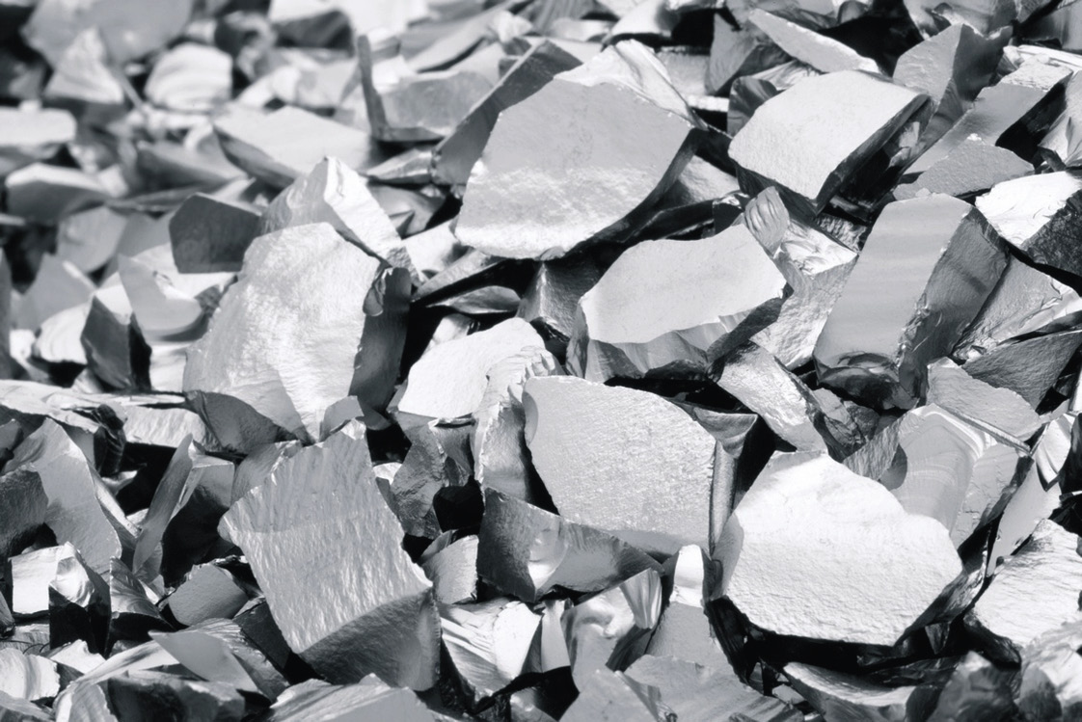

Embodied Carbon
How much carbon is released during module production?
$${SiO}_{2}+2 C=Si+2 CO$$

Slide 17
Embodied Carbon – Reduction of SiO₂
How much carbon is released in the chemical process?
Si – 28.09 u
CO₂ – 44.00 u
→ 3.14g CO₂ / g silicon
2.5g/silicon per Wp
340W module
→ 2.7kg CO₂ / module
(Not a lot)
$${SiO}_{2}+2 C=Si+2 CO$$

Slide 18

Life Cycle Analysis (LCA)
Methodik zur Berechnung verschiedener Schädigungspotentiale
Die Produktion relevanter Stoffe wird bilanziert und auf einen Referenzstoff übertragen.
Bei Treibhausgasen ist die Referenz CO₂, anderen Stoffen wird ein äquivalentes Potential zugeordnet.
Angabe in Tonnen CO₂ Equivalenz
Stoff | Chemische Formel | GWPi
Kohlendioxid | CO₂ | 1
Methan | NH₃ | 25
Lachgas | N₂O | 298
Difluormethan | CH₂F₂ | 675
Schwefelhexafluorid | SF₆ | 22800
$$GWP=\sum{m_{i}∙{GWP}_{i}}$$
Faktoren zur Berechnung der Treibhausgasemissionen gemäß United Nations FCCC/CP/2013/10/Add.3 Anhang III
M. Held, R. Ilg, Update of environmental indicators and energy payback time of CdTe PV systems in Europe, Prog.Photovolt:Res.Appl.2011;19:614–626

Slide 19
Embodied Carbon – Energy need
How much carbon is released by energy needed in the process?
Energy needed for glass and silicon production is the main contributor to embodied carbon.
Carbon balance depends on energy mix and, hence, location!.
Below 1t pro kWp installierter Leistung
For 30 year system life, weigthed carbon emissions are at 38g/kWh.
A. Müller et al., A comparative life cycle assessment of silicon PV modules: Impact of
module design, manufacturing location and inventory, Solar Energy Materials and Solar Cells, 230 (2021) 111277.

Slide 20
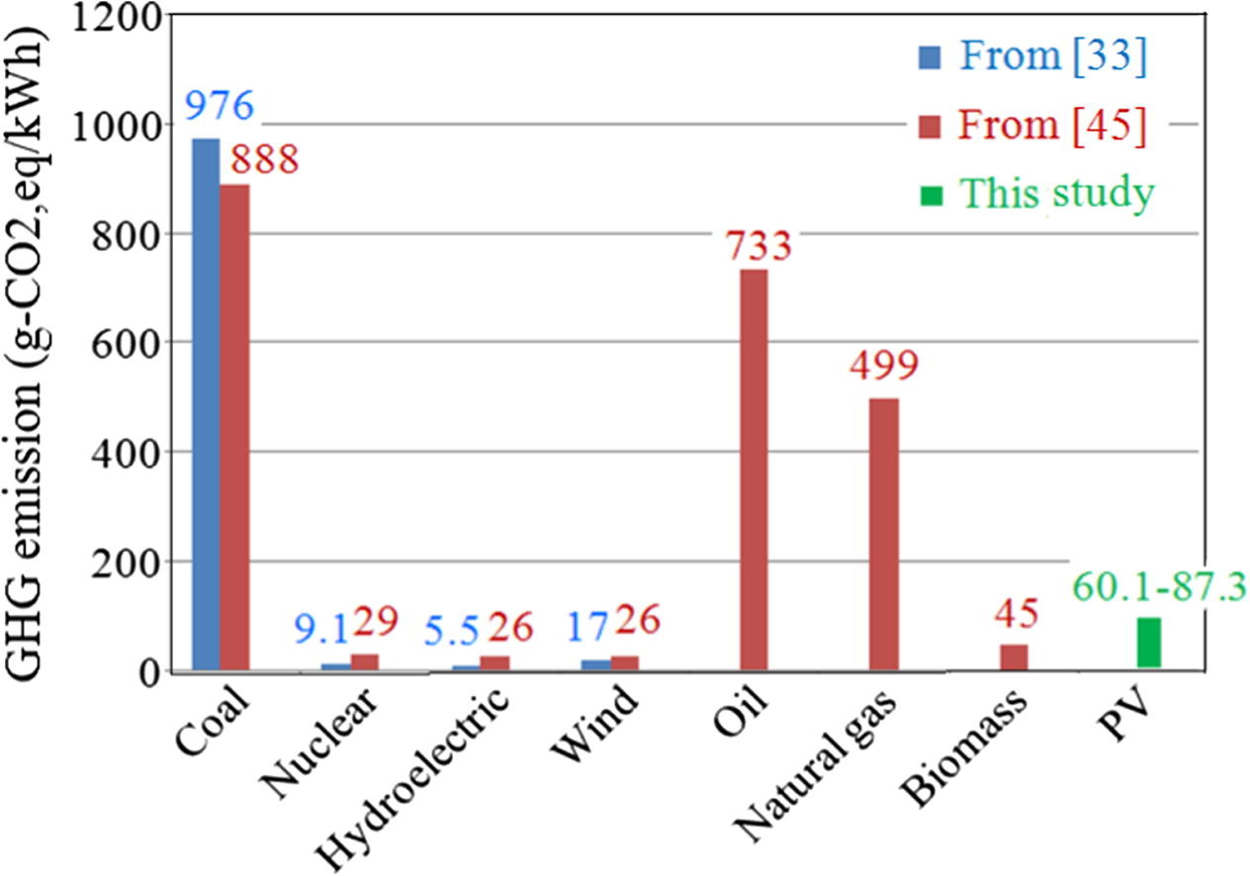
Embodied Carbon in the energy mix
Comparison with other power sources
.
(2016)
38 (2023 - Edinburgh)
G. Hou et al., Life cycle assessment of grid-connected photovoltaic power generation from crystalline silicon solar modules in China, Applied Energy, 164 (2016), 882-890.

Slide 21
Displacing Carbon emissions
The whole point of installing solar panels
A PV plant in operation doesn not emit carbon, but it does produce electricity! The whole point of installing solar panels is to get rid of carbon.
The graph on the right shows one way to account for this carbon displacements.
Each panel displaces an amount of CO₂ equal to that produced by the countries energy mix.
As more panels are installed and the energy mix gets cleaner, the carbon displacement potential is reduced.
I. M. Peters et al., The role of innovations for the sustainability of photovoltaics, iSicience (2023).

Slide 22
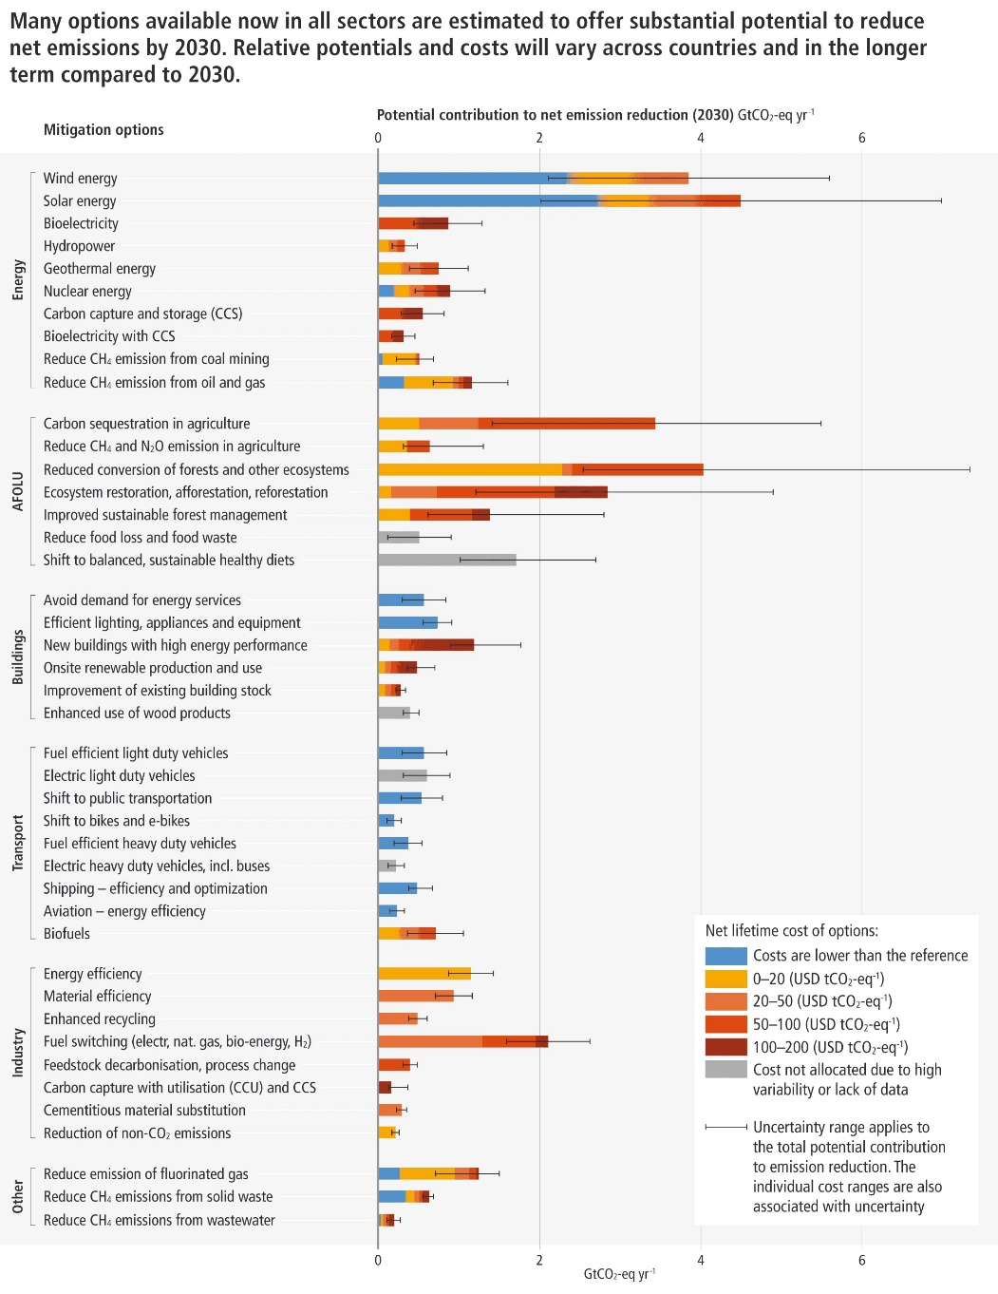

Solar is the best way to reduce carbon!

Slide 23
Displacing Carbon emissions in the Bristish Isles
A scenario for 100% renewable energy
A PV plant in operation doesn not emit carbon, but it does produce electricity! The whole point of installing solar panels is to get rid of carbon.
The graph on the right shows one way to account for this carbon displacements.
Each panel displaces an amount of CO₂ equal to that produced by the countries energy mix.
As more panels are installed and the energy mix gets cleaner, the carbon displacement potential is reduced.
A. Diesing et al., Offshore versus onshore: The underestimated impact of onshore wind and solar photovoltaics for the energy transition of the British Isles, IET Renewable Power Generation 2023; 1–27.

Slide 24
Carbon accounting for solar panels needs to include carbon released during PV panel fabrication and the carbon displacement potential of solar panels!
Embodied carbon in solar panels is dominated by carbon emitted for electricity generation. In a carbon free energy system, solar panel production is (next to) carbon free.
Solar panels do not emit carbon dioxide in operation, but they generate electricity. Fossil-based energy sources are incapable of this.
Solar panels are recognised by the IPCC as the best possible way to reduce carbon emissions, both in potential and in cost.
Solar panels can make a significant contribution to decarbonize the British Isles. In a scenario with 100% renewable energies, solar produces 30% of total energy, requiring a capacity of 200GW in 2040.
Summary
Notes:
In summary:
- We developed a method to determine the enery yield of a solar cell fo…

Slide 25
That‘s all, folks. Questions?
Kontakt:
Dr. Ian Marius Peters-
Helmholtz Institut Erlangen-Nürnberg
+49 9131 9398 152,
im.peters@fz-juelich.de

Slide 26
Energy Return of Investment (EROI) und Energy Payback Time (EPBT)
Energiebilanz der Herstellung eines PV Moduls
Metalurgical grade silicon
(20 kWh / Modul)
Solar grade silicon
(92 kWh / Modul)
Czrochalski Ingot
(67 kWh / Modul)
Wafering
(31 kWh / Modul)
Cell production
(77 kWh / Modul)
Panel Production
(211 kWh / Modul)
-
~500 kWh / Modul
E. Leccisi et al., Updated sustainability status of crystalline silicon-based photovoltaic systems: Life-cycle energy and environmental impact reduction trends, Prog Photovolt Res Appl. 2021;29:1068–1077.
N Cheung, U.C. Berkeley, Lecture on Solar Cell Fabrication Tecniques, UC Berkely (2010)
Notes:
Schwierigkeit hier: Die Werte ändern sich sehr schnell! Innerhalb von 5 Jahre hat sich der Wert für monokristllines Silizium etwa halbiert.

Slide 27



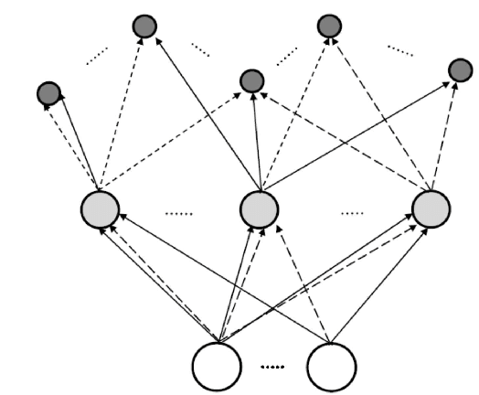

E₁:
Manufacture
module
(480 kWh/Modul)
E₂:
Operation and maintenance
(5 - 35 kWh/Modul)
E₃:
Transport (2.5 kWh/Modul shipping from China)
E₄:
Factory, supply chain,…
E₅:
Energy utilized by workers, their families, the services they use,…

Slide 28
Life Cycle Analysis (LCA)
Kohlendioxid Quellen bei der Herstellung von PV Modulen
Der wesentliche Beitrag zur Freisetzung von Treibhausgasen kommt durch die benötigte Energie und Elektrizität.
Die CO₂-Bilanz hängt damit vom Energiemix ab, die für die Herstellung eines PV Moduls verwendet wird.
Größenordnung: etwa 1t pro kWp installierter Leistung
Bei einer Laufzeit von 30 Jahren ergibt sich für Freiburg ein Wert von etwa 30g/kWh
In einem CO₂ freien Stromnetz ist auch die Produktion von Solarpaneelen (nahezu) Klimaneutral
E. Leccisi et al., Updated sustainability status of crystalline silicon-based photovoltaic systems: Life-cycle energy and environmental impact reduction trends, Prog Photovolt Res Appl. 2021;29:1068–1077.

Slide 29
Life Cycle Analysis (LCA)
Kohlendioxid Vermeidung durch ein PV Modul
Zu Beginn hat ein Modul eine CO₂ Last, durch Freisetzung während der Produktion.
Im Betrieb wird (nahezu) kein CO₂ generiert, und das Modul ersetzt einen Teil der bisherigen Strom-Mixes, dadurch wird CO₂ eingespart.
Über die Zeit reduzieren Staaten den CO₂ Ausstoße in der Energieproduktion, wodurch sich die Einsparungen über Zeit reduzieren.
In einem CO₂ neutralen Stromnetz (angestrebt für 2045) wird kein CO₂ generiert, und auch keines eingespart.

Slide 30
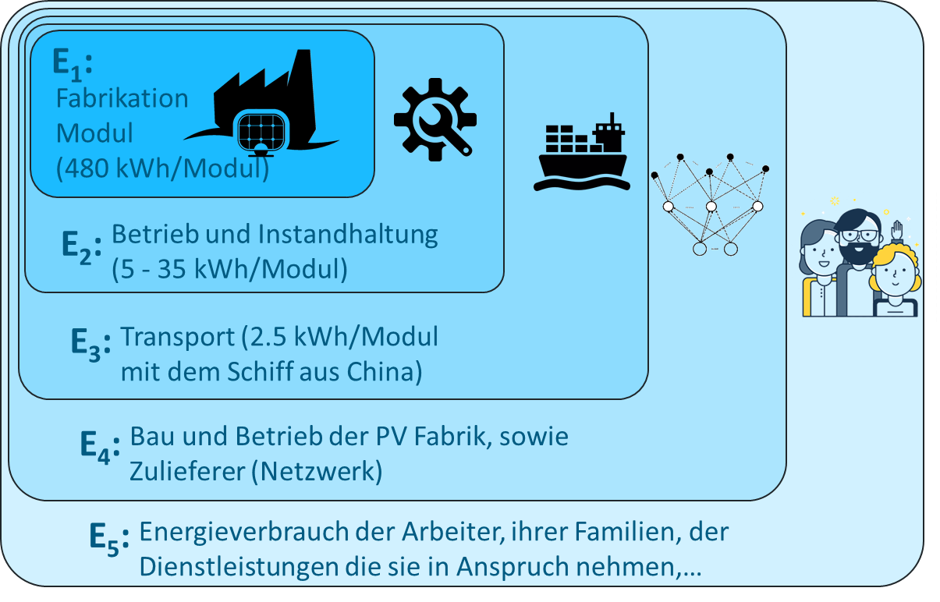
Embodied Carbon – Energy need
Berechnung von $E_{in}$ - oder - ein grundlegendes Problem
Welche Faktoren werden einbezogen
Es gibt Empfehlungen zur Berechnung der International Energy Agency (IEA).
IEA Empfehlung: Produkt, Konstruktion, Verwendung und End-of-Life.
Bei Vergleichen stets darauf achten, dass derselbe Rahmen verwendet wird (Konsistenz).
Richtwert: 500kWh pro Modul
M. Raugi et al., Energy Return on Energy Invested (ERoEI) for photovoltaic solar systems in regions of moderate insolation: A comprehensive response, Energy Policy 102 (2017), 377-384.
R. Frischknecht eal.,, 2016. Methodology Guidelines on Life Cycle Assessment of Photovoltaic Electricity. 3rd ed. International Energy Agency (IEA) PVPS Task 12, Report T12-08:2016. Available at: 〈http://www.iea-pvps.org〉

Slide 31
Embodied Carbon – Energy need
C. Reichel et al. Einfluss des Energiemix und des Energieertrags auf die CO2-Emissionen von Silizium-Photovoltaikmodulen , Presented at the 2023 PV Symposium, Bad Staffelstein

Slide 32
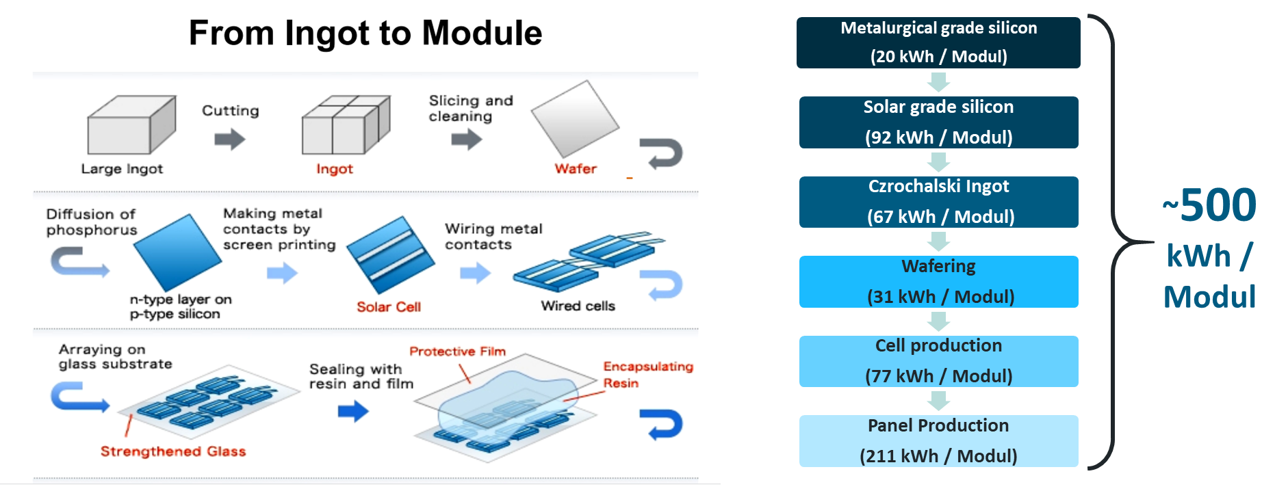
Embodied Carbon – Energy need
E. Leccisi et al., Updated sustainability status of crystalline silicon-based photovoltaic systems: Life-cycle energy and environmental impact reduction trends, Prog Photovolt Res Appl. 2021;29:1068–1077.
N Cheung, U.C. Berkeley, Lecture on Solar Cell Fabrication Tecniques, UC Berkely (2010)
Notes:
Recent studies by Fraunhofer ISE indicate slightly lower numbers of about 400kWh for one 360W module.

Slide 33
Life Cycle Analysis (LCA)
Kohlendioxid Bilanz eines PV Moduls und Vergleich
.
(2016)
30 (2022)
G. Hou et al., Life cycle assessment of grid-connected photovoltaic power generation from crystalline silicon solar modules in China, Applied Energy, 164 (2016), 882-890.

