Slide 1
The Role of Nuclear in a Low Carbon Future: Do the metrics matter ?
ICARB Conference 2023, Edinburgh
Dr Paul Dorfman

Slide 2
IPCC
IPCC: We must significantly cut CO2 emissions by 2030 to have a chance of hitting 1.5 C.
https://twitter.com/IPCC_CH/status/1702271975140577555
IPCC AR6 2023 Summary Report: Renewables 10 times more effective than nuclear at CO2 mitigation to 2030.
https://www.ipcc.ch/report/sixth-assessment-report-cycle/
We don't have the time for nuclear.

Slide 3
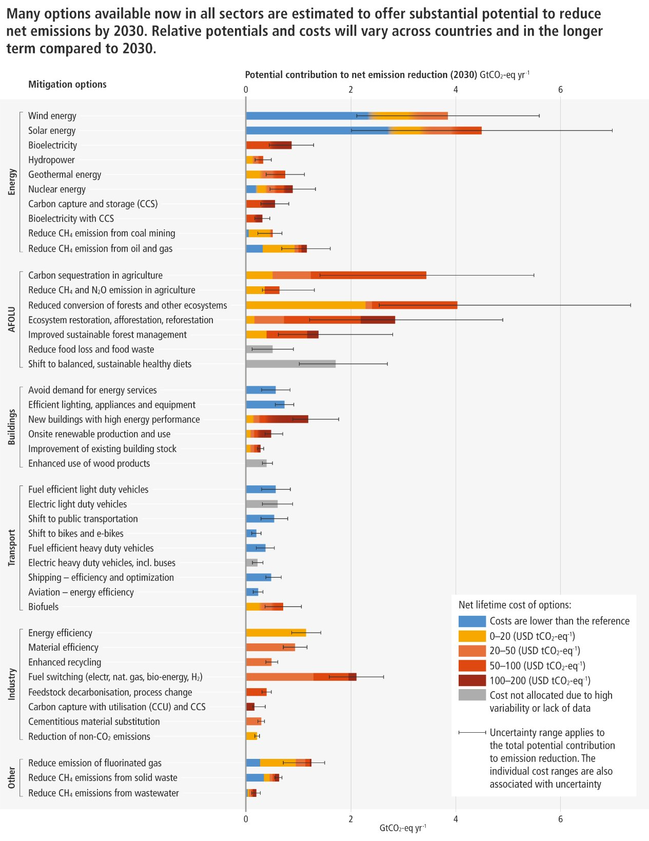

Slide 4
CO2
Prof Alison MacFarlane, former head US Nuclear Regulation (NRC):
‘Given the development timelines for new reactor designs, they are not likely to have a significant impact on CO2 emissions reductions for decades, and as a result their relevance to the climate argument shrinks.’
‘In the nuclear celebratory mood of the moment, there is little patience or political will for sober voices to discuss the reality that new nuclear power is actually many decades away from having any measurable impact on climate change – if at all.’
https://iai.tv/articles/the-end-of-oppenheimers-energy-dream-auid-2549

Slide 5
Back-draft
Russian invasion of Ukraine demonstrates military back-draft from state or non-state ‘bad actors’ - dovetails with nuclear safety and security
All UK civil nuclear infrastructure uniquely implicated in all four ‘Tier 1 Threats’ in the UK National Security Strategy.
https://assets.publishing.service.gov.uk/government/uploads/system/uploads/attachment_data/file/61936/national-security-strategy.pdf

Slide 6
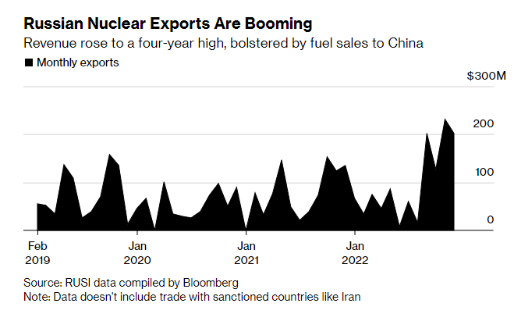

Slide 7
UK new nuclear ambition
24 GW new nuclear by 2050.
Johnson’s joke: ‘One SMR in every Labour constituency.’
Nuclear push involves ‘liberalisation’ of planning, environmental, and local democratic accountability rules and norms.
Via UK Parliament Nuclear Energy Finance Act: Regulated Asset Base (RAB) mechanism.
https://bills.parliament.uk/bills/3057
RAB puts UK electricity consumers and taxpayers on the hook for huge nuclear costs and over-runs.
https://www.nuclearconsult.com/wp/wp-content/uploads/2019/10/NCG_RAB_submission.pdf

Slide 10
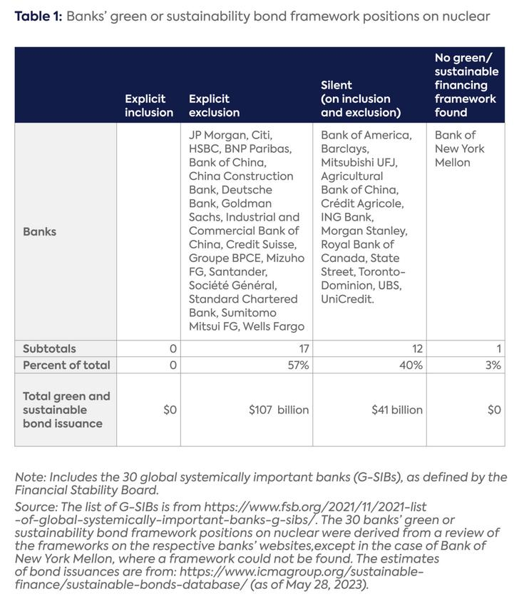

Slide 11
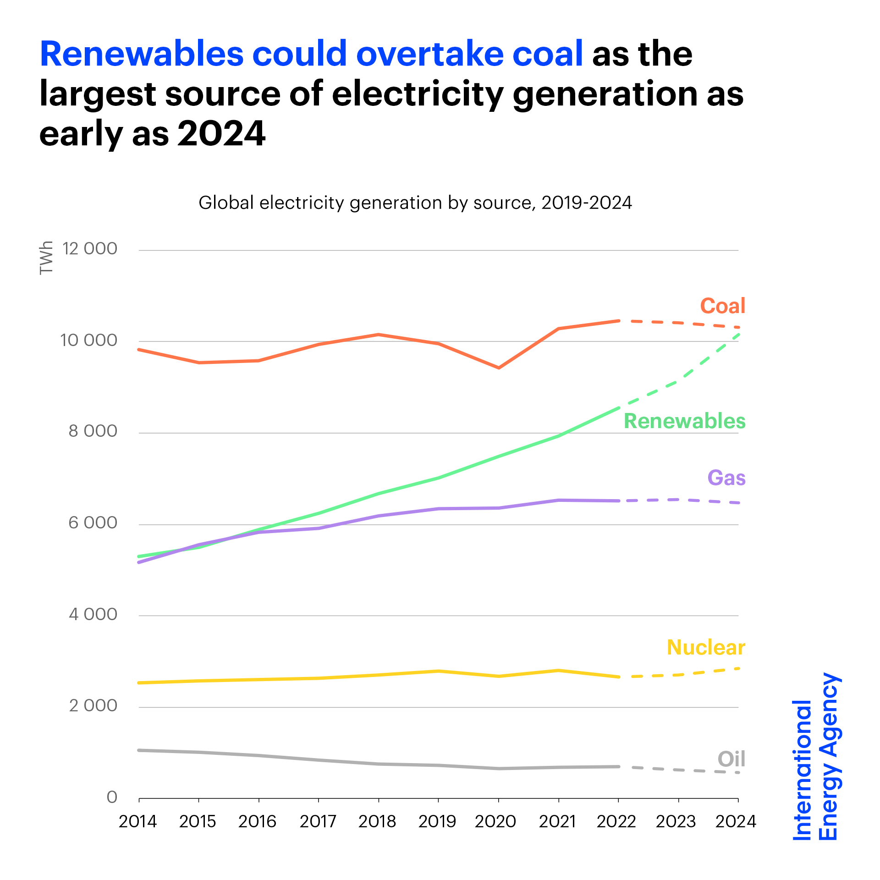

Slide 12
https://www.cambridge.org/core/books/megaprojects-and-risk/78B4E0A8FDBEC72919B832D33BECF083

Slide 13
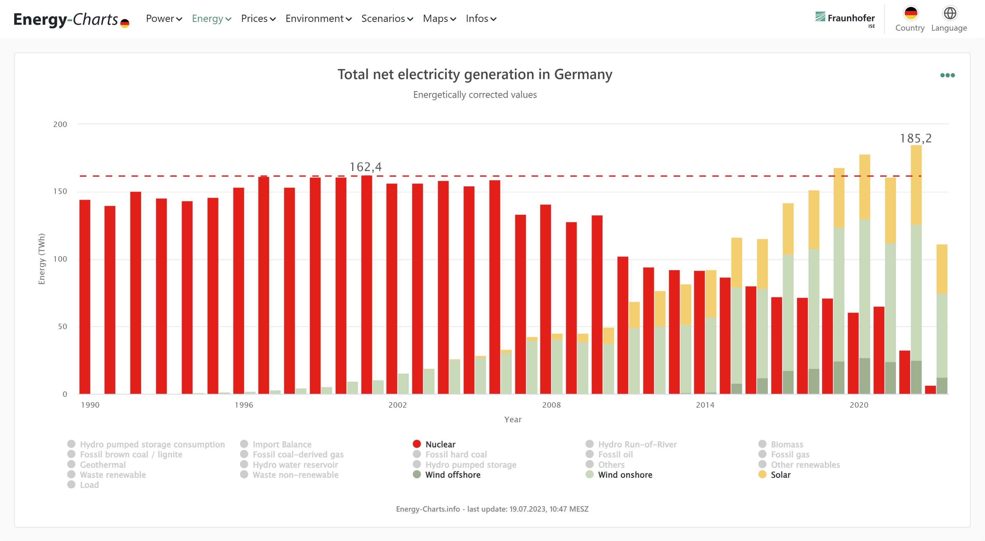

Slide 14
Don’t do the crime if you can’t do the time
UK nuclear waste legacy: 700,000 cubic metres rad-waste.
High-level rad-waste stored at Sellafield. UK Office for Nuclear Regulation (ONR): ‘One of the most complex and hazardous nuclear sites in the world.’
https://www.onr.org.uk/sellafield-dfw.htm
UK Nuclear Decommissioning Authority (NDA): Current cost estimate decommissioning and storing UK rad-waste £132bn.
Current estimate Geological Disposal Facility: £53bn
https://www.gov.uk/government/news/gdf-report-highlights-a-year-of-progress

Slide 15
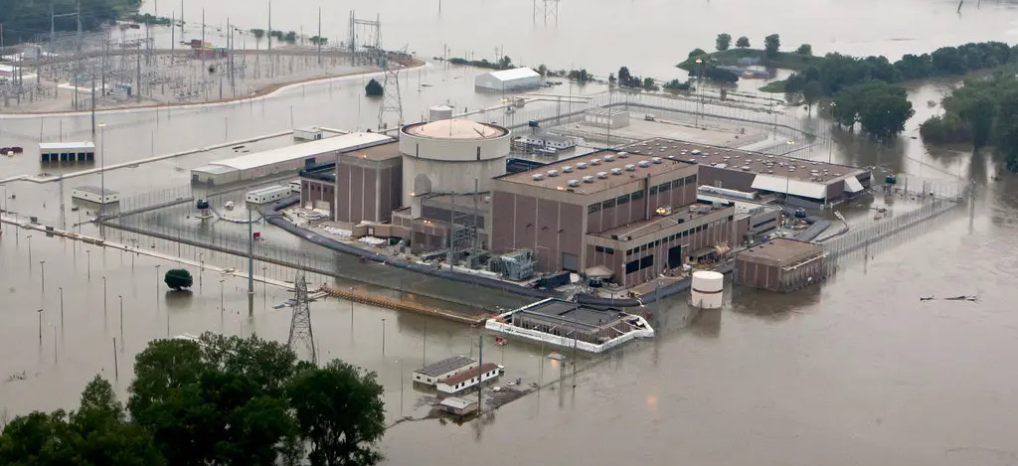
Nuclear on the climate front-line

Slide 16
And not in a good way
As extreme events becomes the norm, defences become obsolete.
Coastal nuclear: Ramping sea-levels, faster, harder, more destructive storm and storm surge.
Inland nuclear: Wildfire, flooding alternating with low river-flow impact on reactor cooling and discharge.

Slide 17
Adapting to the inevitable
US Army War College:
Nuclear at ‘high risk of temporary or permanent closure due to climate threats.’
US civil and military nuclear vulnerable to sea-level rise, severe storms, cooling water issues.
https://climateandsecurity.files.wordpress.com/2019/07/implications-of-climate-change-for-us-army_army- war- college_2019.pdf

Slide 18
‘Relocation or abandonment’
UK Institute of Mechanical Engineers:
UK coastal nuclear infrastructure may need considerable investment to try to 'defend against rising sea levels, or even relocation or abandonment.'
https://imeche.org/policy-and-press/reports/detail/climate-change-adapting-to-the-inevitable
Sir David King, UK former chief scientific adviser and long-standing nuclear supporter:
New nuclear at Sizewell C would be ‘very difficult to protect from flooding’ due to rising sea levels on the Suffolk coast.
https://twitter.com/LBC/status/1597660294192545792

Slide 19
Beyond design-base
UK Parliamentary Office of Science and Technology:
‘Coastal location of UK nuclear power stations makes rising sea levels and storm surge flooding a future risk that will need to be considered.'
https://post.parliament.uk/research-briefings/post-pn-0687/
US Nuclear Regulatory Commission (NRC):
'55 US nuclear sites already experienced flooding hazard beyond design-base.'
https://nrc.gov/docs/ML1713/ML17138A169.pdf

Slide 20
SMR’s ‘in development’
‘Govts, investors, press, media have paid significant attention to small modular nuclear reactors as the solution to traditional nuclear energy’s cost and long build times and renewable's space and aesthetic drawbacks - but behind the hype there is very little concrete technology to justify it.’
https://iai.tv/articles/the-end-of-oppenheimers-energy-dream-auid-2549

Slide 21
UK SMR
Rolls Royce SMR design not an SMR.
SMR defined as 300 MW or less.
https://www.iaea.org/newscenter/news/what-are-small-modular-reactors-smrs
Rolls design is 470 MW.
1/2 size of majority of current French nuclear fleet reactors, 1/3 size of the very large EPR reactor in constuction at Hinkley Point C.
https://www.rolls-royce.com/innovation/small-modular-reactors.aspx#/

Slide 22
Fusion
For the past 70 years, fusion has always been 20 years in the future – perhaps an experiment to prove that time doesn’t exist in modern physics?
https://www.newstatesman.com/spotlight/sustainability/energy/2023/08/nuclear-power-strategy-net-zero-vs-renewables

Slide 23
Opportunity cost
Nuclear takes funds and vital political attention from net-zero investment.
Ramping costs of new nuclear compromises roll-out of more flexible, safer, productive, cost-effective and affordable technologies.
Sustainable low-carbon renewables, energy efficiency and management, are growing economic sectors with huge potential for job creation.
Political win-win.

Slide 24
Fissile: Fossil fuels weapon of choice
UK Govt Dept BEIS: New fissile takes up to 17 years to build one station.
https://publications.parliament.uk/pa/bills/cbill/58-02/0174/ImpactAssessment.pdf
Fossil fuel industry has a long history of climate denial.
https://www.theguardian.com/us-news/2023/sep/14/exxonmobil-documents-wall-street-journal-climate-science
Long fissile construction times - SMRs still in development - implies nuclear is ‘weapon of choice’ for fossil industry.
Normalise significant fissile delays and make every last fossil dollar.
https://reneweconomy.com.au/nuclear-energy-remains-weapon-of-choice-for-climate-deniers-and-coal-lobby/

Slide 25
We can do better
Nuclear can’t compete with the technological, economic, safety and security advantages of the renewable evolution.
Nuclear is an out-dated technology - a tired non-starter in the 21st century.
We can do better.

Slide 26
Energy transition
We need to secure clean, safe, affordable, sustainable, low-carbon energy to power industry, transport, homes and businesses.
This means expansion of renewable energy in all sectors, rapid growth and modernisation of the electricity grid, energy conservation and efficiency, rapidly evolving storage technology, interconnection, market innovation from supply to service provision, built and transport infrastructure evolution.

Slide 27
The key metric
IPCC say we must significantly cut CO2 emissions by 2030 to have a chance of hitting 1.5 C.
https://twitter.com/IPCC_CH/status/1702271975140577555
IPCC AR6 2023 reports renewables 10 times more effective than nuclear at CO2 mitigation to 2030.
https://www.ipcc.ch/report/sixth-assessment-report-cycle/
We just don't have the time for nuclear.

Slide 28
It may get worse before it gets better

