Slide 1
An investigation of the operational energy and carbon savings from practicing adaptive thermal comfort theory
Rajan Rawal¹, Tarjani Mehta¹, Yash Shukla¹ and Susan Roaf²
¹Centre for Advanced Research in Building Science and Energy, CEPT University, Ahmedabad
²Institute for Sustainable Building Design, Heriot-Watt University, Edinburgh

Slide 2
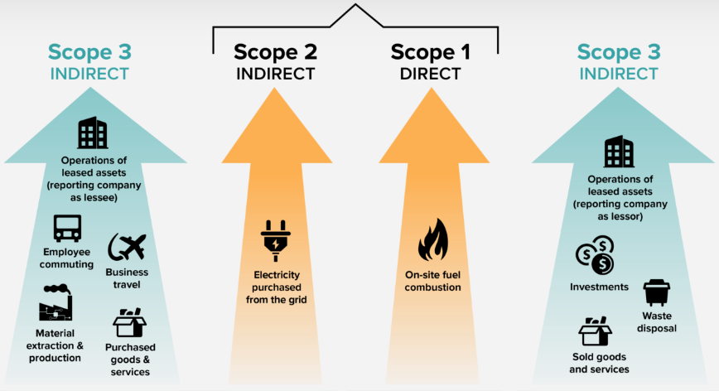
Project to lower electricity use in 2 Indian offices in Mumbai and Ahmedabad

Slide 3
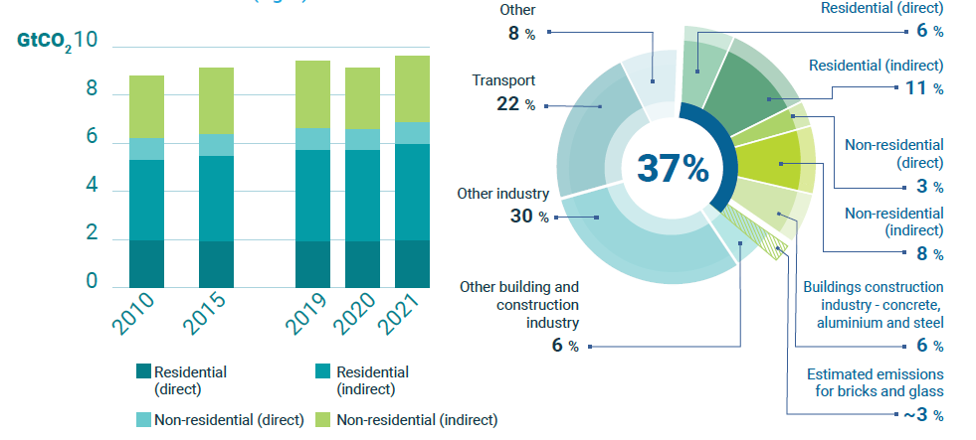
Introduction: Operational Energy Demand In Building Sector & Emissions in Building Sector
Share of Buildings in Global Energy and Process Emissions
Reference :International Energy Agency (IEA) & United Nations Environment Programme (UNEP). (2022). 2022 Global Status Report for Buildings and Construction

Slide 4
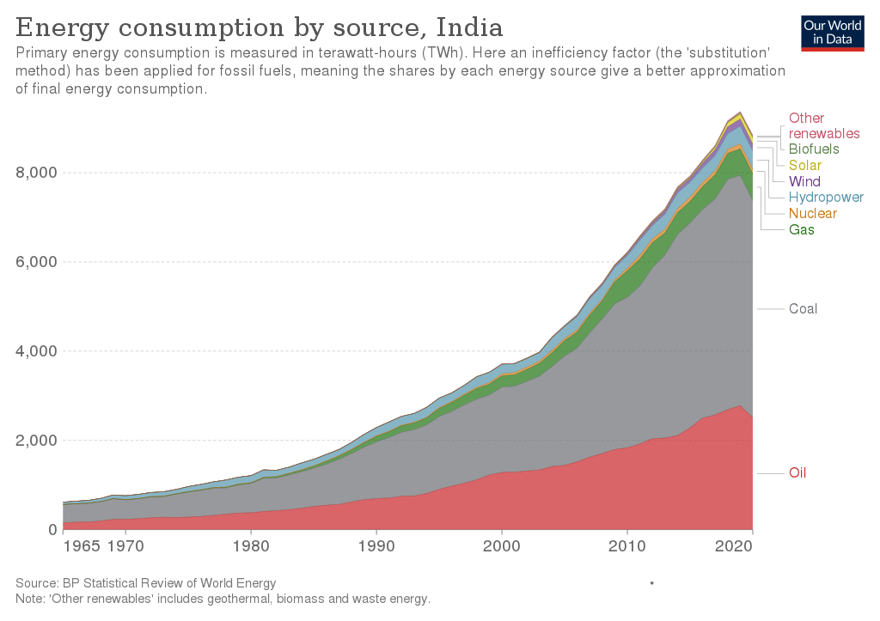
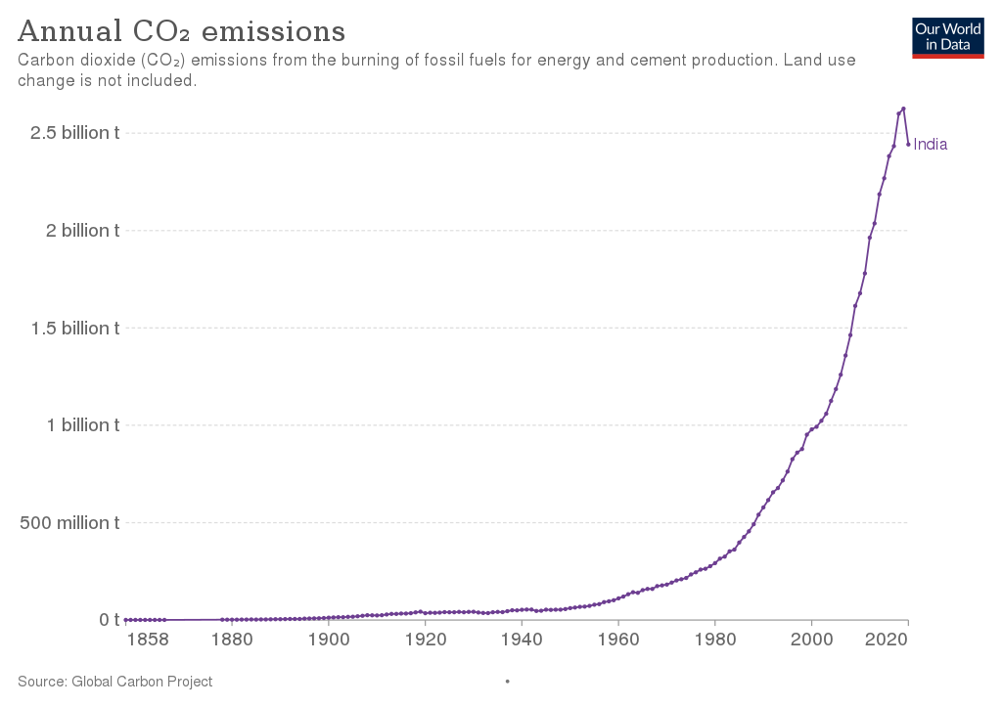
India: Soaring Emissions – 3rd largest emitter of CO2 globally
https://en.wikipedia.org/wiki/Energy_in_India

Slide 5
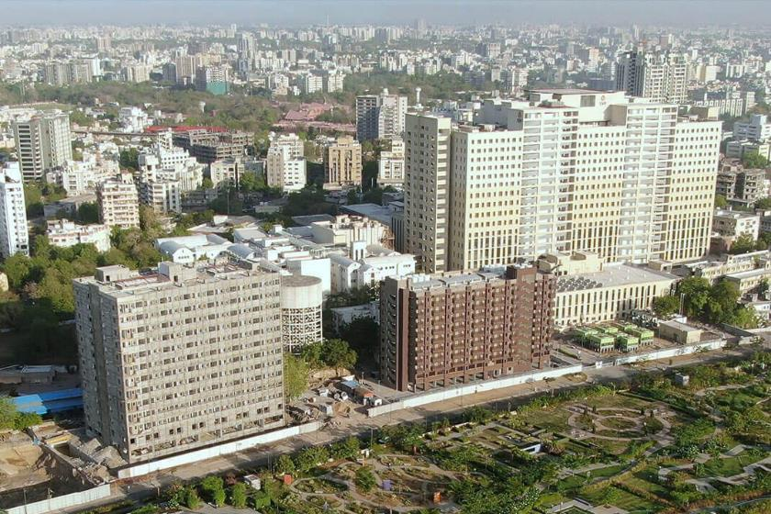
A STUDY IN OFFICES IN 2 CITIES
AHMEDABAD
MUMBAI

Slide 6
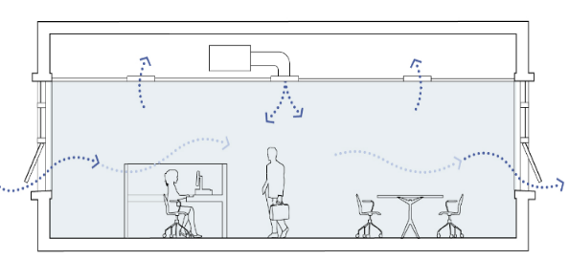
Low-Energy Strategy: Mixed Mode: Improving Building Energy efficiency and User Thermal Comfort
Mechanical cooling and natural ventilation operate in the same space at the same time.
Mechanical Ventilation
Concurrent
Optimized Window Operations
Mixed Mode Ventilation
GHG Reduction
Building switches between mechanical cooling, natural ventilation and ceiling fans on a seasonal or daily basis.
Change Over
Natural Ventilation
Controlled and Comfortable Thermal environment
Mechanical cooling and natural ventilation operate in different areas of the building.
Zoned
Improved Ventilation Rates
Fan Assisted Natural ventilation
Mixed Mode Types of Ventilation
Diagram ref: Center for the Built Environment, University of California, Berkeley ,Mixed-Mode Building Research

Slide 7
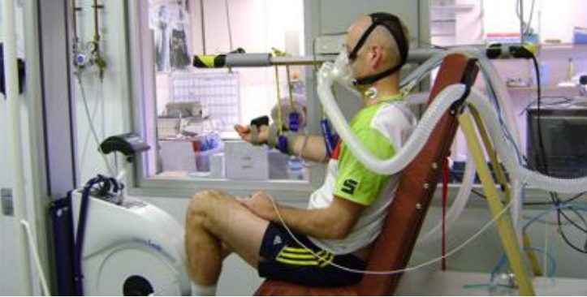
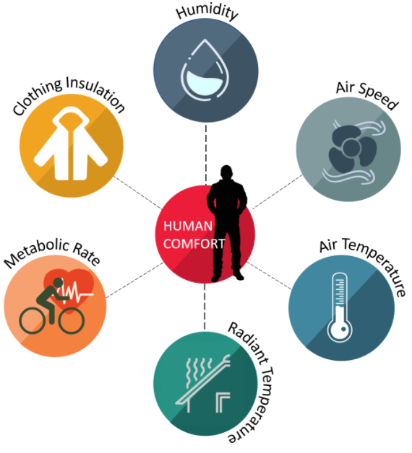
Two different Standards for Measuring Thermal Comfort: US HVAC Industry Standard AHSRAE 55
Involving 4 basic physical parameters and 2 assumed levels of Clothing and Activity
PMV
Largely based on research done in Laboratories in the USA and Northern Europe in the 1950s – 1970s
Humphreys. M., F. Nicol and S. Roaf (2015). Adaptive Thermal Comfort: Foundations and Analysis, London: Earthscan/Routledge. N: 978-0415691611.

Slide 8
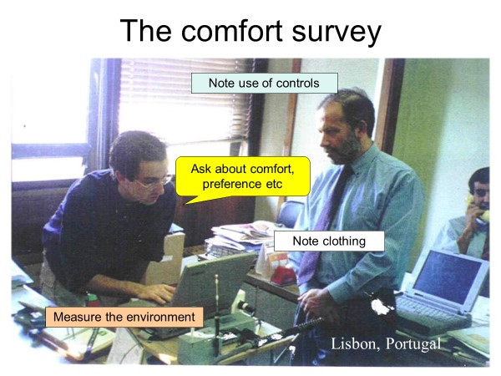
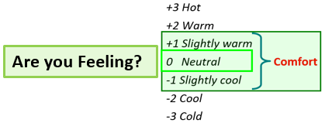
Two different Standards – 2ND: ADAPTIVE MODEL OF THERMAL COMFORT
THE ADAPTIVE PRINCIPLE: PEOPLE ADAPT TO THOSE TEMPERATURES THEY NORMALLY OCCUPY AND IF THEY ARE UNCOMFORTABLE THEY ACT TO RESTORE COMFORT

Slide 9
India Model for Adaptive Comfort (IMAC):
According to the IMAC model:
Neutral Temperatures in naturally ventilated buildings in India vary from
19.6C to 28.5 C
for 30-day outdoor running mean air temperatures ranging from
12.5C to 38.5 C.
Ref: Manu, Sanyogita, Yash Shukla, Rajan Rawal, Leena E. Thomas and Richard de Dear (2016). Field studies of thermal comfort across multiple climate zones for the subcontinent: India Model for Adaptive Comfort (IMAC), Building and Environment, Vol. 98, pp. 55-70, ISSN 0360-1323.

Slide 10
Comfort Analysis
Adaptive Comfort Band for Mixed Mode (90% (+) and 90%(-) Acceptability Limit
24°C - Fixed Setpoint Temperature as per ASHRAE-55
30 Day Running Mean of Outdoor DBT
Operating Neutral Monthly Setpoint Temperature as per the Indian Model for Adaptive Comfort
Climate Type | Duration Outside Comfort Range | Diurnal Temperature Range | Night Purging
Warm and Humid | 18% | 11°C to 32°C | Yes Possible
Hot and Dry | 55% | 8°C to 33°C | Yes Possible
Notes:
Both of these charts illustrate an analysis of comfort using a 30-day running mean of outdoor dry bulb temperature overlaid with the IMAC and ASHRAE comfort bands.

Slide 11
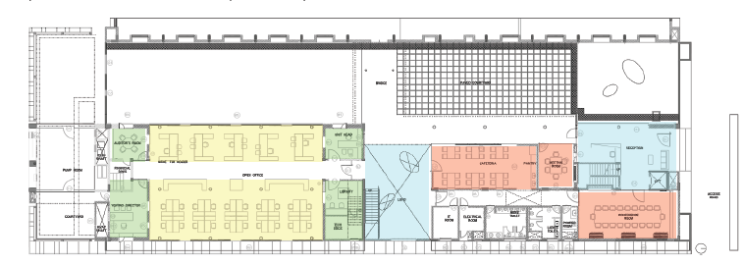
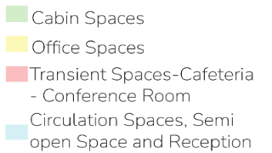
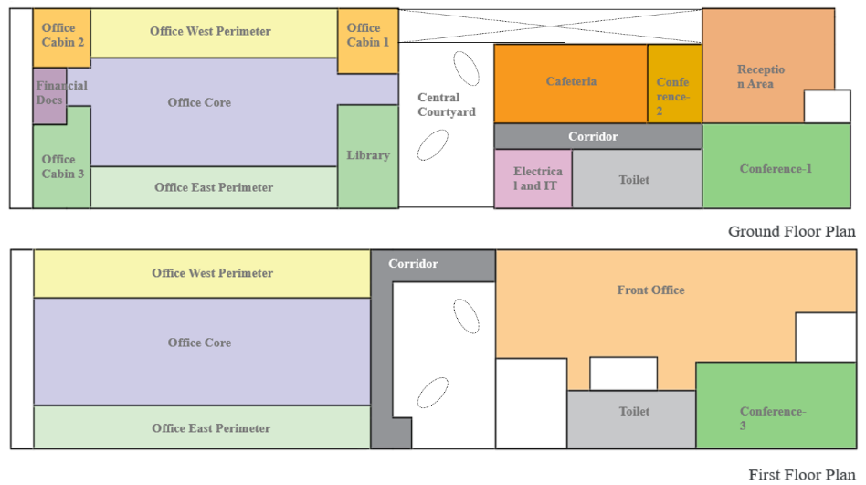
Methodology: Site Description & Thermal Zoning
Building Information
Building Type | Commercial
Location | Ahmedabad, Mumbai
Climate Zone | Hot & Dry, Warm & Humid
Orientation | E-W Longer Axis
Build- Up Area | 1287 m²
No. of Floors | G+1
Conditioned Area | 1100m²
No. of Occupants | 100 ( 0.16 person/m²⁾
Working Days | Mon - Fri
Operation Hours | 09:00 hrs- 19:00hrs
WWR | 40%
HVAC Type | VRF System (Air Cooled), CAV System and DOAS and Heat Recovery
Floor Height | 3.9m

Slide 12
Methodology
Building Envelope optimisation ( U-values , SHGC)
HVAC Systems – VRF System
Lighting Controls
Schedules
Window Aperture ratio
Thermal Zoning Strategies
Natural Ventilation Simulation
Window opening Factor
Cooling Load Analysis
CO2 Emissions
Comfort Assessment by IMAC 90% Acceptability Band
Energy and Comfort Assessment through Ceiling Fan usage ( EPI Base case vs. Proposed Case)
Model parameters: Standard Compliance : ECBC
Base Case Modelling
Boundary Conditions
Passive Strategies
Seasonal Conditioning strategies
Potential for applying Natural Ventilation
Defining acceptable Indoor Operative temperatures and Thermal Conditions
Environmental Analysis
Hot & dry | Warm & Humid
Location & Climate
Zone Groups
Adaptive thermal Comfort Cooling Setpoints IMAC (Indian Model of Adaptive Comfort )
Mechanical ventilation
Window Operation Schedules & Strategies
Zone Operative temperature Operation Schedules
Calculated Natural ventilation
HVAC Simulation
Ventilation Strategies
Control Algorithms
Operational Strategies

Slide 13
Climate Analysis: Potential For Natural Ventilation: Seasonal, Comfort Hours, & Passive Strategies
Notes:
Climate analysis to assess the viability of low-energy cooling and ventilation, aiming to pinpoint the factors affecting mixed-mode.

Slide 14
Ventilation Operation Strategies
Sr no | Mode | Setpoint Indoor operative Temperatures | HVAC system | HVAC Schedule | Setpoint | Window Operation Availability | Window Aperture ratio | Ceiling Fan | Air Conditioner | Thermal Comfort Model
1 | Natural ventilation | IMAC (Indian Model for Adaptive Comfort: Monthly Setpoints) | VRF | On 24/7 | Weekly Adaptive | ON | 95% | OFF | OFF | IMAC
2 | Ceiling Fan Assisted Natural ventilation. | 1.8°C Raised setpoint Temperature as per Elevated Fan Speed | VRF | On 24/7 | Weekly Adaptive | ON | 95% | working at 0.9 m/s | OFF | IMAC
3 | Change – Over Mixed Mode | IMAC | VRF | On 24/7 | Weekly Adaptive | Scheduled | 95% | OFF | Scheduled | IMAC
4 | Fully Air Conditioned | Fixed Setpoint (ASHRAE)- 24 Degrees’ | VRF | On 24/7 | Fixed | OFF | 5% | OFF | ON | IMAC
Notes:
Four Simulation scenarios with variations in ventilation operation strategies were developed to inform the sizing of the HVAC equipment and systems, fixed according to the study’s baseline specification(ECBC) to ensure comparability of results.
These scenarios are focused on leveraging Natural ventilation through window control logic to regulate the window opening based on the outlined criteria and maintain comfortable indoor zone operative temperatures when the HVAC system is not yet providing conditioned air.

Slide 15
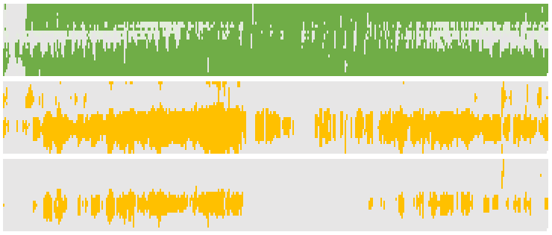
Analysis & Observation: Natural Ventilation + Ceiling Fan : Mumbai : Warm & Humid
1
1
Fully Open
Window Operation: 91.9%
Window opens when:
Tzoneair > Setpoint (IMAC Range)
Tzone air > Toutside air
Availability Value = 1
Unmet Hours for Naturally Ventilated Space - 38%
Degree of Discomfort Hours (1 to 5°C) – Observed in the NV zone We can observe that 80% of the total Unmet hours have Degree discomfort Upto 5°C.
Unmet Hours with Ceiling Fan Integration in a NV Space- 13%
(65% reduction)
9
Hours
19
0
Closed
24
1
1
Met
9
Hours
19
0
Unmet
24
1
ΔT:10° C Degree Discomfort
9
ΔT: 5° C Degree Discomfort
Hours
19
ΔT: 1° C
24
1
1
Met
9
Hours
19
0
Unmet
24

Slide 16
Analysis & Observation: Natural Ventilation + Ceiling Fan : Ahmedabad : Hot and Dry
1
1
Fully Open
Window Operation: 65% (Fully Open)
Window opens when:
Tzoneair > Setpoint (IMAC Range)
Tzone air > Toutside air
Availability Value = 1
Unmet Hours for Naturally Ventilated Space - 63%
Degree of Discomfort Hours (1 to 5°C) – Observed in the NV zone - We can observe that 80% of the total Unmet hours have Degree discomfort Upto 5°C.
Unmet Hours with Ceiling Fan Integration in a NV Space- 41% (35% reduction)
9
Hours
50% open
19
0
Closed
24
1
1
Met
9
Hours
19
0
Unmet
24
1
9
ΔT:10° C Degree Discomfort
Hours
ΔT: 5° C Degree Discomfort
19
24
1
1
Met
ΔT: 1° C
9
Hours
19
0
Unmet
24

Slide 17
Analysis & Observation: Reduction in Cooling Load (W)
Climate Type | Initial Cooling Capacity (TR) | Final Cooling Capacity (TR) | Percentage Reduction (%)
Warm and Humid | 26.74 | 24.58 | 8.07
Hot and Dry | 43.69 | 35.79 | 18.21
Notes:
From the figure, we can observe that the reduction in the cooling loads observed in the Mixed Mode and fully air-conditioned Building

Slide 18
Conclusion: Energy Performance index and Carbon Emissions
Energy Performance Index (kWh/m².year)
Ventilation Operation Scenarios | Warm and Humid | Hot and Dry
Fully AC | 123.12 | 141.26
NV | 57.4 | 58.4
NV+ Ceiling Fan | 63.1 | 64
Mixed Mode | 87.32 | 114.98
Variation in EPI observed in each scenarios
Variation in Carbon Emissions in each scenario
Notes:
Optimizing building operations through Natural Ventilation (NV) and Ceiling Fans (CF) in Mixed Mode (MM) can significantly reduce energy consumption and carbon emissions in different climates. The synergy of NV and CF extends NV hours and transforms discomfort hours into comfort, offering a sustainable approach to thermal comfort.
Study reveals that adopting passive strategies alongside efficient HVAC systems can achieve substantial energy savings (18% to 29%) and reduce carbon emissions, aligning with global Net Zero targets.

Slide 19
Conclusion: Energy Performance index and Carbon Emissions
Using the Indian Adaptive Thermal Comfort Standards (IMAC) rather than the America ASHRAE 55 Standard enabled the studies offices to operate successfully in Natural Ventilation mode and Natural Ventilation with Fan modes for much of the year resulting in radical reductions in energy used to provide comfort and in resulting carbon emissions from the offices in both Hot Dry and Hot Humid Climates in India.
This study indicates the potential energy and CO2 emission benefits of mandating for most offices to be capable of being conditioned using mixed mode methods.
Thank You
S.Roaf@hw.ac.uk

Slide 21
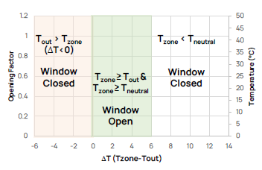

Slide 22
Analysis & Observation
Mixed Mode: Mumbai : Warm & Humid
Fig 12
Fig 12: Window Operation: 27%
Window opens when:
Tzoneair > Setpoint (IMAC Range)
Tzone air > Toutside air
Availability Value = 1
1
1
Fully Open
9
Hours
50% open
19
0
Closed
24
1
Fig 13
8500W
9
Hours
19
0W
24
1
1
Met
9
Fig 13: Hourly Variation of the Cooling Load
Fig 14: Unmet Hours: 1.14%
Hours
19
24
0
Unmet
Fig 14
From the figure, we can observe that cooling loads decrease in the pre-office hours, reducing electricity consumption during that time. In the mornings, the cooling loads ranges from 0-1200W, contingent upon the degree of Window opening. The cooling load is reduced to 0W when the windows are fully open. The maximum cooling load during the summers is noted as 8340 W

Slide 23
Analysis & Observation
Mixed Mode: Ahmedabad : Hot and Dry
Fig 12a
Fig 12a: Window Operation: 15%
Window opens when:
Tzoneair > Setpoint (IMAC Range)
Tzone air > Toutside air
Availability Value = 1
1
1
Fully Open
9
Hours
50% open
19
0
Closed
24
1
Fig 13a
8500W
9
Hours
19
0W
24
1
1
Met
9
Fig 13a: Hourly Variation of the Cooling Load
Fig 14a: Unmet Hours: 3.03%
Hours
19
24
0
Unmet
Fig 14a
From the figure, we can observe that cooling loads decrease in the pre-office hours, reducing electricity consumption during that time. In the mornings, the cooling loads ranges from 0-3200W, contingent upon the degree of Window opening. The cooling load is reduced to 0W when the windows are fully open. The maximum cooling load during the summers is noted as 8500 W

Slide 24
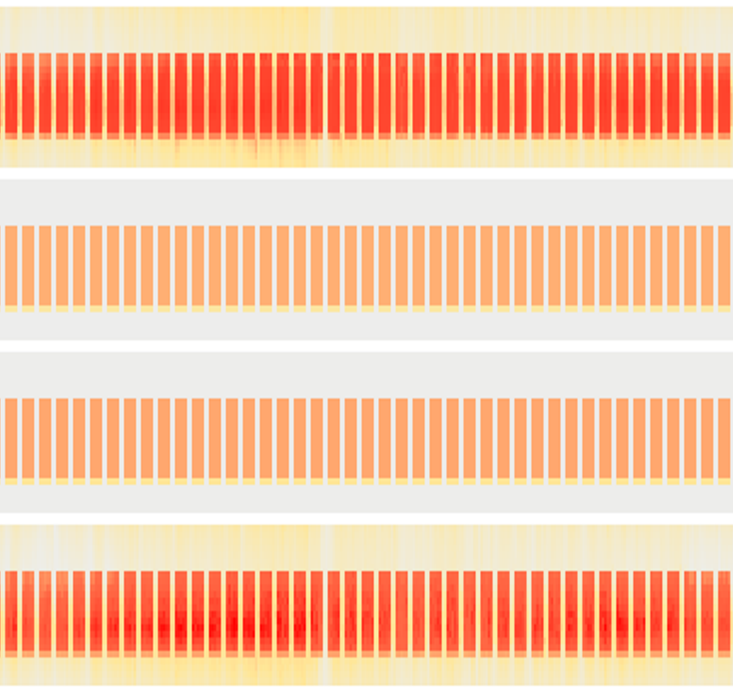
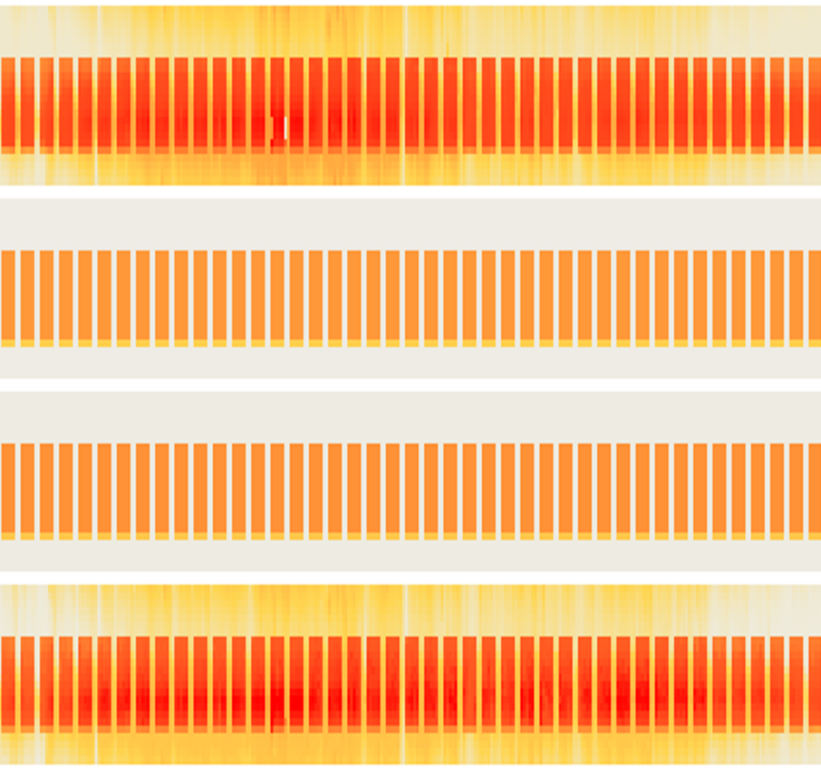
Total Electricity Demand Of the Building
Warm and Humid
Hot and Dry
60 kW
1
Fully AC: 1.85 - 45.36 kW
Fully AC: 1.64 - 58.21 kW
9
Hours
19
24
1
Natural ventilation :0.47 - 18.56 kW
Natural ventilation :0.47 - 19.56 kW
9
Hours
19
24
1
Reduction in Peak Consumption : 48%
Reduction in Peak Consumption: 66%
Fan Assisted NV :0.47 - 19.92 kW
9
Fan Assisted NV :0.47 - 18.82 kW
Hours
19
24
1
Reduction in Peak Consumption : 11%
Reduction in Peak Consumption : 19%
Mixed Mode :0.54 - 38.25 kW
Mixed Mode :0.94 - 42.09 kW
9
Hours
19
24
0 kW
Fig 16: Analyzing the reduction observed in total Energy Demand of the Building in both the Climate Zones

