Slide 1
ICARB 2023
Measuring Net Zero
Energy Efficient Retrofit Strategies towards nZE Preschool Building in Malaysia
Dr. Norhayati Mahyuddin, PhD
Associate Professor, Faculty of Built Environment, Universiti Malaya
Sep 2023

Slide 2
01
Outline
National action plans for net zero carbon in 2050
nZEB definition & retrofit challenges in Malaysia
Introduction
Method
Results
Conclusion
Energy performance audit & monitoring
Energy performance simulation - EE assessment
Retrofit alternatives implementation & potential energy savings
Summary & Future work

Slide 3
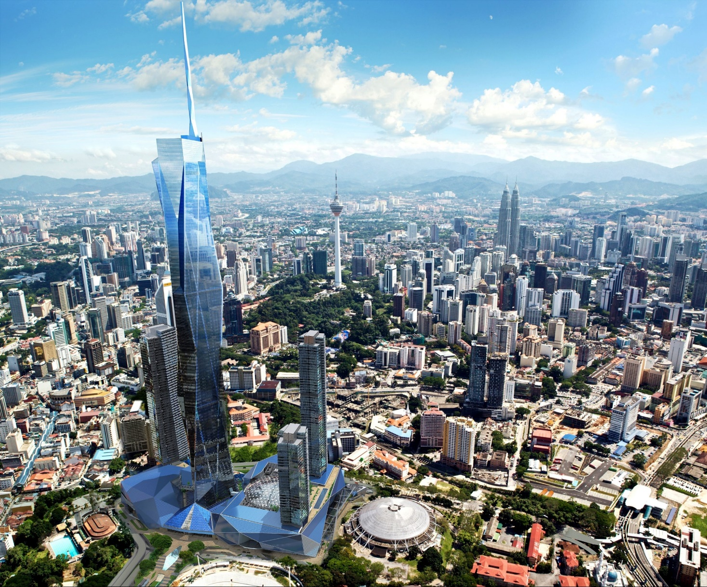
Introduction
02
Malaysia’s per capita CO₂ emissions are rising to about 8t PCPA and categorized as being above the upper middle-income countries at 6.6t PCPA
4%
5%
14%
53%
Global operational energy demand in buildings from 2020
A
B
Global operational CO₂ emissions from 2020
C
Total energy consumption in building sector in Malaysia
D
Total electricity consumption in commercial & residential

Slide 4
Introduction
03
Towards Zero Carbon
National action plans - 2050
By improving EE in the building and transport sectors, RM 46.9 billion (USD 11.2 billion) could be saved between 2016 and 2030 in Malaysia
(Lee, 2019)
12th Malaysia Plan (2021-2025)
To be carbon neutral as early as 2050; 45% reduction in GHG emissions intensity to GDP by 2030
National Energy Policy (2022-2040)
EE savings by non-residential by 11% by 2040
Kuala Lumpur Climate Action Plan 2050 (2021-2026)
To reduce energy consumption of buildings through technical specifications; To develop maximum allowable Building Energy Intensities to support increased EE; To develop a roadmap with strategies across the lifecycle of buildings to reduce GHG emissions have been prioritized
Green Technology Master Plan (2017-2030)
To achieve a nZEB scenario by 2040

Slide 5
Introduction
04
nZEB definition
To optimize passive measures:
50% reduction
Malaysia adopted the Japanese definition of nZEB with minor changes based on the climate conditions and country building standards:
01
envelope insulation, solar heat gain, daylight harvesting, airtight envelope, natural ventilation
Active measures
nZEB Measures
Buildings that realize reduction of primary energy consumption by 75% with energy saving (50% or more) and energy creation (~ 25% residual)
02
To minimize active measures:
HVAC, lighting, electrical appliances
03
nZEB retrofit challenges in Malaysia
Hot and humid conditions - as a norm
Lack of sufficient awareness among the local stakeholders - effective implementation and performance
Adoption of RE technology is not commercially viable yet - lack of experience and suitable support mechanisms in the market environment
EE investment has been regarded as risky and costly by public and building owners
To provide on-site renewable energy generation to supply and counter-balance the residual energy demand of the building

Slide 6
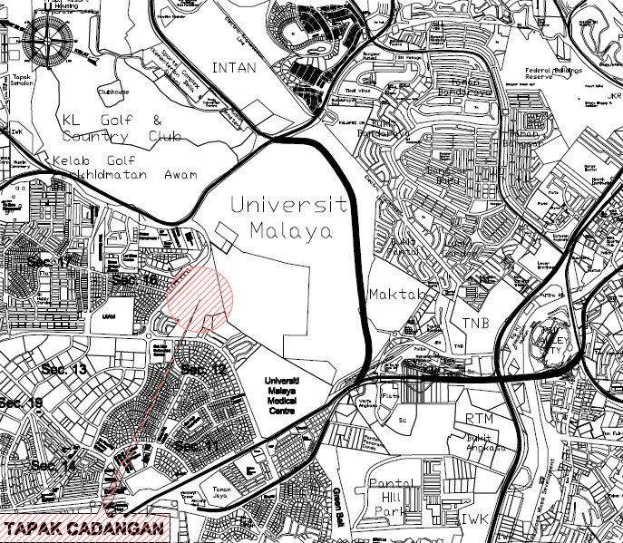
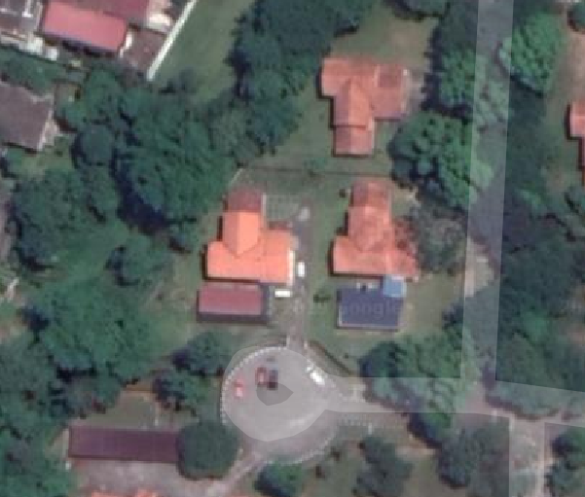
Introduction
05
Preschools
Total schools
To address the gap, an existing preschool building (TADIKUM) at the campus of Universiti Malaya was selected for nZEB refurbishment
25,200
36,249
Aims to facilitate the widespread adoption of the nZEB retrofit strategies, for existing school buildings, as a norm concept in tropical climate regions to reduce the impact that our buildings have on contributing to climate change
EE design strategies’ considerations & limitations
Simple
Easy-to-install
TADIKUM BUILDING
Working with the budget
TADIKUM was constructed in 1984 as a double-storey residential building; a change of use to educational in 2014
Do not affect the daily activities in the school

Slide 7
Method
06
Research method diagram
Location / orientation
Building envelope
Electricity bills
AC system
Lighting fixtures
Onion model approach in implementing EE strategies
01
Solar film on all windows
Retrofit alternatives implementation & potential energy savings
Energy performance audit & monitoring
Add roof insulation
Seal air vent louvered windows
Daylight harvesting
1 2 3 4 5 6 7 8 9
Energy Efficient lights
Energy performance simulation - EE assessment
03
02
Small Power improvements
Heat Recovery Wheel for fresh air intake
Model calibration
EE initiatives
Replacing AC with high COP
Electricity consumption (kWh) of:
AC
Lighting
Plug Load - Appliances
Replacing AC with highest COP
Optimized nZEB

Slide 8
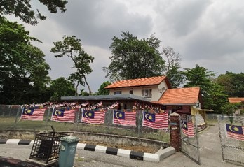
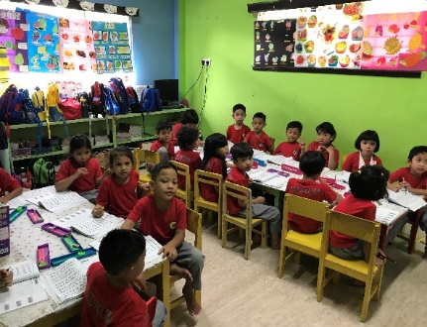
Results
07
1. Energy performance audit & monitoring
Scope
Optimal orientation in tropical climate: North-South
TADIKUM orientation: East-West
Inevitable fenestrations on east (13% WWR) and west (15% WWR) facades
Higher heat conductivity through walls & windows; higher solar heat gain through windows; glare discomfort in classrooms
Poorly sealed horizontal louvre windows on the west façade
High rate of air infiltration and poor thermal efficiency
TADIKUM East-North view
Appliances
Inadequate portion of openings on the North façade (12% WWR)
Full-day dependency on artificial lighting
Lighting (Fluorescent T8 - 36W) | 42
Air conditioner (1 HP - 9,500 Btu/h) | 5
Air conditioner (2.5 HP - 21,000 Btu/h) | 4
Ceiling Fan | 10
Air Purifier | 9
Computer | 7
Projector & TV | 1
Fridge | 1
Freezer | 1
Hot/Cold Water Dispenser | 1
Rice Cooker | 2
Printer/Copy/Scanner | 1
Water Heater | 4
Occupancy | 88
High SHGC
High WWR
Increase in solar heat gain ratio, cooling load of the building, and electricity consumption
Large windows on the south façade (45% WWR) without proper shadings
Excessive heat conductivity, solar heat gain, glare discomfort
Glazing type 6mm clear glass
High U-Value of 5.82 W/m²K; Major contributor to solar heat gain and heat conductivity through the windows
Daily operating hours: 10.00 a.m. to 4.30 p.m.

Slide 9
Results
08
2. Energy performance simulation - EE assessment
School terms
Local climate
Baseline
EE
Prerequisites criteria | EE design considerations & strategies
SHGC | The most EE factor to consider in hot and humid climate Reduction of the glazing area is not possible to decrease the high rate of WWR in TADIKUM, thus reducing SHGC values is implemented | 0.8 | 0.25
Roof insulation | Poor roof insulation: 25% of total building heat losses Cooling savings are more than 3 times higher than the insulation on the walls Simple, easy-to-install, does not affect the daily activities | No EE insulation | 50 mm Rockwool on ceiling of all roof attic
Sealing fenestrations | ASHRAE 62.1 requirement: 0.5 ACH Malaysia requirement: 1.0 ACH | 1.8 ACH | 1.0 ACH
Daylight harvesting | Solar Heat Gain Minimization (1st scenario) Glare Protection (1st & 4th scenarios) Deep Daylight Penetration (4th scenario) Uniform Daylight Distribution (1st & 4th scenarios) | 1.8 kW | 0.9 kW
EE light | LED light | 0.9 kW | 0.45 kW
Small power improvements | Use of notebook (laptop) instead of PC, EE refrigerators/printers/TV | 1.2 KW | 0.8 KW
Heat recovery wheel for fresh air intake | Most appropriate to recover both sensible and latent heat in hot and humid climate Not a feasible EE option in a leaky building: higher infiltration into the building; condensation and mould growth problems | - | 0.5 ACH
Coefficient of Performance of ACs | Feasible and available higher COP in the market (8th & 9th scenarios) | 3.0 | 5.0
 |  | 3.0 | 6.0

Slide 10
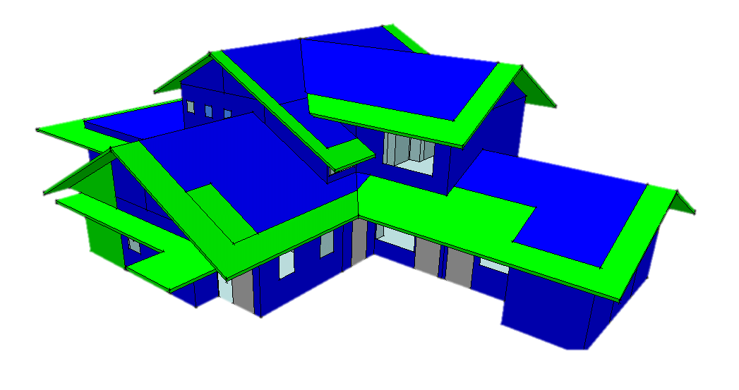
Results
09
3. Retrofit alternatives implementation & potential energy savings
Model validation
Simulated annual primary electricity consumption (IES-VE software)
Actual annual primary electricity consumption (electricity bills)
31,152.5 kWh
31,018 kWh
Simulated annual primary electricity consumption
0.4% Discrepancy
Validates the accuracy

Slide 11
Results
10
3. Retrofit alternatives implementation & potential energy savings
The strategies conducted in IES-VE in onion model approach to reach 50% or more reduction from EE improvements to reach nZEB scenario in TADIKUM building
AC electricity
Lighting electricity
Plug load electricity
Energy saving (%)
Total Electricity (kWh)
Saving Amount (kWh)
Scenario 5: Scenario 4 + Energy Efficient Lights |  | 24% | 23,683.9 | 7,468.6
Scenario 1: Strategy 1 - Solar Film
Scenario 6: Scenario 5 + Small Power improvements |  | 26.3% | 22,972.1 | 8,180.4
Scenario 2: Scenario 1 + Roof Insulation
Scenario 7: Scenario 6 + Heat Recovery Wheel |  | 31.1% | 21,449.6 | 9,702.9
Scenario 3: Scenario 2 + Seal Air Vent Louvered Windows
Scenario 8: Scenario 7 + Replacing AC with high COP |  | 53.7% | 14,430.3 | 16,722.2
Scenario 4: Scenario 3 + Daylight Harvesting
Scenario 9: Scenario 7 + Replacing AC with highest COP |  | 59.3% | 12,675.4 | 18,477.1
Scenario 4: Scenario 3 + Daylight Harvesting
Scenarios
Scenario 1: Strategy 1 - Solar Film |  | 2.4% | 30,395.1 | 757.4
Scenario 1: Strategy 1 - Solar Film
Scenario 2: Scenario 1 + Roof Insulation |  | 2.5% | 30,358.7 | 793.8
Scenario 2: Scenario 1 + Roof Insulation
Scenario 3: Scenario 2 + Seal Air Vent Louvered Windows |  | 12.2% | 27,347.5 | 3,805
Scenario 3: Scenario 2 + Seal Air Vent Louvered Windows
Scenario 4: Scenario 3 + Daylight Harvesting |  | 20.1% | 24,905.3 | 6,247.2
Scenario 4: Scenario 3 + Daylight Harvesting

Slide 12
Conclusion
11
Actual primary
Electricity: 31,018 kWh
EE strategies
Climate-responsive
ZEB-ready (>50%)
Scenario 8 – 53.7%
Scenario 9 – 59.3%
Most effective
Easy-to-install
The least impact on the daily activities
Electricity: 14,430.3 kWh
nZEB (75%)
Electricity: 12,675.4 kWh
Residual energy demand - Solar panels on TADIKUM building roof:
15% – ~ 10,000 kWh/year
BEI: 115.78 kWh/m2/year
BEI: 53.86 kWh/m2/year
BEI: 47.36 kWh/m2/year
Summary
Energy Independence
Local climate considerations; Modeller’s knowledge; Local achievable values of different materials; Appropriate implementation of local responsive systems; Local requirements & standards
Not purely data-driven approach; Not by default international standards’ inputs
EE modelling
feasibility & accuracy
Dos
Don’ts

Slide 13
Conclusion
12
Summary & Future work
This study observed and proved how implementing passive design strategies and active design technologies in an old non-climate responsive building in hot and humid weather could improve its energy efficiency by almost 60% reduction in primary electricity consumption.
The strategies employed the least structural changes on the characteristics of the building envelope due to health considerations of pupils and operation conditions of the TADIKUM preschool.
The most effective measure:
Reduction of the building’s heat loss and infiltration through fenestrations
The higher COP implementation
High airtightness strategies should be accompanied by proper air ventilation to reduce the cooling load and prevent excessive moisture, condensation, and mould growth risks in the building
In this paper, energy-efficient retrofit strategies towards nZEB were investigated. The life cycle cost and payback period analyses for each implemented scenario will be presented in a future paper

Slide 14
Thank you!
Authors:
Assoc. Prof. Dr. Sr Norhayati Mahyuddin
Faculty of Built Environment
Universiti Malaya
hayati@um.edu.my
Mozhgan Samzadeh
Faculty of Built Environment
Universiti Malaya
mozhgan.s@um.edu.my
Grant number: IIRG015A-2019
1
3
2

