Slide 1


Toward Passive Survivability
Barriers and Opportunities to Optimize the Built Environment for Greater Thermal Safety
Daniel Overbey, AIA, NCARB, LEED Fellow (BD+C, ID+C, O+M), WELL AP, EcoDistricts AP, ActiveScore AP
8th International ICARB Conference 2023
Measuring Net Zero: Carbon Accounting for Buildings and Communities
Edinburgh, Scotland
September 25 – 26, 2023
Notes:
Hello everybody, my name is Dan Overbey.

Slide 2
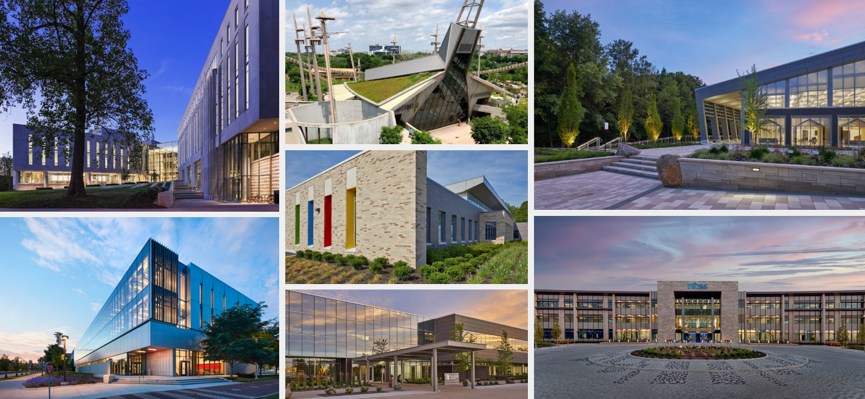
Images courtesy of Browning Day
Notes:
I am an Associate Principal at Browning Day in Indianapolis, Indiana – a leading architecture firm in the US Midwest for sustainable design.

Slide 3
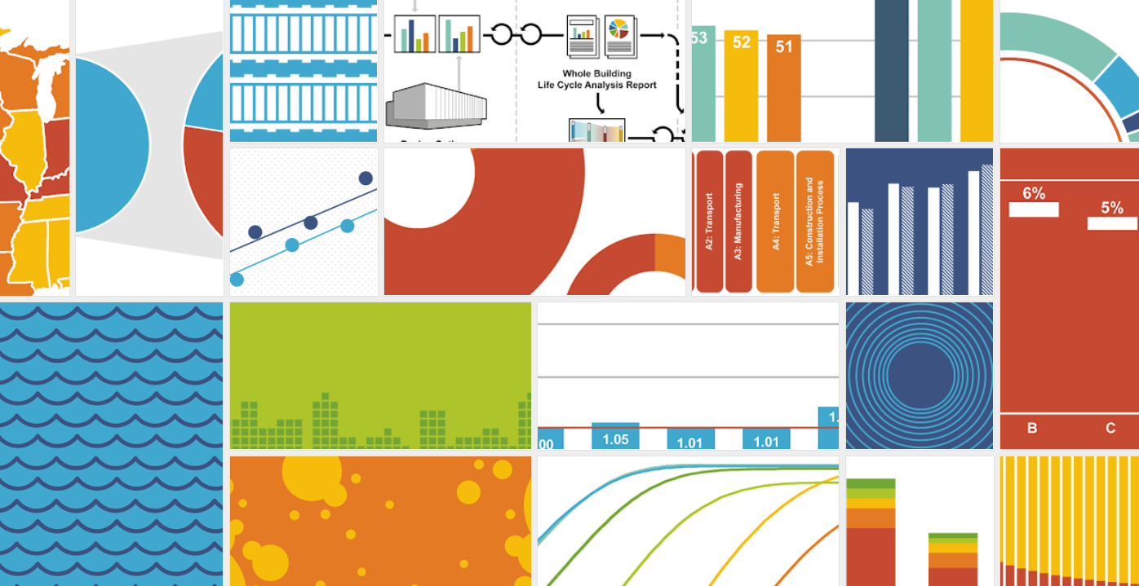
Notes:
I am also building science educator at Ball State University in Muncie, Indiana – where I get to regularly MAKE METRICS RELATABLE AND INTERESTING.
Which is what I am aim to do for the next 20 minutes.

Slide 4

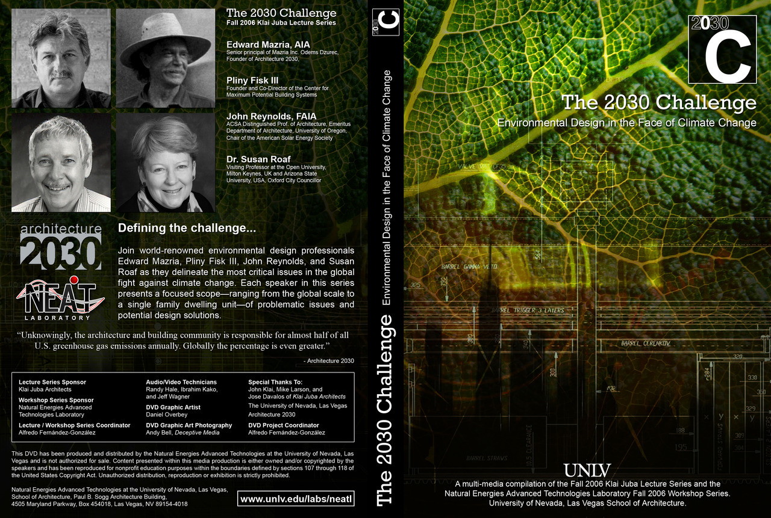
Notes:
I was honored and excited when my colleague, Alex Wilson (Director of the Resilient Design Institute) connected me with Sue for this conference to share some of our recent work.
I have been an admirer of Sue's leadership since I had the pleasure of hosting her at the University of Nevada, Las Vegas (UNLV) 17 years ago (2006) as part of the 2030 Challenge Lecture series.
Ed Mazria actually gave us a preview one of the first 2030 Challenge keynotes, which was given in Los Angeles the day after he addressed our college.

Slide 5

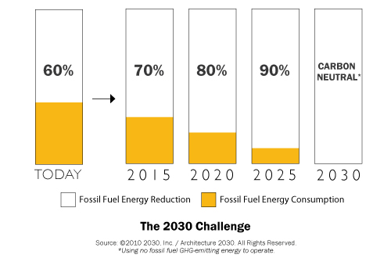
50%
60%
70%
80%
90%
Source: 2030 Inc. / Architecture 2030. All rights reserved. *Using no fossil fuel GHG-emitting energy to operate.
Notes:
The 2030 Challenge was simple: Immediately reduce fossil fuel energy use in buildings by 50% and then cut 10% more every five years until we reach carbon neutrality in 2030.

Slide 6
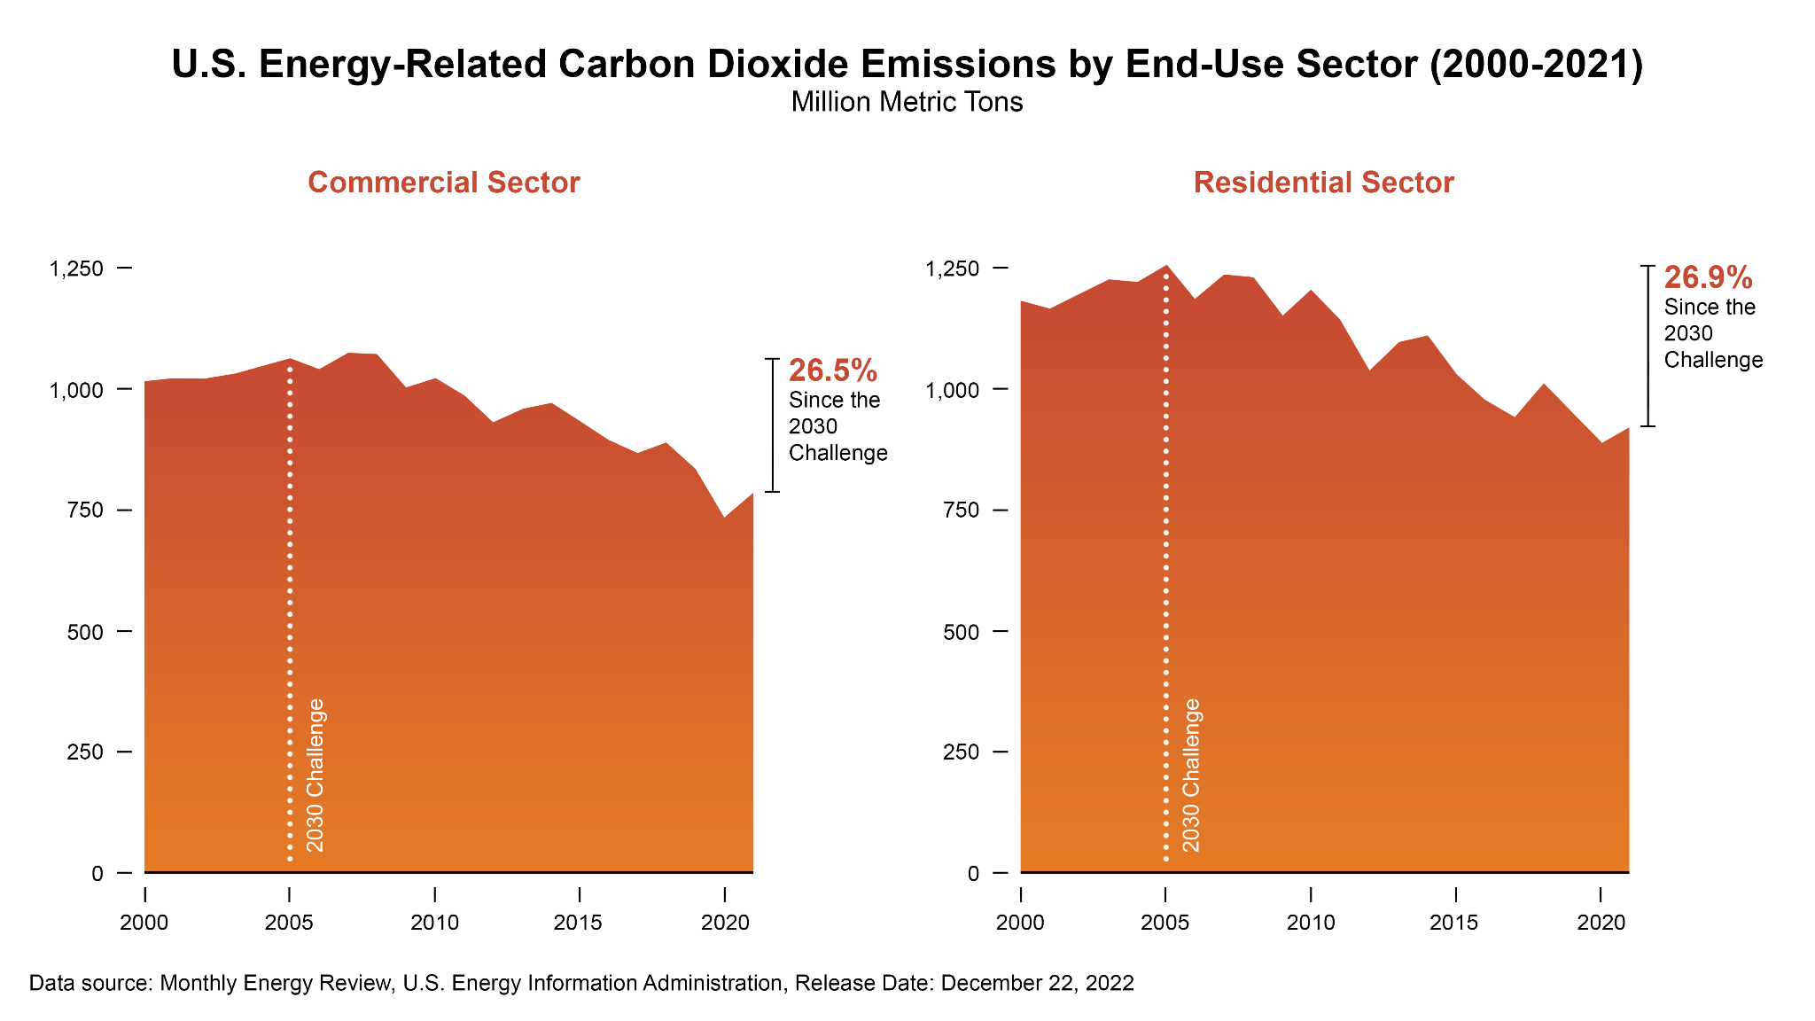
Source: Daniel Overbey
Notes:
How have we done in the States?
On one hand, we have made significant cuts in both the commercial and residential building sectors since the 2030 Challenge was issued.
But it's clearly not deep enough, fast enough.

Slide 7
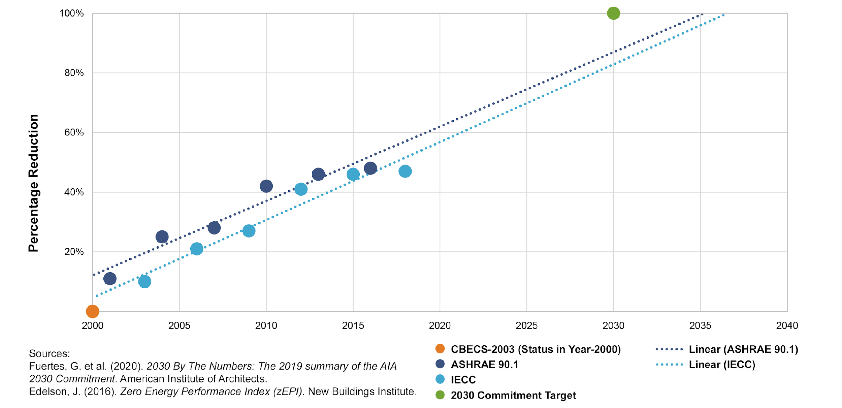
Influence of the Minimum Standard
LEED BD+C v4
LEED BD+C v4.1
2023
Source: Daniel Overbey
Notes:
Our model codes and standards in the US have fallen off of their 2030 trajectories.
Even the LEED rating system, which references these same documents, consequently, falls staggeringly short.

Slide 8

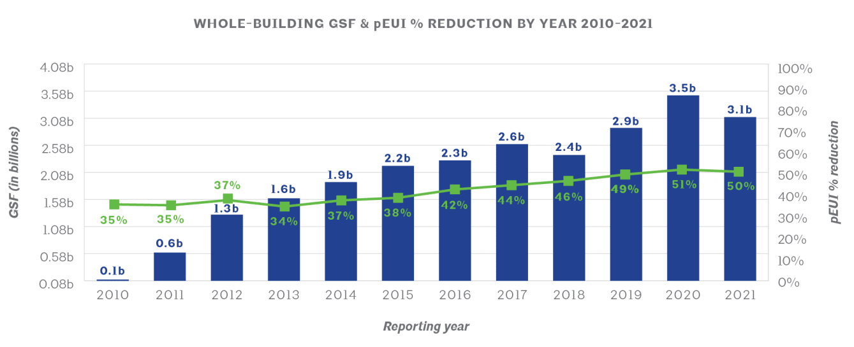
Source: American Institute of Architects
Notes:
The AIA's +1000 firms who have signed up for the 2030 Commitment have FLATLINED in their progress.
It has taken these leading firms 15 years to meet Ed Mazria's 50% starting point.
Moreover, these firms represent 0.1% of total architecture firms in the US.
--
(79,000 firms per US Bureau of Labor Statistics (0.001265 or 0.1%))

Slide 9

The global carbon binge continues
Notes:
Yet, our global carbon binge continues.

Slide 10
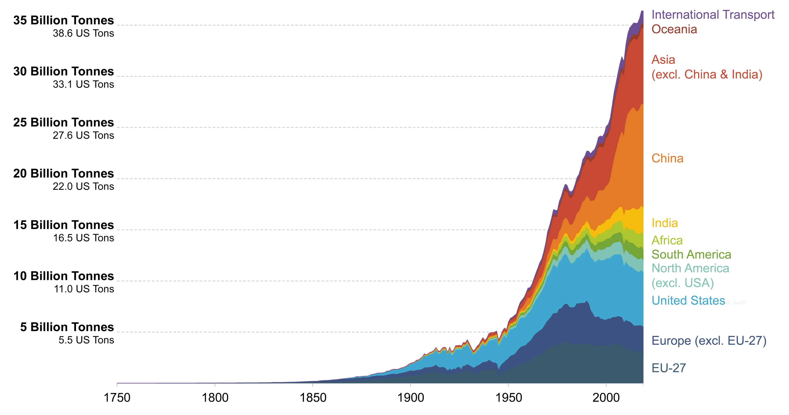
Source: Our World in Data, 2020; Global Carbon Project
Notes:
Since the Industrial Revolution, we have seen an exponential increase in global greenhouse gas emissions - across all regions of the globe.
The US and Europe combine for about 1/3 of total emissions.

Slide 11

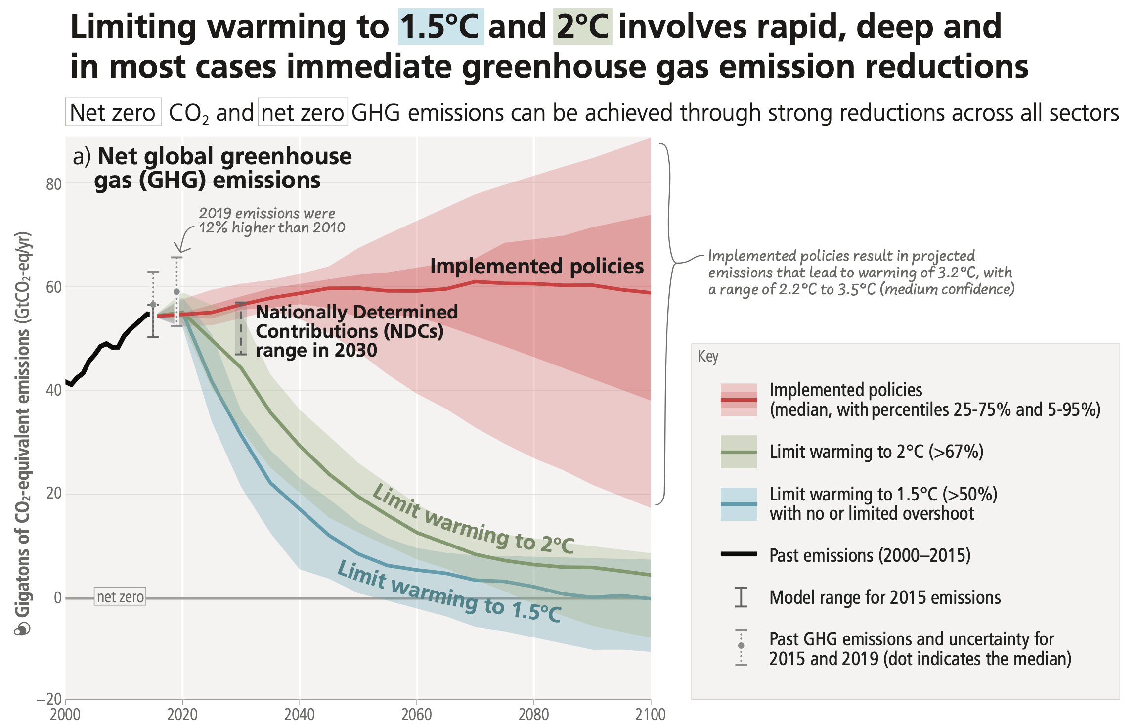
Excerpt from the Synthesis Report of the IPCC Sixth Assessment Report (AR6)
Notes:
Per the IPCC (sixth assessment report) AR6 Synthesis Report, current policies are likely to maintain a FLATLINE in emissions reductions - nowhere near the cuts we need to limit warming to 2*C or better.

Slide 12

The consequences of our collective flatlining.
Notes:
There has been - and will continue to be - consequences for our collective FLATLINING...

Slide 13
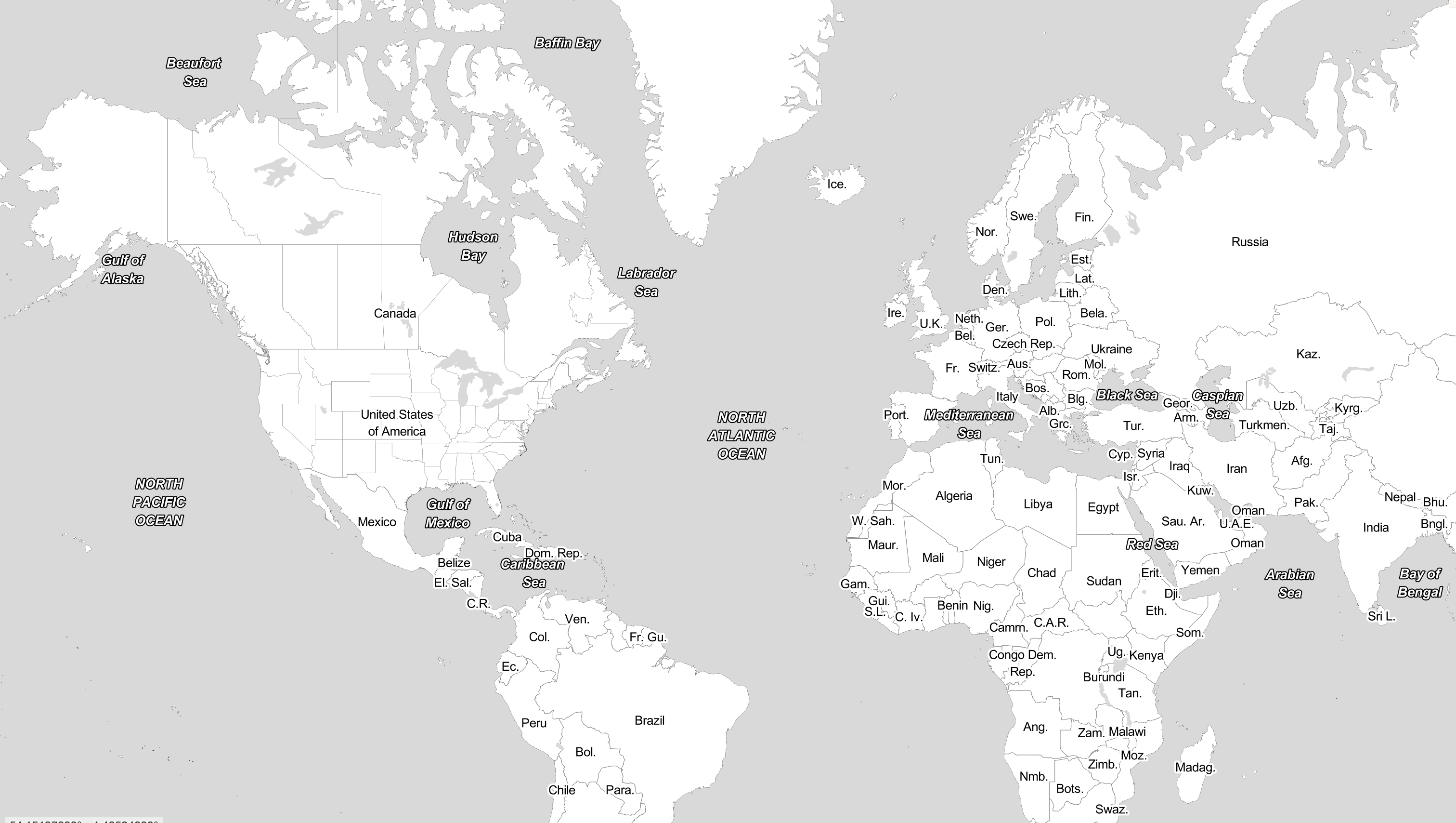
Notes:
This is where Alex’s story comes in.
In New Orleans, Louisiana.

Slide 14
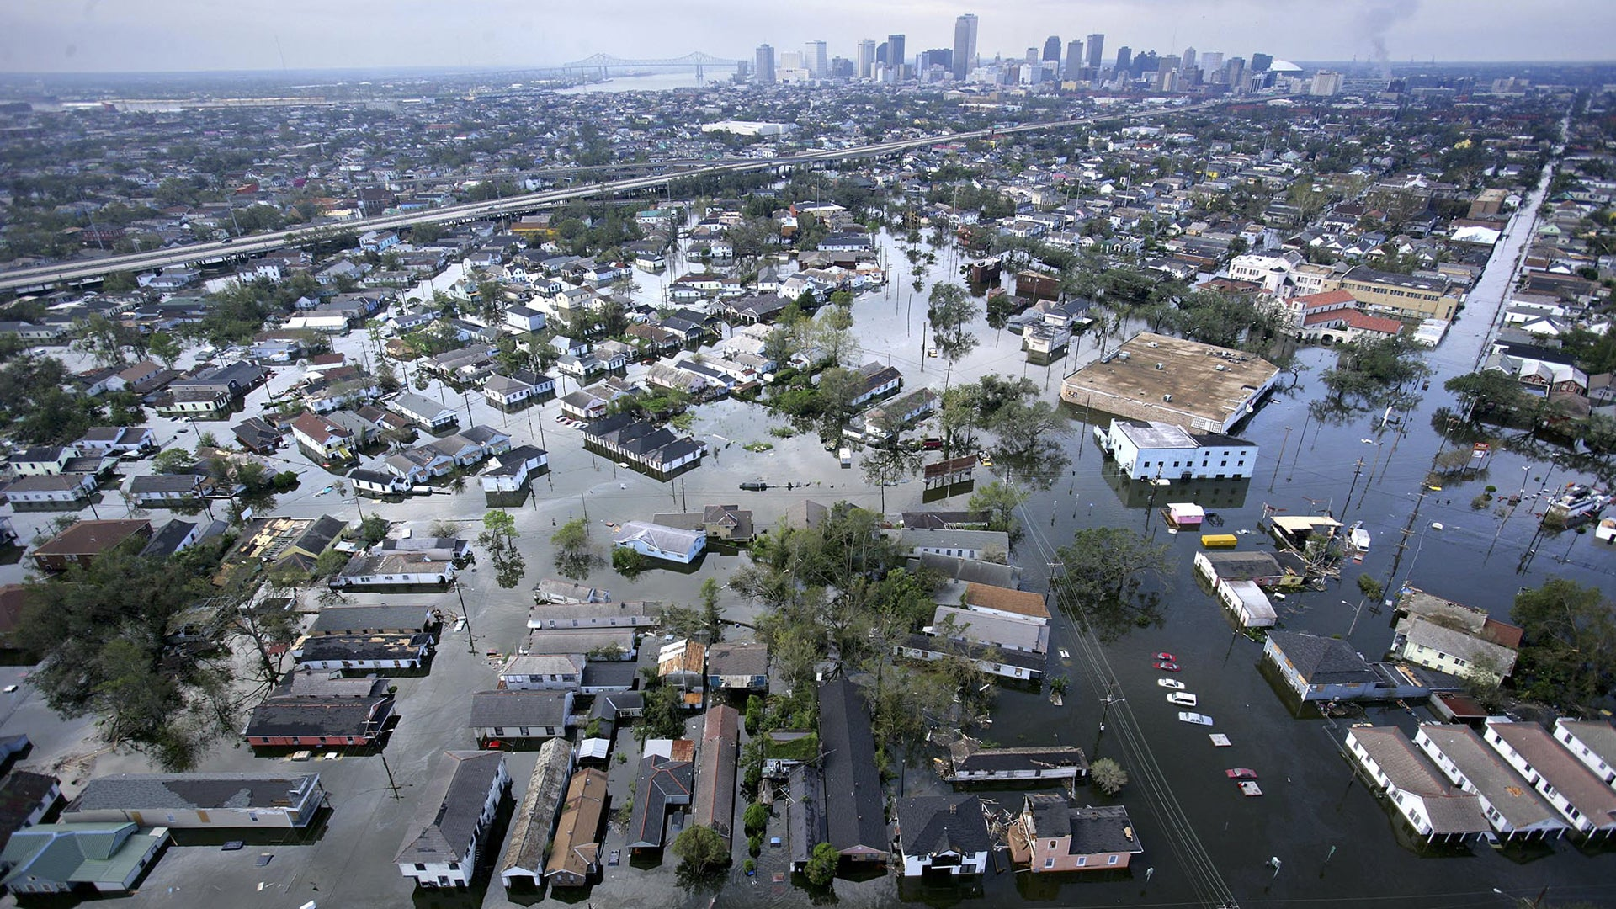
Source: History.com
Notes:
Where Hurricane Katrina devastated this major US city in late August 2005.

Slide 15
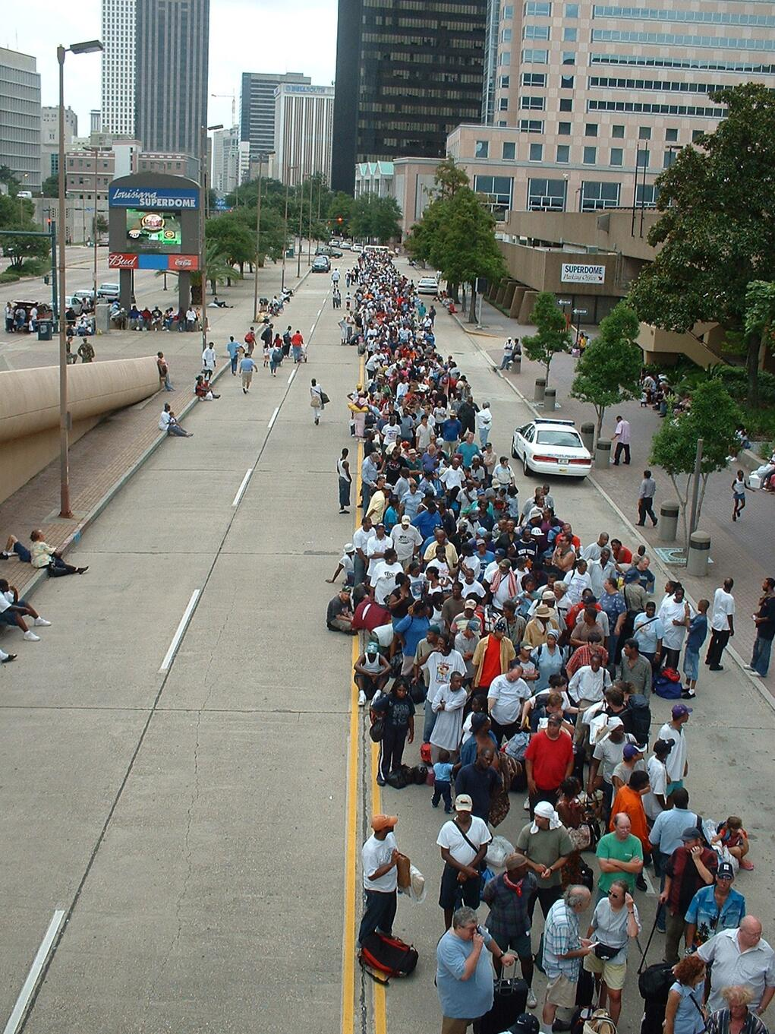
Hurricane Katrina in 2005
Building performance without power
Thousands of residents evacuated to the Superdome.
Then evacuated FROM the arena a day later.
The building wasn't able to maintain safe conditions without power.
Older homes without power did better than homes built since the 1940s.
Shouldn't today's homes do at least as well as those our grandparents and great-grandparents built?
Photo: Marty Bahamon, FEMA
Notes:
Thousands of residents were forced to evacuate their homes due to flooding.
Many took refuge in the 83,000 seat Superdome. Only to be evacuate away a day later. The arena was not able to maintain safe thermal conditions without power.
Older homes in New Orleans fared fine without power. These pre-war structures were in the “shotgun” vernacular and designed without needing to rely on mechanical air conditioning.
Shouldn’t today’s homes do at least as well as those our grandparents and great-grandparents built?

Slide 16
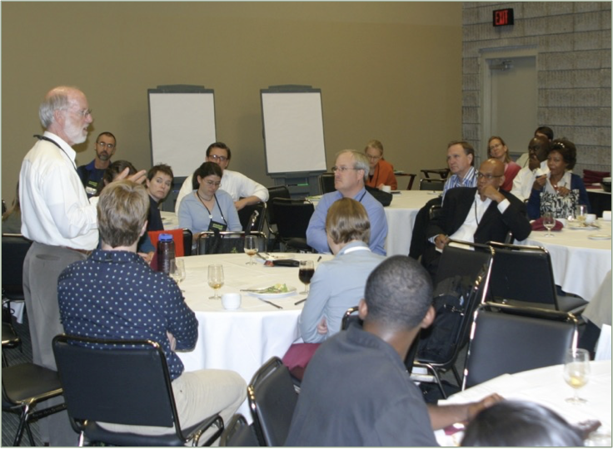
The New Orleans Principles in 2005
Two-day charrette in Atlanta, Oct 2005
Sponsored by USGBC.
200 participants; large delegation from the Gulf Coast.
Outcome: The New Orleans Principles.
A set of ten principles to guide the reconstruction in New Orleans.
Hurricane Katrina Charrette in Atlanta, October 2005
Photo: Alex Wilson
Notes:
Alex and a group of roughly 200 participants gathered in Atlanta a few weeks after Katrina to being the redesign and rebuild of the city.
The outcome was the New Orleans Principles.

Slide 17

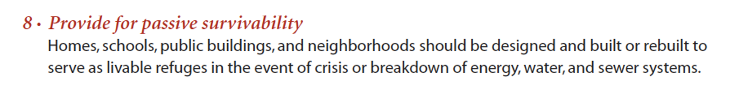
Passive Survivability
One of ten principles in The New Orleans Principles
The idea that our buildings should be designed and built to keep occupants safe in the event of an extended power outage or loss of heating fuel.
Passive design that makes sense for the bioclimate—vernacular architecture.
Taking advantage of today's advanced insulation materials, high-performance glazing, software design tools.
Photo: Alex Wilson
Notes:
Among the 10 principles is number 8, exhibited here: Provide for Passive Survivability.
”Homes, schools, public buildings, and neighborhoods should be designed and built or rebuilt to serve as livable refuges in the event of crisis or breakdown of energy, water, and sewer systems.”

Slide 18

The acute threat was flooding.
The chronic threat is thermal stress.
Notes:
The acute threat during Katrina was FLOODING.
We quickly learned that the chronic threat was (and IS) THERMAL STRESS.

Slide 19
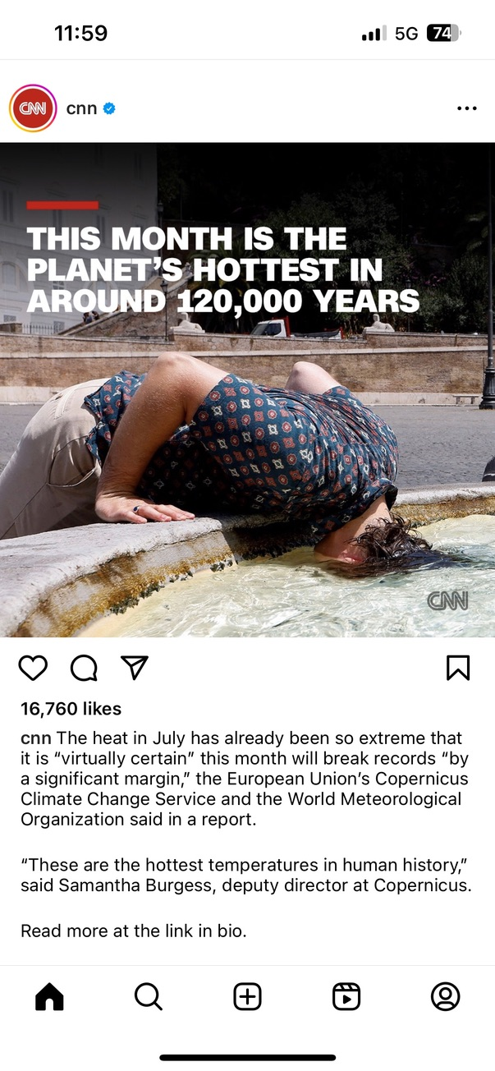
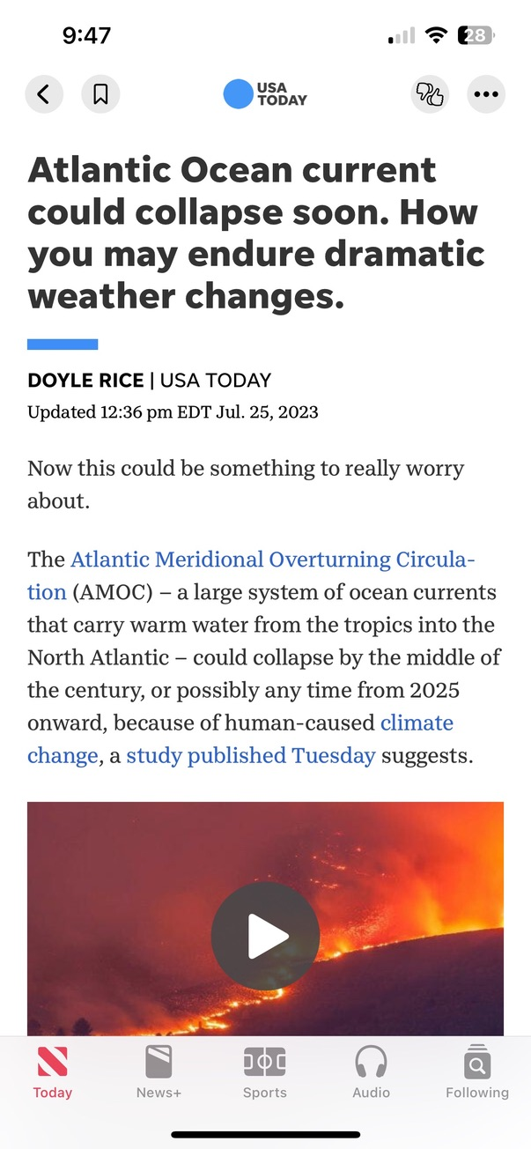


Slide 20
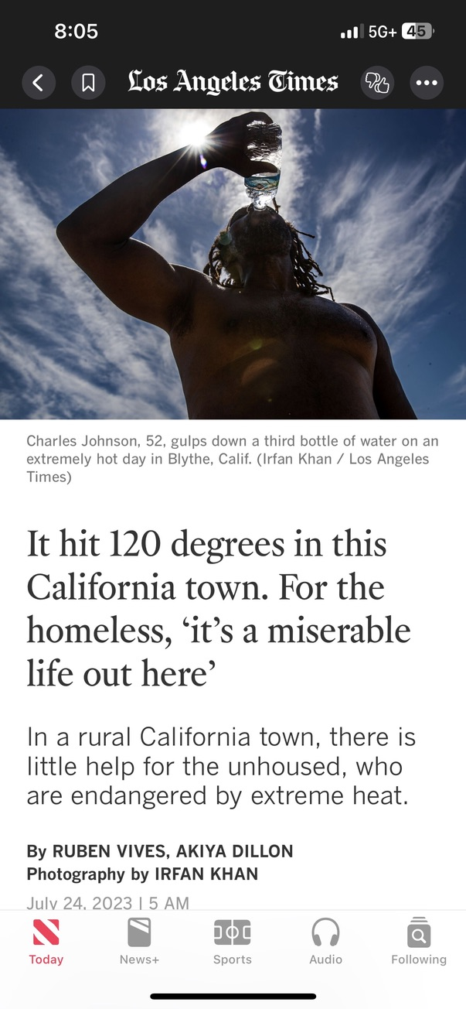
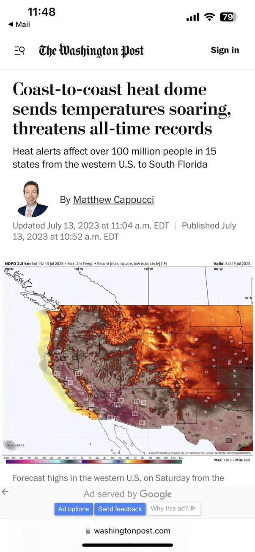
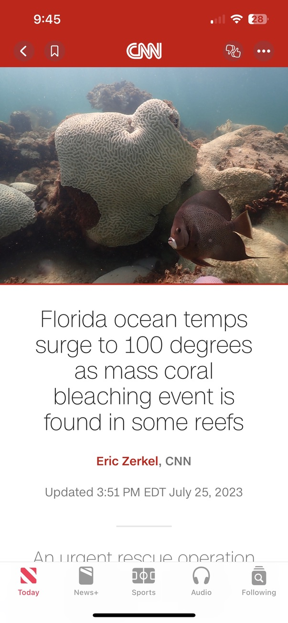

Slide 21

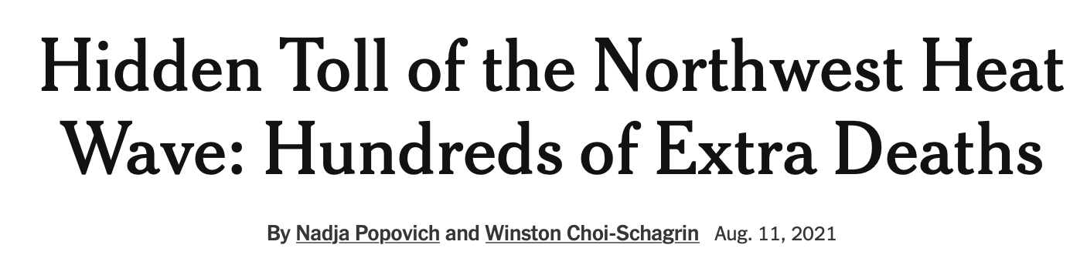
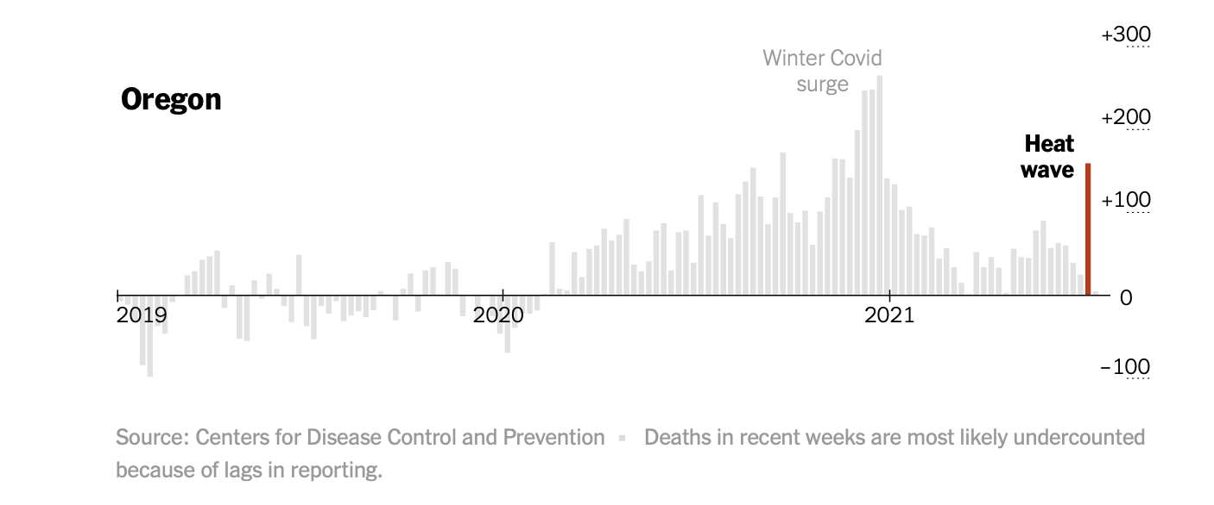
Source: New York Times

Slide 22
Concerns over thermal stress has resulted in institutional guidance for passive survivability.

Slide 23

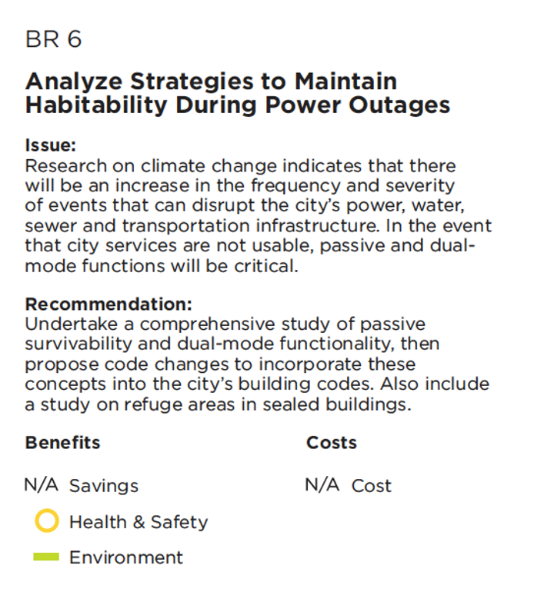
Passive Survivability Addressed by New York City in 2010

Slide 24
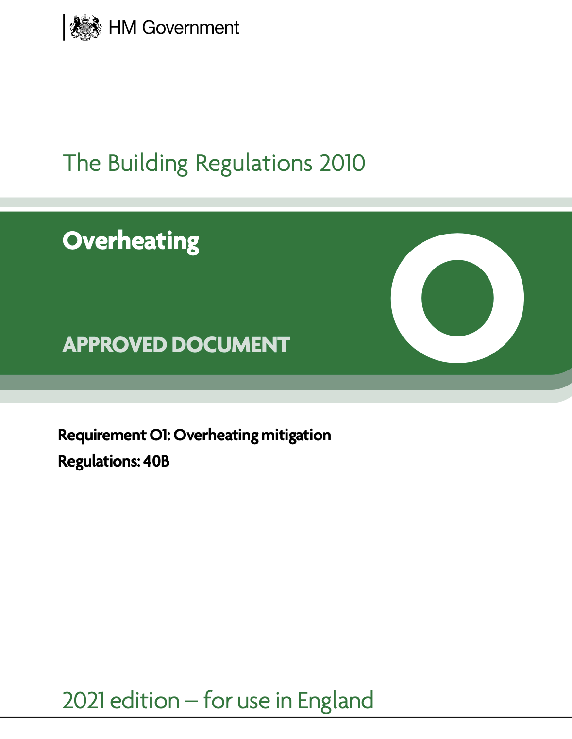
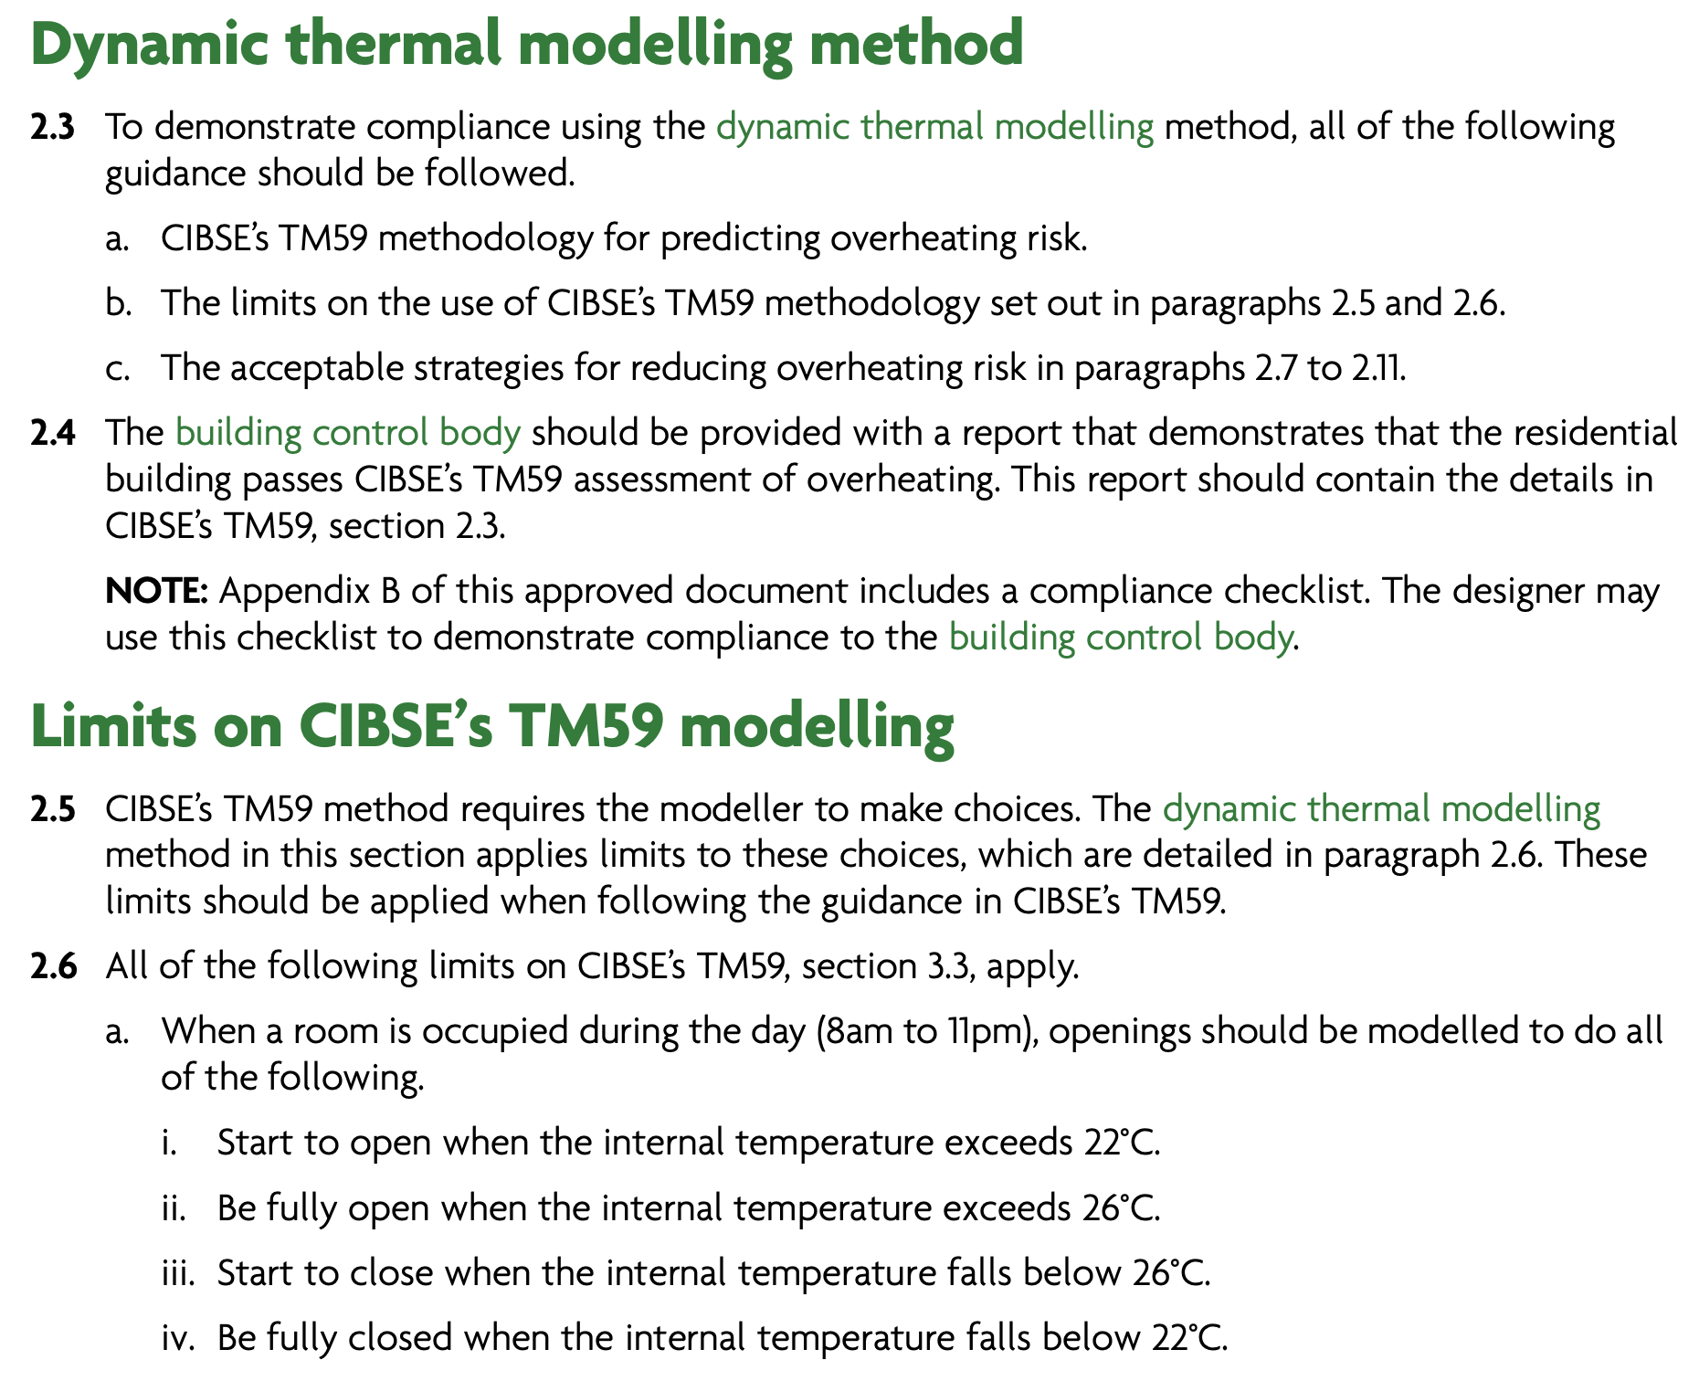
UK Introduced Overheating Regulation in 2010
Notes:
Scope: Overheating, applies to new residential buildings only.
Metric: For naturally ventilated homes- Hours of exceedance, additionally for bedrooms fixed operative temp threshold.
For mechanically ventilated homes, fixed operative temperature threshold.
22°C = 71.6°F
26°C = 78.8°F

Slide 25
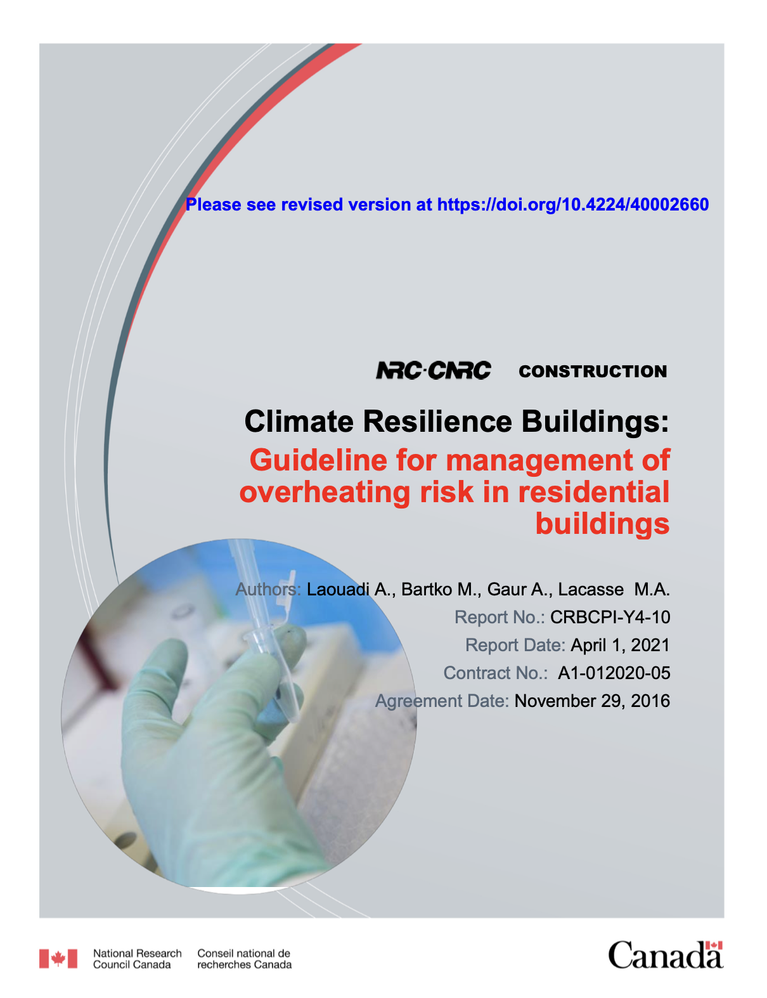
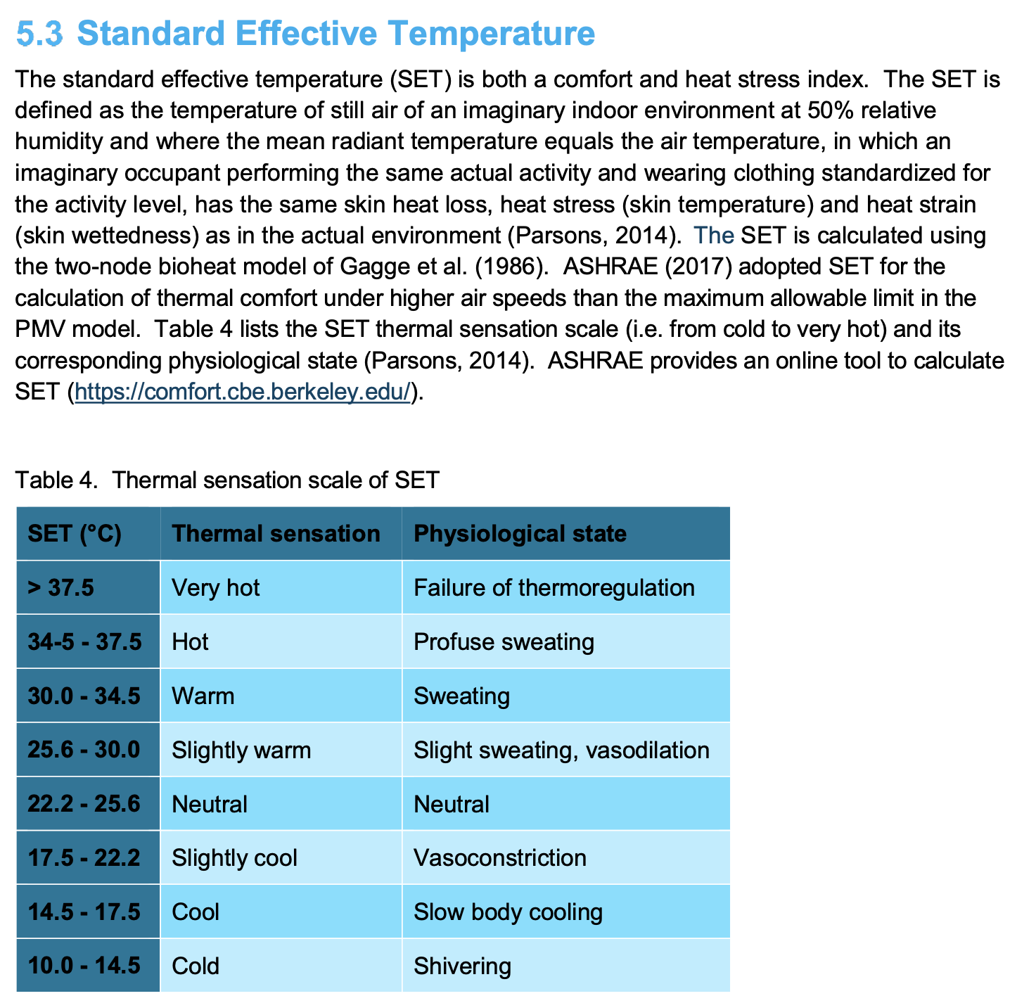
Canada Issued Climate Resilience Guidance in 2016
Notes:
Scope: Overheating in residential buildings located in typical cold climates.
Metric: SET thresholds for occupants in the sleeping and active states, for different building types, adaptation and age groups.

Slide 26
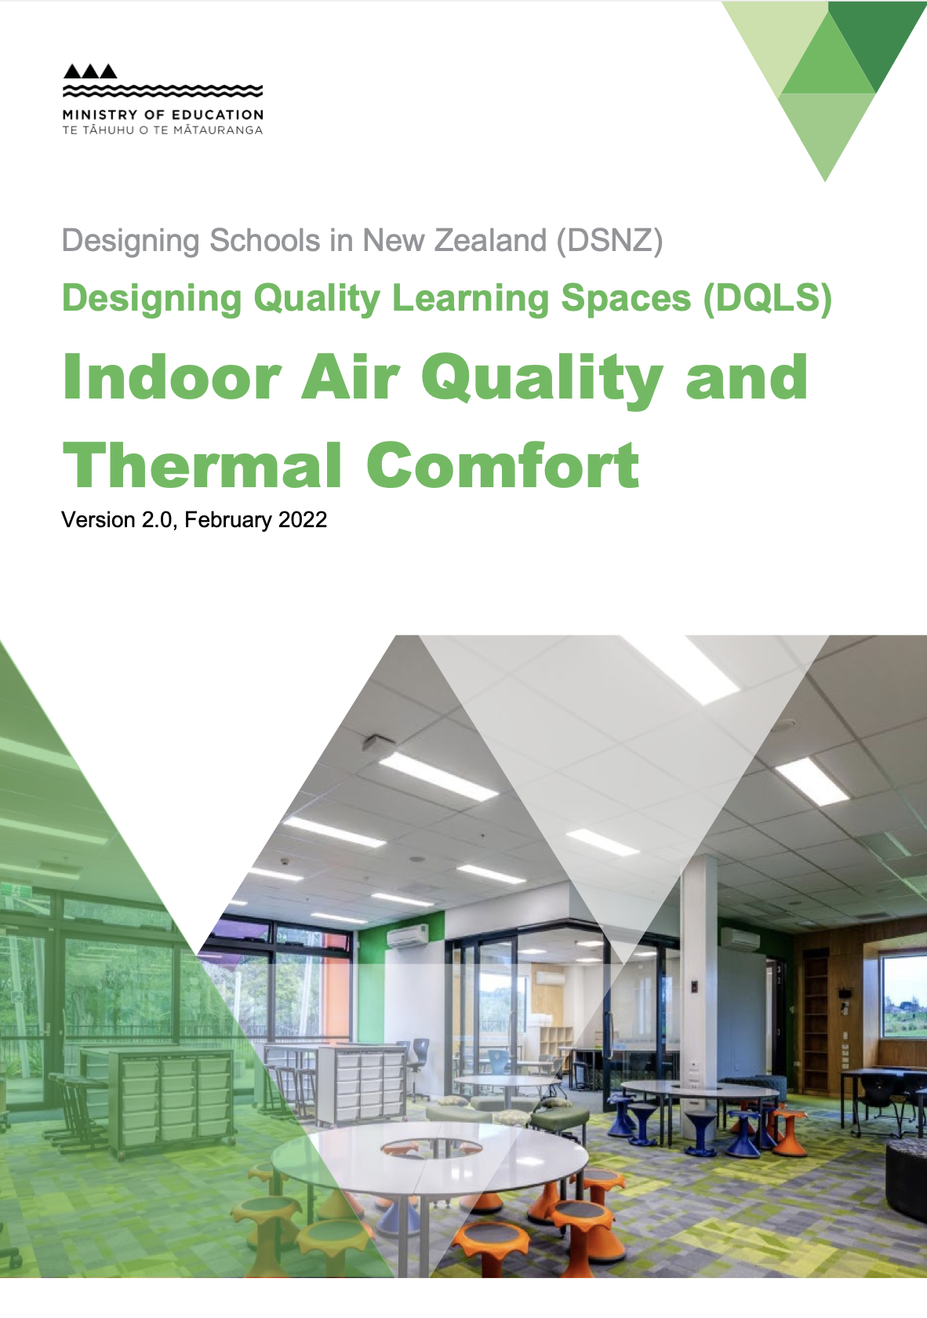
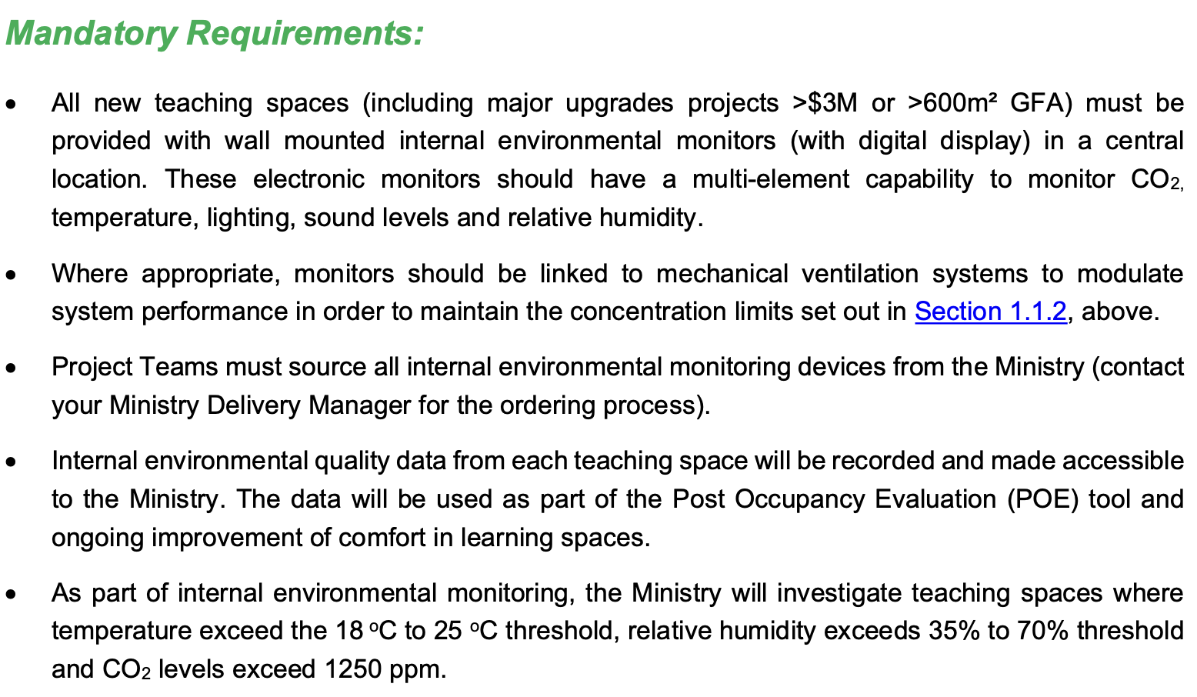
New Zealand Addressed Overheating in 2017
Notes:
Scope: IAQ & Thermal Comfort, applies to new and refurbished school buildings.
Metric: CO2 concentrations (800 -1250 ppm) and
Temperature (18-25°C) (64.4-77°F)

Slide 27
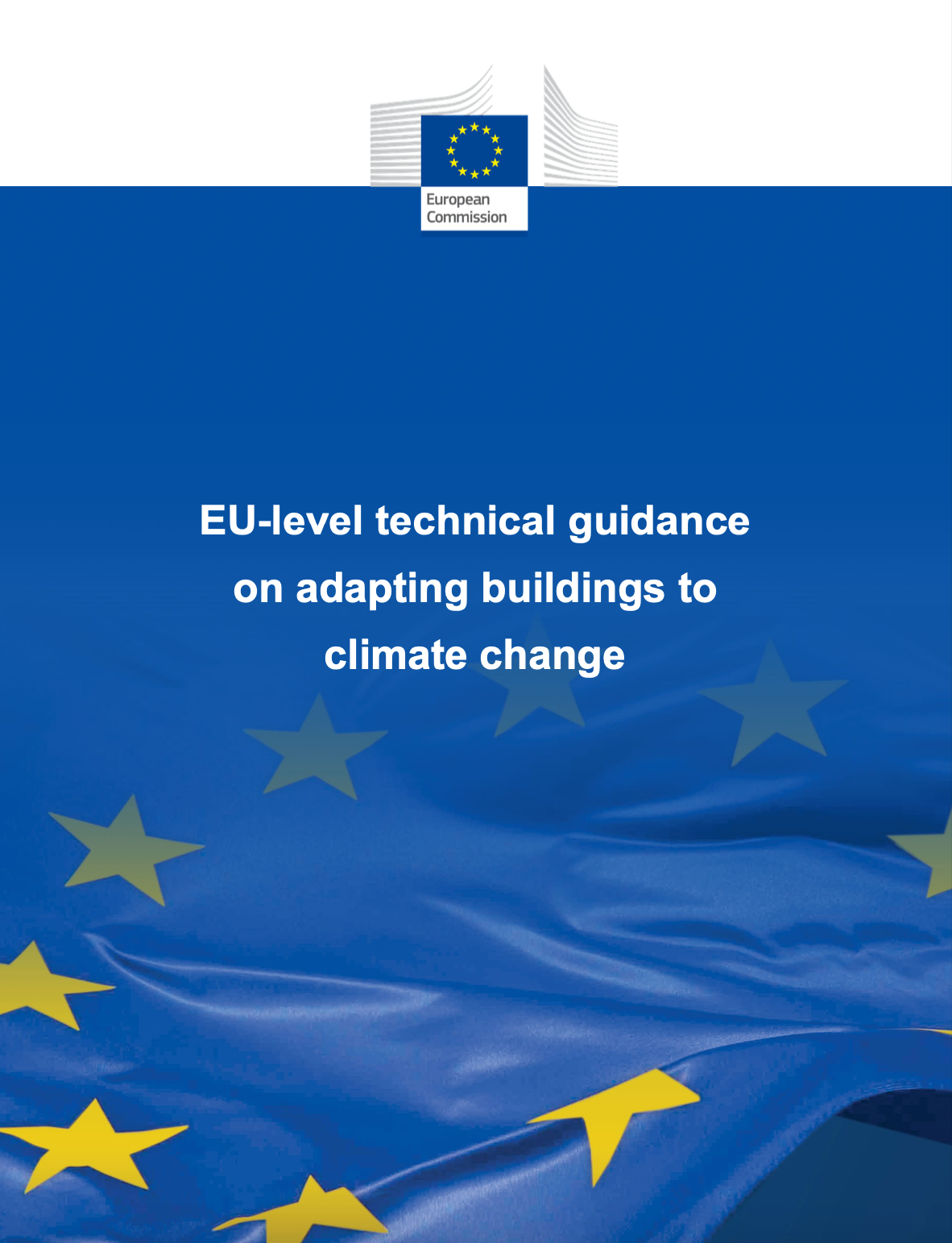
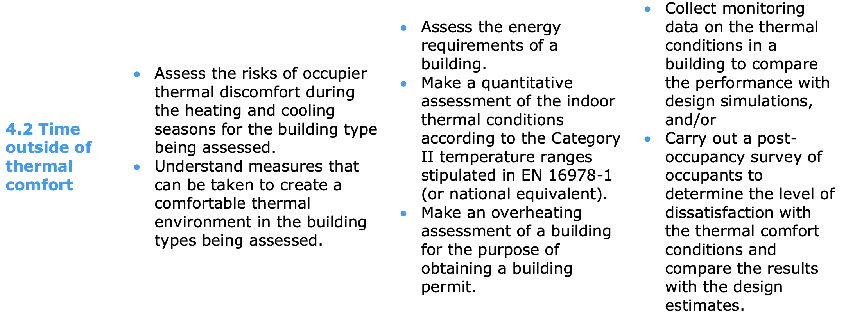
UK-Level Technical Guidance on Adapting Building in 2023
Notes:
Scope: Multiple hazards: Heatwave, Flooding, Storms, Subsidence, Heavy precipitation,
Drought. (for both new and existing buildings)
Provides best practices for each hazard and proposes a climate resilience rating approach based on vulnerability and risk assessment.

Slide 28
Building Strategies to Achieve Passive Survivability
Provide high levels of insulation.
Install high-performance glazing.
Incorporate passive solar design.
Orient building on an east-west axis.
Include thermal mass in the building.
Provide natural ventilation.
Provide nature daylight.
Incorporate cooling load avoidance strategies:
Reduce glass on east & west.
Overhangs on the south to block summer sun.
Spectrally selective (sun-control) glazing.
Exterior window treatment, awnings, roller blinds.
Reflective roofs.
Deep overhangs or wrap-around porches.
Notes:
Passive Survivability is not magic. It’s all about tapping into the natural energy flows of a site to create safe and enduring structures.
These strategies make sense for resilience AND energy efficiency.

Slide 29
Resilient design and sustainable design: Do they overlap?
Notes:
Which gets us to the foundational question that brings me here today.
Does resilient design and sustainable design OVERLAP?

Slide 30
Sustainable Design
Energy-Efficiency
Water-Efficiency
Healthy Buildings
Materials Optimization
Site Ecosystem Services
Low/Zero-Carbon Design
Net-Zero Energy
Net-Zero Carbon
Net-Zero Water
Passive Survivability
Rainwater Management
On-Site Renewables
Walkable Communities
Resilient Design
Thermal Safety
High-Wind Resistance
Redundant Power
Back-Up Power
Earthquake Resistance
Fire Tolerant
Source:
Resilient Design Institute
Notes:
When you pursue NET-ZERO, you necessarily address both Sustainable Design and Resilient Design.
BUT we have largely failed to achieve basic levels of passive survivability.

Slide 31
3
barriers to passive survivability uptake:
Notes:
Through my work with Alex, RDI, and others, we've determined 3 primary barriers to passive survivability uptake.

Slide 32
1
Utilization of climate projection data

Slide 33
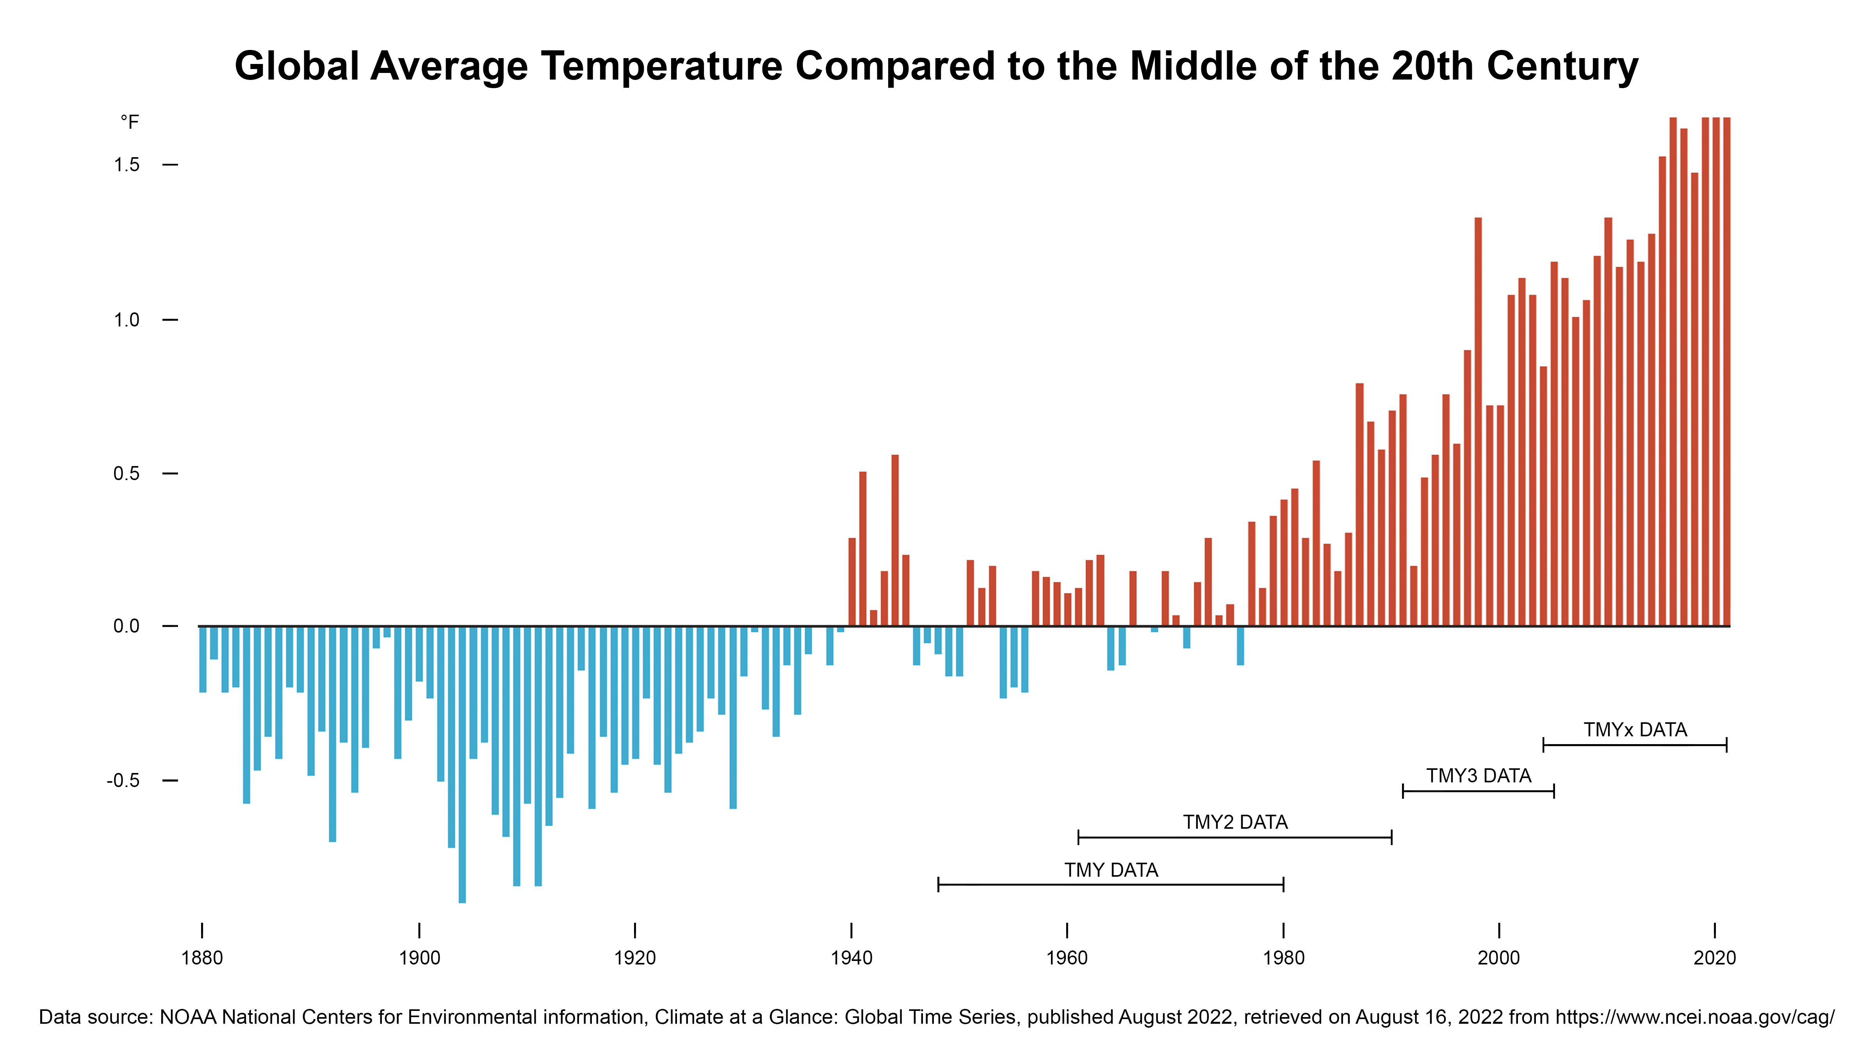
Notes:
Today, it is considered best practice to assess a location's MACROclimate in advance of developing a building design.
We do this using climate data.
However, standard practice entails aggregating historic data to determine a TYPICAL meteorological year - TMY.
When we look at the shifts in global average temperature, we see how deeply flawed this standard practice has become.

Slide 34
Notes:
Take the Windy City for instance. Chicago, Illinois.

Slide 35

Source: World Ware Zero
Notes:
One would consider Chicago predominantly COLD.

Slide 36
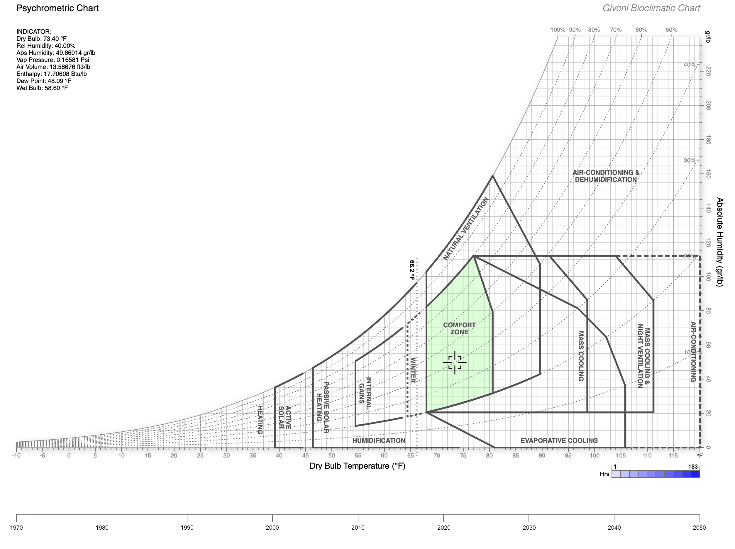
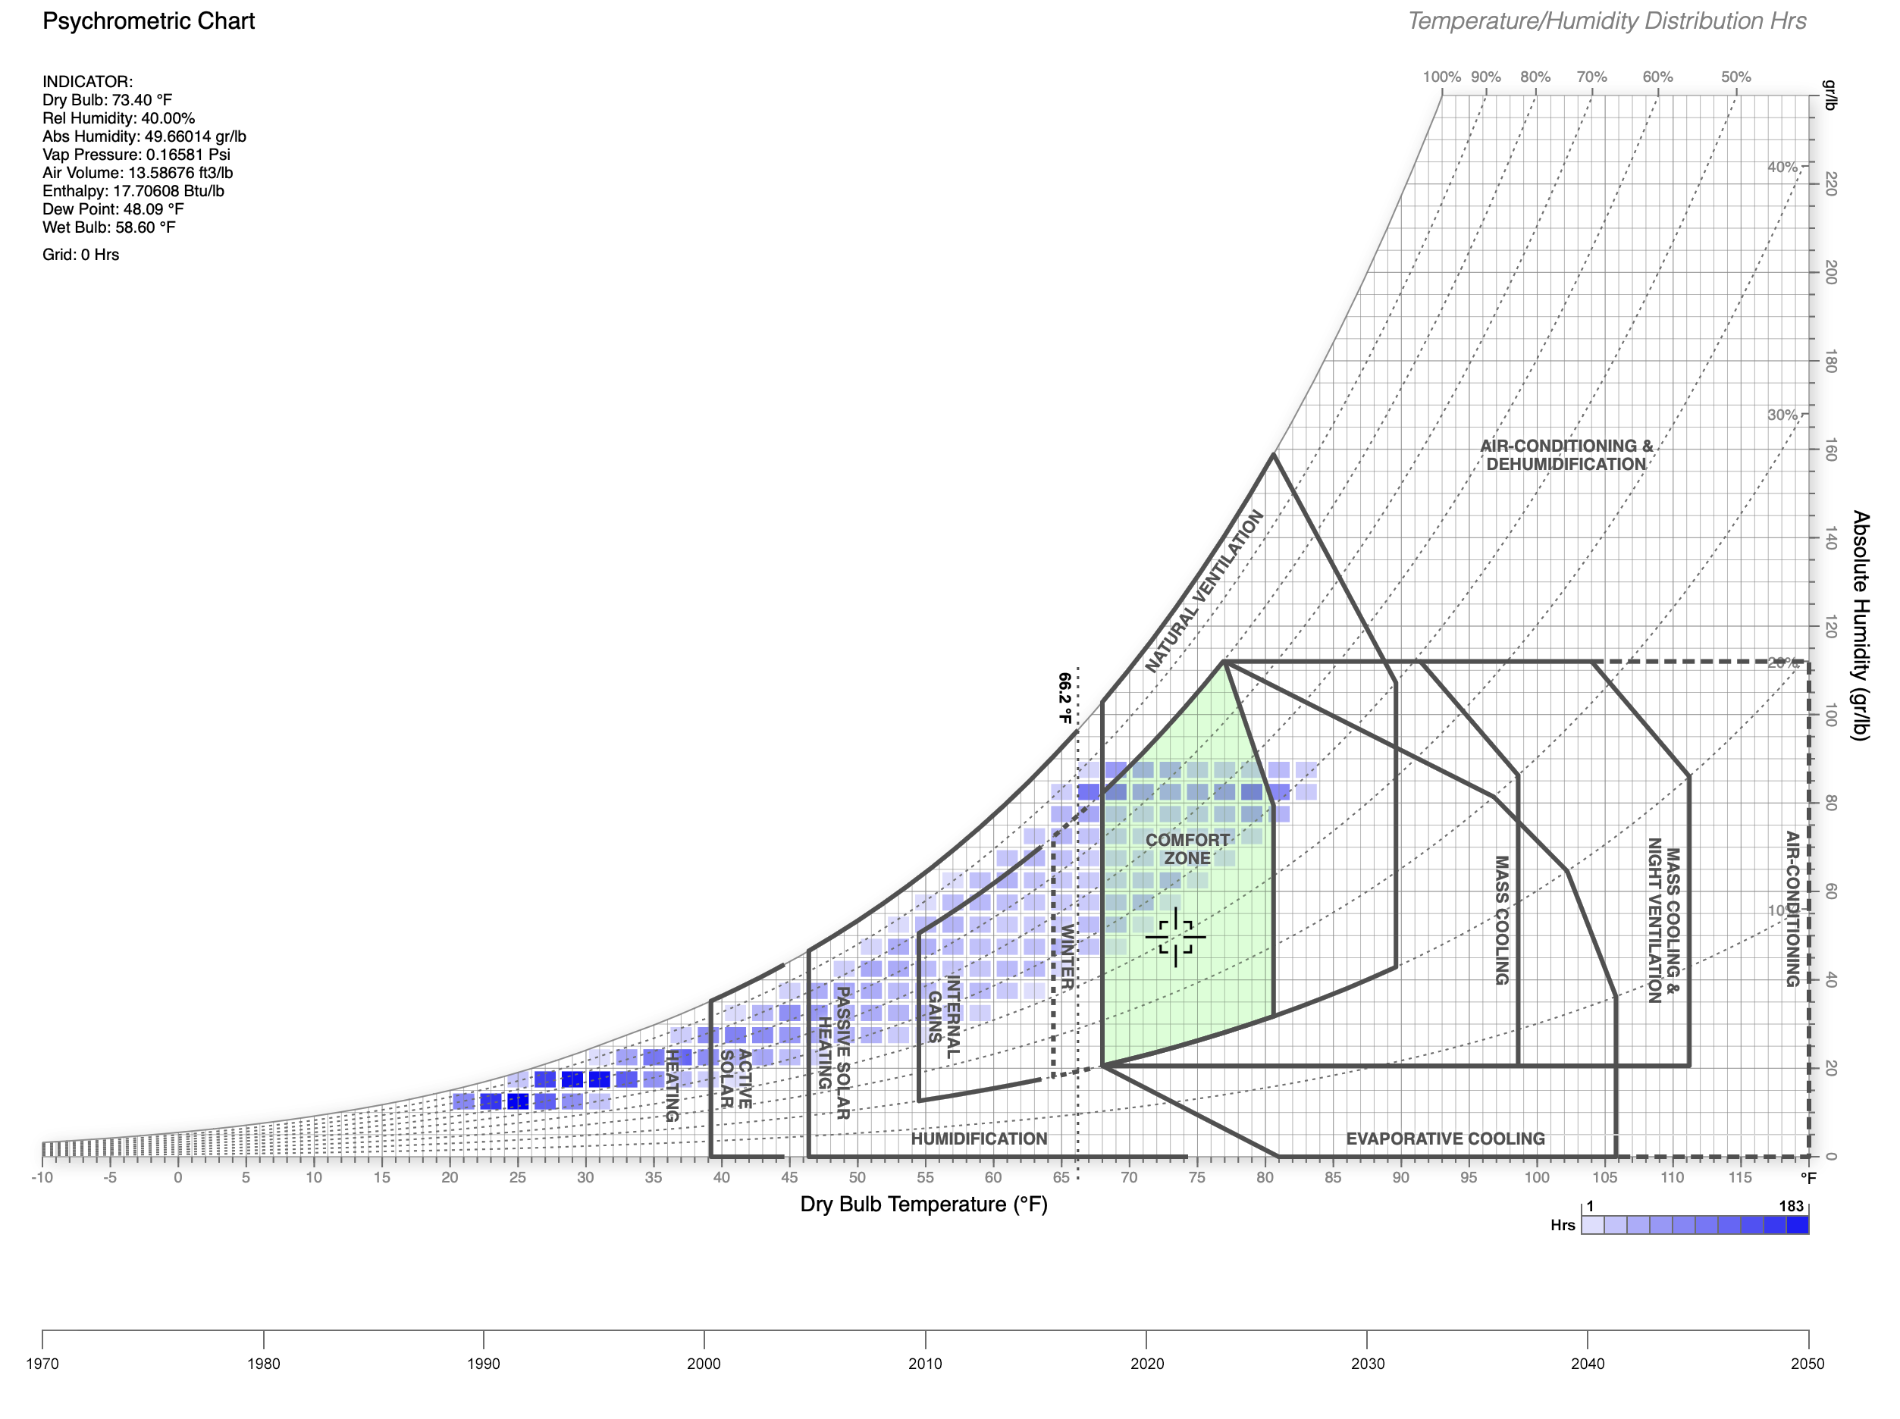
Climate Projection Data Example
Chicago, Illinois (O’Hare Intl’)
U.S. Climate Normals: 1991-2020
2023
Source: Dr. Andrew Marsh, Climate.OneBuilding.Org, WeatherShift
Notes:
My students may very well pull this exactly data set for their projects.
Depicted here are US.Normals for Chicago using data from 1991-2020

Slide 37
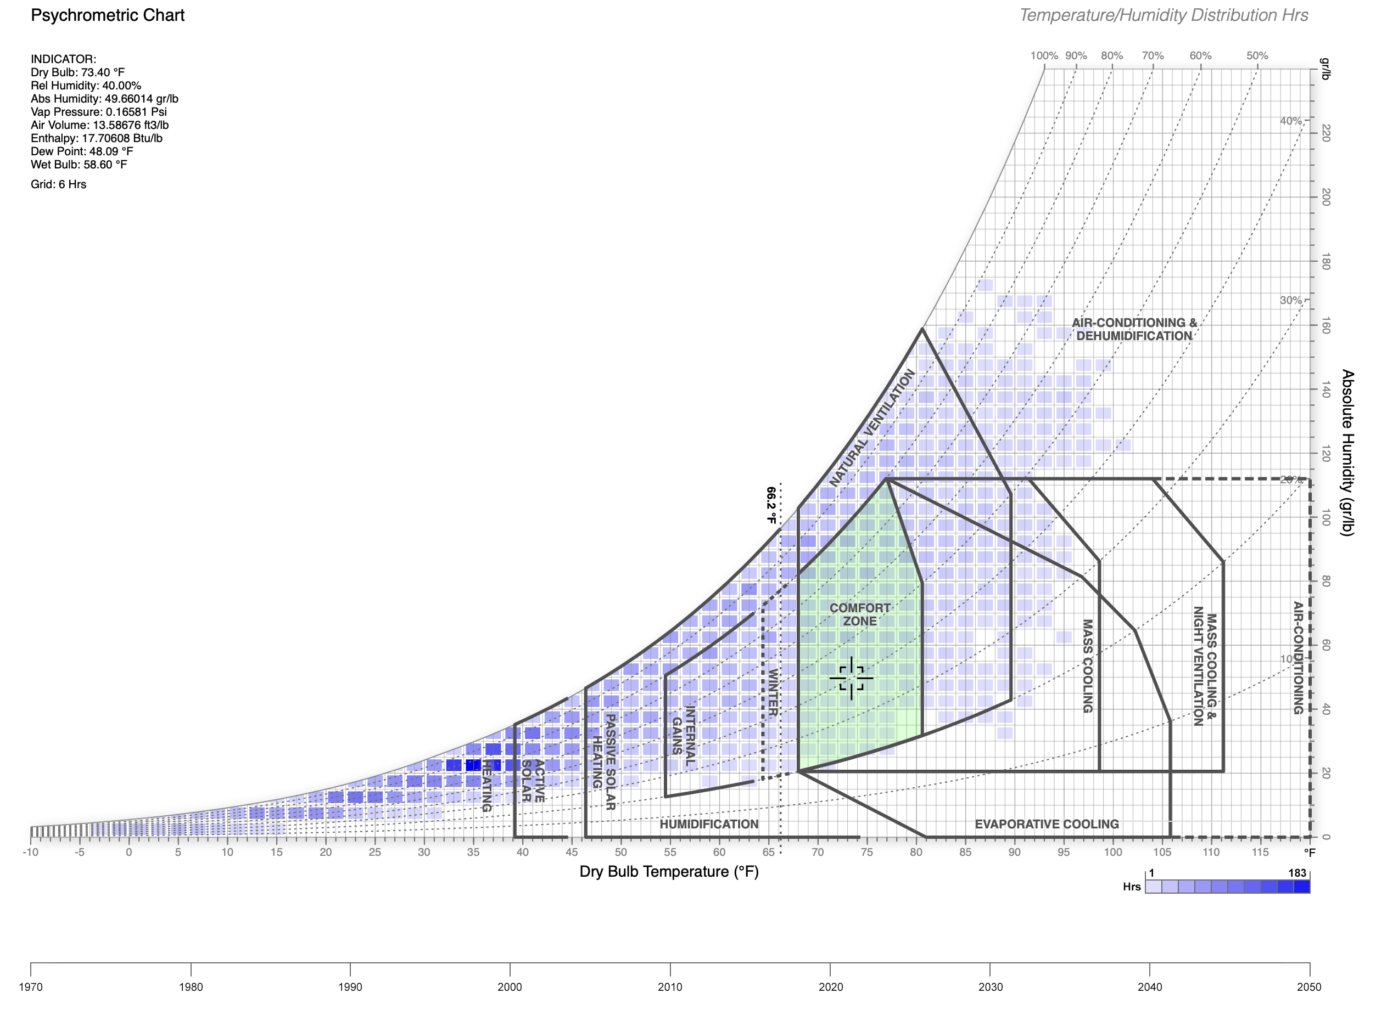
Climate Projection Data Example
Chicago, Illinois (O’Hare Intl’)
Climate Projection Data
TMY3 / RCP8.5 / 2021-2040
90th Percentile
2023
Source: Dr. Andrew Marsh, Climate.OneBuilding.Org, WeatherShift
Notes:
If we instead use downscaled climate projection data
And assume RCP 8.5, we have quite a different story. NO LONGER PREDOMINANTLY COLD.
(RCP 8.5 would result in the highest greenhouse gas concentration)
(“representative concentration pathways”)

Slide 38

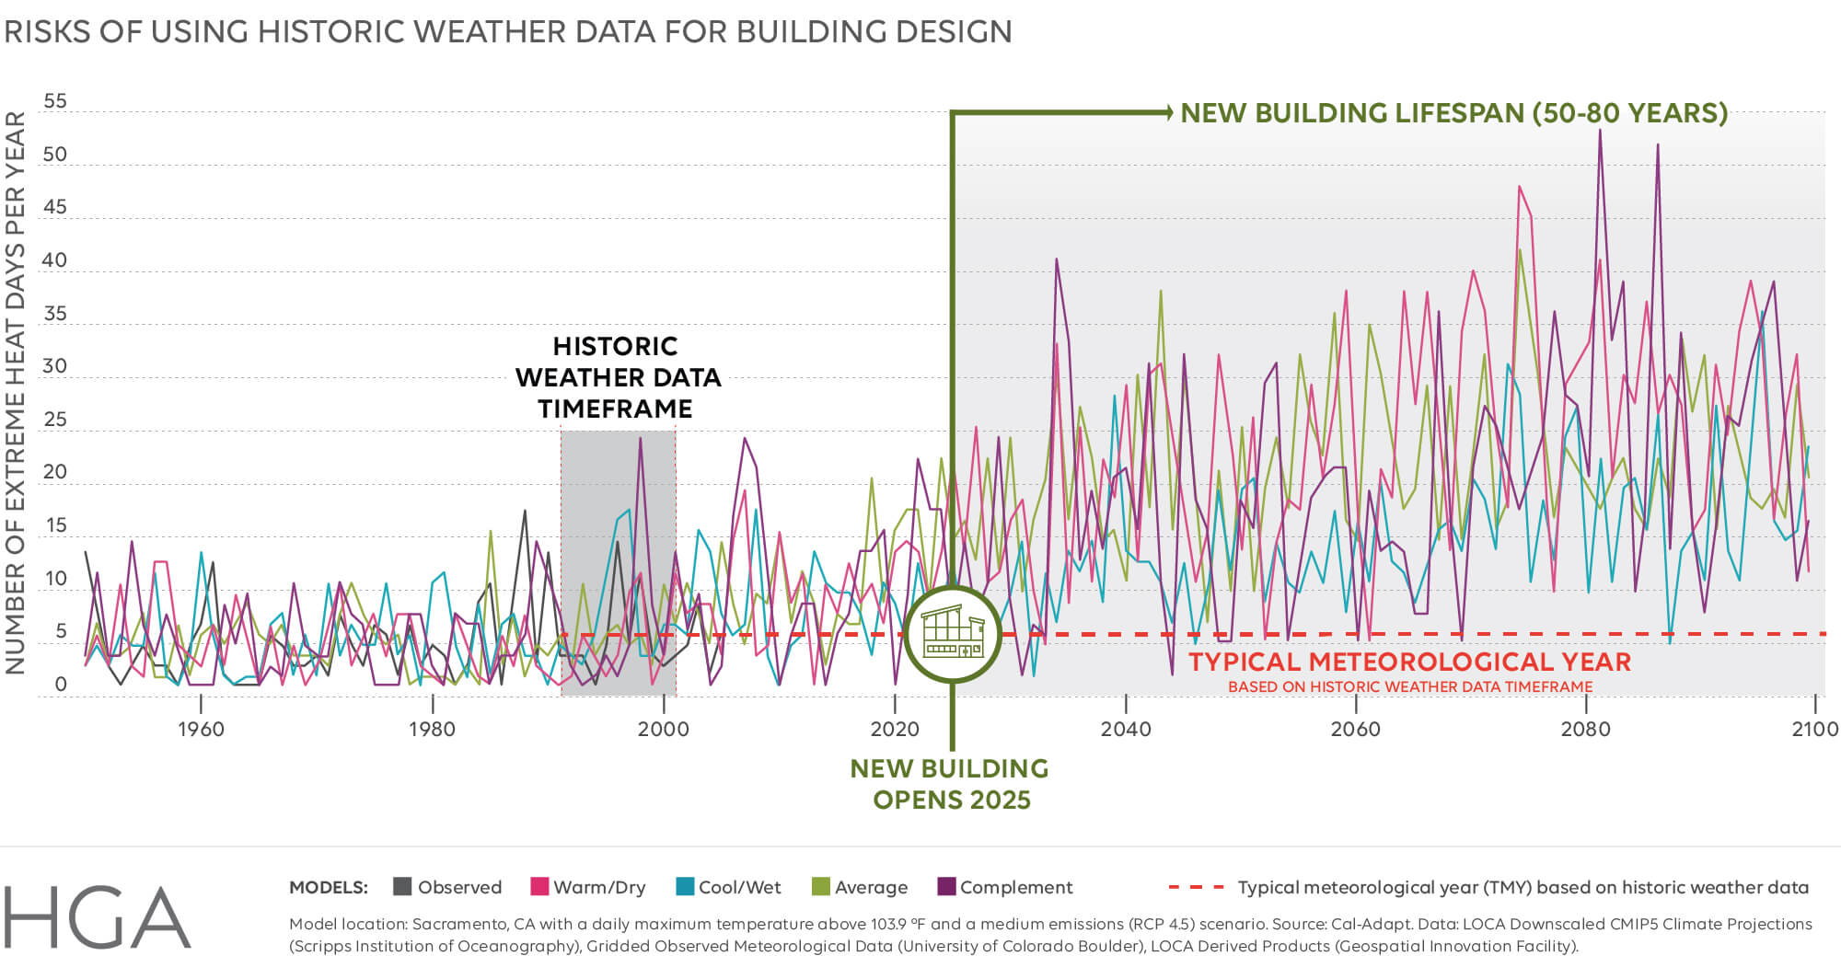
Excerpt from Climate Forward? How Climate Projections Are(n’t) Used to Inform Design by Ariane Laxo (2023)
Source: HGA
Notes:
Even if we don’t use the RCP 8.5 scenario, recent work by HGA and the University of Minnesota shows that the FUTURE will not mimic the PAST.

Slide 39

We cannot design for tomorrow using yesterday’s data.

Slide 40
Notes:
I’ll give you a great example of this from my time at the Boston Architectural College, where Alex and I have both provided guest lectures and workshops on resilient design.

Slide 41
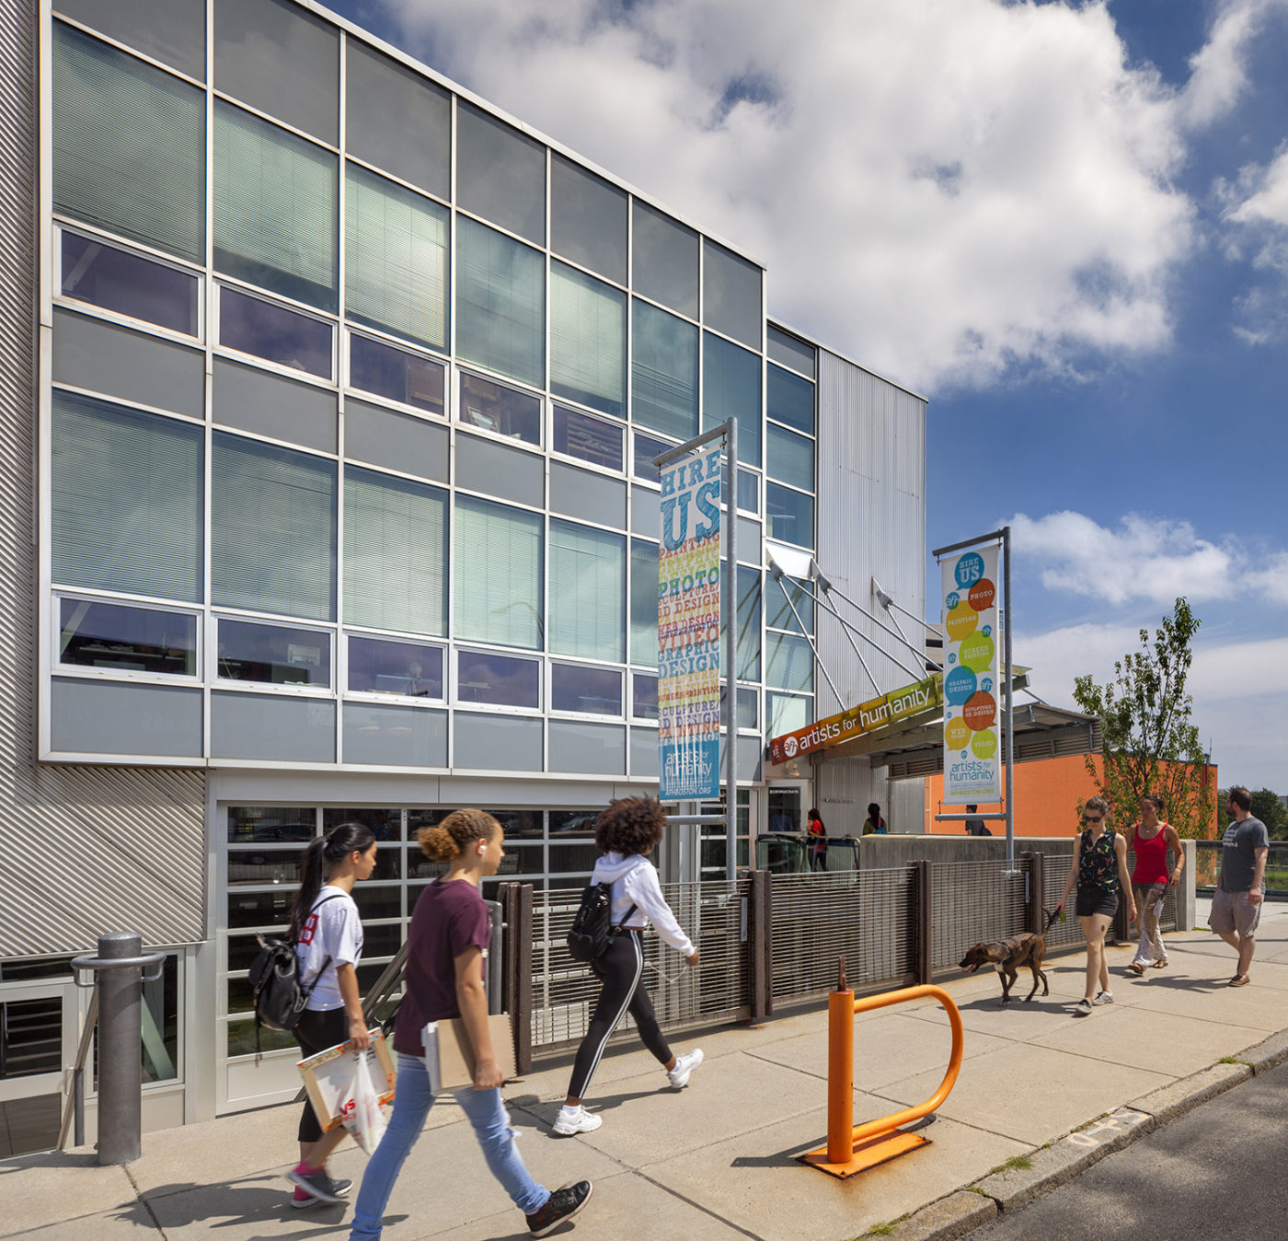
Source: Arrowstreet
Notes:
2004: Boston’s christened its first Platinum LEED-certified facility, the Artists For Humanity EpiCenter

Slide 42

Source: Arrowstreet
Notes:
Artists For Humanity (AFH) provides underserved teens the skills and resources for self-sufficiency through paid employment in art and design.

Slide 43
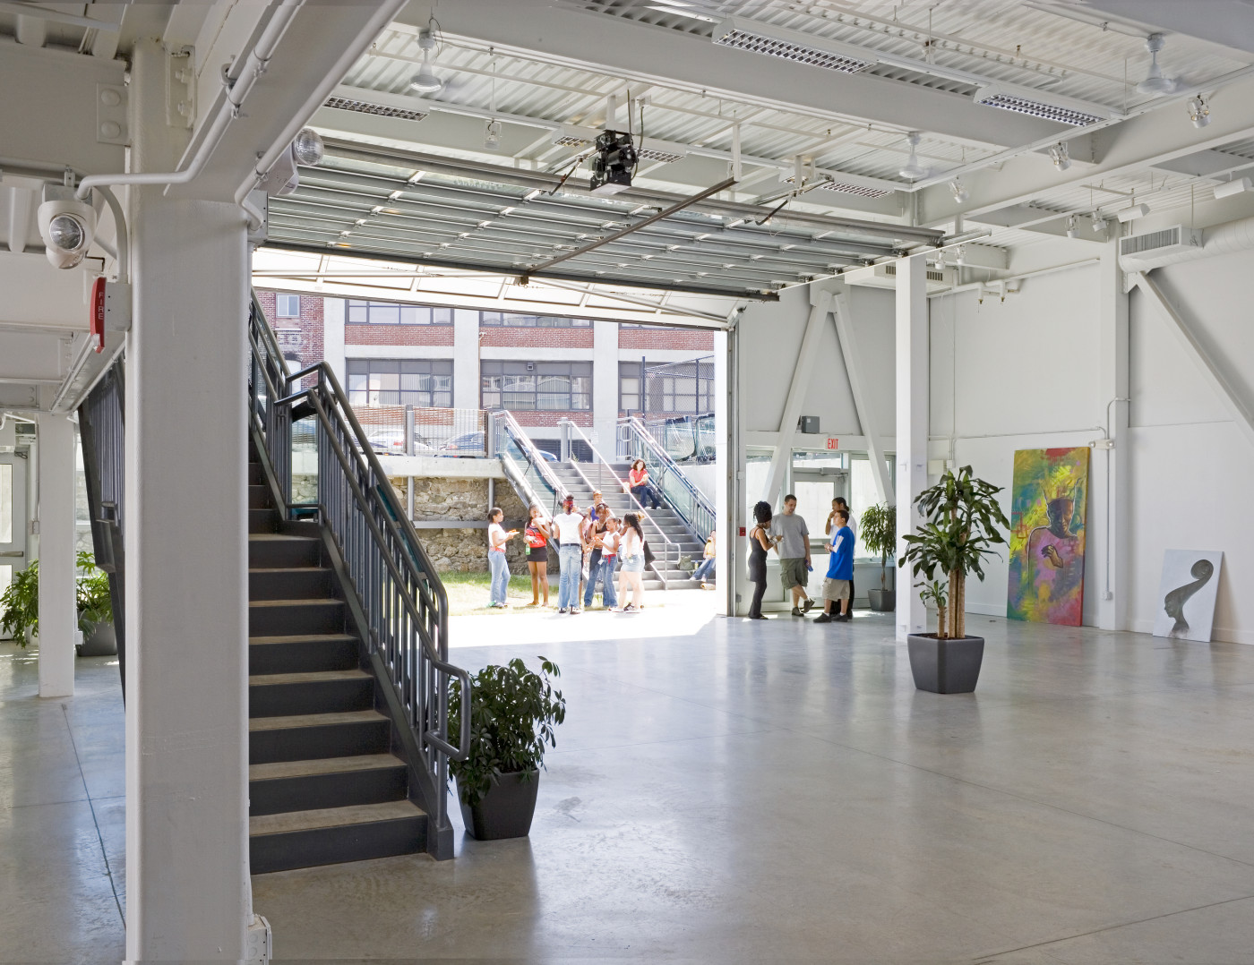
Source: Arrowstreet
Notes:
The facility is designed for extremely low-energy needs using passive systems.

Slide 44
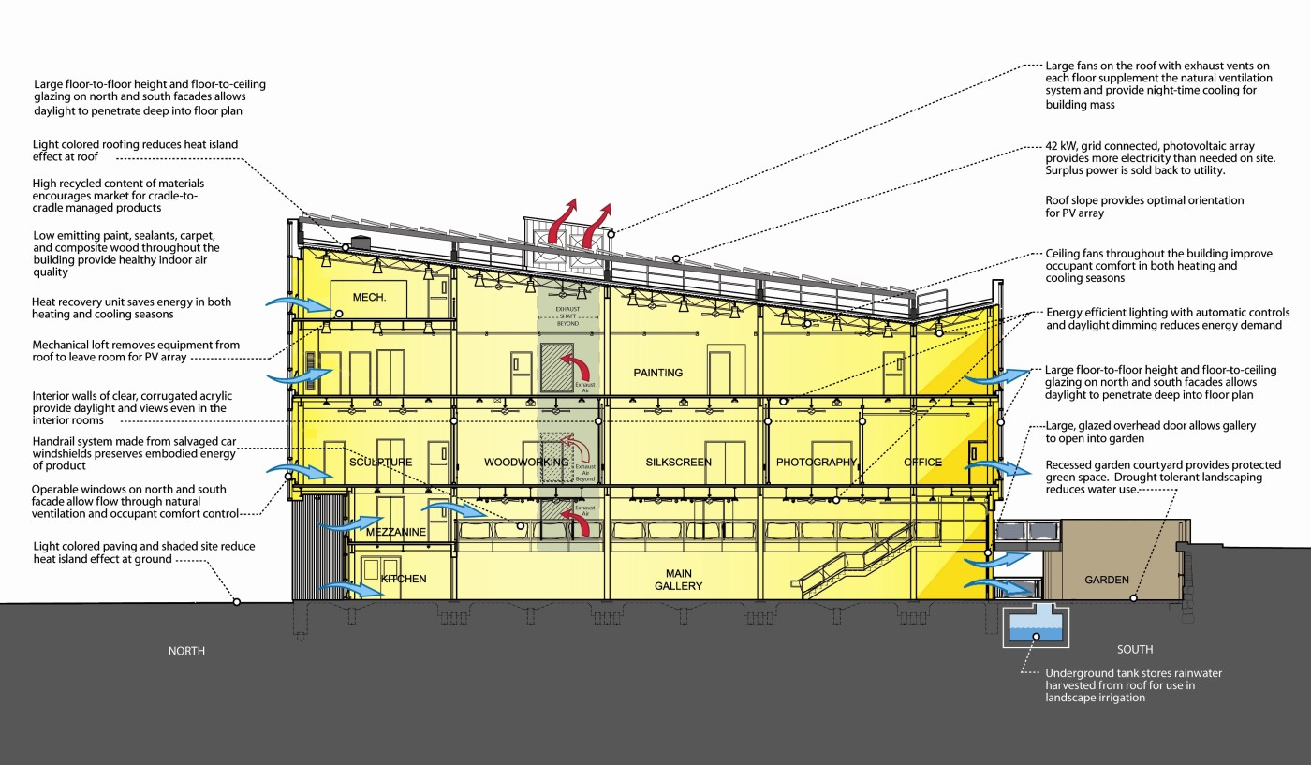
Source: Arrowstreet
Notes:
The EpiCenter was designed for natural ventilation and night flushing.
But several years after it opened, staff observed that the natural ventilation system was not performing as well. This has resulted in a higher operational cost burden for this nonprofit due to increased mechanical air conditioning.

Slide 45
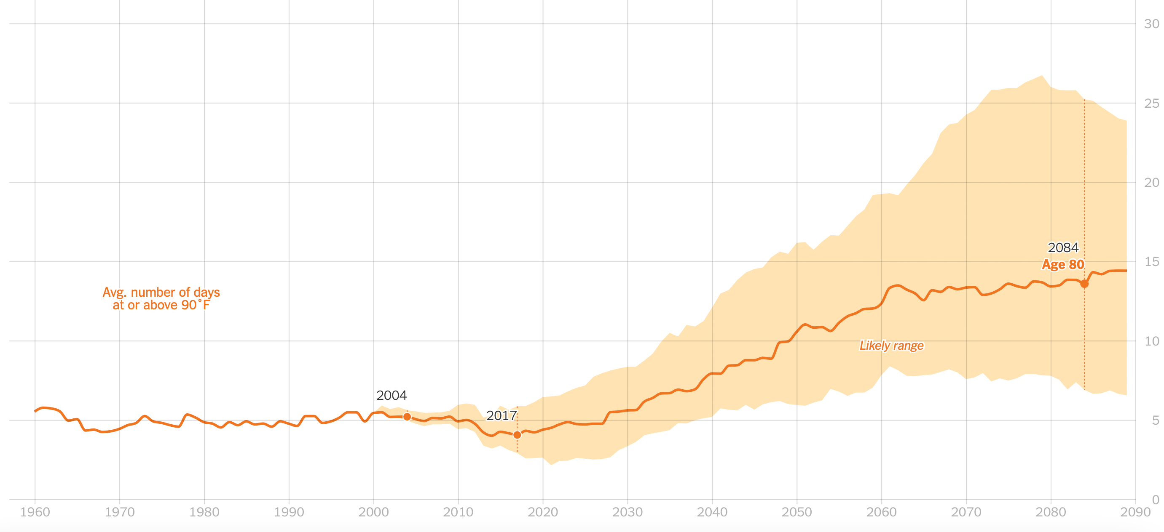
Boston, MA
Days at or above 90°F per year
EpiCenter Opens
Source: New York Times
Notes:
The reason for the failure is clearly evident. Days above 90*F will continue to increase exponentially in Boston over the coming decades.

Slide 46

We need publicly accessible climate project data.
It must be publicly available through a professional or governmental institution.
It must be provided in a resolution, scale, and format suitable for building analysis.
Its use must adhere to a consensus-based standardized framework.
Its use must be codified and regulated.
Notes:
In order for building project teams to design and adapt our building stock to become more resilient from the standpoint of thermal safety, climate projection data must be leveraged with the following caveats:
a. It must be publicly available through a professional or governmental institution.
b. It must be provided in a resolution, scale, and format suitable for building analysis.
c. Its use must adhere to a consensus-based standardized framework.
d. Its use must be codified and regulated.

Slide 47
2
Address our collective passive survivability failure

Slide 48

Establishing Passive Survivability Metrics
Today’s passive survivability metrics were born out of Katrina and LEED.
2012: Resilient Design Institute is established.
2013: USGBC committee developed resilient design pilot credits for LEED.
2013-2015: Co-chaired by Alex Wilson and Mary Ann Lazarus, FAIA, the committee developed three pilot credits:
Assess vulnerabilities.
Pest practices for mitigation.
Ensure passive survivability.
2015: GBCI adopted the RELi rating system and withdrew the pilot credits.
2018: Revised pilot credits released.
2022: GBCI ceded ownership of RELi.
Spaulding Rehabilitation Hospital (Boston, MA)
Source: Steinkamp Photography, courtesy Perkins&Will.
Notes:
Shortly after founding the Resilient Design Institute in 2012, Alex Wilson proposed to the U.S. Green Building Council the development of a suite of pilot credits for the LEED Rating System focusing on resilient design. With encouragement from USGBC, a pilot credit committee was assembled in 2013 and work commenced on developing the pilot credits. Co-chaired by Alex Wilson and Mary Ann Lazarus, FAIA, the committee spent nearly two years developing three pilot credits: the first to assess vulnerabilities for a particular location; the second to use best practices to mitigate the most pertinent vulnerabilities; and the third to ensure that a building maintain at least limited functionality in the event of extended lost power (Wilson 2020).
The pilot credits were adopted by USGBC in the Fall of 2015; however, all three were removed a year later as Green Business Certification Inc. (GBCI), which manages third-party certifications for LEED and several other rating systems in the building sector, adopted of the RELi Rating System in 2017. Developed by the Institute for Market Transformation to Sustainability (MTS) and its Capital Markets Partnership (CMP) coalition in 2012, the RELi standard facilitates an integrative process, hazard preparation and adaptation along with chronic risk mitigation at the building and neighborhood scales (Keane, 2017). The methods and targets of the LEED pilot credits were not consistent with the RELi standard. In late 2018, the revised pilot credits were relaunched. However, in 2022, GBCI ceded ownership of RELi and chose to no longer certify RELi projects (Melton 2021). Today, the revised pilot credits endure as the de facto standard for resilient design at the building scale – including passive survivability via Innovative Process pilot credit 100 (IPpc100), Passive Survivability and Back-up Power During Disruptions (USGBC 2022).

Slide 49
Passive Survivability Metrics
1
&
2
3
Heat Index
WBGT
SET

Slide 50
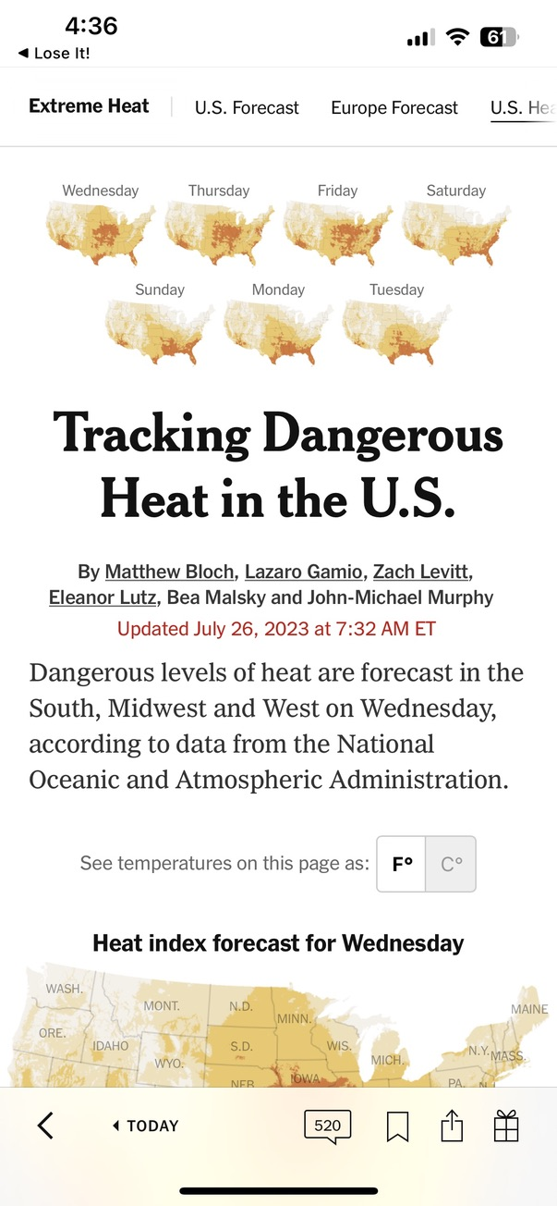
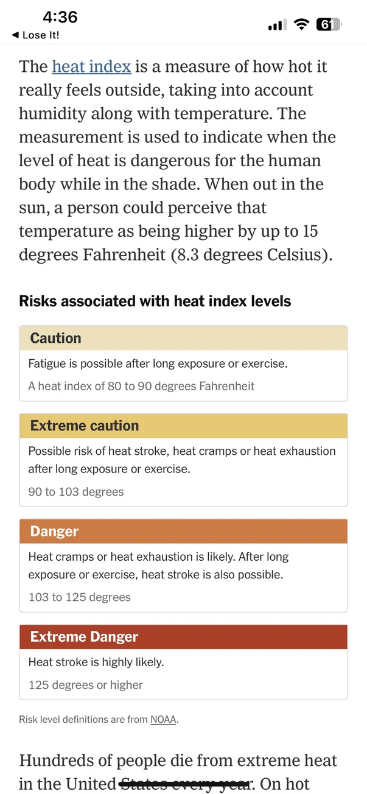
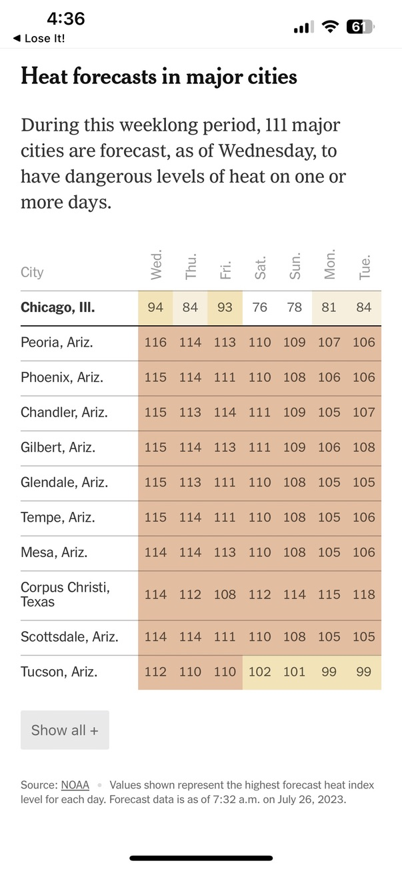
Notes:
You know it’s getting pretty bad when the mainstream media is explaining HEAT INDEX to explain thermal safety risk.

Slide 51
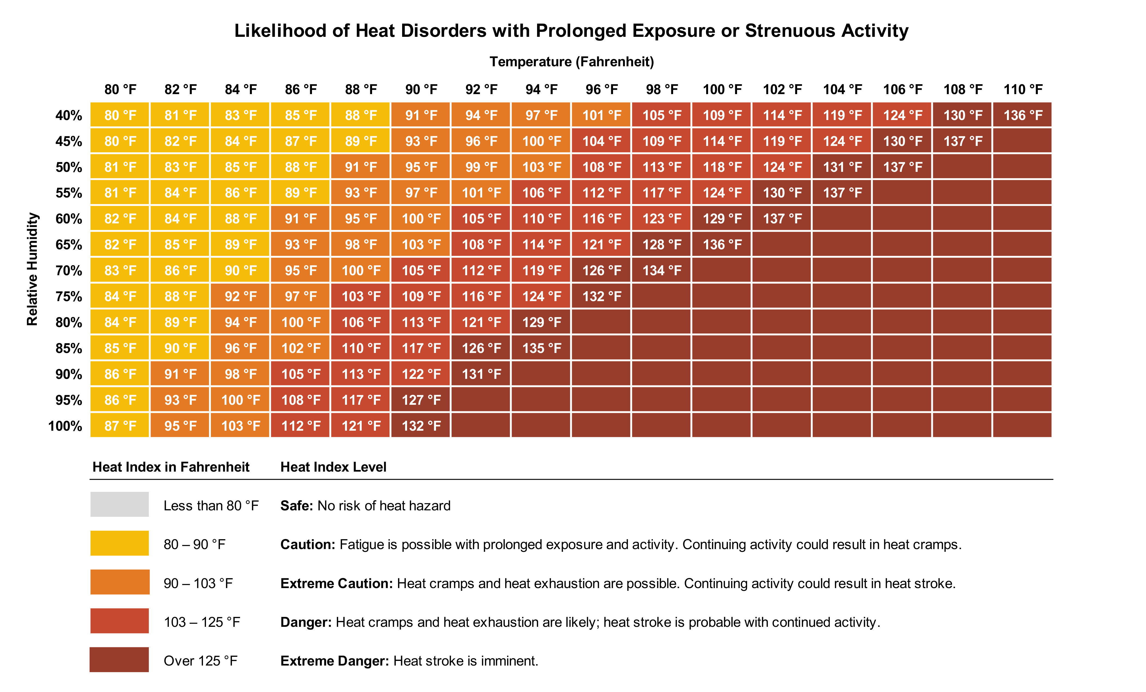
Heat Index
Source: Browning Day
Notes:
+2*F and +20% RH can be the difference between “cautious” and “danger”
--
The heat index, sometimes referred to as the apparent temperature, is used to communicate what the ambient air temperature is considered to feel like to the human body when relative humidity is taken into consideration. In other words, the heat index is a reference temperature that considers both the sensible and latent heat of the air. It also typically presumes strenuous activity by the individual.
As such, HI offers a gauge of heat stress when relative humidity is taken into effect. When the body overheats, it perspires to cool itself off. If the perspiration is not able to evaporate because the air has too much moisture in it, the body cannot regulate its temperature. Therefore, when humidity is high, the rate of evaporation diminishes and heat stress increases.

Slide 52
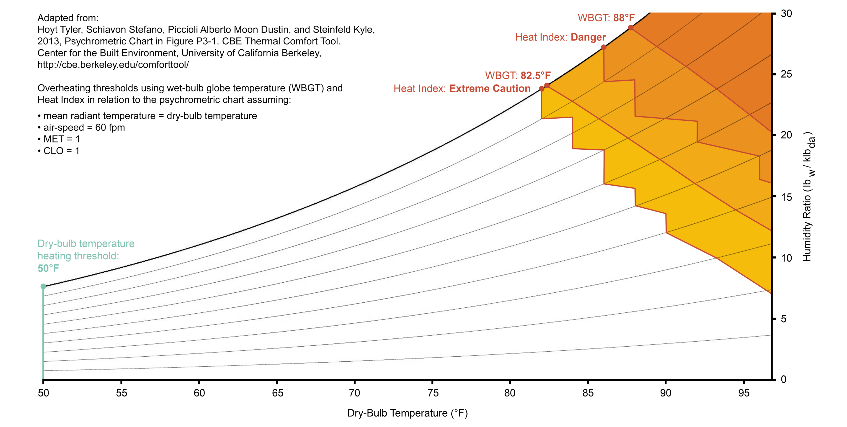
Wet-Bulb Globe Temperature (WBGT)
Source: Browning Day
Notes:
Wet-bulb globe temperature (WBGT) is a measurement used to assess the sensible and latent heat stress on the human body. It is commonly referenced in occupational health and safety determinations, for sport activities, and military settings to evaluate the risk of heat-related ailments.

Slide 53
Neither Heat Index or WBGT are appropriate or suitable for assessing indoor conditions.

Slide 54
Passive Survivability Metrics
1
2
3
Heat Index
WBGT
SET

Slide 55
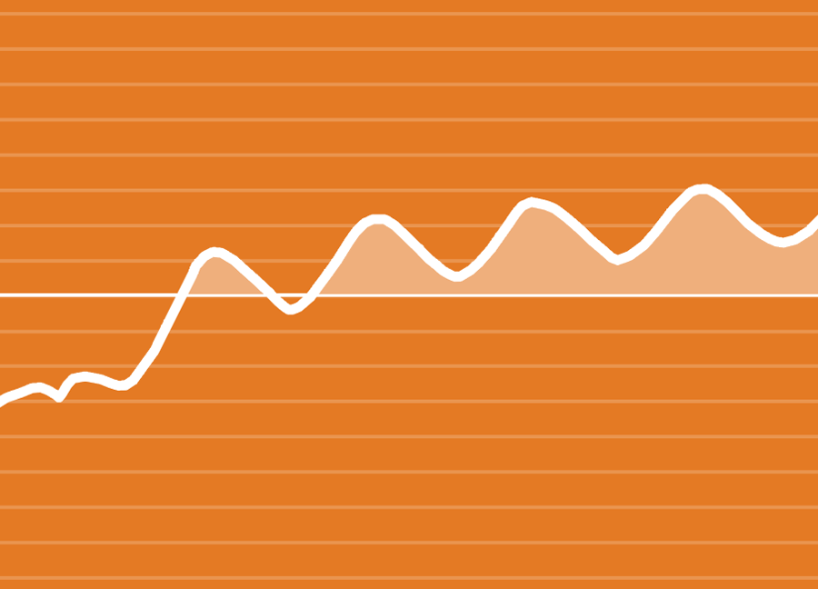
Passive Survivability Metrics
Standard Effective Temperature (SET):
SET is a simple cross reference of:
Indoor dry-bulb air temperature
Relative humidity
Mean radiant temperature
Air velocity
Activity level (1.0)
Clothing level of occupants (0.6)
SET passive survivability thresholds:
Maintain SET between 54°F and 86°F (12.2°C and 30°C)
During an extreme week, keep under 216 °F SET-Hours
SET Threshold
SET-Hours
Source: Daniel Overbey

Slide 56
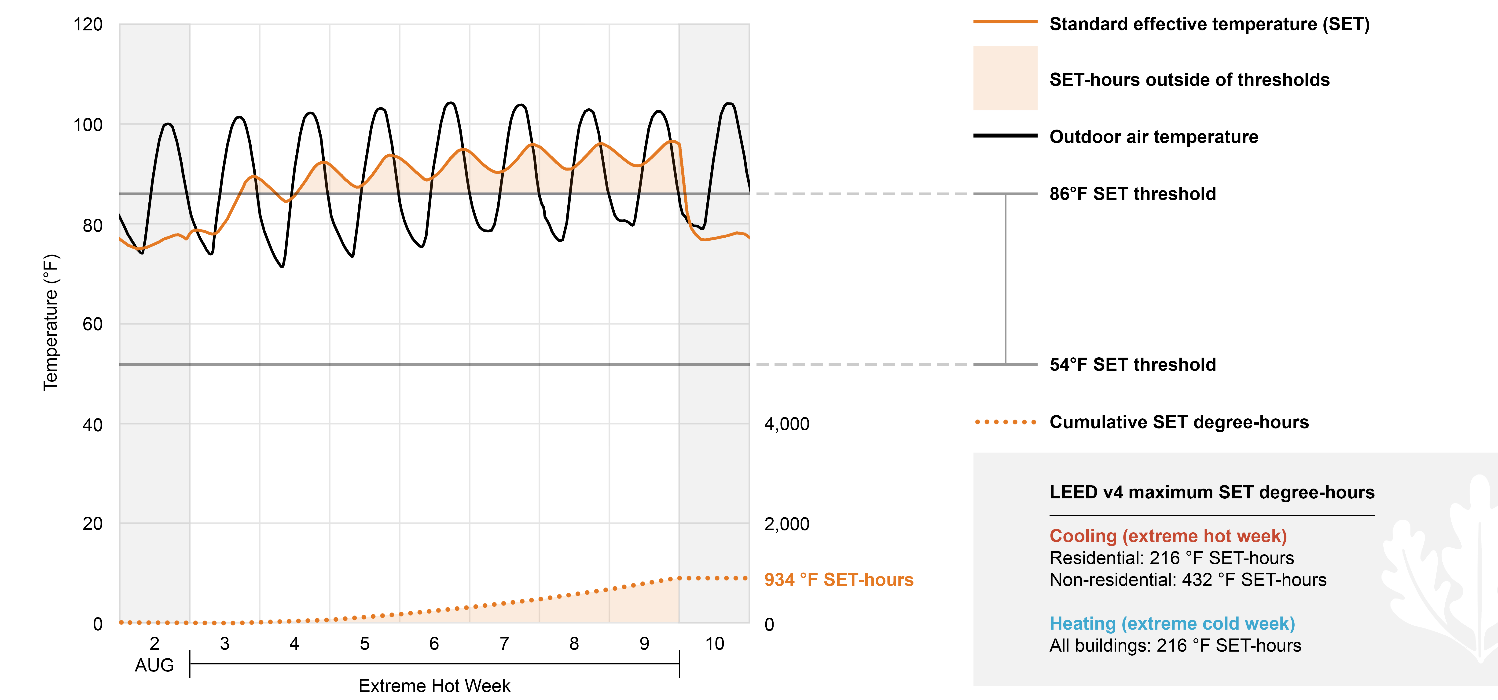
Standard Effective Temperature (SET): Hot Week
Keep Under 216
Source: Browning Day
Notes:
What is standard effective temperature (SET)?
Developed by A.P. Gagge and accepted by ASHRAE in 1986, ASHRAE Standard 55 defines SET as follows:
The temperature of an imaginary environment at 50% relative humidity, less than 20 feet per minute (fpm) average air speed, and mean radiant temperature equals average air temperature, in which the total heat loss from the skin of an imaginary occupant with an activity level of 1.0 met and a clothing level of 0.6 clo is the same as that from a person in the actual environment with actual clothing and activity level.
Basically, SET is a comfort indicator that considers indoor dry-bulb temperature, relative humidity, mean surface radiant temperature, and air velocity, as well as the activity level and clothing of occupants in the space.
Defining "livable conditions" using SET
LEED pilot credit IPpc100: Passive Survivability and Back-up Power During Disruptions allows project teams to prove that a building will maintain passive survivability during an extreme temperature event by maintaining livable (not necessarily comfortable) conditions indoors if the building loses all mechanical functionality for a week.
In accordance with industry guidance, the pilot credit defines "livable conditions" as maintaining an SET between 54 °F and 86 °F.

Slide 57
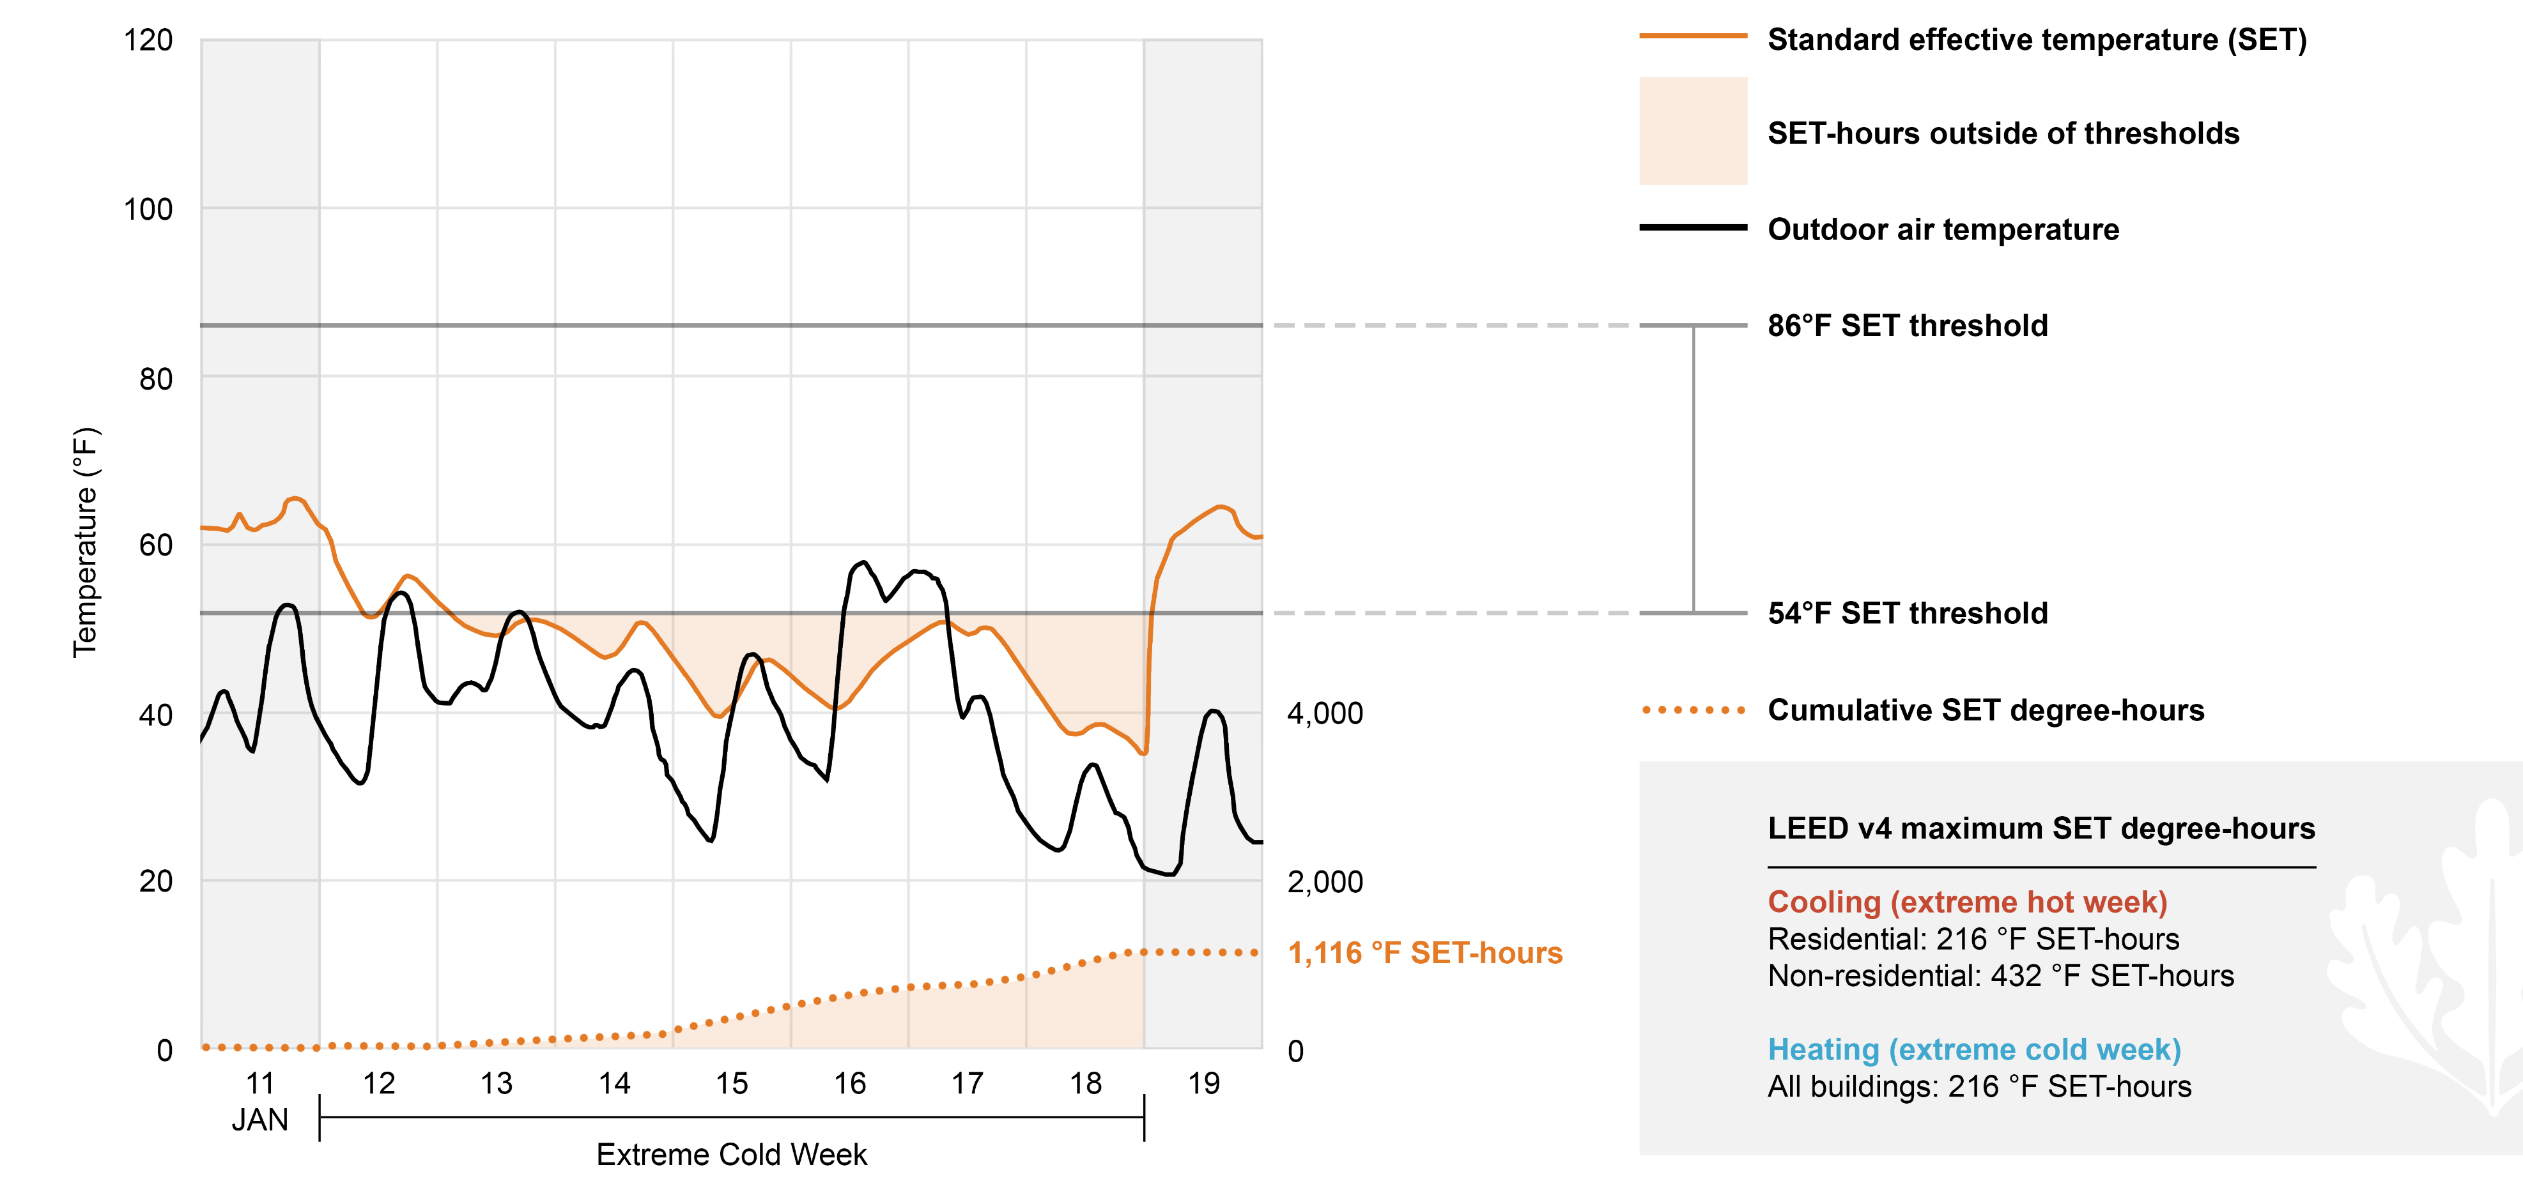
Standard Effective Temperature (SET): Cold Week
Keep Under 216
Source: Browning Day
Notes:
What is standard effective temperature (SET)?
Developed by A.P. Gagge and accepted by ASHRAE in 1986, ASHRAE Standard 55 defines SET as follows:
The temperature of an imaginary environment at 50% relative humidity, less than 20 feet per minute (fpm) average air speed, and mean radiant temperature equals average air temperature, in which the total heat loss from the skin of an imaginary occupant with an activity level of 1.0 met and a clothing level of 0.6 clo is the same as that from a person in the actual environment with actual clothing and activity level.
Basically, SET is a comfort indicator that considers indoor dry-bulb temperature, relative humidity, mean surface radiant temperature, and air velocity, as well as the activity level and clothing of occupants in the space.
Defining "livable conditions" using SET
LEED pilot credit IPpc100: Passive Survivability and Back-up Power During Disruptions allows project teams to prove that a building will maintain passive survivability during an extreme temperature event by maintaining livable (not necessarily comfortable) conditions indoors if the building loses all mechanical functionality for a week.
In accordance with industry guidance, the pilot credit defines "livable conditions" as maintaining an SET between 54 °F and 86 °F.

Slide 58
The industry is utilizing standard effective temperature (SET) as the de facto passive survivability metric.

Slide 59
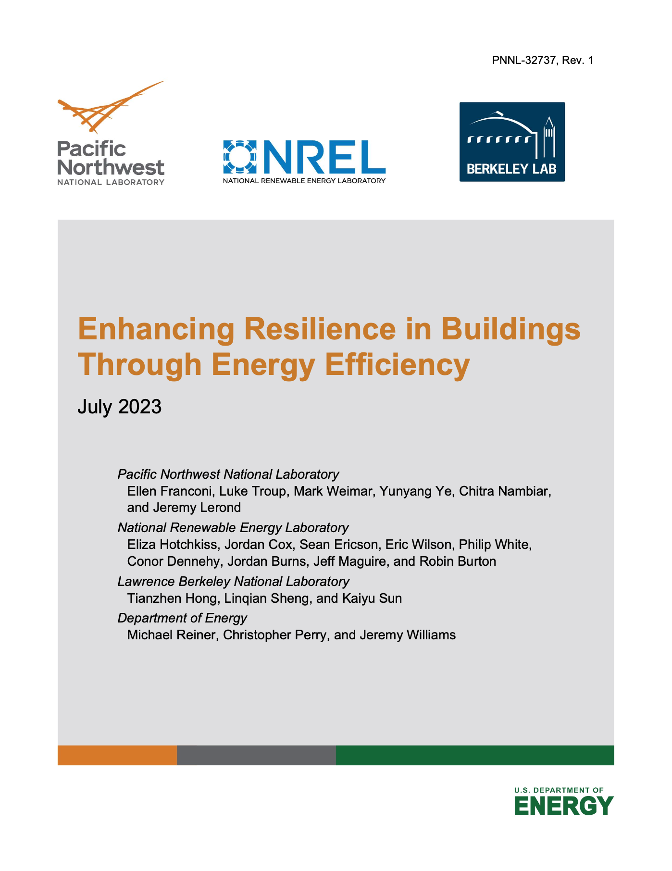
DOE-BTO Resilience Report
Report: Enhancing Resilience in Buildings Through Energy Efficiency.
The DOE Building Technologies Office (BTO) commissioned three national research laboratories:
Pacific Northwest National Laboratory
National Renewable Energy Laboratory
Lawrence Berkeley National Laboratory
These groups developed a standardized methodology to quantitatively assess how energy-efficiency measures affect building thermal resilience.
This July 2023 report summarizes the research findings, reports initial findings resulting from the efficiency-resilience valuation effort, and identifies areas of need for continued research and analysis.
Notes:
In July 2023, the U.S. Department of Energy’s (DOE) Building Technology Office (BTO) released a report outlining a standardized methodology and resulting analysis demonstrating the impact of code and above-code measures toward hazard resilience.

Slide 60

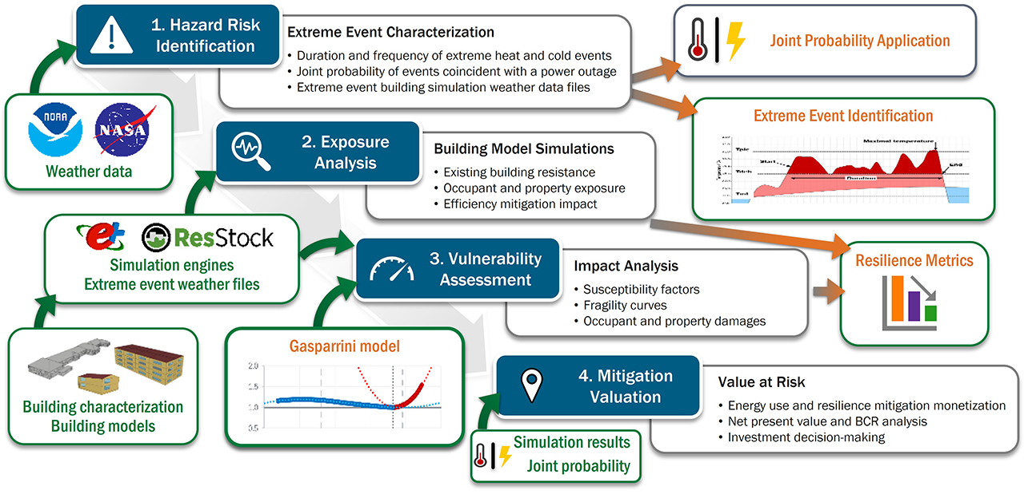
Excerpt from Enhancing Resilience in Buildings Through Energy Efficiency (2023)
Source: U.S. Department of Energy
Notes:
The study applied the SET thresholds over an extreme seven-day heating and cooling event to ascertain the passive survivability of:
an average existing residential building,
a similar new house built to the latest energy standard adopted by the local jurisdiction,
a similar house built in accordance with the 2021 edition of the International Energy Conservation Code (IECC 2021),
and a similar house built to PHIUS.

Slide 61
Notes:
The work assessed six representative cities in the contiguous U.S.:
Atlanta (Georgia),
Houston (Texas),
Los Angeles (California),
Portland (Oregon),
Minneapolis (Minnesota),
and Detroit (Michigan).

Slide 62
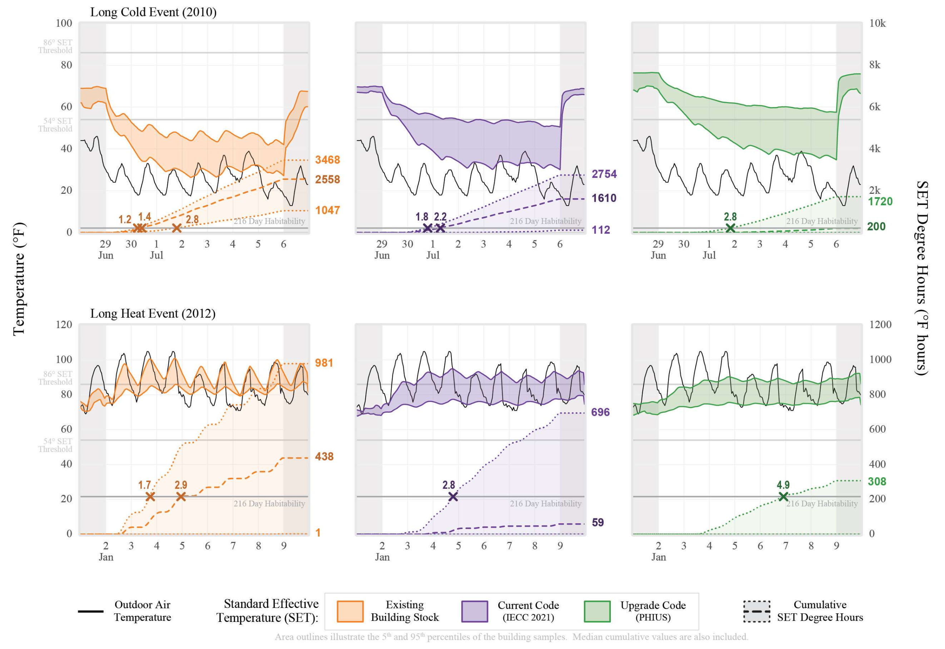
Occupant Exposure over Seven Days for Existing Single-Family Homes in Atlanta, GA (3A).
Excerpt from Enhancing Resilience in Buildings Through Energy Efficiency (2023). Source: U.S. Department of Energy
Notes:
I will describe the results as ”compelling.”

Slide 63
SET Degree-Hours Summary
Source: Adapted from the U.S. Department of Energy (2023)
Notes:
The BTO study found that approximately 50% of the analyzed housing conditions failed to meet the SET passive survivability degree-hour limits.
1/3 of all PHIUS scenarios also FAILED.

Slide 64

We cannot insulate our way to passive survivability.

Slide 65

Notes:
We must equip design teams with quick, iterative tools that can be deployed at the earliest stages of the design process when the ability to impact cost and performance is high but the cost for change is minimal.

Slide 66

Credit: Browning Day
Notes:
This notion is not new.
Dr. Andrew Marsh – formerly of the Welsh School of Architecture at Cardiff University – developed a range of tools through his research group at Square One.
(I understand he was exiled to the Ilse of Man after Autodesk acquired his assets in 2008?)

Slide 67

Credit: Ennead
Notes:
I was an Ecotect power user – on marquee projects.

Slide 68

Credit: Browning Day
Notes:
We were doing passive gains / losses analyses.

Slide 69


Credit: Browning Day
Notes:
Optimizing shading devices with ease.

Slide 70

Notes:
And could still execute early stage whole-building energy assessments – including passive strategies.

Slide 71

Notes:
When the tools are available early and used often, solutions can be integrated into a project budget.

Slide 72


HVAC
Notes:
Another novel concept… We need the ability to simulate ”HVAC/off” mode.
Most BEM platforms presume the reliance on mechanical HVAC systems. This makes sense since HVAC system manufacturers help fund the development of these tools, which gauge performance based on standards developed by HVAC system trade organizations.
(Trying not to name names.)

Slide 73

Building energy modeling software needs to allow “HVAC/off” mode with early-stage SET analysis.
Allow HVAC/off mode within familiar, validated, industry-recognized, building energy modeling software.
Easily accessible SET analysis through graphic user interfaces that facilitate quick, iterative, early-stage studies.
Notes:
Building energy modeling software needs to allow "HVAC/off" mode with early-stage SET analysis.
It needs to be made available to design professionals with core competencies - through they should be presumed to lack technical knowledge into BEM platforms.

Slide 74
3
Passive systems as the key "unlock"
Notes:
This brings me to the third and final barrier to passive survivability uptake.

Slide 75

Source: Margo McDonald and Carolina Dayer
Notes:
I want to shift attention to an old friend of mine: the late Harold R. Hay.
During my time as a researcher at UNLV (when I first met Sue) – I was collaborating directly with Harold.
I also gained access to his archives before his passing. I became intimately familiar with information about his life’s work that very few individuals would know about today.

Slide 76
Notes:
Take his Phoenix roofpond prototype.

Slide 77

Source: Harold R. Hay
Notes:
Using Water as a Thermal Mass
Following his assignment to India, Hay took on a series of assignments in Latin America. It was during these assignments that he observed the virtues of applying movable insulation to solar desalination systems (or solar "stills") (Hay 1984).
In later work, Hay began adapting the concept of movable insulation to a water-based storage mass. He conducted preliminary experiments in Tempe, Arizona, in 1966 and 1967 with 2-foot square, 7-inch deep water basins. Horizontal insulation covered the basins during the day, and the water was exposed to the sky at night. Results indicated that 6 inches of water provided adequate thermal storage for year-round air-conditioning (Marlatt 1984).
In a 1989 white paper, Harold noted, "Water is the cheapest and most efficient heat storage material for buildings. Its fluid convection provides an outstanding advantage over the heat lag of solar materials."
Drawing on his experiences in India, Harold theorized that a combination of movable insulation atop a flat (i.e., slow-sloped) roof comprised of water would yield tremendous thermal comfort in even the most challenging of climates.
After several attempts at branding the system under different names, Hay would eventually coin this strategy as the "roofpond" system.
Hay's experiments with water in Tempe caught the attention of the revered passive solar engineer, John I. Yellott. Thanks to Yellott's belief in the roofpond concept, Hay received an opportunity to test his theoretical system in a full-scale test building in the Sonoran Desert.

Slide 78

Source: Harold R. Hay
Notes:
This is the kind of FLATLINING we want to see.
--
Performance of the Phoenix Prototype
According to data published by the Energy Technology Engineering Center in a report contracted by the U.S. Department of Energy (US DOE), the Phoenix Prototype maintained an interior ambient air temperature between 70 and 80°F during approximately 91% of the hours of the year under "normal" weather conditions (as defined by Phoenix weather data). At all times, the interior ambient air temperature was maintained in a range between 68 and 82°F, with daily temperature swings from 4 to 8°F (with extremes of 2 and 12°F) (Marlatt 1984) (Fig. 4).
During the three summer months, when temperatures reached 110°F and the humidity was high, a fan coil unit was used to enhance cooling inside the structure by circulating cool roofpond water through the unit.
For approximately one quarter of the year, it was not necessary to move the insulation to maintain thermal comfort because the average indoor air temperature stayed within an acceptable range.

Slide 80

Source: John Reynolds
Notes:
The "Atascadero House" was build in 1973 and features one of Harold Hay's roofponds.
Location: Atascadero, California

Slide 81

Source: John Reynolds
Notes:
The first full-scale roofpond project.

Slide 82

Source: LA Times
Notes:
Another FLATLINE in a challenging hot-dry climate.

Slide 83
Notes:
But Harold also adapted the roofpond for an application in severely cold climate - St. Paul, Minnesota.

Slide 84

Source: Harold R. Hay
Notes:
The project performed.

Slide 85

Source: Harold R. Hay
Notes:
And Harold's work began to catch the attention of the DOE.

Slide 86

Source: U.S. Department of Energy
Notes:
1984 study for the DOE.

Slide 87
“Well-designed roof ponds can provide… relatively even indoor temperatures (approximately 60 to 80°F year round) [16 to 27°C] in climates with an outdoor temperature that ranges between 32 and 115°F [0.0 to 46°C].”

Slide 88

Source: Alfredo Fernandez-Gonzalez
Notes:
Pictured here is the Muncie Passive Solar Project that operated at Ball State University in Muncie, Indiana – a temperate / predominantly cold climate location.
We measured date on a number of passive solar heated “test cells” for about 2-1/2 years. INCLUDING A ROOFPOND / DIRECT GAIN hybrid.

Slide 89



Muncie Passive Solar Project (MPSP)
Source: Daniel Overbey
Notes:
As part of an Arab response to Western aid provided to Israel during the Yom Kippur War, the Organization of the Petroleum Exporting Countries (OPEC) dramatically reduced oil exports to the U.S. By the end of 1974, the average price of crude oil had risen to more than quadruple the average price from 1972. This prompted Congress to quickly pass legislature designed to protect American consumers from gasoline shortages and high prices. The federal government also began to heavily invest in alternative energy sources and technologies of all types. During this time, the U.S. Department of Energy’s Passive Solar Group Q-11 funded what would become the United States’ foremost passive solar research facility at the Los Alamos National Laboratory. Led by Dr. J. Douglas Balcomb, the facility was in operation from 1977 through 1984 and helped catapult the U.S. to the forefront of passive solar heating research. Among other efforts, the Los Alamos group executed a landmark passive solar project that examined four “classic” strategies: Direct Gain, Trombé-Walls, Water-Walls, and Sunspaces. (There is a fifth “classic” strategy—the Roofpond—but for several reasons, the Los Alamos group decided not to include this system with their research.) Ultimately, Dr. Balcomb and his team developed a validated methodology for passive solar heating analysis that can be applied to any location in the contiguous U.S.
--
Figure: The solar savings fraction (SSF), developed by J. Douglas Balcomb and the Los Alamos National Laboratory is the most widely accepted metric used to evaluate the performance of passive solar buildings. The SSF may be defined as the extent to which a building’s passive solar feature(s) reduces a building’s auxiliary heat requirement relative to a comparable building devoid of any passive solar feature(s). The figure above illustrates the maximum SSF value possible in a number of cities if a building (with a balance point temperature of 65°F) utilizes an optimal passive solar heating system.
Illustration property of Daniel Overbey.

Slide 90

Muncie Passive Solar Project (MPSP)
SET-Hours
Source: Daniel Overbey

Slide 91

Ghost Ranch, Abiquiu, NM
Source: © Bruce Hunn
Notes:
Moreover, the Muncie Passive Solar Project was also used to validate the work of Dr. Douglas Balcomb, who conducted a groundbreaking study into passive solar systems through the Los Alamos National Laboratory.
Dr. Balcomb developed the Load Collector Ratio (LCR) method of determining the Solar Savings Fraction (SSF) for a number of passive solar systems.
Coincidentally, also published in 1984 - the same years as the DOE's roofpond report.

Slide 92



SET-Hours
Source: Daniel Overbey
Notes:
Dr. Balcomb's work included DIRECT GAIN and SUNSPACE strategies;

Slide 93

SET-Hours
Source: Daniel Overbey
Notes:
As well as TROMBE WALLS and WATER WALLS.

Slide 94

Solar Savings Fraction (SSF)
SET-Hours
Source: Daniel Overbey
Notes:
The Balcomb work showed that passive systems could provide savings well over 70% across virtually all parts of the contiguous US.

Slide 95
Validation of the Load Collector Ratio (LCR) Method
University of Nevada, Las Vegas (UNLV) Study
- 4.65%
Deviation by LCR Method vs simulated performance :
Simulated performance data validated against two-years of measured data.
Study examined two variations of Direct Gain, Trombé Wall, and Water Wall.
Notes:
Our work at UNLV validated the LCR Method, demosntrating a deviation of less than 5% using measured data.

Slide 96

We need easily accessible early-stage energy modeling tools that allow design teams with basic competencies to optimize passive strategies.
Notes:
We need to put the potential of passive systems in the hands of designers.
We need easily accessible early-stage energy modeling tools that allow design teams with basic competencies to optimize passive strategies.
It is important to note that there are products in the marketplace that allow for varying levels of passive solar heating and cooling analysis. The APACHE engine used in IES’ Virtual Environment (IESVE) software offers passive capabilities. Advanced multiphysics computational fluid dynamics (CFD) simulation software such as Simcenter STAR-CCM+ is capable of advance thermal energy transfer; however, such commercially developed products are difficult to access by novice design professionals and the products are cost-prohibitive to all but the largest architecture firms in any given market.

Slide 97
Net-Zero
+
Passive Survivability
Sustainability
Resilient Design
Notes:
We can operate in the nexus of sustainability and resilient design.
We have all the pieces and parts to do this immediately.

Slide 98
3
critical needs that must be addressed:
Notes:
But we must address the three critical barriers.

Slide 99
Passive survivability metrics (namely, SET thresholds) must be available within early-stage modeling with “HVAC/off” functionality.
1.
Downscaled climate projection data must be methodically developed, regularly updated, and publicly available.
2.
3.
Early-stage simulation tools to incorporate, compare, and optimize passive solar heating and cooling strategies.

Slide 100
Thank you!

Slide 101
Toward Passive Survivability
Barriers and Opportunities to Optimize the Built Environment for Greater Thermal Safety
Daniel Overbey, AIA, NCARB, LEED Fellow (BD+C, ID+C, O+M), WELL AP, EcoDistricts AP, ActiveScore AP
8th International ICARB Conference 2023
Measuring Net Zero: Carbon Accounting for Buildings and Communities
Edinburgh, Scotland
September 25 – 26, 2023

