Slide 1
ICARB 2023
Measuring Net Zero
UK Net Zero Carbon Buildings Standard
David Partridge – Chair of the Governance Board

Slide 2
Notes:
Founded with the principle of collaboration, by 9 leading organisations from across the built environment

Slide 3
Collaborative effort
Cross industry
Self-Initiated
Purpose, not profit driven
Notes:
The Standard seeks to address the lack of a level playing field when it comes to net zero definition in the built environment.

Slide 4
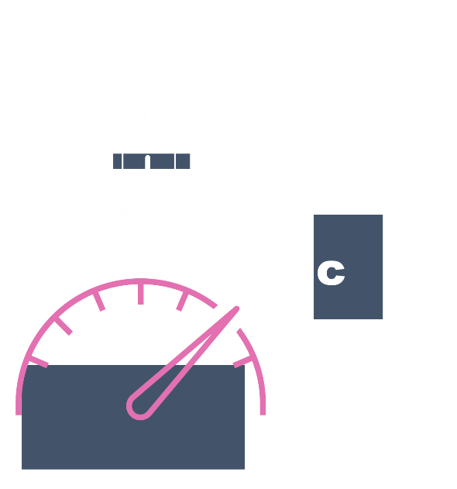
UK NZCBS
The UK Net Zero Carbon Buildings Standard will enable our industry to robustly verify that our built assets are Net Zero Carbon in line with our nation’s climate targets.
Rule book
Typology specific
Carbon-only
Science-based
nzcbuildings.co.uk
Notes:
What is it?
The Standard will set out metrics by which net zero carbon performance is evaluated, and provide performance targets and limits.
The Standard will incorporate performance targets that have been derived from an analysis of the UK’s Sixth Carbon Budget and from data gathered across different sectors within the built environment.
The Standard will be science-based, aligned with delivering a Net Zero Carbon UK by 2050 and a 78% reduction by 2035 in the UK in order to limit global warming to 1.5°C.
Who is it for?
The Standard is for developers, contractors, asset owners and managers, occupiers, investors, financiers and funders, consultants, building industry professionals, building managers and product/material manufacturers, suppliers, and distributors.
It is for anyone who wants to either fund, procure, design, or specify a Net Zero Carbon building and anyone wanting to demonstrate that their building is Net Zero Carbon in accordance with an industry-agreed Standard.

Slide 5
A NZCB Standard will provide:
A clear definition of Net Zero buildings/assets.
A Standard against which buildings/assets can be verified to increase integrity and avoid greenwashing.
A Standard around which the built environment sector can coalesce to prevent proliferation and duplication.
A Standard which investors can use to inform investment decision-making.
A Standard which financiers can be use for sustainable finance, lending and debt.
A Standard which occupiers with can use when buying or leasing buildings.
A Standard which policy-makers at national, city and local level can incorporate into planning, procurement and leasing.

Slide 6
Principles of the Standard
Overall principles
Providing clear, consistent definitions and trajectories for Net Zero Carbon (NZC) buildings and the built environment. This will make it simpler to specify and deliver NZC, and also prevent unfounded “NZC” claims
Driving market transformation through industry engagement, uptake and support
Ensuring that the Standard is easy to understand and use, with achievable but stretching requirements
Aligning asset-level requirements with the system-level
changes needed for a NZC UK.
Technical Principles
Creating a Standard which is science-based
Including both operational and embodied carbon
Prioritising energy efficiency and eliminating the performance gap
Prioritising reuse of existing buildings and assets
Adopting a whole life carbon approach
Enhancing renewable energy generation
Ensuring that buildings are responsive to electricity grid fluctuations
More detailed explanations of these principles can be found in our April Quarterly Update.

Slide 7
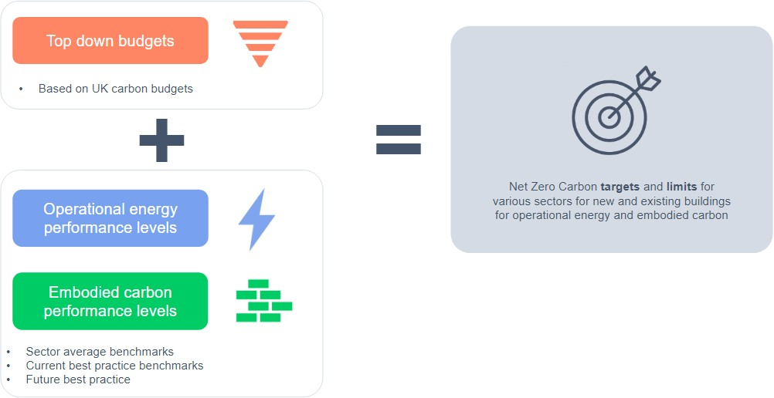
Developing Net Zero Carbon Limits
Two key principles for the Standard are that it should be stretching but achievable, and also that will be science-based.
To reconcile these aims, two workstreams have been established to develop the Net Zero Carbon limits.
The top-down workstream will establish the relevant national carbon ‘budgets’ which show what the industry needs to achieve to play its part in a NZC UK.
The bottom-up workstream will use benchmarking, case studies and modelling to create Levels of Performance.
EUIr
kWh/sqm/yr
kg/CO2e/sqm
The outputs from these workstreams will then be combined to create NZC limits and targets for the Standard.
Glossary: Performance levels: These levels provide the technical evidence on what can be achieved by the individual sectors, based on benchmarking, case studies and modelling. They are not limits or targets, but will be used to inform the NZC limits and targets in the next stage of work.
11
nzcbuildings.co.uk

Slide 8
Progress so far
WE ARE HERE
Top-down workstream
Carbon budgets
Limit-setting tool
Finalise budgets
NZC targets & limits
“Balancing
the budget”
Bottom-Up workstream
Collect data
Process data + carry out modelling
Prepare new build performance levels
Existing building performance levels
nzcbuildings.co.uk

Slide 9
Stakeholder Engagement
David
Who are our Stakeholders and how will we engage with them?
Initial Key Stakeholders
Our Initial Engagement Strategy
Initially, we intend to engage with all parts of the built environment and the real estate sector, especially those who are not engaged in the Technical Groups who are developing the Standard:
We will shortly be issuing a call for engagement to all of the professional bodies which represent the initial key stakeholders we have highlighted, along with anyone else who puts their name forward.
Owners
Investors
Developers
Lenders
Funders
Insurers
Occupiers
Contractors and their Supply Chain
Housebuilders
The main purpose of this consultation is to ensure that the Standard will meet the needs of the organisations who will be commissioning it and using it to measure the performance of their built assets, whether new or existing.
Further Engagement
Once the Standard has begun to be developed we will consult with
Impact groups, Thinktanks, NGOs, Academics and other opinion formers and influencers
Central Government and the Devolved and regional Authorities
Other Standards - eg CRREM, SBTs, GRESB etc

Slide 10
https://www.nzcbuildings.co.uk/
https://www.nzcbuildings.co.uk/

