Slide 1
ICARB 2023
Measuring Net Zero
Whole life carbon as a socio-political issue
Alice Moncaster
Professor of Sustainable Construction
University of the West of England (UWE Bristol)

Slide 2
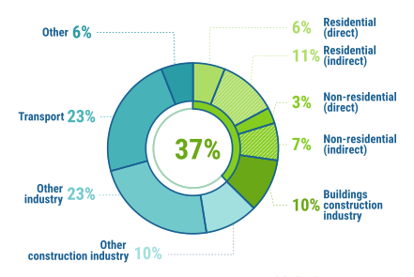
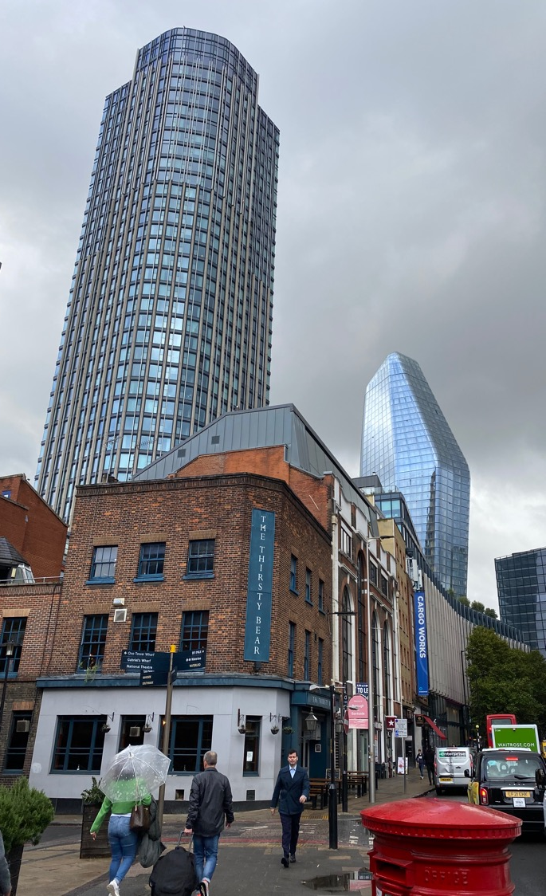
Global carbon emissions from buildings & construction
Operational carbon of existing buildings
= 27%
Embodied carbon of new buildings
= 10%
Embodied carbon of infrastructure = 10%
≈ 50% of global carbon emissions from built env + construction
2021 Global Status Report for Buildings & Construction (IEA+UNEP) - adapted from Fig 2 (p15)

Slide 3
Constructing Sustainability: connecting the social and the technical
Moncaster (2007-12)
Annex 72 Report J: Understanding the impact of individual, industry and political decisions on transitions towards environmental sustainability
Moncaster, Malmqvist, Polycarpou, Francart & Anderson (2017-22)
Annex 89 ST4: The impacts of structures and agents on sustainability decisions and outcomes (2023-27)

Slide 4
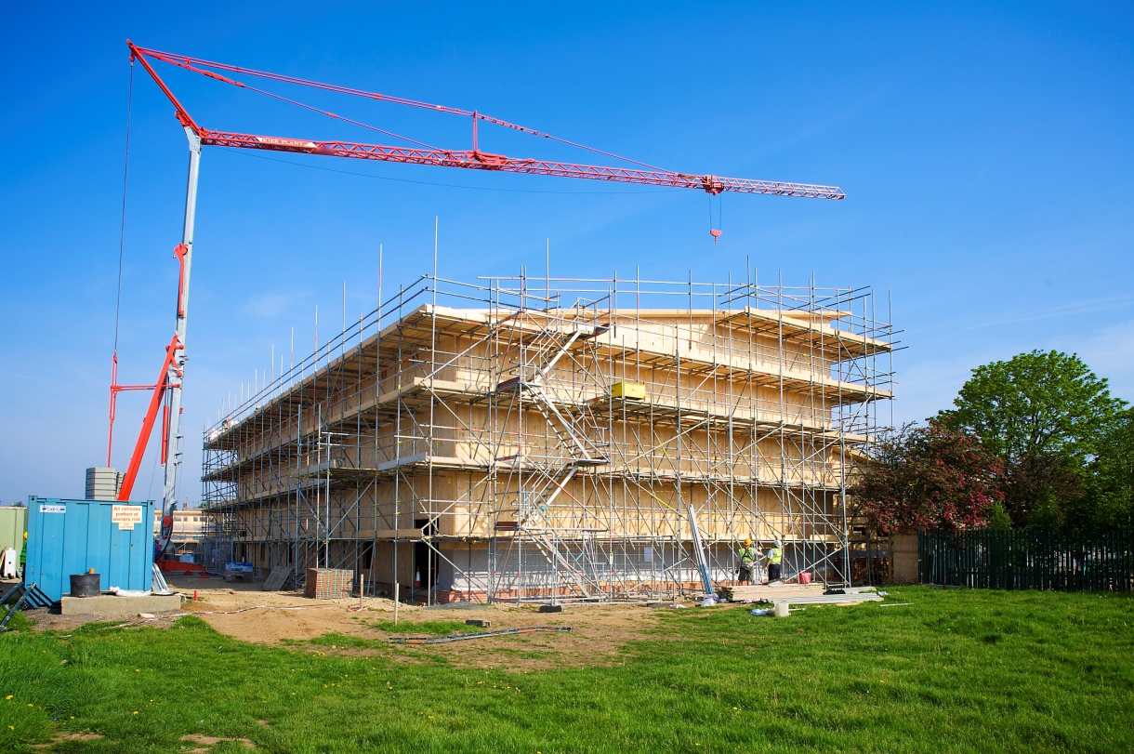
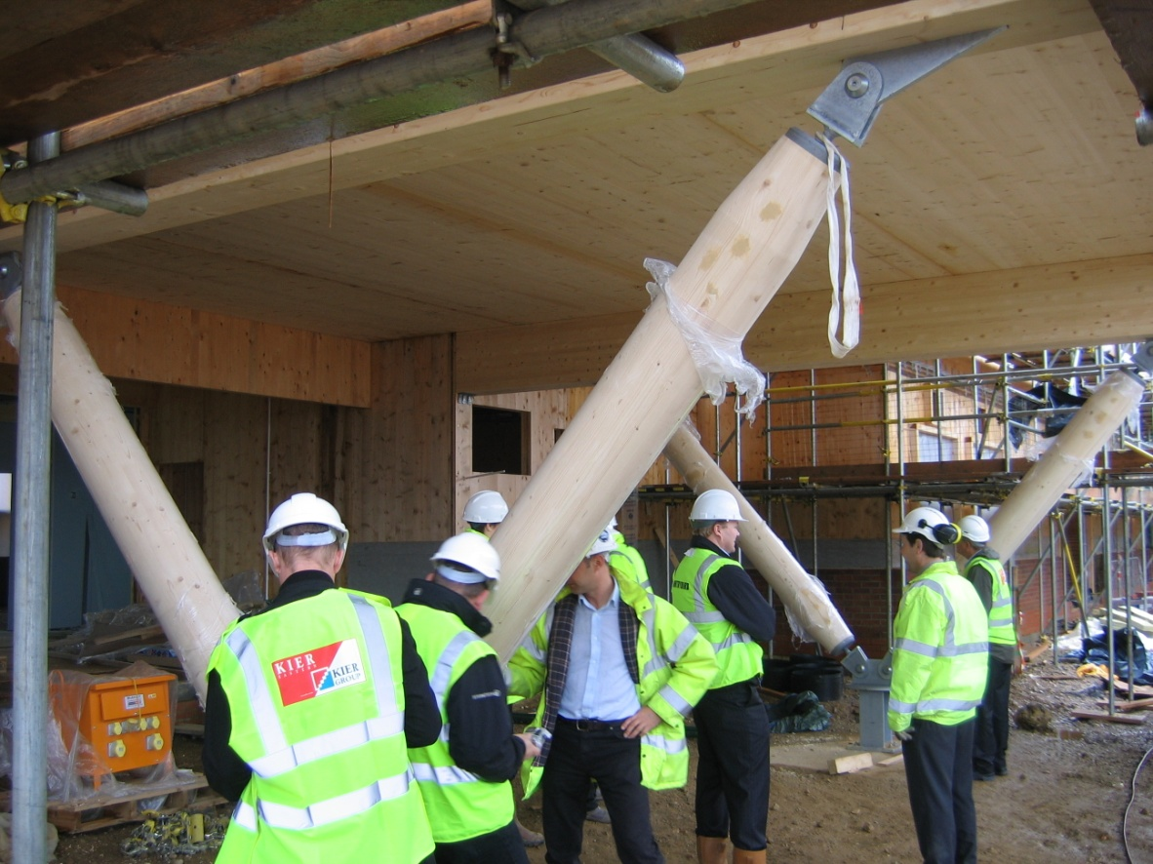
St John Fisher School, Peterborough
Embodied CO₂ steel/brick timber
Sports hall / drama studio: 155t 60t

Slide 5
Why did they build it?
And what was the impact?
‘We’re talking about sustainability, well, what actually are we talking about? We’re talking about carbon, something physical, you know, which you can measure…’
‘... you know heart in heart that it’s the right thing to do’
The embodied carbon … to me is what BREEAM should be about
‘Once you get to the end you’ve more likely saved along the way...it’s got to be because it’s more efficient...’
Designers
Contractors

Slide 6
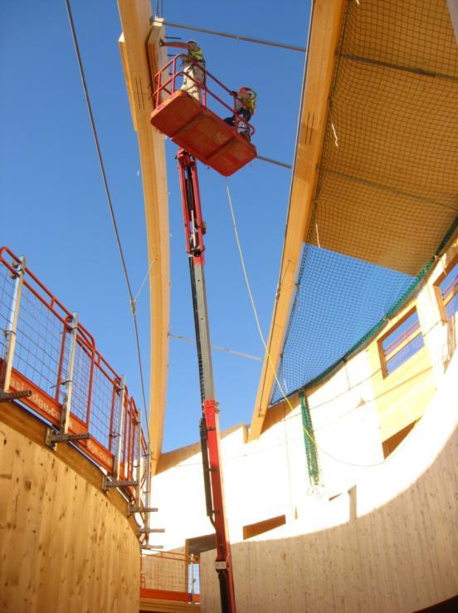
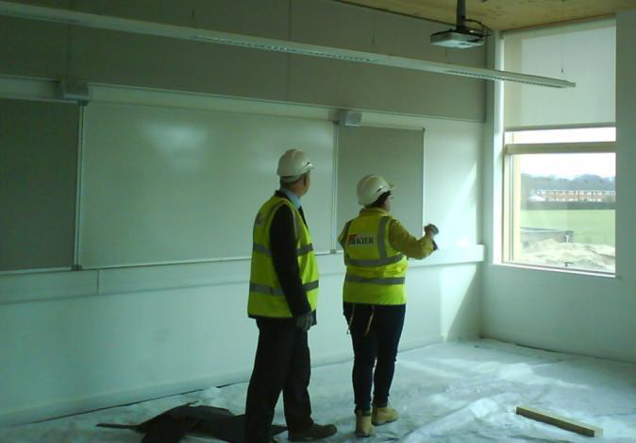
The Open Academy, Norwich
‘ it was a hoop I’d got to jump through …I had to say yes, we'd done the DQI. … it was just a paper exercise. But it's measurable, I suppose, isn’t it?

Slide 7
So what else was affecting decisions for school buildings?
…the shame is that biomass is almost the default position
the carbon calculator … [allows us to see] how they plan to meet that 60% reduction, so 90% or so are planning to meet it with biomass
Government
Director of Education, Kier
they end up getting a biomass boiler because that seems to be the only option….
Engineer, DfE School Design Unit
Schools’ Carbon Calculator
The common choice of biomass reflects its effectiveness in reducing carbon emissions at relatively low capital cost
Senior Advisor, CABE
it is very difficult to get it to work if you don't use biomass
DCSF report
Designers, advisors & contractors
Head of Sustainable Development,
Willmott Dixon
’
we recognise that it's a bit daft to put a wood burning thing in the middle of town

Slide 8
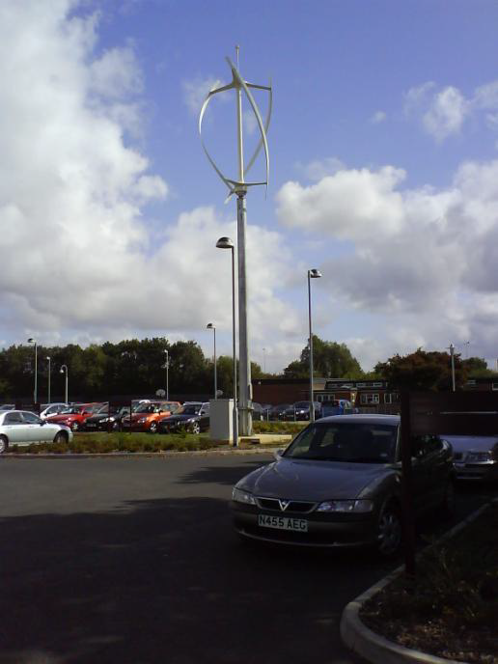
What about other renewables?
‘You can’t get the payback on a wind turbine, they are a symbol’
‘It’s doing 6kW per hour or something, which to ignorant builders like me I believe is a kettle.’
‘I think the only things that people tend to see are wind turbines, and they think they’re the best things since sliced bread... maybe not the case!’
‘..so the night before we found out we’d won, they said can we have solar panels? So we ended up putting two solar panels on the roof… it's just a gesture and it’s pointless …what's being generated is being used for that kettle…’

Slide 9
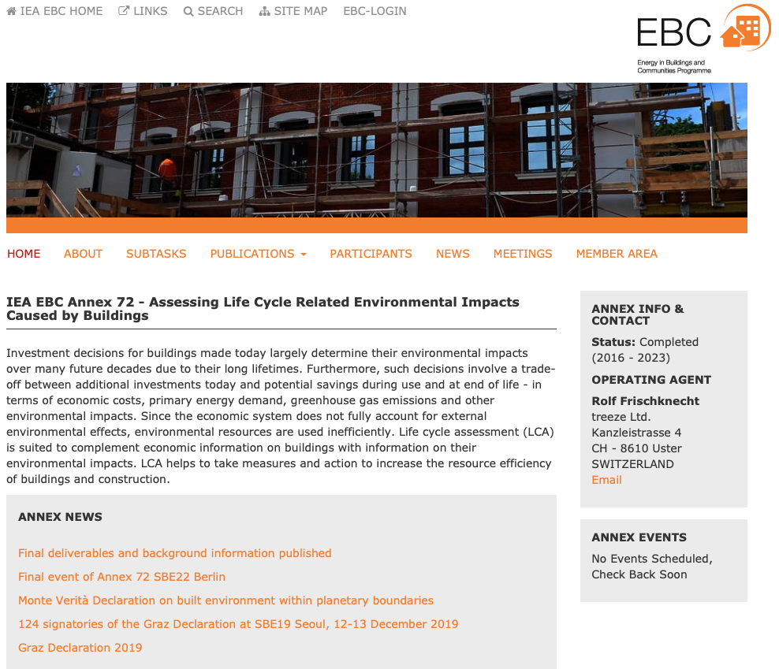
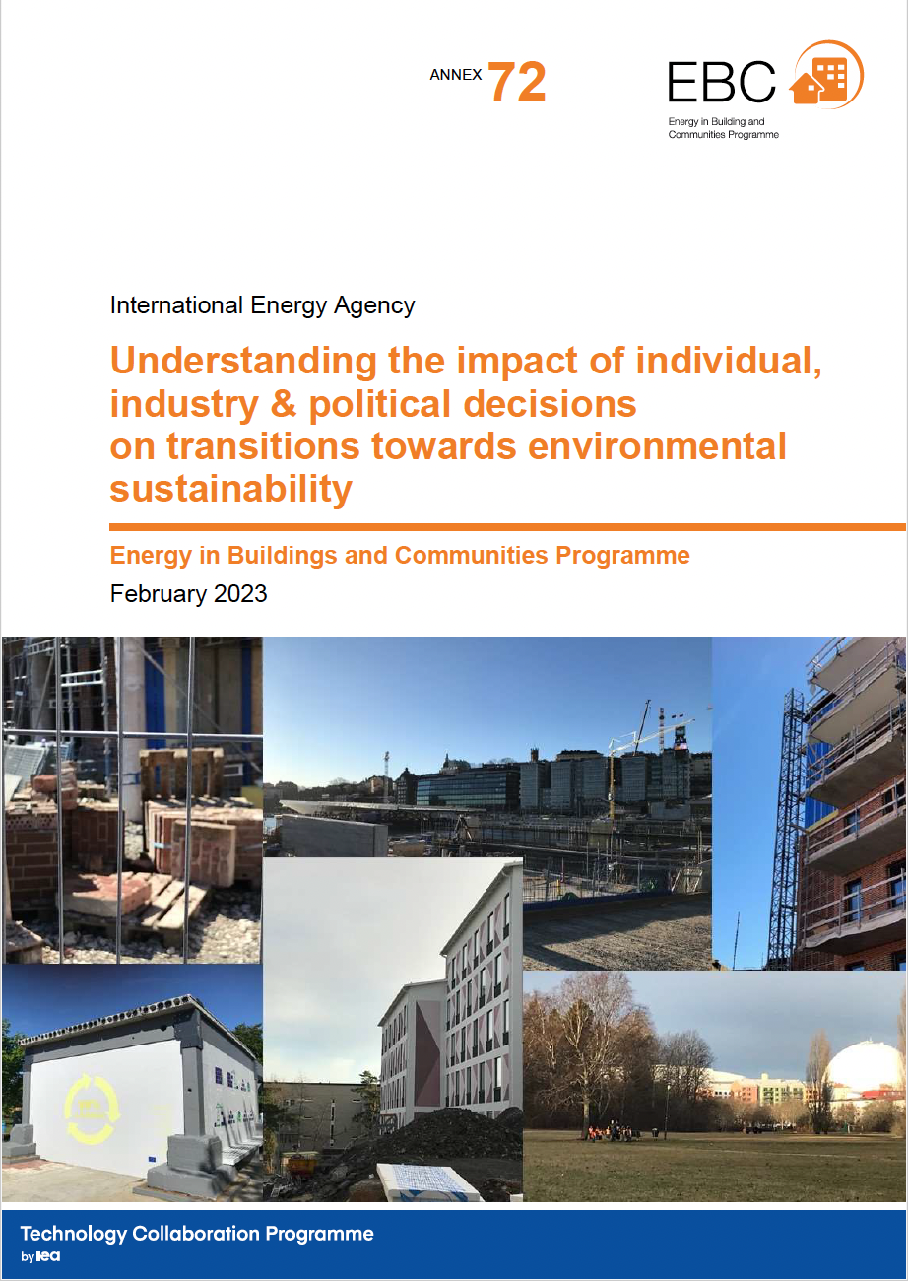
IEA EBC Annex 72
What is the whole life carbon of buildings?
How can we measure it?
How can we reduce it?
Why, and where, is – or isn’t – change happening?
https://annex72.iea-ebc.org

Slide 10
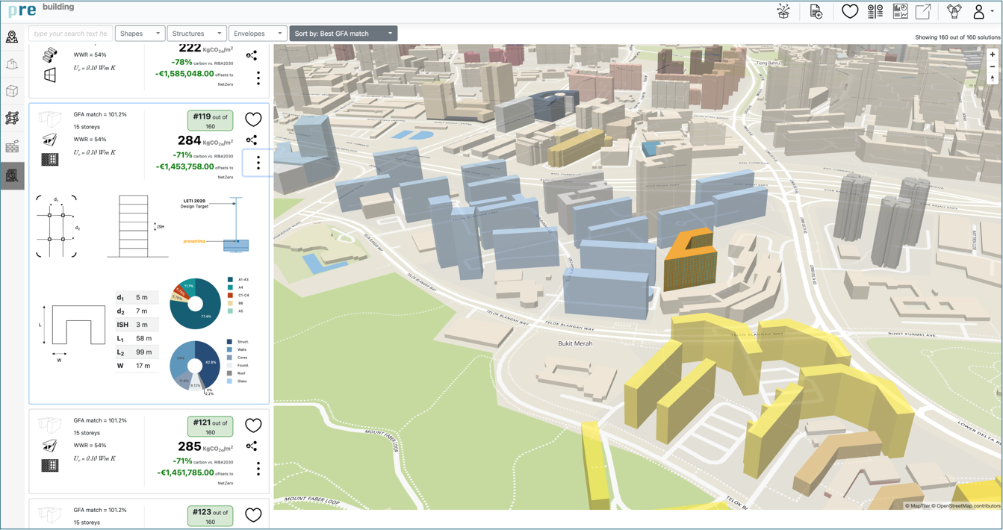
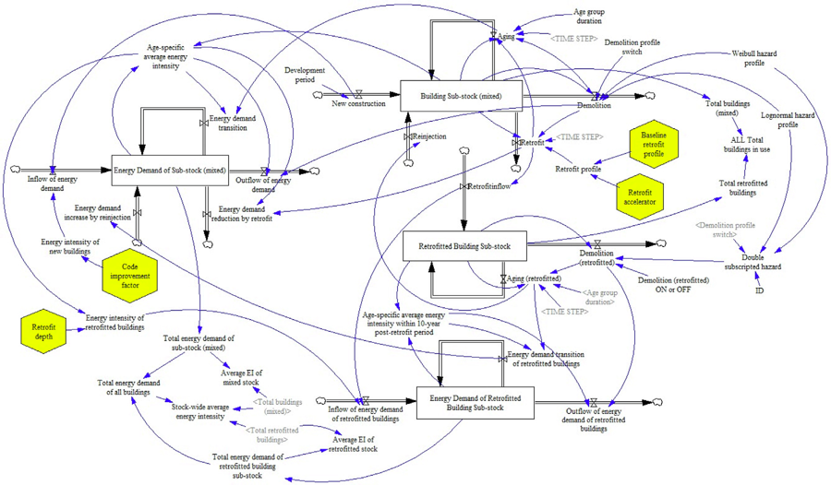
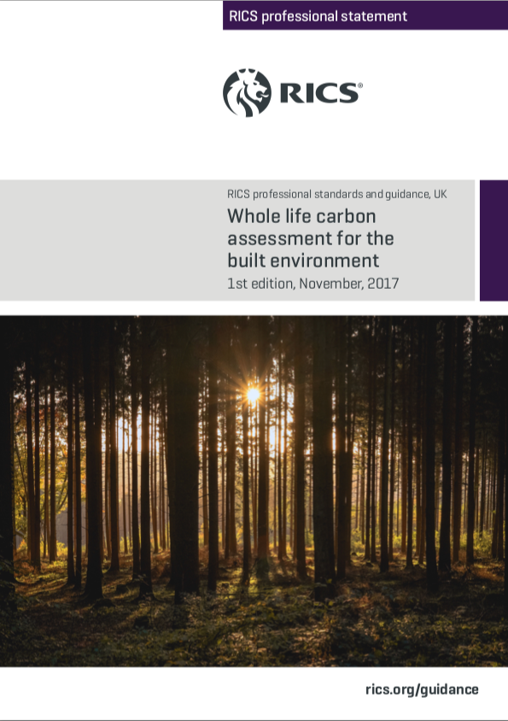
Research questions, hypothesis, & research design
RQ1: How does transition to lower-impact buildings happen?
RQ2: How might LCA be introduced?
Hypothesis: 4 mechanisms:
(1) the role of individuals in projects;
(2) the tools and artefacts that are used in design;
(3) the industry and organizational context; and
(4) the national policy and regulation landscape.

Slide 11
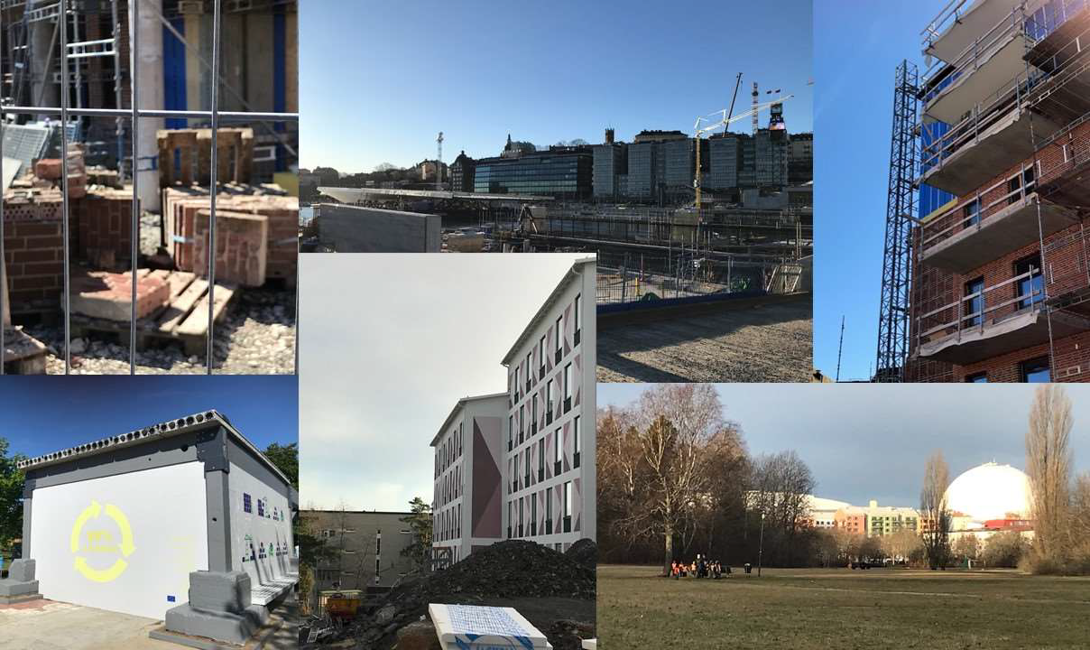
Qualitative case studies
Alice Moncaster
Tove Malmqvist
Kyriacos Polycarpou Nicolas Francart
Jane Anderson
Social housing projects Cyprus, Sweden & UK
Developers (of single housing) Sweden
LCA tool developers UK
Policy and industry instruments Sweden & UK

Slide 12
RQ1: How does transition to lower-impact buildings happen?
a) Individuals and artefacts, + interactions
Tools, guidelines, planning requirements
Artefacts mediate decisions of designers
External actors can also steer decisions
Concepts & artefacts can act as boundary objects (Leigh Star, 1989)
Artefacts and individuals act as knowledge brokers
Policymakers, planners
Designers
‘objects that are plastic enough to be adaptable across multiple viewpoints’ –
they translate between actors and enable cooperation, yet also limit and restrict ambition

Slide 13
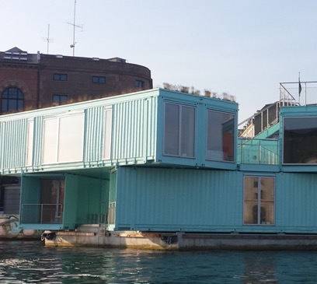
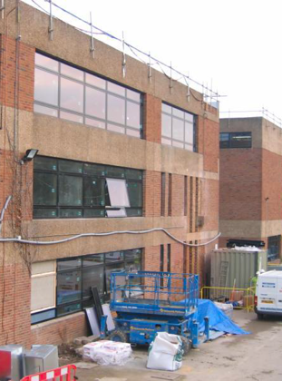
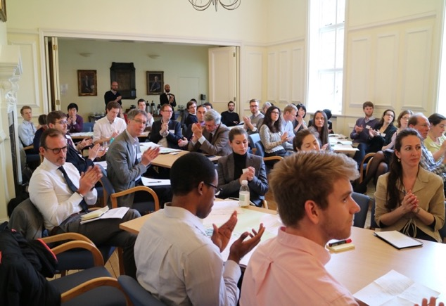
RQ1: How does transition to lower-impact buildings happen?
b) Industry & organizational contexts
National context determines decision makers
Building type determines when decisions are made
c) … & their interaction with policy
Policy influenced by ‘issue networks’ & ‘policy communities’
Knowledge can empower organisations to influence policy
Charismatic individuals can have direct influence on policy

Slide 14
RQ2: How might LCA best be implemented?
1. Development of open access national databases
2. Encouragement of tool development, open source not black box
3. Assess own national context for most appropriate implementation of LCA
4. Assess project-type for most appropriate implementation of LCA

Slide 15
IEA EBC Annex 89 ST4 (2023-2027)
The impacts of structures and agents
on sustainability decisions and outcomes within….
Impacts on sustainability decisions and outcomes
Individuals
Project type
Procurement approach
Political & regulatory
National construction culture
Tools and artefacts
Industry/
organisational culture
A construction project or project type
An organization, or organization type
A country, or smaller or larger region
The use/creation of an LCA tool
A regulation or standard
A procurement approach (PPP, etc)
A construction approach (MMC, etc)
….. Etc.

Slide 16
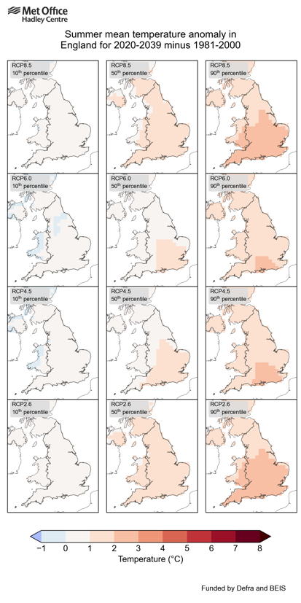
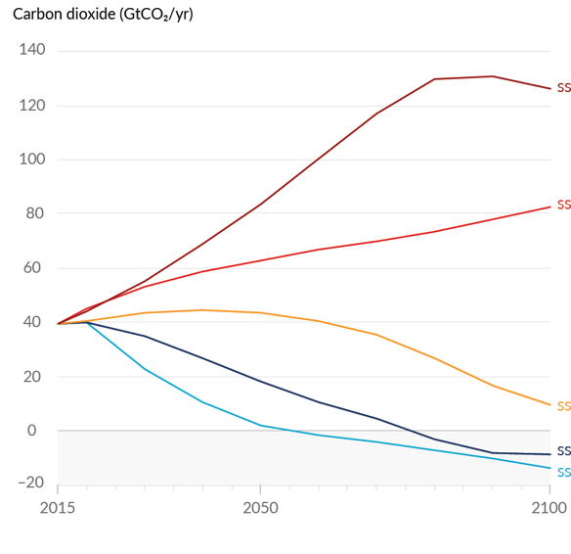
We know what is happening to the climate and what to do about it:
but alternative future scenarios depend on the choices we make
SSP-RCP
5 - 8.5
3 - 7.0
2 - 4.5
1 - 2.6
1 - 1.9
Ave global temp4.4°
3.6°
2.7°
1.8°
1.4°
RCP 8.5
6.0
4.5
2.6
Projected CO₂ annual emissions to 2100
for different Shared Socio-economic Pathways (SSPs)
Ave global temperature rise 1850-2020
(already over 1°)
UK climate projections to 2039
Representative Concentration Pathways (RCPs)
We need to make the right choices, and we need to understand why we haven’t been making them up to now!

Slide 17
ICARB 2023
Measuring Net Zero
Thank you!
Alice Moncaster
Alice.Moncaster@uwe.ac.uk

Slide 18
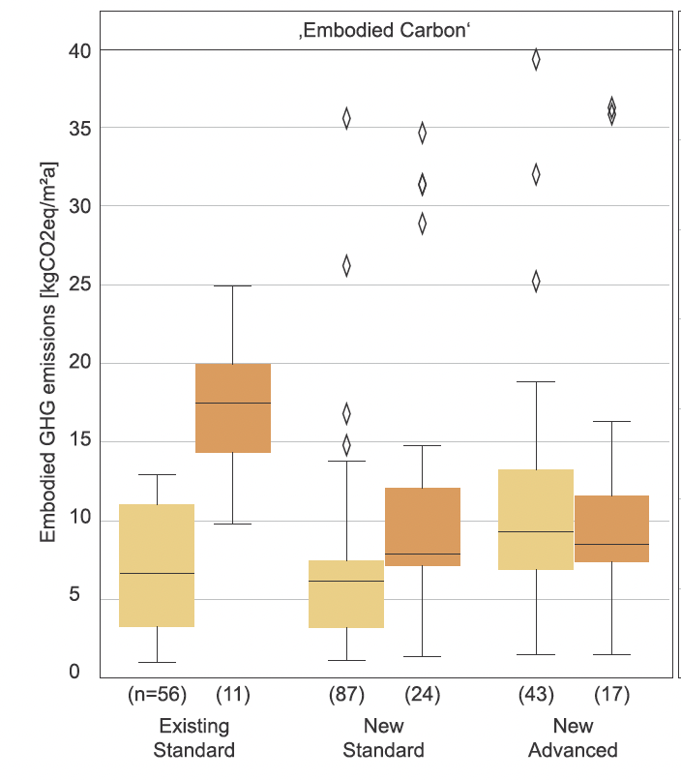
How much?
Systematic analysis of 650 building LCAs
Embodied GHG emissions of buildings – The hidden challenge for effective climate change mitigation
Martin Röck, Marcella Ruschi Mendes Saade, Maria Balouktsi, Freja Nygaard Rasmussen, Harpa Birgisdottir, Rolf Frischknecht, Guillaume Habert, Thomas Lützkendorf, Alexander Passer (2020)
Applied Energy, 258, 114107,https://doi.org/10.1016/j.apenergy.2019.114107.
Fig. 3bi Distribution of embodied GHG of residential and office buildings by energy performance class

Slide 19
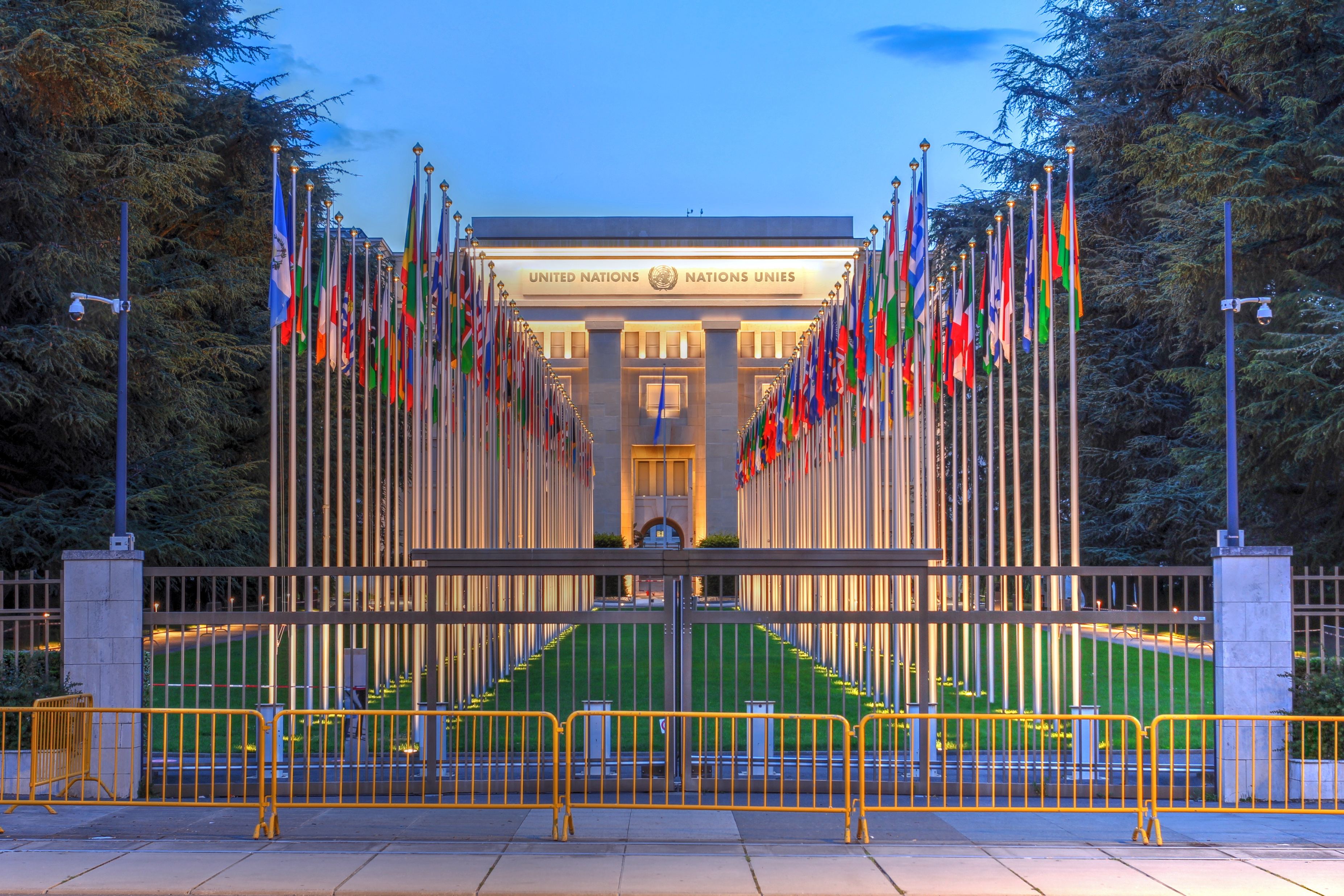
UN SDG Action Week
‘The buzz word of the day is “Mobilization”’
António Guterres,16 Sept 2023

