Slide 1

The Buried Giant:
Construction Materials Shape the Environmental Footprint of Buildings
Dr. Rolf Frischknecht
8th International ICARB Conference 2023
Ishiguro 2015
Edinburgh, Scotland, 26 September 2023

Slide 2
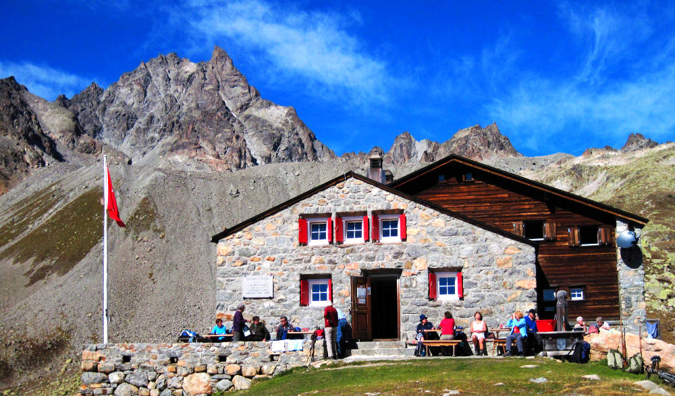
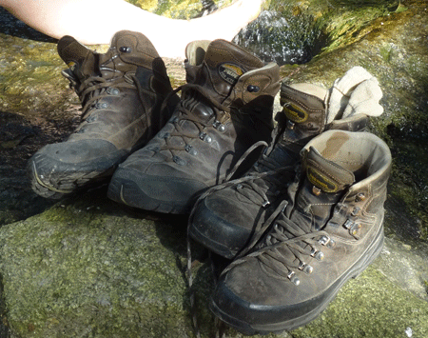
Zero emissions!

Slide 3
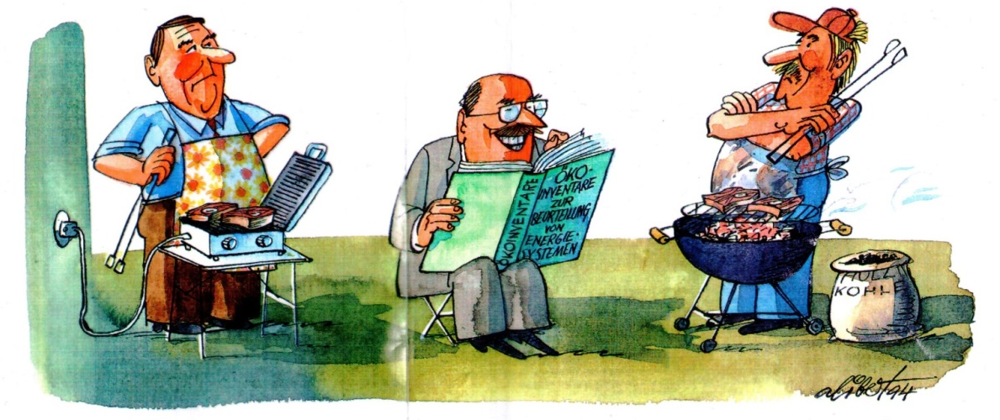
4 questions
On whose shoulders do we stand?
Construction materials: the buried giant?
Net zero emission buildings: Castles in the air?
What remains to be done?
Notes:
Graue Energie zunehmend wichtig -> bei Neubauten oft wichtiger als gesamte Betriebsenergie über Lebensdauer (SES)
Pariser Abkommen: 1.5 Grad-Ziel -> Fokus Treibhausgasemissionen
CH: 26% der THGe durch Gebäude verursacht
SIA-Fachblatt 2040 (SIA-Energieeffizienzpfad): Ausnahme: individuelle Mobilität (3l/100km)

Slide 4
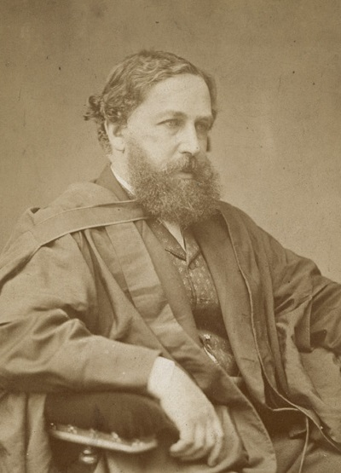

Exponential growth in the past:
What policy to adopt?
« We have to make the momentous choice between brief greatness and longer continued mediocrity. »
Prof. William S. Jevons (1835-1882)
Economist and Logician
Born in Liverpool, UK
Jevons (1865)

Slide 5
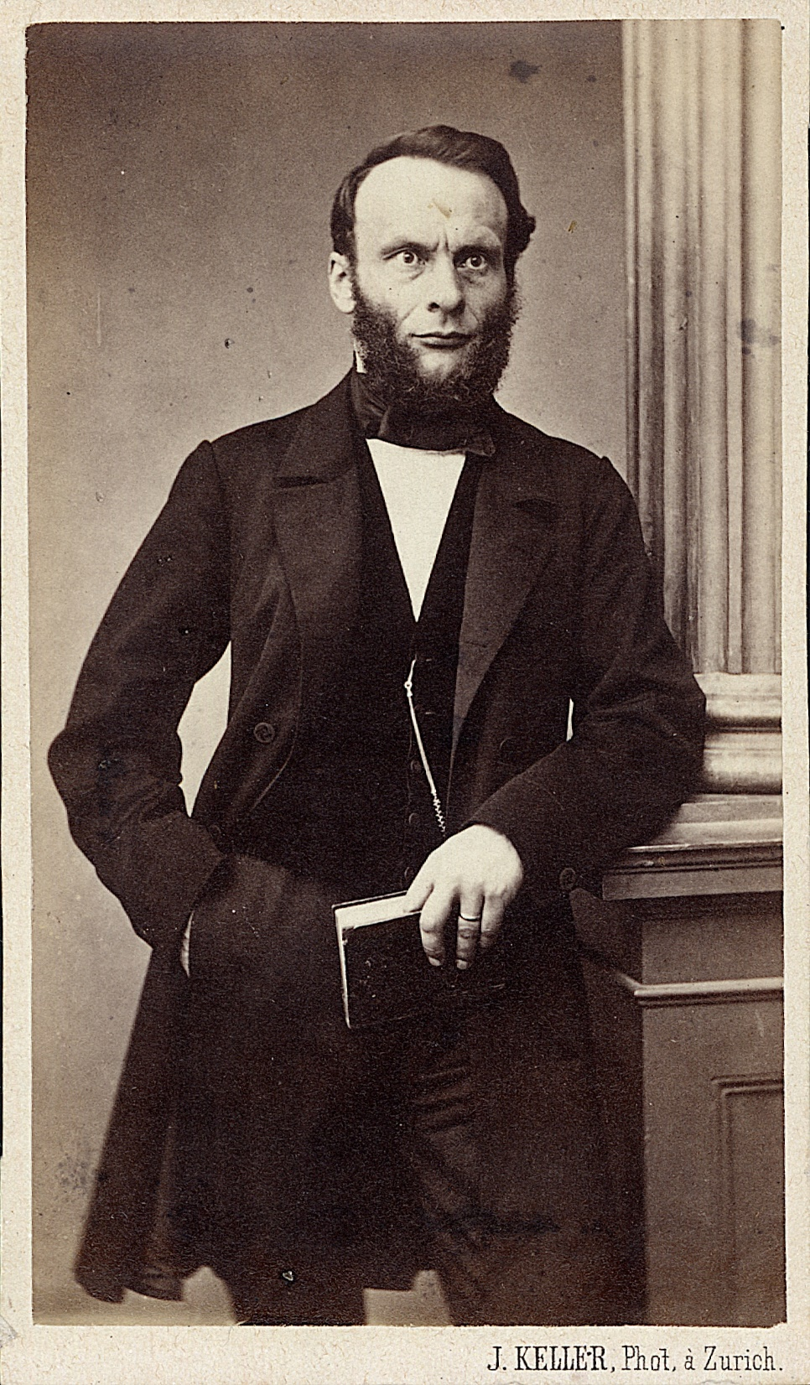
A more sustainable solution:
Use of renewable energies
«People will then have to rely on the energy which the sun will continue to supply with its rays in the course of the distant future.»
Prof. Rudolf Clausius (1822-1888)
Born in Poland
Professor at ETH Zürich
Jevons (1865)

Slide 6
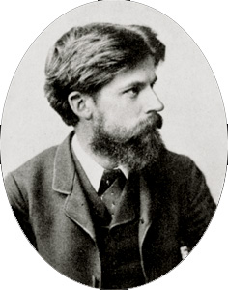
First life cycle considerations
Poor efficiency in coal supply chain
Coal available
Coal lost
Used
Prof. Patrick Geddes (1854-1932)
Born in Scotland
Professor at University Edinburgh
Geddes (1884)

Slide 7
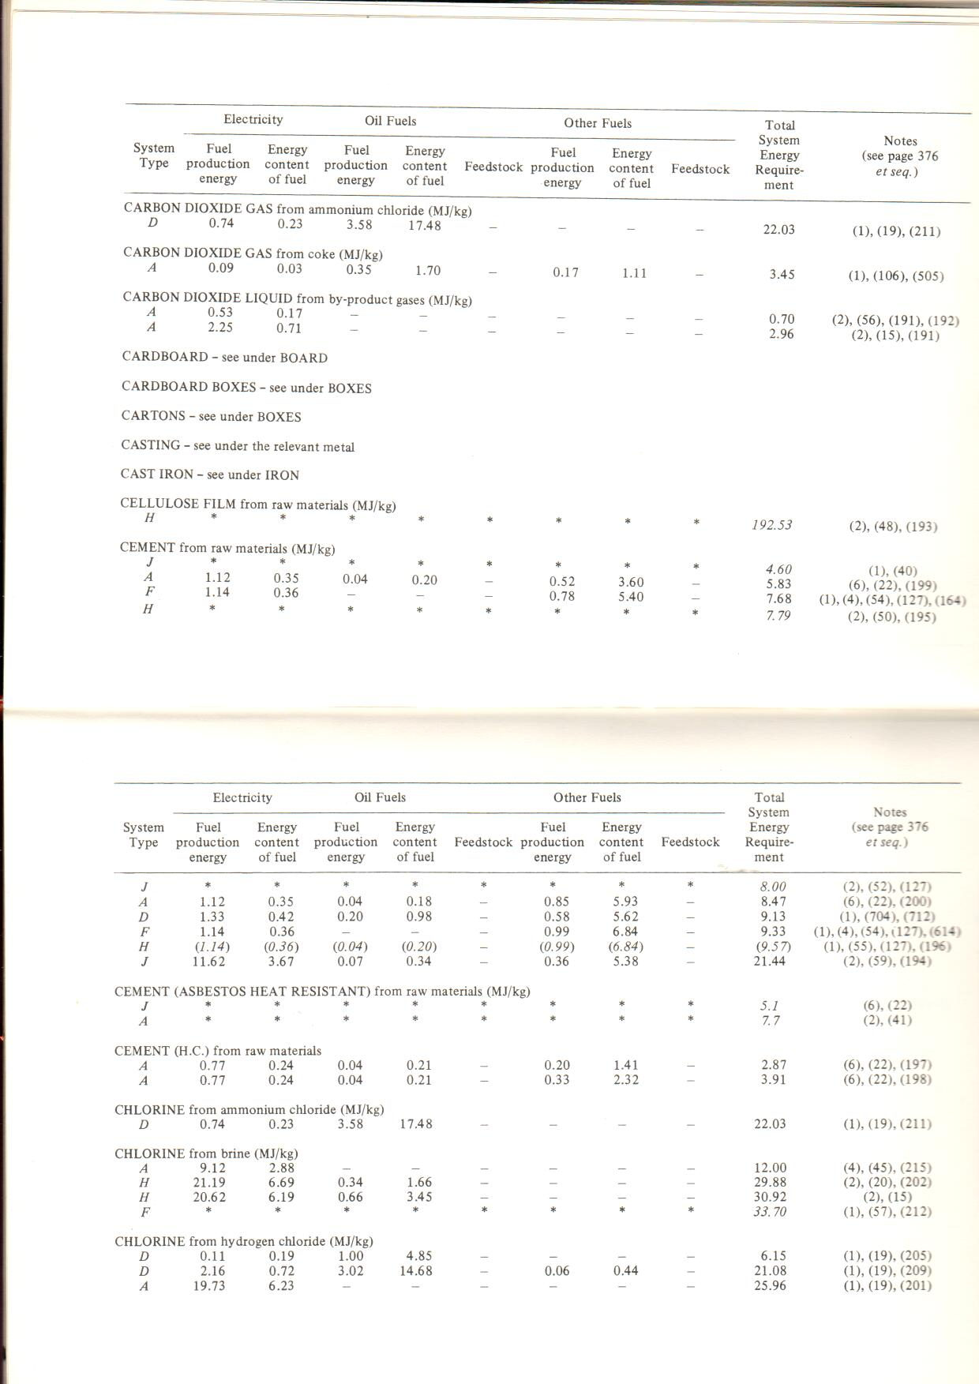

Seventies: Cumulative energy demand of materials and chemicals
Boustead & Hancock 1979
Notes:
Bedeutung der Phase Erstellung nimmt zu:
Metaanalyse von scientific papers zu Carbon footprint von Gebäuden (Autoren: Experten aus dem IEA EBC* Annex 72).
Sample: 650+ Gebäude (Wohnen und Büro) in Europa, Asien und Nordamerika, darunter auch rund 1 Dutzend CH-Gebäude.
Rund 240 in der Analyse verwendet
Einteilung in drei Klassen: Durchschnitt, heutiger Standard und erhöhte Anforderungen
=> Anteil Gebäude-Erstellung (rot, Herstellung der Baumaterialien, -elemente und Haustechnik) hat zugenommen und erreicht bei Gebäuden mit hohem Energiestandard im Schnitt schon 50%
*EBC: Energy in Buildings and Communities Programme

Slide 8
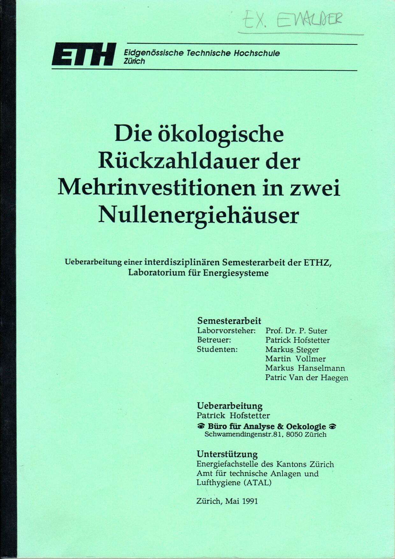
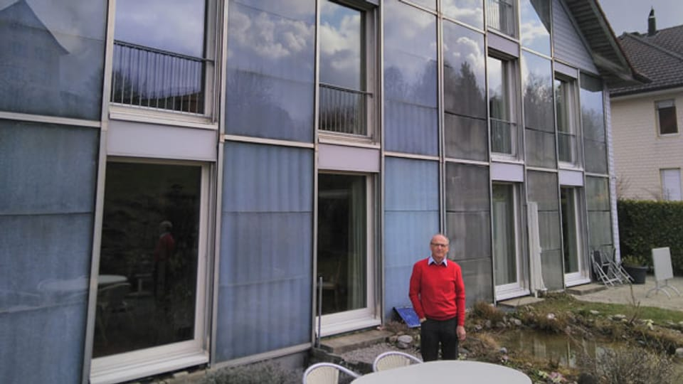
Eighties: LCA of first zero energy buildings
Hofstetter et al (1991)
© srf.ch

Slide 9

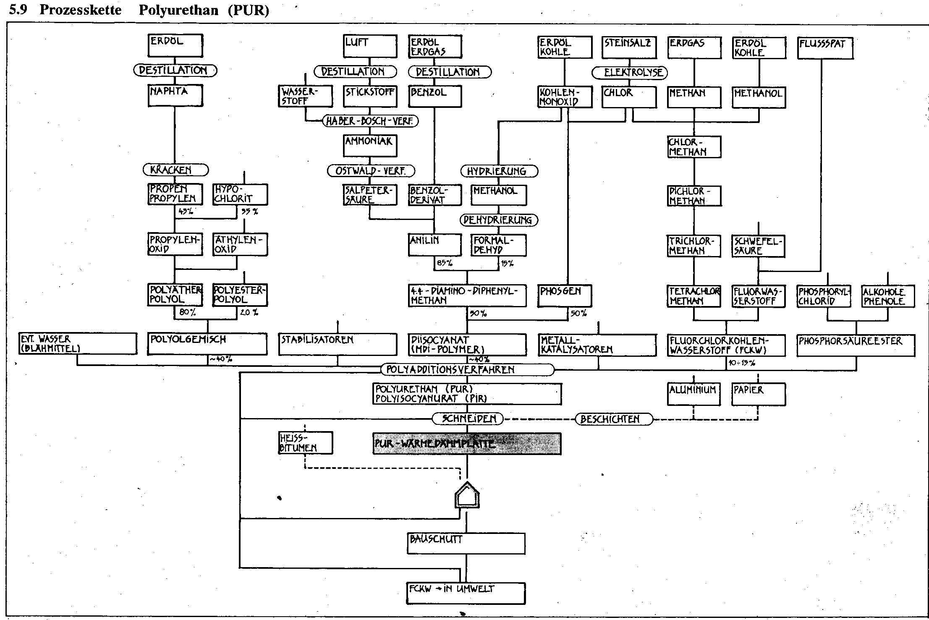
Eighties:
Comparative assessment of insulation materials
Ems et al (1989)

Slide 10
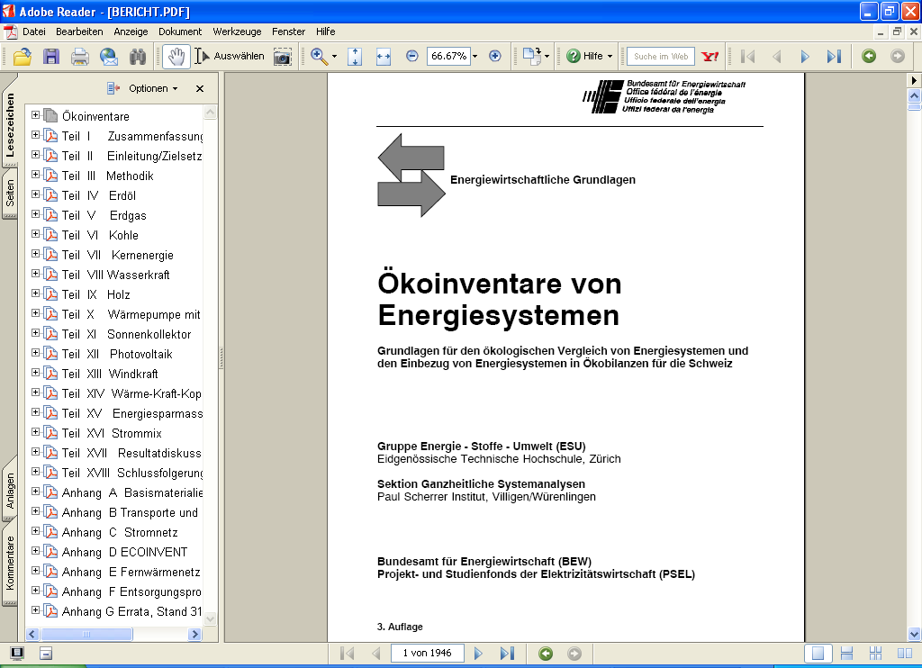

Nineties: Cornerstone of LCA in buildings
LCA Database Switzerland
  ETH Zürich, 1994:
  “Ökoinventare von Energiesystemen”
  about 500 Data sets on
    energy supply
    building materials and chemicals
    transport services
    waste management services
Frischknecht et al (1994)

Slide 11
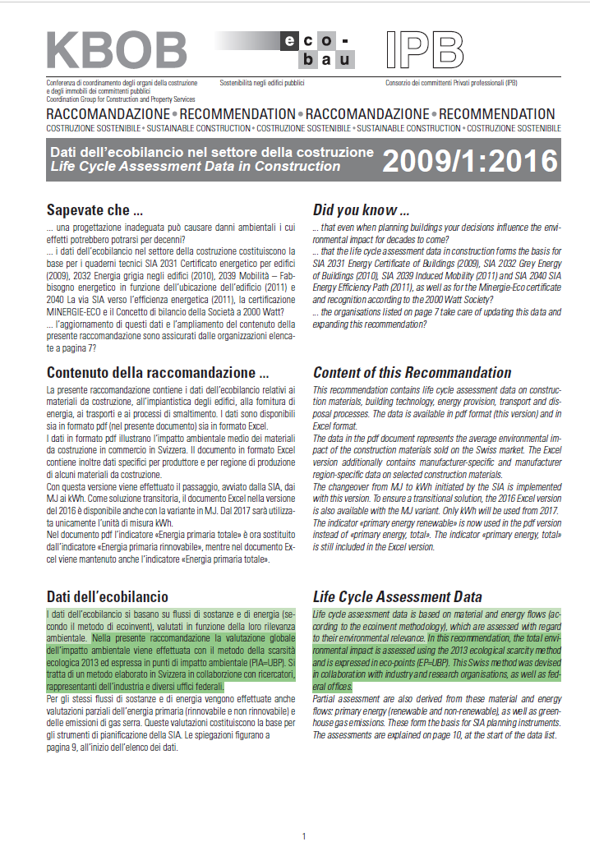
Noughties:
Evolution to ecoinvent and UVEK databases
  ecoinvent Centre, 2003-2008,
  UVEK Data 2012-today:
  Online LCA database with
  about 2500-4000 datasets on
    energy supply
    water supply
    building materials, chemicals, packaging, textiles
    electronics
    mechanical engineering
    transport services
    waste management services
    agriculture

Slide 12
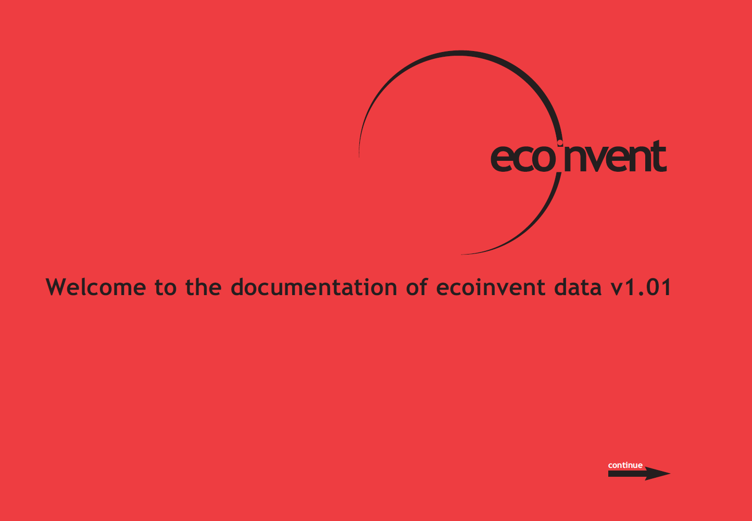
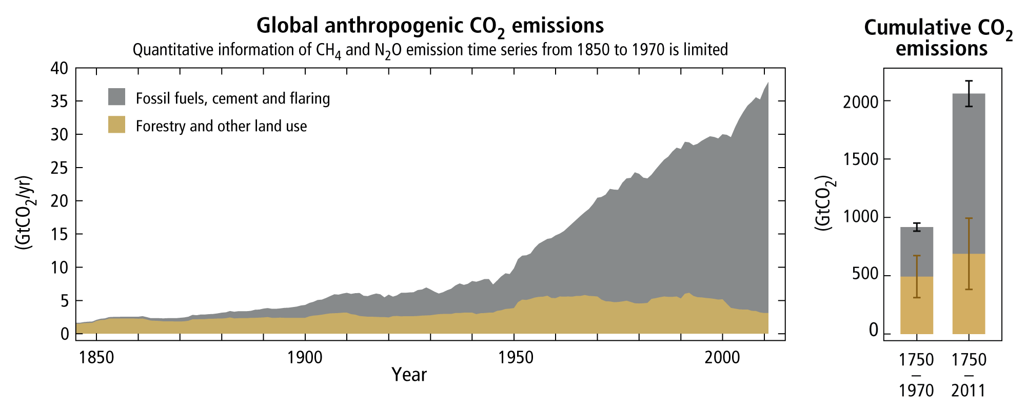
Fossil CO₂ emissions and LCA in the construction sector
180 years (1750-1970): 5 GtCO₂ per year
40 years (1971-2011): 30 GtCO₂ per year
Source: IPCC (2013)

Slide 13
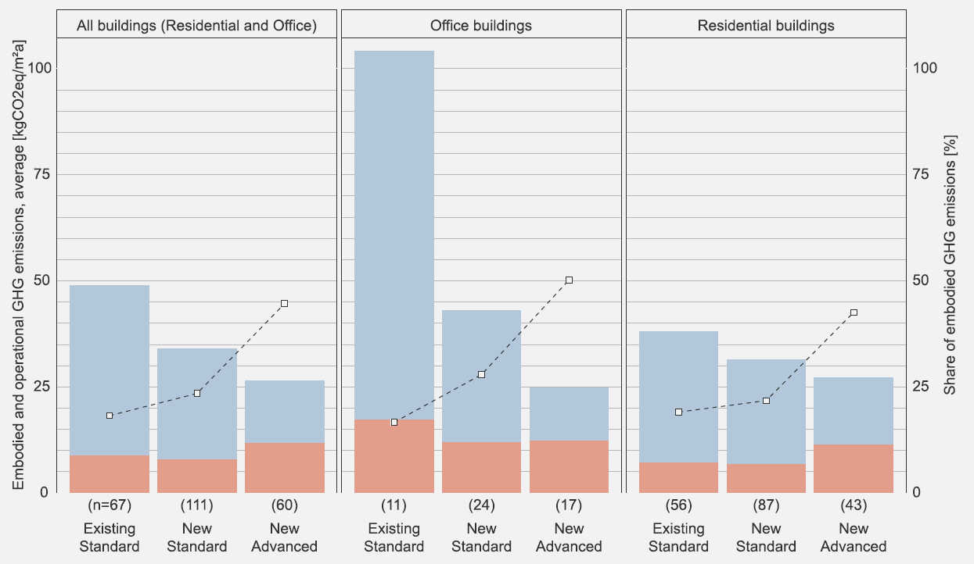

ASSESSING OPERATIONAL AND EMBODIED EMISSIONS – CURRENT TRENDS
There is a downward trend in operational emissions relating to an improved energy performance and increasing use of renewable energy.
The relative and absolute values of embodied impacts (here embodied GHG emissions) increase.
The consideration of the entire life cycle, the limitation of the upfront/initial emissions, as well as the development of overall goals and guidance values for operational and embodied GHG emissions are necessary.
Röck et al. 2020

Slide 14
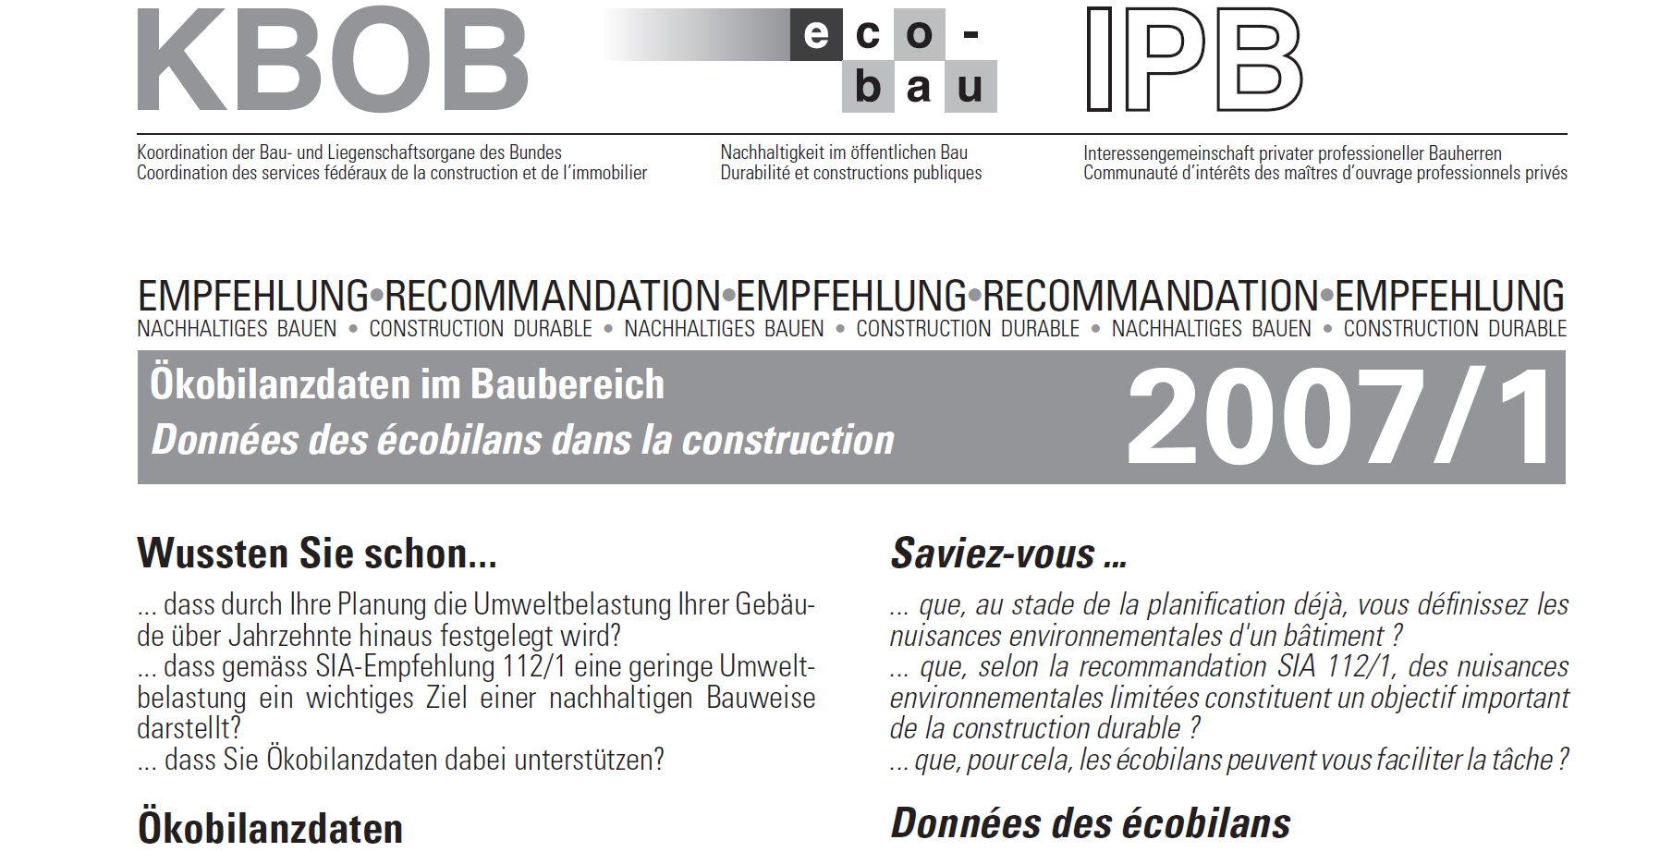
LCA data for the construction sector in CH
The KBOB recommendation 2009/1
Contains LCA data on:
Construction materials
Building technology
Energy supply
Transport services
Waste management services

Slide 15
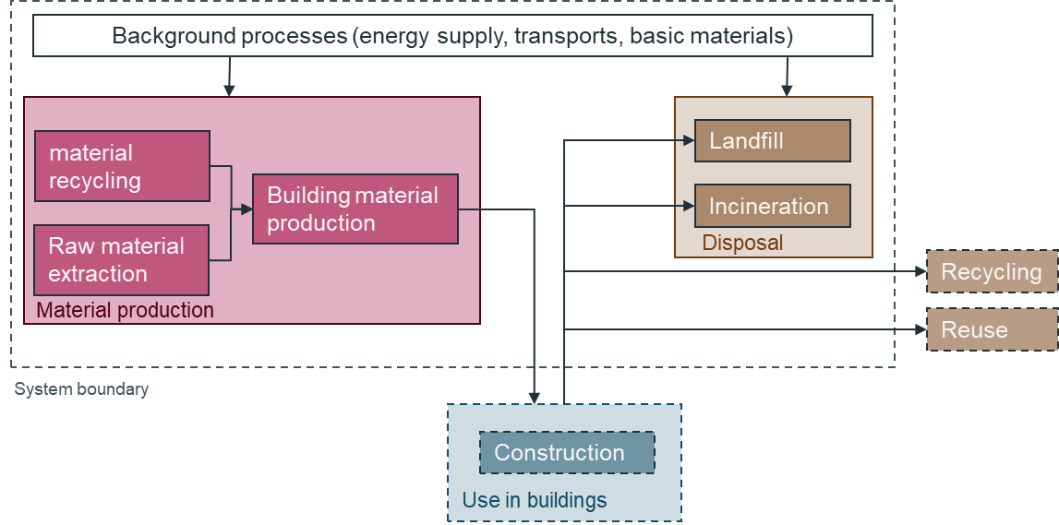
System boundary
LCI of construction materials
No credits

Slide 16
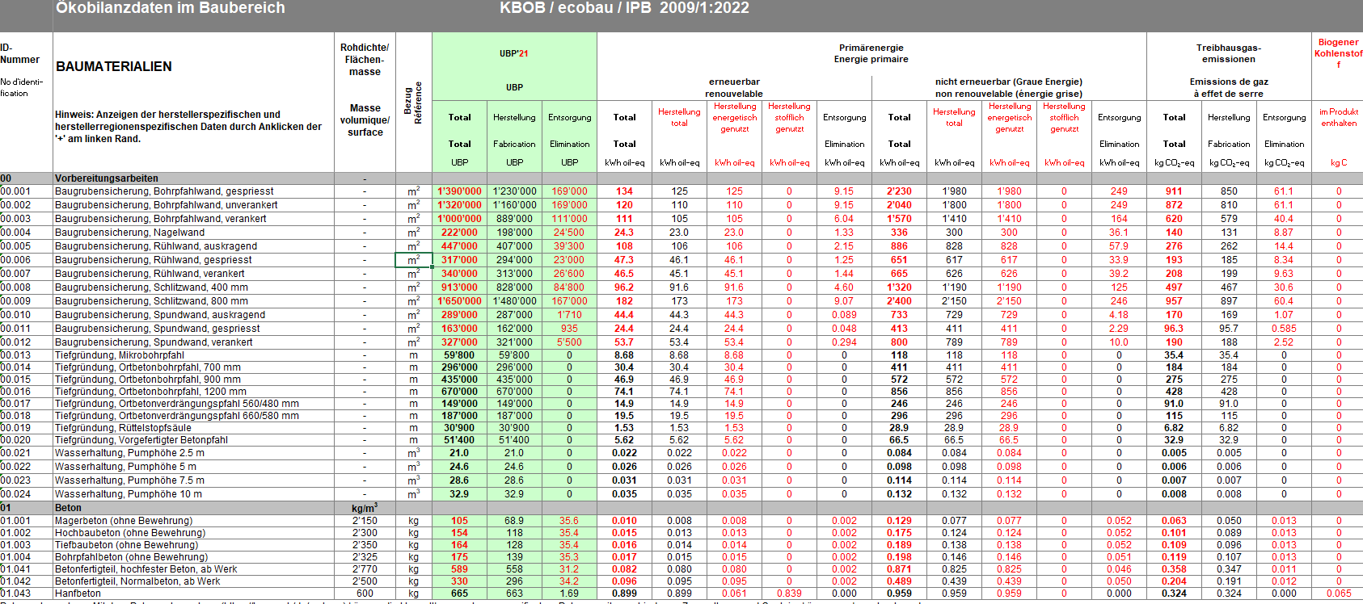

LCA data for the construction sector in CH
The KBOB recommendation 2022
Total environmental impacts 2021
production
end of life
Further features:
Potential benefits and loads beyond system boundary (module D) excluded
UUID number
company specific datasets available
background LCI database available for SimaPro, openLCA* and Brightway*
*expected
Primary energy total and Primary energy non renewable
production
end of life
Further distinction in
energetic use
use as raw material
Greenhouse gas emissions
production
end of life
Biogenic carbon content

Slide 17
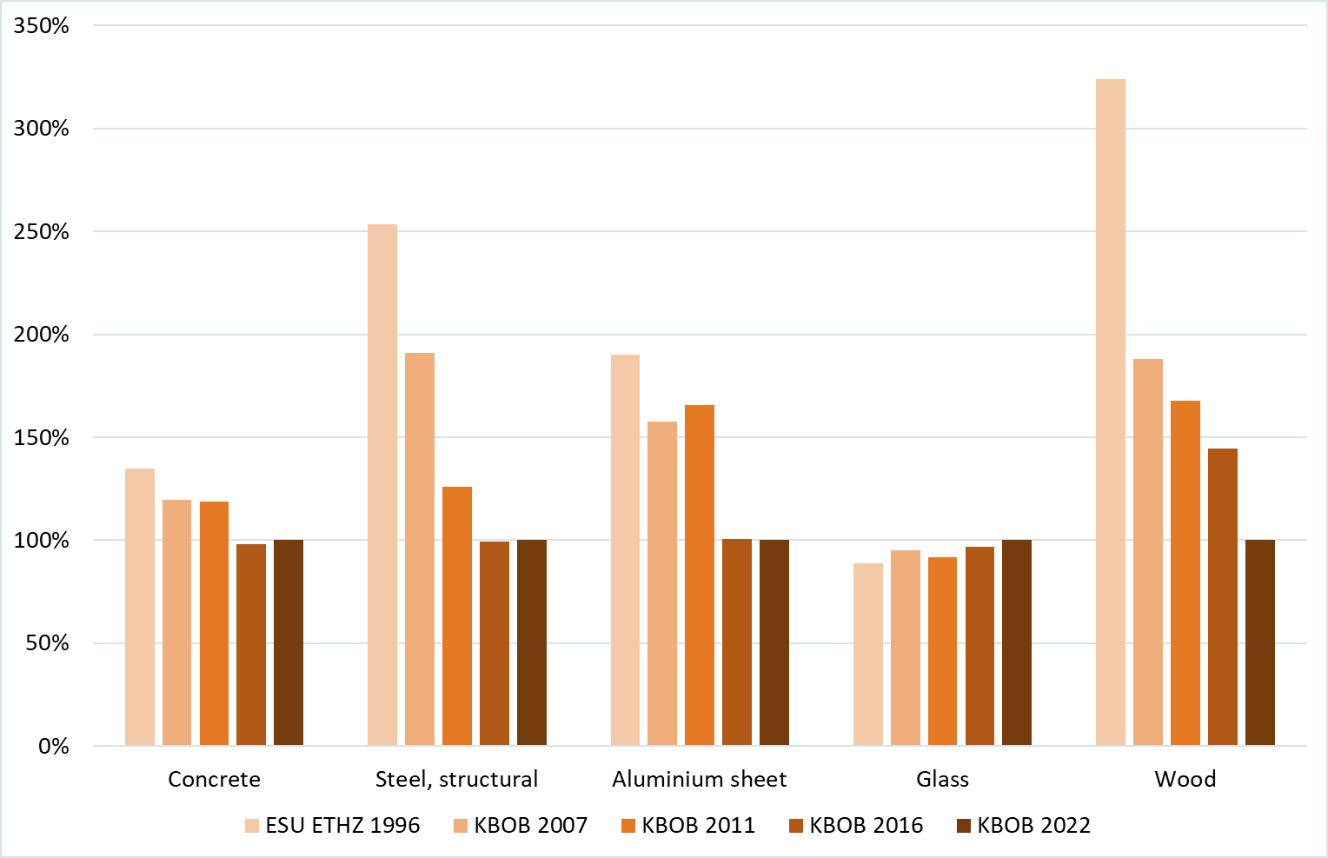
Evolution of the carbon footprint (production and end of life) of construction materials
Evolution | Past
Concrete | ↘
Steel | ↘↘↘
Aluminium | ↘↘
Glass | →
Wood | ↘↘↘
values 2022 in g CO₂-eq/kg
100
740
5600
1200
340

Slide 18
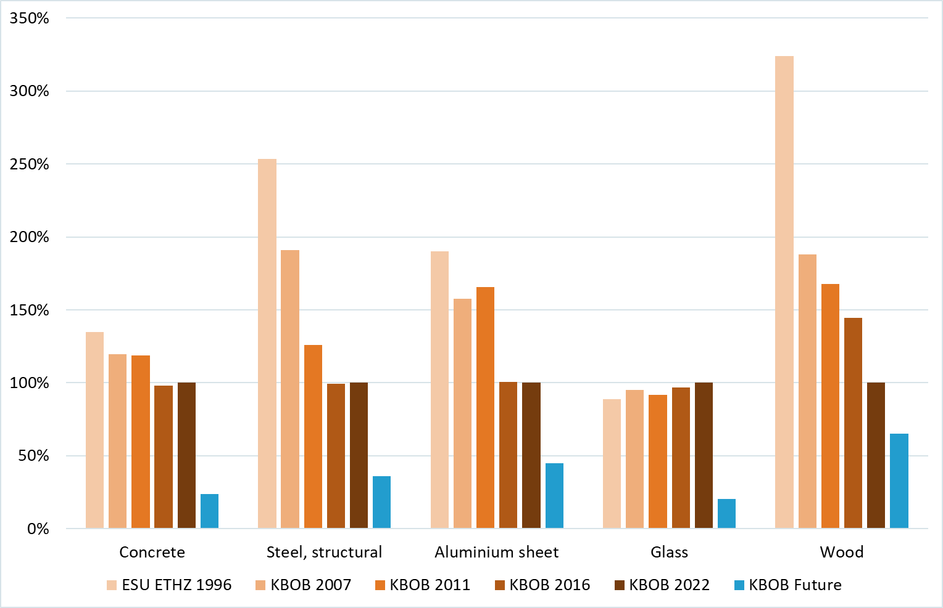
Evolution of the carbon footprint of construction materials
Evolution | Past | Future *
Concrete | ↘ | ↘↘↘
Steel | ↘↘↘ | ↘↘↘
Aluminium | ↘↘ | ↘↘
Glass | → | ↘↘↘
Wood | ↘↘↘ | ↘↘
future values in g CO₂-eq/kg
24
270
2500
260
220
* requires substantial industry investments

Slide 19
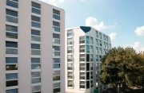
Case study buildings
Office building ARE-Ittigen with 96 working places
Minergy-P-ECO
Concrete kernel and wood façade, compact
Heating and hot water: 82 MJ/m²a (electric heat pump)
Ventilation & lighting: 70 MJ/m²a
Residential building Rautistrasse with 104 flats
Minergy-ECO
Massive construction
Heating and hot water : 107 MJ/m²a (electric heat pump)
Ventilation & lighting : 45 MJ/m²a
Notes:
Heizung: Wärmepumpe bei beiden Gebäuden

Slide 20
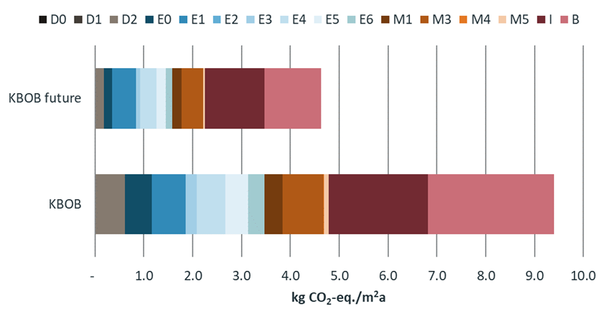
GHG-Emissions Office building
embodied
operational
Embodied
Embodied and operational
target values
SIA 2040:2017
Notes:
D0: Excavation
D1: Backfilling
D2: Foundation
E0: Slabs
E1: Roofs
E2: Pillars
E3: External walls basement
E4: External walls above ground
E5: Windows
E6: Interior walls, load bearing
M1: Partitions / interior doors
M3: Floor coverings
M4: Wall finishes
M5: Ceiling finishes
I: Building technology
9.4kg CO2eq/m2a; 4.6kg CO2eq/m2a (Reduktion um 51%)
Richtwert SIA 2040: 9 + 4 kg CO2eq./m2
Abdeckung Materialen durch zukünftige Produktion: 70%

Slide 21
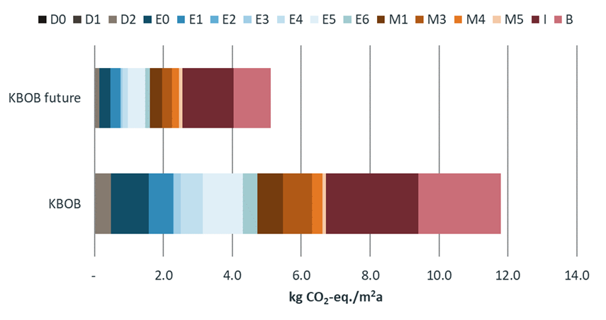
GHG-Emissions Residential building
embodied
operational
Embodied
Embodied and operational
target values
SIA 2040:2017
Notes:
11.8kg CO2eq/m2a; 5.1kg CO2eq/m2a (Reduktion um 57%)
Richtwert SIA 2040: 9 + 3 kg CO2eq./m2
Inklusiv Karbonatisierung: Reduktion der THGem um 0.25-2.5%
Abdeckung Materialen durch zukünftige Produktion: 96%

Slide 22
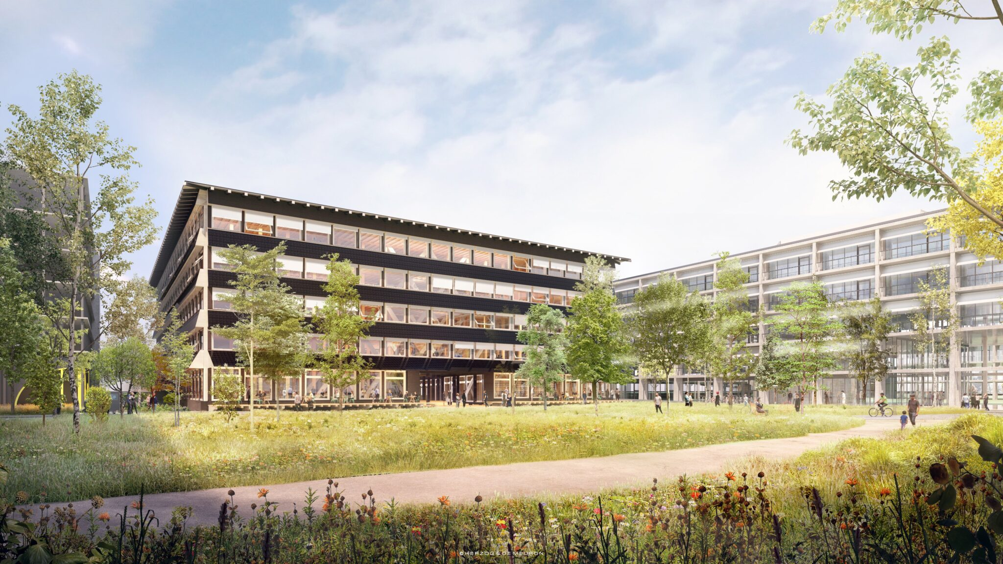
How does “net zero” work?
HORTUS Building Allschwil/Switzerland
HORTUS pays back its construction energy in one generation. On the BaseLink site in Allschwil near Basel, SENN, Herzog & de Meuron and ZPF Ingenieure are jointly developing an office building with approx. 10,000 m² of usable space for environmentally conscious (tech) companies. The building sets a new standard for sustainability: it pays back the grey building energy and is already energy-positive after around 30 years. In addition, it is constructed from an unusual mix of natural materials.
Translated with www.DeepL.com/Translator (free version)
© Herzog & de Meuron

Slide 23
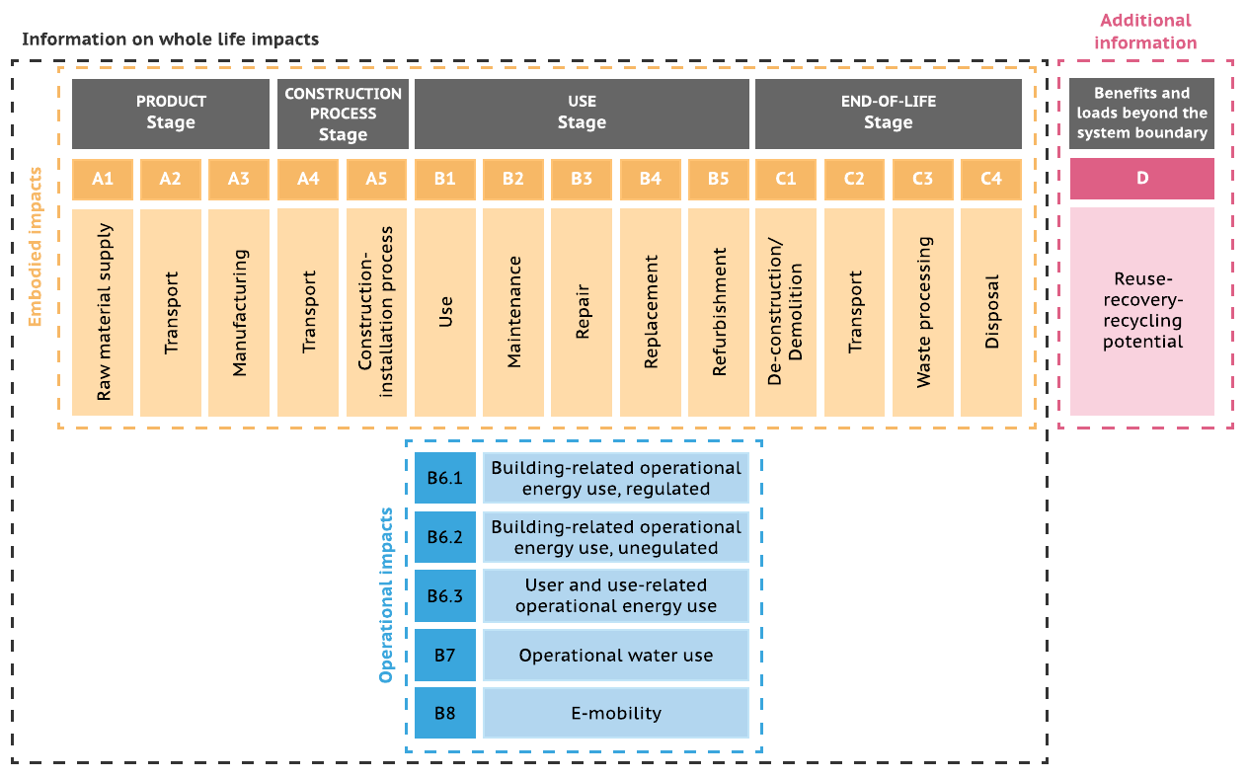

(Net)Zero GHG-emission buildings
System boundary
Production,
construction,
use
and end of life
Operation, energy, all
Operation, energy, regulated
Lützkendorf & Frischknecht (2020)

Slide 24
Taxonomy of Carbon offsets
(adapted from Oxford Principles 2020)
How is the offset generated | Is carbon stored | How is carbon stored | Example
Potentially avoided emissions | No | - | Forward-looking, counterfactual baseline: Renewable energy potentially replacing fossil fuels
Emissions reduction | No | - | Clear retrospective emissions data: N2O abatement; Methane abatement
Emissions reduction | Yes | short | Changes to agricultural practices that retain already stored carbon
Emissions reduction | Yes | long | Carbon Capture and Storage (CCS) on industrial facilities, fossil fueled power plants
Carbon removal | Yes | short | Afforestation, reforestation Soil carbon enhancement
Carbon removal | Yes | long | Direct air carbon capture and storage (DACCS) Biogenic energy carbon capture and storage (BECCS) Mineralisation, enhanced weathering
adapted from Oxford Principles (2020)

Slide 25
OPTIONS TO DEFINE AND ACHIEVE
(NET) ZERO GHG-EMISSION BUILDINGS
Net Zero emission approaches |  |  |  | Zero emission a.
Net balance | Net balance | Economic compensation | Technical Removal | Absolute Zero
potentially avoided emissions | allocation
Accounting for the potential benefits caused by exported energy produced on-site | Attributes the pro rata share of GHG emissions caused by on-site energy production to the exported energy | Purchase of CO₂ certificates based on potentially avoided or reduced GHG emissions | Investment in negative emission technologies to offset life-cycle-based GHG emissions caused by the building | Use of construction materials/operational energy with zero GHG emissions (including supply chain emissions)
-
+
Lützkendorf & Frischknecht (2020)
Level of effectiveness and thus ambition
Lützkendorf & Frischknecht 2020

Slide 26
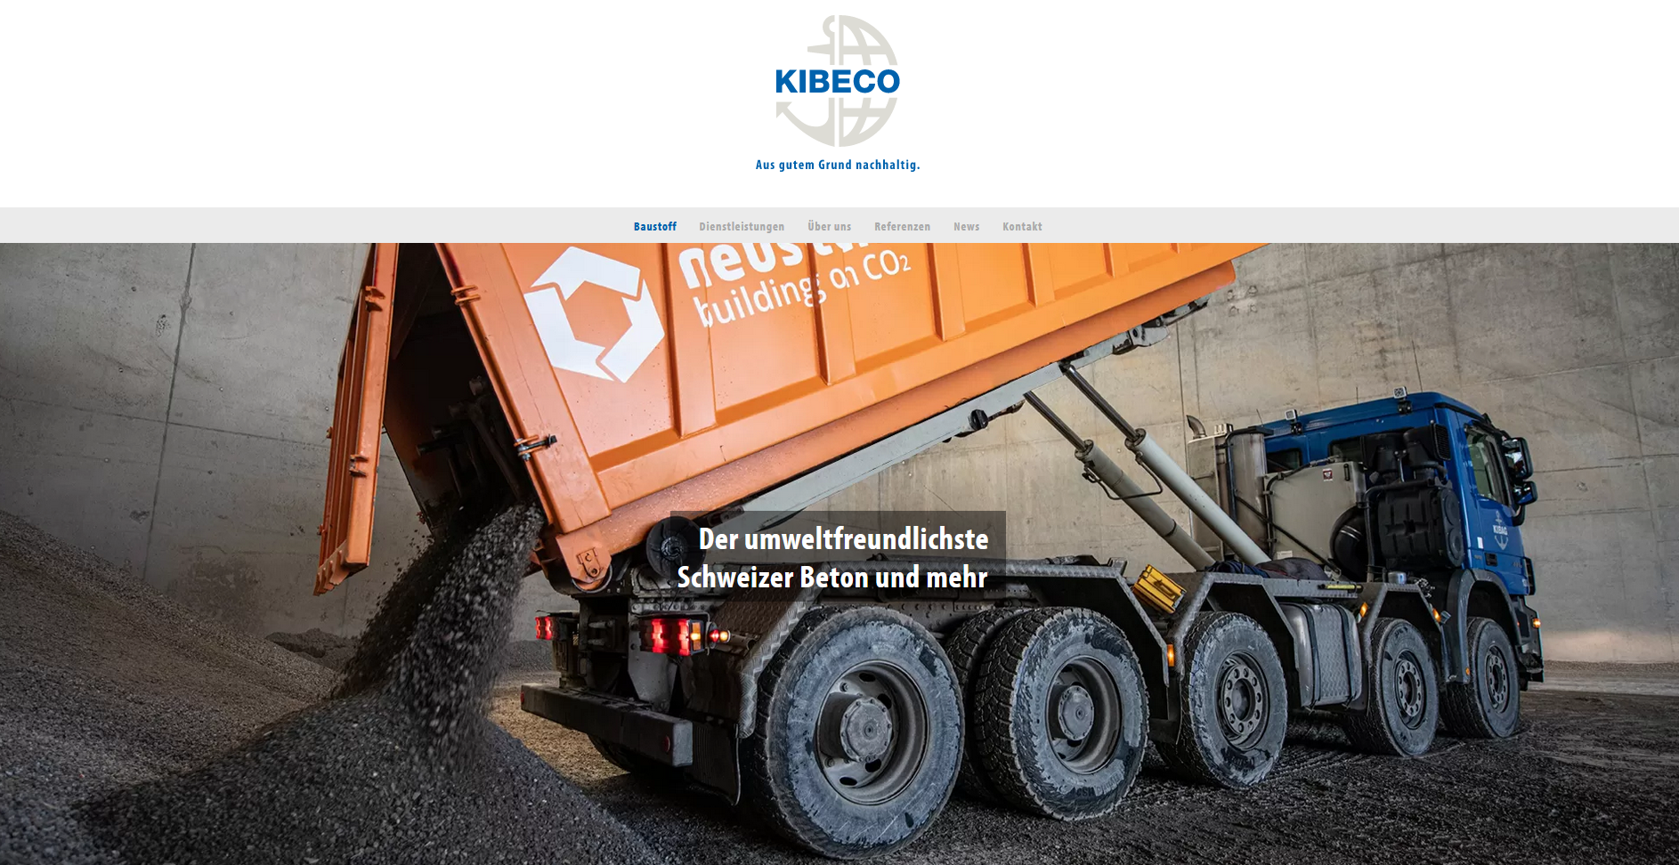
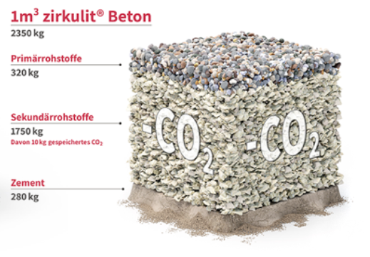
Biogenic CO₂ from biogas purification used to recarbonise recycled concrete aggregate
Negative Emission Technology with
10 kg CO₂ removed per m³ concrete

Slide 27
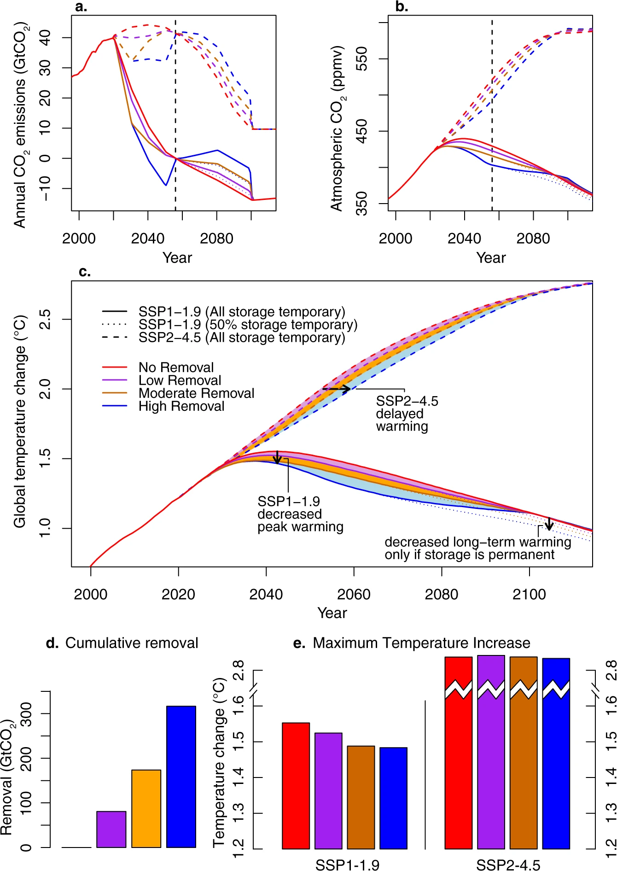
Temporal nature based carbon
removal (NbCS)
Lower peak temperature increase in ambitious mitigation scenarios
Delay of temperature increase in weak mitigation scenarios
NbCS not an alternative but a complement to the reduction of fossil emissions to net zero by 2050
Sigriswil/BE
© Johanna Frischknecht, 2017

Slide 28
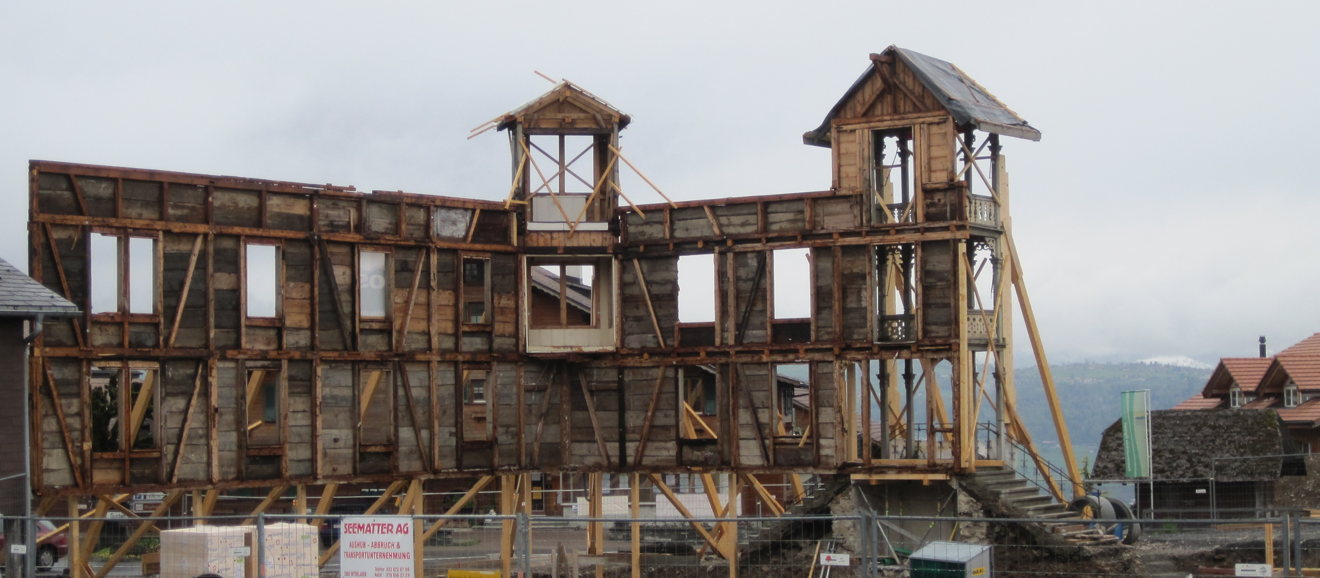
Modelling biogenic carbon in buildings
(wood, straw, hemp, etc,)
Negative Emission technology
if
multiple reuse of building elements or
permanent sequestration
for at least 3000 to 8000 years
How to ensure:
Legally binding entry in land register:
„Separation and permanent storage“
Sigriswil/BE
© Johanna Frischknecht, 2017

Slide 29
Conclusions and recommendations
Buildings and their supply chains are important emitters of CO₂ and greenhouse gases
Embodied emissions more and more important despite significant reduction in construction materials production
Further reduction efforts in materials industry needed, in particular cement, steel, glass, aluminium and wood
Negative emission technologies are indispensible to reach net zero emission buildings (and societies)

Slide 30
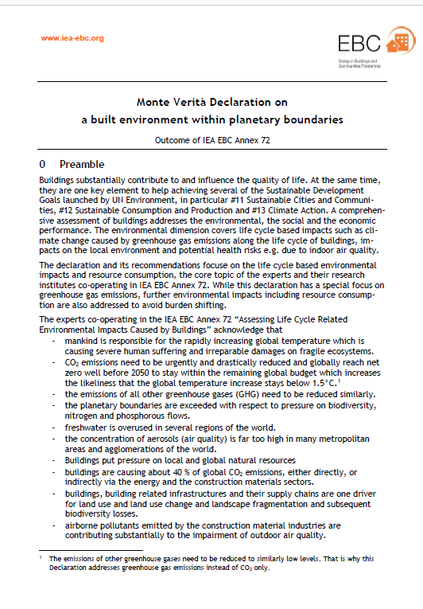
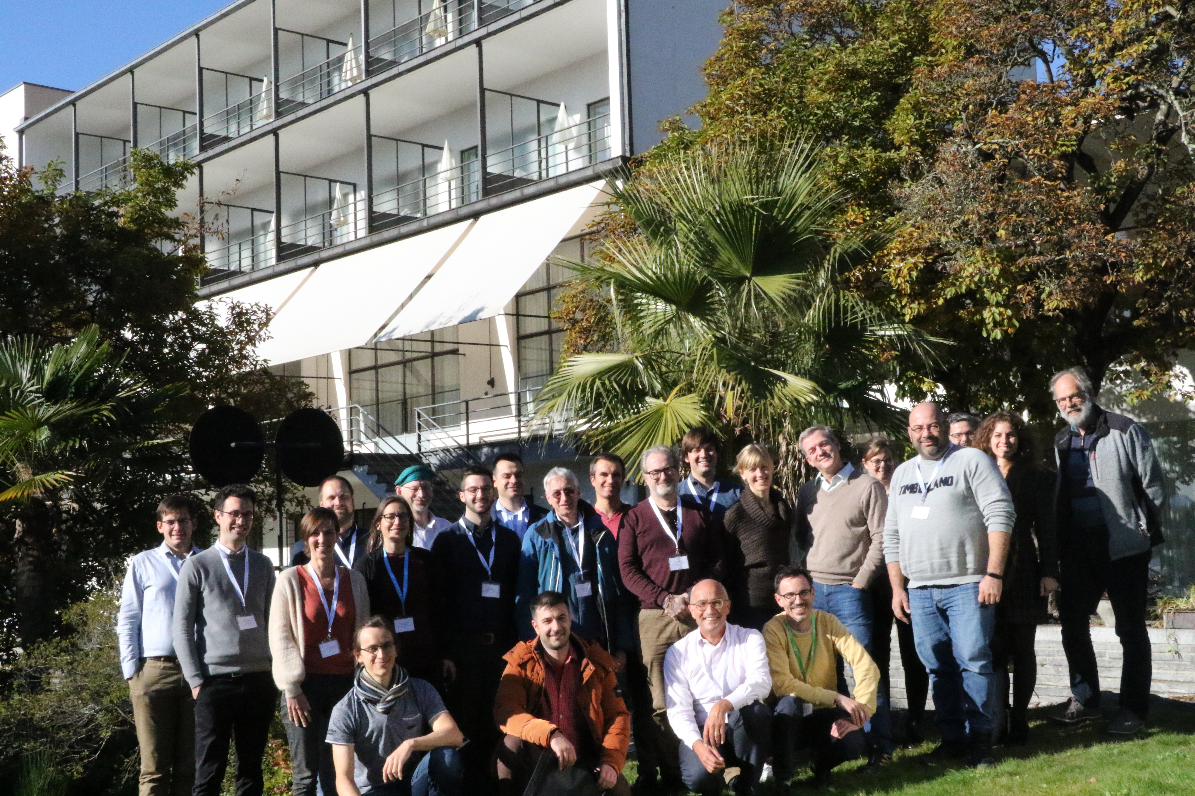
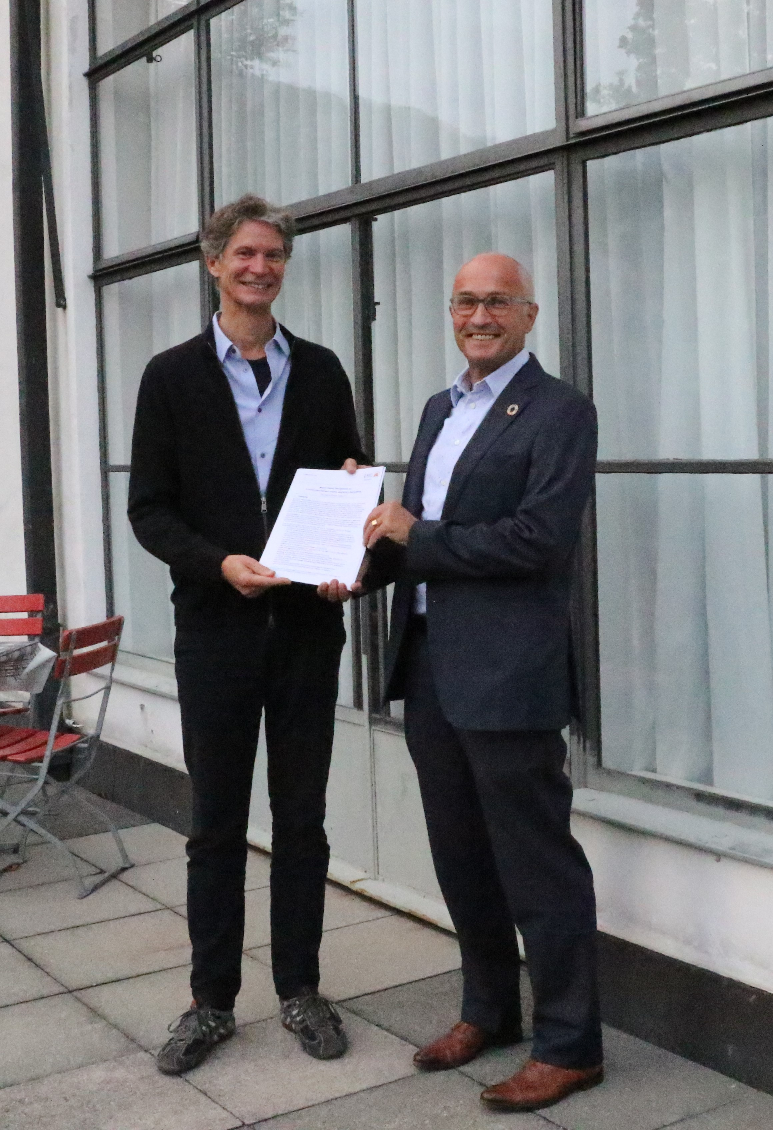

Monte Verità Declaration on a built environment within planetary boundaries
... until 2025 legally binding target values for carbon footprints of buildings with reduction path to net zero by 2035
signed by 40+ experts/researchers from 20 countries in Europe,
the Americas and Asia
39 %

Slide 31
Thank you very much for your attention!
Contact: frischknecht@treeze.ch
Website: www.treeze.ch
Ishiguro 2015
Notes:
Let’s dig out the buried giant!

Slide 32
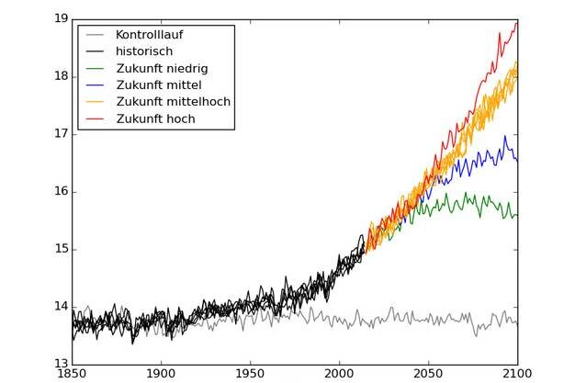
Growth in the future:
The global average temperature
Jevons (1865)
https://phys.org/news/2019-09-climate-ipcc.html

Slide 33
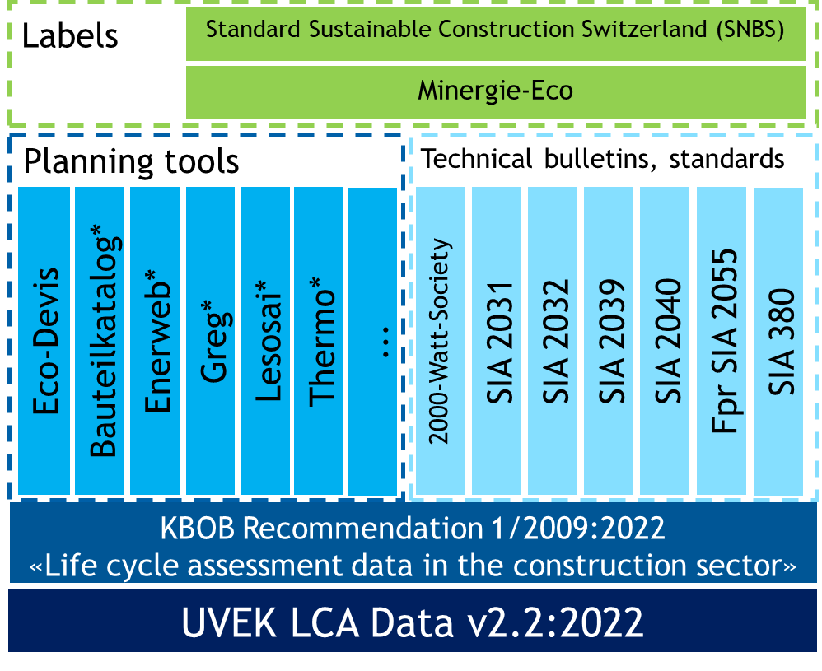
Application of KBOB recommendation 2009/1
KBOB recommendation offers average and company specific data
All relevant building related standards refer to KBOB recommendation
Background database relies on ecoinvent protocol v1&2

Slide 34
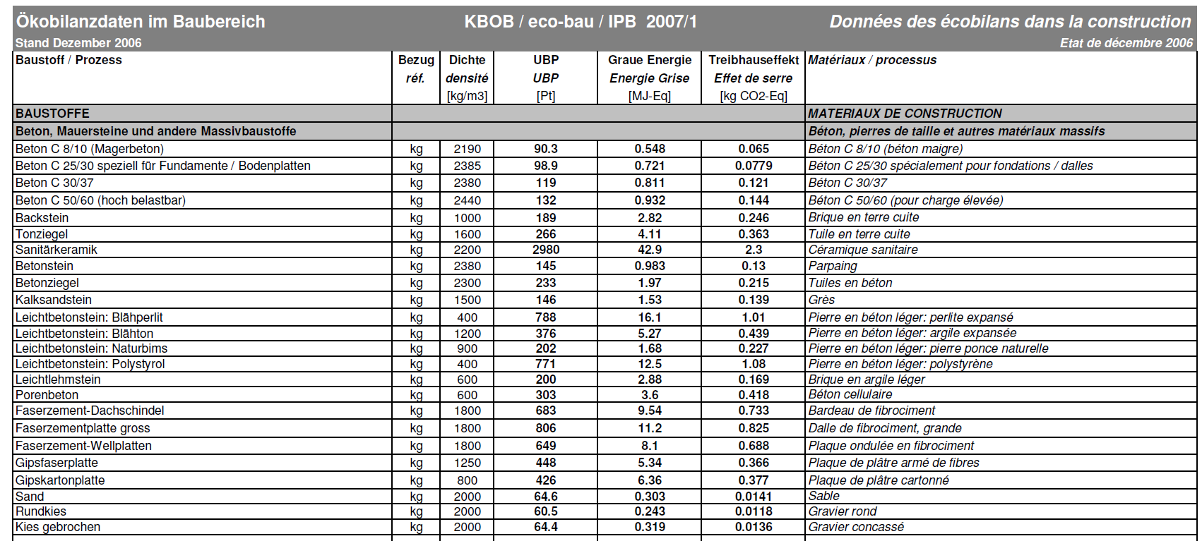
LCA data for the construction sector in CH
The KBOB recommendation 2006
Total environmental impacts 2006
Primary energy non renewable
Greenhouse gas emissions

Slide 35
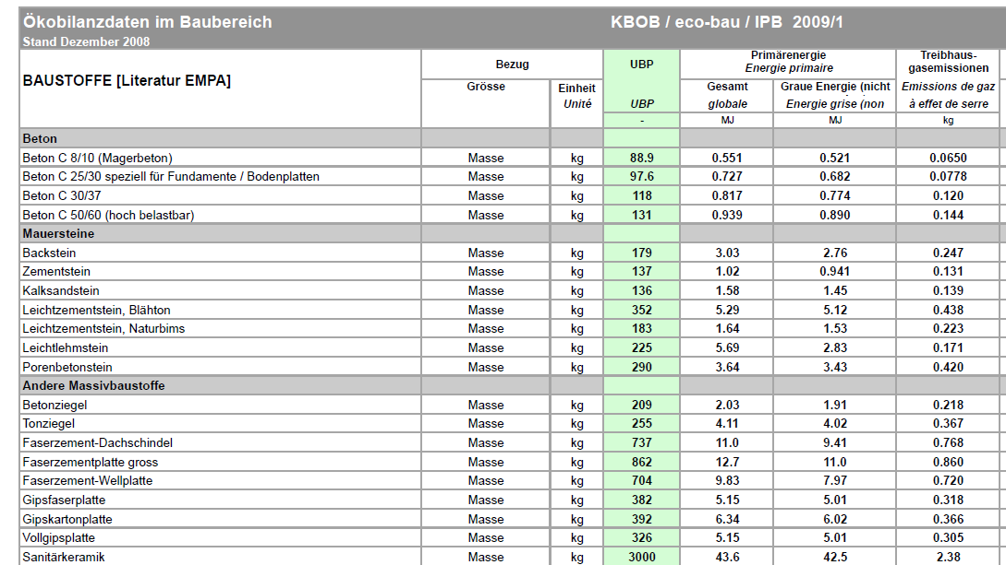
LCA data for the construction sector in CH
The KBOB recommendation 2008
Total environmental impacts 2006
Primary energy
- total
- non renewable
Greenhouse gas emissions

Slide 36
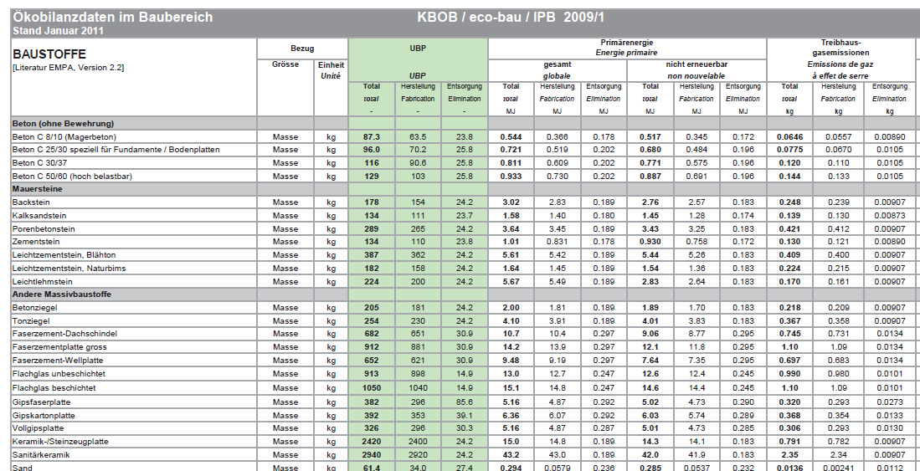
LCA data for the construction sector in CH
The KBOB recommendation 2011
Total environmental impacts 2006
production
end of life
Primary energy total and Primary energy non renewable
production
end of life
Greenhouse gas emissions
production
end of life

Slide 37
LCA on future materials production
Data and information on GHG-emissions and environmental impacts of future construction material production
Establish LCA data on future
    Production of construction materials
    Supply of energy (electricity & fuels)
    Supply of transport services (lorry, train & ship)
preferably compliant with the Paris Agreement 2015 (and the
1.5ºC goal)
Contribution of construction materials industry
Notes:
Pariser Abkommen: 1.5 Grad-Ziel -> Fokus Treibhausgasemissionen

Slide 38
Modelling principles
Data acquisition with materials associations and innovative companies, complemented with literature research
Information used to adapt key LCI parameters
No change in recycled content
Thermal energy (fuels) based on biogas and wood
Future electricity mixes of CH, Europe, further countries
Future modes of transportation (electric and biodiesel lorries)
Carbon capture and storage (CCS) applied on CO₂-emissionen
Notes:
Pariser Abkommen: 1.5 Grad-Ziel -> Fokus Treibhausgasemissionen

Slide 39
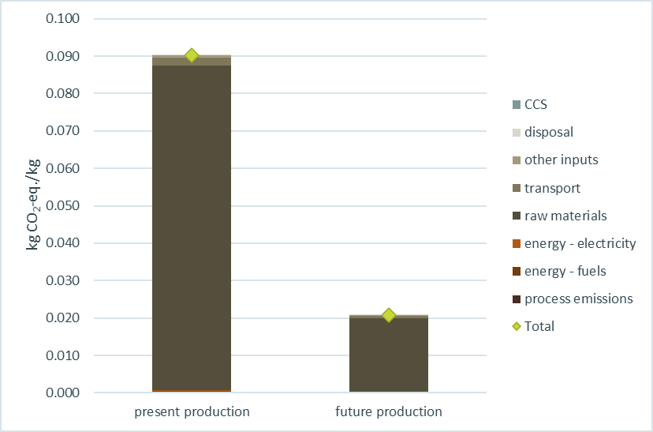
Average concrete CH, production
Greenhouse gas emissions
Notes:
THGem: -62%
Anpassung Emissionen gemäss Inputs (Primärstahl in EAF, nicht Schrott): Gesamtumweltbelastung reduziert sich auch (-15%)
CED non-renewable: -11%

Slide 40
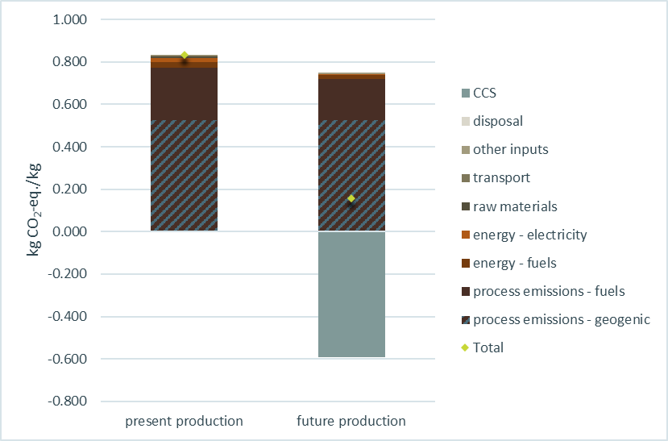
Clinker production, CH
Greenhouse gas emissions

Slide 41
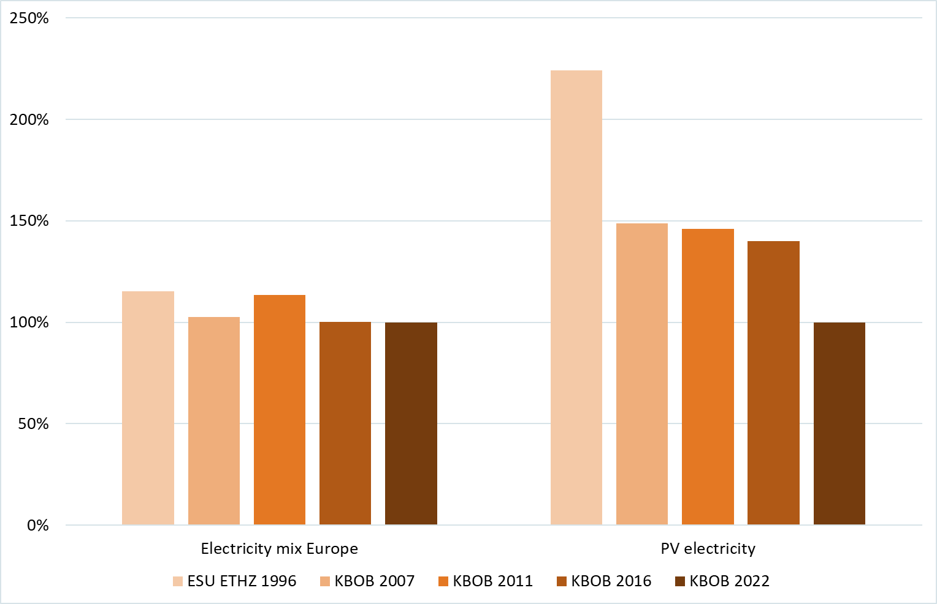
Evolution of the carbon footprint of
EU electricity mix and PV electricity (low volt.)
Evolution | Past
EU Mix | ↘
Photovoltaics | ↘↘↘
values 2022 in g CO₂-eq/kWh
520
55

Slide 42
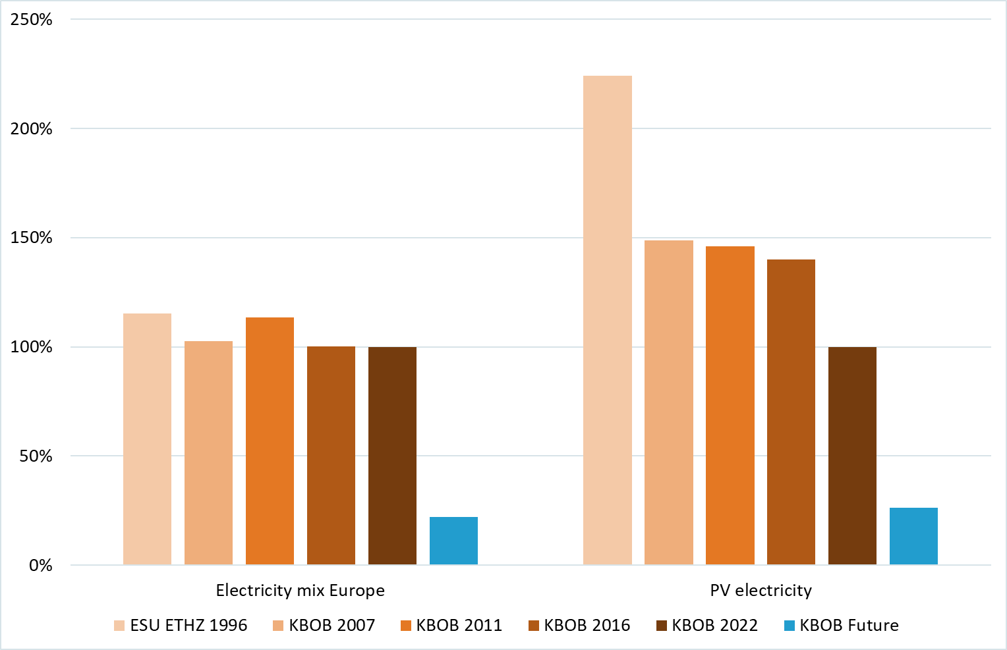
Evolution of the carbon footprint of electricity mix and PV electricity
Evolution | Past | Future
EU Mix | ↘ | ↘↘↘
Photovoltaics | ↘↘↘ | ↘↘↘
future values in g CO₂-eq/kWh
120
15

Slide 43
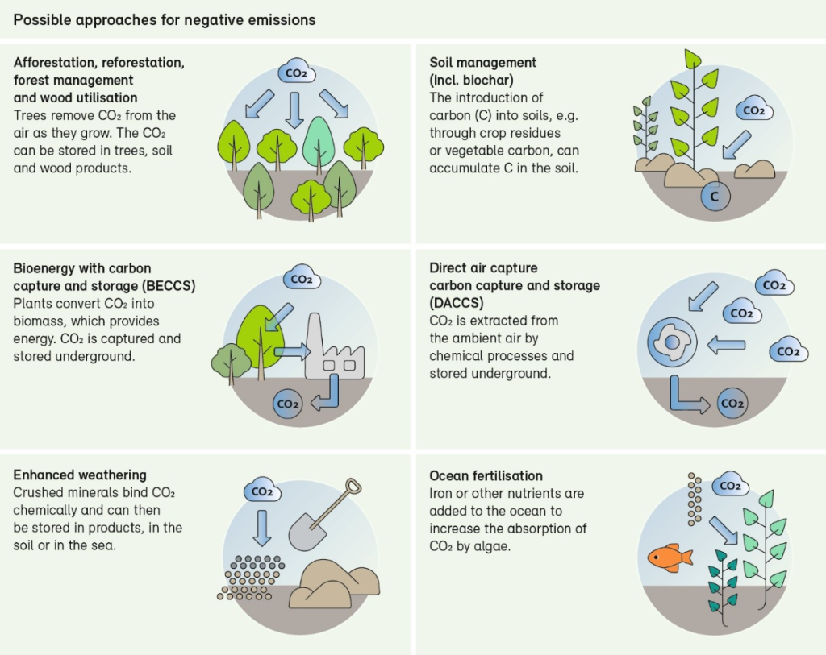
Negative emission technologies

Slide 44



The effect of potentially avoided emissions explained with “Forged Alliance Forever”

Slide 45
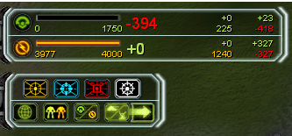

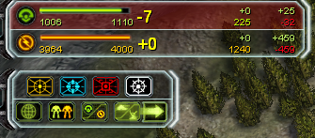
Potentially avoided emissions require allies
(Illustrated with Forged Alliance Forever)
Gamer Jacob
Gamer Nick
Notes:
well-meaning and generous allies

Slide 46
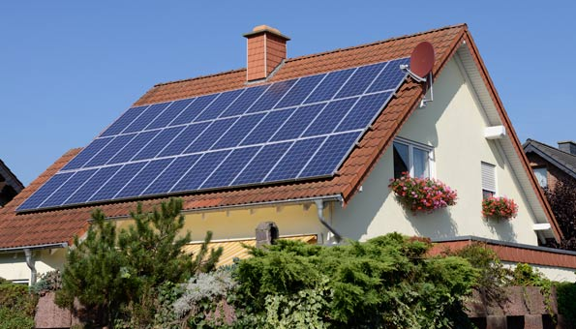
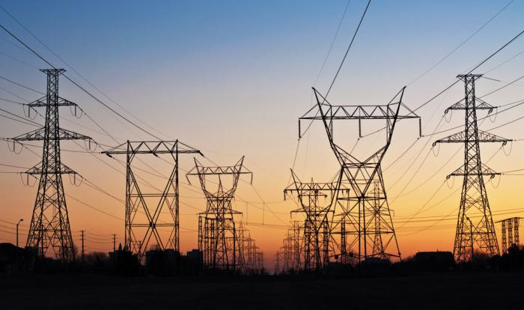
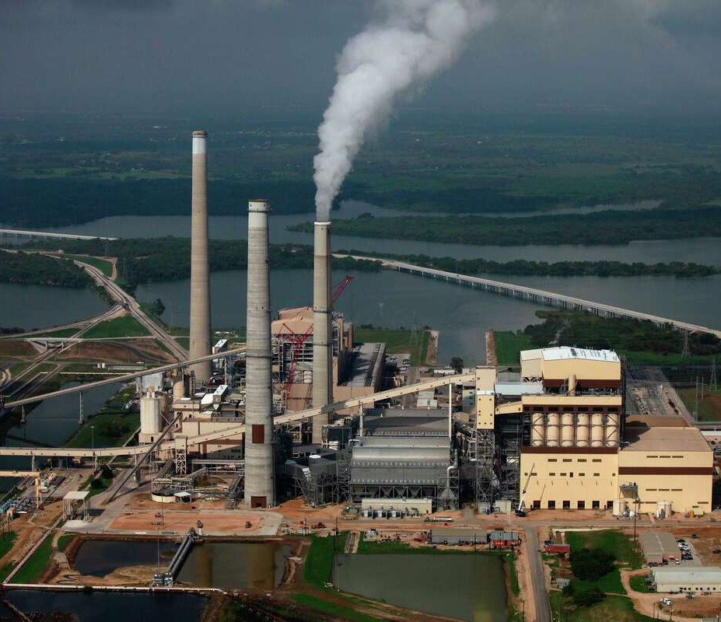
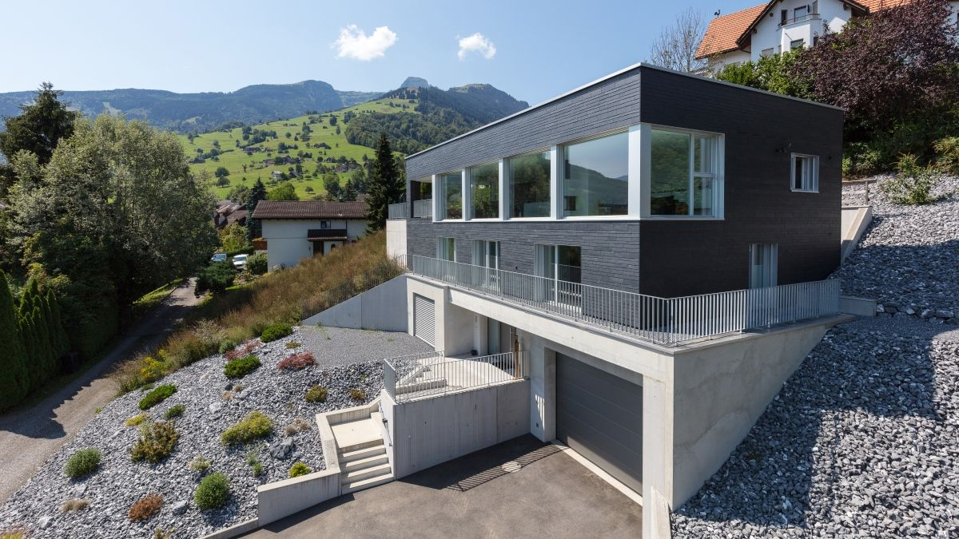
Potentially avoided emissions (Module D):
Building with Photovoltaic (PV) System
PV electricity is partly used by the building and partly exported and fed into the grid
Utility purchases exported electricity
Scenario: potentially reduced (or non increase) production of fossil power plants
This is not a
Negative Emission Technology

Slide 47
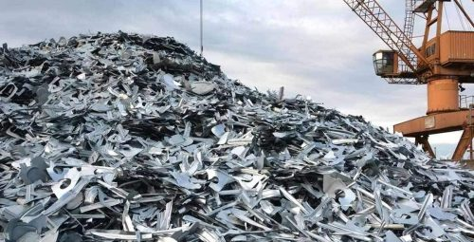
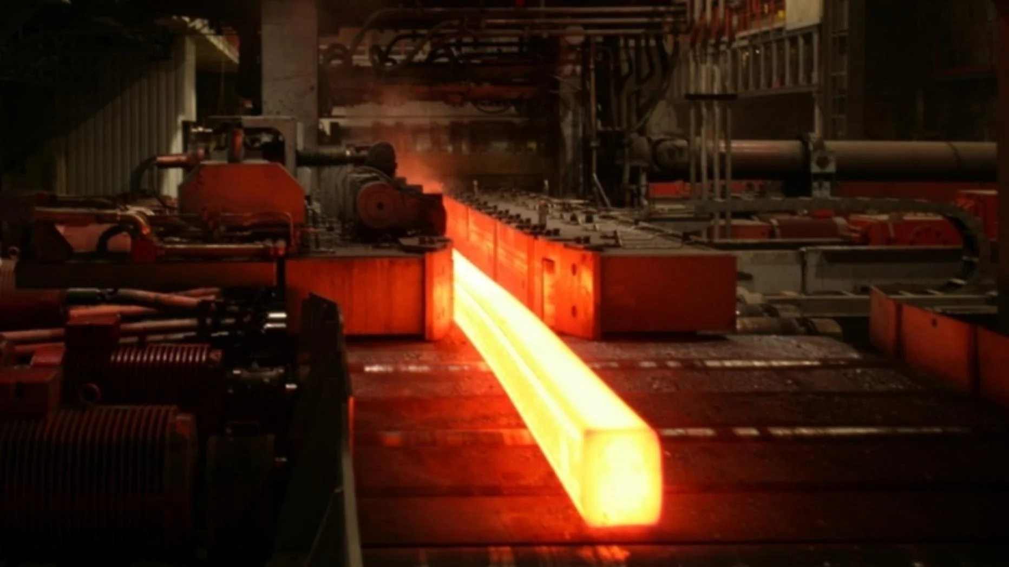



Potentially avoided emissions (Module D):
Materials recycling at end of life
construction materials are expected to be (partly) recycled at end of life
Scrap/secondary raw materials are used to produce construction materials
Scenario: potentially reduced (or non increase) extraction of primary resources
This is not a
Negative Emission Technology

Slide 48


Building with Photovoltaic (PV) System
Situation (before allocation)
All impacts caused by the building project are caused by the building and the PV system
PV electricity is partly exported and fed into the grid
Utility purchases exported electricity
Building
+
Utility
+
Y kWh
electricity
exported
PV System
Building
Environmental impacts
Environmental impacts
Functional unit:
X m² floor area
Functional unit:
Y kWh electricity
-
-

Slide 49
Building with exporting excess PV electricity
Step A&B (ISO 52’000-1) combined
Emissions of share of self consumption attributed to building
impacts related to the exported share attributed to electricity
Credit for potentially avoided emissions are outside the system boundary
LCA of complete building split in two (combinable) parts
Building project
exported
PV electricity
in utility mix
Building
excess
electricity
+
Utility
+
+
Y kWh electricity
exported
PV System
Offsetting position in utility’s electricity supply mix
Building
Environmental impacts
Environmental impacts
Environmental impacts
PV System
Functional unit:
X m² floor area
Functional unit exported electricity:
Y kWh electricity
Functional unit utility:
Y kWh electricity
vermiedene Umweltbe-lastung (Kredit) im Produktsystem 1’ (PV System, Anteil für Export)
-
-
-

