Slide 1
Does net-zero address the seriousness of the climate challenge?
Eliza Hotchkiss
PhD Candidate, Advanced Energy Systems Graduate Program, Colorado School of Mines
Senior Resilience and Energy Security Analyst
Energy Security and Resilience Center

Slide 2
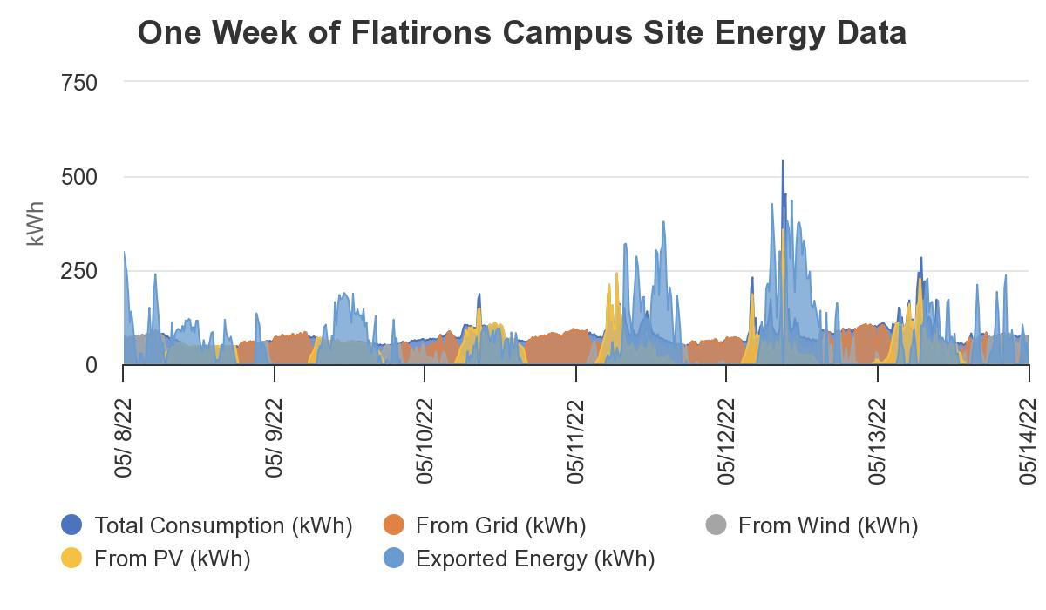
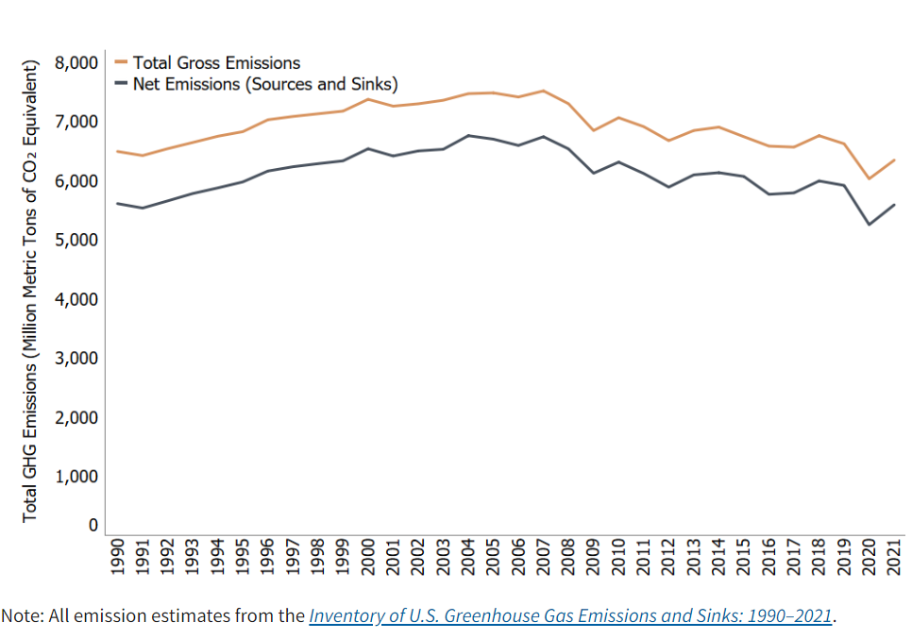
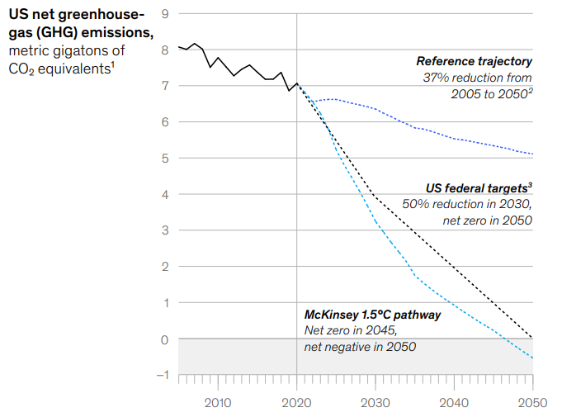
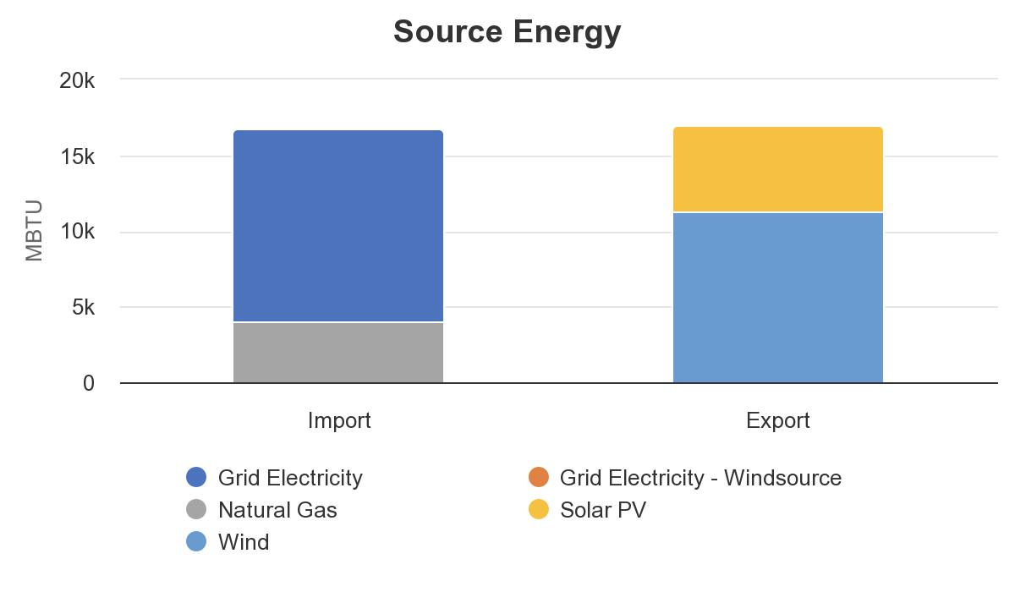
Net Zero Pathway
U.S. Environmental Protection Agency, Inventory of U.S. Greenhouse Gas Emissions and Sinks, Annual Report, 2022
Rory Clune, et al., McKinsey, 2022
Notes:
In the United States we currently emit between 6 and 7 billion metric tons of CO2 equivalent. Looking at the chart on the left you will most likely notice a dip in emissions due to COVID-19 lockdowns, which was something we saw globally. The United States has goals of reducing emissions by 50% by 2030, having 100% clean electricity by 2035, and achieving a net-zero economy by 2050. There is a wide gap between the current emissions trajectory and the trajectories needed to meet emissions targets.
NREL's Net-Zero Goals
NREL will demonstrate its commitment to a net-zero future by:
Decarbonizing its Flatirons Campus near Boulder, Colorado, by 2023
Decarbonizing its Golden campus by 2026
Engaging with utilities, energy service companies, technology companies, and other private industry partners to integrate new technologies.
Learn about NREL's other sustainability initiatives, including its progress toward achieving net-zero emissions.
Leading by Example
NREL's campuses are research instruments that demonstrate living laboratories, and those facilities have some of the highest energy demands in the country. Although NREL already has several sustainable and net-zero buildings on its Colorado campuses, our team aspires to full net-zero energy status. If we can achieve net-zero emissions and carbon neutrality in these complex, energy-intensive facilities, we can do the same within others across the country.
The NZL pilot will provide a path forward for organizations with large emissions footprints as well as a springboard for innovation to achieve decarbonization. It will also launch partnerships critical to the net-zero transition and the communities it will serve.

Slide 3
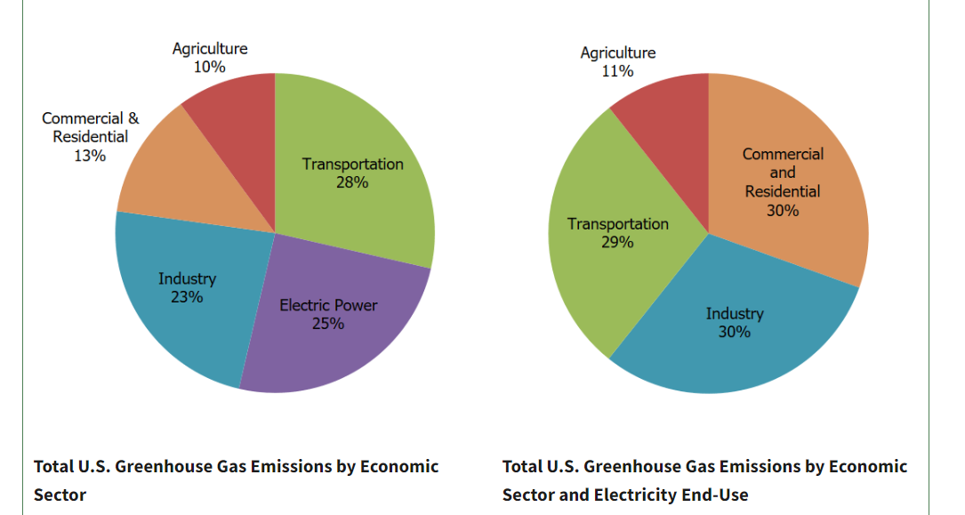
U.S. Emissions
Reduction pathways need to include:
  Buildings efficiency
  Agricultural emissions reductions
  Power (coal and gas) diversification
  Transport decarbonization
  Industrial reductions (e.g., oil, gas, chemicals, refining, steel, mining, cement)
  Land use and forestry management
Total U.S. Emissions in 2021 (6,340 Million Metric Tons of CO₂ equivalent)
Source: U.S. Environmental Protection Agency, Inventory of U.S. Greenhouse Gas Emissions and Sinks
Notes:
For the United States, the path to net-zero emissions by 2050 entails a comprehensive and rapid effort to decarbonize the economy. A comprehensive effort is necessary because America’s 7.2 billion metric tons of annual GHG emissions come from a variety of sources, spanning every sector. While there is a range of future decarbonization scenarios, reduction pathways need to include:

Slide 4
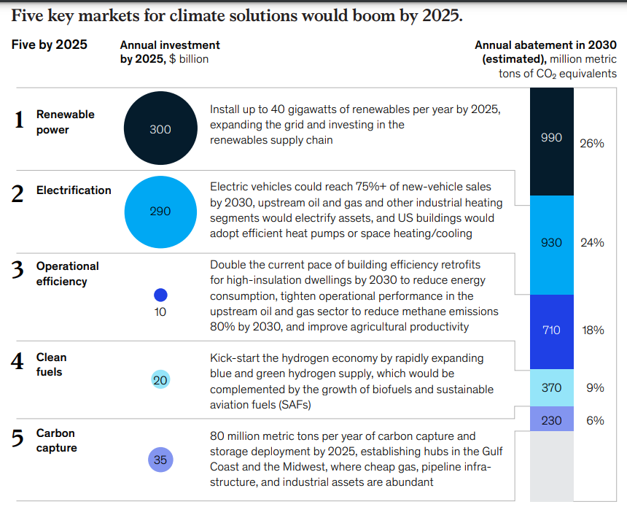
Key Markets for Climate Solutions
Renewable energy: 40 GW per year by 2025
Electrification: EVs as 75% of new vehicle sales by 2030
Efficiency: Double building efficiency retrofits by 2030
Clean fuels: Hydrogen economy, biofuels, sustainable aviation fuels
Carbon capture: 80 MMT CO₂ per year of carbon capture and storage by 2025
Rory Clune, et al., McKinsey, 2022

Slide 5
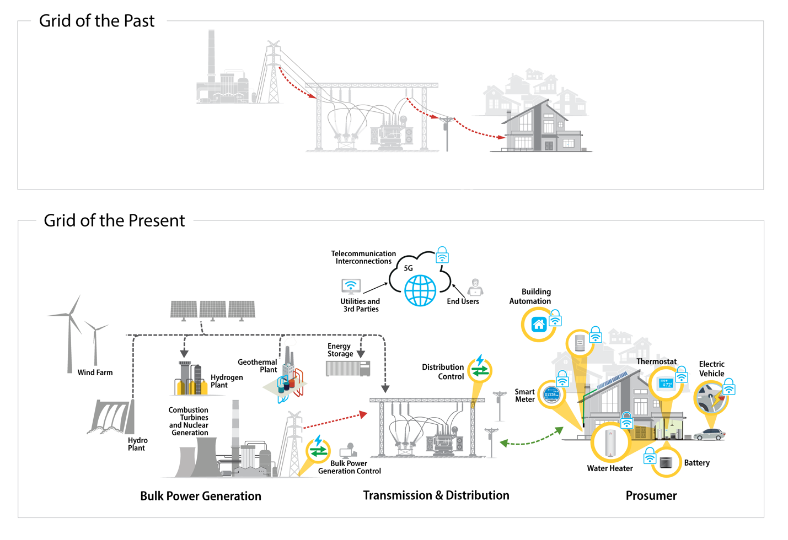
Notes:
If we had had the technologies we have today 100 years ago we wouldn’t have designed our buildings and systems the way we have. We no longer have a unidirectional grid of the past, but have evolved to using distributed energy resources, we use control algorithms and smart devices to turn devices and assets on and off, and we are able to be prosumers – with EVs connected at home and smart thermostats enabling us to control the setpoint in our homes through our smart phones. This is complex and poses new challenges, and opportunities, not just across America, but also across the globe.
Advanced energy, information and communication technologies are changing the way energy is produced, delivered and used as we transition to a decarbonized grid.
While these changes promise great benefits to consumers in the forms of choice, cost savings and business opportunities, the vulnerabilities of emerging energy systems to disruption from natural and human causes—and the possibilities of technological and operational mitigations—are not yet well understood.
Modern system designs must be adopted to support this transition.
NREL's research in energy security and resilience aims to minimize the occurrence of energy system disruptions and, when they occur, their impact on services, missions, and people.

Slide 6
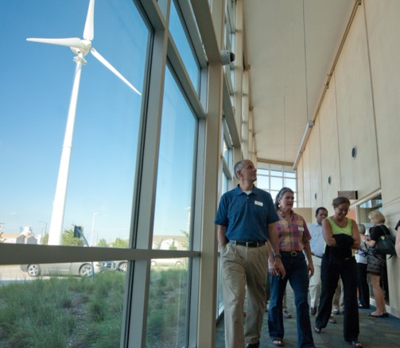
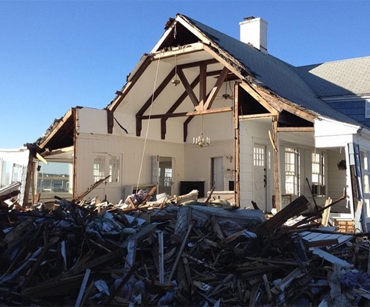
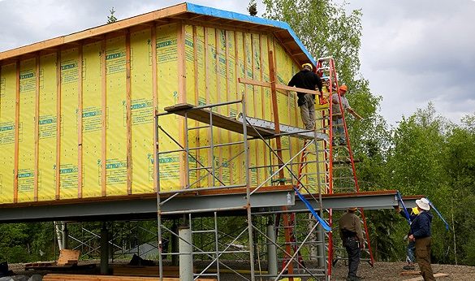
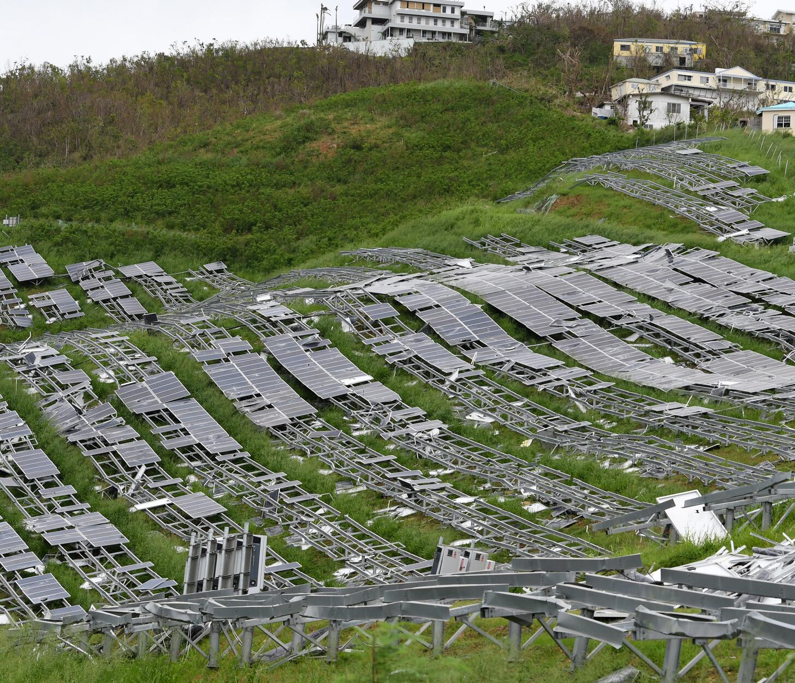
Planning for Resilience
Tornado in Greensburg, KA
Rebuilt LEED hospital in Greensburg, Kansas
Hurricane Sandy damage in New Jersey
Planning for resilience is key in all energy domains: generation, transmission, distribution, and end use. Planning for extreme conditions will help us become resilient to what will become normal conditions.
Flood recovery in Galena, Alaska
FEMA blue roof program in USVI
Hurricane damage to a solar PV array in the U..S Virgin Islands
Notes:
Talking points: NREL staff have supported disaster recovery efforts for 15 years, funded either through DOE or through mission assignments with FEMA. We have been asked to identify opportunities for including energy efficiency, sustainability, and resilience into rebuilding and recovery efforts. We’ve learned a lot from these recovery deployments and have used the lessons that we’ve learned to inform our resilience research. We currently have over 50 projects at the lab that are categorized as resilience which range from grid stability, community planning, resilient transportation, and codes. We’ve worked with FEMA’s Community Planning and Capacity Building staff, with the Materials Assessment Teams and forensic architects after disasters, to understand points of failure in systems and in buildings and where those lessons can be shared more broadly to enhance the resilience of infrastructure in communities. The disasters where NREL staff have been deployed are shown on the right hand side of the slide and you can see that we’ve assisted with recovery in a range of geographic locations, but these communities also had very different energy needs. Galena, Alaska was spending 67 cents/kWh on electricity when they experienced a spring flood and the Oglala Sioux Tribe had an 80% unemployment rate at the time of extreme storms. The work that we’re able to do with FEMA allows for recommendations of energy system improvements that not only improve the efficiency of energy systems, but also lowers the cost of energy in locations where the energy burden and energy poverty are high.
Photos clockwise from upper left:
LEED Platinum hospital in Greensburg, KS built after a 2007 tornado leveled the town (Photo by Dennis Schroeder / NREL / 21762)
February 2013, Hurricane Sandy damage to New Jersey shore. (Photo by Eliza Hotchkiss / NREL / 25308)
Galena, Alaska (NREL)
Solar PV in USVI (Jocelyn Augustino, FEMA)

Slide 7
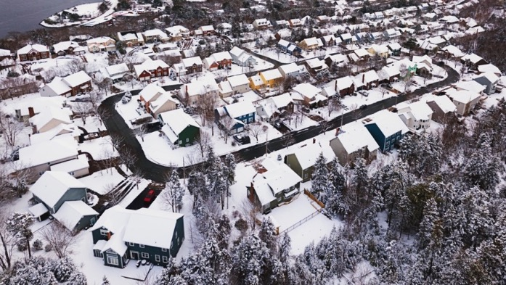
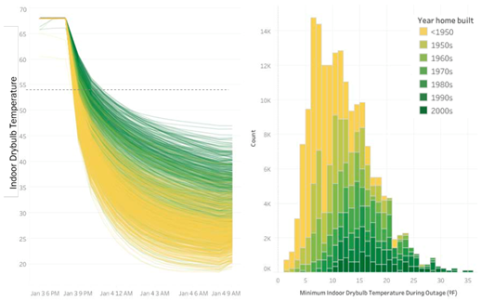
Energy Efficiency + Resilience
NEED
No research study has modeled the synergies of energy efficiency in building design and passive survivability to value the resilience benefit.
IMPACT
With support from the DOE Building Technologies Office, NREL and two other labs evaluated the impact of simulated power outages on occupants of different types of buildings. The results inform what energy-efficiency measures can be taken to increase human survivability under extreme weather conditions, such as a heat wave or a cold snap.
OBJECTIVES
Define thermal resilience of buildings
Explain a framework to assess thermal resilience of buildings
Explain how to model thermal resilience from simulation-based case studies for individual buildings, a district of buildings, and residential building stock in cities
Notes:
Graph from Adapting Models report Feb 2020 NREL/TP-6A20-74241 100% RE policy commitments occurring as early as 2030 and Zero GHG as early as 2040.
I’m going to focus on energy efficiency and an analysis that is counterfactual, but poses some key research areas where we could collectively focus on the science that’s needed to solve many of these challenges within buildings.
The previous example was informative in developing research funded by DOE where we modeled the synergies between energy efficiency and the ability to shelter in place – or as the architect Alex Wilson states, “passive survivability”. We used our residential building stock model, called ResStock, to model 6 representative cities in different climate zones across the U.S. during historic extreme heat and cold scenarios, combined with power outages of different lengths, to understand the innate resilience of buildings based on envelop design of different vintages and building designs and practices. This research is being continued this year where we’re supporting the White House Council on Environmental Quality, FEMA, and DOE with resilient building code discussions.

Slide 8
Valuation of Energy Efficiency for Energy Resilience
Project objective: develop a standardized methodology to quantitatively
assess how building efficiency impacts energy resilience.
 | PNNL | NREL | LBL
Building Types | New single family New and existing multifamily | Existing single family | Nursing home case study
Modeling Platform | Code modeling framework | ResStock; EnergyPlus | EnergyPlus
Resilience Analysis Method Development | Extreme event excess death analysis | Extreme event-power outage probability | Extreme weather event characterization
Notes:
The National Academy of Sciences defines resilience as “the ability to prepare and plan for, absorb, recover from, and more successfully adapt to adverse events.” National Research Council. 2012. Disaster Resilience: A National Imperative. Washington, DC: The National Academies Press. https://doi.org/10.17226/13457.

Slide 9
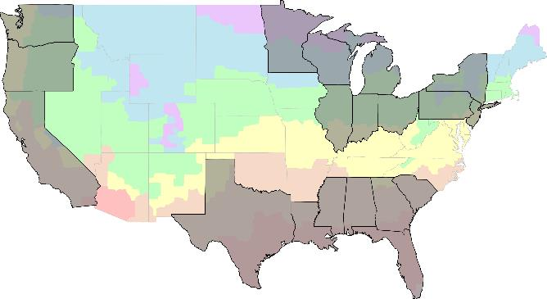




Extreme Cold & Heat Events
Coincident with a power outage
Multi-Family
Minneapolis/St. Paul, MN (6A)
Portland, OR (4C)
Detroit, MI (5A)
New & Existing
Baseline Condition
Historic Code/Existing Stock
Passive Measures Current Code
ASHRAE 90.1-2019 & IECC-R 2021
Passive Measures Beyond Code
Informed by 2021 Passive House
Los Angeles, CA (3B)
Atlanta, GA (3A)
Assisted Living Facility
Houston, TX (2A)
Single-Family
Metrics & Valuation
Thermal Resilience: Standard Effective Temperature, Heat Index
Mortality: Gasparrini Relative Rate Model
Investment: Benefit Cost Ratio (BCR)
Counterfactual Case Study
2021 Texas Winter Storm and
Extreme Heat Event
Notes:
With input from the TAG, we established 3 regions in the U.S. to consider .. The gulf coast states, pacific coast states, and great lakes area/
Within each region, we selected 2 cities for analysis., each in a different CZ and potentially a different demographic
We focused on residential buildings including a mid rise apartment and single family home

Slide 10
Project Approach
Hazard Risk Analysis
Exposure Analysis
Damage Analysis
Mitigation Valuation
Historical extreme temperature event identification
Severe weather -power outage data review
Baseline and efficiency packages
Building energy simulation models and analysis
Historical property damage data
Epidemiological fragility models
Related to extreme temperatures
Valuation of loss
Mitigation costs
Annualized impacts
Net present value analysis
Coincident probability
Indoor condition effect on habitability
Property damage and excess mortality
Return on investment

Slide 11
Coincident Power Outages + Extreme Temperatures
What is the coincident probability of extreme temperature events coinciding with a power outage?
  Notes:
  Power outage data extracted from the DOE Office of Cybersecurity, Energy Security and Emergency Response Electrical Emergency Incident and Disturbance data collected on form OE-417. The assessment assumes reported outages affect the entire state.

Slide 12
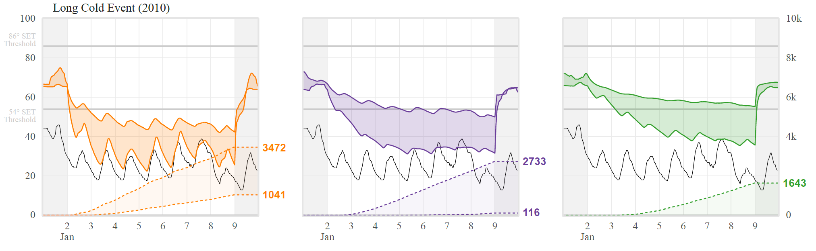
Exposure Analysis
What is the effect of passive efficiency measures on indoor comfort conditions during extreme temperature events that coincide with a power outage?
Standard Effective Temperature (F)
Cumulative SET Degree Hours
Existing Single-Family SET and SET Degree Hours
Atlanta, GA (3A): Long Heat Event (2012)
Notes:
Standard Effective Temperature (SET) was used as a metric for indoor thermal safety, going beyond thermal comfort to include thermal discomfort.

Slide 13
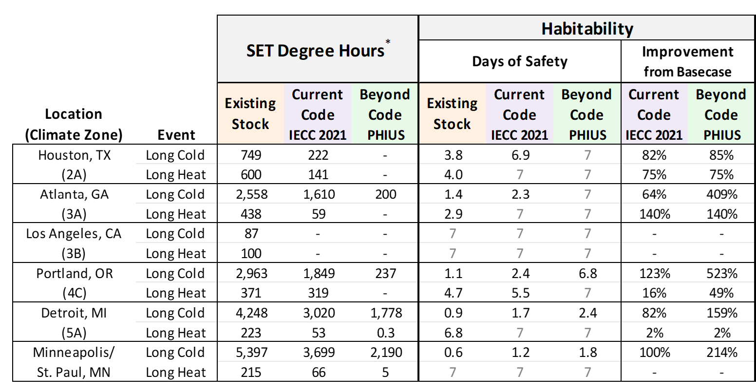
Exposure Analysis
* Data are for existing single-family building median SET degree hours from the stock analysis. SET Degree Hours are cumulative SET hourly values > 86 F for extreme heat and < 54 F during extreme cold. The values in the table are based on a 7-day period. The threshold for habitability is 216, which is in accordance with the USGBC LEED resilience credit.
Notes:
Do passive efficiency measures improve habitability?

Slide 14
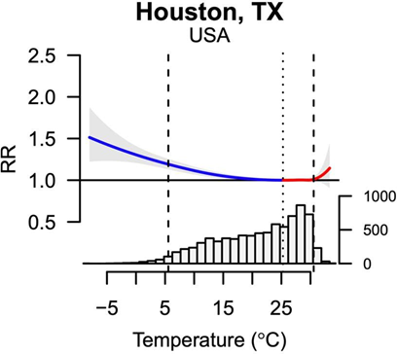
Damage Analysis
Relative rate of death curves as a function of outdoor temperature published by Gasparrini available for over 130 U.S. locations.
How does extreme heat and cold impact mortality rate?
How do the study estimates compare to published data?
2021 Texas Winter Storm Event Case Study
Relative Rate of Mortality
 | Texas | Harris County | Harris County
 | Published | Published Prorated | Study Estimate
Excess mortality | 755 | 249 | 202
Notes: The published value for excess mortality for Texas is 755 per Aldhous P, and Z Hirji. 2022. “Texas Is Still Not Recognizing the Full Death Toll of Last Year’s Devastating Winter Storm.” Buzzfeednews.com. Accessed June 1, 2022. The event occurred from February 13 to February 24, 2021. The study excess mortality analysis is for the entire event period over the 12 days.
Mean Daily Outdoor Air Temperature (C)
Notes: Vertical dashed lines indicate the temperature at 2.5th percentile and 97.5th percentile. The vertical dotted line indicates the temperature at which the relative rate of death is one or the temperature at which deaths are not attributed to severe temperatures
Notes:
Relative rate of death curves as a function of outdoor temperature published by Gasparrini available for over 130 U.S. locations

Slide 15
Exposure and Population Damage Trends
Note: The values in the table are based on a 7-day analysis period.
Notes:
Exposure and Population Damage Trends

Slide 16
Example Benefit Cost Ratio Results
What is the return on building efficiency investment with annual energy cost saving, societal value of reduced CO₂e emissions, and annualized excess deaths?
New Single-Family Building Benefit Cost Ratio (BCR)
Efficiency measure costs and benefits relative to IECC-R 2006.
Benefits account for energy costs, greenhouse gas emissions societal value, excess mortality, and property damage.
Notes:
Operating emissions: EIA and EPA egrid regions for each location, does not include building envelope.

Slide 17
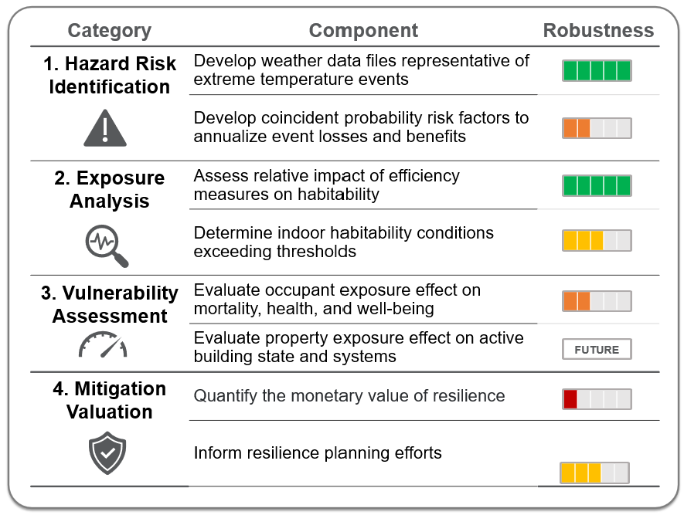
Methodology Robustness
Improvements to be made in the methodology
More analysis needed to understand the impacts on building components and systems

Slide 18
Key Take-Aways
Net zero alone will not address our energy challenges – we need building codes for future conditions and factor in resilience!
Improving envelope efficiency to meet or exceed code requirements extends occupant habitability during extreme temperatures.
In nearly every situation, improving envelope efficiency has the potential to save lives.
Methodological improvements:
  Coincident probability of occurrence of power outage –extreme temperature events
  Gasparrini relative rate of mortality fragility curves
  Property damage estimation
Notes:
Net zero alone will not address our energy challenges – we need building codes for future conditions and factor in resilience!
Improving envelope efficiency to meet or exceed code requirements extends occupant habitability during extreme temperatures.
In nearly every situation, improving envelope efficiency has the potential to save lives during extreme temperature events and increasing efficiency at the time of construction provides a good investment opportunity for addressing resilience.
Methodological improvements:
Coincident probability of occurrence of power outage –extreme temperature events
Gasparrini relative rate of mortality fragility curves
Property damage estimation

Slide 19
Acknowledgements
Project Team and DOE Advisors | Technical Advisory Group
U.S. DOE Building Technologies Office Building Energy Codes Program Michael Reiner, Christopher Perry, and Jeremy Williams National Renewable Energy Laboratory (NREL) Eliza Hotchkiss, NREL PM Jordan Cox, Sean Ericson, Eric Wilson, Philip White, Conor Dennehy, Jordan Burns, Jeff Maguire, Robin Burton Lawrence Berkely National Laboratory Tianzhen Hong, LBNL PM Linqian Sheng, and Kaiyu Sun Pacific Northwest National Laboratory Ellen Franconi, Project PI and PNNL PM Luke Troup, Mark Weimar, Yunyang Ye, Chitra Nambiar, and Jeremy Lerond | Fred Malik, Insurance Institute for Business & Home Safety (IBHS) Rick Jones, Hartford Steam Boiler JiQiu (JQ) Yuan, National Institute of Building Sciences (NIBS) Ryan Colker, International Code Council (ICC) / Alliance for National and Community Resilience (ANCR) Sheila Hayter, ASHRAE / NREL Alex Wilson, Resilient Design Institute Camille Crains, FEMA, Building Resilient Infrastructure and Communities (BRIC) Daniel Nyquist, FEMA, Threat and Hazard Identification and Risk Assessment (THIRA) Steve Cauffman, Cybersecurity & Infrastructure Security Agency (CISA) Laurie Schoeman, Enterprise Community Partners Jesse Rozelle , Federal Emergency Management Agency (FEMA) Joshua Kneifel , National Institute of Standards and Technology (NIST) Ed Carley, National Association of State Energy Officials (NASEO) Rodney Sobin, National Association of State Energy Officials (NASEO) Jenn Kallay, Synapse Energy Economics Kristie Ebi, University of Washington Colby Tucker, U.S. EPA

Slide 20
Thank you!
Eliza.Hotchkiss@nrel.gov
This work was authored by the National Renewable Energy Laboratory, operated by Alliance for Sustainable Energy, LLC, for the U.S. Department of Energy (DOE) under Contract No. DE-AC36-08GO28308. Funding provided by U.S. Department of Energy Office of Energy Efficiency and Renewable Energy. The views expressed in the article do not necessarily represent the views of the DOE or the U.S. Government. The U.S. Government retains and the publisher, by accepting the article for publication, acknowledges that the U.S. Government retains a nonexclusive, paid-up, irrevocable, worldwide license to publish or reproduce the published form of this work, or allow others to do so, for U.S. Government purposes.

Slide 21
Franconi, E, E Hotchkiss, T Hong, M Reiner et al. 2023. Enhancing Resilience in Buildings through Energy Efficiency. Richland, WA: Pacific Northwest National Laboratory. PNNL-32737, Rev 1 https://www.energycodes.gov/sites/default/files/2023-07/Efficiency_for_Building_Resilience_PNNL-32727_Rev1.pdf
Publications

