Slide 1
Building in solar more than just a transition
People|Place|Planet

Slide 2
Leading Scotland’s transition to integrate solar and roofing in the built environment
Roofers of the future, and roofing for the future
Founded over 30 years ago – traditionally a roofing company
Now a business in both construction and energy
Actively informing integrated thinking across policy, standards, education, skills, stakeholders and industry
Setting the bar high and sharing the journey

Slide 3
Installed solar PV in 5000+ new homes in last 5 years
Commercial energy division

Slide 4
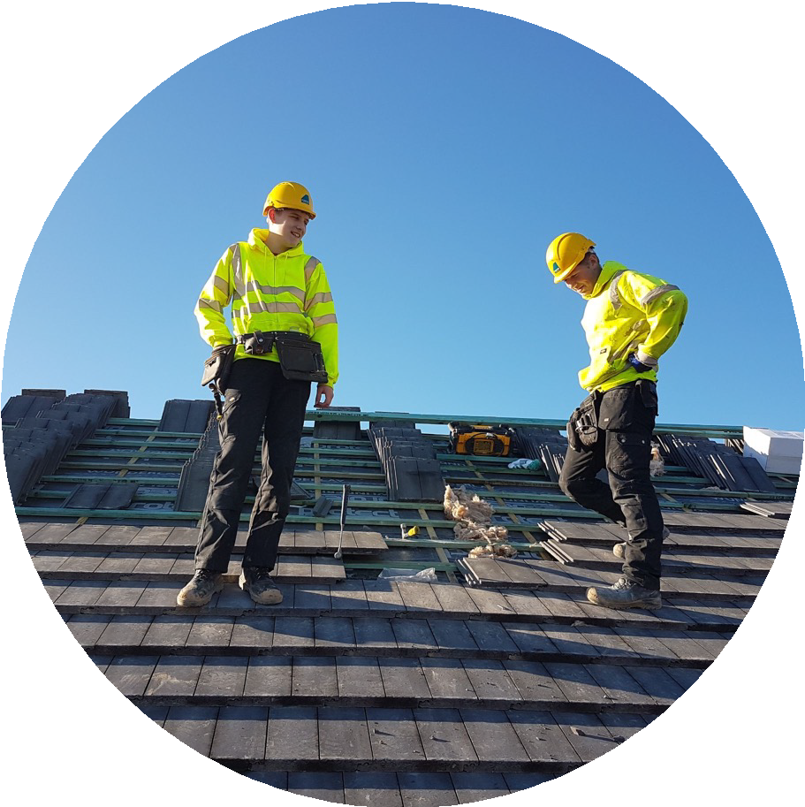
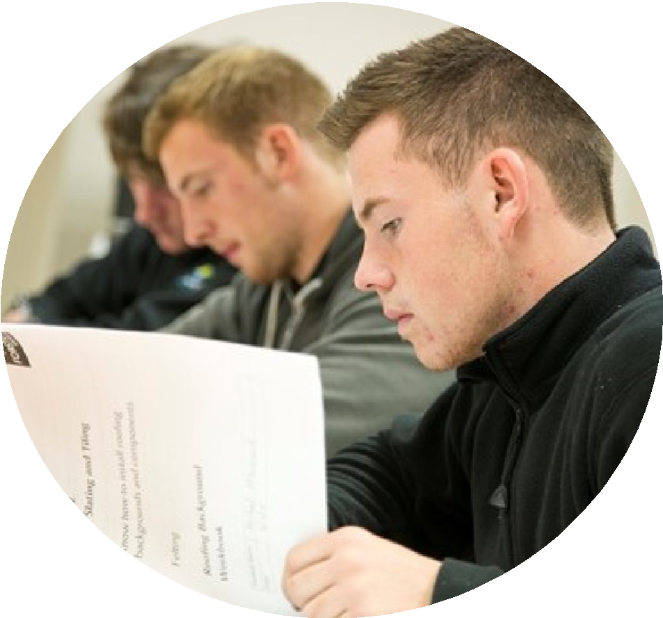
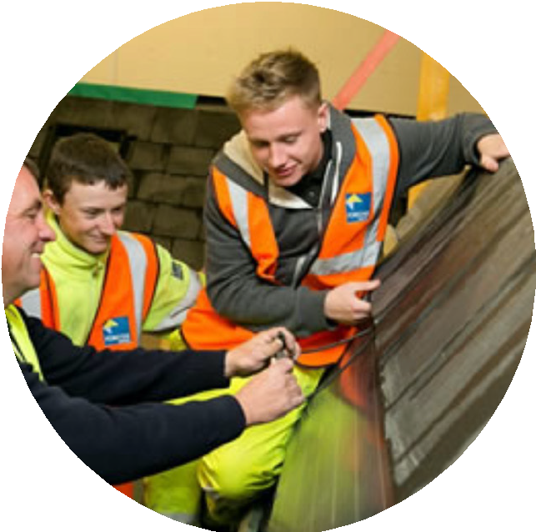
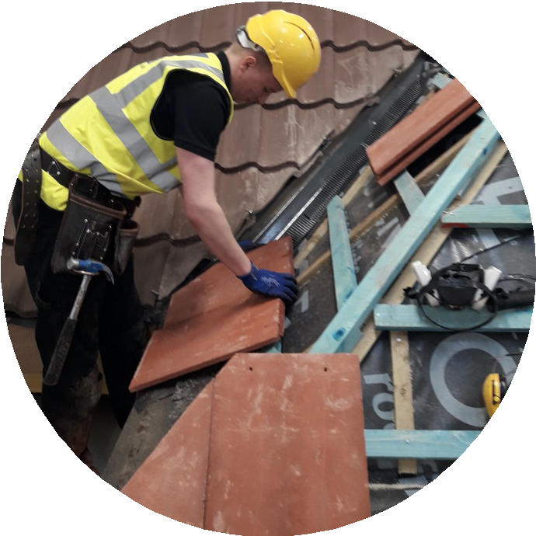
Shaping the provision of construction skills of the future
Forster Skills Academy
Training new generation of roofing professionals and shared this best practice across Scotland’s approach to apprenticeships generally
Forster Standard
Reaching beyond the basic qualification

Slide 5
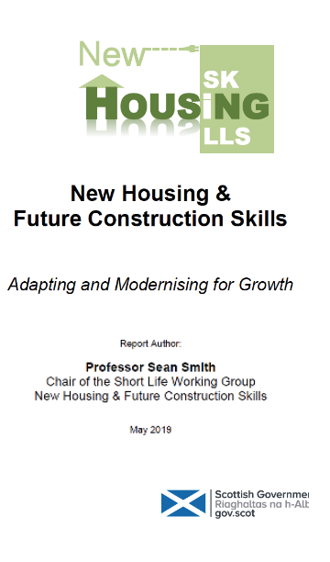
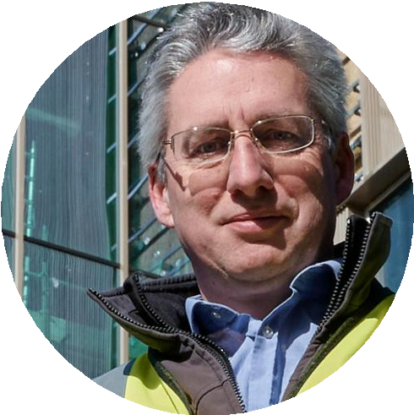
Adaptating to specific skills sets and industry needs
“Through the Forster Roofing Academy apprentices are trained for specific skills and general skills, creating an expert supply of installers and erectors with an approved qualification.
...The Forster Roofing Academy has set a precedent on how [to provide] an offsite trainee with a portfolio of multi-skills for a specific sector involving a range of skills that do not sit within a traditional MA route.”
—Sean Smith Professor of Future Construction at the School of Engineering
University of Edinburgh

Slide 7
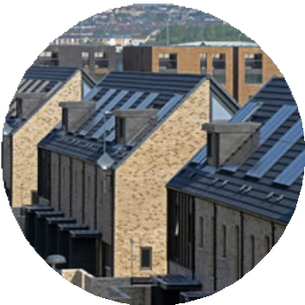
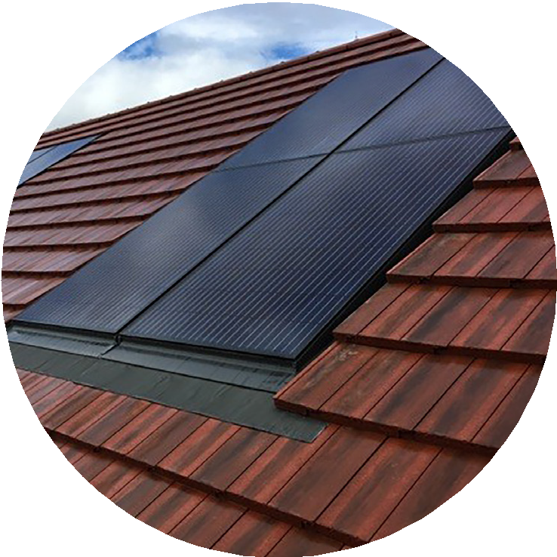
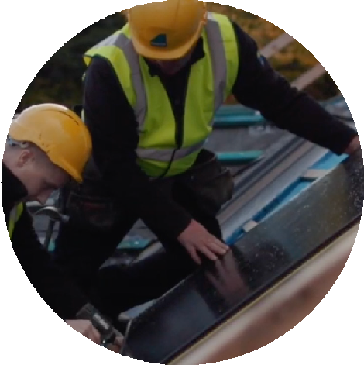
Committed to changing the way we build more affordable energy-efficient homes
More sustainable
More productive
More affordable
Healthier, safer and to a higher standard
Supporting the transition to net zero for the whole industry

