Slide 1
An update on the latest changes to building regulations and onward review
Stephen Garvin
Scottish Government

Slide 2
Building (Scotland) Act 1959
An Act to make as respects Scotland new provision for safety, health and other matters in respect of the construction of buildings and for safety in respect of the conduct of building operations; for these purposes to establish buildings authorities for burghs and landward areas of counties and to amend the law relating to dean of guild courts; to amend the powers of local authorities in relation to buildings which are below prescribed standards or dangerous; and for purposes connected with the matters aforesaid.
Building Scotland Act 1970

Slide 3
Building (Scotland) Act 2003
An Act of the Scottish Parliament to make further provision with respect to buildings, building standards, work in relation to buildings and related matters; and for connected purposes
The Scottish Ministers may, for any of the purposes of—
(a)securing the health, safety, welfare and convenience of persons in or about buildings and of others who may be affected by buildings or matters connected with buildings,
(b)furthering the conservation of fuel and power, and
(c)furthering the achievement of sustainable development, make regulations (“building regulations”) with respect to the design, construction, demolition and conversion of buildings and the provision of services, fittings and equipment in or in connection with buildings.

Slide 4
Building Scotland Act 2003
Building Scotland Regulations 2004
Technical Handbooks (Domestic and Non-Domestic) 2005
Section 0 – Introduction
Section 1 – Structure
Section 2 – Fire
Section 3 – Environment
Section 4 – Safety
Section 5 – Noise
Section 6 – Energy
Section 7 – Sustainability
Procedural Handbook, Certification Handbook, Enforcement Handbook (Compliance Handbook)

Slide 5
Building Standards Principles
The Scottish building regulations - powers in section 1 of the Act
The regulations apply to the design, construction or demolition of a building, the provision of services, fittings or equipment in or in connection with a building, and the conversion of a building
A warrant is required for all building work to which the regulations apply, with the following exception

Slide 6
Building Standards System - Principles
System is pre-emptive
Building Warrant must be approved before work is carried out
Applies to all types of project of any size
Staged warrants can be used, typically larger projects

Slide 7
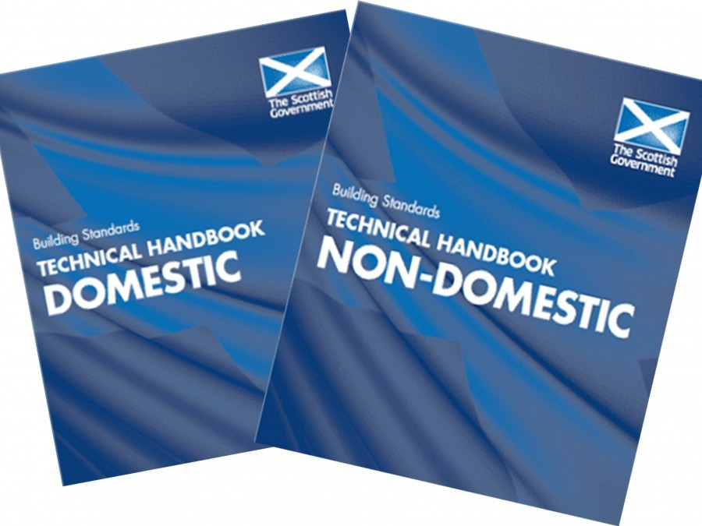
Introduction to 1 February 2023 Changes
Review process began in 2020
Consultation on Energy Standards ran from July to November 2021
176 responses and the consultation analysis have been published
Regulations were initially laid on 22 April 2022, with amendments June 2022 and November 2022
Provisions within The Building Scotland (Amendment) Regulations on energy performance came force on 1 February 2023

Slide 8
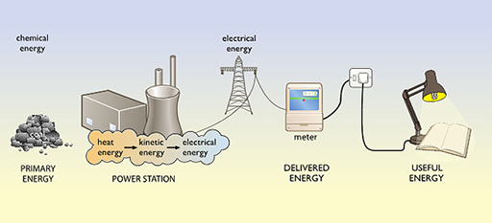
Standard 6.1 – Energy demand and carbon dioxide emissions
The scope of the standard is unchanged for 2022 - new buildings and large non-domestic extensions
Delivered energy target introduced as the metric (alongside the existing emissions target)
No emissions target for any new building not using ‘direct emissions heating systems’
Separate consultations - New Build Heat Standard
Supporting change – removing the option for at-building combustion solutions for new buildings from 2024

Slide 9
Standard 6.1 – Energy demand and carbon dioxide emissions
Notional building specifications aggregate emission reduction
32% for new homes; 20% for new non-domestic buildings
Only three notional dwellings - main heating fuel choice – heat pump, heat network or any other fuel
Similar approach for new non-domestic buildings, plus space and water heating now assessed separately in the notional building
Appendix M of SAP 10 now calculates the portions of on-site generation of power – we apply this to exclude the export component from the 6.1 compliance calculation
The exported component is still calculated and available for reporting e.g., for EPC production

Slide 10
Standard 6.1 – Energy demand and carbon dioxide emissions
Performance of new buildings and performance of heat networks should be regulated separately
The former through building regulations and the latter through pending regulations made under The Heat Network (Scotland) Act 2021
Heat networks are a ‘zero direct emissions’ heat solution and therefore connected buildings no longer need to meet an emissions target, just the new energy target

Slide 11
Standard 6.2 - Building Fabric
Improved ‘backstop’ U-values for elements of fabric
Values cited are from ‘improved’ standard consulted upon and represent elemental values of the best 50% of recent new construction
This single set of values is applied now to all new construction – newbuild, extension, alteration, conversion and shell
Thermal bridging at junctions – to note that no updated BSD detail sets are provided

Slide 12
Standard 6.2 - Building Fabric
 | Area-weighted average U-values (W/m²K) for all elements of the same type | Notional Building U-values (W/m²K)
Wall | 0.17 | 0.15
Floor | 0.15 | 0.12
Roof | 0.12 | 0.09
Windows and doors | 1.4 | 1.2
Rooflights | 2.1 | 1.7
Cavity separating wall | 0 | 0
Notes:
Domestic values are on page 386
Non domestic values are on page 408

Slide 13
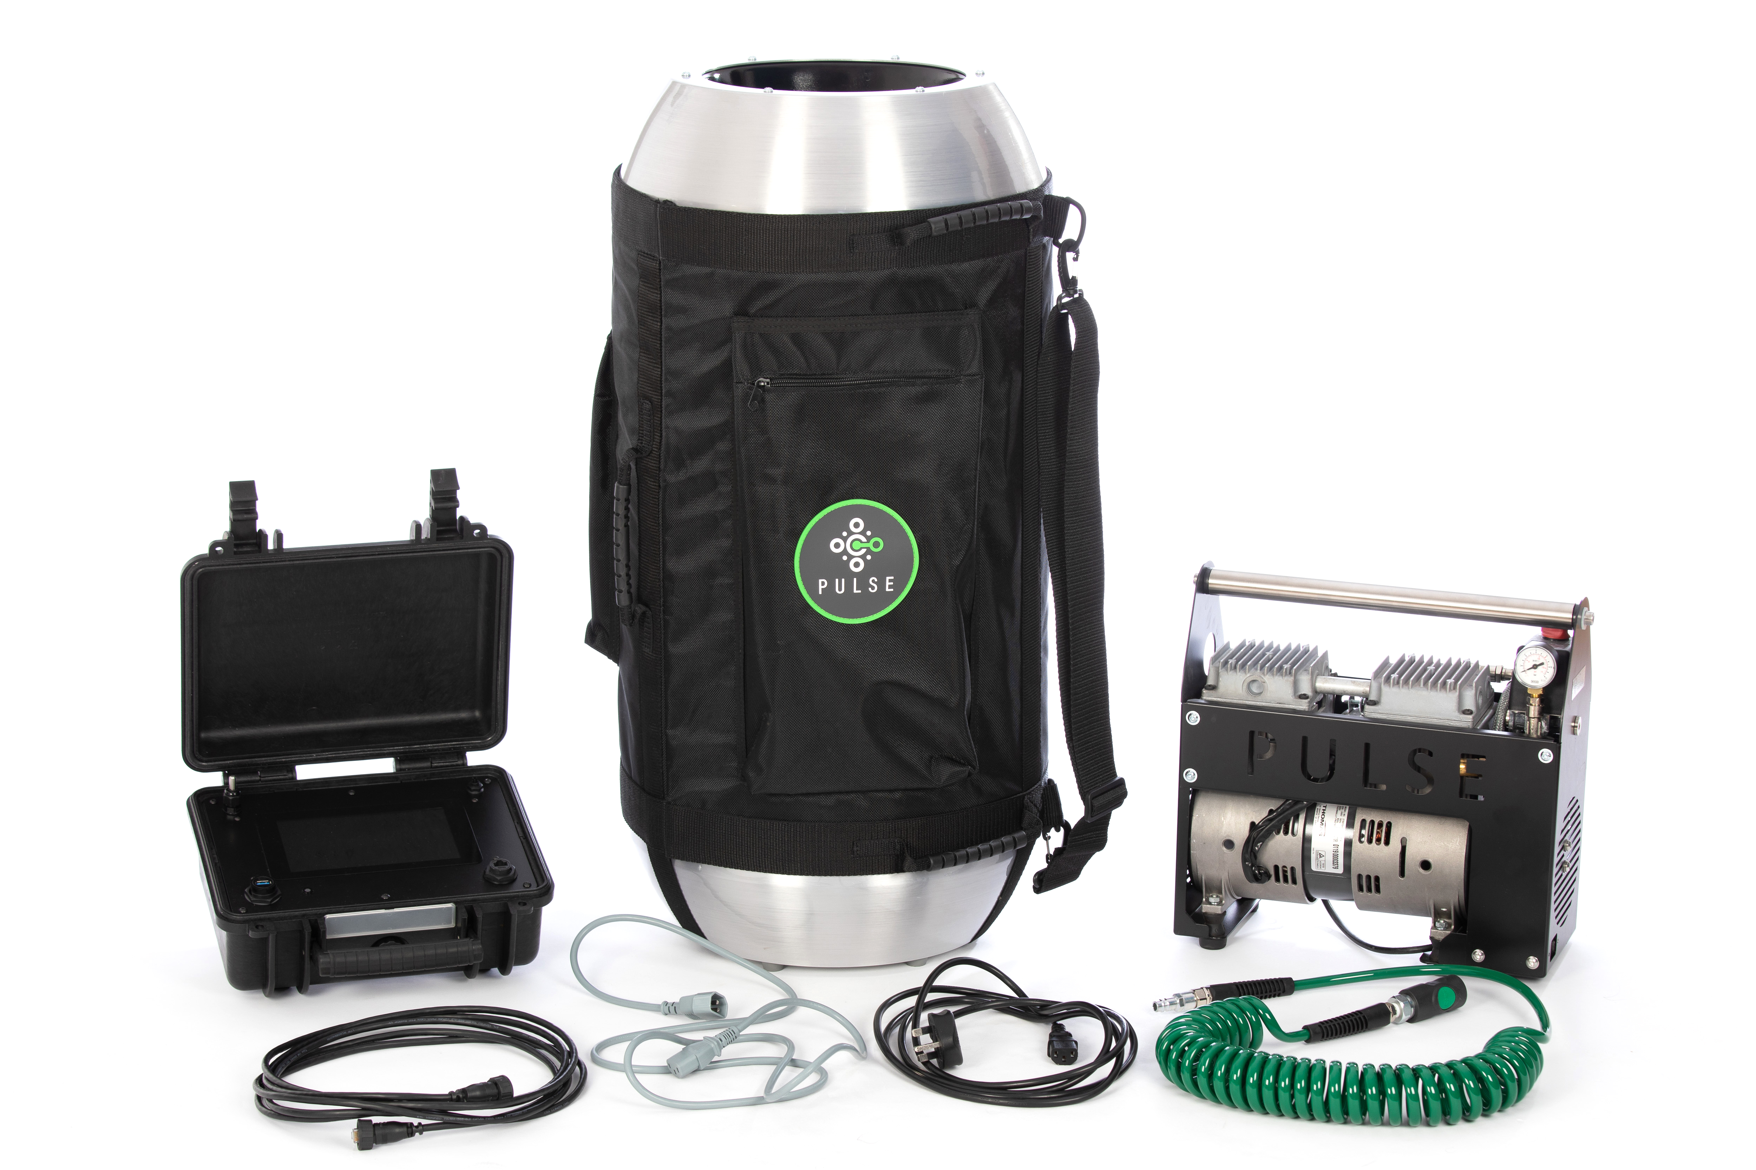
6.2 – Airtightness Testing
New homes moves from sample testing to testing all completed dwellings
Reduced exceptions to the need to test for new non-domestic buildings
As in the rest of the UK, Scotland has moved to adopt CIBSE TM23 as the cited base methodology for airtightness testing
Similarly, the option to test using the newer ‘low pressure pulse’ method is now recognised
University of Nottingham

Slide 14
Further Changes
Standards 6.3 to 6.6 – Building Services
Standard 6.7 – Commissioning
Standard 6.8 – Written Information

Slide 15
Change to adopt SAP 10 & SBEM v6
Changes to energy standards for new buildings are supported by the adoption of new tools: SAP 10.2 and SBEM v6.1
Designers should be aware of the significant changes to carbon factors assigned to fuels, particularly the far lower factor for grid electricity, reflecting more recent grid decarbonisation (SAP table 12)
Previous compliance solutions such as offsetting of emissions from fossil fuel solutions through use of onsite generation are now far less effective
In SAP, effectiveness of onsite generation and export is now calculated (Appendix M); assessment of summer overheating (Appendix P) now removed

Slide 16
Supporting further change in 2024
Separate consultations have proposed a New Build Heat Standard from 2024.
Regulations laid 8 June 2023
Implementation of the standard on 1 April 2024 removes the option of current ‘at-building’ combustion solutions for new buildings. The 2023 standards support this intent through:
the introduction of the delivered energy target as an ongoing performance metric
removing the emissions target where ‘direct emission heating’ is not used
simplifying compliance for new buildings connected to a heat network
requiring new buildings with direct emission heating systems to be designed for easy retrofit with a future ‘zero direct emissions’ heat solution
setting standards for wet heating systems based upon lower distribution temperatures compatible with effective use of heat pumps and heat connections

Slide 17
Passivhaus equivalent standard
May 2022 - Alex Rowley MSP issues a draft members’ bill seeking to set “new minimum environmental design standards for all new-build housing to meet a Scottish equivalent to the Passivhaus standard, in order to improve energy efficiency and thermal performance”
Consultation
16 November 2022 – Final proposal is lodged and gains necessary cross-party support
15 December 2022 – Mr Harvie submitted written statement to Mr Rowley and to The Scottish Parliament confirming intent to bring forward legislation to give effect to Mr Rowley’s final proposal – alignment with Bute House Agreement and Climate Assembly recommendations
10 January 2023 – Mr Harvie makes verbal statement in The Scottish Parliament confirming earlier written statement

Slide 18
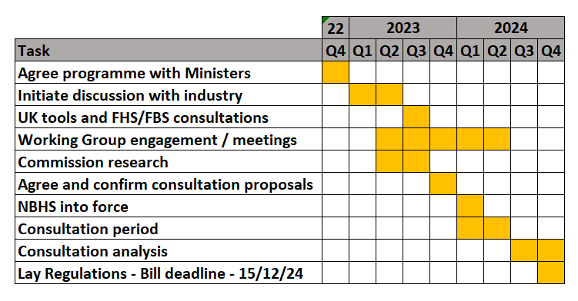
Programme

Slide 19
Two Key Themes
A package of measures that use reliable solutions to optimise building fabric and service performance, reduce delivered energy demand and provide a healthy indoor environment
The design and construction of new buildings must be supported by quality assurance and verification (compliance) processes that result in buildings that meet the high standards set

Slide 20
Additional Tenets
Recognition that the level of ambition must consider the scale of implementation
Implementation through the building standards system without the need for additional third-party certification
Development of options based on what the 2023 standards deliver compared to other best practice standards

Slide 21
Additional Tenets
Agreement on:
how to define targets and measure success
the level of prescription or flexibility which will support successful building outcomes
Recognition of the need for early identification of risks and interdependencies

Slide 22
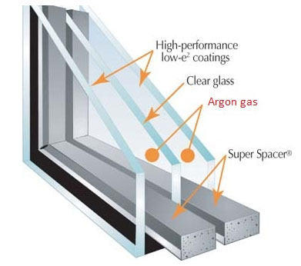
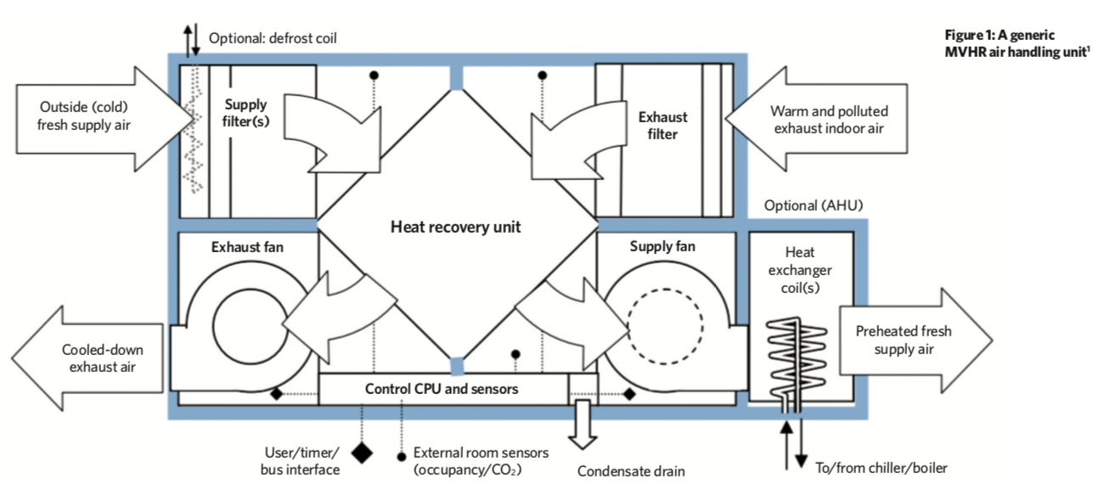
Risks and Opportunities
Performance gap and compliance vs design tools
Timeline for development of SAP and SBEM methodologies
Skills for designers, contractors and verifiers
Getting it right first time and space for POE
Early sight of proposed changes is needed
Cost implications
Technology risk
CIBSE Journal

Slide 23
Working Group
Co-chairs – Stephen Good, BE-ST; Stephen Garvin, BSD
Core membership
First meeting held 21 June 2023
Webpage
BE-ST to facilitate upcoming workshops on key Passivhaus items

Slide 24
Onward review – whole life emissions
December 2021 - our response to Scotland’s Climate Assembly Recommendations for Action, included the commitment to investigate opportunities for whole life emission reporting
Follows representation by the Climate Change Committee and industry groups on the need to link future review of standards on topics such as operational energy performance
2022 – work undertaken by Zero Waste Scotland on the topic including recognition of the pilot work already underway trough standards such as the Net Zero Public Sector Building Standard
Engaging with key organisations to understand the viability and benefit of reporting whole life emissions

Slide 25
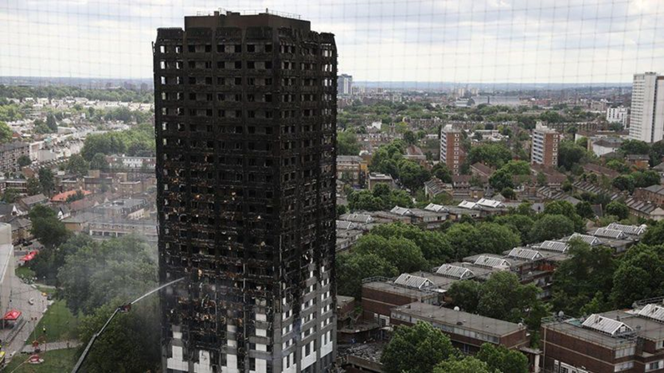
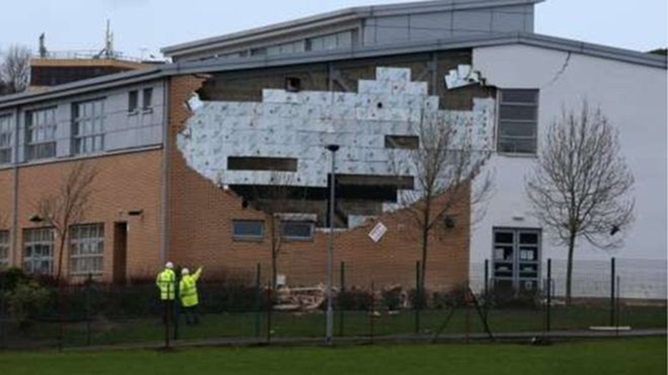
Futures Board - Compliance Plan
Ministerial Working Group set up following Grenfell fire in 2017
Two review panels set up:
Compliance and Enforcement, and
Fire Safety
Formation of Futures Board
Development of a national Compliance Plan approach
Result in more compliant buildings being constructed

Slide 26
Compliance Plan
Creation of new Compliance Plan Manager (CPM) role
Support the building owner
Oversee compliance of building regulations from pre-warrant to completion of work
High Risk Buildings
CPM to have appropriate levels of experience and qualifications

Slide 27
Compliance Plan Manager (CPM)
Hold pre-warrant meetings with verifiers
Agree compliance plan together (what inspections are required and when)
Notify the verifier at all agreed inspection stages, when work starts
Ensure all inspections undertaken and Compliance Plan (CP) completed
No completed CP, no completion certificate accepted

Slide 28
Compliance Plan Handbook
Compliance Plan handbook to be developed
Will provide guidance on:
Identified compliance risks associated with sections of the Technical Handbooks, including Section 6, Energy
How risks could be reduced/mitigated by the owner/developer
What evidence should be collected to demonstrate compliant construction and what should provided to the verifier

Slide 29
Compliance Plan Benefits
Strengthening of compliance
Increased enforcement powers and sanctions:
Maximum fines increased to £50,000 and possibly 2 years imprisonment
Result in improved energy efficiency and thermal performance in homes of the future.

Slide 30
An update on the latest changes to building regulations
www.gov.scot/bsd buildingstandards@gov.scot

